Slide 1
Motion Control System For LCLS-II
SLAC National Accelerator Laboratory and Cosylab
Žiga Oven <ziga.oven@cosylab.com>
Miroslav Pavleski <miroslav.pavleski@cosylab.com>

Slide 2
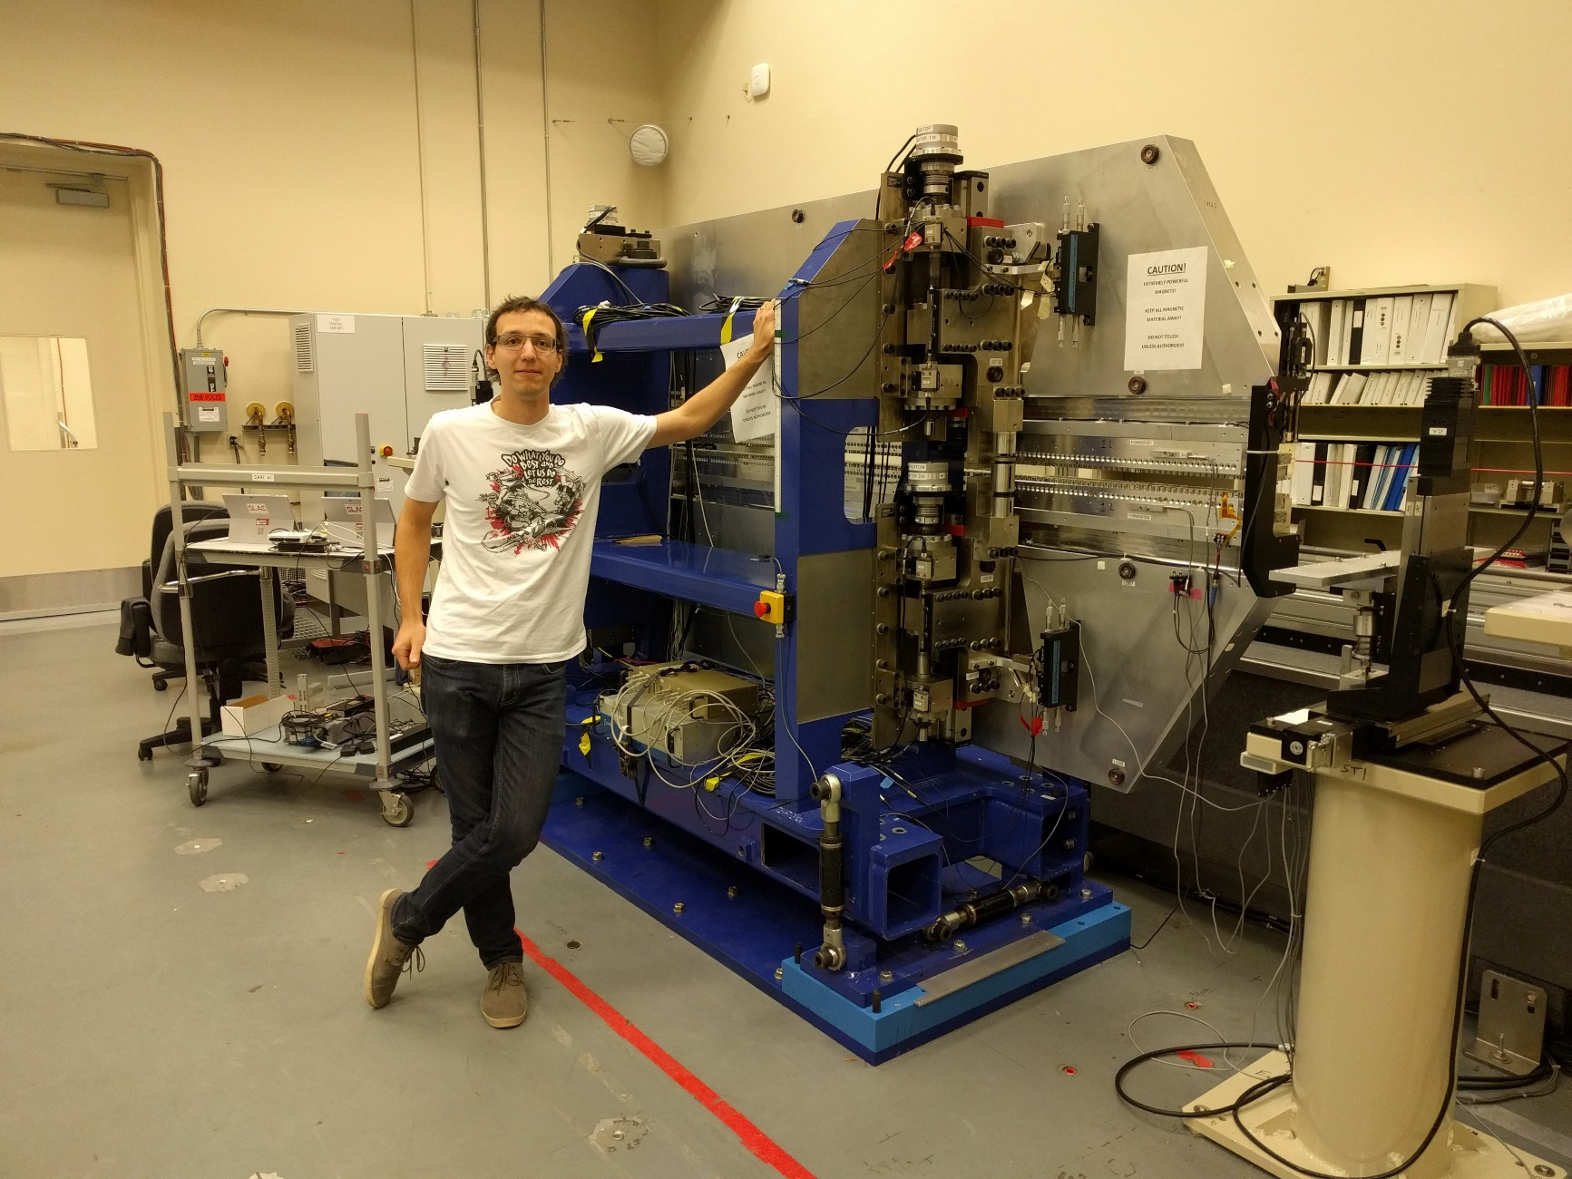

Slide 3
LCLS-II Undulators
WECPL03 Maria Alessandra Montironi
Implementation of the Motion Control System for LCLS-II Undulators
Focus on collaboration
  Subsystem technical lead and project management
    Working on project from mid 2015 through end of 2018
Notes:
Project specific details will be presented by Mrs Montironi from SLAC
Wednesday 12:30 -- 12:45 WECPL03 Maria Alessandra Montironi
Implementation of the Motion Control System for LCLS-II Undulators
We were responsible for the Motion Control System for the LCLS-II Undulators and all corresponding motion devices (interspaces, phase shifters, …)
Design, implementation, testing and verification of motion control for all different compontnes:
-

Slide 4
Cosylab Responsibilities
Project Management
Technical Lead
Project Documentation
  Controls requirements
  Design of control system
  PDR and FDR
  DOE reviews
  Test and device acceptance plans
  Mechanical non-conformance reports (SAT), …
Interfacing
  SLAC
    Project team, physicists, mechanical engineers, technicians, ...
  LBNL
    Mechanical engineers, physicists
  Various vendors
    Undulators
    Motion controllers
Notes:
All this items apply to the Motion Control Subsystem for the LCLS-II Undulator project
PDR – Preliminary Design Review
Committee of people from other National Labs, that have experiences with the system in question
Presenting the preliminary design, asking for comments if there is any big items that are missing from the planning and design
After this, is the development and implementation of the prototype system on prototype device
FDR – Final Design Review
Committee of people from other National Labs, that have experiences with the system in question
Review of the system and if it’s ready for mass production/procurement of components
DOE Reviews:
Committee of people from other National Labs, that have experiences with the system in question
System readiness and progress report (will it be inside the timeframe and budget)
Communication with National labs:
Project team
Undulator Physicists who were responsible for measurement and alignment of the undulators
First users of the motion control system
Communication with various vendors
Motion controllers:
Firmware issues on motor controllers that produced issues with calculation of the commutation angles
Undulators:
Support when assembling the undulators
Support when using our motion controllers to perform the Factory Acceptance Testing

Slide 5
Cosylab Responsibilities (contd.)
Development of full motion control software (and partially hardware) for
  Soft X-Ray Undulators
  Soft X-Ray Interspaces
  Hard X-Ray Undulators
  Phase Shifters (both SXR and HXR)
Integration into EPICS software toolkit
Support of test stands at various locations
  @SLAC
    Magnetic measurements
    Long term test-stand
    SAT
  @LBNL
    Magnetic measurements
  @Vendors
    Assembly
    FAT
Notes:
SXR stands for Soft X-Ray
HXR stands for Hard X-Ray

Slide 6
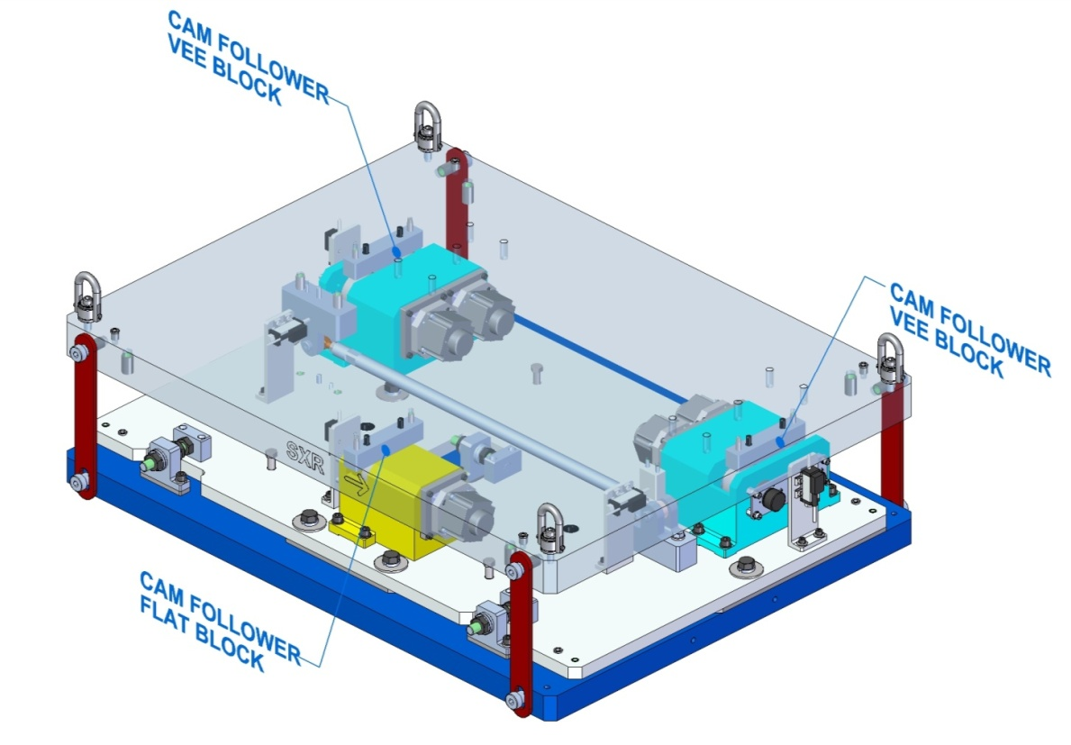
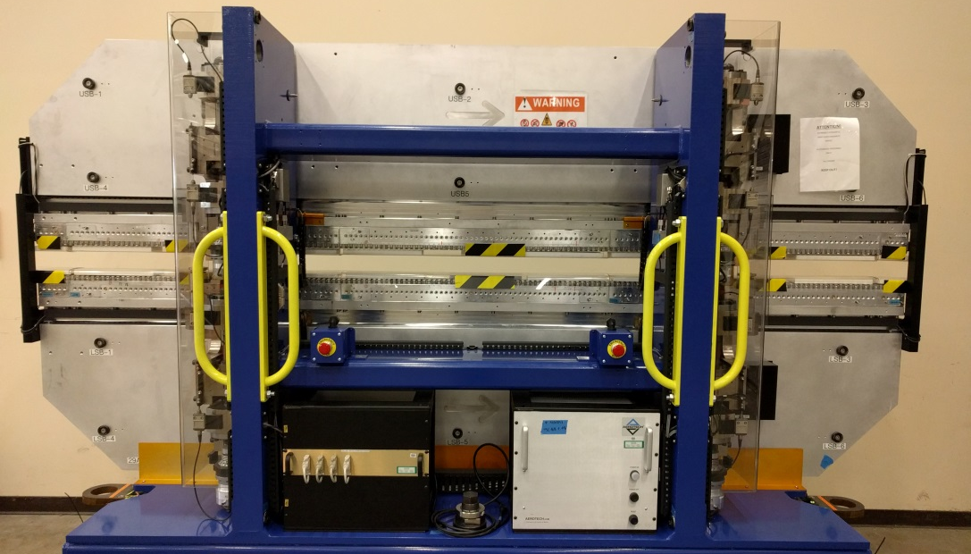
Motion components
Soft X-Ray Undulators
  Aerotech Motion Controllers
  Harmonic Drive servo motors with planetary gearbox (51:1)
    Absolute rotary encoders
    Incremental rotary encoders
  Renishaw linear absolute encoders
  Linear potentiometers
    Measure distance between magnets and the vacuum chamber
Soft X-Ray Interspaces
  Aerotech Motion Controllers
  Applied Motion stepper motors with harmonic drive gearbox (4900:1)
  Linear and rotary potentiometers

Slide 7
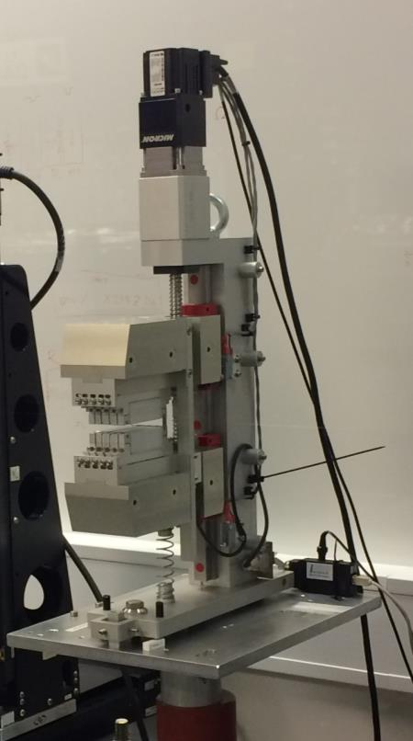
Motion components
Hard X-Ray Undulators
  Animatics Smart Motors (servo with integrated controller) with 100:1 gear boxes
  AMO and Fagor linear absolute encoders
Phase Shifters (SXR and HXR)
  HXR
    Animatics Smart Motors (servo with integrated controller)
    AMO linear absolute encoders
  SXR
    Aerotech motor and controller
    Renishaw linear absolute encoders
All devices had end of travel limit switches
  Some had end of travel kill switches
  (in line with Emergency-Stop push buttons)

Slide 8
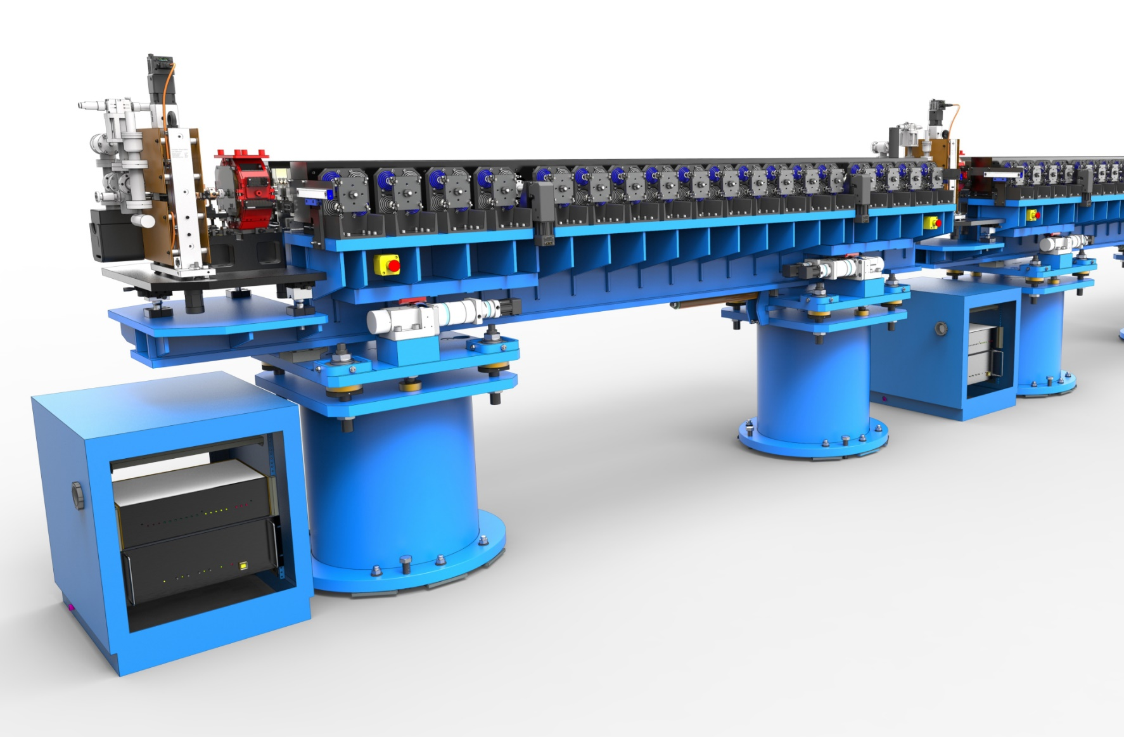
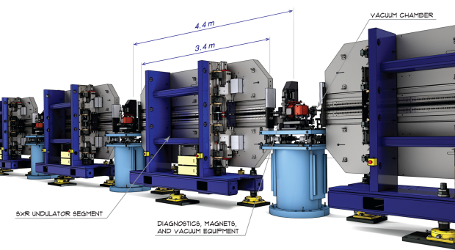
Undulator lines

Slide 9
Challenges
Rotary absolute encoders loose position on power cycle
  Solution: additional battery boxes, that provide auxiliary power when the main controller is powered off.
Commutation angle calculated from absolute encoder readback
  Solution: Motion controller vendor fixed the firmware
Synchronizing 4 motors with individual controllers
  Solution: Synchronize over CAN bus with on controller programing (one program for all 4 motors, actions differs by CAN address)
Closing the loop between absolute encoders and motors that only accept incremental encoders
  Solution: Closed loop in higher level control system (EPICS)
Notes:
Rotary absolute encoders are only absolute inside the one rotation, number of rotations is held in counter that needs power source to retain its information.
Problem with motion control firmware: reading of the absolute position was too slow for the calculation of the commutation angle (no hall sensors on motor) up to the point that the motor was stalling when there was no load attached.
Each Animatics Smart motor has integrated controller, which we were controlling through serial communication
Animatics Smart motors only accept single ended quadrature encoder signals, where as encoders were providing 1Vpp signals
We tried conversion but the signal conversion using Renishaw REE interpolators
We had some power supply for the interpolators
Signal wasn’t good enough
Challenge how to mount everything onto the undulator, that will be in radiation area …

Slide 10
Thank you!
Miroslav Pavleski
COSYLAB
Web: www.cosylab.com

