Slide 1
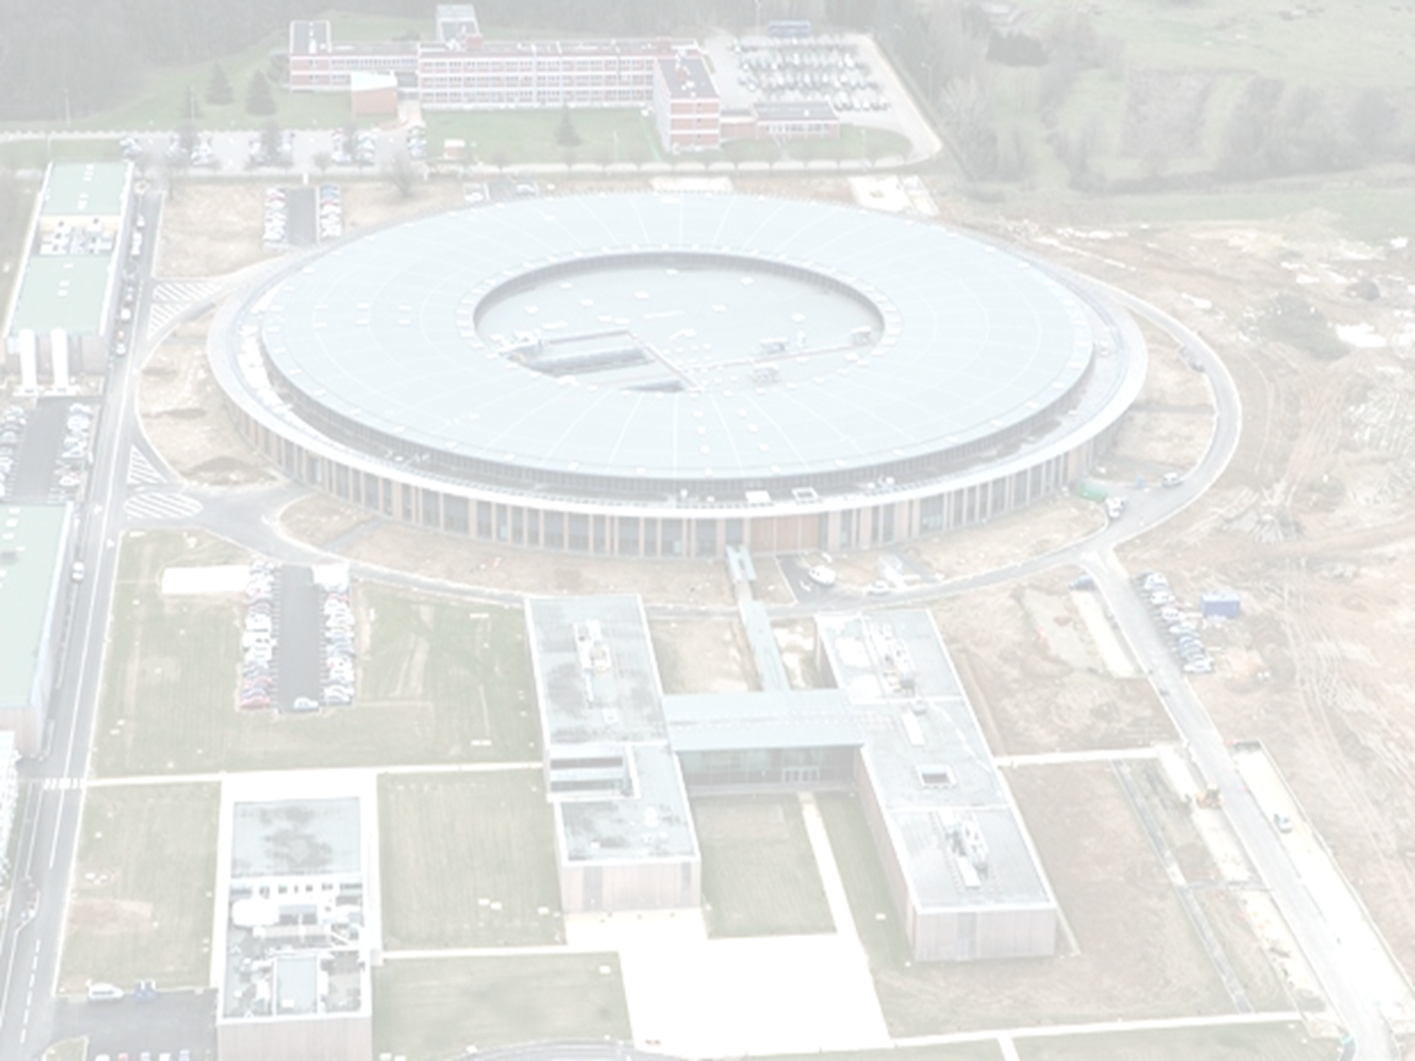
22nd European Synchrotron Light Source
Radio-Frequency Meeting
Synchrotron SOLEIL,
November 8 - 9, 2018
SOLEIL DLSR RF system preliminary investigations
Basic DLSR parameters and RF requirements
Impact of the longitudinal injection on the RF
Harmonic RF system for bunch lengthening
P. MARCHAND

Slide 2
Basic SOLEIL DLSR parameters and RF requirements
Basic DLSR RF requirements, V_{RF} = 1.5 MV , P_{b} = 250 kW can be achieved using 3 n.c. 352 MHz cavities, with :
P_{dis} = 25 kW , P_{beam} = 85 kW , P_{tot} = 110 kW per cavity
Under such conditions, re-using our s.c. system is not relevant → Waste of electrical power and anyway the actual cryomodule doesn’t fit into a 4m straight section
An ESRF - EBS type cavity is emerging as a good candidate
 | SOLEIL today | SOLEIL DLSR
E [MeV] | 2.75 | 2.75
f_{RF} [MHz] | 352 | 352
I_{b} [mA] | 500 | 500
σ_{E} /E | 1 10⁻³ | 0.8 10⁻³
α | 4.2 10⁻⁴ | 1.4 10⁻⁴
dU [keV] | 1150 | 500
V_{RF} [MV] | 3 | 1.5
P_{b} [kW] | 560 | 250
τ_{s} [ms] | 3.3 | 9.3
τ_{x} /τ_{z} [ms] | 6.6 / 6.6 | 7.4 / 21
f_{s} [kHz] | 3.5 | 2
ǂ
LONGITUDINAL HOM IMPEDANCES → LCBI
Need for 3 times more damping than the ESRF - EBS
→ Test of the ESRF spare cavity in SOLEIL SR in 2022,
namely ~ 3 years before the SOLEIL shutdown
→ ESRF experience feedback with 200 mA (2020 - 21)
→ An agreement with ESRF is under way
→ Need for a b. b. b. longitudinal feedback (?)
It is less critical for the transverse HOM impedances (low <β-function> + existing b. b. b. transv. feedback)
^{ǂ} Including 200 keV for the IDs

Slide 3
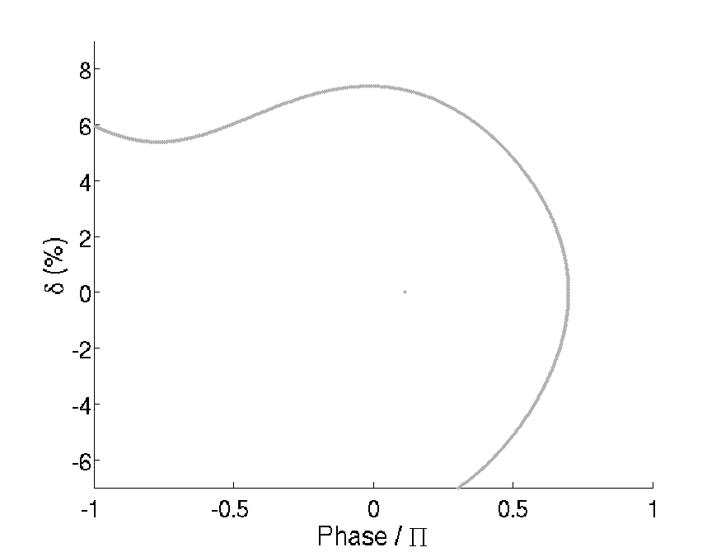
Longitudinal injection principle (→ M.A. Tordeux’s talk )
V = V₁ (CW)
* Multipole Injector Kicker → Injection 6% off-momentum without
perturbing the already stored beam ; but with V_{RF} = 1.5 MV only,
the injected bunch would not be captured into the RF bucket.
MIK *
V₁ = 1.5 sin (wt + ϕ_{s})
V₁ (CW)
A
Stored bunch
ϕ_{s}
0

Slide 4
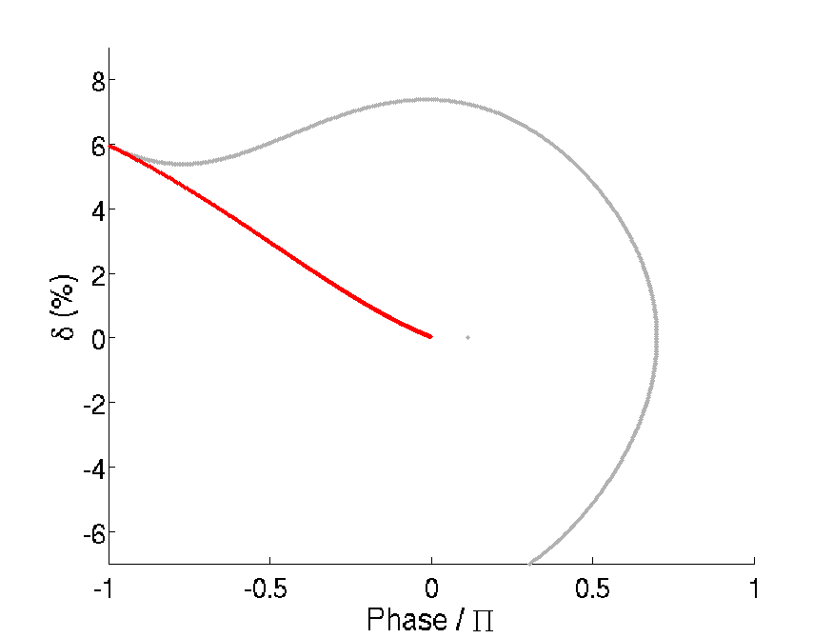
Longitudinal injection principle
V = V₁ (CW)
V = V₁ + V_{ad}
V_{ad} “on” for injection and
“off” when particle reaches ϕ_{s}
T ~ 300 µs
V_{ad}
τ ~ 10 µs
V₁
Injection
V₁ = 1.5 sin (wt + ϕ_{s})
V₁ (CW)
V_{ad} = 1.5 sin (wt)
A
V_{ad} (pulse)
Stored bunch
ϕ_{s}
0

Slide 5
Longitudinal injection principle
V = V₁ (CW)
V = V₁ + V_{ad}
V_{ad} “on” for injection and
“off” when particle reaches ϕ_{s}
T ~ 300 µs
V_{ad}
τ ~ 10 µs
V₁
Injection
Injected bunch
V₁ = 1.5 sin (wt + ϕ_{s})
V₁ (CW)
+
A
V_{ad} = 1.5 sin (wt)
V_{ad} (pulse)
V_{tot} = V₁ + V₂
Stored bunch
ϕ_{s}
0
It is assumed that the change in the RF slope for a time as short as 300 µs does not significantly affect the stored bunch

Slide 6
Impact of the longitudinal injection on the RF requirements
Use of a fourth cavity to keep the peak voltage at reasonable level, 750 kV/cav
The 4 cavities can be easily installed into a 4 m straight section
300 µs
3 MV
1.5 MV CW P_{cw} [kW] / cav | 1.5 MV CW + 1.5 MV pulse P_{cw} + P_{peak} [kW] / cav
1.5 MV
Coupling | P_{i} | P_{r} | P_{i} | P_{r}
5.4 | 77 | 0 | 155 (77 + 78) | 37 (0 + 37)
4.5 | 78 | 1 | 140 (78 + 62) | 22 (1 + 21)
4 | 79 | 2 | 135 (79 + 56) | 17 (2 + 15)
3.5 | 81 | 4 | 130 (81 + 49) | 12 (4 + 8)
2.1 | 97 | 20 | 118 (97 + 21) | 20 (20 + 0)
V_{tot} / V_{CW} = 2
We cannot match both cases
Incident and reflected powers (P_{i} , P_{r}) vs coupling factor assuming
the use of 4 cavities (P_{i} = P_{r} + P_{dis} + P_{beam} ; P_{beam} = 65 kW in all cases)
The choice of a coupling factor, β = 4, is a quite good compromise. With a 300 µs pulse at injection rate > 1 s, the contribution of P_{peak} to the average power is negligible.
By keeping the present SOLEIL configuration, 1 SSPA per cavity, the required performance is well within the capability of our SSPAs, which can deliver up to 200 kW CW and, in principle, there is no need for power circulator at the SSPA output.

Slide 7
Power dependence on the tuning angle
P [kW]
CW P_{i}
Total P_{i}
Total P_{r}
(CW + peak)
4 cavities
β = 4
tan(ψ)
As the tuners are much too slow, we cannot tune both cases
→ Free to choose the tuning angle ψ for the best compromise
tan (ψ) | CW P_{i} | CW P_{r} | CW + peak P_{i} | CW + peak P_{r}
2.5 | 78.5 | 1.7 (min) | 139 | 21
2.35 | 79 | 2 | 135 | 17
2.25 | 80 | 3 | 133 | 15
1.9 | 86 | 9 | 130 | 12 (min)

Slide 8
Longitudinal injection feasibility tests on SOLEIL
Although the first computed results are quite promising, the feasibility of the long. injection remains to be demonstrated → Tests of the principle are planned in the present machine.
The present SOLEIL RF system, which consists in 2 cryomodules, each containing a pair of sc cavities, allows for separating the functions : two “active” cavities providing the CW voltage and power, the two others “passive” for the injection pulse (RF delayed by ϕ_{s}).
This makes the test of feasibility with moderate beam loading (I_{beam} < 200 mA) quite easy from the RF point of view (almost no modification).
300 µs
2 « active » cavities 1 MV CW / cav P_{cw} [kW] / cav | 2 « passive » cavities 1 MV peak / cav P_{peak} [kW] / cav
4 MV
Study capture
process
2 MV
I_{beam} [A] | P_{i} | P_{r} | P_{i} | P_{r}
0 | 56 | 56 | 56 | 56
0.2 | 126 | 14 | 56 | 56
Stored beam
perturbation ?
Optimum tuning in all cases → P_{r} only from mismatch (Q_{ext} = 5 10⁴)
The above operating conditions have been recently validated after having enlarged the BW of the AVC loop from ~ 1 kHz up to ~ 20 kHz on the passive cavities
Partial tests with the actual standard kickers → 2019
« Complete » tests with the Multipole Injector Kicker (MIK) under fabrication → 2020

Slide 9
Harmonic RF system for bunch lengthening
Bunch lengthening is needed as well for beam lifetime as for preserving the emittance.
For this purpose, using a passive harmonic s.c. RF system is considered as the best way for several reasons :
In the hybrid mode of operation, the required gap of empty buckets generates transient beam loading (TBL) effects, which dramatically reduces the effective bunch lengthening; the TBL can be minimized using a s.c. system (factor ~ 10)
Simply powering the system, either n.c. or s.c. doesn’t help to cope with the TBL as the cavity BW is too narrow; on the other hand, that could be achieved by a feedforward compensation into a specific strongly loaded n.c. cavity → Naoto Yamamoto’s talk
Operating a passive s.c. system is particularly easy : V_{ind} ∝ I_{b} / δf (δf >> cavity BW) and it is naturally at the right phase (cavity ⇔ pure inductance) → no need for any LLRF control or feedback
No need for power coupler and RF amplifier either
At SOLEIL, the 4.2K cryogenic station and the expertise are already existing
Robinson stability in a powered system, either n.c. or s.c. ??
Operation of a powered s.c. system with very high Q_{load} particularly tricky
Need for feedbacks
Possible issue :
Robinson instability at average current as low as 10 - 20 mA in single bunch mode (is it really needed in addition to the hybrid mode ??) → The cavity resonance could interact with the first satellites of f_{s} ; this is even much more critical with a passive n.c. system.

Slide 10
Harmonic RF system practical solutions
The Super3hc cryomodules, which have been successfully operating in the SLS and Elettra since 2002, were the 1st application of harm. passive s.c. systems (→ Cristina’s & Lukas’ talks).
They are “babies” of the SOLEIL cryomodule, obtained more or less by its scaling from 352 MHz to 1.5 GHz, the 3rd harmonic of 500 MHz.
For the SOLEIL DLSR purpose, a rescaling of Super3hc to the 3rd or 4th harmonic of 352 MHz could be done, leading to a quite modest accelerating gradient of ~ 1.8 MV / m *.
Our existing 4.2 K cryogenic station could be re-used.
* It is assumed that changing the slope of V_{RF} for a time as short as 300 µs during the top-up
injections doesn’t significantly affect the stored bunch ; otherwise, keeping it constant
would impose to double quickly the harmonic voltage → E_{acc} = 3.6 MV/m (peak)
→ Powering of the system would become unavoidable
Super3hc has 2 free ports for possible power couplers
☺
😢
Complementing the harmonic sc system with a feedforward compensation into a specific highly loaded (Q_{ext} ~ 200) n.c. cavity should allow to get rid of the transient beam loading and preserve the full lengthening of all the bunches (→ N. Yamamoto’s talk)
Using a cavity similar to the accelerating one would be of interest
An ESRF - EBS type cavity with high over-coupling from 2 power couplers ?
Possible collaborations in these domains are under discussions with ESRF and KEK.

Slide 11
Summary and conclusions
Preliminary investigations show that the RF requirements for the SOLEIL DLSR, including the extra voltage and power needed for a possible longitudinal injection, can be achieved using four n.c. cavities of the ESRF-EBS type. Each cavity can be powered by one of the already existing SOLEIL SSPAs. Digital µTCA-based LLRF to be developed (→ R. Sreedharan’s talk).
The operational experience in the ESRF-EBS with such cavities and test of a spare one in the present SOLEIL SR should help to anticipate whether the implementation of a longitudinal b.b.b. feedback is needed, in addition to the existing HOM damping, to cope with the LCBI.
Although preliminary beam dynamics and RF computations are quite promising, the feasibility of the longitudinal injection remains to be demonstrated ; further computations are under way and tests of the principle in the present SOLEIL SR are planned.
The use of a passive harmonic s.c. RF system is considered as the best way of providing the required bunch lengthening to insure reasonable beam lifetime and preserve the emittance. It could be a Super3hc type cryomodule (SLS & Elettra), scaled to the 3rd or 4th harmonic of 352 MHz, with re-use of the existing SOLEIL cryogenic station at 4.2 K.
This could be complemented by a feedforward into a specific strongly loaded n.c. cavity, as proposed by N. Yamamoto et al, in order to cope with the transient beam loading.
Possible collaborations in these domains are under discussion with ESRF and KEK.
Possible upgrade to VSR version with few ps bunch length → Phase 2, if relevant (?)
→ Higher harm. RF systems (h & h + 0.5), either high gradient s.c. cav. @ 2K or crab cav.

Slide 12
Thank you for your attention

