Slide 1
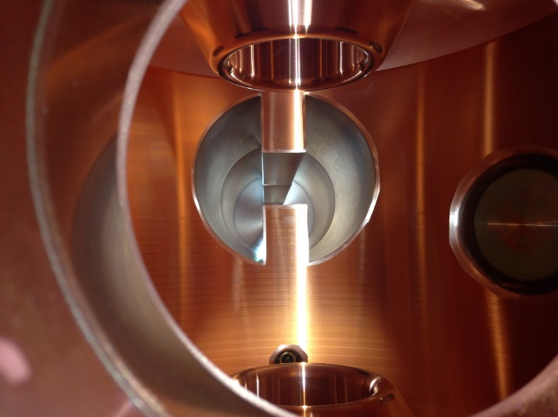
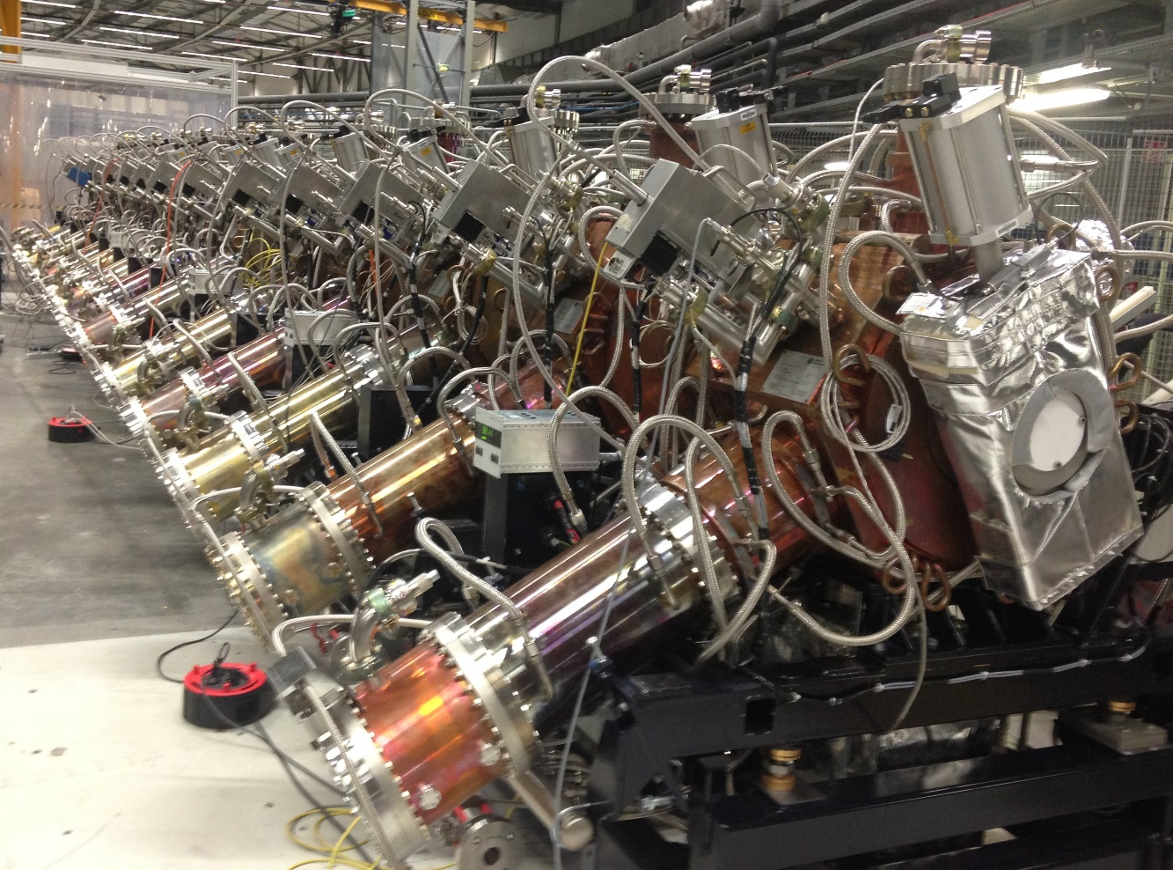
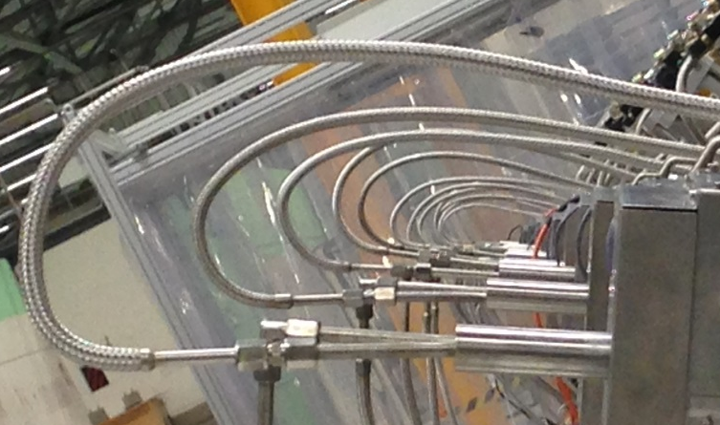
22nd – ESLS RF Meeting - soleil
Impedance Characterization of the HOM Damped Cavities for the ESRF-EBS
Alessandro D’Elia – ESRF – ASD/RF Group

Slide 2
contents
Motivations
Longitudinal impedance:
All dampers installed: GdfidL simulations and presentation of a reconstruction technique using HFSS to cross check the results;
Removal of the small damper;
Effect of the ancillaries: ion pump and tuner;
Transverse impedance:
With and without small damper
Effect of the ancillaries: tuner.

Slide 3
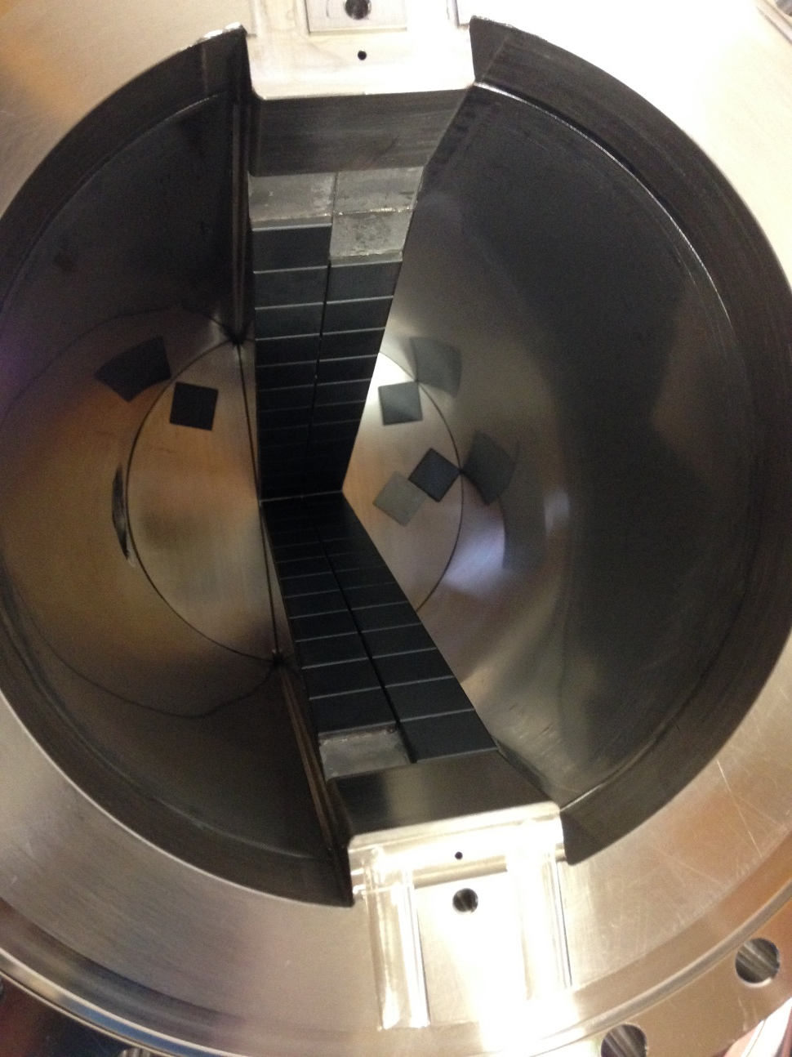
motivations
Despite of a fully satisfactory prototype phase, during the production of the HOM Absorbers, severe issues have been encountered in brazing the ferrite tiles on their metallic wedges.
This forced us to revise our strategy and to move to a different design of the HOM Absorbers. This implied to resume the impedance studies in order to:
Verify that the new design was as good as the original one;
Verify the “damping performances” of each damper (in particular the small one on the top of the cavity) to run properly the ESRF-EBS machine in case of “emergency”.

Slide 4

Possible Consequences of falling tiles
7th June 1788 in Grenoble:
the beginning of the French Revolution
La journée des Tuiles par Alexandre Debelle

Slide 5
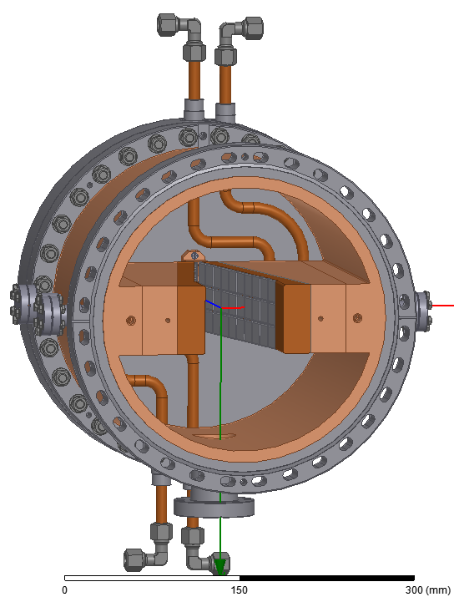
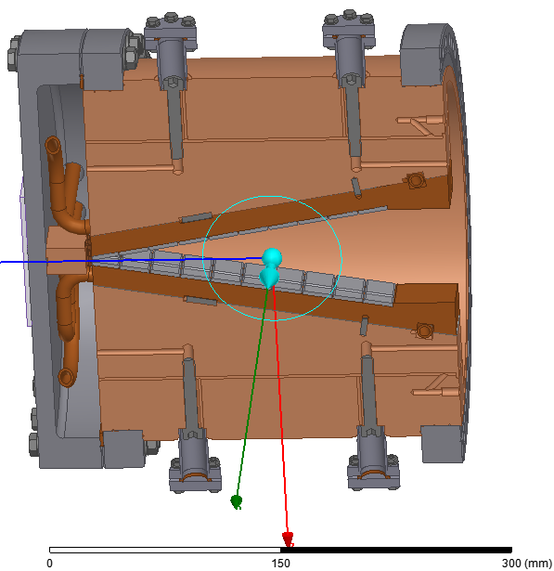
HOM absorbers – the new design
Original Design
New RI Design

Slide 6
contents
Motivations
Longitudinal impedance:
All dampers installed: GdfidL simulations and presentation of a reconstruction technique using HFSS to cross check the results;
Removal of the small damper;
Effect of the ancillaries: ion pump and tuner;
Transverse impedance:
With and without small damper
Effect of the ancillaries: tuner.

Slide 7
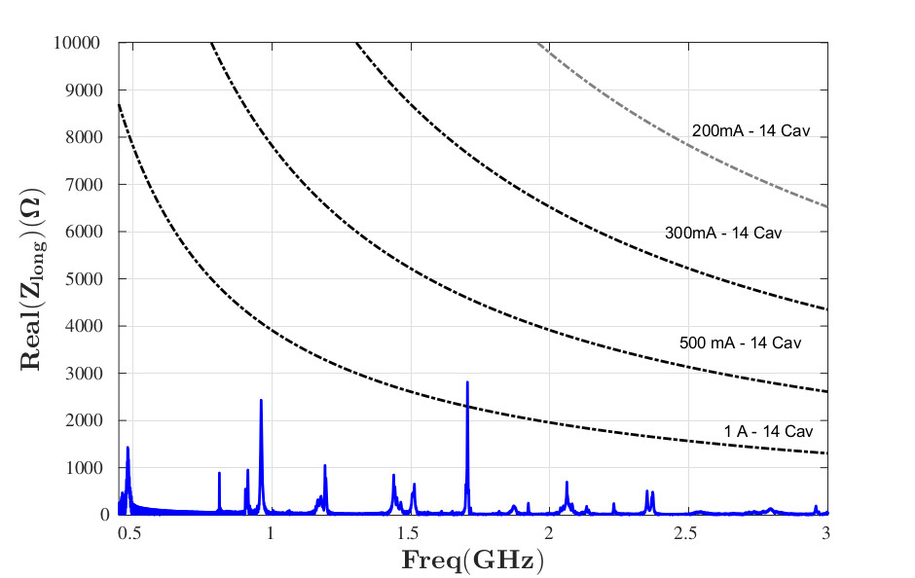
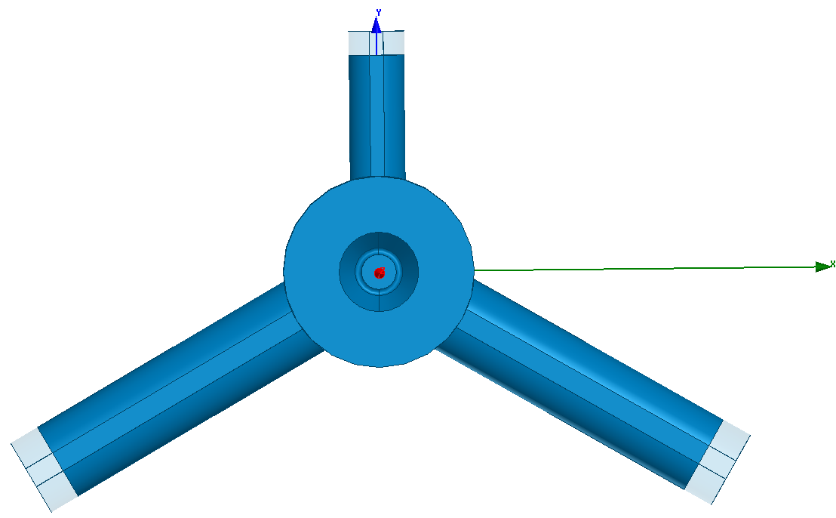
Longitudinal impedance: ideal structure with PML, gdfidl
PML
PML
PML

Slide 8
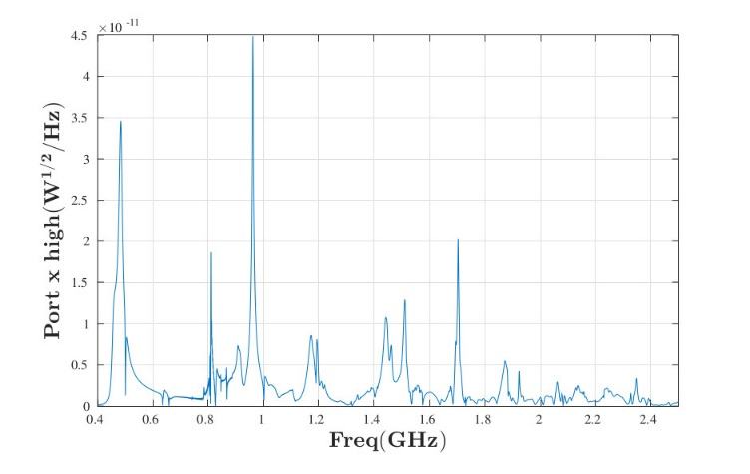
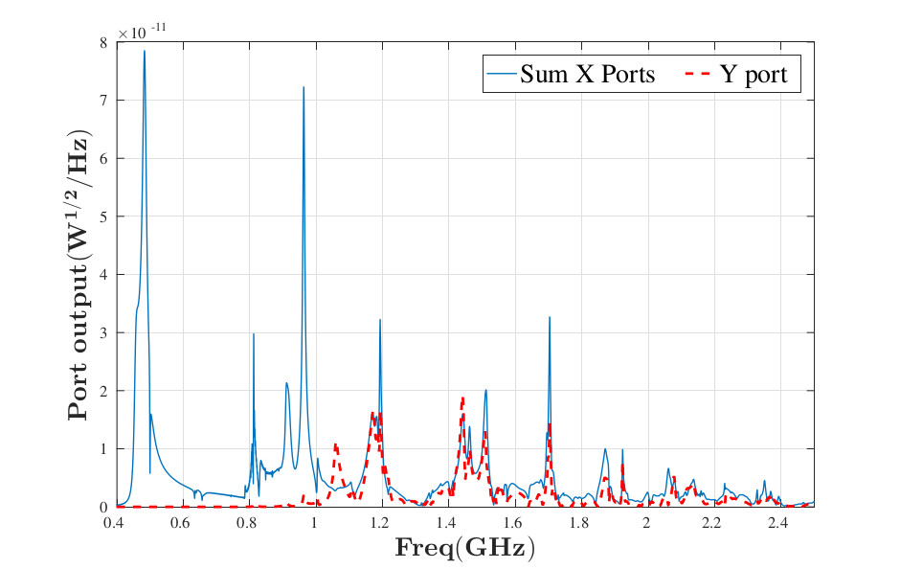
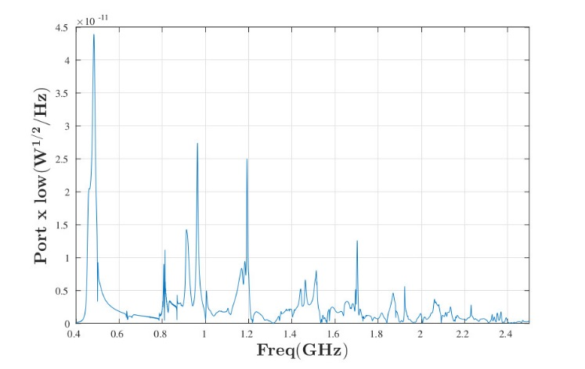
Power flow through the coupling sections: gdfidl
Port Y
Port X low
Port X high

Slide 9
Power flow through the coupling sections: measurements vs gdfidl
In May 2016, a measurement of the power flow, through the HOM dampers on the cavity 23-2, has been planned and performed during a run in 16 bunches.
Some remarks:
The power in GdfidL is a power per bunch per cavity, this means that, to compare the results, also the measured beam power must be scaled per bunch and per cavity. Scaling the power per bunch is trivial, scaling the power per cavity is less trivial as the storage ring install 5 X 5-cell cavities and 2 Monocell cavities. For the sake of the simplicity, each 5-cell cavity has been considered equivalent to 5 Monocell cavities.
Furthermore the water flow rate must be strongly reduced to measure decent temperature variations from input to output (<1degC); dealing with these small quantities induces an uncertainty in the measurements, estimated to be around 10%.

Slide 10
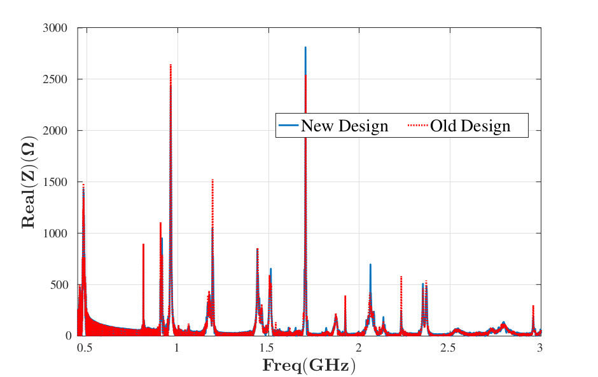
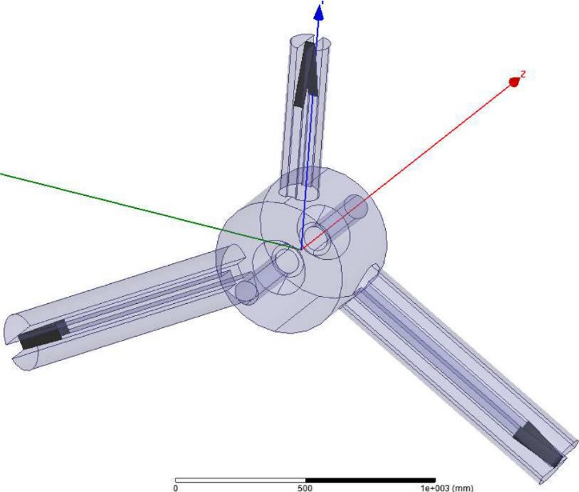
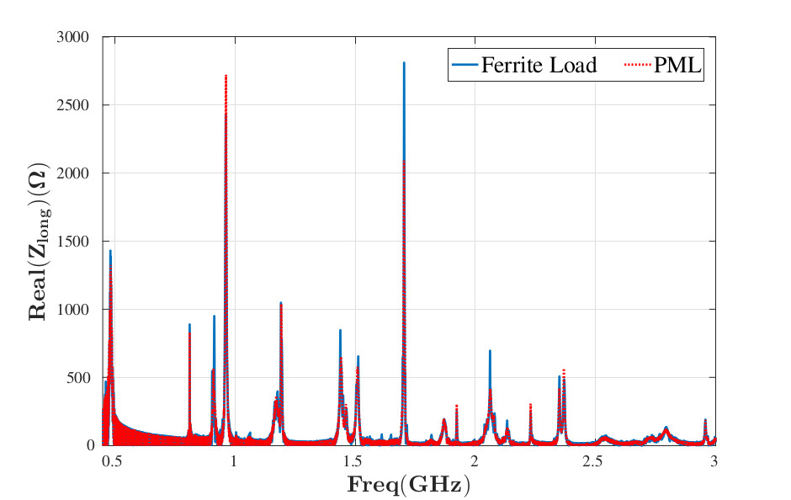
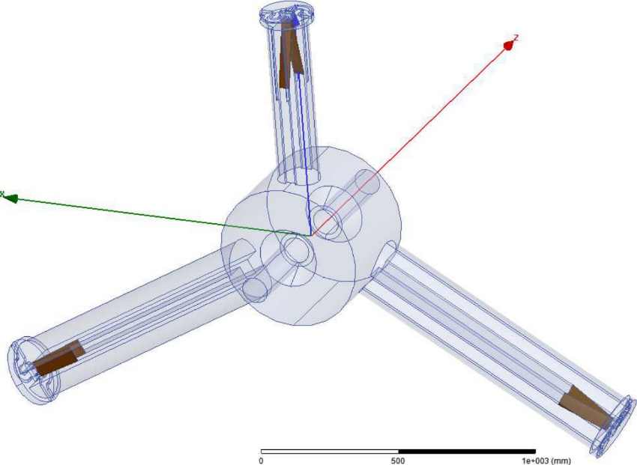
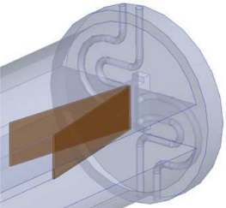
Full structure Simulations

Slide 11
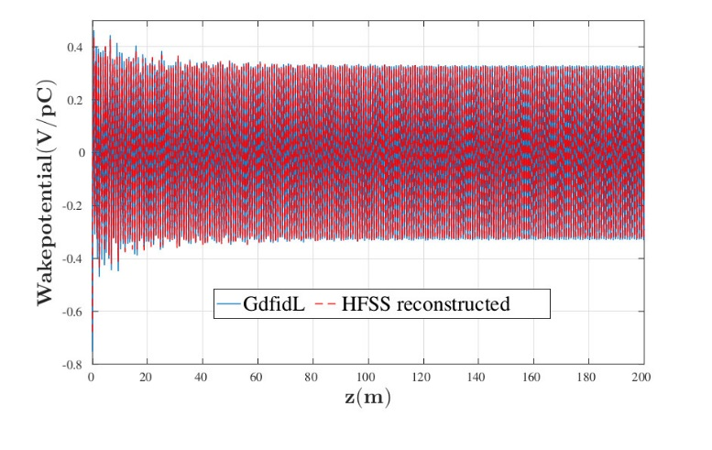
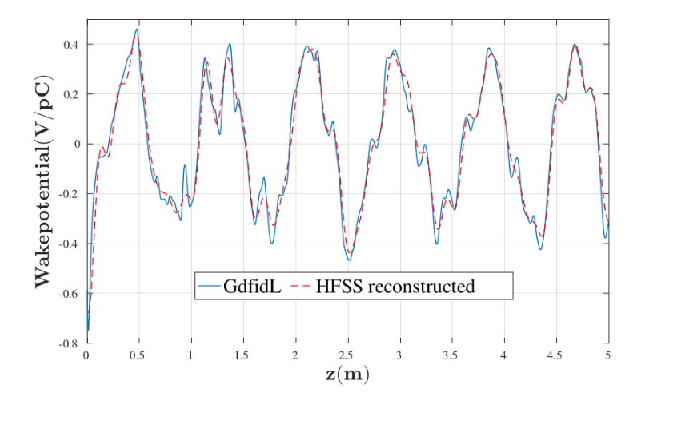
Reconstructed wakepotential using HFSS
In parallel with GdfidL, we can reconstruct the wakepotential behavior using HFSS by means of *
being the index of the mode
This technique is particularly interesting to cross check our results basically because HFSS is a frequency domain solver and therefore:
External Q’s are directly calculated → particularly important to study cavities without dampers;
Ferrite can be easily modeled as a frequency dependent material (as it is in reality).
* Bane, Wilson and Weiland, “Wake Fields and Wake Field Acceleration”, SLAC-PUB-3528

Slide 12
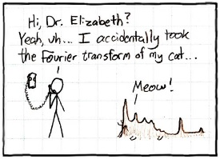
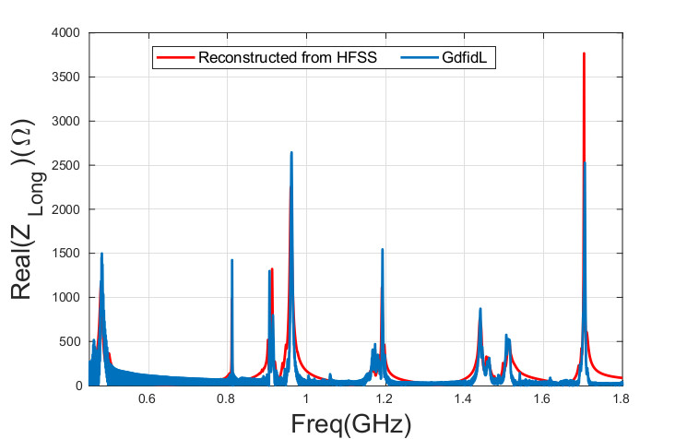
FFT: Reconstructed Impedance using HFSS

Slide 13
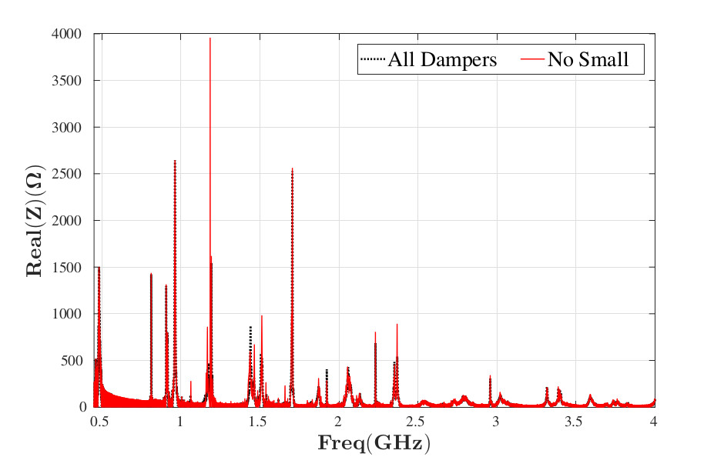
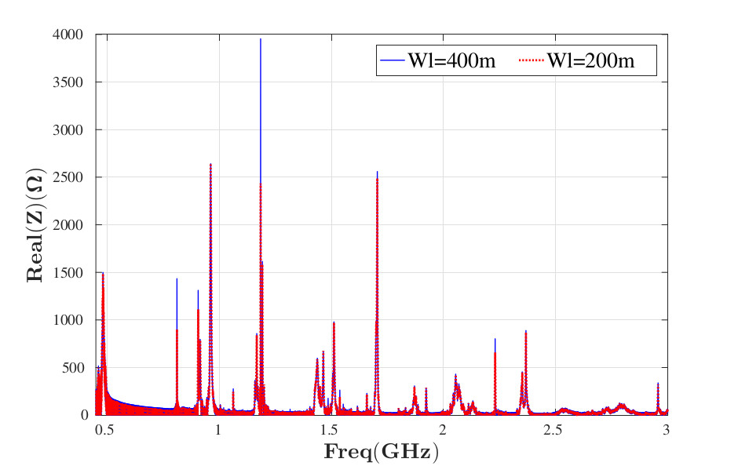
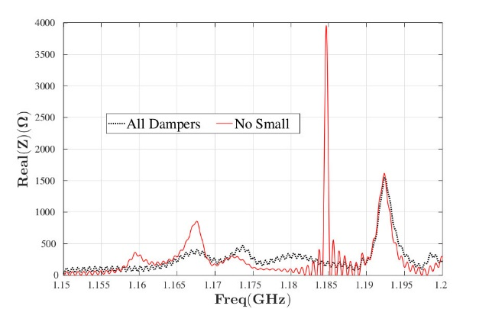
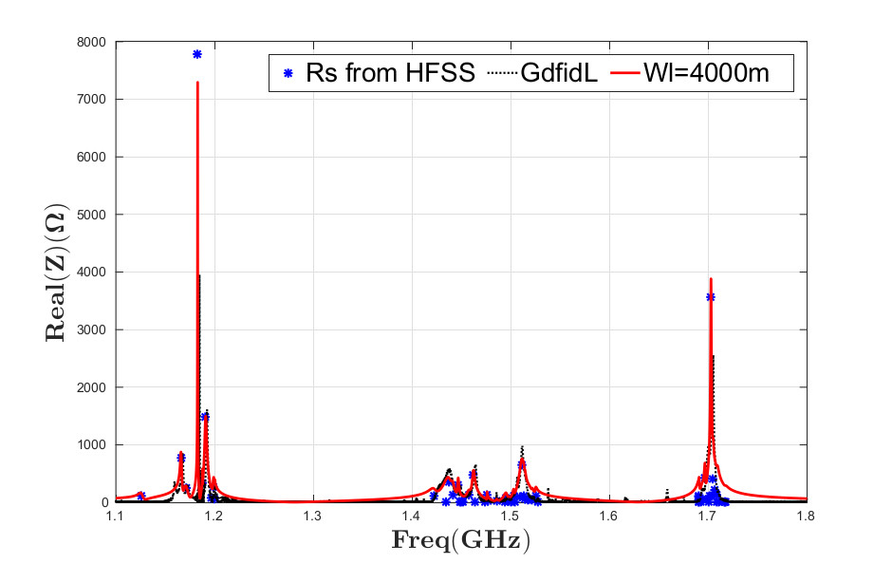
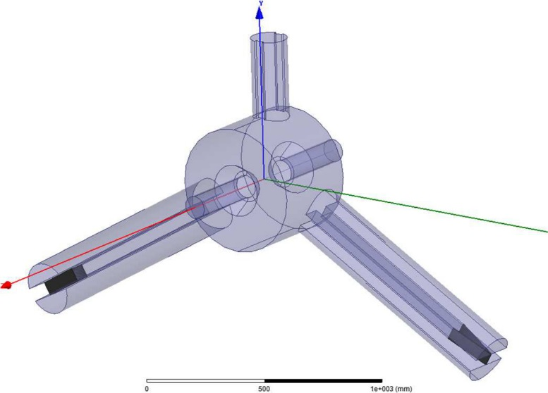
Removal of the small damper

Slide 14
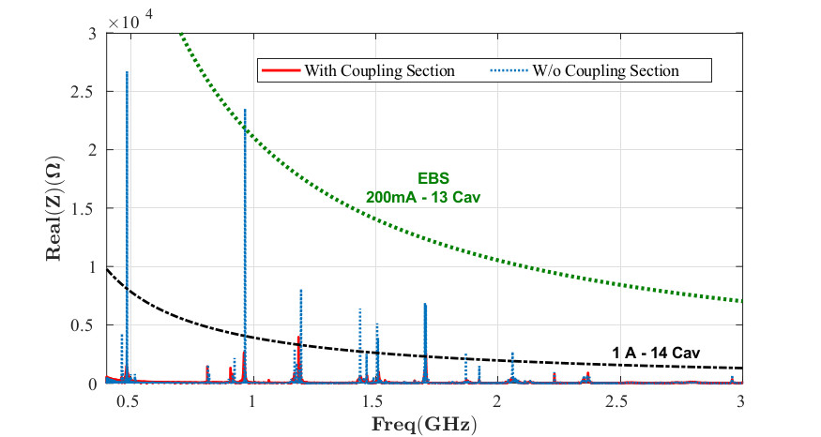
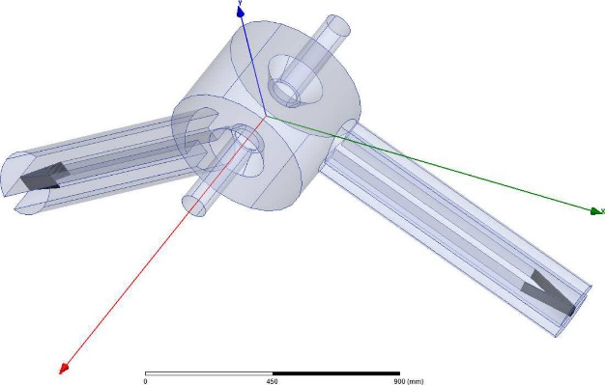
Removal of the small damper: no coupling sections

Slide 15
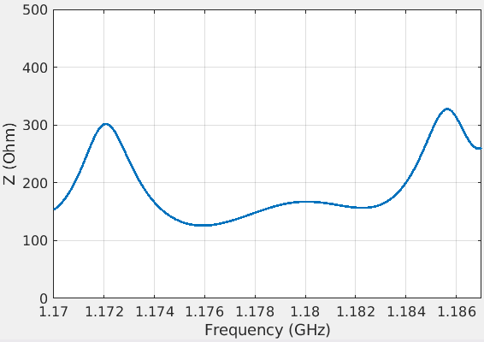
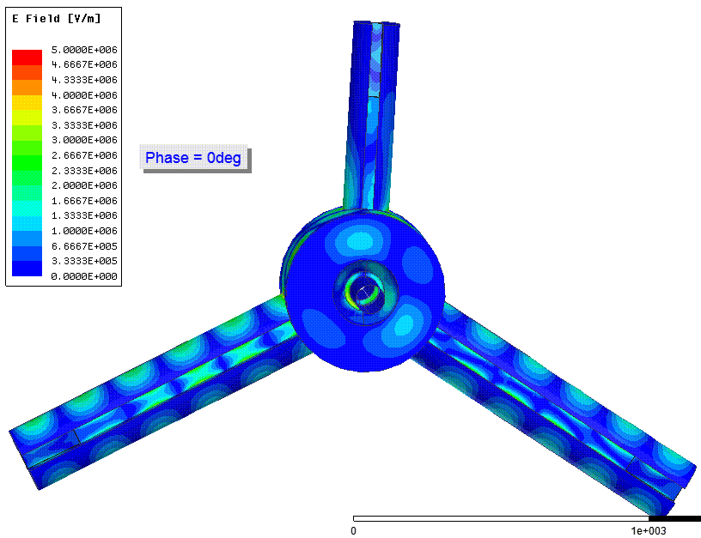
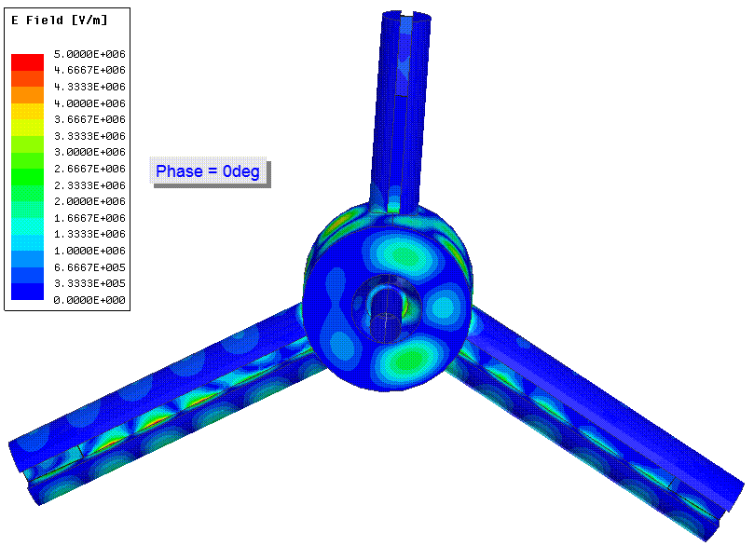
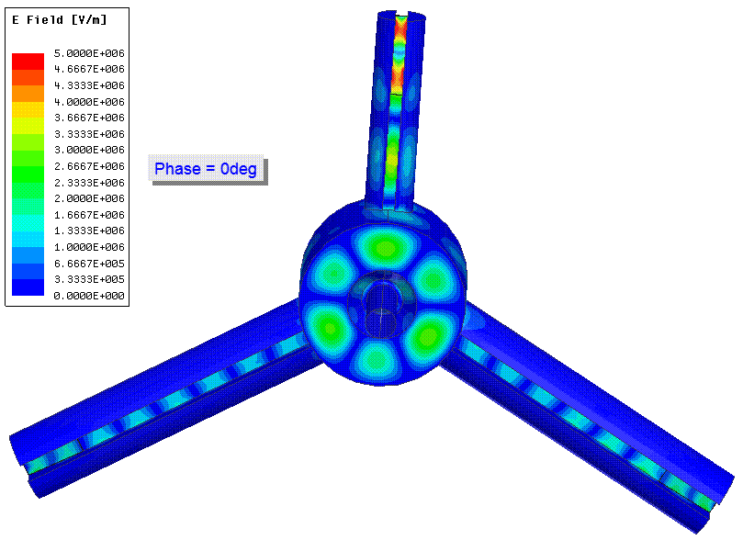
Looking at the fields: all dampers

Slide 16
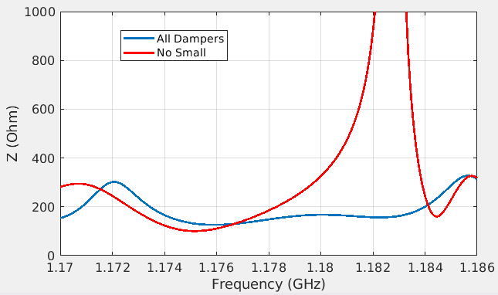
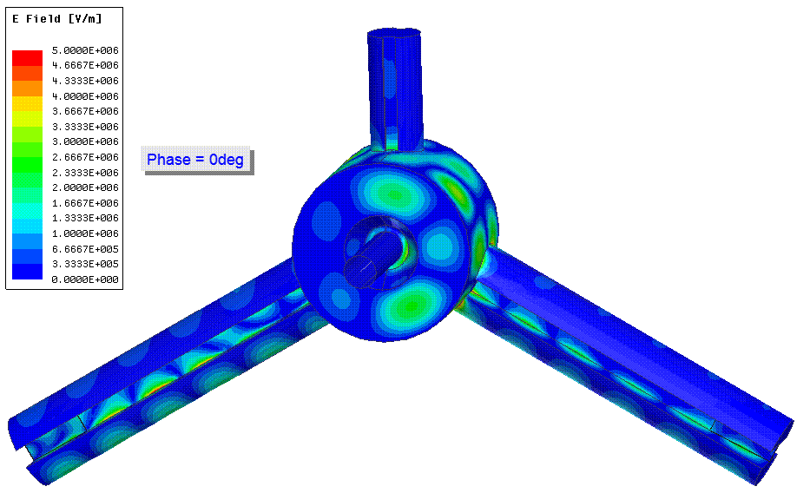
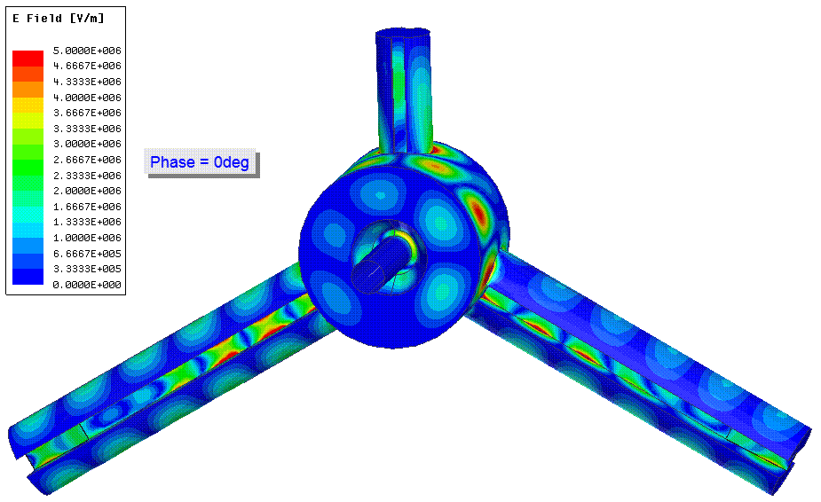
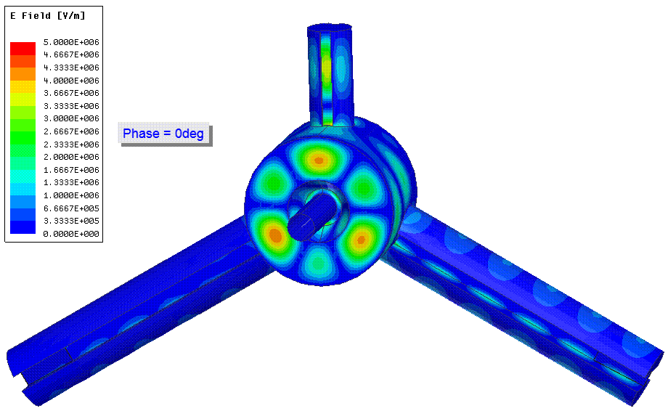
Looking at the fields: no small damper

Slide 17
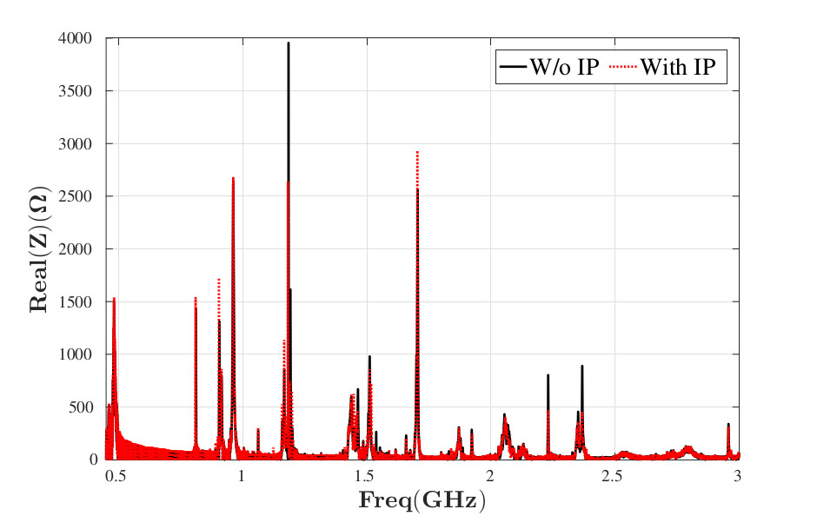
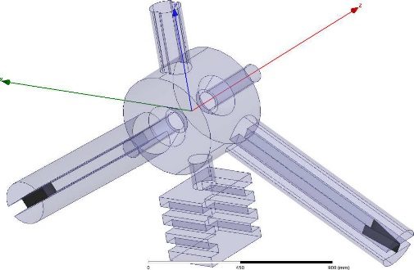
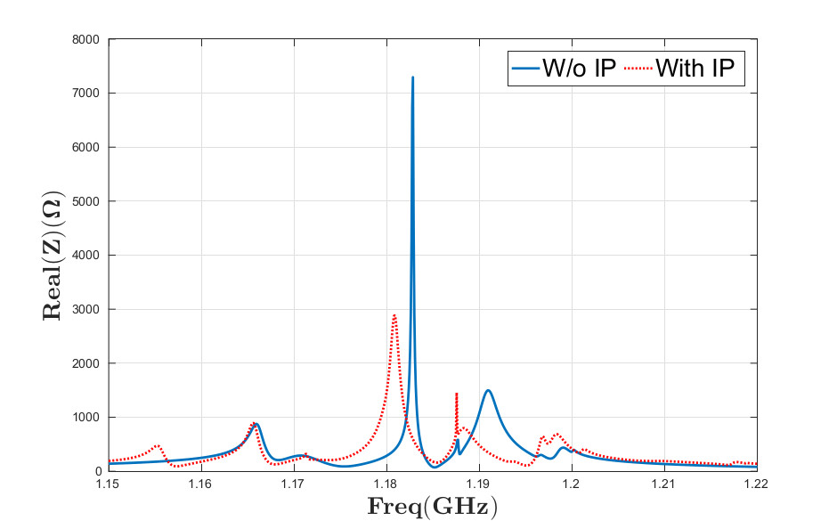
Removal of the small damper: ion pump

Slide 18
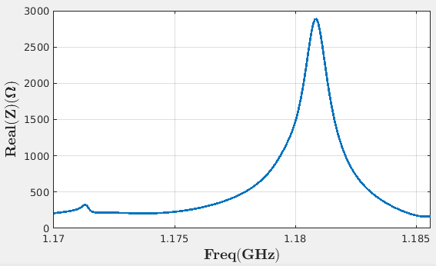
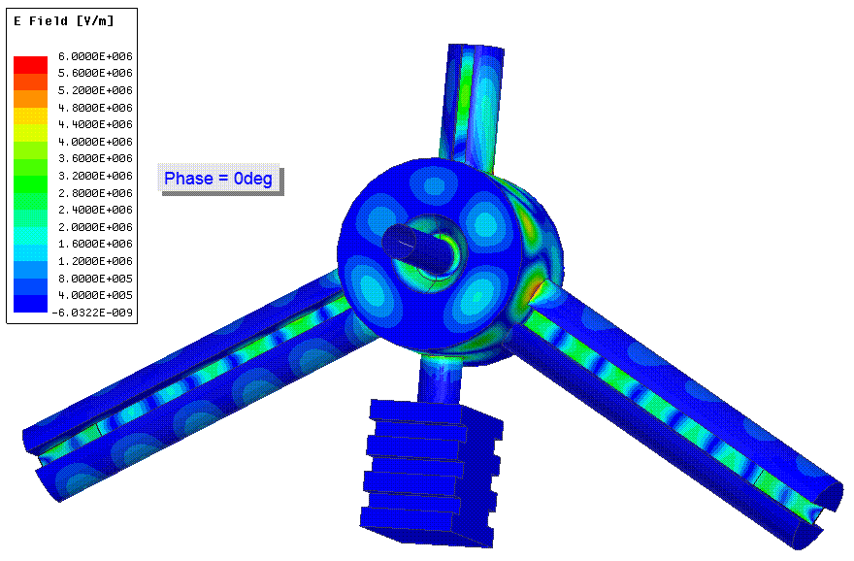
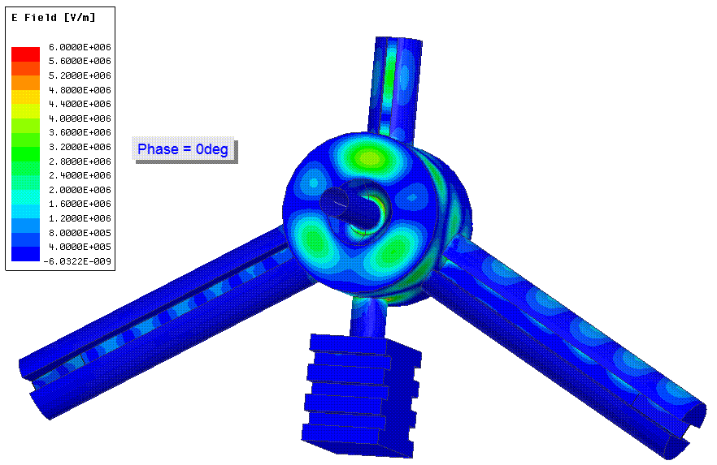
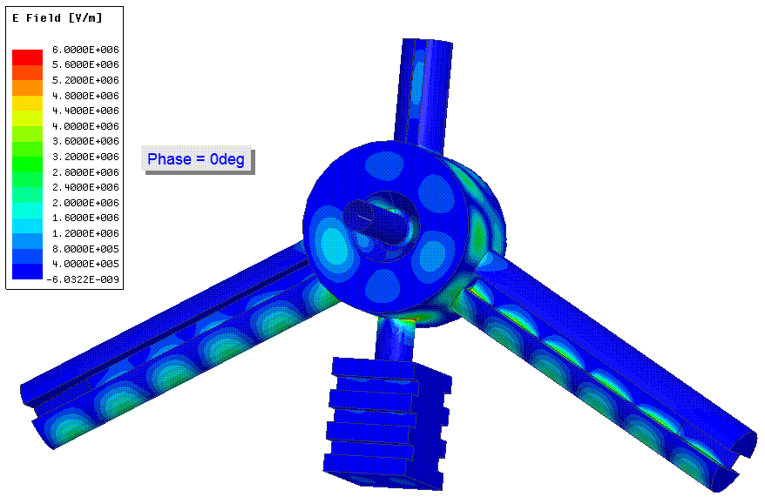
Again the fields: with and without the ion pump

Slide 19
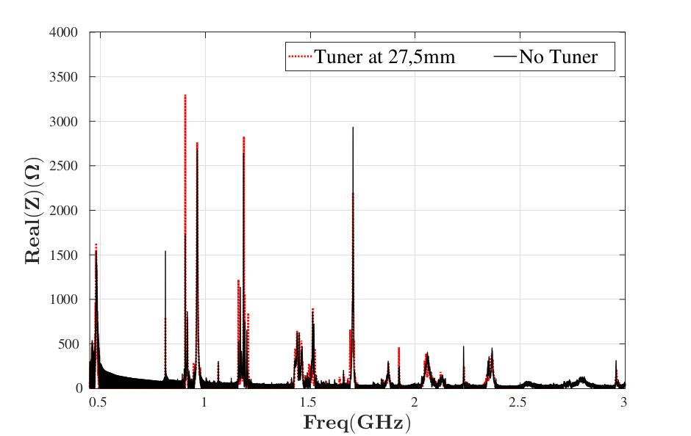
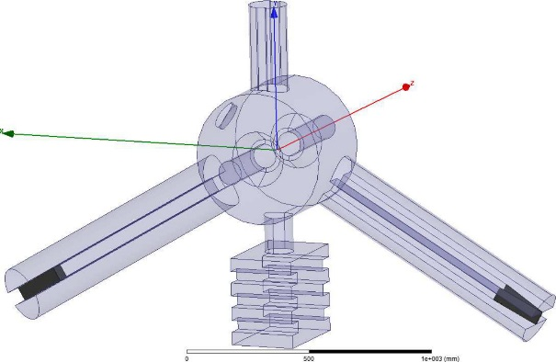
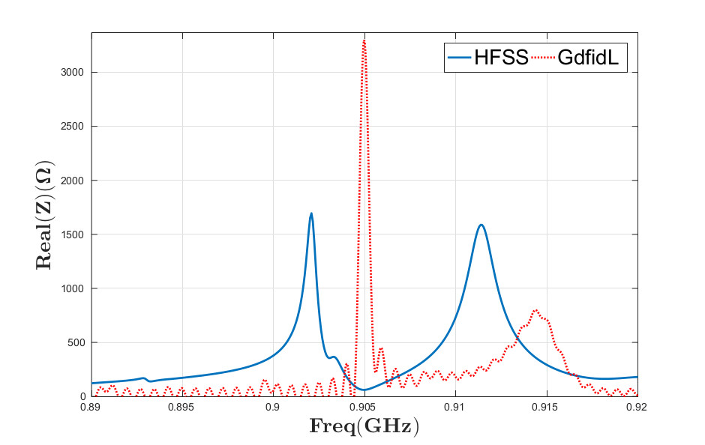
Removal of the small damper: ion pump + tuner

Slide 20
contents
Motivations
Longitudinal impedance:
All dampers installed: GdfidL simulations and presentation of a reconstruction technique using HFSS to cross check the results;
Removal of the small damper;
Effect of the ancillaries: ion pump and tuner;
Transverse impedance:
With and without small damper
Effect of the ancillaries: tuner.

Slide 21
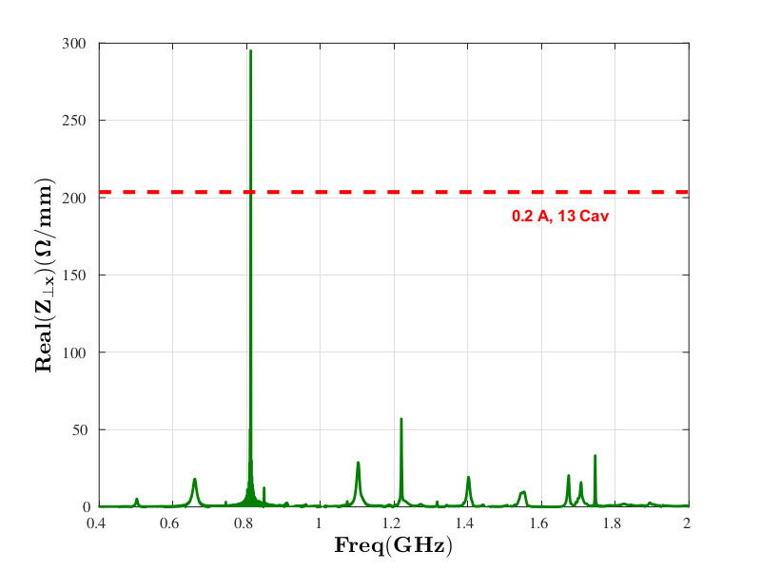
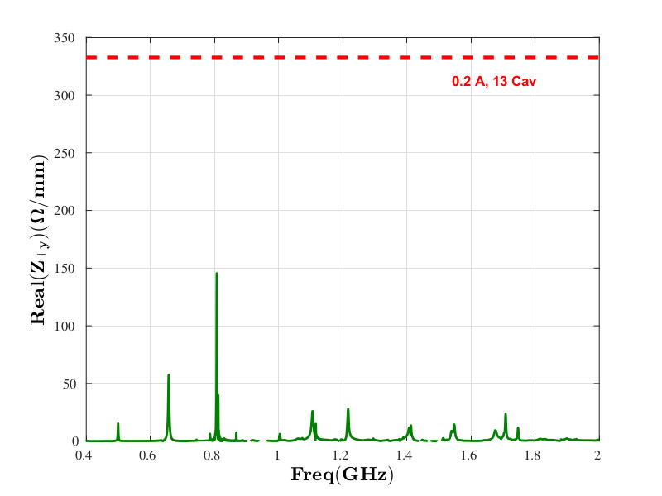
Transverse plane: all dampers
The EBS machine as well as the present one, will be a high chromaticity machine.
Moreover a transverse feedback system is efficiently in use and will also be available for the new machine.
Since its commissioning, the present SR (which installs 5-cell cavities, LEP type) has never suffered of coupled bunch transverse instabilities. Nevertheless a characterization of the transverse plane is anyhow welcomed also in view of further, future upgrades.

Slide 22
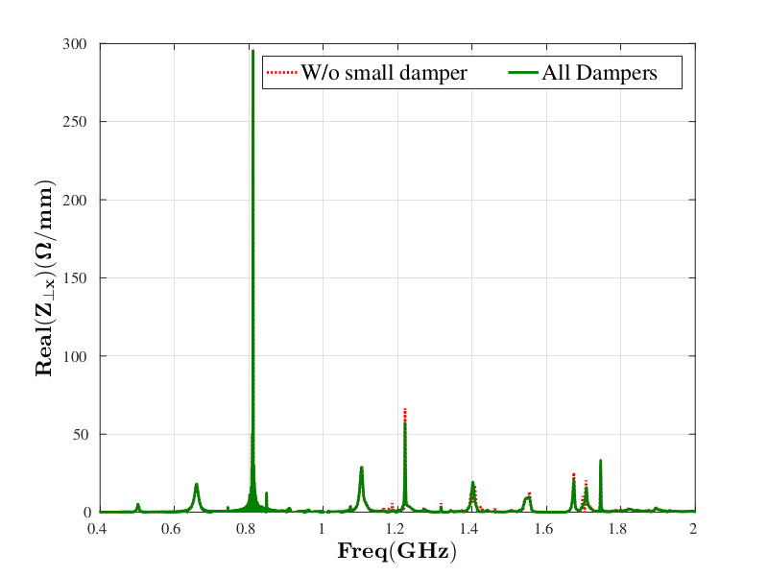
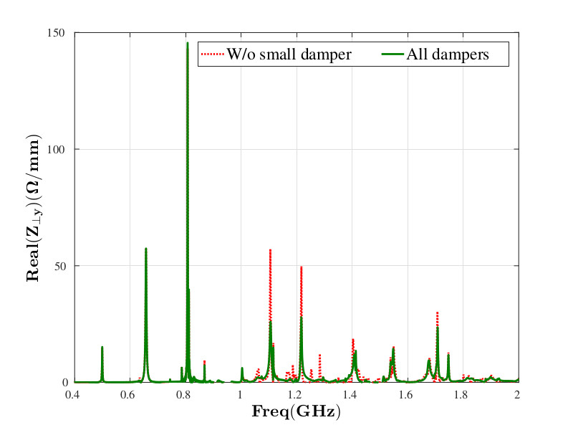
Transverse plane: no small damper

Slide 23
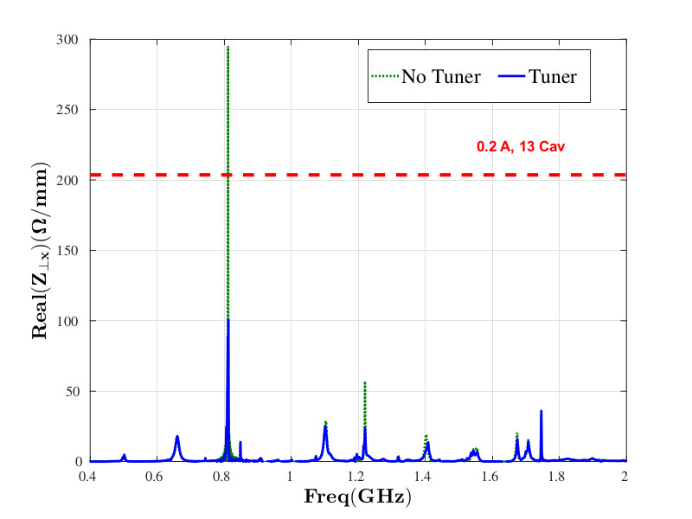

Transverse plane: no small damper + tuner

Slide 24

Conclusion: the small damper will not be installed
No small damper with Ion Pump

Slide 25

Thanks for your attention!!!
Tool to remove the small damper
Modified from https://www.fritzcartoons.com/product/646-guillotine-guy/

Slide 26
Additional slides

Slide 27
Hom absorbers – Ultrasonic tests of ferrite brazing at the “Institut de Soudure” (IS)
Brazing definitely improved, to be confirmed by a microscopic cut analysis
Brazing Samples
1st Samples
2nd Samples
April 2017
July 2017

Slide 28
Hom absorbers – Microscopic cut analysis at the IS
All these defects make the brazed interface more fragile and in principle there is no guarantee of a good adhesion of the ferrite tiles in time.
Tile 2
Micro-porosities due to trapped gas during brazing
Cavities
Intermetallic compounds

Slide 29





Ageing tests
570 cycles switching the RF power on/off ➔ at least 5 years of 16 bunches (with 1 beam loss/day)
1/3 of the cycles at 360W (max dissipated power measured in the dampers in cell 23), 2/3 at 500W
Measure the temperature on the ferrite tiles and looking at the time thermal constant of each cycle: if something is getting degraded the time constant should change;
In addition when RI produced the HOM absorber to submit to the tests, they produced 3 wedges, 2 for the damper and one reference in order to compare their ultrasonic cartographies before and after tests
Old Absorber
RI
HOM n. 2
HOM n. 1
HOM ref.

Slide 30




Deeper analysis: 0-padding
Just a reminder: 0-padding means that we are just adding zeros, in general, to the extremities of the signal interval, in this case only on the right side. The effect is to artificially reduce the frequency step in the frequency domain giving better resolution. Of course that does not add any more information to the measured/simulated signal. Finally also the noise will be “better resolved”.
Noisy but the original is well shaped: I do not expect big surprises
Interesting: it looks having a very high Q (see next slide)
The rest is well shaped and 0-padding confirms that all the frequencies above 900MHz are well resolved for a wake 200m long (we remind that the final purpose hereby is to study the effect of the small damper)

