Slide 1
Notes:
Slide 1: Company Logo Full Page
Before you start editing the slides of your talk change to the Master Slide view:
Microsoft Office :Menu: View > Slide Master;
Macintosh – View > Master > Slide Master
Edit the following items:
On the Slide Master (first master slide) – lower area
a) On the left Delete the text and write the title of the event/Conference, Location
b) On the right delete the text and write the name and surname of the speaker and the date (day, month , year)
Close Master View

Slide 2
RF System at Elettra: present status and outlook M. Bocciai, C. Pasotti, M. Rinaldi
Notes:
Slide 2: Title of the Presentation
Before you start editing the slides of your talk change to the Master Slide view:
Microsoft Office :Menu: View > Slide Master;
Macintosh – View > Master > Slide Master
Edit the following items:
On the Slide Master (first master slide) – lower area
a) On the left Delete the text and write the title of the event/Conference, Location
b) On the right delete the text and write the name and surname of the speaker and the date (day, month , year)
Close Master View
To start adding slides insert a new slide and select a Layout:
For Title & Subtitle
For text with bullet points
For Text
For Picture, graphs, visuals
Two columns
Blank

Slide 3
Outline
Elettra, RF and 3HC systems parameters
3HC commissioning and operational experiences
3HC and RF systems DOWN-TIME
RF system main issues
Elettra 2.0 project
RF system for Elettra 2.0
* From RF power meters data

Slide 4
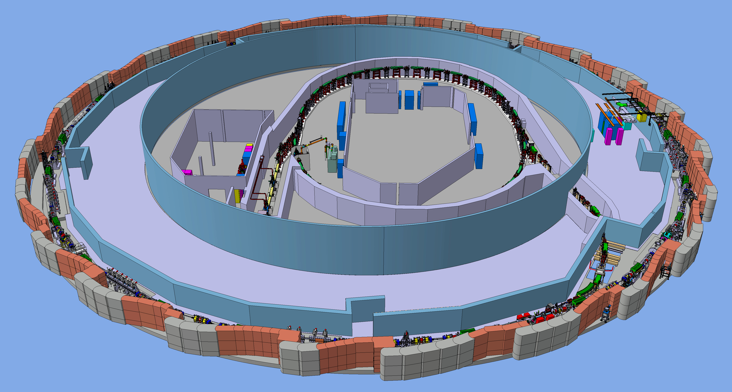
Elettra Facility
2.0 / 2.4 GeV Machine in operation since 1994
3rd generation light source, user dedicated facility ( > 5000 h/year)
1994 - 2008 Decay mode
2008 up to date Full Energy Injection and Top-Up mode
* From RF power meters data

Slide 5
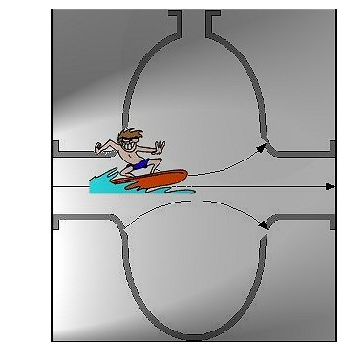
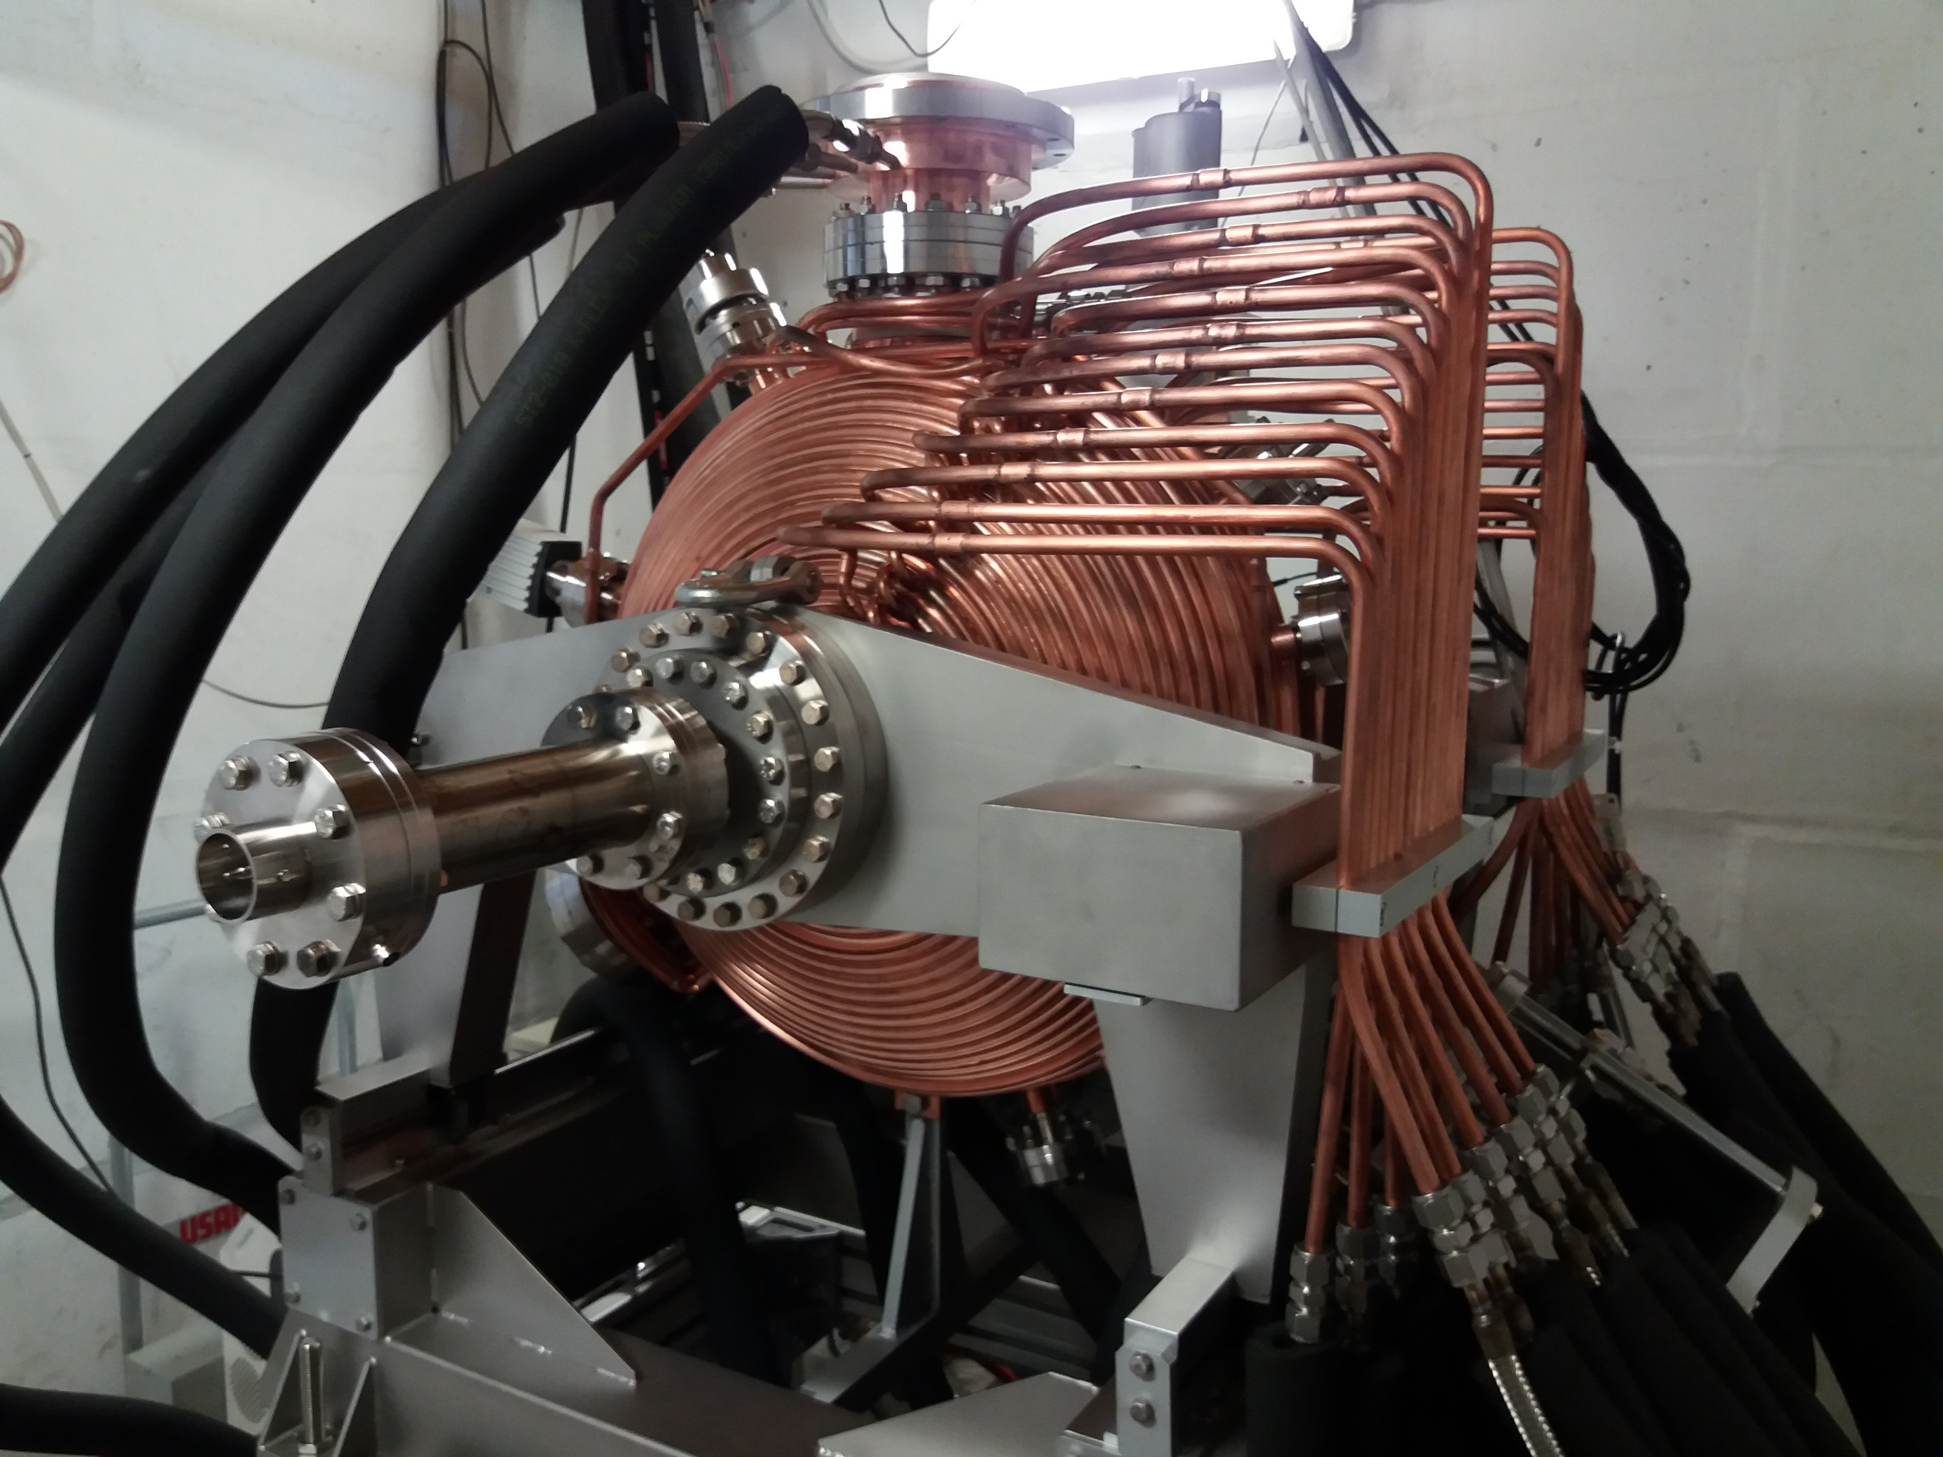
RF System
Elettra SR cavity:
single cell
normal conducting
multipacting free
Booster cavity:
5 cell Petra type cavity
Operating parameters (flat top) 14 kW - 600 kV
Available RF power: 18 kW since Oct 2017, before it was 55 kW !

Slide 6
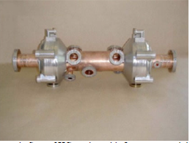
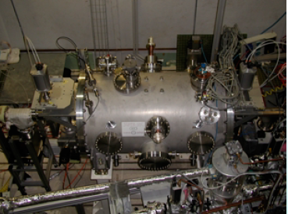
3HC System
The 3HC system comes from a joint project among CEA (France) , PSI ( Switzerland), Elettra and CERN and it is based on the SOLEIL (scaled) cavity.
CEA lab has designed, fabricated and tested two cryomodules.
CERN lab has built two resonant cavities and made the vertical tested .
One system has been installed at SLS and it is in operation since June 2002.
The second system has been installed at Elettra and it is in operation since January 2003.

Slide 7
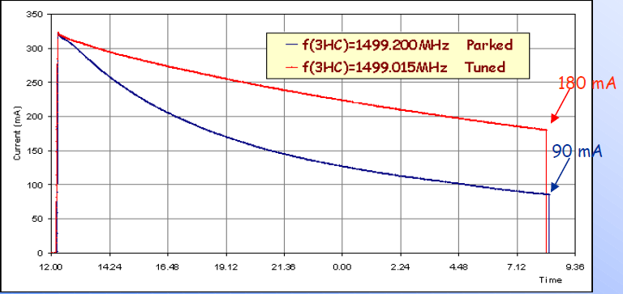
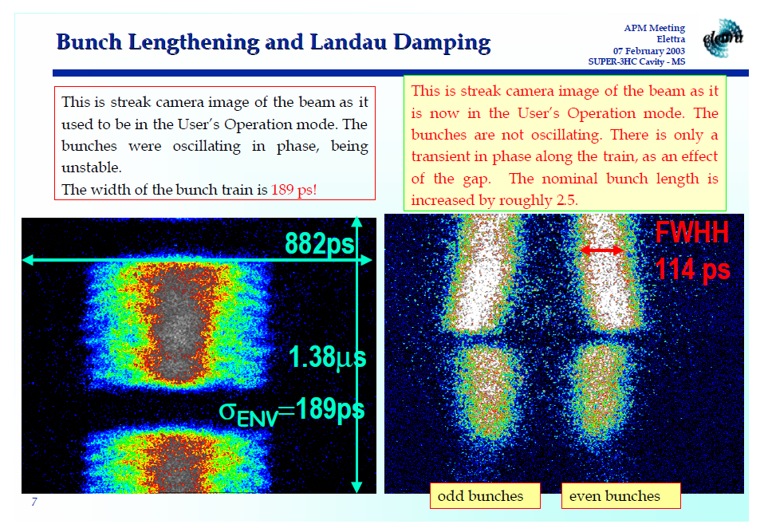
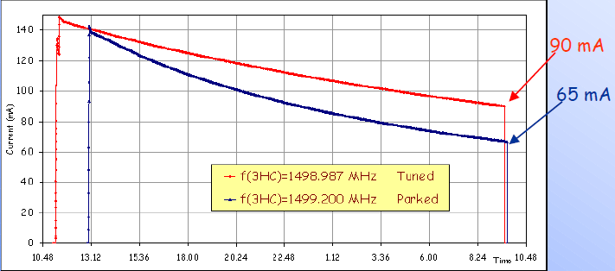
3HC Commissioning
3HC commissioning started in January 2003.
M. Svandrlik, G. Penco
Burn-in phase of the failure rates:
50% of the total user down time in run 81 (Jan 16 – Mar 2; 2003) was due to the 3HC system:
Turbine control board, vacuum interlock logic to check, high pressure alarms, vacuum insulation leak on the return line, gearbox of the tuning system motor in fault and to be replaced…
The gearboxes became the main hardware issue: even after their replacement some atypical overheating occurred ( design and/or implementation error ? Mitigated by minimising the tuning stroke movements)

Slide 8
3HC Planned & Achieved Operation
3HC installed to:
Longitudinally stabilize the beam due to the induced by Landau damping
Increase the beam lifetime
WARM PARKED
to safely operate 3HC in case of cryomodule’s failure
Operating Conditions:
No induced beam voltage with de-tuning range Δf = 5 MHz+500 kHz
COLD PARKED
to avoid any effect on the beam due to 3HC
Operating Conditions:
No induced beam voltage with
De-tuning range Δf = 500 kHz
OC ATTAINED
at 0.9, 2.0 and 2.4 GeV at any current value
COLD TUNED
to implement all
the 3HC benefits
Operating Conditions:
up to 1 MV induced voltage kept constant by automatic feedback loop
OC NON FULLY ATTAINED
induced voltage limited to 400 kV and no voltage FB
OC FAILED @ 2.0 Gev 320 mA
OC ATTAINED @ 2.4 GeV 160 mA
From July 2003 a LONGITUDINALLY STABLE BEAM was routinely
delivered to the Elettra USER!
SIDE EFFECT: the Multi Bunch Transverse Feedback could be set into operation easily

Slide 9
Operation with/with out 3HC
DECAY MODE
Daily, injection and beam storage at 0.9 GeV then ring energy was ramped to the final value 2.0/2.4 GeV Refill procedure average time <1 hours.
Before 3HC
User operation achieved by exciting a longitudinal CBM from a HOM cavity at constant level to overtake any transverse and longitudinal “competitors” instabilities. Constant level of the CBM instability was tolerated by the beam lines and the CBM mode was also harmless for the cavity equipment.
WITH 3HC
Beam injection and storage at 0.9 GeV achieved by exciting a longitudinal the very same CBM and 3HC nearly parked (no induced voltage but close to the tune position to minimize the motor tuning steps). Before the energy ramping, 3HC was tuned to kill the longitudinal oscillation mode Energy was ramped and beam delivered to user.
TOP UP
First injection at the beginning of the run, then refill of 1 mA each 10/20 minutes depending on beam energy and lifetime.
WITH 3HC
At 2.4 GeV 3HC is cold with no beam induced voltage.
At 2.0 GeV 3HC is tuned: as soon as the beam intensity reaches 200 mA , 3HC starts to accumulate some induced voltage and eventually, at 310 mA the last longitudinal oscillation are killed and the maximum 3HC voltage, 400 kV, is achieved.
WITH OUT 3HC
Warm operation only at 2.4 GeV, due to the equipment overheating.
Cold parked not useful at all @ 2.0 & 2.4 GeV.

Slide 10
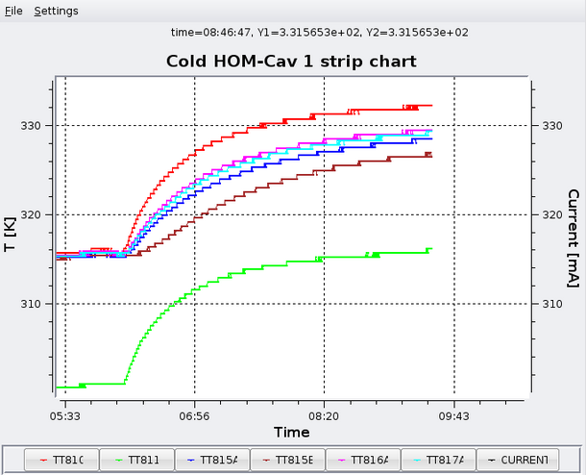
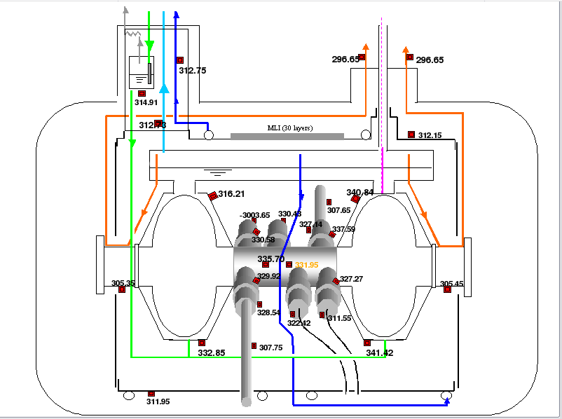
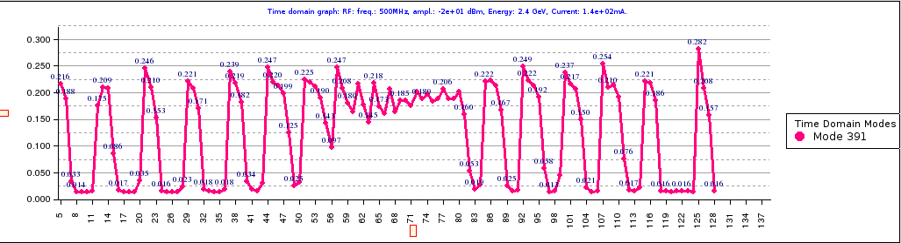
3HC warm mode operation
After a cold to warm unwanted failure, if feasible, the 3HC system wall always cool down as soon as possible (typical user down time 10-12 hours)
3HC warm parked operation arranged ONLY to cover the time request to procure the components or helium gas to recover the ongoing cryogenic system failure. It works at 2.4 GeV only.
Monitored heating increase, measured in May 2011
To prevent further harmful heating of the warm 3HC, the RF temperature of one cavity is carefully adjusted to cure the longitudinal CBM excitation
for example:Cavity #8 from 58.2 ⁰C to 58.8 ºC to stabilize the CBM 391 in may 2011.

Slide 11
Down-Time in decay mode
RF and 3HC faults number (all) and user down time during the Elettra operation in decay mode (2003-2007)
3HC performances:
After the commissioning phase, run 81 and 82, 3HC fault number mainly due to the need to check the cell tuning ( setting troubles) not to the hardware but during run 101 when 9 hours of user down time occur due to the cryogenic compressor failure
RF performances:
As usual, but during run 94 the IPC from cavity RF#9 had to be replaced (HOMs damages) due to the wrong temperature setting after a 4 beam SR laser operations.

Slide 12
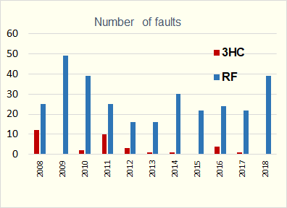
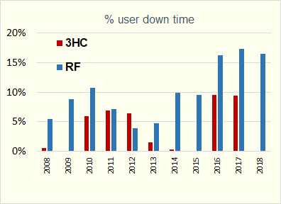
Down-Time in TOP-UP mode
RF and 3HC faults number and user down time during the Elettra Full Energy Injection (2008) and TOP-UP mode ( from 2010 to date)
3HC performances: Few but fatal faults!
2010 a cold down during user operation performed +turbine failure fixed:15 hours User Down Time (UDT)
2011 cryogenic system failure 18 h UDT + several days in “3HC warm operation” user operation
2012 insulation vacuum above the threshold. Fixed and 18 h of UDT
2016 insulation vacuum above the threshold. Fixed but recovering the cryogenic temp was difficult (18 h of UDT)
2017 cell tuning problems (wrong calibration) and compressed air + pressure problem on the compressor ( 18 h UDT)

Slide 13
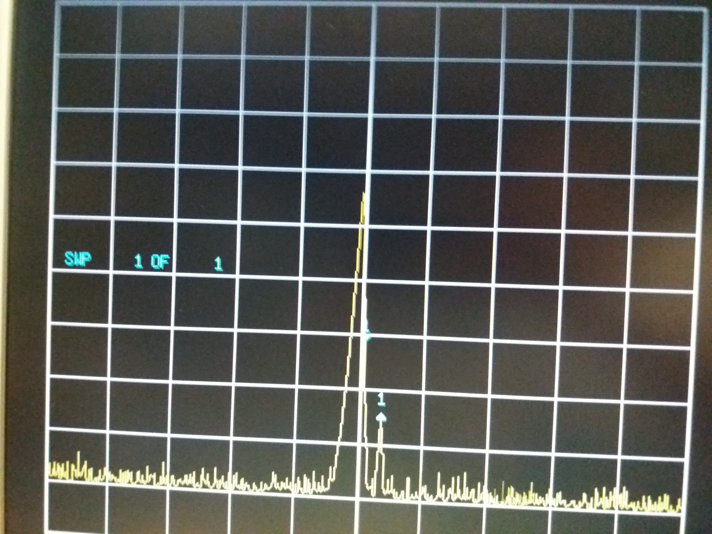
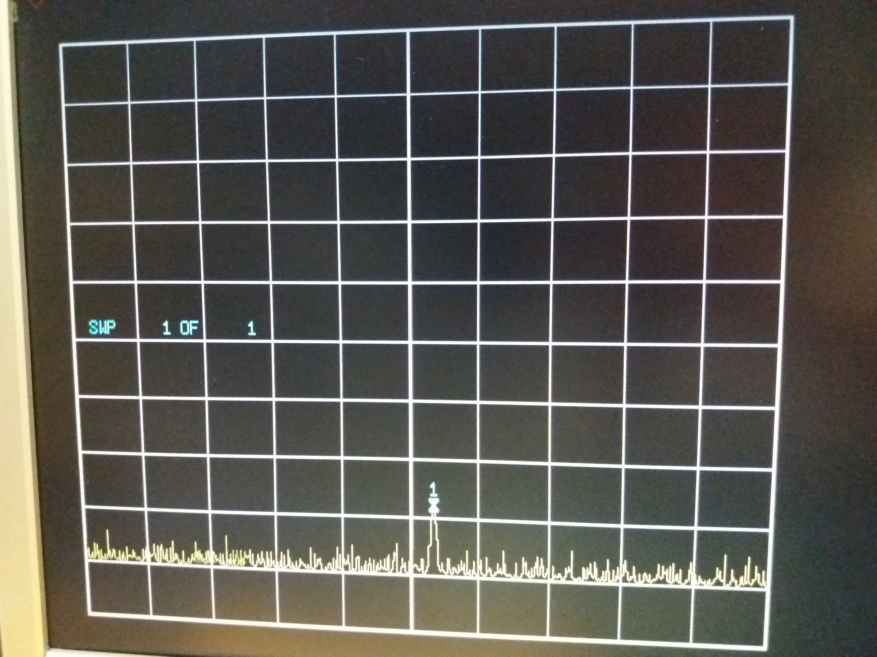
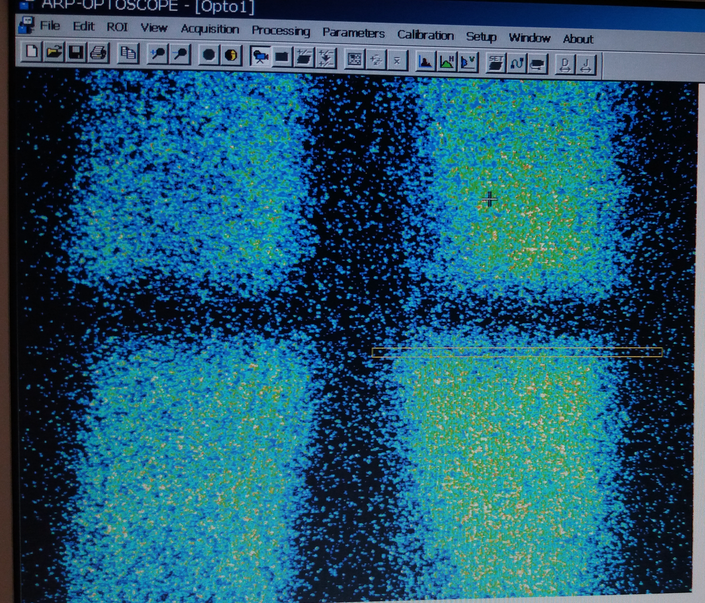
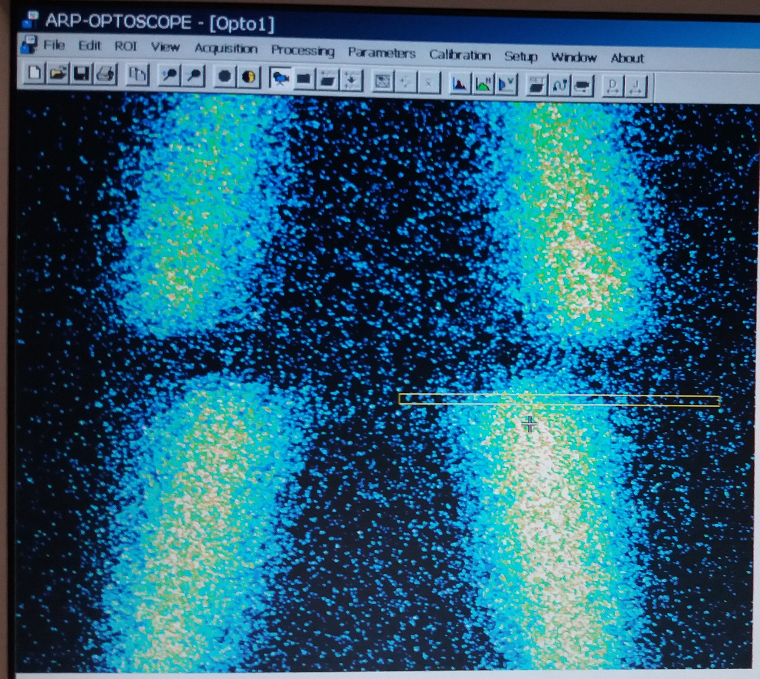
3HC and beam stability
QUALITATIVE snapshot taken on May 2018 ; Energy 2.0 GeV; beam current 310 mA
CBM 388 instability intentionally excited driven by one RF cavity width huge excitation level (CBM 388 10-20 degree unstable)
Lifetime drop: - 6 %
3HC parked: Δf =-19 kHz, V_{3HC} /cell < 140 kV ( RF pick up reading unstable)
NO CBM : beam longitudinally stable
3HC tuned:
V_{3HC} /cell = 180 kV (stable reading)

Slide 14
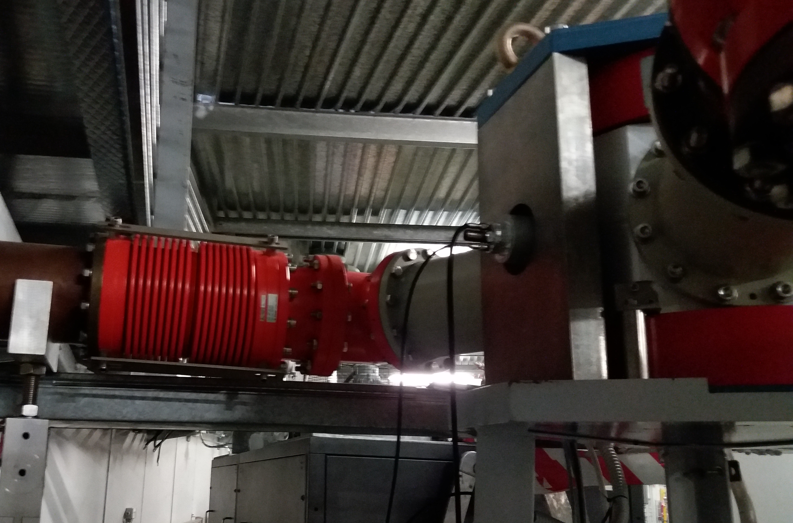
RF System & down time
RF performances in 2018: high failure rate due to the interlock analogue electronics!
RF interlock switch is home made and it has been built with analogue electronics, no PLC, no digital memory. Capacitors and AC/DC power supplies ageing…More than 60% of down time due to these issues…
Circulator arc detector doubled…each interlock has risen both the detectors!

Slide 15
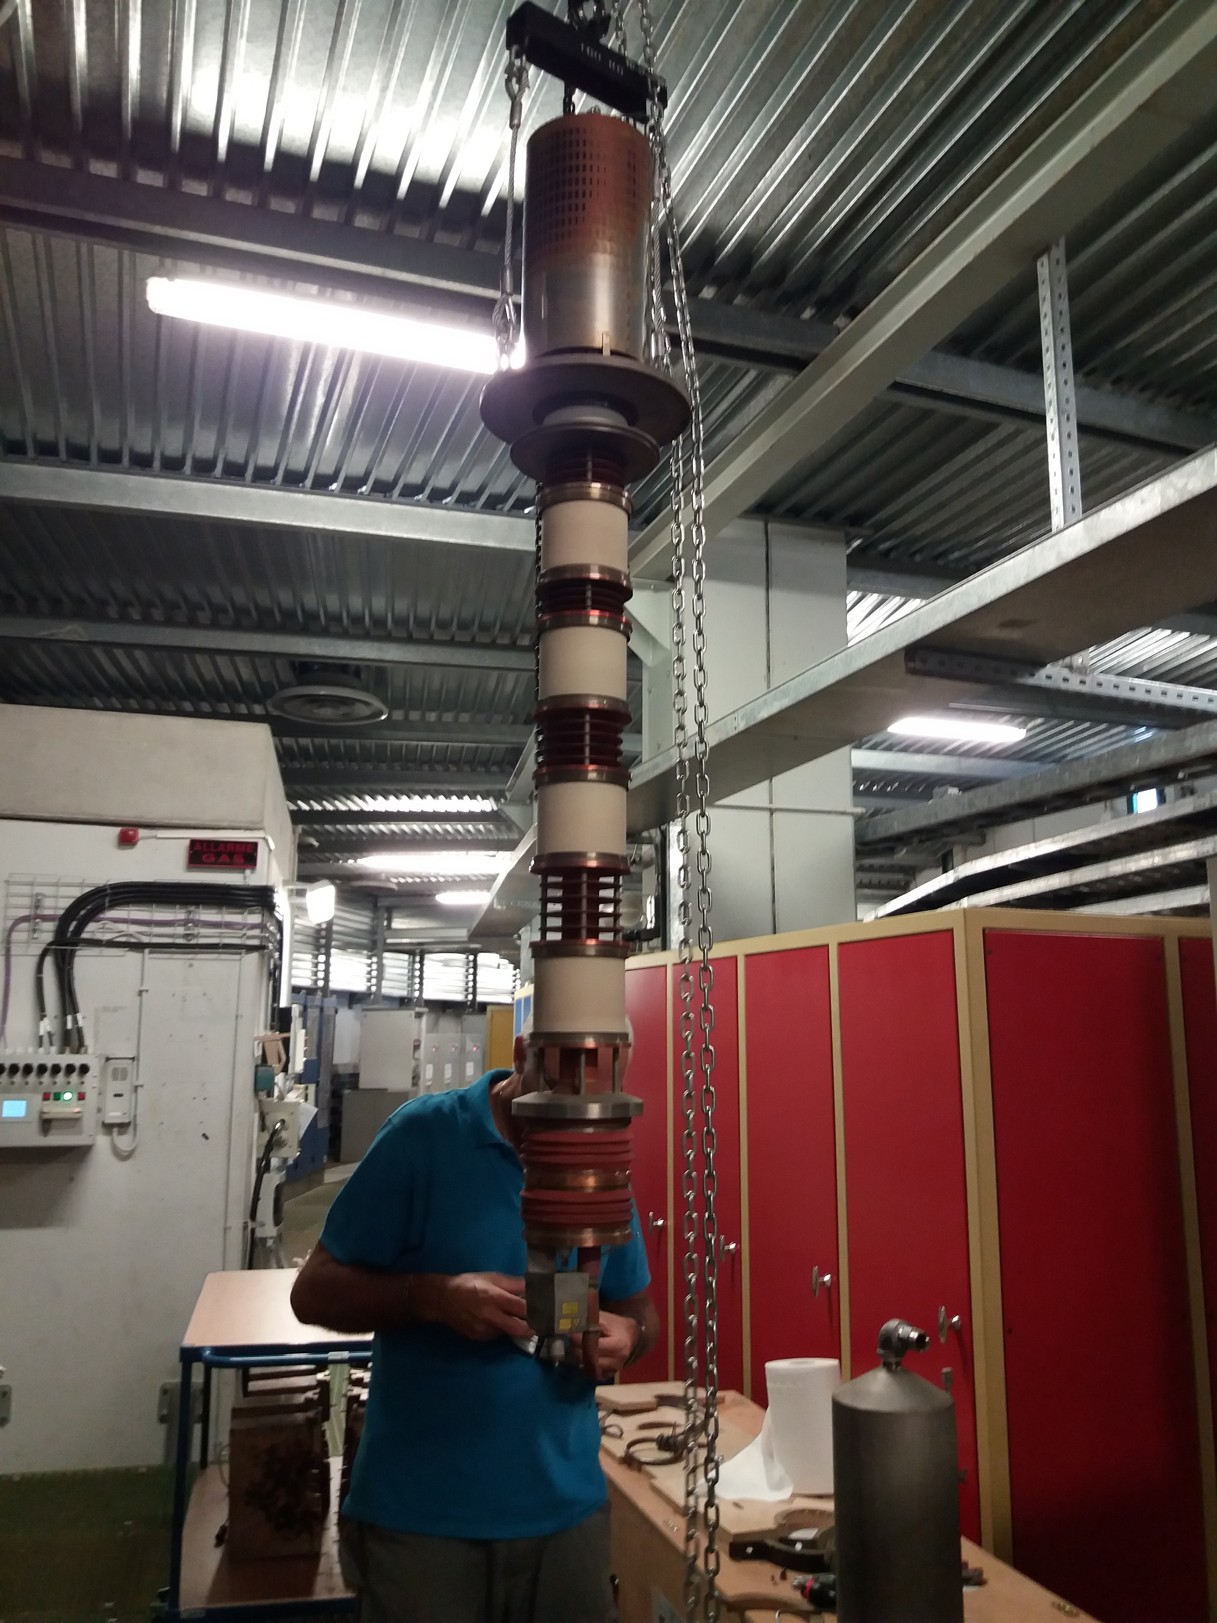
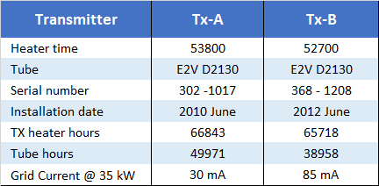
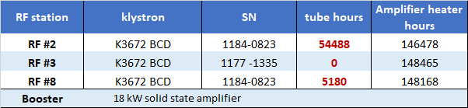
RF Power Station
BOOSTER SSA is working fine, no down time so far , ≈ 6500 operating hours.
Warranty repair:
Two RF power transistors replaced (out of 96)
One water pump replaced and the water liquid cleaned
(cold plate maximum temperature drop of 8 ⁰C)
IOTs still the original ones, but their operating power is around 35-40 kW each.
Klystron-based amplifier: two klystrons replaced during shut down (only one spare left).
Removed klystron operation hours 49800 and 42600 (Standard operating hours ≈ 30000)
Philips YK1256 Klystron set into operation in 1991 in RF lab and then in RF# 3 in 2014, removed for low collector current after 42600.

Slide 16
Elettra 2.0
Courtesy of E. Karantzoulis
The future for Elettra?
A new machine following the Ultimate Storage Rings developments
Established items in 2017:
Same building, same position Circumference ~259.2 m
Energy 2.0 GeV
Brilliance increase at 1 keV by more than 1 order of magnitude
Spot size less than 40 um
and
Maintain the existing ID straight sections
Maintain the existing bending magnet beam lines
Multi-bunch current 400 mA, maintain the filling patterns as before (hybrid, single bunch etc.)
free space not less than that of Elettra, LS: 6 m (4.5 for Ids) + (SS: 1.1 m , SLS: 1.46 ) total 8.56 m
Use off axis injection
* MOPRO075, IPAC2014

Slide 17
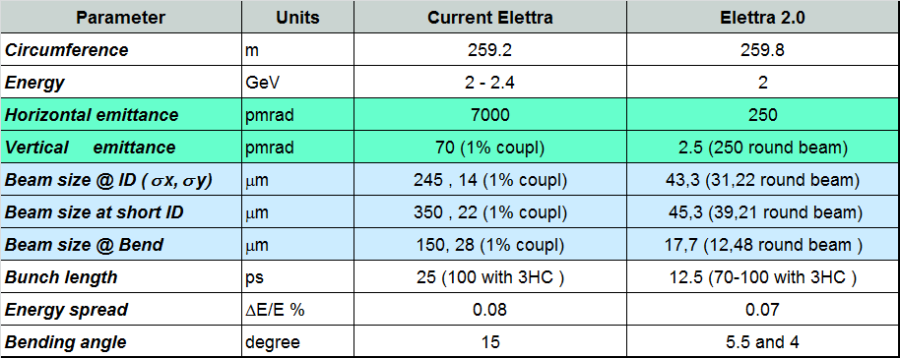
Elettra 2.0
Courtesy of E. Karantzoulis
New optic design with a 6-bend achromat
Elettra 2 will have:
larger magnets number with
higher field strength
larger power supply number
Smaller diameter vacuum
chamber (halved)
Upgraded injection system
Dedicated wiggler for the
dipole beam line (user request)
A 4-bend achromat optic design solution is ready too…
Waiting for the final decision from the User community:
high brilliance and low emittance machine
or
time resolved experiments machine

Slide 18
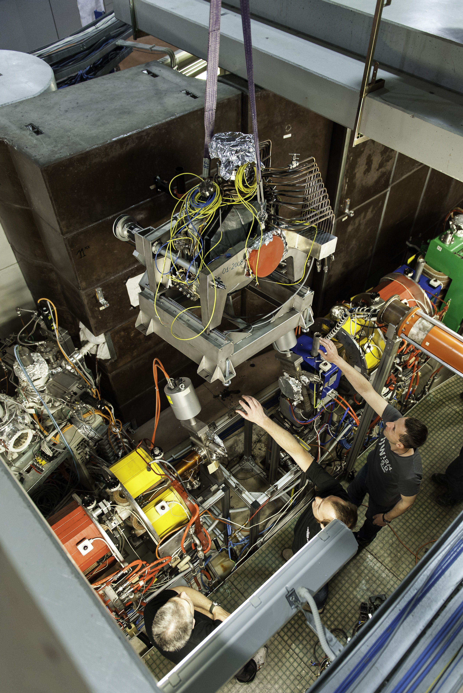
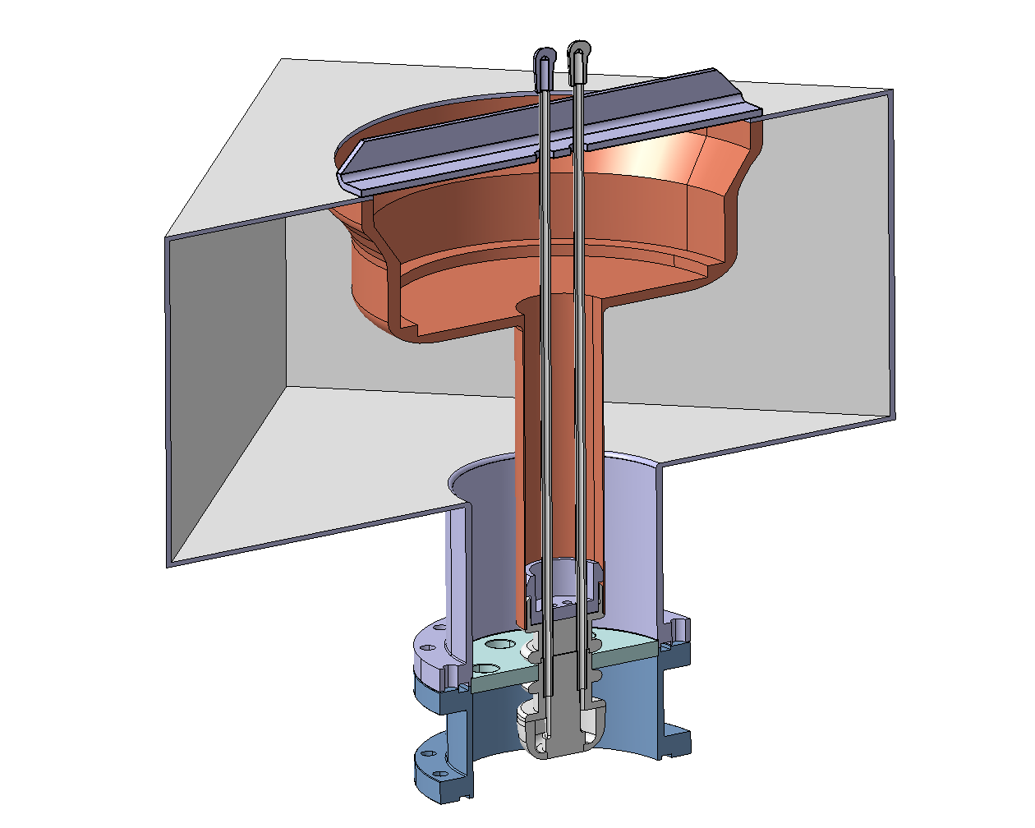
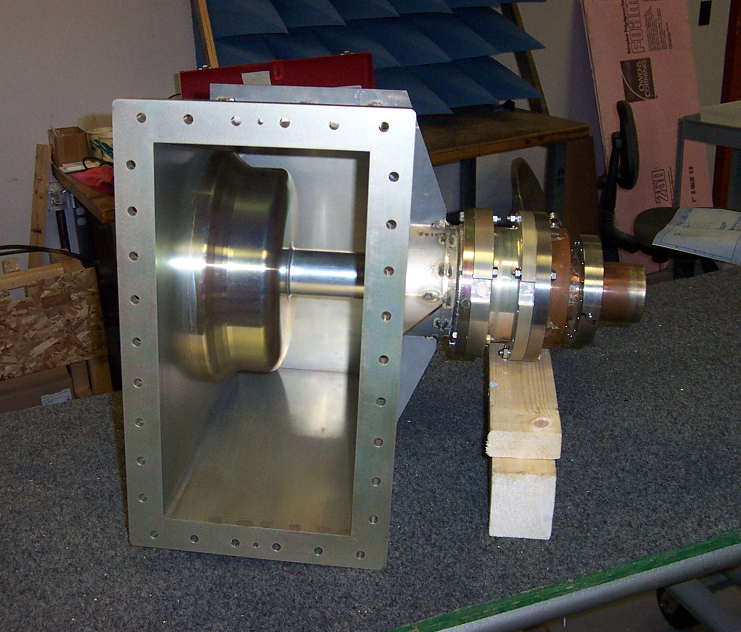
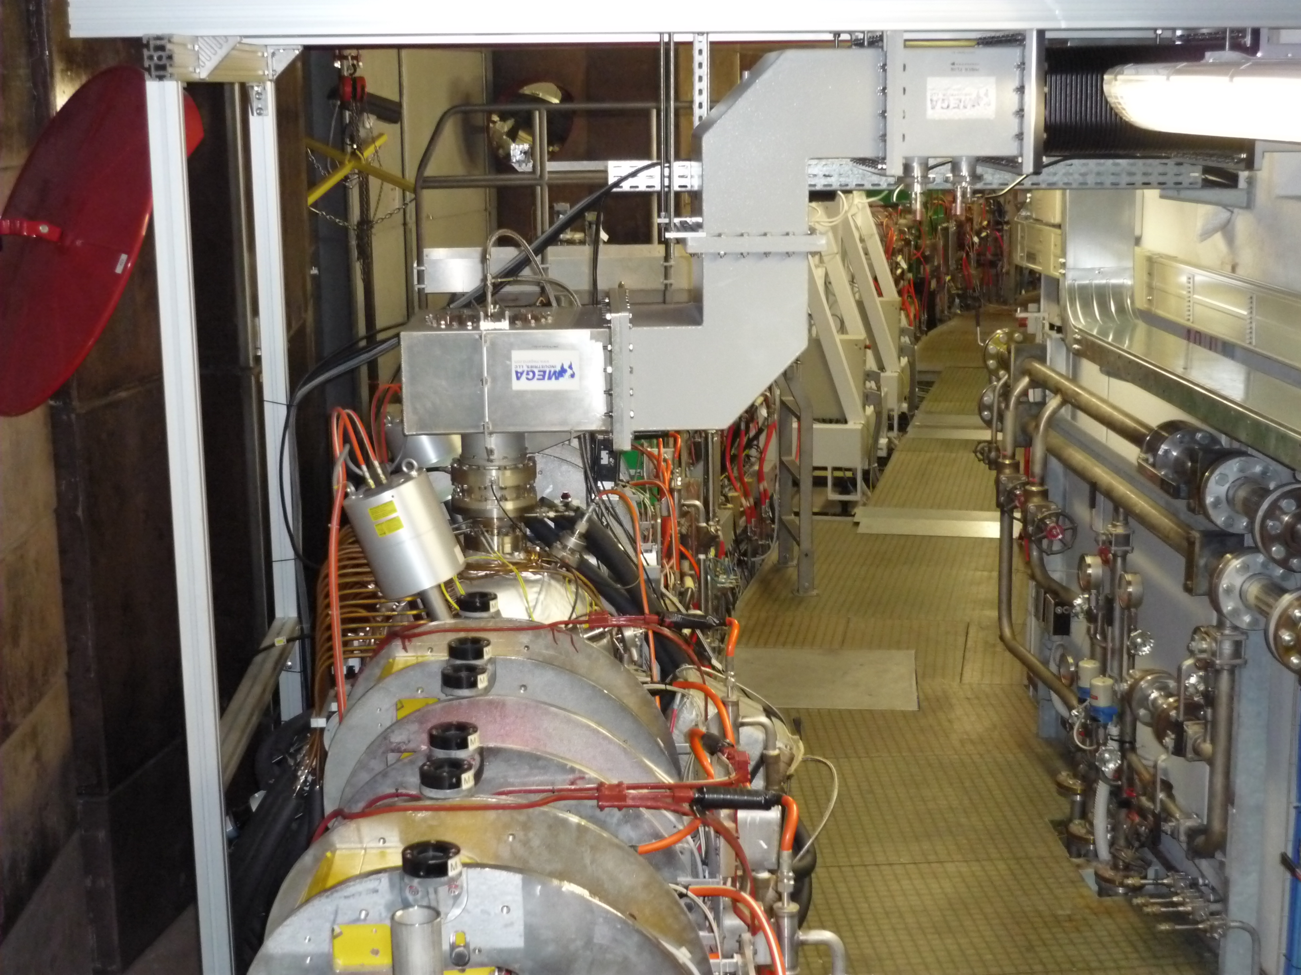
RF for Elettra (2.0)
The RF system for (Elettra) Elettra 2.0:
Keep the same RF Frequency (trade off between the Elettra revamp needs and Elettra 2.0 parameters, mainly for the RF power)
Elettra Cavity performances:
60 kW copper losses + 60 kW beam /each cavity
Total accelerating voltage 2.4 MV (4 cavities)
From 2003 up to 2015 all the four Elettra cavities has been replaced. One spare cavity ready in RF laboratory
Input Power Coupler: water cooled WG to coaxial transition installed to withstand full reflection due to beam losses for 60 seconds.
100 kW SSA transmitters procurement is running.

Slide 19
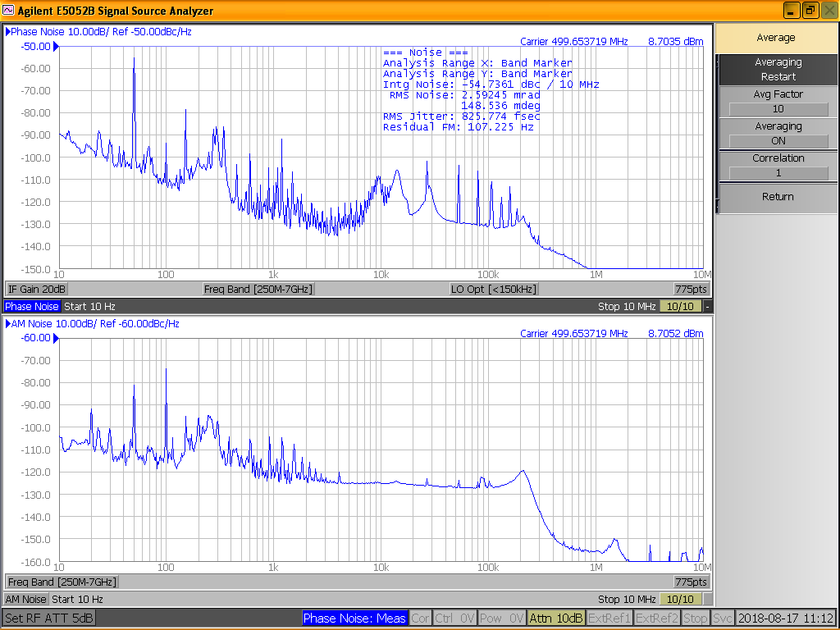
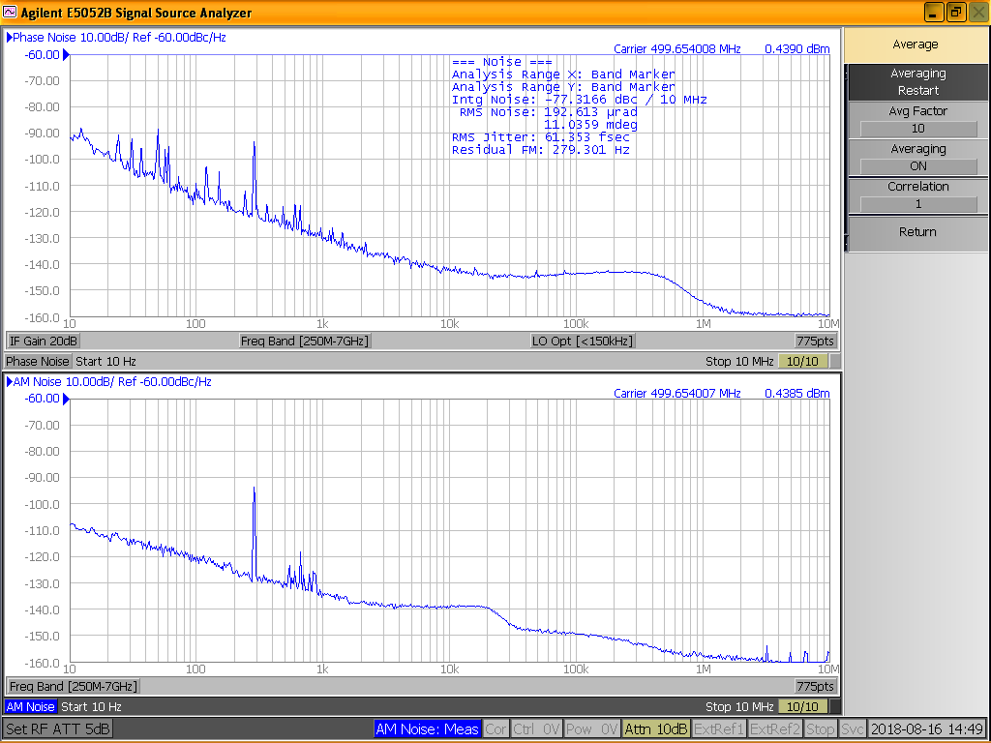
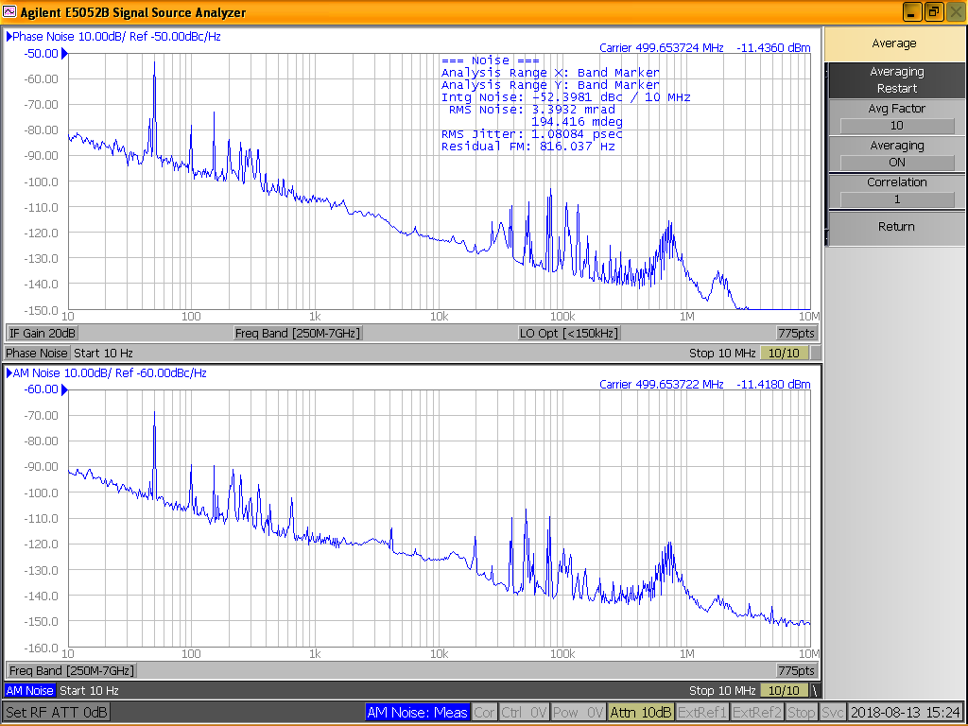
RF for Elettra (2.0)
The RF system for (Elettra) Elettra 2.0:
RF distribution and lay out: to be re-designed. More attention to the spectral purity of the RF pre-drivers amplifier ( 2 W and 25 W).
Klystron amplifier: phase and amplitude noise of the RF output power
Phase and Amplitude noise from the MASTER OSCILLATOR
Room for improvement for the spectral purity of the RF output power: RF pre-drivers first!
DLLRF : project coming soon !!!
IOT amplifier: phase and amplitude noise of the RF output power

Slide 20
Conclusion 1/2
3HC passive system is:
essential for the beam stability of the user operation at 2.0 GeV 310 mA. Without 3HC, the maximum stable beam current is around 200 mA and it is gained “playing” only with the RF cavities HOM (no MB Longitudinal Feedback in operation at Elettra). At 2.4 GeV the beam stability is achieved at 160 mA without 3HC induced voltage. 3HC warm parked operation it should be avoided ( if possible) due to 3HC components overheating.
helping the MBTF operations. TOP-UP operations somehow masks the beam lifetime increase effect, however it make a huge difference starting the user operation after recovering from any the vacuum troubles.
BUT:
Elettra TOP- UP operation has greatly lessened the requirements on the 3HC operations (induced voltage feedback loop is not need any more).
Cryogenic system maintenance and fixing is a “hard task”: at Elettra only part–time resources take care of it. The Elettra open position for a cryogenic expert not answered for so far.

Slide 21
Conclusion 2/2
The RF system for Elettra 2.0
revamp already started for the very Elettra machine.
RF distribution system and RF pre-drivers will be revamped ASAP, improving the RF noise.
BUT:
DLLRF is the next priority project of fundamental importance. A crucial decision shall be made first: in house development and expertise ( the DLLRF prototype successfully tested on storage ring in 2011/2012 ) or turn key system? More people shall join the RF group.
RF Interlock system shall be revamped as well: digital to analogic technique?
Elettra 2.0 RF power requirement seems relaxed (6-bend bare achromat losses ΔE/turn = 180 keV)
If not:
Possibility to add one more 500 MHz cavity and another 3HC cavity for beam stabilization, but room for these devices is uncertain & Longitudinal Feedback system project is also started.
New cavities design (wake fields issues) and/or SC cavity ( acceptance and/or HOM issues) to be addressed in the Elettra 2.0 “second stage”.

Slide 22
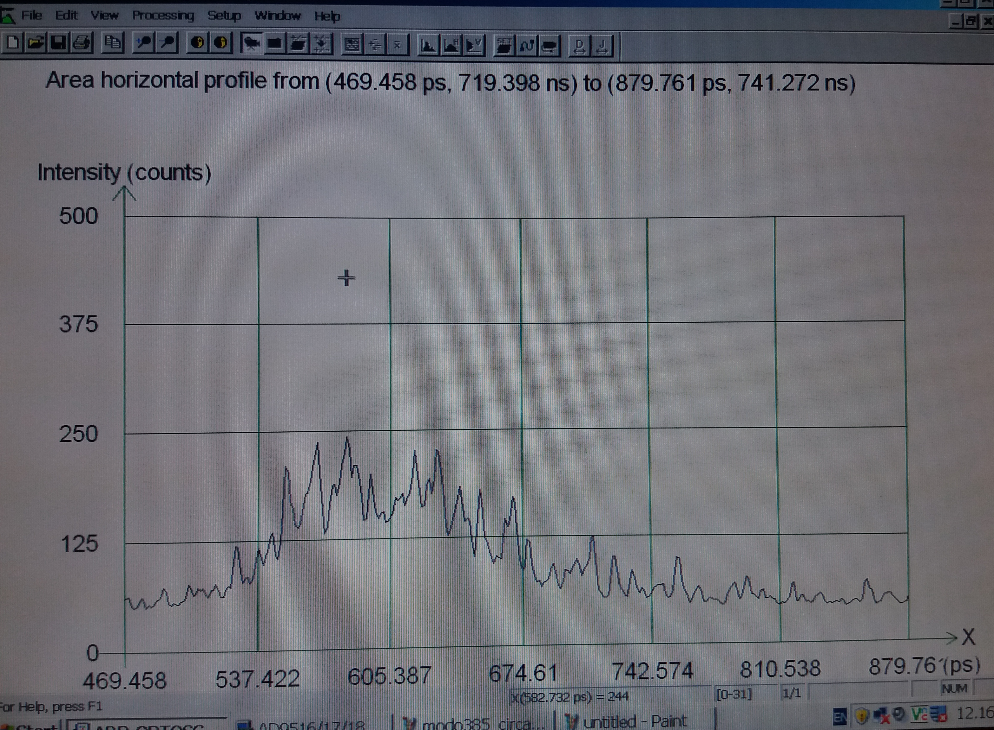
Bunch Length ≈ 137 psec (but signal to noise ratio too bad!

Slide 23
Notes:
Last Slide 2: Aerial Photo of Elettra

