Slide 1
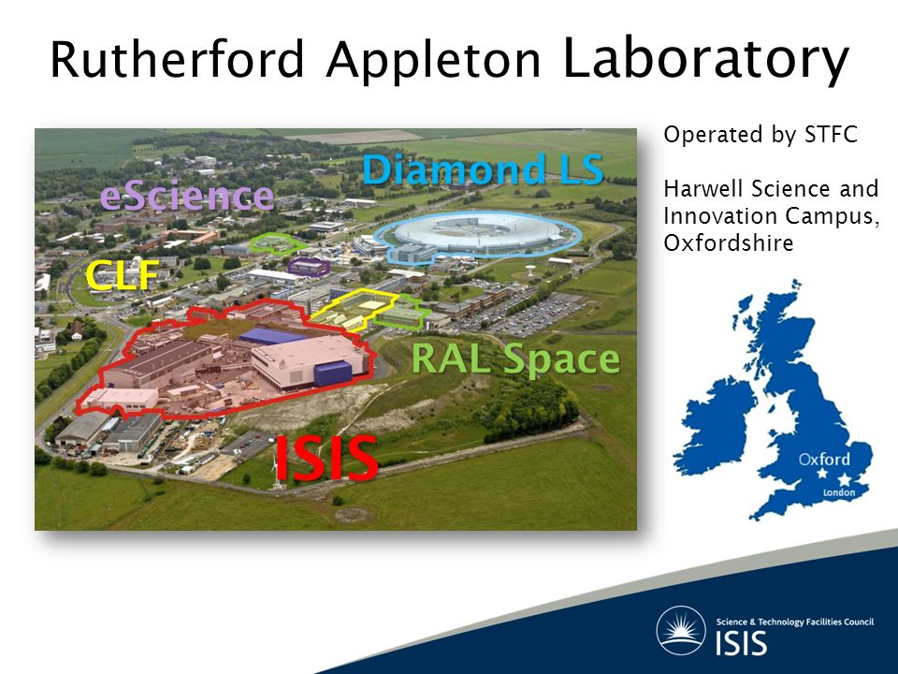

Slide 2
ISIS Standard Motion Controller
Motion Control Hardware:
Stepper Motors w. Inc Encoders
Piezo Motors
Motion Control Teams:
Design Division
Experimental Operations
Control Computing

