Slide 1
ISIS Neutron and Muon Spallation Source
Motion Control Workshop Introduction
Simon Cooper MEng (Hons) MIET
FS Tech (TÜV Rheinland, # 1536/ 18, Machinery)
Mechatronics Engineer
ISIS Design Division - Motion Control
simon.cooper@stfc.ac.uk

Slide 2
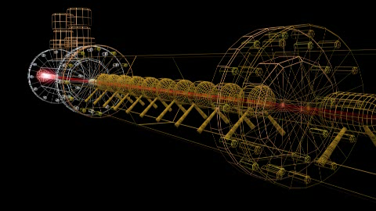
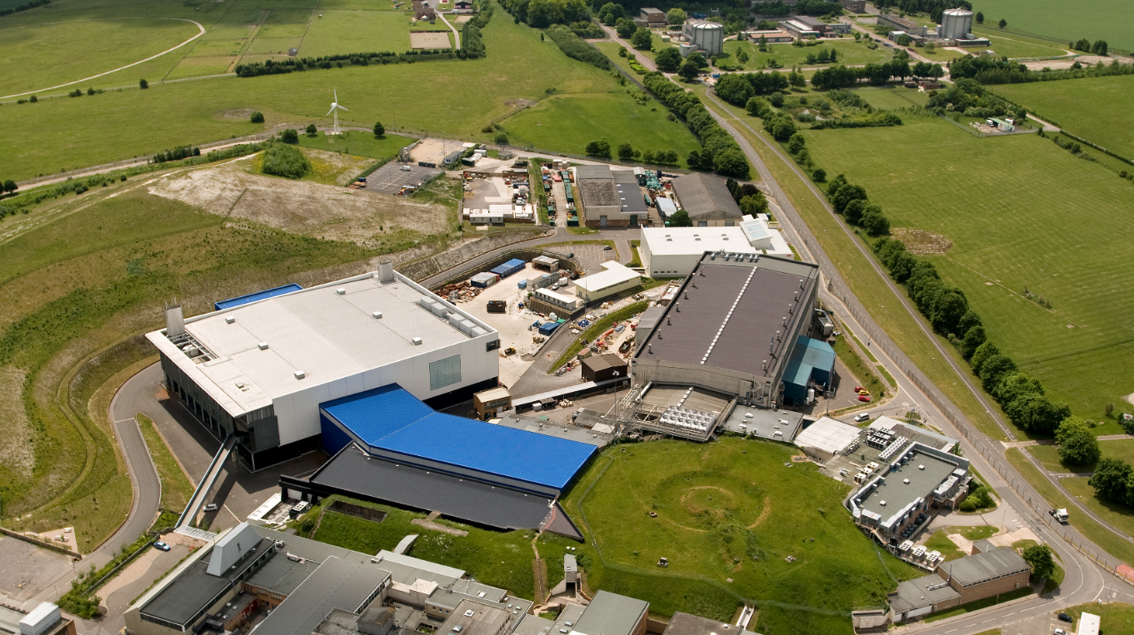
ISIS Neutron and Muon Source
Neutron and muon pulsed spallation source, located in Oxfordshire, UK
Two instrument target stations
Facility and Target Station 1 opened 1985
Target Station 2 opened 2008
Over 30 operation beamlines
350 staff members
Free facility for academic use, beam time assigned based on scientific merit
Wide-ranging applications using spectroscopy, diffraction, reflectometry etc…
Medicine
Cultural Heritage
Materials and much more
Notes:
Very quickly, ISIS is a neutron and muon spallation source in the UK. We’ve been operating for over 30 years now spread across two target station halls and run over 30 operational beamlines.

Slide 3
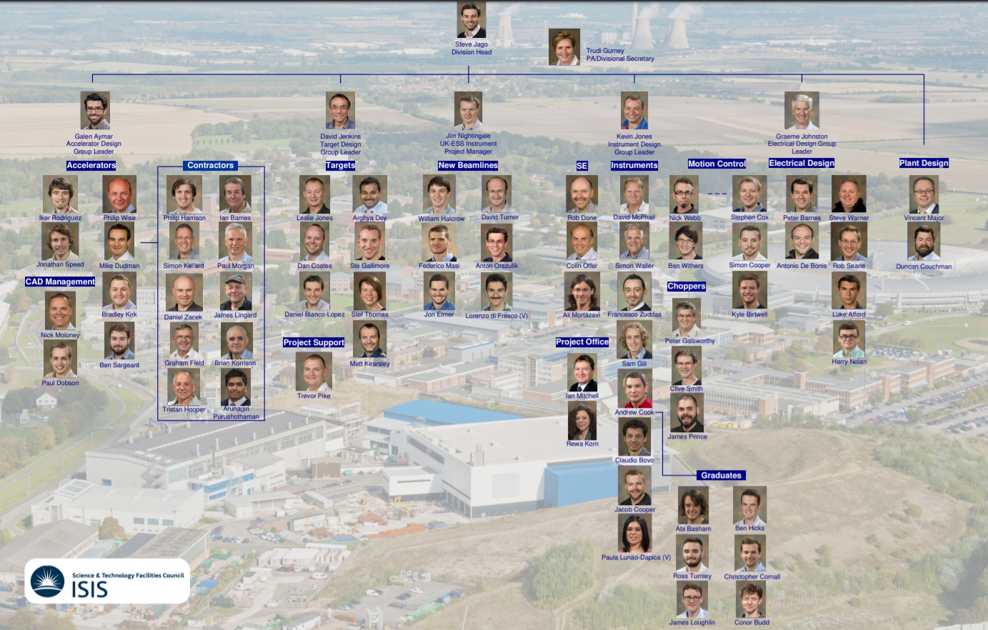
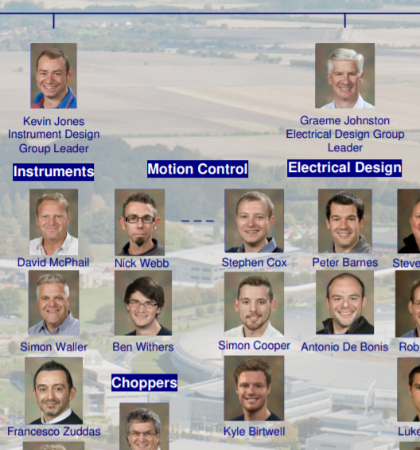

Slide 4
Motion at ISIS
Organisation
Designed/developed by Design Division (by or overseen by Motion Team)
Electrical Operations group responsible for installation, commissioning, and lifetime maintenance
Computing/Controls team responsible for user commissioning and software integration and support
Uses
Over 600 axes of motion on instrument beamlines
Used for sample handling/positioning as well as beam collimation and blocking
Technologies
Running old (very) custom GALIL hardware, no control/software complexity exists on controller
Currently rolling out next-generation motion control programme using Beckhoff
Presenting on this later in the week
Looking to move more functionality on to the controllers

Slide 5
Current Challenges
Roll out of new controller hardware
Learning new technology
Management of this roll out
Integration with existing systems
Joint code development with ESS and JCNS neutron facilities
Higher performance system design
Accuracy
Repeatability
Speed
Better commissioning methods
Use of external calibration/surveying tools
Process and ownership when split between three different groups

Slide 6
Aims of this Workshop
Design tips for alignment/performance
See how other facilities commission systems
How/where other facilities split control complexity
User level
EPICS level
Controller level
Individual axes or system control?

