Slide 2
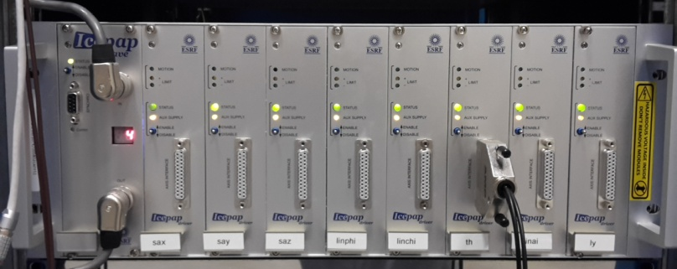
Motion Control At The ESRF
Standard motion controller at ESRF:
Other controllers used at the ESRF:
COTS controllers - interfaced or not with IcePAP
Specified or/and chosen or/and validated by ESRF
Directly bought by ESRF or, more frequently, procured by the subcontractors in charge of instrument/mechanics design and production
. 8 axes per crate
. 1 controller board
. System up to 128 axes
. More than 6000 axes installed at the ESRF
. Around 9 000 in total
. Collaboration with ALBA & MAX IV

Slide 3
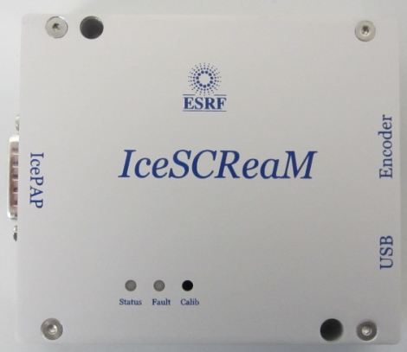
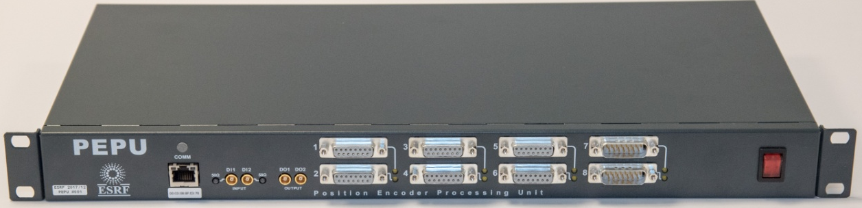
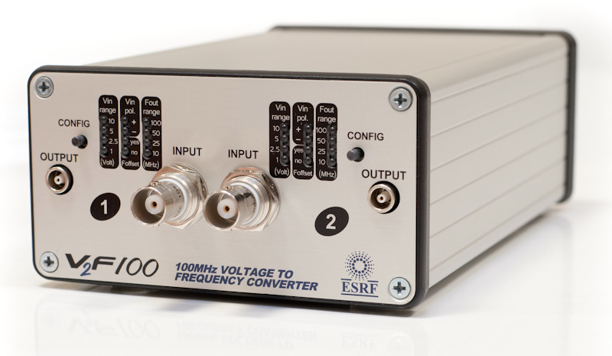
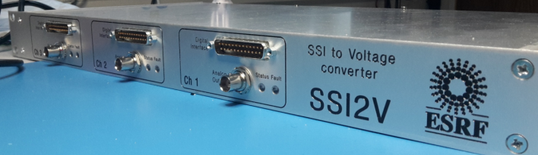
Motion Control At the ESRF
ESRF in-house developed motion interfaces:
      Positioning Encoder Processing Unit
      Voltage to SSI and SSI to Voltage interfaces
      IcePAP - Encoder interface:
        Sin-Cos
        EnDAT
        Biss-C
      Voltage to frequency converters 100 MHz

Slide 4
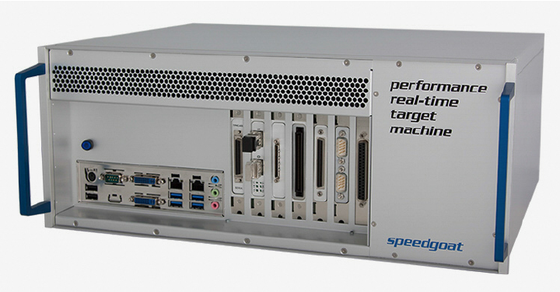

Motion Control At the ESRF
ESRF solution for real-time applications:
    Speedgoat Hardware:
      Real-time PC programmable from Matlab Simulink
    Used for:
      Rapid control prototyping
      Hardware in the loop tests
      Fast data acquisition and online data treatment
      …

