Slide 1
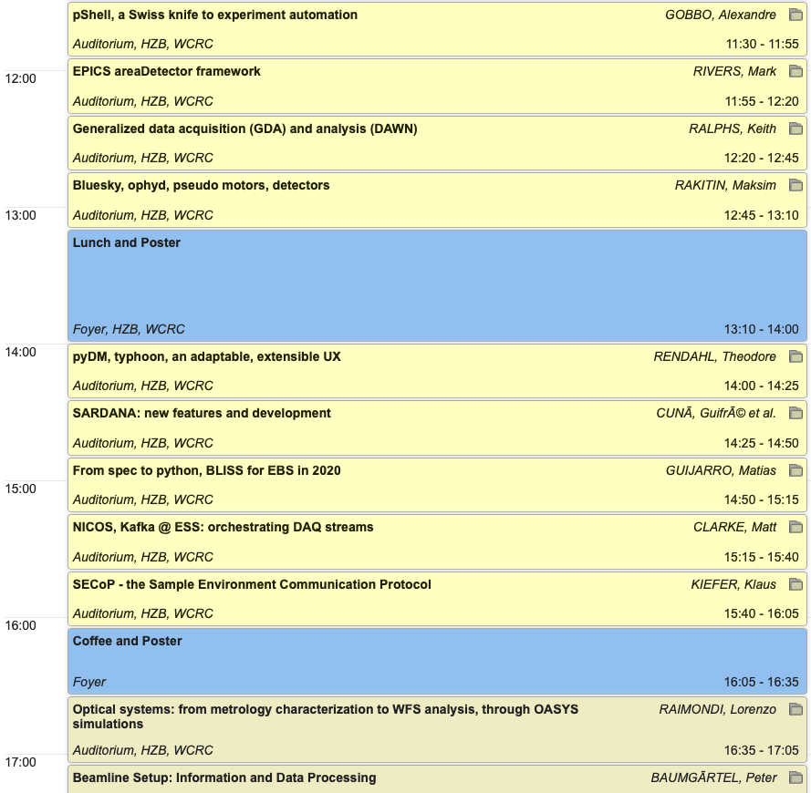
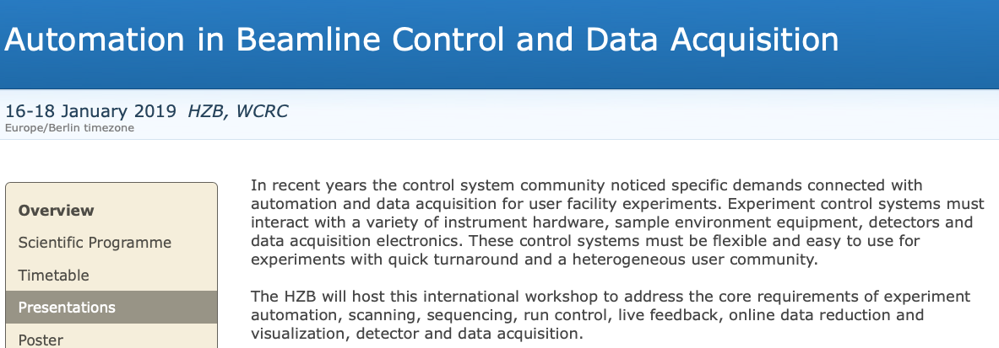
MOCRAF Related Activities at BESSY, HZB
HZB hosted a workshop Automation in Beamline Control and Data Acquisition
community supported tools
proven outreach and portability
new trends / requirements in DAQ
https://indico.helmholtz-berlin.de/conferenceDisplay.py?confId=11
For a more complete picture see the proceedings

Slide 2
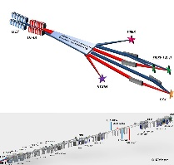
BESSY Goals Regarding Workshop Items
“Strategic projects” for BESSY activities in BL control:
Understand the complex handling of multi-optional set-ups like two independent undulators and multiple beamlines allowing for two color and polarization combination capabilities (EMIL BLs).
Develop a motor control concept allowing precise and flexible continuous scans with polarization control, orchestrating monochromators and insertion devices (fly-scan).
Envisage a good integration of high speed detectors synchronized to the mechatronic environment of the experiments.
Harmonize beamline development and operation tools to an extent, that allows to run simulation of x-ray generation and preparation parallel to the real installation (digital twin).
Fly Mode
Synchronous
FPGA
PandA
Beamline + ID
Simulation Software

Slide 3
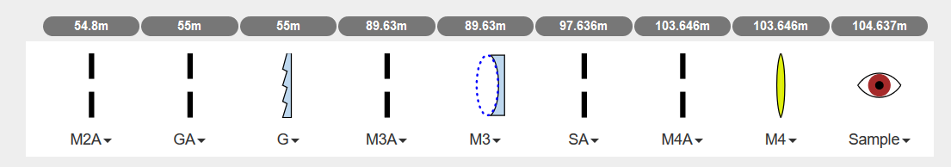
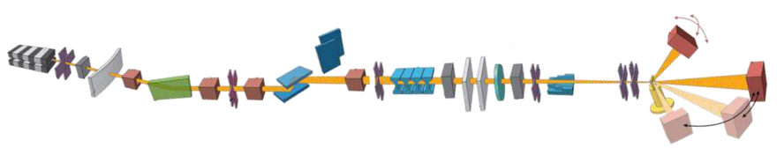

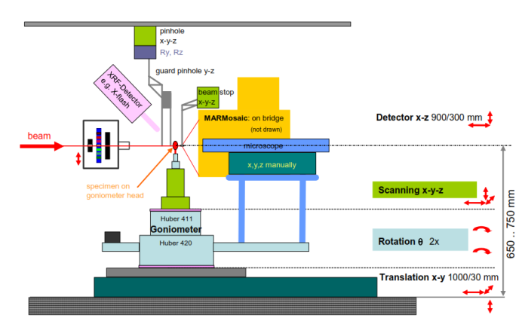
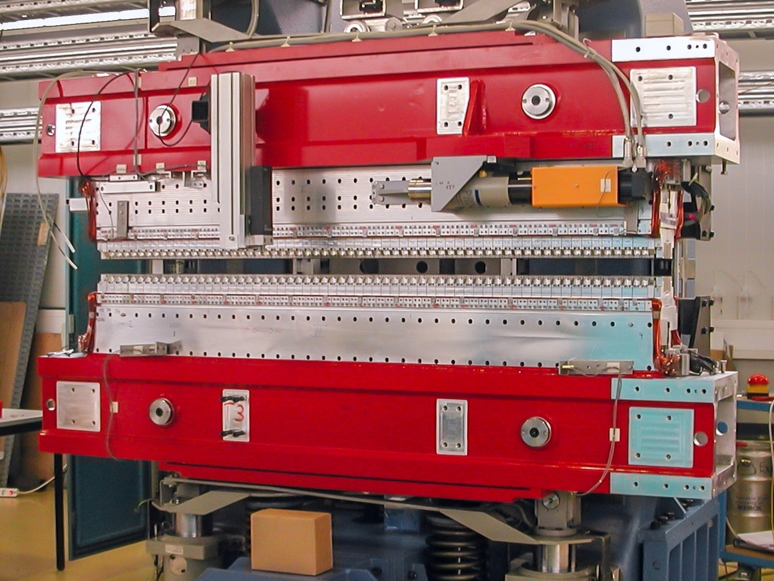
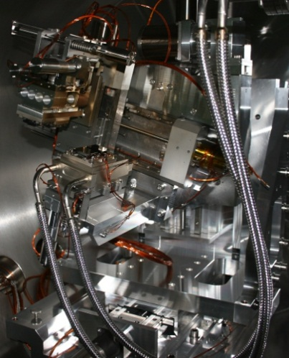
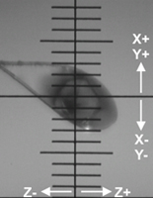
“The Big Automation in BL Control and DAQ picture”
Beamline + ID
Simulation Software
Fly Mode
Synchronous
X-ray Source
Beamline
Experiment
Data Management and Analysis
Insertion Device (ID)
hardware
Beamline
hardware
Experiment
Hardware, Detector
Sample Environment
Live evaluation during the measurement
Data Storage
Digital User Office
FPGA
PandA
Motor
Encoder
Motor
Encoder
…
Motor
Encoder
Motor
Encoder
…
Motor
Encoder
Motor
Encoder
…
Graphical user interface
Experiment flow control: Device, component
DAQ, Area
Detector
Beamline
Software
User

Slide 4
Workshop Programme
Thursday
Friday
Experiment Controls Architecture Options
Task synchronization methods
Software Stacks for Experimental Flow Control and Data Acquisition
Task synchronization methods
Software Stacks for Experimental Flow Control and Data Acquisition
Collaborations, partners
Beamline Simulation and Tuning tools
Workshop Discussion/Close-out
Workshop Dinner
Visit of the BESSY II Experimental Area
Further workshops planned… cooperations most welcome!

