Slide 1
Metrology in High-precision Systems

Slide 2

- Mostly “off the shelf” metrology solutions are used
“Precision, Dynamics & Mechatronics Team” within the Mechanical Engineering Group of the Instrumentation Division
A laboratory (Precision Engineering Lab) dedicated to Performance Checks on mechanical instruments - dedicated human resources and equipment.
Typically: Commissioning / Acceptance of instrumentation received from subcontractors
An engineer developing advanced solution for online metrology – optical based systems.
Ex: Interferometer based systems

Slide 3

Nanoprobe Prototype (ICALEPCS 2017, WEAPL04)
Metrology in Sample Stage 2D-scans & rotation

Slide 4
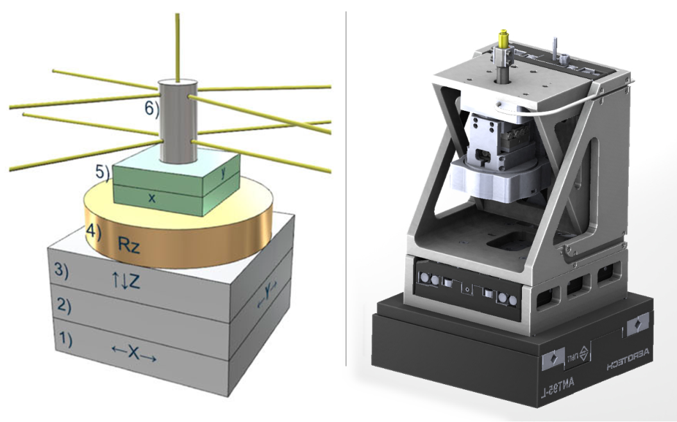
Sample Stage Setup
Stacked design
1 (X): flyscan
2-4 (Y, Z, Rz): stepscans
5 (x,y): sample alignment
6: Sample holder + interferometry reflector (sample tracking)

Slide 5
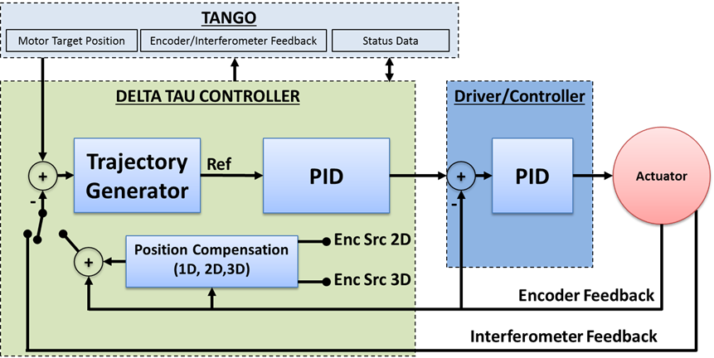
Sample Stage Control Setup
Control →Cascaded
Compensation Tables (feedforward) ➔ Need repeatable errore
Interferometry feedback control

Slide 6
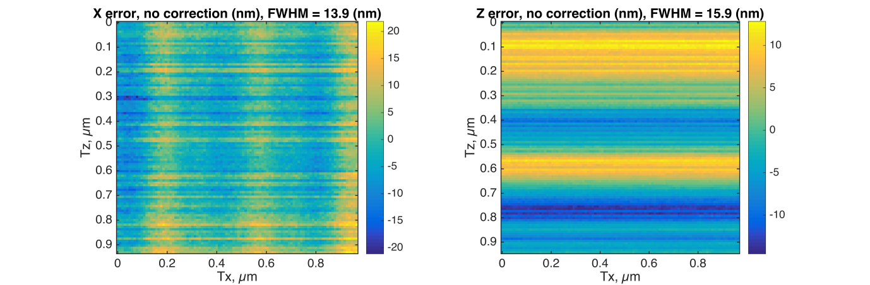
Trajectory errors during 1x1 µm 2D-scan
Encoder feedback, no feedforward, no interferometer feedback

Slide 7
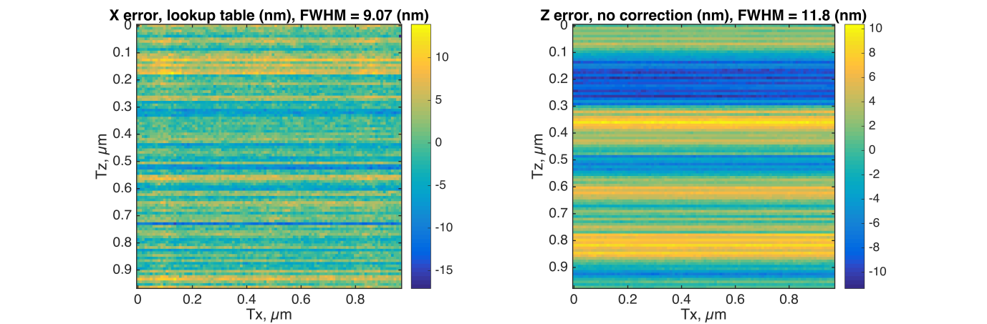
Trajectory errors during 1x1 µm 2D-scan
Encoder feedback, XY-feedforward, no interferometer feedback

Slide 8
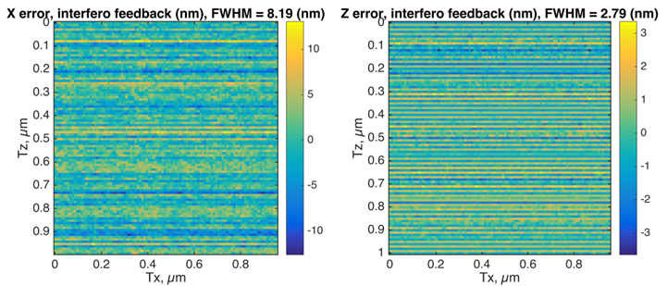
Trajectory errors during 1x1 µm 2D-scan
Encoder feedback, XY-feedforward, XY-interferometer feedback

Slide 9
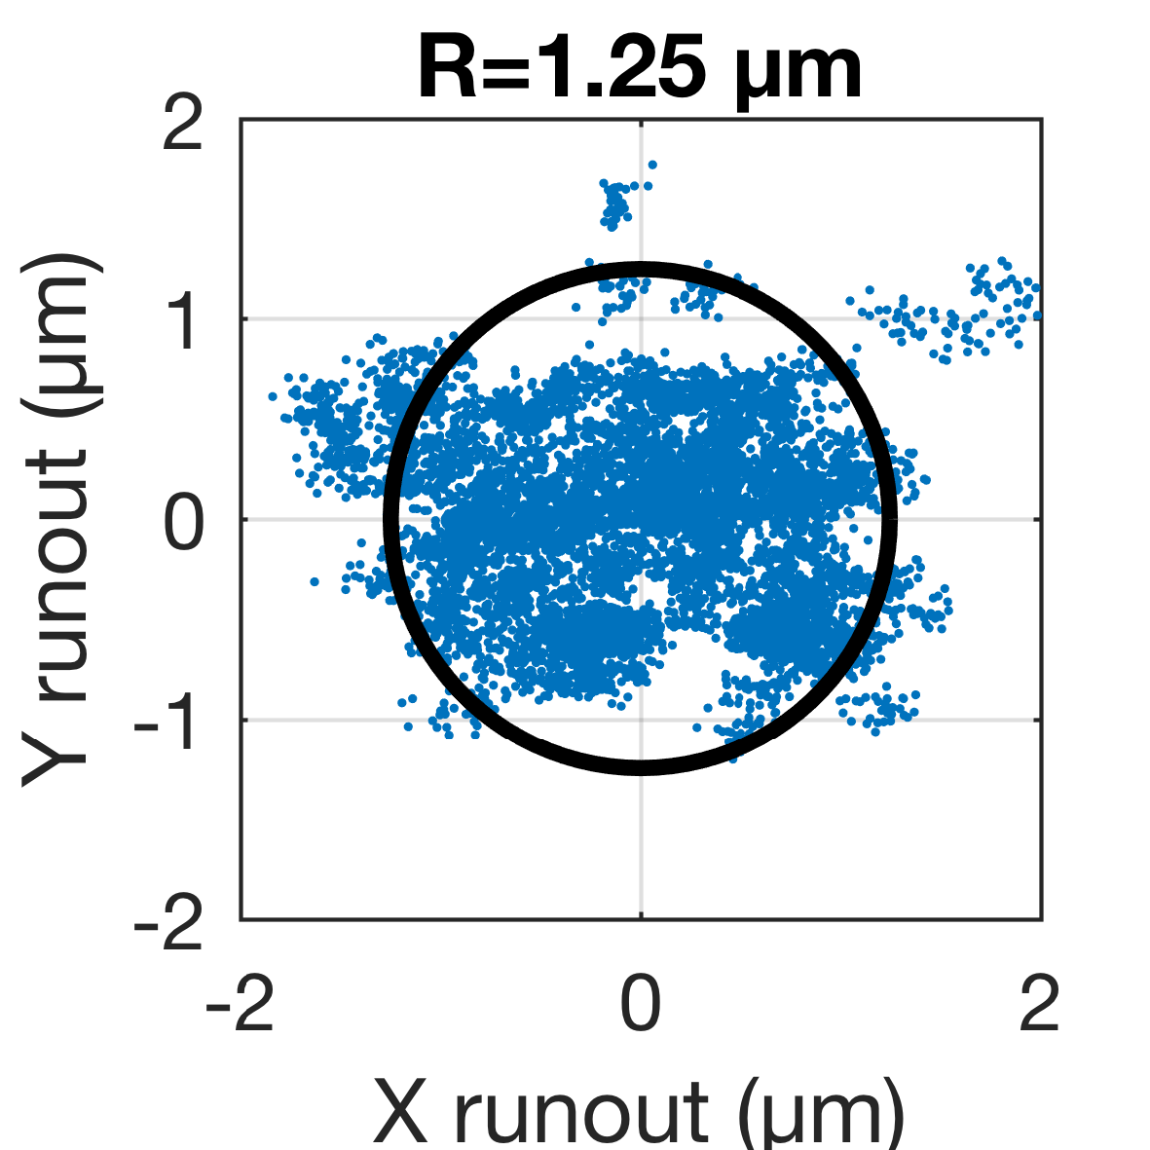
Trajectory errors during 360° sample rotation scan
Encoder feedback, no feedforward, no interferometer feedback

Slide 10
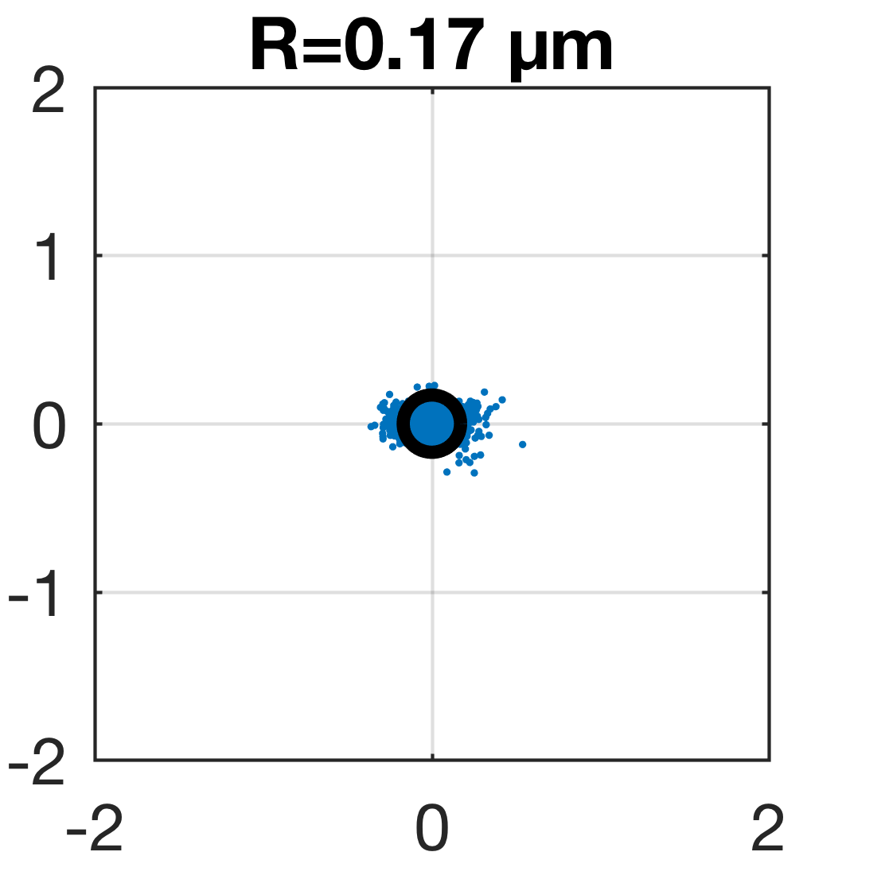
Trajectory errors during 360° sample rotation scan
Encoder feedback, XY-feedforward, no interferometer feedback

Slide 11
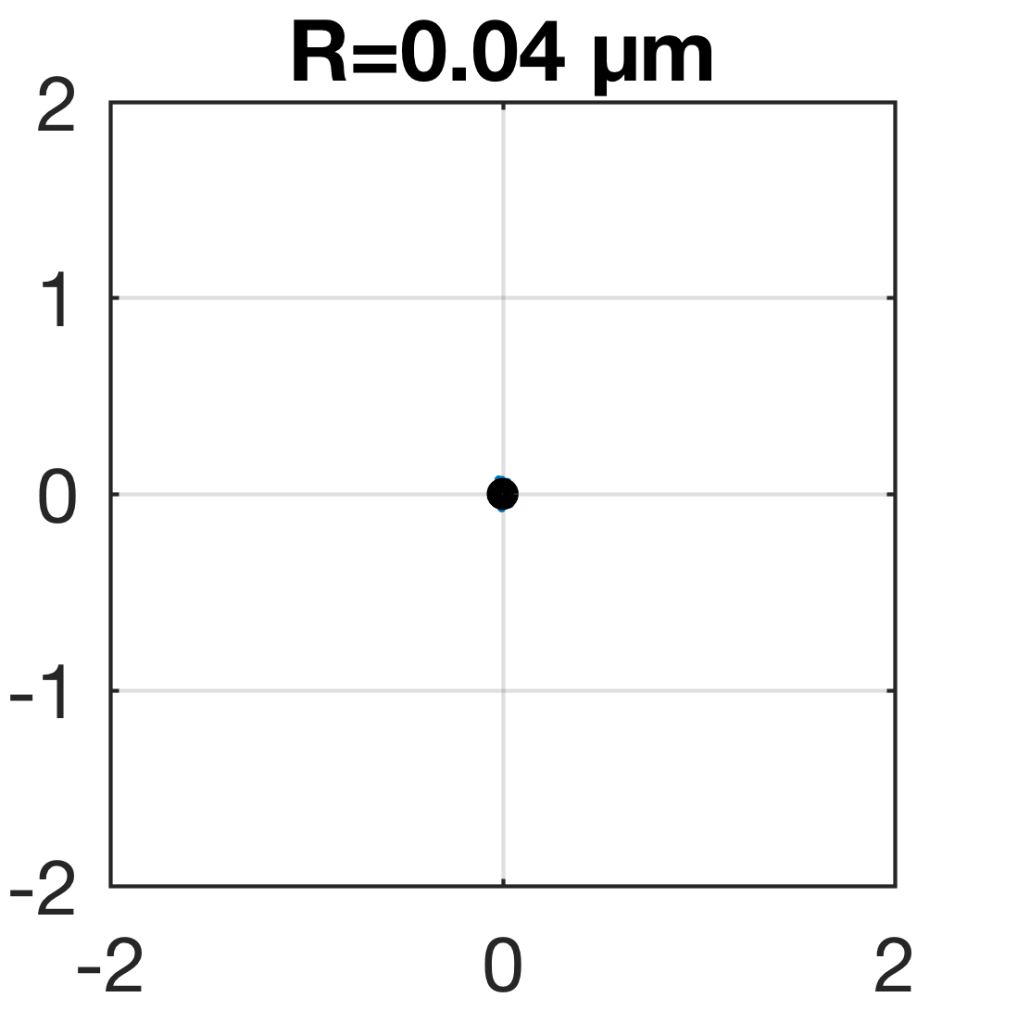
Trajectory errors during 360° sample rotation scan
Encoder feedback, XY-feedforward, XY-interferometer feedback

Slide 12
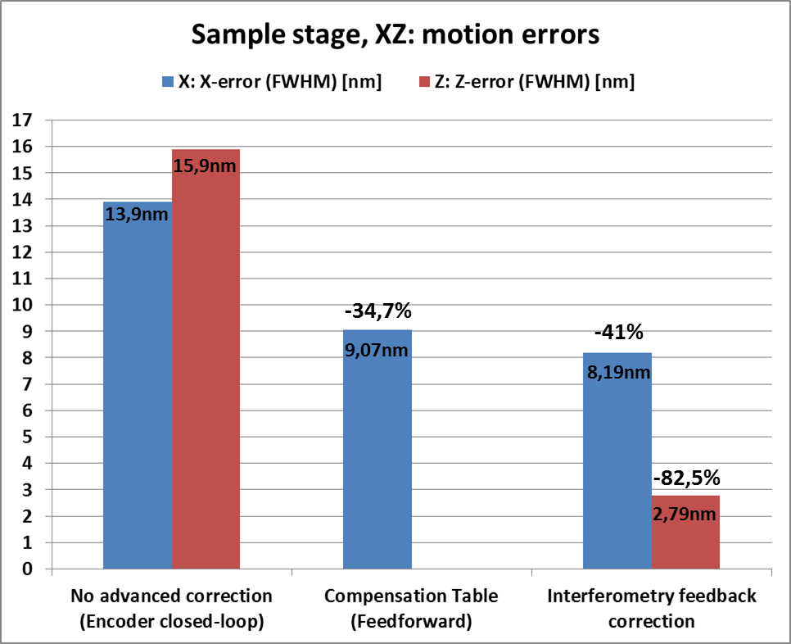
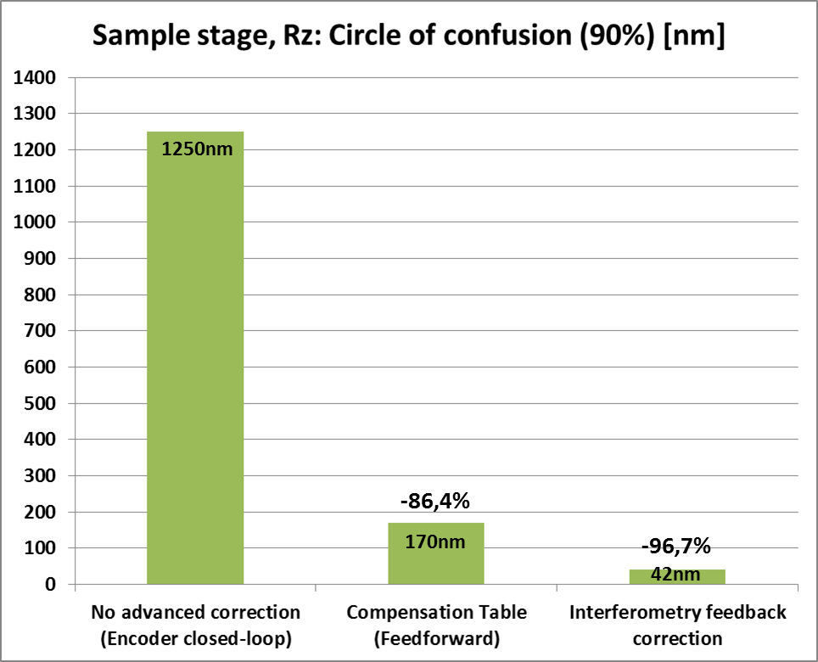
Sample Stage Results

