Slide 1
Cooling, scanning, sensing
MOCRAF, Barcelona 08.10.2017
attocube systems AG
Königinstr.11a
D-80539 Munich
Dr. Ida Simson

Slide 2
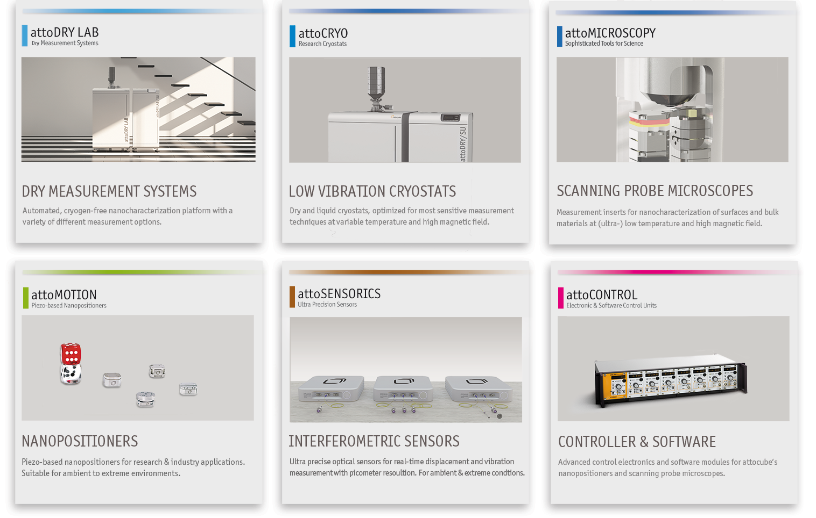
Overview
attocube systems product range

Slide 3
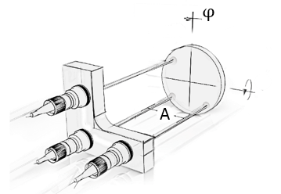
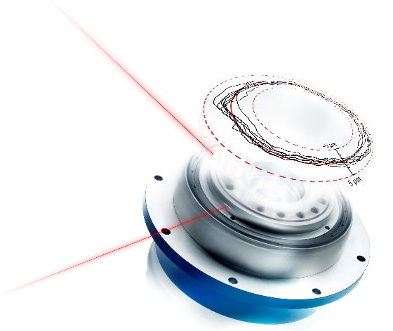
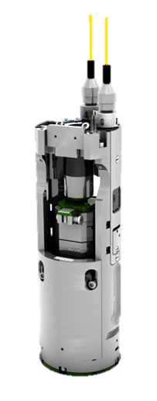
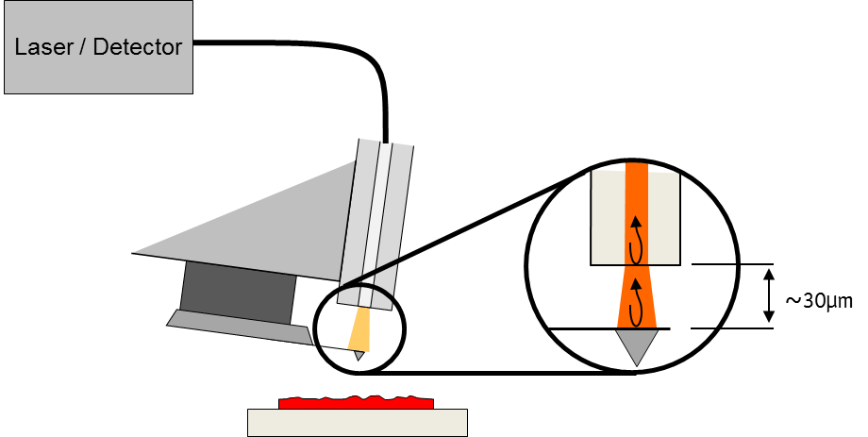
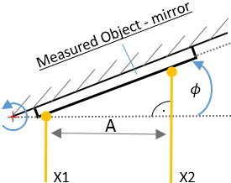
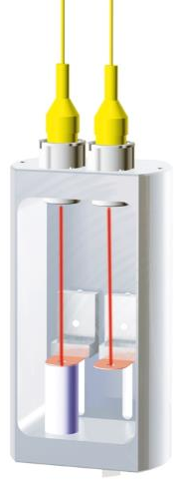
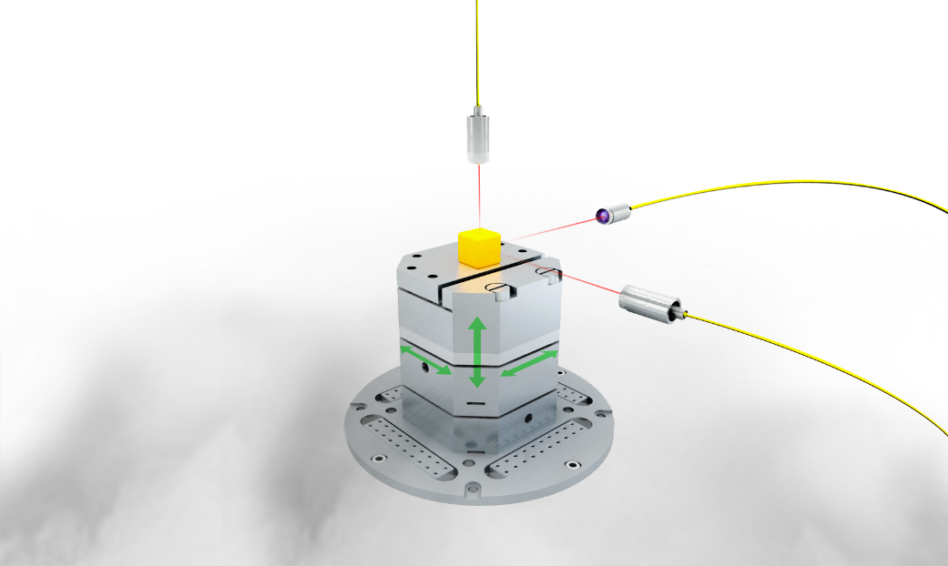
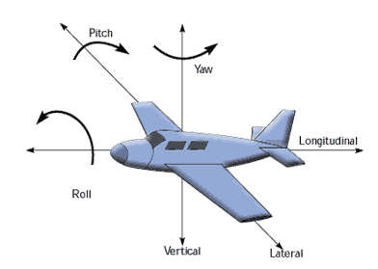
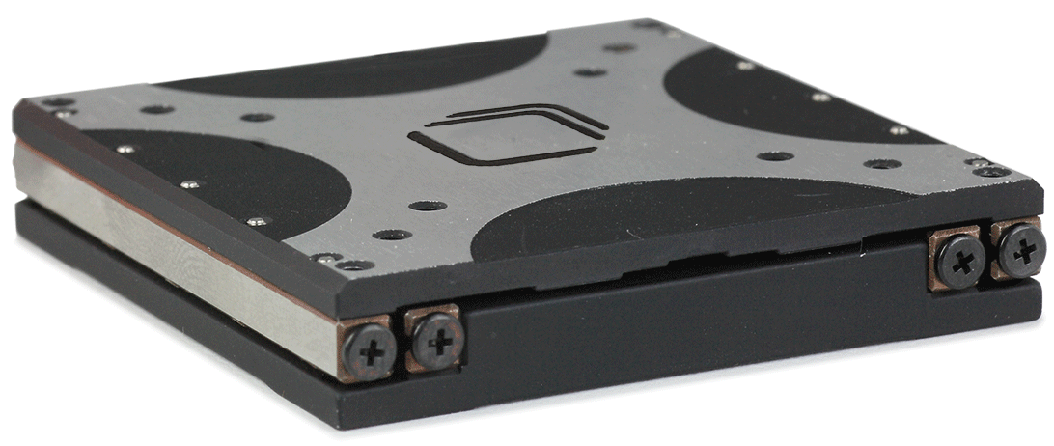
Everything is connected:

Slide 4





































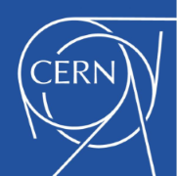



















The world‘s leading scientists and innovators trust attocube‘s products
Just to name a few…

Slide 5
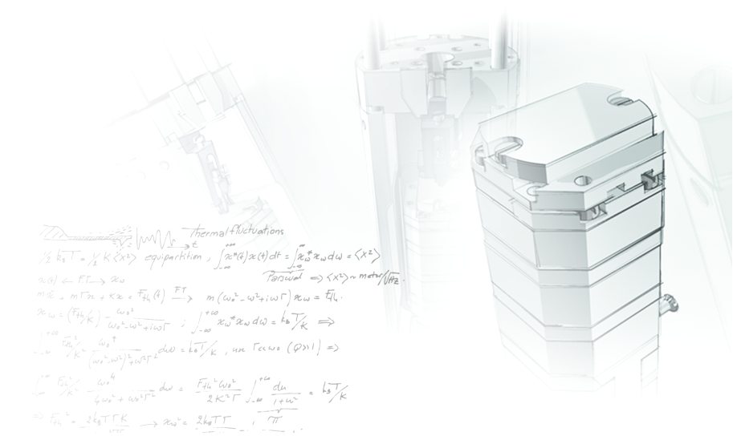
Our mission: Creating Scientific Impact.
Selected customer publications 2011 - 2015
F. Najafi et al., Nature Communications 6, 5873 (2015)
B. Bryant et al., Phys. Rev. B 91, 134408 (2015)
J. Herranz et al., Nanotechnology 29, 195301 (2015)
T. S. Jespersen et al., Phys. Rev. B 91, 041302 (2015)
C. Neumann et al., Nano Lett. 15, 1547–1552 (2015)
V. Stepanov et al., Appl. Phys. Lett. 106, 063111 (2015)
T. Häberle et al., Nature Nanotechnology 10, 125–128 (2015)
D. Rugar et al., Nature Nanotechnology 10, 120–124 (2015)
J.-P. Tetienne et al., Science 344, 1366-1369 (2014)
M. Montinaro et al., Nano Letters 14 (8), 4454–4460 (2014)
J. Rieger et al., Nature Communications 5 3345 (2014),
M.G. Tanner et al., Applied Physics Letters 104 063503 (2014)
A.K. Nowak et al., Nature Communications 5 3240 (2014)
M. Timmermans et al., ACS Nano 8 2782 (2014)
P.J.W. Moll et al., Nature Materials 12, 134–138 (2013)
O. Gazzanoet et al., Nature Communications 4, 1425 (2013)
W. E. Shankset et al., Nature Communications 4, 1991 (2013)
E. Gil-Santoset et al., New Journal of Physics 15, 035001 (2013)
L. Rondin et al., Nature Communications 4, 2279 (2013)
T. Baroiset et al., Nano Lett. 13, 1451-1456 (2013)
M. Sabooniet et al., Phys. Rev. Lett. 110, 133604 (2013)
R.J. Warburton, Nature Materials 12, 483–493 (2013)
Y.-M. Heet et al., Nature Nanotechnology 8, 213-217 (2013)
P. Maletinskyet et al., Nature Nanotechnology 7, 320–324 (2012)
A. Schumannet et al., New Journal of Physics 14, 035015 (2012)
S.T. Boles et al., Appl. Phys. Lett. 100, 243901 (2012)
W. Walden-Newman et al., Nano Lett. 12, 1934-1941 (2012)
L. Rondin et al., Appl. Phys. Lett. 100, 153118 (2012)
J.-P. Tetienne et al., New J. Phys. 14, 103033 (2012)
A. Finkler et al., Rev. Sci. Instrum. 83, 073702 (2012)
L. Robledo et al., Nature 477, 574 (2011)
C. Latta et al., Nature 474, 627 (2011)

