Slide 1
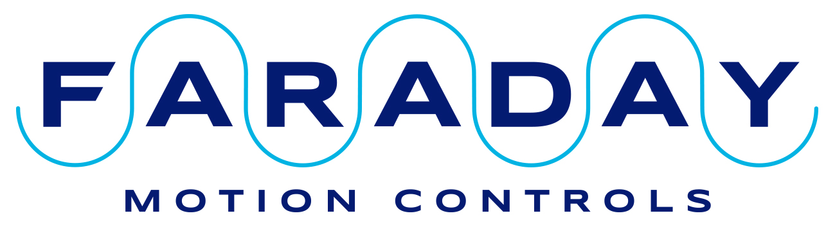
EtherCAT on Power PMAC Systems
Presented by Tony Jacobs

Slide 2
Who are Faraday Motion Controls
Formerly Delta Tau (UK).
OMRON took over the whole of Delta Tau.
Andy Joslin and Tony Jacobs bought back Delta Tau UK from OMRON to form Faraday Motion Controls in 2017.
Same people providing the same systems to the scientific community.

Slide 3
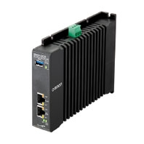
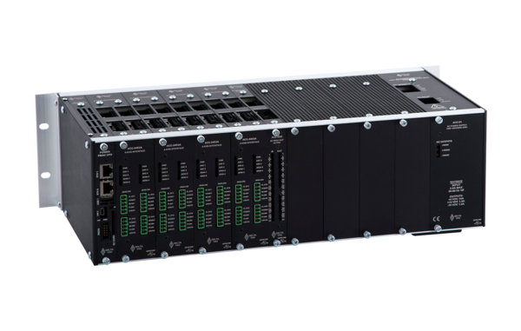
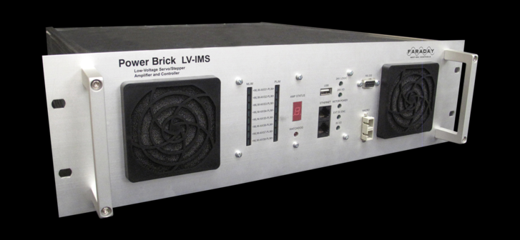
Power PMAC Systems
Advantages/disadvantages of local vs. distributed control with Power PMAC
Use of EtherCAT with Power PMAC
PowerBrick LV-IMS
CK3E EtherCAT master
UMAC

Slide 4
System Architectures
Direct connection (e.g. PowerBrick LV)
EtherCAT (e.g. CK3E master)
Mixed (e.g. PowerBrick LV + EtherCAT)
Controller
Controller
Amplifiers
Controller
Amplifiers
Motors
Motors
Motors
Motors
IO Devices
IO Devices
IO Devices

Slide 5
Advantages of direct connection
CPU has direct access to hardware. Direct access is very fast. Important in fast (high frequency) or high resolution systems.
Allows:
Very fast servo loops 5-10kHz typical, 60kHz possible
Very low latency Inputs read on rising edge of clock Outputs written on falling edge
All configuration, tuning, programs, PLCs etc. in one place (Power PMAC IDE).
Only one system to learn, e.g. motor tuning is always the same.
Can use PMACs sophisticated servo algorithm.
Can use custom phase and servo algorithms for unusual configurations.
Positions can be captured in hardware on an interrupt. The exact position of each motor is known at the same time. Important for correlating data later.

Slide 6
Advantages of direct connection
Nanometer/sub nanometer positioning can be achieved. Keep it simple – do it quickly approach works well.
Power PMAC’s 64bit floating point maths gives huge dynamic range.
No problems with position, velocity or acceleration register rollover at very high resolutions and high speed.

Slide 7
Disadvantages of direct connection
Cabling can be more difficult. Everything must be wired to a central point.
CPU load must be managed. Not normally a problem with standard settings but care must be taken if the frequencies are increased significantly. Distributed system can share the CPU load.
Can be difficult to configure without good Power PMAC knowledge.

Slide 8
Advantages of EtherCAT with PMAC
Probably the most universal of the many fieldbus standards that have appeared over the years. MACRO, SERCOS, CAN, Profibus, Modbus etc.
Distributed control can simplify the machine wiring. Possibility of shorter motor and encoder cables.
Many manufacturers of EtherCAT enabled devices.
Many types of devices. Amplifiers, IO devices, encoders etc.
EtherCAT masters should work with devices from any manufacturer.

Slide 9
Advantages of EtherCAT with PMAC
EtherCAT is available as an option on most Power PMAC systems.
Older PowerPC based Power PMAC systems used the EtherLAB stack. Excellent performance but not user friendly.
New ARM CPU based Power PMACs follow the OMRON standard and use the Acontis stack.
EtherCAT can be used to add extra axes or IO to a Power Brick LV-IMS.
Possible to control a complete EtherCAT enabled robot (e.g. Staubli) from Power PMAC.

Slide 10
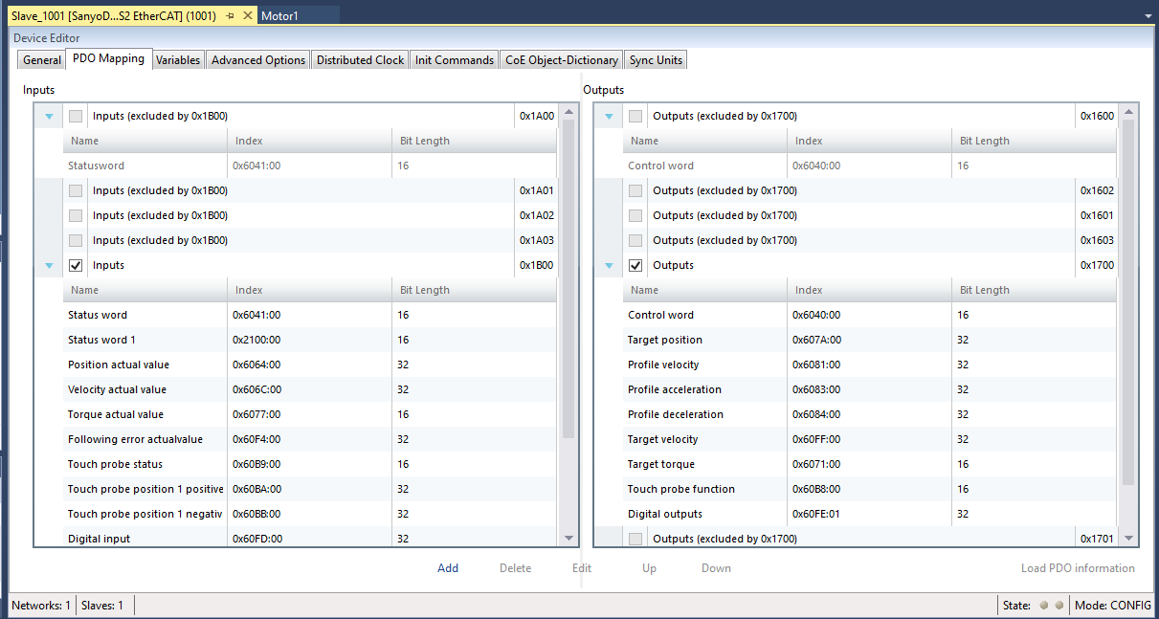
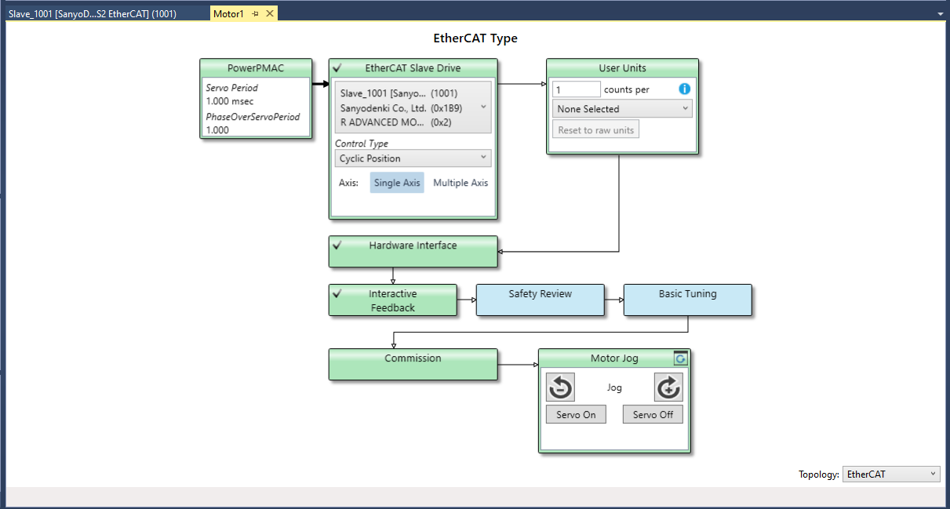
Advantages of EtherCAT with PMAC
Acontis setup is much more user friendly than EtherLAB.
Setup tools built into the latest IDE makes EtherCAT setup much easier.

Slide 11
Disadvantages of EtherCAT with PMAC
Power PMAC EtherCAT setup requires the EtherCAT Slave Information (ESI) files for each device. Some manufacturers make them easy to obtain, some are near impossible to find.
ESI file must match the firmware in the device otherwise it won’t work. Can cause problems when manufacturer updates the firmware.
Firmware updates of master or slaves often seem to break a working system. For example, we saw a case where the original amplifier firmware defaulted to CSP mode (8) but a new batch of amplifiers were delivered with a version that defaulted to mode zero and so did nothing. Easy to fix once we realised what the problem was!

Slide 12
Disadvantages of EtherCAT with PMAC
Most systems configure the amplifiers in Cyclic Synchronous Position (CSP) mode. Servo tuning has to be done in the amplifier. Every manufacturer is different. Requires learning many tuning tools and techniques. PMAC is not in full control!
Cannot use the PMACs sophisticated servo algorithm with CSP mode.
Many devices are limited to 1,2 or 4kHz update frequency. Too slow for fast or high resolution systems.
Cyclic Synchronous Torque (CST) mode allows full PMAC control but does not perform as well as a directly connected configuration.

Slide 13
Traps when using EtherCAT with PMAC
Device manufacturers always say “it works with Beckhoff” when you have a problem!
Many devices need extra settings to make them work. For example, you may find that your amplifier enables but the motor will not turn. The cause is usually something simple but each device is likely to be different.
Settings that commonly cause problems:
Mode of operation (CSP, CSV, CST). May default to CSP or No Mode.
Maximum speed. Sometimes defaults to zero.
Torque limits. Sometimes defaults to zero.
Position limits.
Scaling (Position, torque etc.)
Encoder configuration

Slide 14
Traps when using EtherCAT with PMAC
Most EtherCAT servo amplifiers use CAN over EtherCAT (CoE). Power PMAC can control them.
Beckhoff amplifiers use SERCOS over EtherCAT (SoE). Power PMAC does not allow SoE at the moment, so cannot control Beckhoff amplifiers.

Slide 15
Conclusions
Direct control provides the best performance due to fast updates, low latency and Power PMAC features.
An integrated controller such as the Power Brick LV-IMS provides one solution for many applications.
Distributed control requires a pick and mix approach.
EtherCAT provides a convenient method to add extra axes and IO devices to a Power PMAC system.
EtherCAT works well for less demanding applications.
An EtherCAT label doesn’t guarantee a trouble free integration!

