Slide 1


asynMotor: Support For Coordinated Multi-Axis Motion In EPICS
Mark Rivers
University of Chicago

Slide 2
Motivation
Traditional step scanning overheads:
Start and stop motors & mechanical systems
Arm and read detectors.
Typically much more efficient to collect data on-the-fly as the motors are moving.
Better detectors, more flux with APS Upgrade, don’t waste photons and time
However, on-the-fly scanning with EPICS has been subject to limitations.
Typically limited to simple single-motor scans because EPICS did not provide a way to program motor controllers to perform synchronized motion of multi-axis controllers.
Exception to this was the Trajectory Scanning software I wrote for the Newport XPS and MM4005 motor controllers.
Not a clean solution: EPICS SNL program talking directly to the controller, “behind the back” of the motor record driver.
PMAC does have motion control programs – good for fixed, simple geometry
New solution that incorporates a coordinated motion API in the motor driver layer

Slide 3
asynMotorController
class epicsShareFunc asynMotorController : public asynPortDriver {
asynMotorController(const char *portName, int numAxes, int numParams,
int interfaceMask, int interruptMask,
int asynFlags, int autoConnect, int priority, int stackSize);
virtual asynMotorAxis* getAxis(asynUser *pasynUser);
virtual asynMotorAxis* getAxis(int axisNo);
virtual asynStatus startPoller(double movingPollPeriod, double idlePollPeriod, int forcedFastPolls);
virtual asynStatus wakeupPoller();
virtual asynStatus poll();
void asynMotorPoller();
virtual asynStatus initializeProfile(size_t maxPoints);
virtual asynStatus buildProfile();
virtual asynStatus executeProfile();
virtual asynStatus abortProfile();
virtual asynStatus readbackProfile();

Slide 4
asynMotorAxis
class epicsShareFunc asynMotorAxis {
virtual asynStatus move(double position, int relative,
double minVelocity, double maxVelocity, double acceleration);
virtual asynStatus moveVelocity(double minVelocity, double maxVelocity,
double acceleration);
virtual asynStatus home(double minVelocity, double maxVelocity,
double acceleration, int forwards);
virtual asynStatus stop(double acceleration);
virtual asynStatus poll(bool *moving);
virtual asynStatus setPosition(double position);
virtual asynStatus initializeProfile(size_t maxPoints);
virtual asynStatus defineProfile(double *positions, size_t numPoints);
virtual asynStatus buildProfile();
virtual asynStatus executeProfile();
virtual asynStatus abortProfile();
virtual asynStatus readbackProfile();

Slide 5
Coordinated Motion (Now called ProfileMove, previously TrajectoryScan)
Create arrays of target locations of each motor in a multi-axis controller
Create array of time per element
Define times/locations to output synchronization pulses to trigger detectors
Execute coordinated move
Optionally read back encoder positions when each synchronization pulse was output
Many controllers have this Position/Velocity/Time (PVT) capability
Newport XPS, Delta Tau PMAC, Pro-Dex MAXv, Parker ACR series, Galil etc.
We now have an API to take use this capability in a consistent way
Now done in same driver as for motor record, eliminates conflicts

Slide 6
Client Software
Interface from clients is simple
Define arrays containing target location for each axis in each segment of scan
Define array of time per point for each segment of scan
Define when to output trigger pulses for detector
Send these arrays to EPICS records
Build and execute scan
Optional read back actual encoder positions at each point in scan
Easy to implement in any language with EPICS bindings:
Python, SPEC, Matlab, IDL, C/C++, etc.

Slide 7
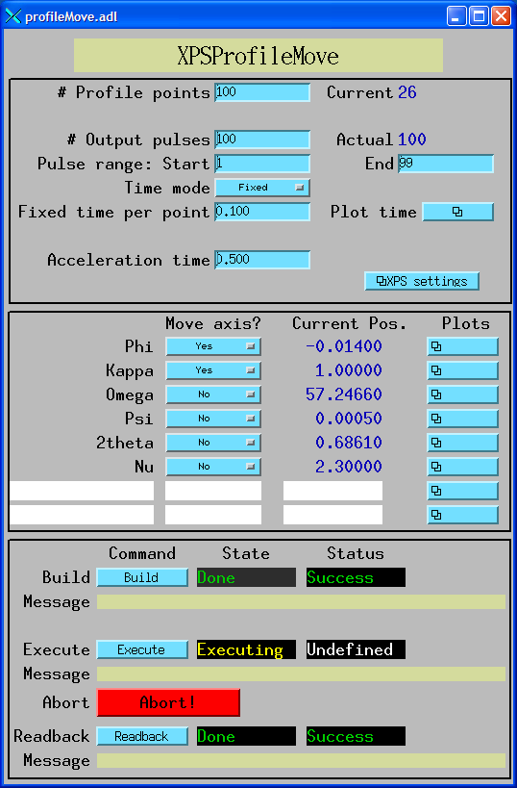
Coordinated Motion
; IDL program to build, execute and readback profile
; This program builds a profile and executes it.
nelements = 100 ; 100 elements in the profile.
npulses = 100 ; 100 pulses in the profile.
naxes=2 ; We will move the first 2 motors (Phi and Kappa)
; Define array of positions
positions = dblarr(nelements, naxes)
; The Phi profile is a sin wave with two complete periods and an
; amplitude of +-1 degrees
positions[*,0] = 1.*sin(findgen(nelements)/(nelements-1.)*4.*!pi)
; The Kappa profile is a sin wave with one complete period and an
; amplitude of +-1 degrees
positions[*,1] = 1.*sin(findgen(nelements)/(nelements-1.)*2.*!pi)
profile = 'IOC:Prof1:'
group = 'GROUP1'
time = 0.1 ; Fixed time per profile point
status = profile_move(profile, positions, group=group, maxAxes=6, $
build=1, execute=1, readback=1, time=time, $
npulses=npulses, actual=actual, errors=errors)
end

Slide 8
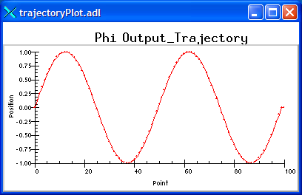
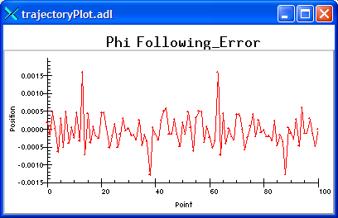
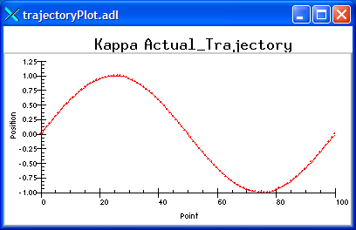
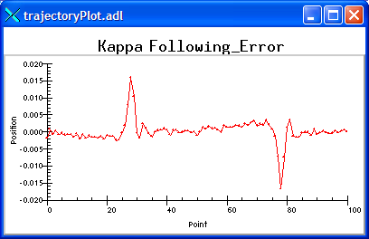
Phi output profile
Phi following error
Kappa readback profile
Kappa following error

Slide 9
SPEC Interface
SPEC macros have been written to allow SPEC to utilize profile moves via EPICS interface
Low level interface, all of SPEC's standard scans can be done "on-the-fly" with profile move software. Replacement macros for:
_ascan # Used by all ascan and dscan macros
Mesh
hklscan # Used by hscan, kscan and lscan
_hklmesh
_hklline # Used by hkcircle, hlcircle, klcircle, hkradial, hlradial and klradial
_scanabort resume
_loop

Slide 10
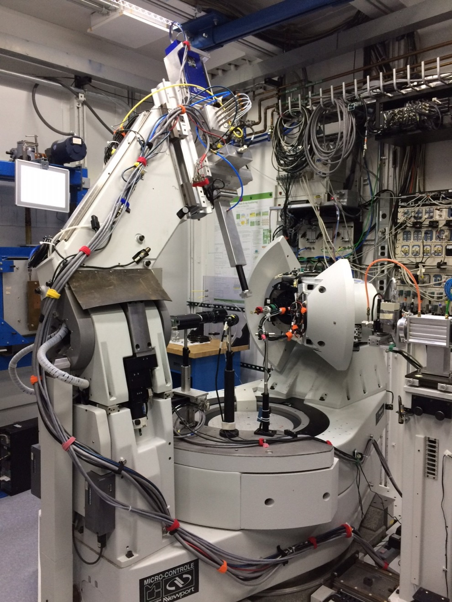
SPEC Scan Using Newport 6-Circle Diffractometer
Newport XPS is used to drive 6-circle diffractometers at APS (3), SLS
SPEC is the control software
Use Profile Moves both for initial alignment and for data collection
Pilatus 100K is typically used for collecting crystal truncation rod data
Up to 200 frames/s
Use counts in areaDetector ROI and statistics plugins as a SPEC counter
Pilatus TIFF files are saved for use with later data analysis

Slide 11
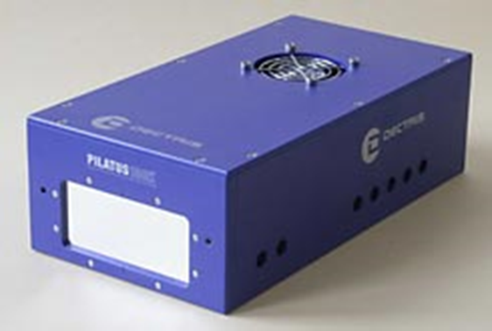
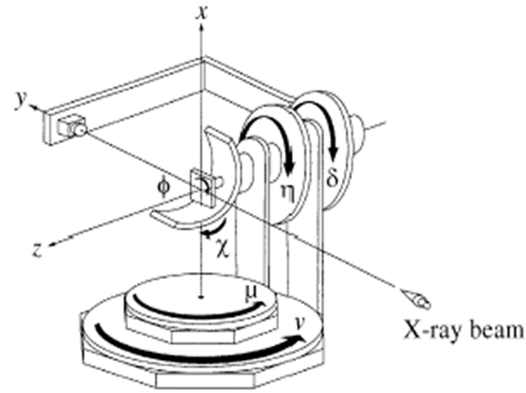
SPEC 6-Circle Diffractometer Control
Trigger
Struck Scaler
Trigger
Io
Pixel Array Detector 100k Pilatus
Readout time 2.7 ms
Framing rate 200 Hz
Dimensions 275 x 146 x 85 mm
EPICS Trajectory Scanning Support
I1
Newport XPS
Complex Coordinated Trajectory Using PVT
Record Encoder Values at each Trigger
DC Servo Control
Encoder Read-Back for Data Logging
Newport 6-Circle Diffractometer

Slide 12
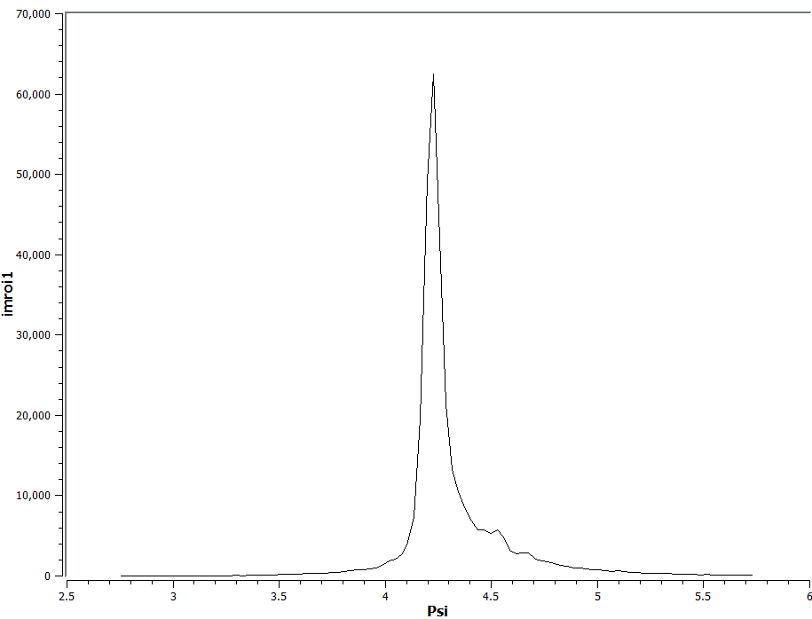
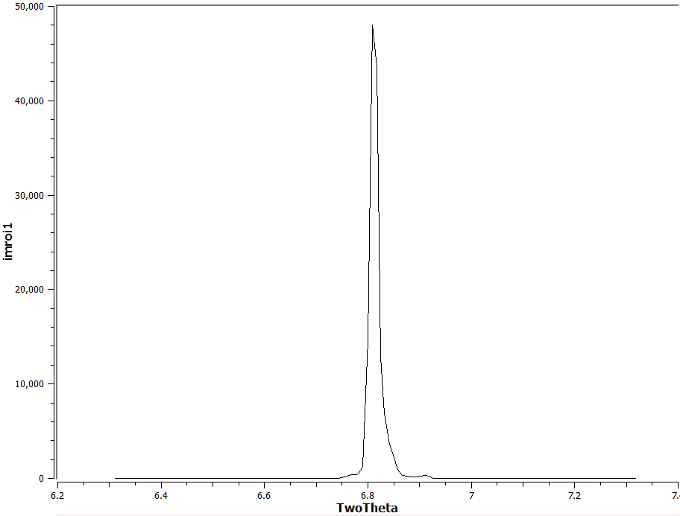


Trajectory Scan For Single Crystal Alignment
Scan Mu to maximize Bragg peak on Ewald Sphere
Scan Del to horizontally center Bragg peak on detector
Scan Nu to vertically center Bragg peak on detector
lup mu -2 2 120 .05
mv mu CEN
“5 sec scan”
lup del -.5 .5 120 .05
mv del CEN
“6 sec scan”
Total Scanning Time 17 sec
lup nu -.5 .5 120 .05
mv nu CEN
“6 sec scan”
Pilatus 100 k Pixel Array Detector

Slide 13
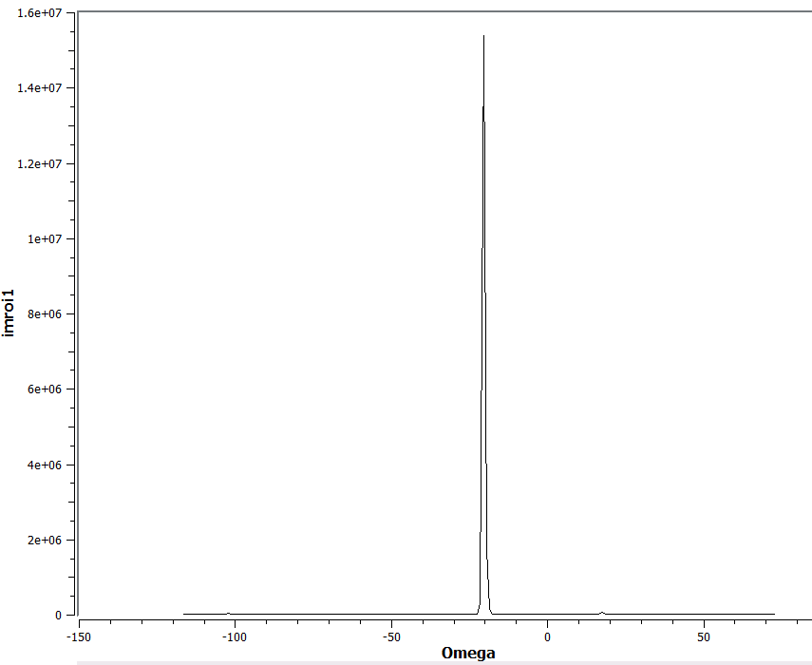
Fast wide scan to find first reflection
190 deg Scan in Omega, 47 sec total scan time
On The Fly – the detector is always measuring so the sharp Bragg peak is not missed
Automated single crystal orientation refinement using trajectory scans to center on each Bragg peak
# 6
br -1 0 5
do HKL_lup.mac
orient_add -1 0 5
# 7
br -2 1 6
do HKL_lup.mac
orient_add -2 1 6
# 8
br -1 3 8
do HKL_lup.mac
orient_add -1 3 8
# 9
br 0 2 4
do HKL_lup.mac
orient_add 0 2 4
# 10
br 1 1 6
do HKL_lup.mac
orient_add 1 1 6
orient_show
print "done with orienting the crystal"
# 1
br 0 0 12
do HKL_lup.mac
orient_add 0 0 12
or0 0 0 12
# 2
br 1 0 4
do HKL_lup.mac
orient_add 1 0 4
or1 1 0 4
# 3
br 2 -1 3
do HKL_lup.mac
orient_add 2 -1 3
# 4
br 1 -2 6
do HKL_lup.mac
orient_add 1 -2 6
# 5
br -2 -1 8
do HKL_lup.mac
orient_add -2 -1 8

Slide 14

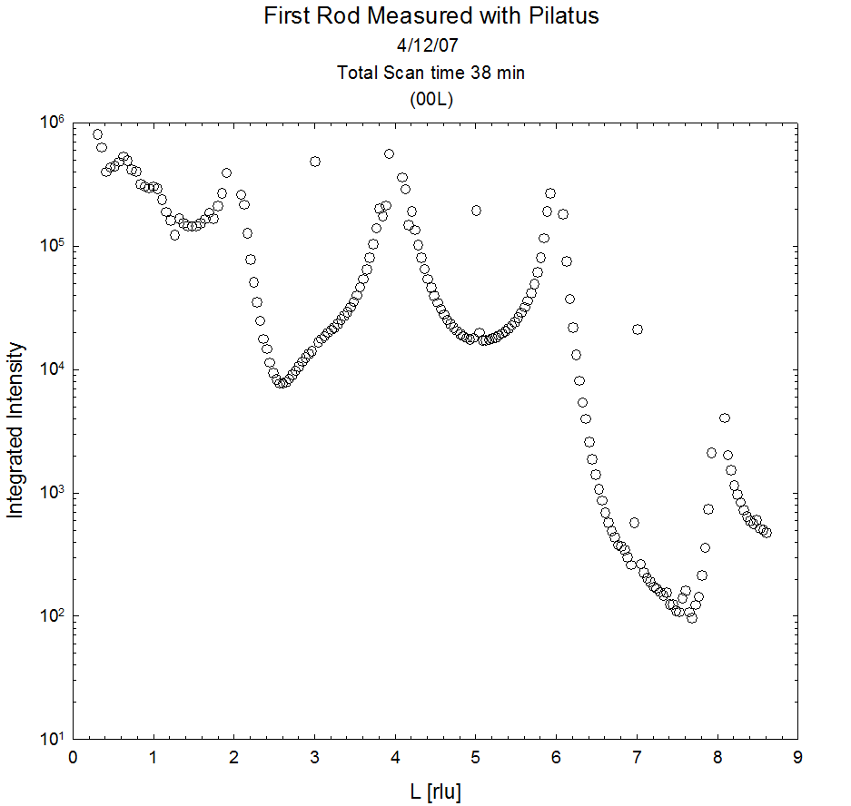
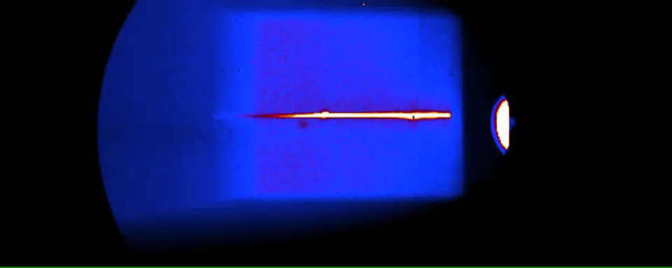
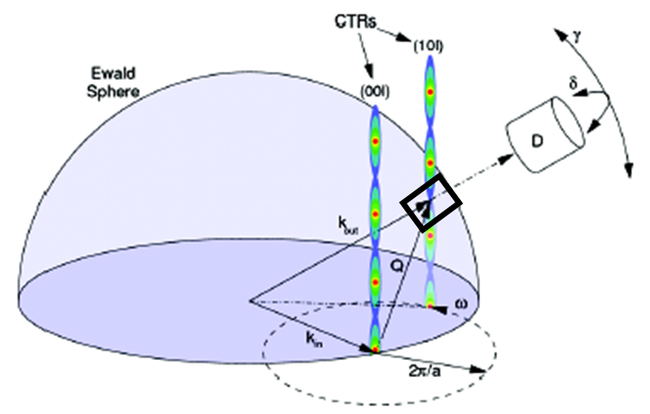
Crystal Truncation Rod (CTR) measurement using complex coordinated motion control and on-the-fly data collection
FeOOH 00L Rod
Notes:
This slide is animated showing a movie of an on the fly measurement of the 00L rod Goethite. The movie is 6 sec long but the scan was 39 sec. In the last slide I have the same movie but time scaled to 60 sec.

Slide 15
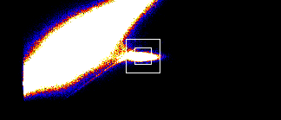
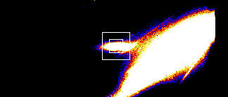
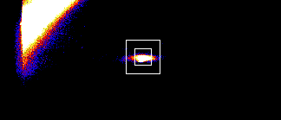
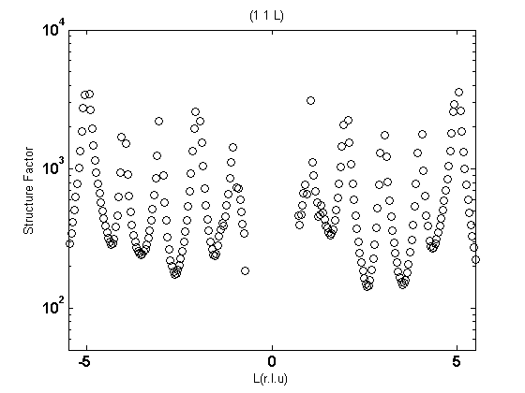
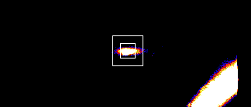
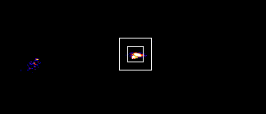
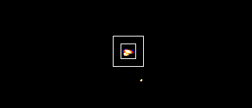



Slide 16
Future Work
Convert Pro-Dex MAXv, Aerotech Ensemble to Model 3
Tim Mooney already has trajectory scanning running in SNL program on each of these
Support other controllers
See if API needs changes based on mapping to other controllers
Work on replacement for EPICS motor record?

