Slide 1
Multi- axis control for in-vacuum diffractometer
for SIRIUS Beamline at Synchrotron SOLEIL
Christer Engblom, on behalf of the ECA group & SYMETRIE Company

Slide 2
Contents
Introduction
  Context & overview
  SIRIUS beamline & SYMETRIE
In-vacuum diffractometer
  Axis Setup
  Hardware setup
  TANGO devices
  Controller embedded software
  Control/Drive Setup
Installation
  FAT
  SAT
Conclusion

Slide 3
Contents
Introduction
  Context & overview
  SIRIUS beamline & SYMETRIE
In-vacuum diffractometer
  Axis Setup
  Hardware setup
  TANGO devices
  Controller embedded software
  Control/Drive Setup
Installation
  FAT
  SAT
Conclusion

Slide 4
Introduction – Context & overview
Joint funding project (2 years),
  SIRIUS beamline (Synchrotron Soleil)
  FemtoMAX beamline (MAXIV)
  Complementarily funded by an Ile-de-France region project (DIM Oxymore) [1]
In- vacuum diffractometer, produced by SYMETRIE
  4-circle goniometer
  Hexapod implementations
    Sample alignment
    System X-ray beam- alignment
[1] The Ile de France region (project,DIM-Oxymore)

Slide 5


Introduction – SIRIUS beamline & SYMETRIE
SIRIUS: Soft Interfaces and Resonant Investigation on Undulator Source
  Energy range. 1.4-13 keV
  Structural studies of soft interfaces (ex. Biological systems, polymers, etc.)
  Semiconductor or magnetic nanostructures
SYMETRIE: specializing in high-precision hexapod systems
  Delta Tau PowerPMAC controllers for multi- axial, synchronous control

Slide 6
Contents
Introduction
  Context & overview
  SIRIUS beamline & SYMETRIE
In-vacuum diffractometer
  Axis Setup
  Hardware setup
  TANGO devices
  Controller embedded software
  Control/Drive Setup
Installation
  FAT
  SAT
Conclusion

Slide 7
Contents
Introduction
  Context & overview
  SIRIUS beamline & SYMETRIE
In-vacuum diffractometer
  Axis Setup
  Hardware setup
  TANGO devices
  Controller embedded software
  Control/Drive Setup
Installation
  FAT
  SAT
Conclusion

Slide 8
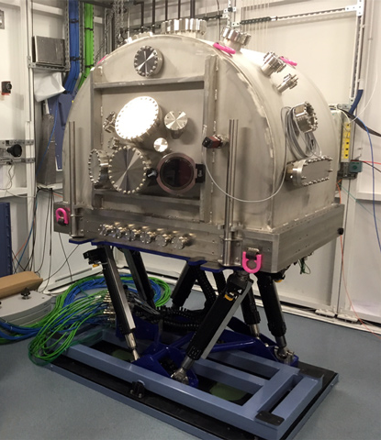
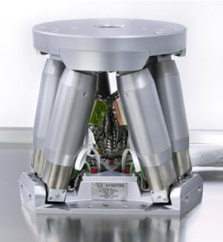
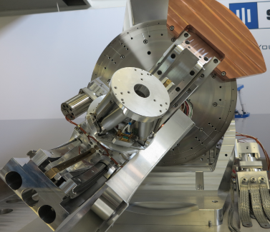
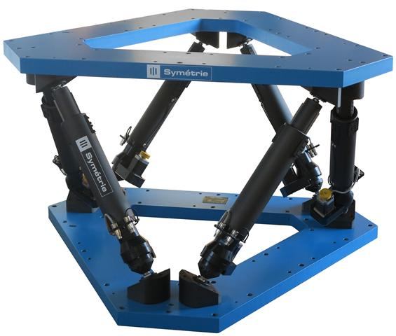
In- vacuum diffractometer - Setup
Series of Stacked systems:
  Large hexapod, JORAN
  4-circle goniometer
  Small hexapod, BORA

Slide 9
In- vacuum diffractometer – Axis Setup
Series of Stacked systems:
  Large hexapod, JORAN
  4-circle goniometer
  Small hexapod, BORA
System X-ray beam alignment
6 DOF
Circular sample- & detector movements
4 DOF
Sample alignment
6 DOF

Slide 10
In- vacuum diffractometer – Axis Setup
Series of Stacked systems:
  Large hexapod, JORAN
  4-circle goniometer
  Small hexapod, BORA
System X-ray beam alignment
6 DOF
Circular sample- & detector movements
5 DOF
Circular sample- & detector movements
Sample alignment
6 DOF

Slide 11
In- vacuum diffractometer - Hardware Setup
Control
  Delta Tau PowerBrick
Motor Drive
  Delta Tau Powerbrick
  Phytron
Temperature handling
  PLC solution

Slide 12
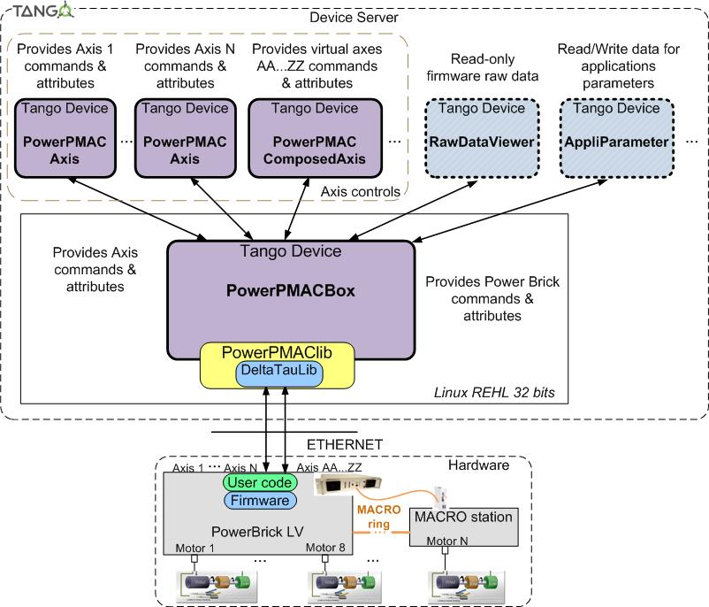
In- vacuum diffractometer– TANGO devices
Rough overview:
PowerPMACBox
Powerbrick commands & attributes
  PowerPMACAxis
  Single- axis movement commands & attributes
  PowerPMACComposedAxis
  Multi- axis movement commands & attributes
PowerPMACdataviewer
Controller variable exchange

Slide 13
In- vacuum diffractometer – Controller embedded software
System integration with pre-compiled libraries
  Intellectual properties
  System evolutions
SOLEIL libraries (for TANGO interfacing)
SYMETRIE libraries & motor configurations
    Ex: Hexapod kinematics

Slide 14
In- vacuum diffractometer - Control/Drive Setup
JORAN/circles controllers synchronized via MACRO interface
  Virtual axis calculations (kinematics) performed by master controller
BORA controller
  Virtual axis calculations (kinematics)

Slide 15
Contents
Introduction
  Context & overview
  SIRIUS beamline & SYMETRIE
In-vacuum diffractometer
  Axis Setup
  Hardware setup
  TANGO devices
  Controller embedded software
  Control/Drive Setup
Installation
  FAT
  SAT
Conclusion

Slide 16
Contents
Introduction
  Context & overview
  SIRIUS beamline & SYMETRIE
Diffractometer
  Axis Setup
  Hardware setup
  TANGO devices
  Controller embedded software
  Control/Drive Setup
Installation
  FAT
  SAT
Conclusion

Slide 17
Installation - FAT
End of april 2017- performed at SYMETRIE site
System evaluated concerning:
  Single- axis movements (via low-level- and TANGO)
  Multi- axial movements (via low-level- and TANGO)
  Scans
  Temperature- measurements
  System security (ex: encoder failure, limit switches...)
  Sphere-of-confusion at sample
  Vacuum- tests
  ...

Slide 18
Installation - SAT
Beginning of june 2017 – SIRIUS beamline, SOLEIL
Successfully installed into the beamline
Installed & interfaced PLC system against over-temperature
Improved accuracy by implementing compensation tables into Delta Tau controllers (reduce cross- coupling errors)

Slide 19
Installation - SAT

Slide 20
Installation - SAT

Slide 21
Contents
Introduction
  Context & overview
  SIRIUS beamline & SYMETRIE
Diffractometer
  Axis Setup
  Hardware setup
  TANGO devices
  Controller embedded software
  Control/Drive Setup
Installation
  FAT
  SAT
Conclusion

Slide 22
Contents
Introduction
  Context & overview
  SIRIUS beamline & SYMETRIE
Diffractometer
  Axis Setup
  Hardware setup
  TANGO devices
  Controller embedded software
  Control/Drive Setup
Installation
  FAT
  SAT
Conclusion

Slide 23
Conclusion
Diffractometer installation proved successful
  Mechanical integration in beamline
  Beamline TANGO control via Delta Tau controllers: synchronized movements, single- axis movements, etc.
  PLC integration
Verified: Delta Tau software architecture controller well adapted for collaborations while still respecting intellectual properties.
Commissioning with beam in end-of-this-year
Smaller sphere-of-confusion with compensation tables on BORA platform

