Slide 1

Installing a robot mounted detector on DIAD beamline
2019 MOCRAF Workshop,
ICALEPCS conference
Brian Nutter
Head of Motion Controls

Slide 2
P99-‘beamline development test rig’ see also xxxxxxxx
A beamline simulacrum specifically designed to provide a facility for full scientific testing of instrument prototypes.
Includes light sources, detectors and high precision motion stages.
Mainly used to develop the software stack for Mapping and Malcolm projects
Invaluable for testing the new coarse/precision stage stack for beamline J08
Provided verification for the DIAD beamline 10Hz beam selector between imaging and Diffraction.

Slide 3
P99-‘beamline development test rig’ see also xxxxxxxx
At MOCRAF 2017 we presented “I08-SXM: Experiences in interferometric control of piezo stages at the Diamond Light Source”
The motion team have tested the stacked Stepper + Piezo stages on different controllers aiming for dynamic errors of much less than 10nm
Despite best efforts struggled to get less than 20nm
Significant redesign of interferometer mount and vibration isolation we are now seeing +/- 1.5nm on the piezo stage
This with our standard phase 2 GeoBrick + BrickController platform

Slide 4
Inverted Pendulum
What to do with a Summer Student
Diamond Light source operates a ‘summer student’ scheme for undergraduates, working on real beamline projects.
Beamline I16 wanted a controls theory project to ‘stabilise the triple inverted pendulum’
To develop and understand controls beyond P I D with a longer term view of improving the performance of their 6 circle diffractometer.
A state space representation of the system was developed and an LQR controller implemented in C

Slide 5
Inverted Pendulum
What to do with a Summer Student
A carriage was built and stepper motor fitted. Its performance was tested and found wanting.
The stepper was replaced by a similarly sized DC servomotor, its performance was found to be adequate.
Reasonably high resolution rotary encoders were wired through slip rings to allow continuous rotation.
Tests were successful for the single pendulum, but failed for the double and triple pendulum.
Problem with lost counts from second and third encoders discovered. Encoders or slip ring?
Summer is over. We will fix the encoders and try again.

Slide 6
Robot mounted Diffraction detector
DIAD beamline Dual Imaging and Diffraction
Imaging camera plus 2D diffraction detector
Robot to be moved to ‘any?’ position around sample
Robot must NOT be a risk to personnel
Robot must NOT be a risk to the detector
Robot must NOT be a risk to external equipment
Robot must NOT be at risk from external equipment
Robot must be integrated into EPICS and GDA
Safety rated PLC for Machinery Protection not PSS

Slide 7
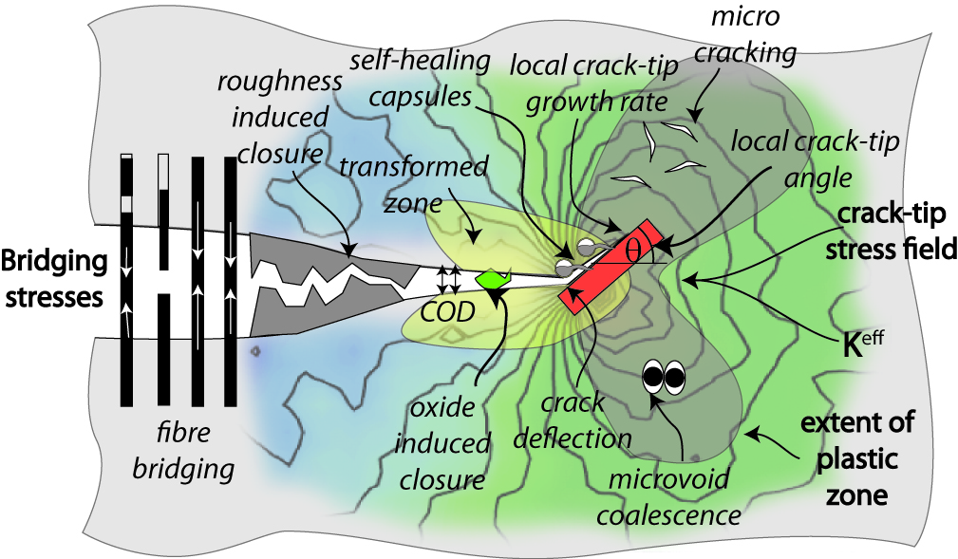
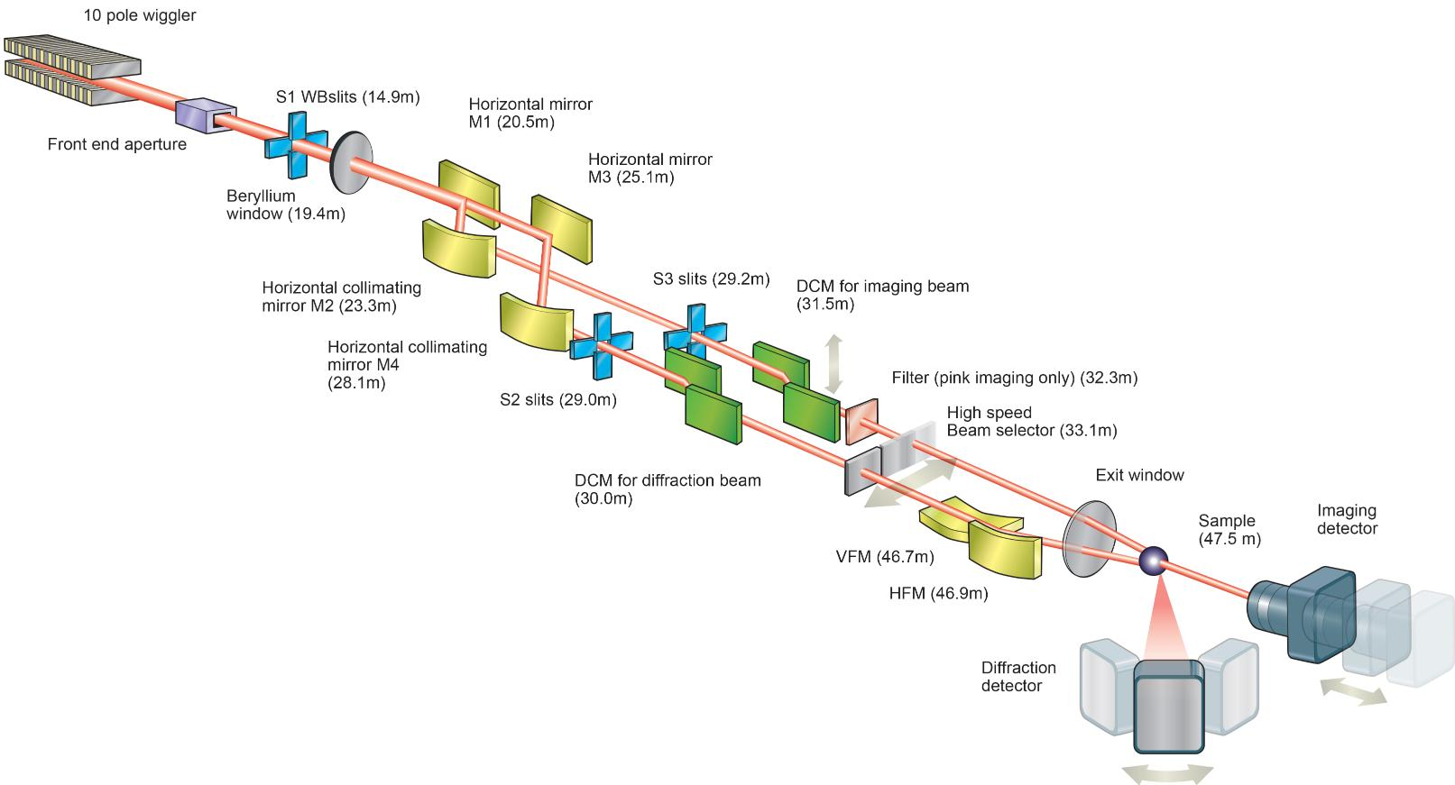
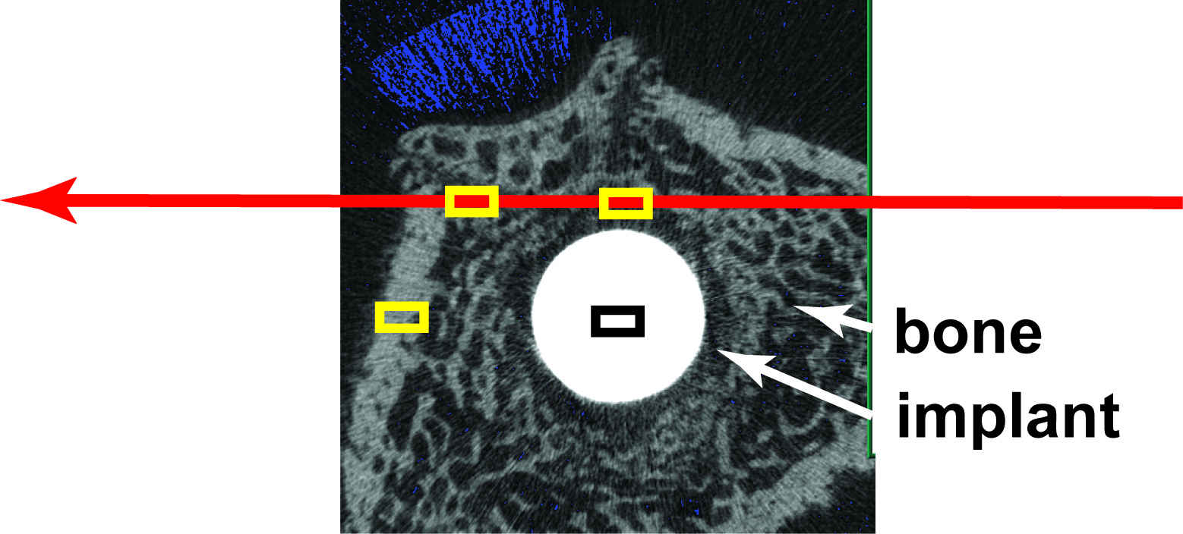
DIAD: Two beamlines combined at the sample: micro-tomography and micro-diffraction.
All to be done in-situ
Notes:
The main drive for building DIAD is that many scientific questions can only be answered by obtaining information of microstructure and crystalline structure at the same time.
Applied material science deals with heterogeneous samples under dynamic processes.
Top right: Crack growth, plastic deformation, strain fields
Bottom left: Implant, local structure and mineralisation of bone around implant.

Slide 8
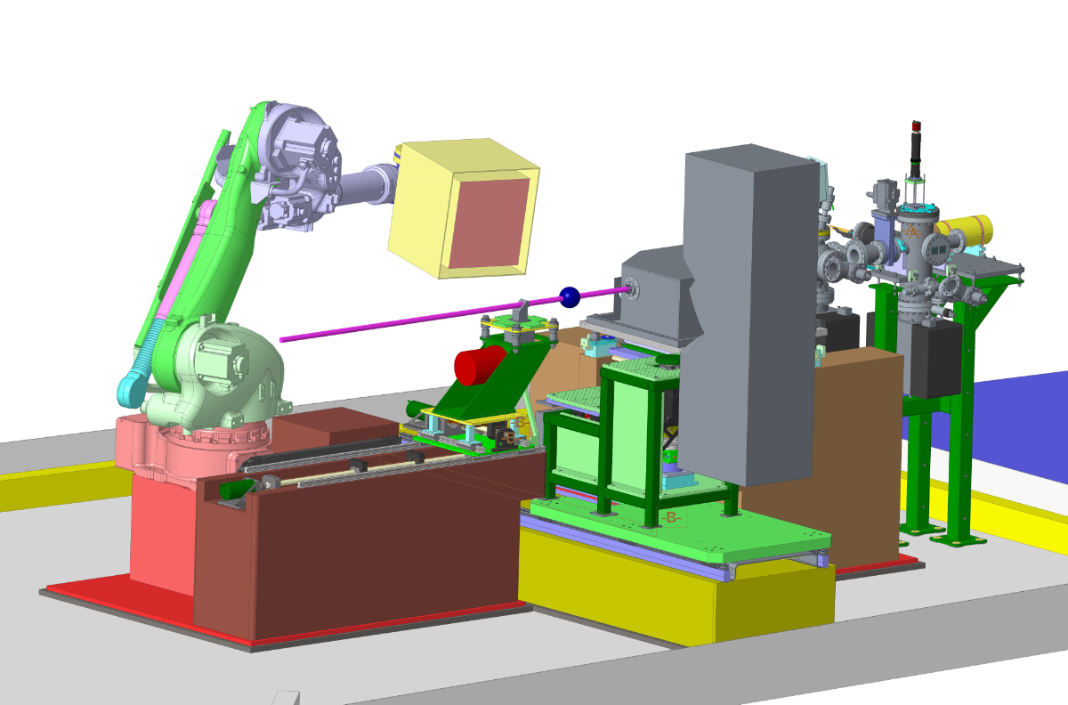
Experimental Hutch – under design
3 sample positions:
  General tomography stage
  Mechanical test rig
  3rd position for user setup
Robot carries the Diffraction detector
Custom built table carries the imaging detector

Slide 9
Functionality Summary
The robot will position a detector within an area of the DIAD experiments hutch.
This area is part of a sphere, the positions are all referenced to the centre of the sample:
The sphere is 300 – 600mm radius.
The closest detector position is 300mm from the sample.
The furthest detector position is 600mm from the sample
Tdetectors angular range is 0° - 155°
When seen from the side; the detector will be positioned above the XZ plane (the origin of this coordinate system is the sample position).

Slide 10
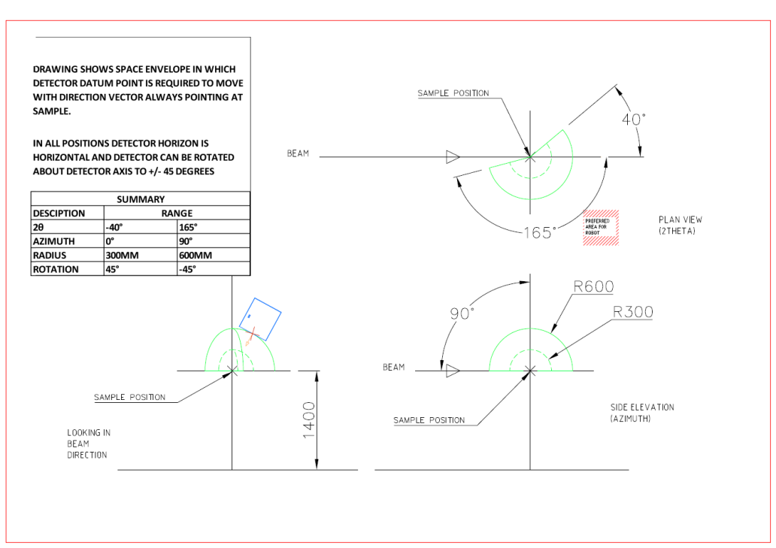
The detector will need to be positioned within a given working area and held there while measurements are taken. At all points the detector will be required to ‘face’ the sample positon. It is expected that the robot will have to hold a positon for up to six hours before repositioning is necessary. Payload is 80KgRepeatability <=0.2mm

Slide 11
Things to miss, and be missed by!
Static Equipment- cable trays, Sample X translation base, Imaging camera base
Moving equipment – 3 movable sample environments
  Mechanical rig ( 500mm x 2300mm x 550mm)
  Tomography stage (400mm x 1250mm x 550mm)
  User plinth (400mm x 900mm x 550mm)
Imaging camera

Slide 12
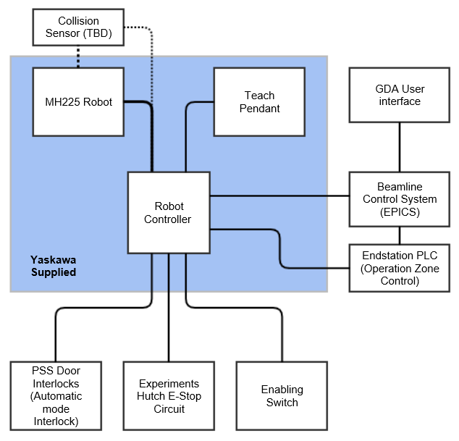
System description
Yaskawa MH225 Robot
DX200 Yaskawa Robot Controller
Teach pendant
End station PLC Omron NX series with safety CPU
Interlocks to the PSS system
Connection to Beamline E-Stop system
Connection to EPICS and GDA
Collision Sensor

Slide 13
DX200 Yaskawa Robot Controller
The controller contains all equipment needed to move the robot in a safe, coordinated manner. This includes 2 specific optional items relating to the safety of the robot system
1 Machine Safety board (MSB) - certified to Category 4/PLe according to EN ISO 13849-1 and SIL 3 according to EN 62061/IEC61508. The MSB is responsible for all standard safety functions including, but not limited to:
  Connection of emergency stop signals to external systems
  Supervision of operating modes, ensuring compliance to ISO 10218, e.g. ensuring teach mode is limited to 250mm/s
  Connection to the robot cell guarding

Slide 14
DX200 Yaskawa Robot Controller
The controller contains all equipment needed to move the robot in a safe, coordinated manner. This includes 2 specific optional items relating to the safety of the robot system
2) Functional Safety Board (FSB) - certified to Category 3/PL d according to EN ISO 13849-1 and SIL 2 according to EN 62061/IEC61508. The FSB has been added to this system to make the following functionality available:
  Axis Range limitation
  Axis speed limitation
  Safety range limits
  Tool change monitoring
  Speed limitation of the tool
  Tool angle monitoring

Slide 15
DX 200 Yaskawa Robot Controller
Functional safety unit
The FSB allows the Functional Safety Unit (FSU) to be used by the Robot system, the above named functionality is contained in the FSU.
The safety range function for the FSU allows keep-in and keep-out areas to be defined, these areas use a 3D model of the robot and tool to limit the motion of the robot. The robot is unable to move either into or out of a defined ‘box’. Each of these zones can be either permanently activated or switched using a safety input; each active zone also has a CPU utilisation overhead value, all active zones combined must not use more than 100% of the available CPU utilisation overhead or the Robot system will stop.
15 digit numeric password to enter FSU programming mode.
Notes:
Also wont allow the crossing of a plane

Slide 16
DX 200 Yaskawa Robot Controller
Functional safety unit- 32 conditional ‘files’
Must not leave
Must not enter
Tool Shape defined by up to 5 envelope curves-cylinders & hemispheres
Cannot cross

Slide 17
DX 200 Yaskawa Robot Controller
And Don’t get hit by
The Robot will provide digital outputs to the end station PLC for interlocking other machinery.
Interference zones should be setup to indicate when the Detector is within certain zones:
    When the detector is within the main translation stage envelope.
    When the detector is within the imaging camera stage space envelope.
    When the detector is home.

Slide 18
Functionality Summary
There will be 3 modes of operation
1 Automatic Full Speed.
ONLY when hutch searched and locked. Position requests via EPICS. 2 radii 600mm and 300mm in 5degree increments. Detector face rotation +/-45 degree. Robot operates at programmed speed.
2 Automatic safe speed. For doing set up checks
Position requests via EPICS. Movement ONLY if the end station PLC allow it. Robot can only operate a safe speed or slower. Key controlled access from PBS. Trained Diamond personnel only
3 Teach Mode. For programming and recovery of the robot system
Pendant controlled. Pendant in locked ‘safe’ key controlled by PBS. Trained Diamond staff only
Notes:
1. Automatic full speed – the hutch will be searched and locked, the robot will be controlled from EPICS. When a position request is made via the EPICS interface, and the End-station PLC allows it, the robot will move the detector to the requested position at the programmed speed.
2. Automatic safe speed – the hutch may be open, the robot will be controlled from EPICS. When a position request is made via the EPICS interface, and if the End-station PLC allows it, the robot will move the detector to the requested position with a restricted maximum speed.
In this mode an enabling switch will be used within Experiments hutch to override the hutch door interlock. This will allow the robot to be moved while being observed by one of the Beamline team. This mode will only be used by trained Diamond personnel or Yaskawa Engineers.
Teach mode – the hutch may be open, the robot will be controlled from the teach pendant. This mode will only be used by trained Diamond personnel or Yaskawa Engineers (Endsation PLC protection may be disabled via keyswitch that is tightly controlled)
Programmes to be written by Yaskawa personnel

Slide 19
Thank you for your attention
Questions
More hidden slides below

Slide 22
67. DIAD Robot Metrology
Dates of measurement: 21st – 24th September 2018
Location: YAKSAWA Banbury Site
H. Patel (Optics and Metrology) ,C. Reinhard, C. Charlesworth, M. Drakapolous, M. Burt (DIAD beamline team)

Slide 23
Background and Motivation
Procurement of a Yaksawa robotic arm to manoeuvre a diffraction detector for the Dual Imaging and Diffraction beamline (DIAD).
Detector has a pixel size of 172um; stability requirement of < 35um; approximately 5% of the pixel size.
Metrology request to provide reassurance of its performance before purchasing.
Measure the repeatability, long and short term stability in the XYZ direction at the Banbury Yaksawa site.

Slide 24
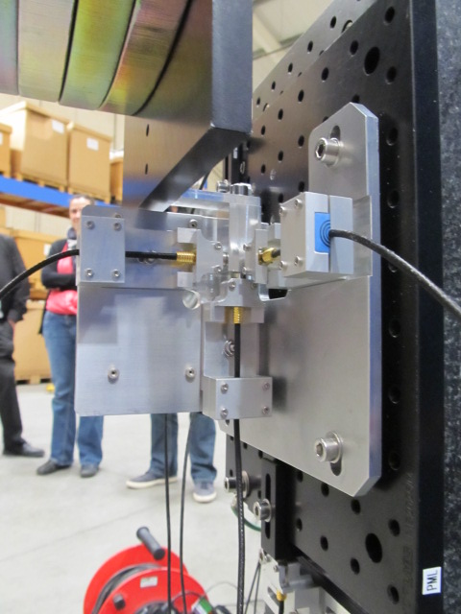
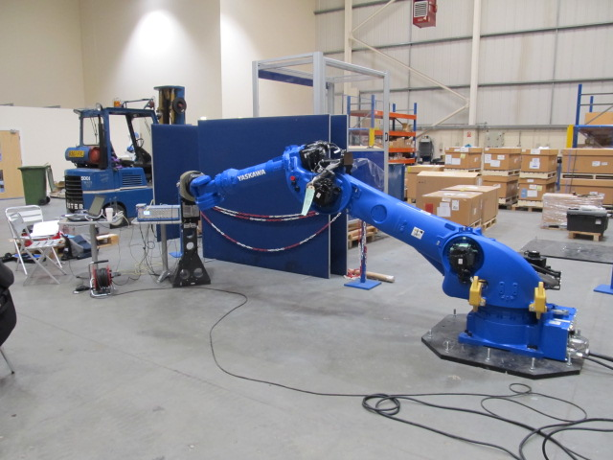
Instrument Setup 1
Target
109kg Payload
+Y
Capacitive sensors
+Z
+X
Three capacitive sensors positioned on the granite pillar to measure the displacement in XYZ direction.
Target was approximately 3m away from the robot base.

Slide 25
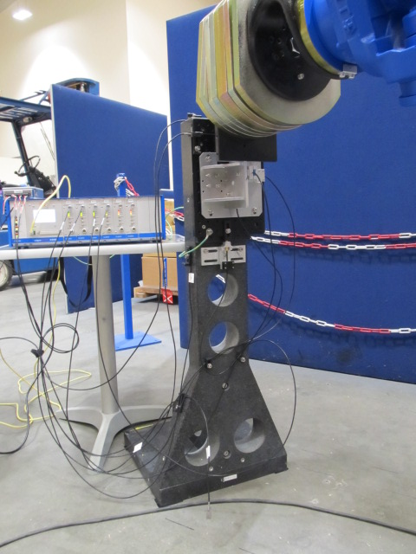
Instrument Setup
Pt100 Temperature Sensor Locations
CH1 – Low Air Temperature
CH2 – Mid Granite Temperature
CH3 – High Air Temperature
CH4 – Capacitive Sensor Base Temperature
CH3
CH4
Reference Sensor
Reference capacitive sensor mounted on the granite pillar to measure vertical position of a static target.
CH2
CH1

Slide 26
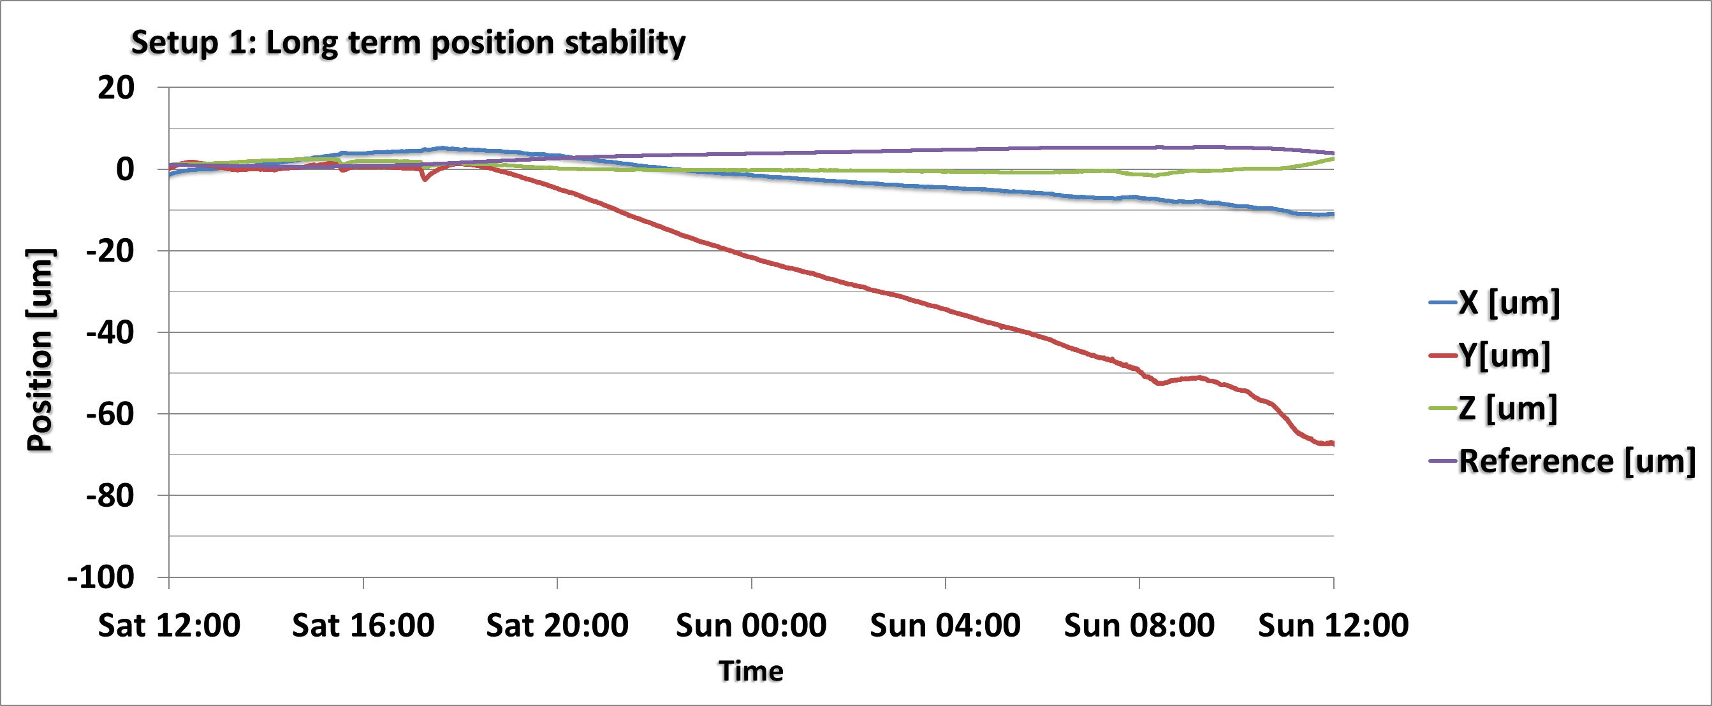
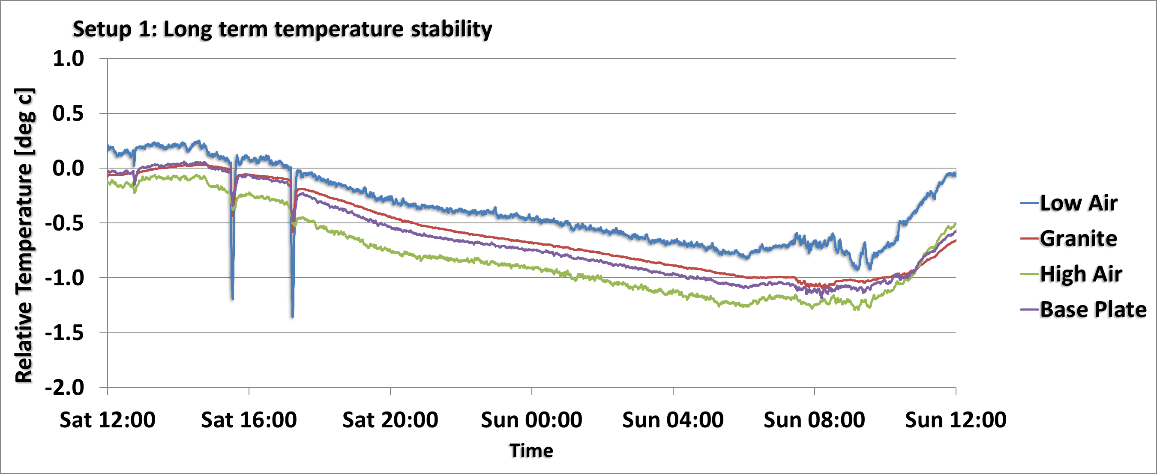
Setup 1: Long term position stability (24 hours)
Over a period of 24 hours the drift in position measured by the capacitive sensors for:
X = 20 um
Y = 70 um
Z = 5 um
Reference Sensor = 5 um
Temperature variation for the duration of the measurement = 1.3 deg c

Slide 27
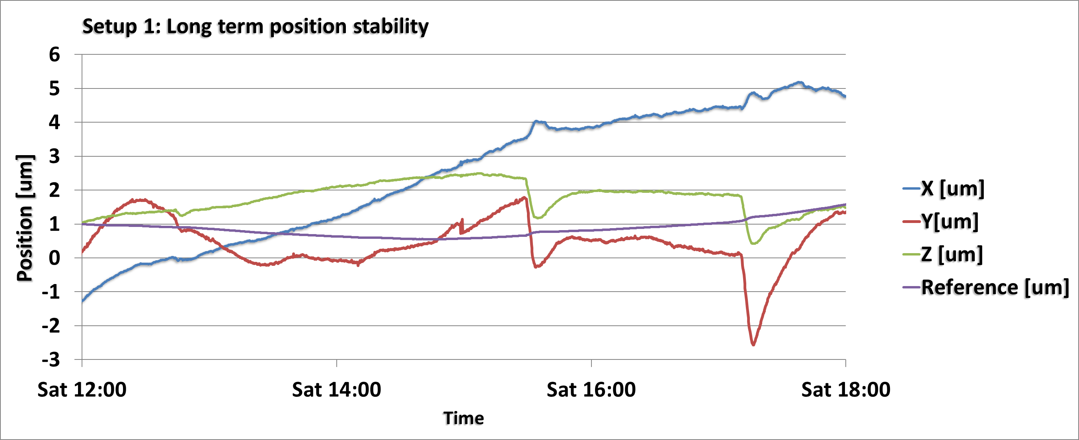
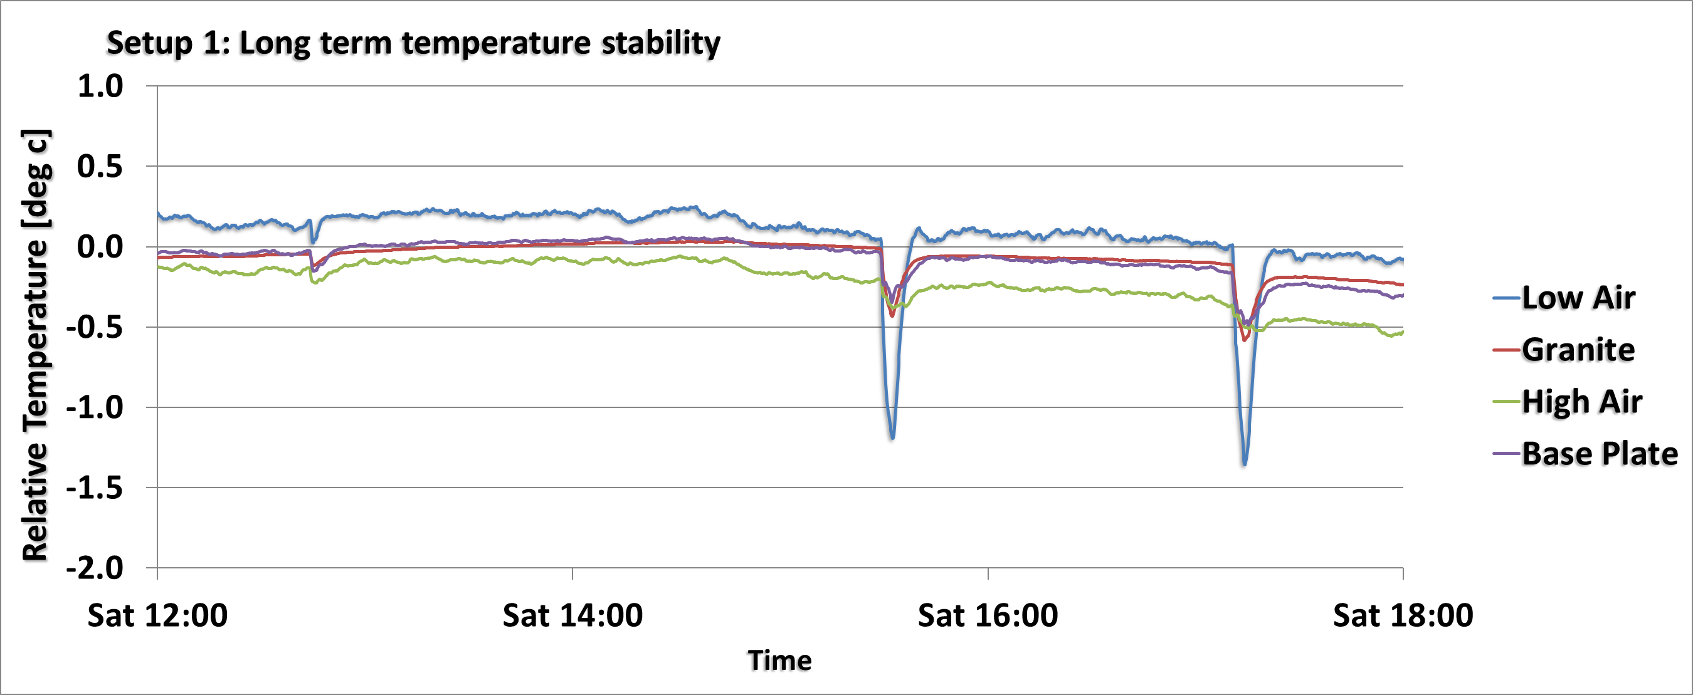
Setup 1: Medium term position stability (6 hours)
Over a period of 6 hours the drift in position measured by the capacitive sensors for:
X = 6 um
Y = 5 um
Z = 3 um
Reference Sensor = 1 um
Temperature stability for the duration of the measurement was typically 0.5 deg c.
The sudden drops in the temperature of around a degree which correlate with XYZ displacement was due to doors being opened at the Yaksawa factory site.

Slide 28
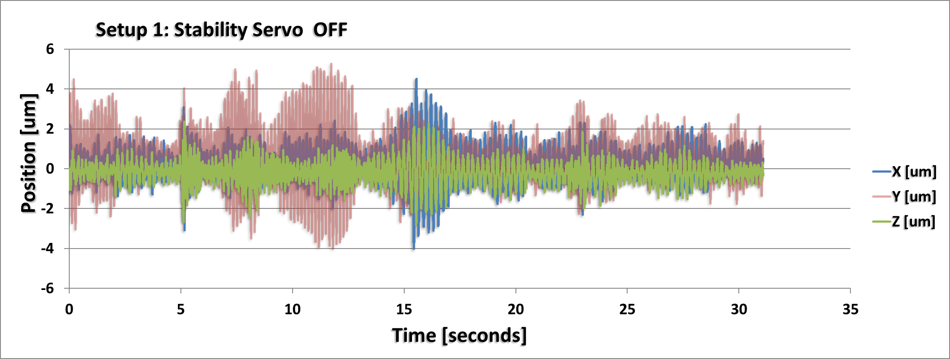
Setup1: Stability with Servo Off
Recorded position with capacitive sensors at 1KhZ over 30 seconds. Nearby disturbances at the Yaksawa sites should be taken into account. Typical positional stability with Servo Off :
X = 4um (Horizontal)
Y = 8um (Vertical)
Z = 4um (Horizontal)

Slide 29
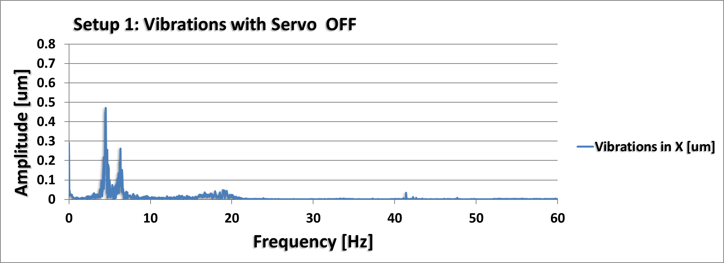
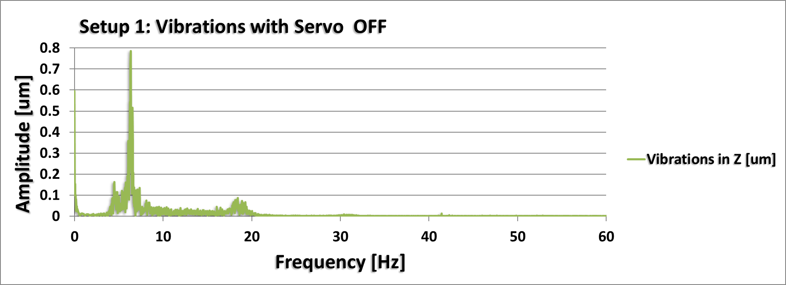
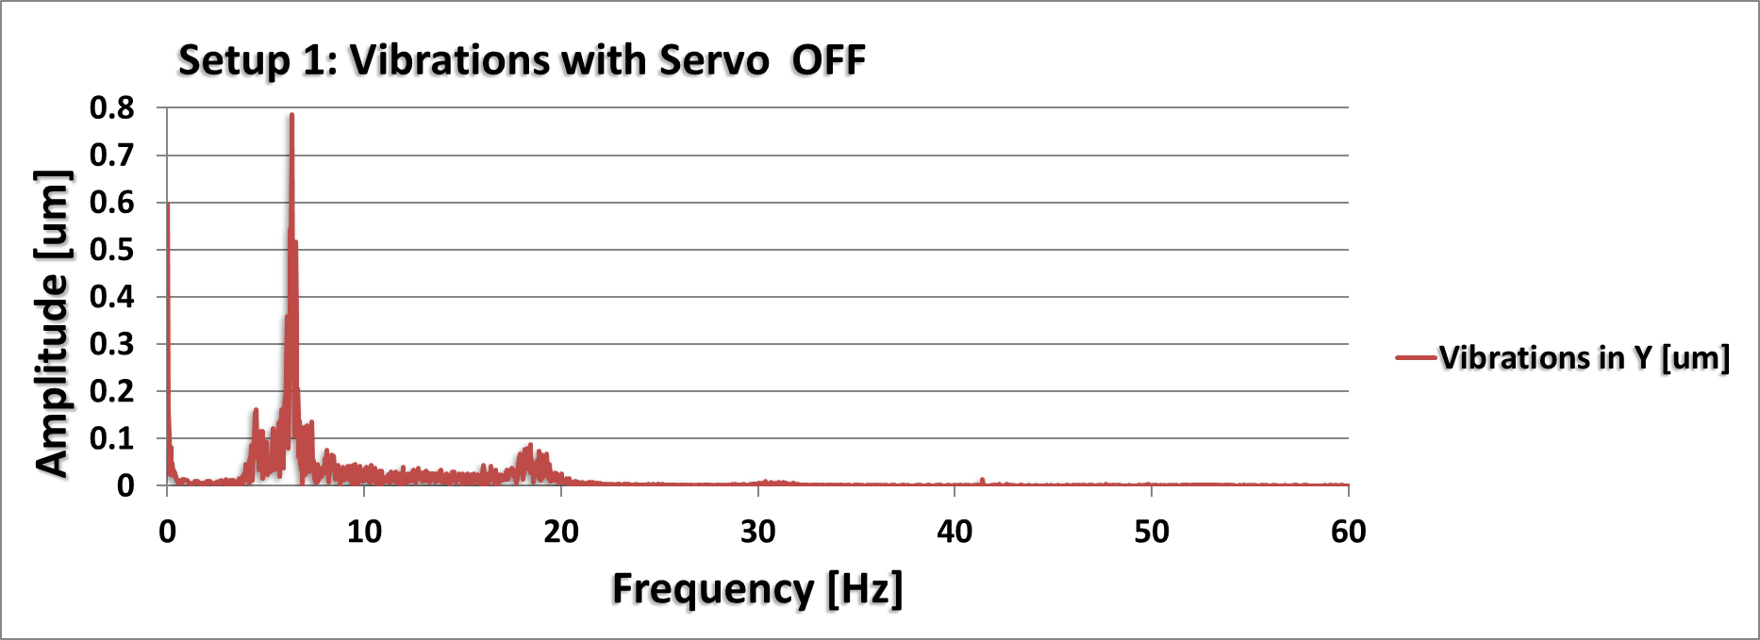
Setup 1: Vibrations with Servo OFF
FFT of the displacement data recorded at 1KhZ over 30 seconds.
Majority of the vibrations measured with servo OFF occur below 20Hz.

Slide 30
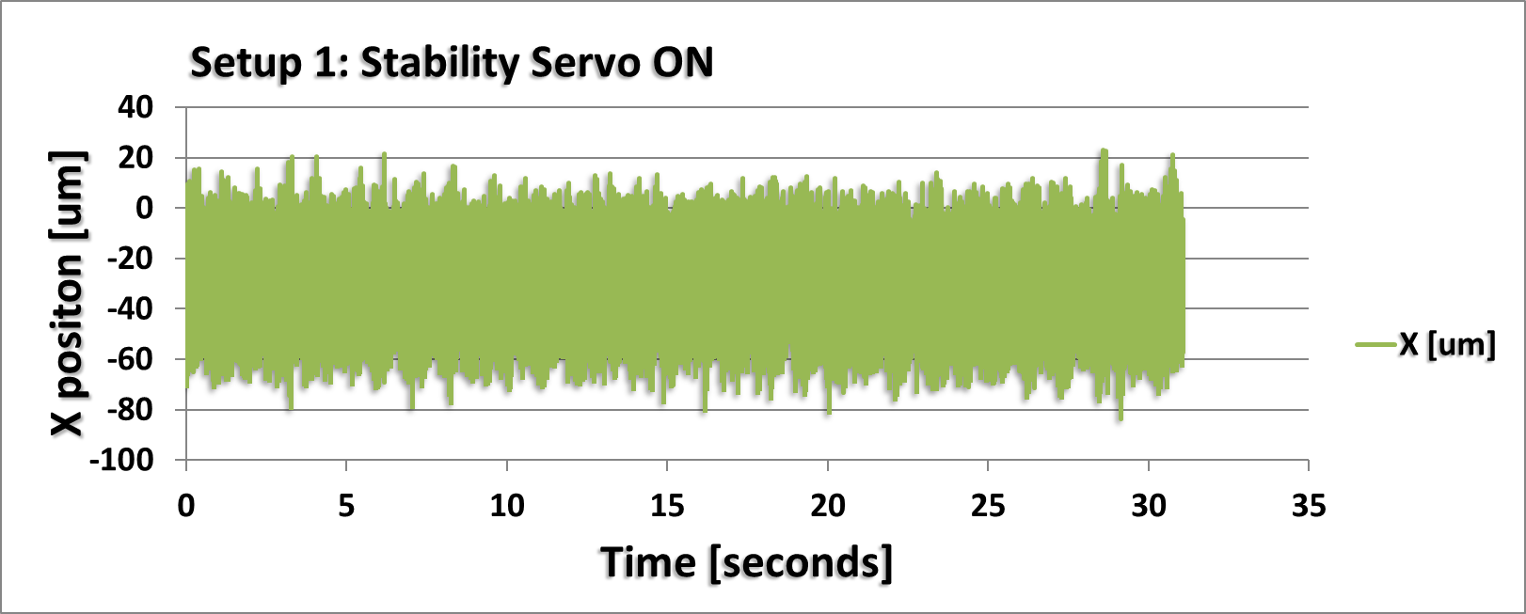
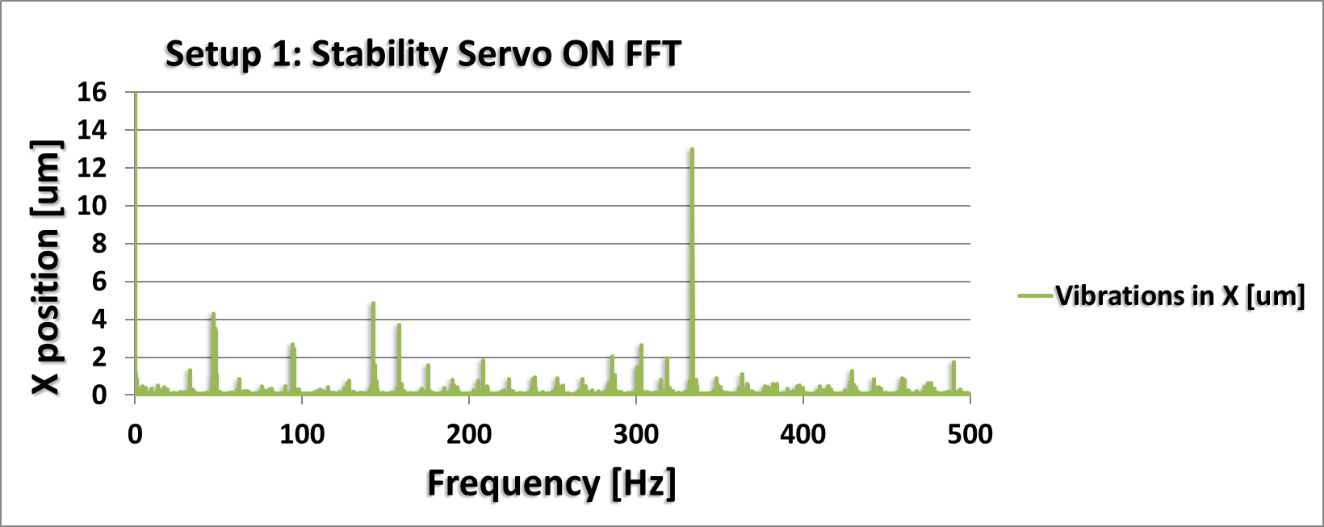
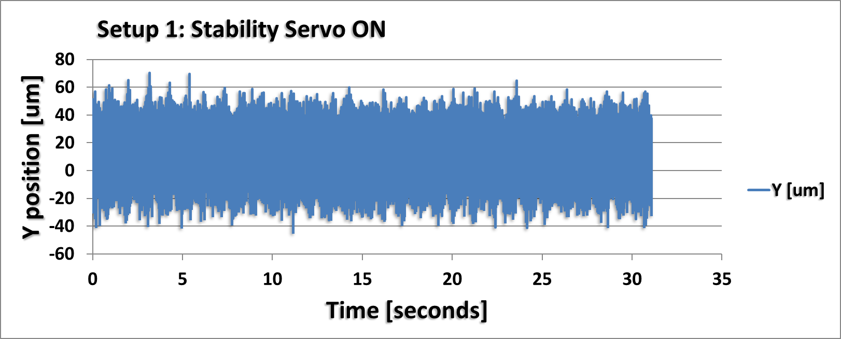
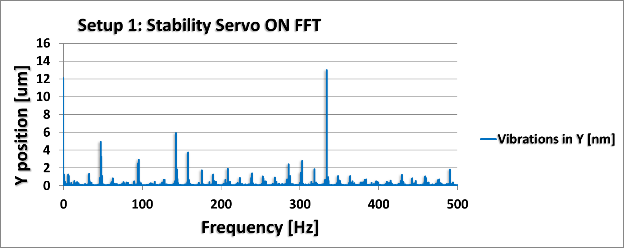
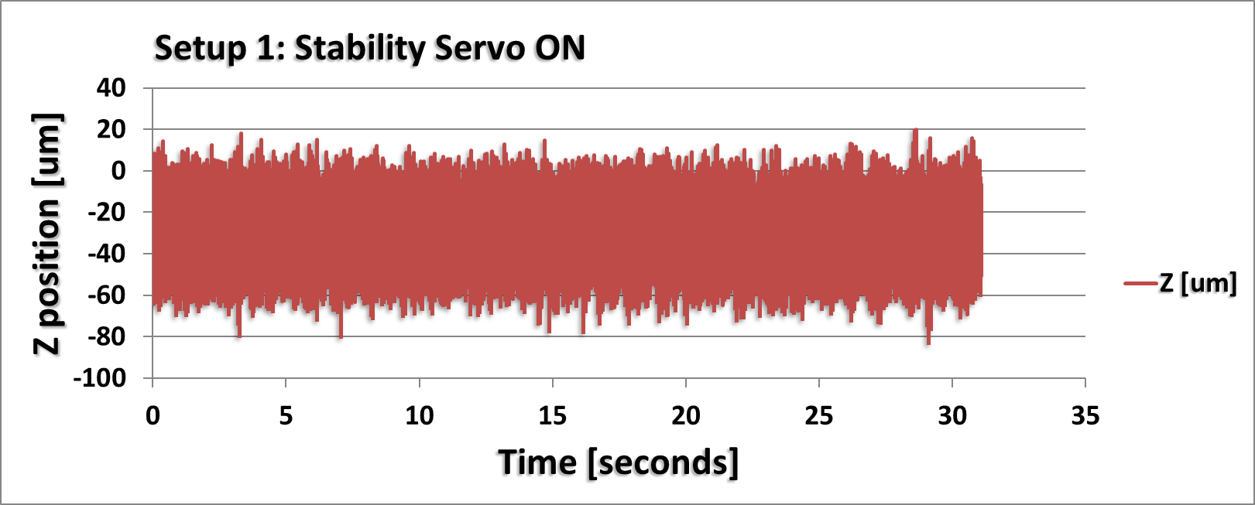
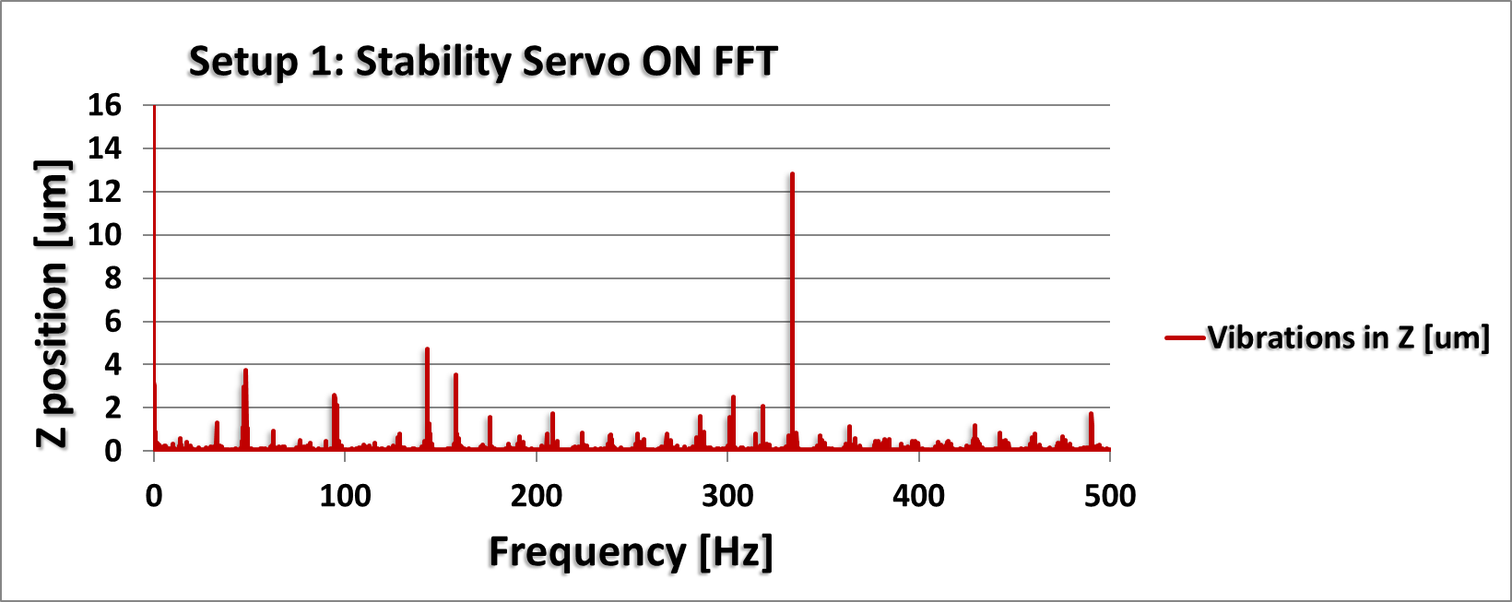
Setup1: Stability with Servo On
Servo ON Positional Stability:
X = 80 um
Y = 100 um
Z = 80 um
Similar amplitudes to the vibrations measured in XYZ .
Ground cable not connected to setup at this point; electrical noise is also present in the measurement.
Most significant vibration measured at 334 Hz with amplitude of 12um.
This is likely to be the closed loop frequency of the servo.

Slide 31
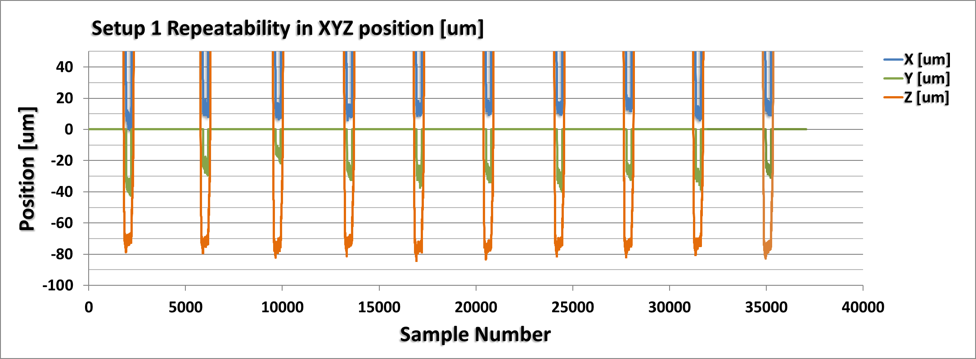
Setup 1: Repeatability of XYZ position
Target in position
Repeatability measured:
X = 20 um
Y = 30 um
Z = 20 um
Data recorded at sample frequency of 50Hz
Robot was programmed to approach capacitive sensors from home position (3m away)
Servo was turned off once within position
5 second settle time at measurement location
10 cyclic movements

Slide 32
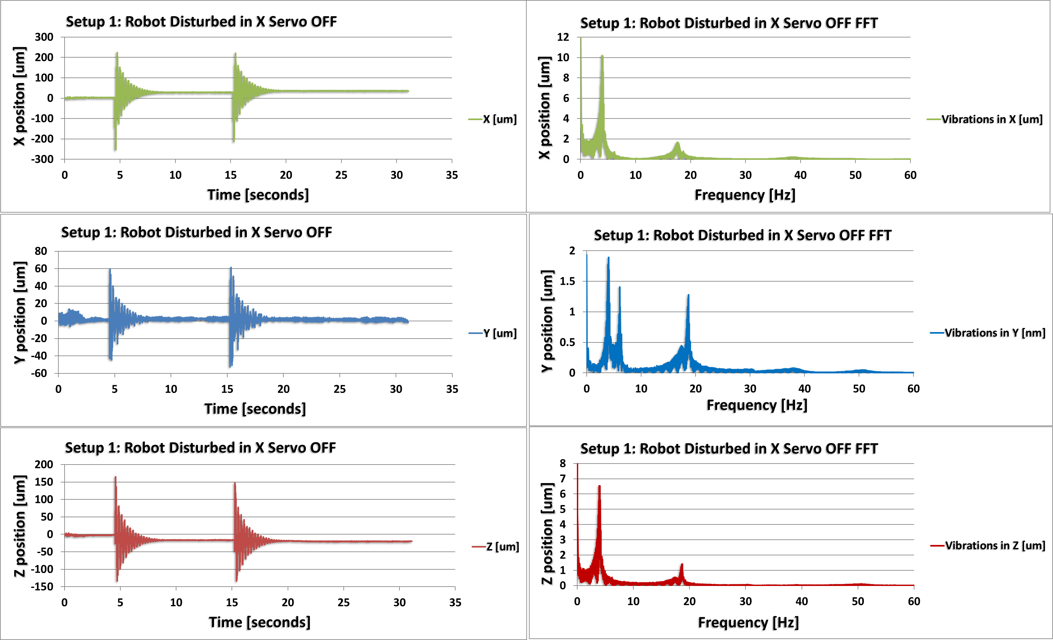
Setup 1: Robot Disturbed in X direction Servo OFF
Positon in XYZ recorded at a rate of 1Khz Hammer was used to strike the payload connected to the robotic arm in the X direction.
After impact the robot stabilises within 4 seconds.
Resonant frequencies identified at 4, 6 and 19 Hz.
Most significant disturbance measured in the X direction as expected.

Slide 33
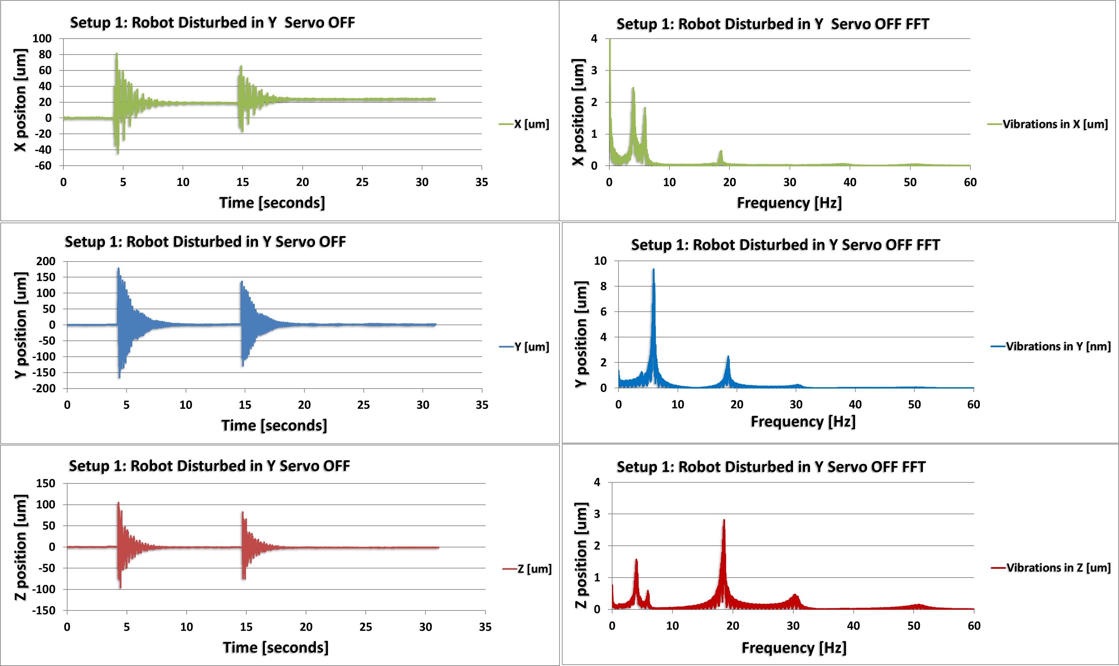
Setup 1: Robot Disturbed in Y direction Servo OFF

Slide 34
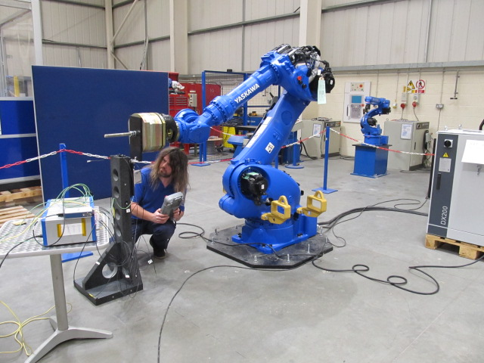
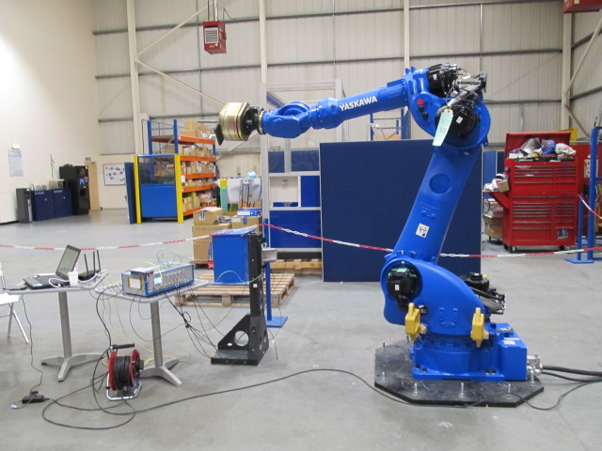
Instrument Setup 2
Capacitive sensors setup was moved 1.5m closer to the robot.
+Y
+X
+Z

Slide 35
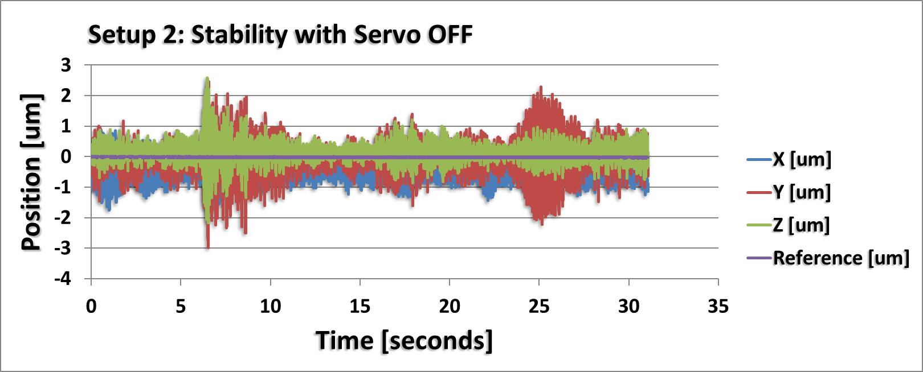
Setup 2: Stability with Servo OFF
Recorded position with capacitive sensors at 1KhZ over 30 seconds. Nearby disturbances at the Yaksawa sites should be taken into account. In comparison to Setup 1 (with the robot arm outstretched) the typical positional stability with Servo Off closer to the robot is improved by approximately factor 2.
X = 2.5 um (Horizontal)
Y = 4 um (Vertical)
Z = 2 um (Horizontal)

Slide 36
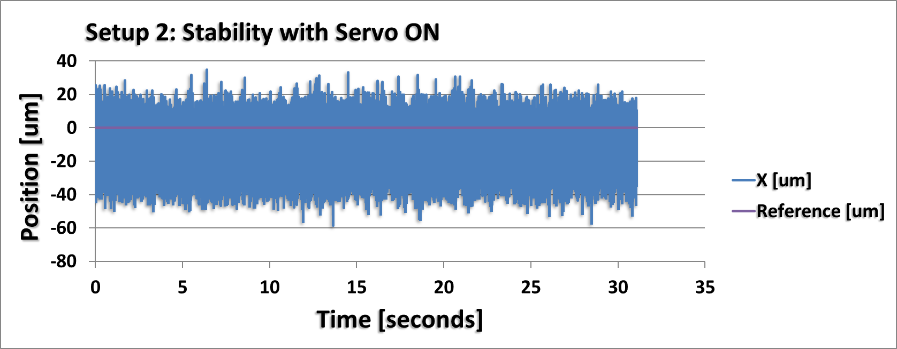
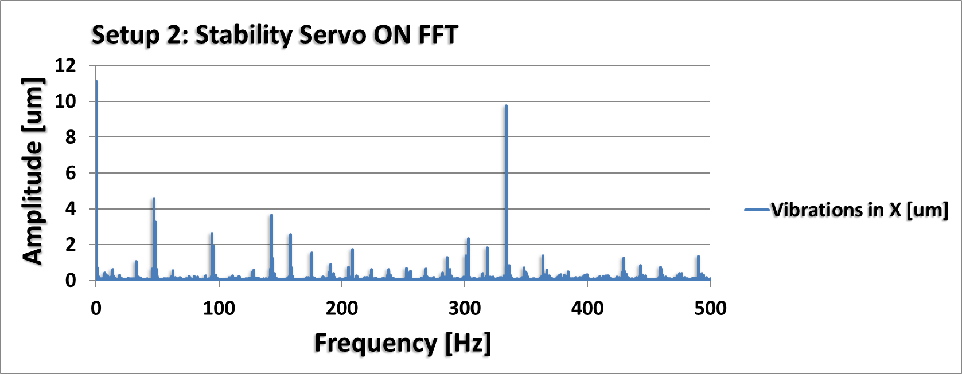
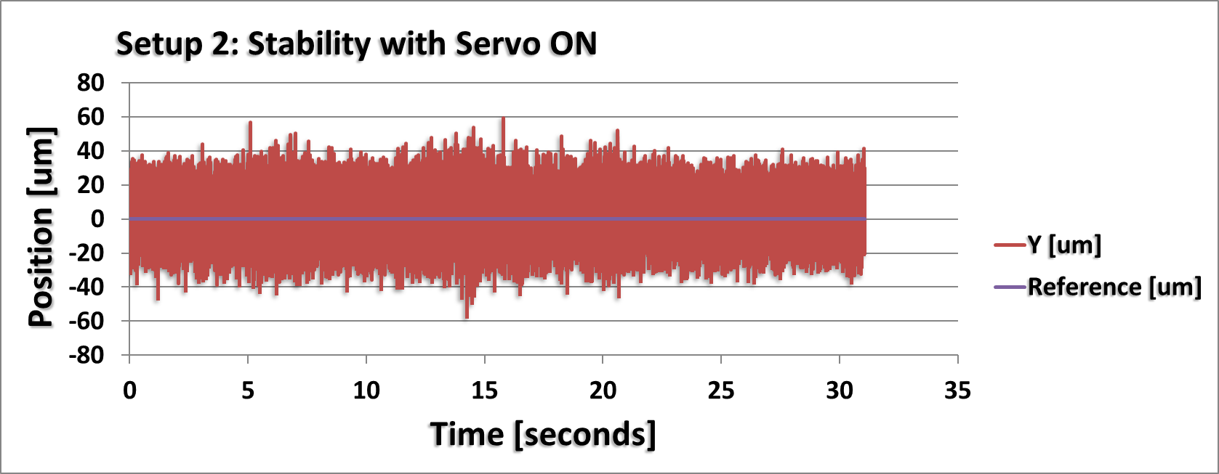
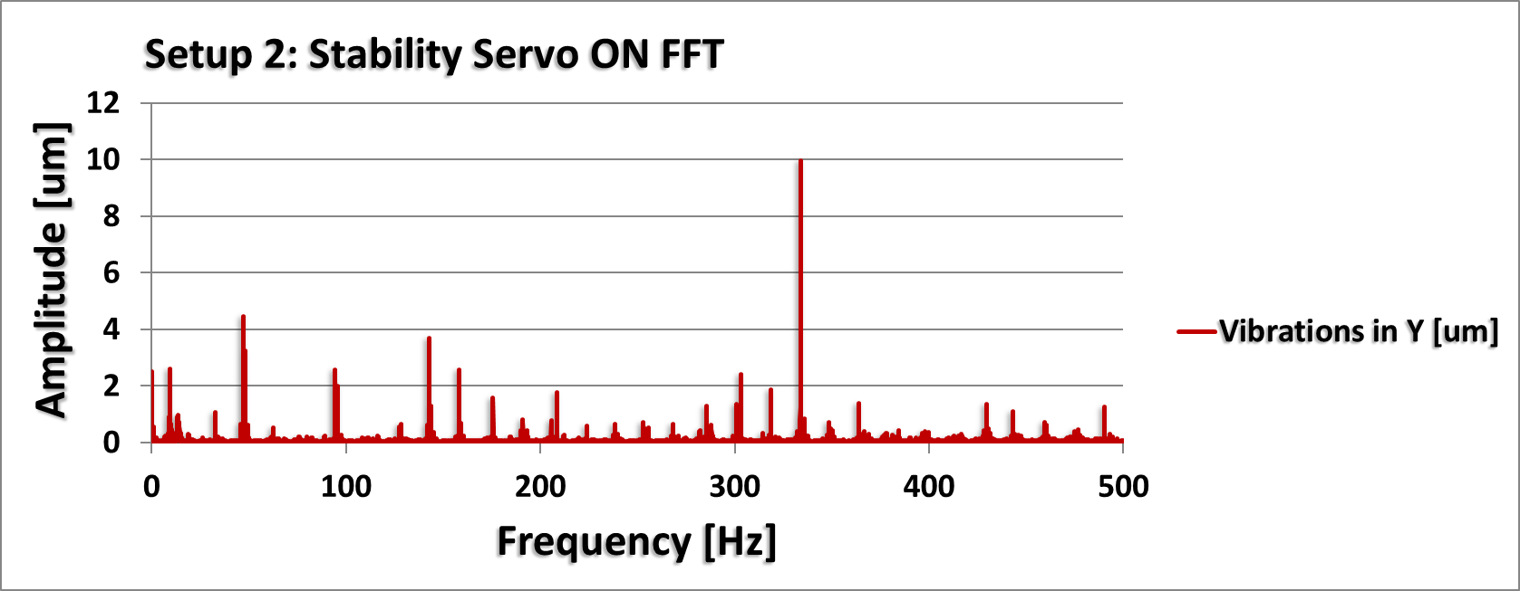
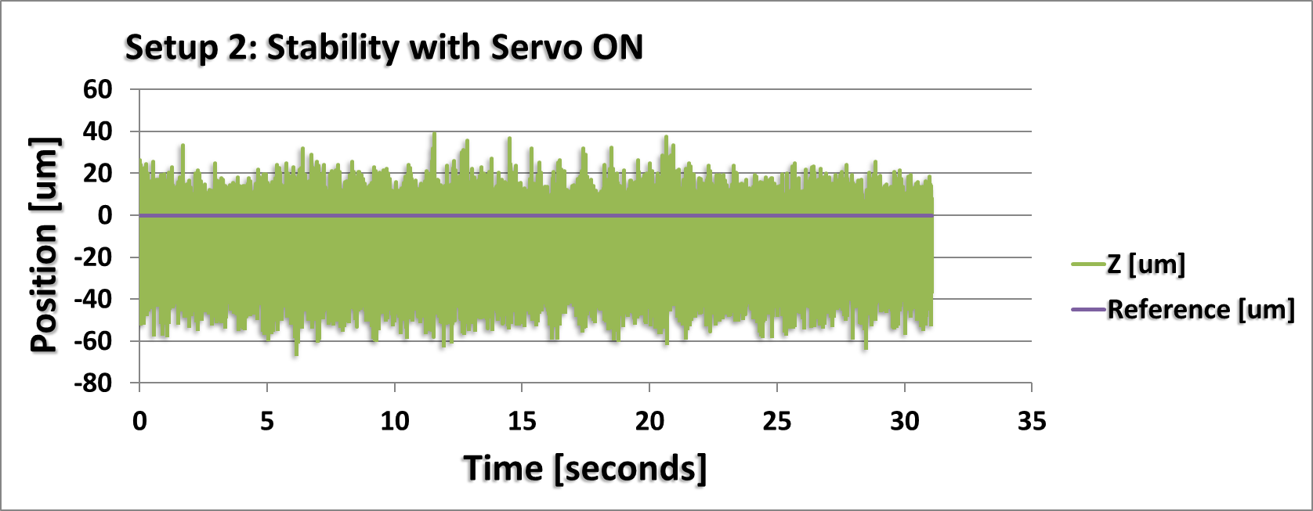
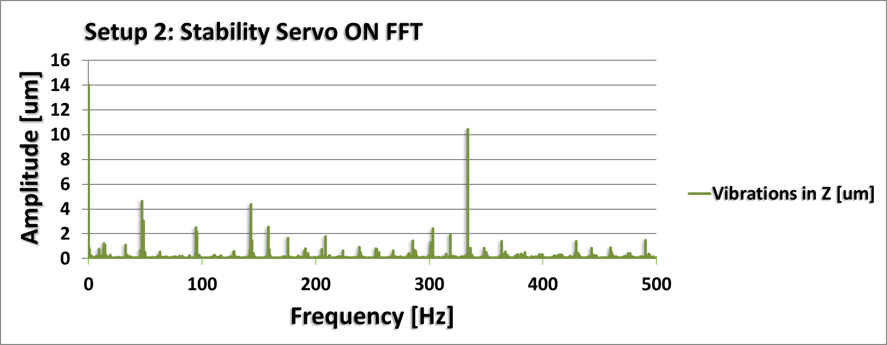
Setup 2: Stability with Servo ON
Servo ON Positional Stability in XYZ = 80um.
Similar performance as measured in Setup 1.
Most significant vibration with Servo ON is 333 Hz with amplitude ± 10um.

Slide 37
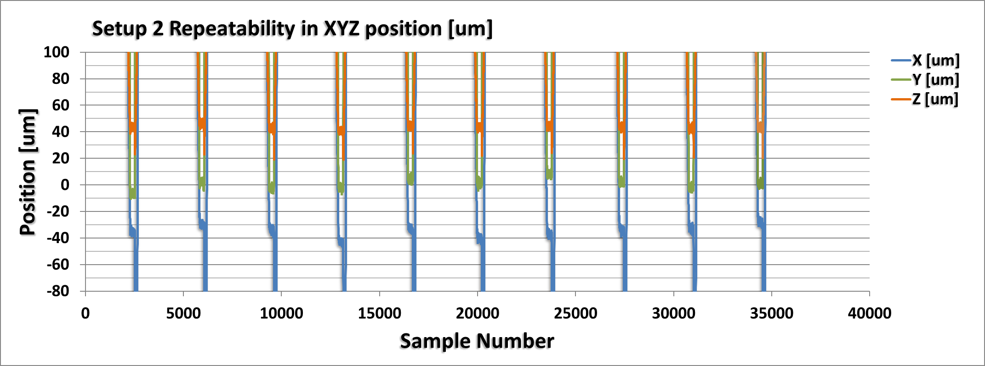
Setup 2: Repeatability of XYZ position
Target in position
Repeatability measured:
X = 25 um
Y = 20 um
Z = 20 um
Data recorded at sample frequency of 50Hz
Robot was programmed to approach capacitive sensors from home position (1.5m away)
Servo was turned off once within position
5 second settle time at measurement location
10 cyclic movements

Slide 38
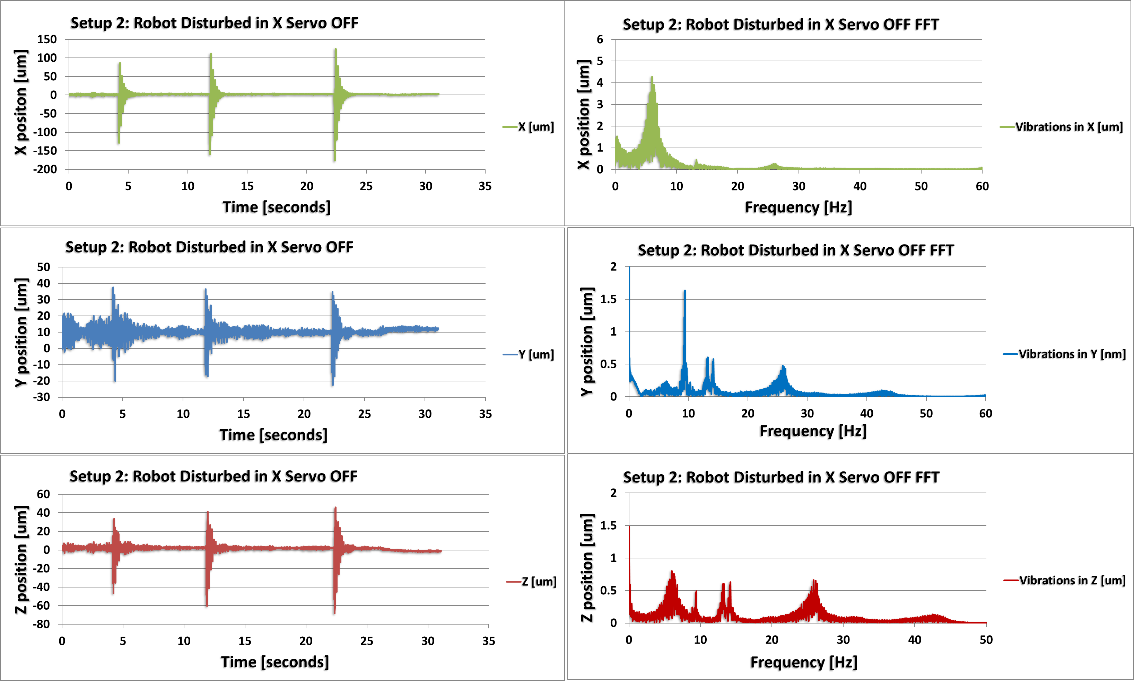
Setup 2: Robot Disturbed in X direction Servo OFF

Slide 39
Summary
Results indicate the robot will perform within the required specification.
Yaksawa robotic arm to be purchased by April 2019.
Further testing is planned once installed on the DIAD beamline at Diamond.
Expect to improve upon the long term and vibration stability as there will be less disturbance on the beamline and significantly better temperature stability.

