Slide 1

MOCRAF Workshop
6th workshop dedicated to
MOtion ContRol Applications in large Facilities
Brian Nutter ( DLS), Yves-Marie Abiven ( SOLEIL) , Guifre Cuni (ALBA), Nicolas Janvier (ESRF),
Nicola Coppola( eXFEL), Christer Engblom (SOLEIL),

Slide 2
MOCRAF Workshop
Why?
Who?
What?
How?

Slide 3
MOCRAF Workshop
Who?
How?
Why?
What?
Motion control is a key element ,which enables high level of performance at scientific facilities
5 previous MOCRAF Workshop
(2011 in SOLEIL, 2012 in Diamond, 2013 ICALEPCS San Francisco, 2015 ICALEPCS Melbourne, 2017 ICALEPCS Barcelona )
ICALEPCS 2019 is an ideal place for the 6th WS,
meeting new friends

Slide 4
MOCRAF Workshop
Applications experiences:
interesting motion experiences since the last workshop.
Robotics and Beamline automation:
Integrating industrial robots into beamlines
Collaborative robotics
Experiment automation
Experiences Combining high precision metrology/feedback
Stacked sample stages
measuring and Maintaining compensation tables
Interferometry as feedback
Experiences Modelling Motion Systems
Is anyone designing their motion systems based upon a modelling approach
what benefits and improvements have been realised
Hardware Challenges
End of life challenges
Keeping up with faster detectors
multivendor systems or dedicated bespoke subsystems
Who?
How?
Why?
What?

Slide 5

MOCRAF Workshop
Who?
How?
Why?
What?
42 attendees
9 countries
22 Institutes
4 trading companies
https://www.google.com/maps/d/edit?hl=en&mid=1IJHQnihWT_Sk_-aLoR_gkVmAY2g&ll=5.108998801646877%2C0&z=2

Slide 6
MOCRAF Workshop
  Knowing each others
  Short introductions of 3-5 minutes followed by a 10-15 minutes presentations
  and Coffee
Round table sessions
The remaining sessions will feature one or two talks followed by a 30 minute round table discussion in 7 groups, with a 15 minutes round up from the groups
  Please respect the speaking time
Who?
How?
Why?
What?

Slide 7
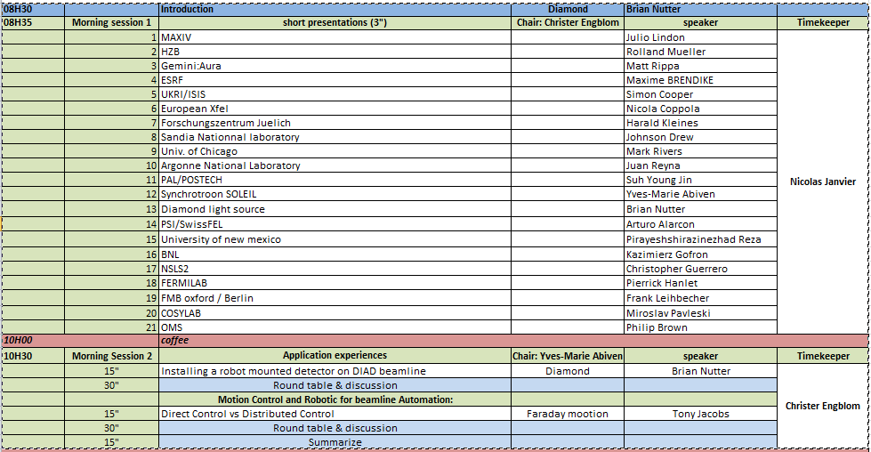
MOCRAF Workshop

Slide 8
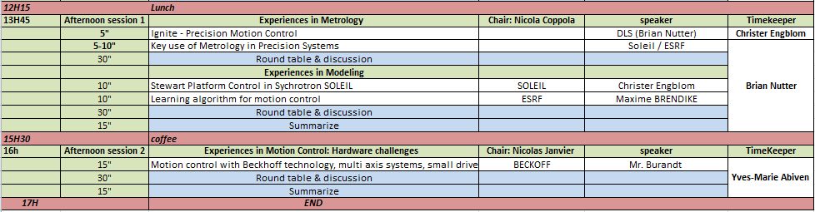
MOCRAF Workshop

Slide 9
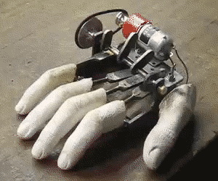
MOCRAF Workshop

