Slide 1
Predictive Modelling and Error Budget
Experience with HD-DCM Project
MOCRAF
Hardware challenge session
Ricardo Caliari – SIL
ricardo.caliari@lnls.br
Gabriel Moreno – SIL
gabriel.moreno@lnls.br

Slide 2
Outline
High-Dynamic DCM concept
Predictive modelling
Error budget
System characterization
Partial results

Slide 3

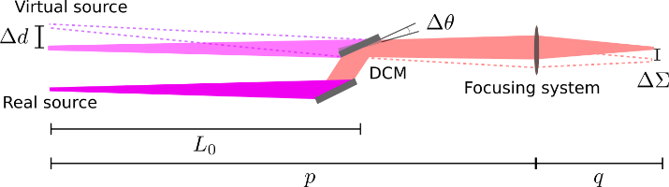
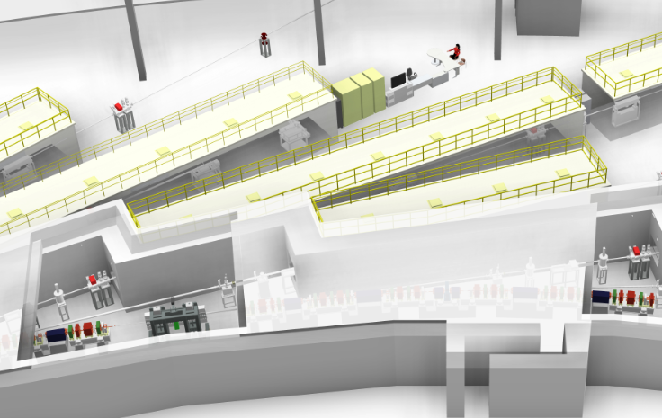
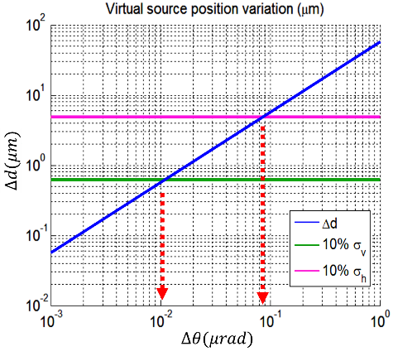

Motivation
DCM performances for the next generation machines
Sirius
$$L_{0}≈30 m$$
10%
source
size

Slide 4
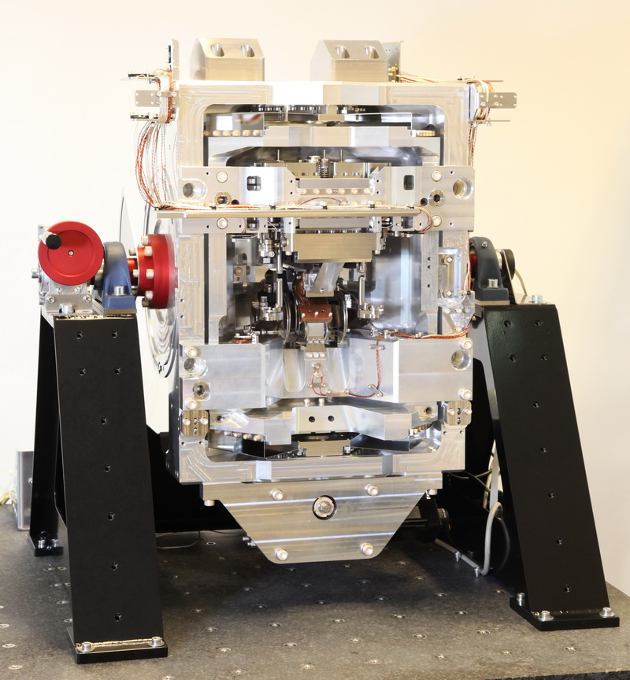
Specifications
Parameter | Description
Type: | Vertical DCM
Beam offset: | 18 mm
Angular range: | 3 to 60°
Angular resolution: | 0.2 μrad
Pitch/roll stability: | in-position: < 10 nrad (+3σ) flyscan: 200 nrad (+3σ)
Crystal sets: | Si(111): 2.3 to 38 keV Si(311): 4.4 to 72 keV
Crystal sizes (W x L): | 1st crystal: 15 x 35 mm² 2nd crystal: 15 x 190 mm²
Crystal cooling: | 1st crystal: Indirect LN₂ (80 K) 2nd crystal: Copper straps (155 K)
Crystal DoF: | 1st crystal: fixed at rotation center 2nd crystal: gap, pitch, roll
Beam size: | 1.7 x 1.7 mm²
Input Power: | 150 W
Base pressure: | < 5 x 10⁻⁸ mbar

Slide 5
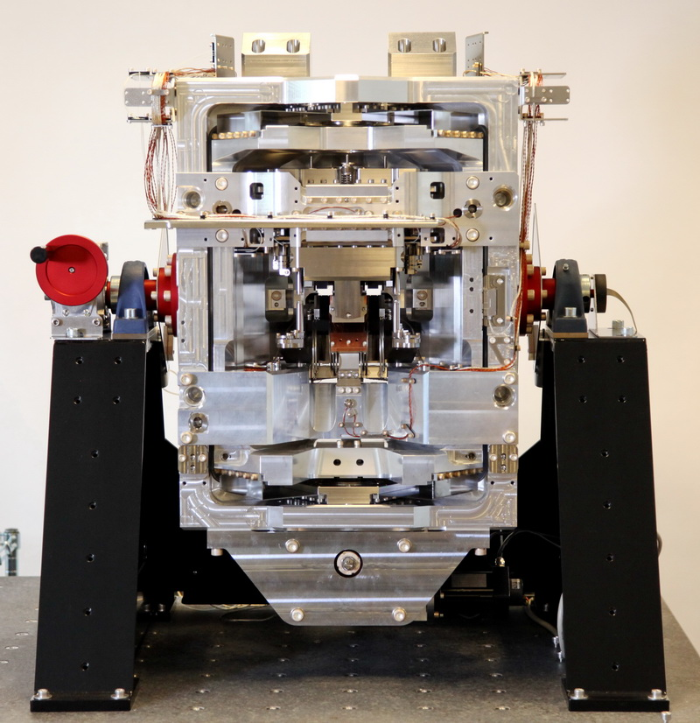
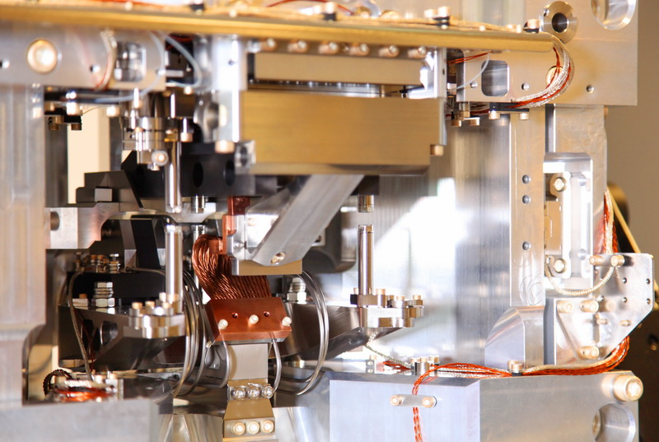
High-Dynamic DCM
PCT/BR2017/050262, Patent Application.

Slide 6
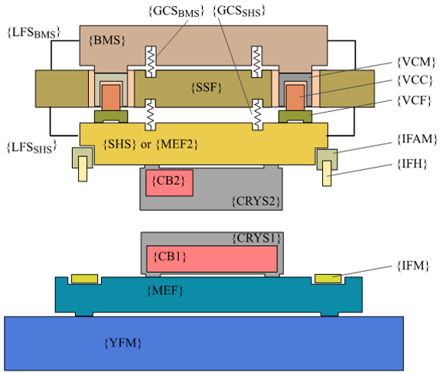
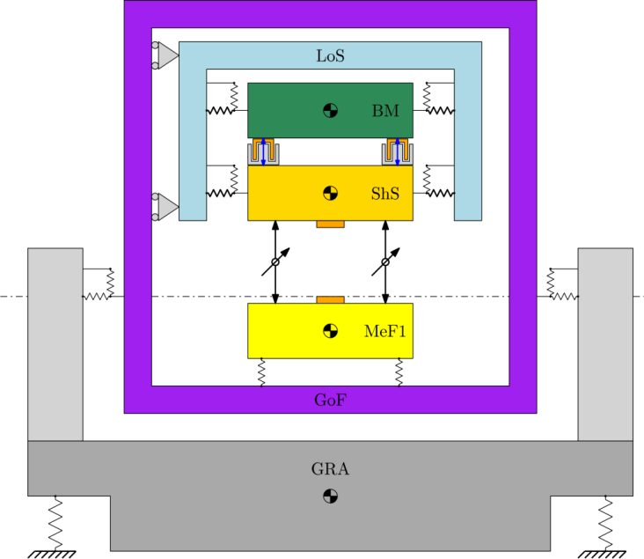
Concept
1D dynamic model
Schematics

Slide 7
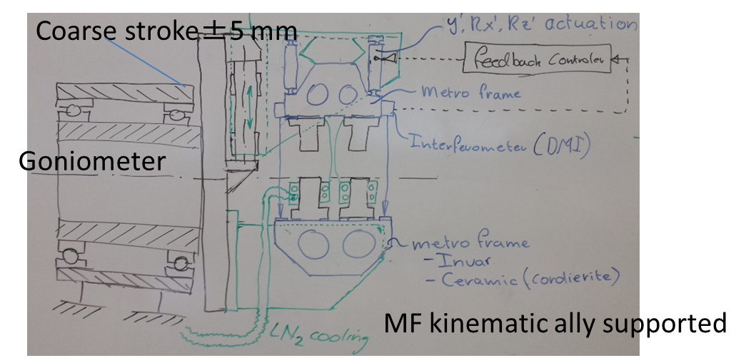
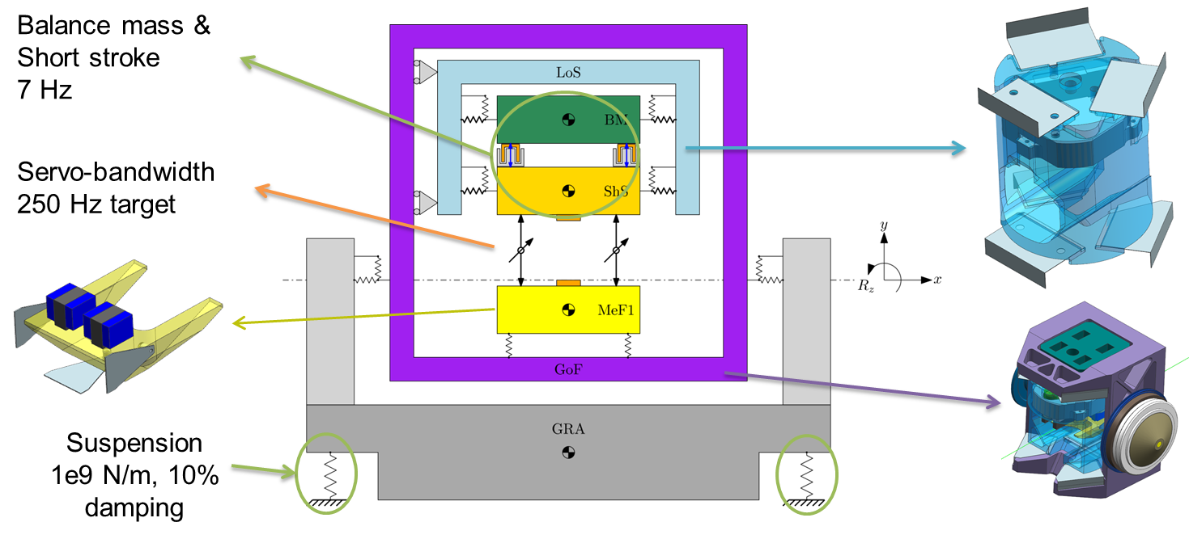
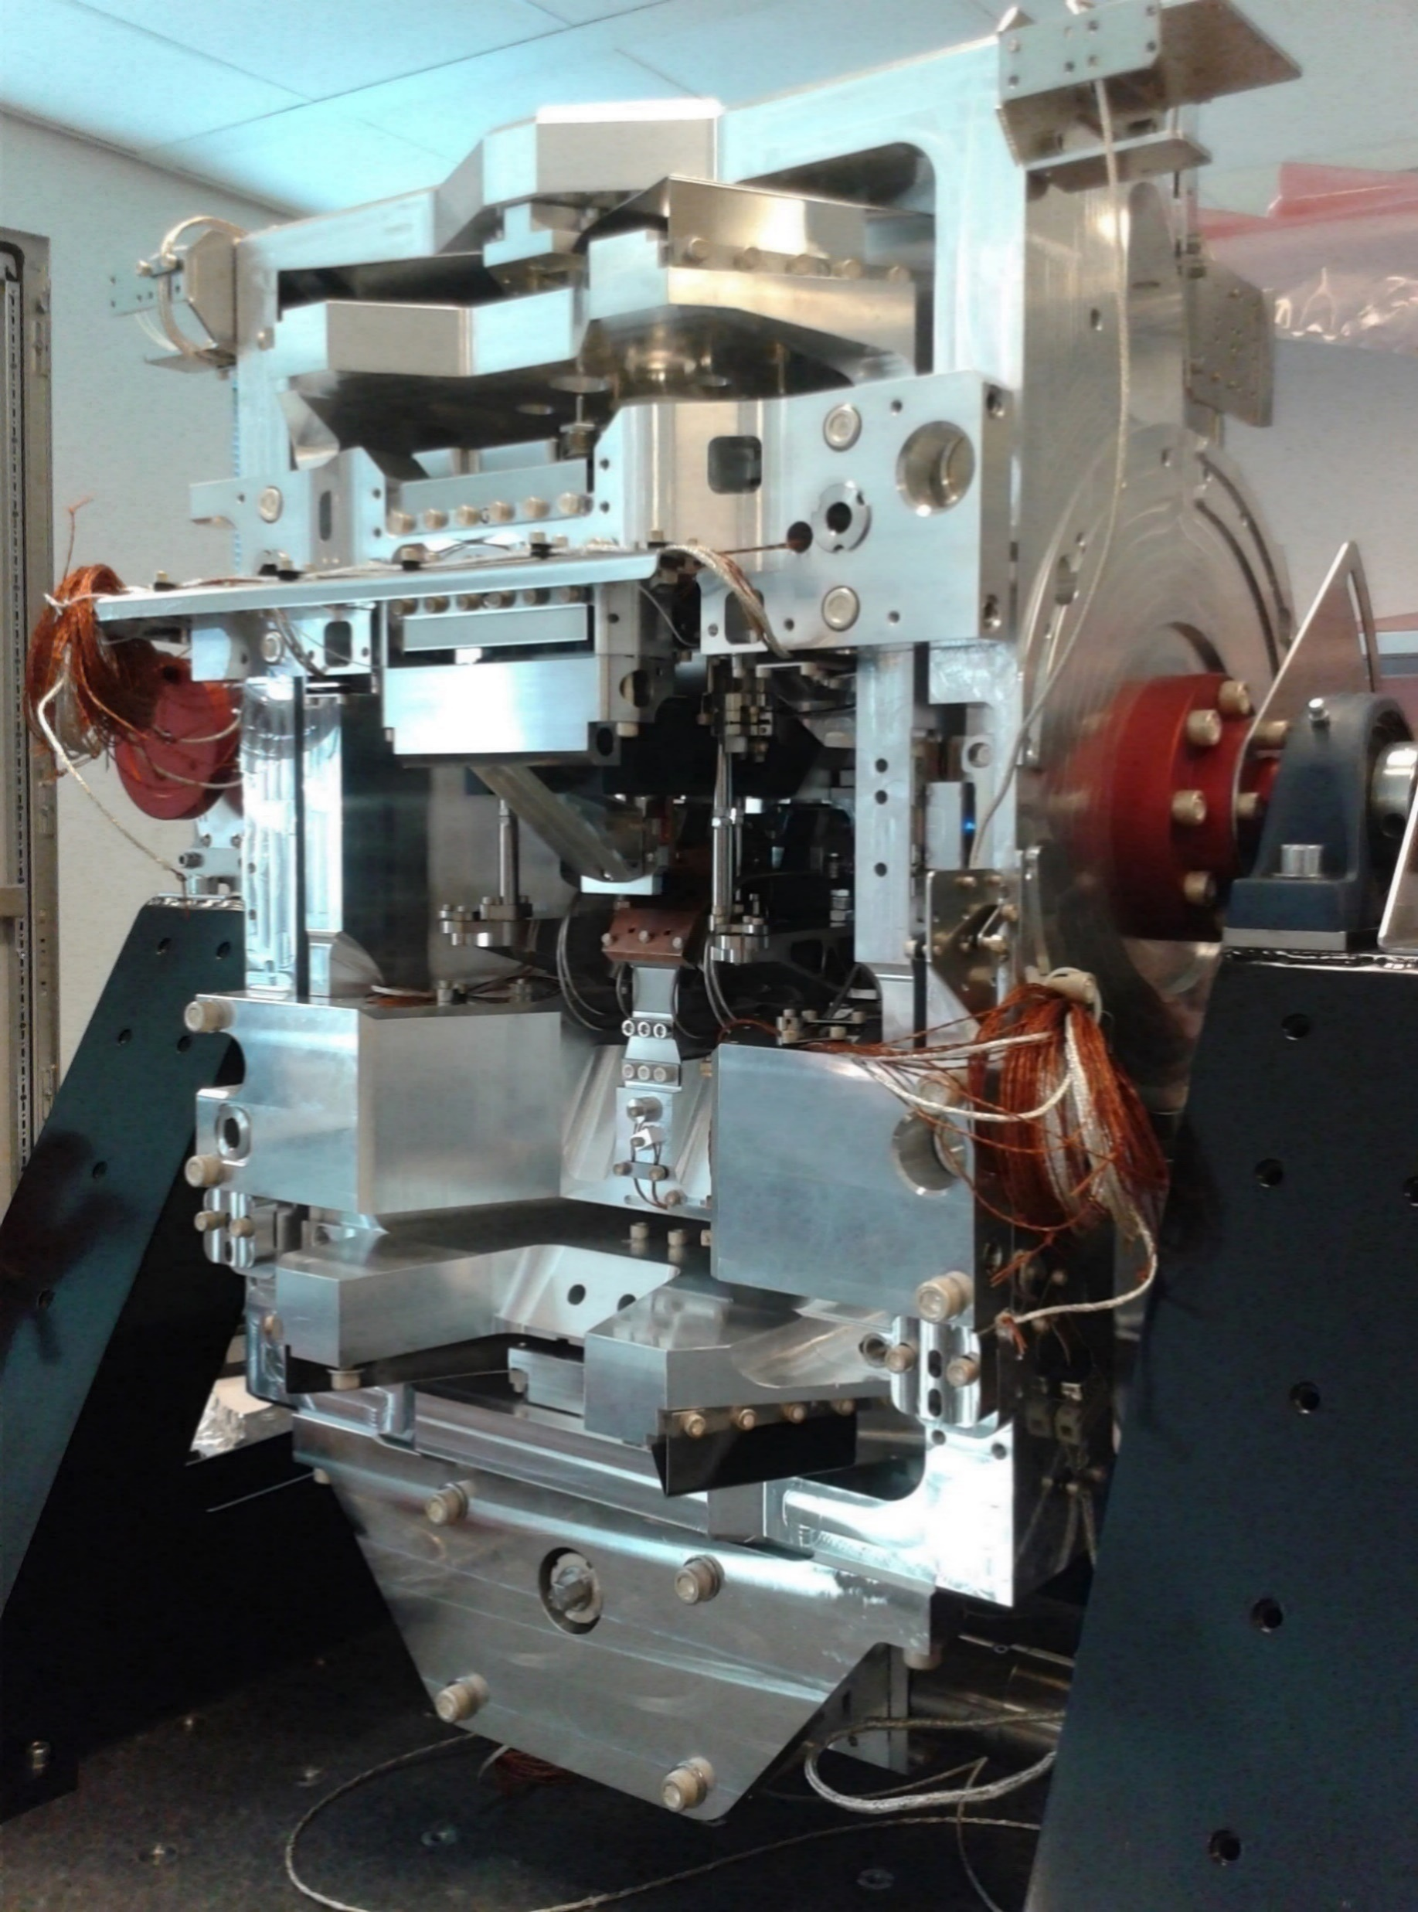
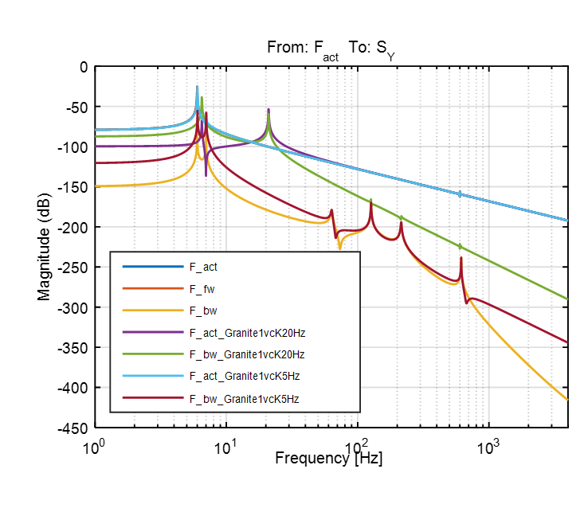
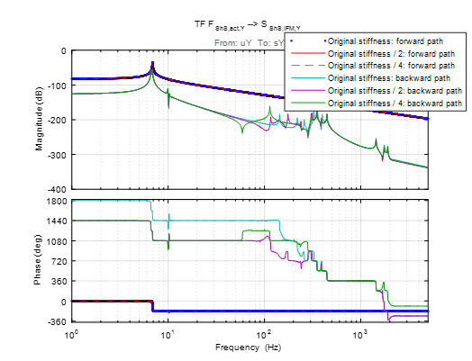
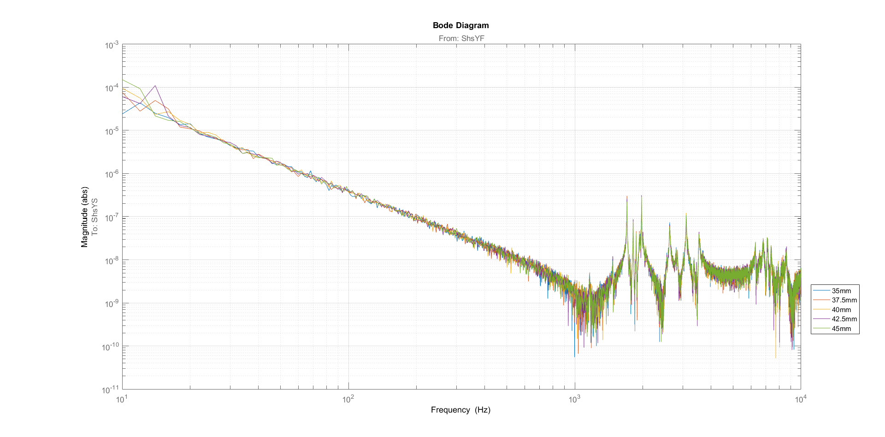
Predictive Modelling
12/2015
Voice Coil – Balance mass
Concept presentation
09/2016
Stiffness definition
Detail mechanical project
11/2016
Robustness evaluation
Parameters uncertainty evaluation
03/2017
System identification
Target achieved
Robustness test made
Lumped-mass model
and Error budget
1D dynamic model
6DoF model
System identification

Slide 8
Error Sources to Budget
Alignment Errors (Mounting)
Thermal Drifts
IFM Mirror Surface Flatness
Cooling System Vibrations
Floor Vibrations
Instrument Induced Errors
  Amplifiers
  Actuator Disturbances
  Sensor Disturbances (i.e. SDE, non-linearity, quantization...)
And Much More!!!

Slide 9
Error budget analysis (ShS-3DoF)

Slide 10
Example: BW and sample freq.
Analysis made in preliminary phase, to choose the minimum suitable BW
BW = 250 Hz
BW = 200 Hz
BW = 150 Hz

Slide 11

Closed loop control
Motion control axes:
  Goniometer (1 DoF)
  Long Stroke (1 DoF)
  Short Stroke (3 DoF)
  All linear drivers for all motors, controlled by the same ECU (same error spectra, same clock etc..)
3
1
2

Slide 12
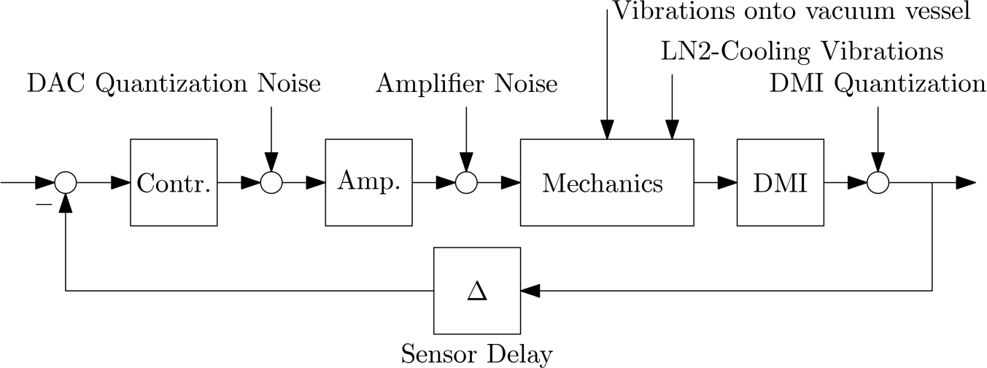
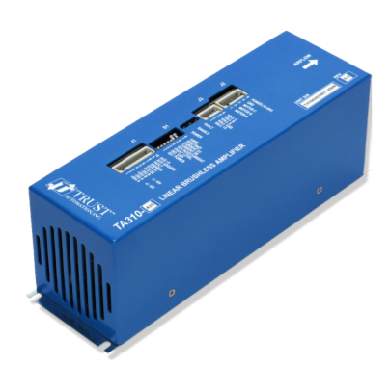

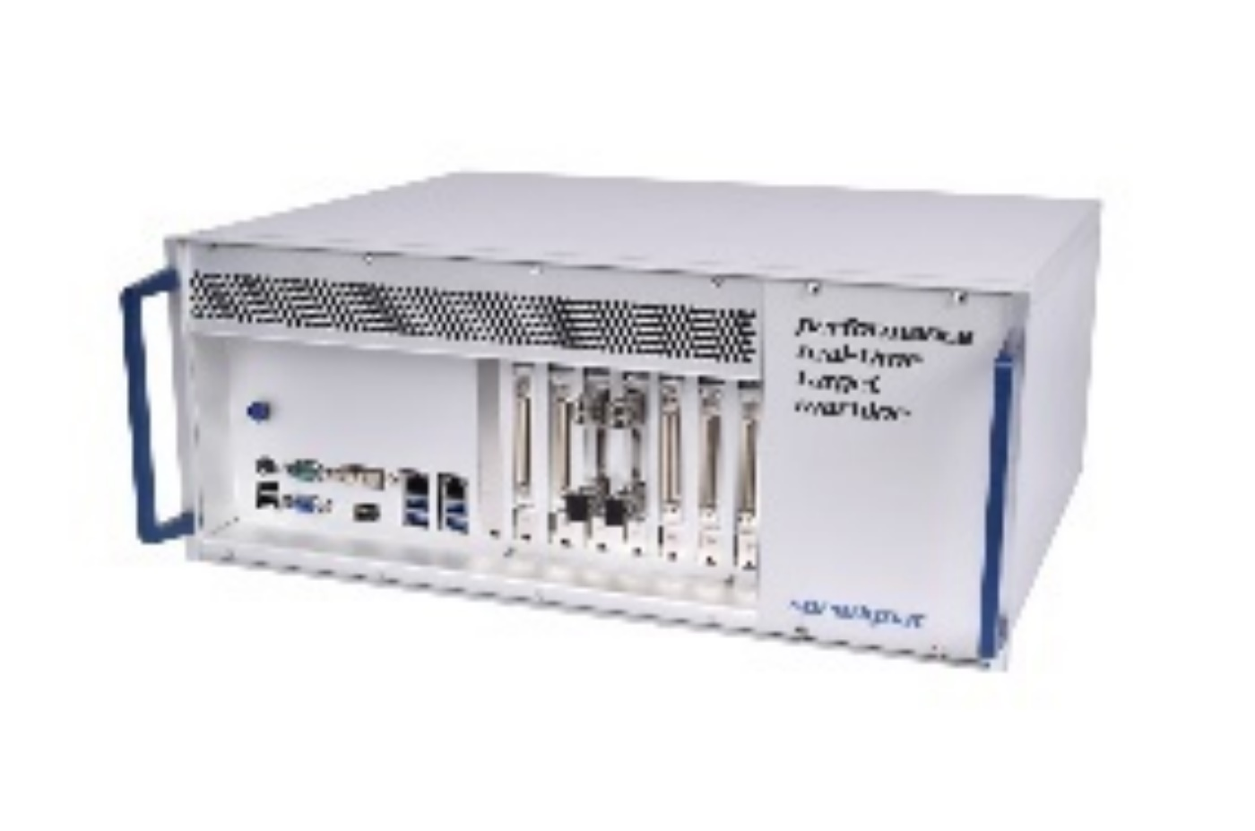
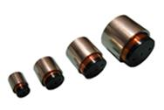
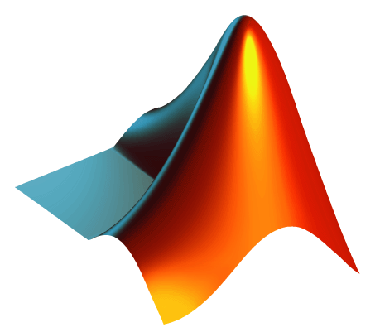
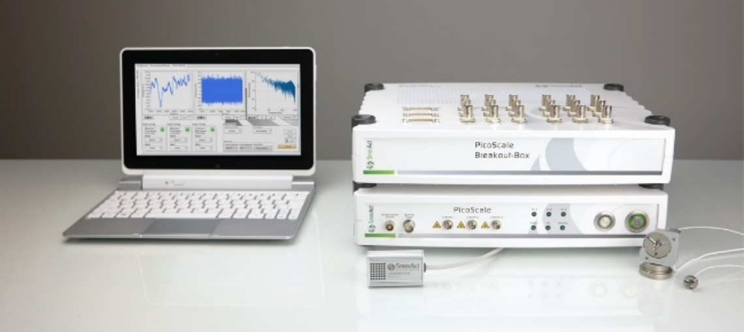
Short Stroke closed loop control
3
1
2

Slide 13
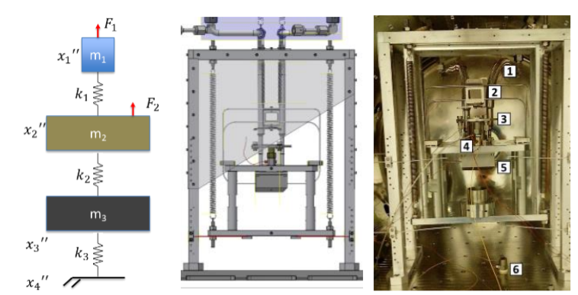
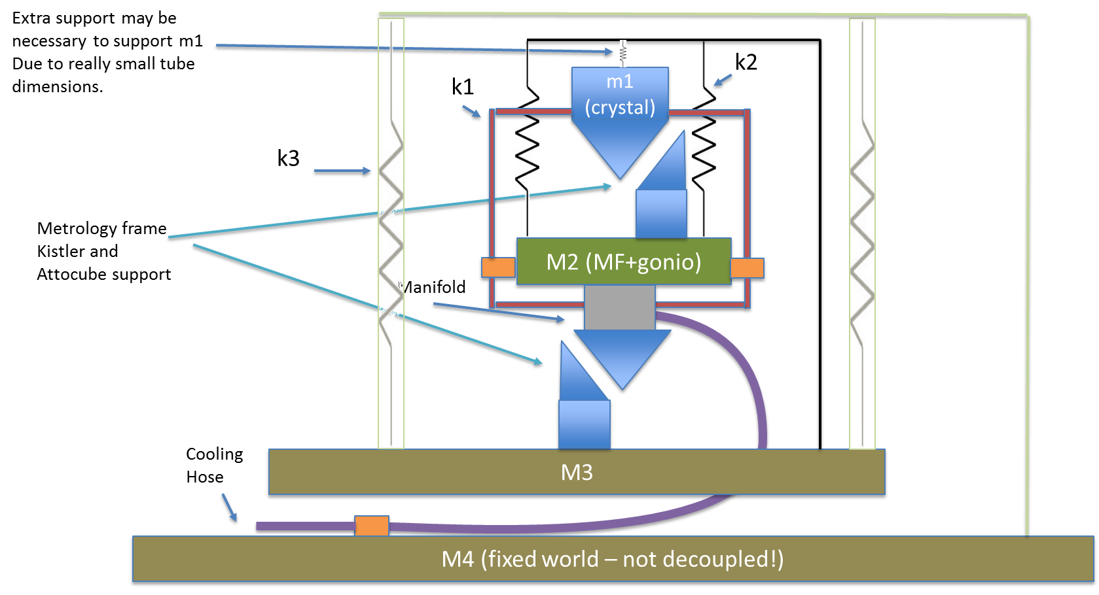
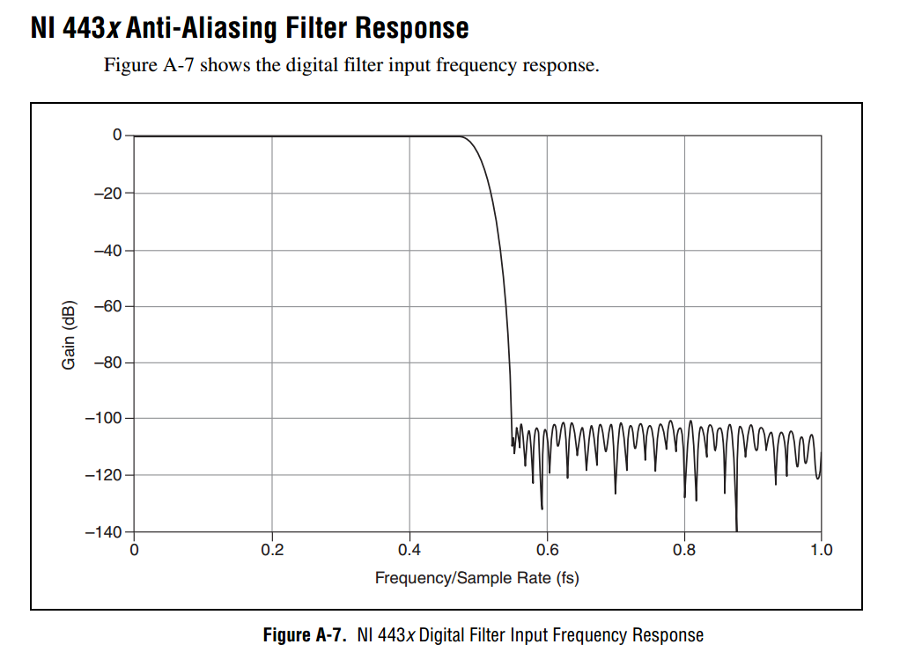
Short Stroke disturbances
3
1
2

Slide 14
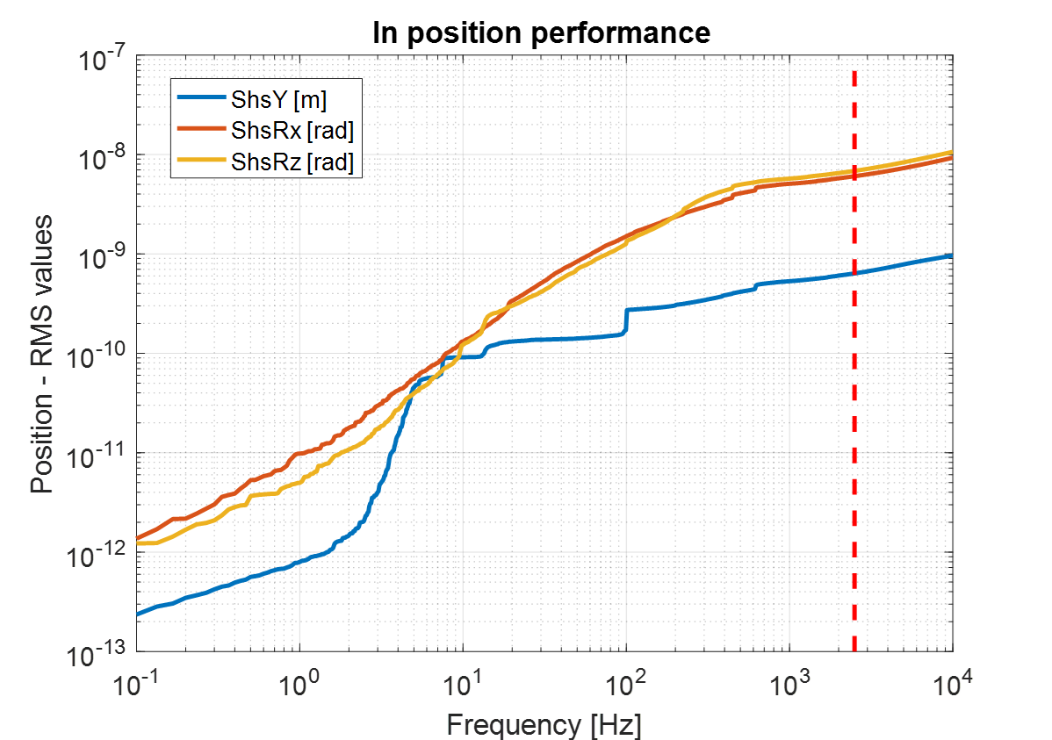
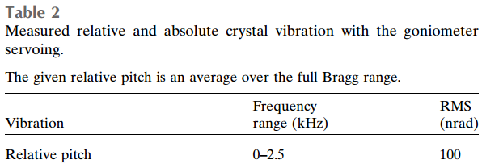
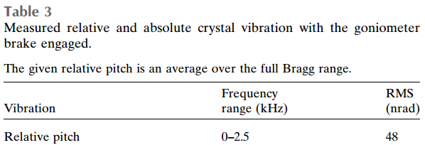
Partial Results: In-Position Stability
HD-DCM Partial Results
Relative pitch: 9.2 nrad RMS
* Note: This performance is also valid for step-by-step scans, provided that the settling time is allowed.
[Kristiansen,2015]

Slide 15
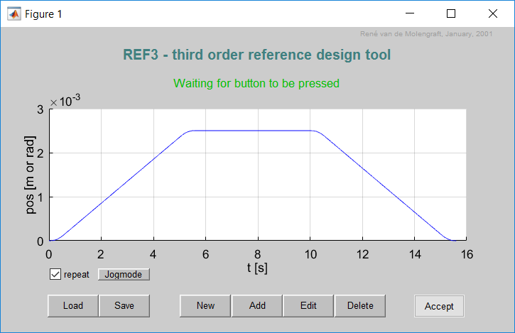
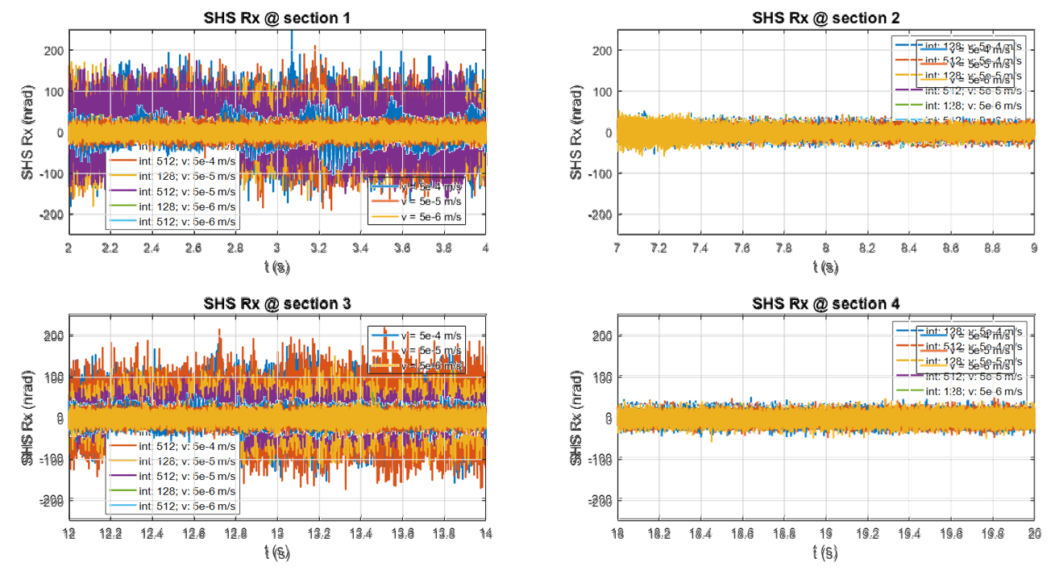
Partial Results: Flyscan w/ Stepper
HD-DCM Partial Results:
Relative pitch: < 60 nrad RMS

Slide 16
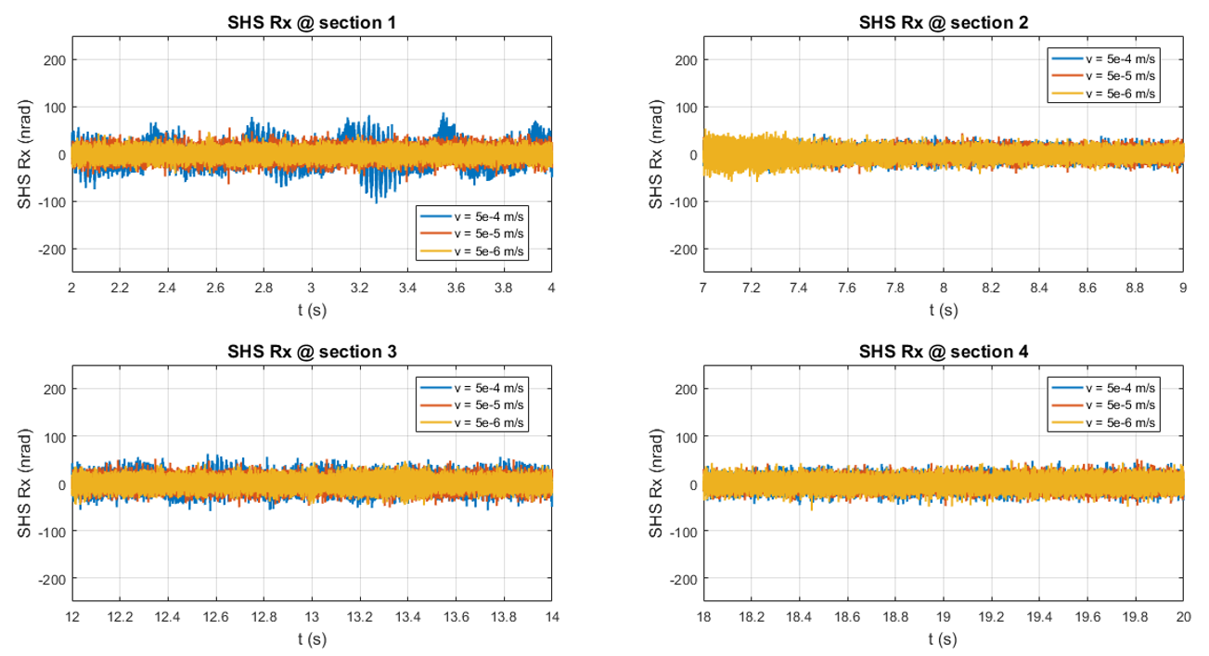
Partial Results: Flyscan w/ Servo
HD-DCM Partial Results:
Relative pitch: < 25 nrad RMS
Problems: Servo UHV suppliers (Faulhaber, Wittenstein)
Power dissipation.

Slide 17
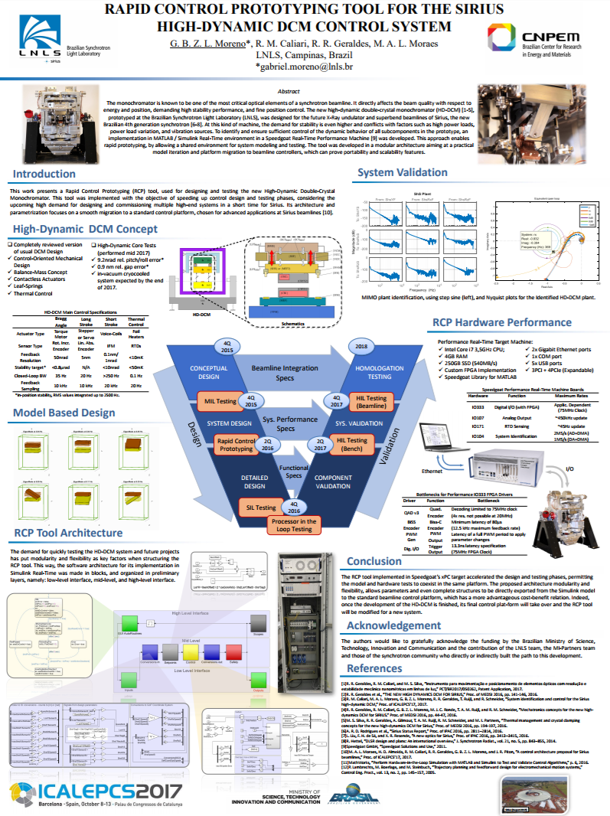
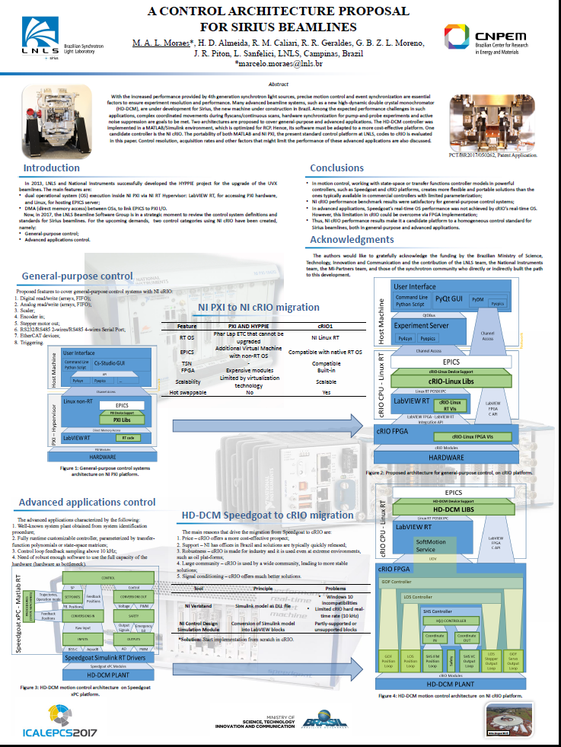
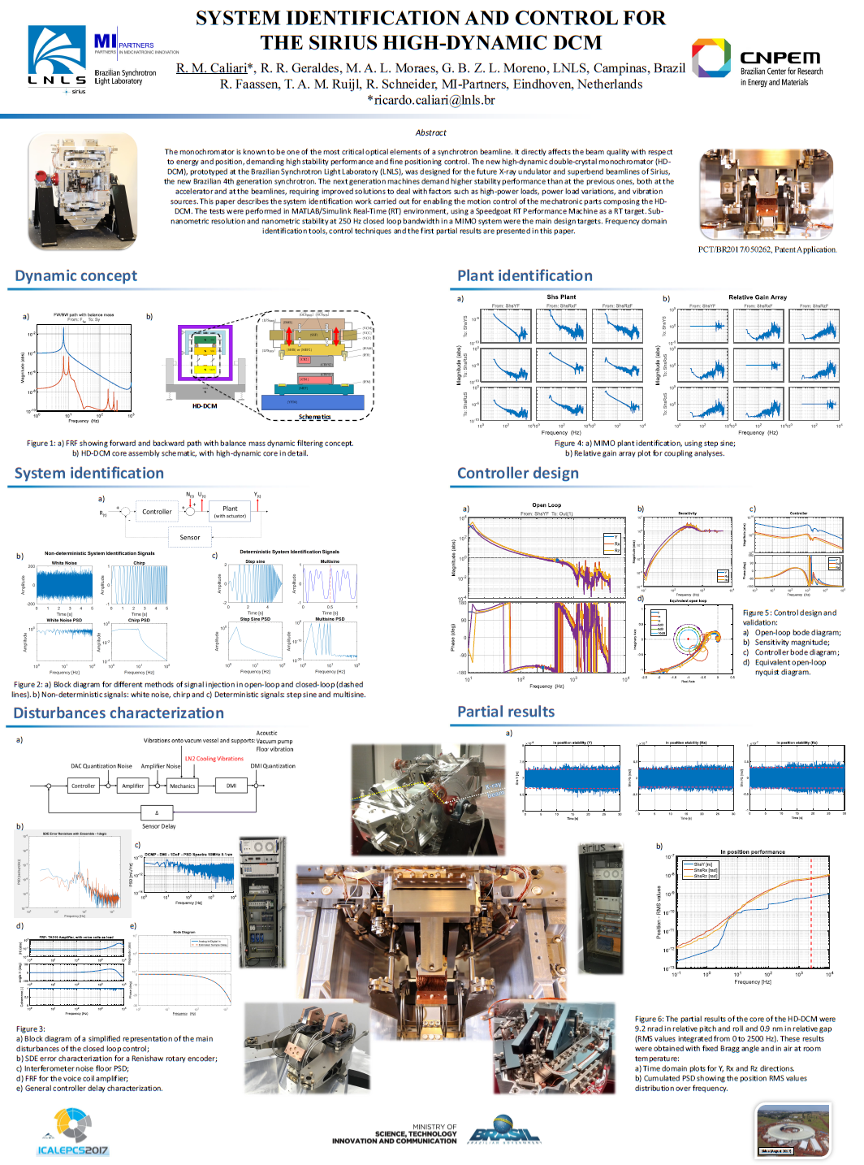
See our work at ICALEPCS!
TUSH203
Speakers’ corner
Tuesday – 18:15 to 18:45
THPHA214
Poster Session
Thursday 16:45 to 18:20
THPHA215
Poster Session
Thursday 16:45 to 18:20
System Identification
Rapid Control Prototyping
Beamlines Control Platform

Slide 18
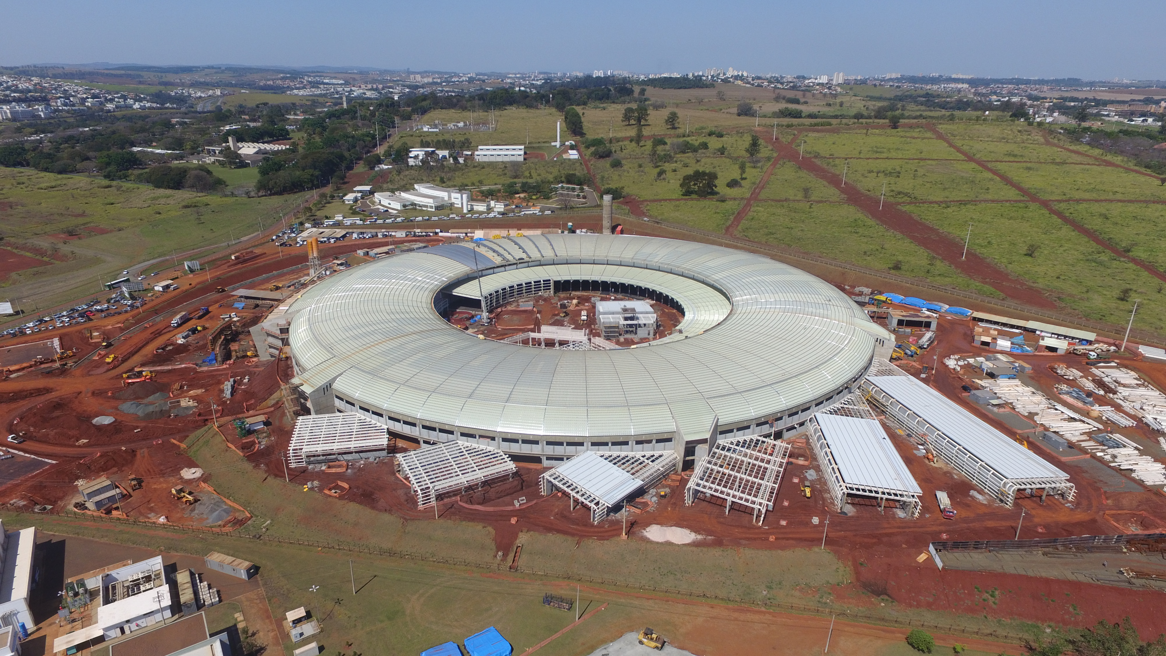
Thank you!
23.08.2017

