Slide 1
Sample Changer Development for Sample Environment
Rise of the Robots?
MOCRAF 2017
Matt North, STFC, ISIS
matt.north@stfc.ac.uk

Slide 2
Sample Changers
Provides sample automation.
c. 30 mins minimum to obtains useful statistics from sample for powder diffraction measurement c. 3hrs for neutron spectroscopy measurement.
In general, sample throughput, not a major cause for concern, caveat cryo experiments.
Provides ‘quick check’ for sample / technique.
Gives experimental flexibility at low cost (time)
Reduces ‘lost time’ risk across a sample set; multiplexing.
Minimise operating stresses.
Reduces support requirements.
Supports ‘Xpress’ facility access.

Slide 3
Xpress Access
‘Xpress’ Facility access is a remote access mechanism not requiring approval from Facility Access Panel.
General Guidelines:
Short measurements c. <1 hour.
Initial sample characterisation.
Demonstrate feasibility for further proposals
Small ‘top-up’ data to complete analysis.
In the year 16/17, 25% of facility proposals were Xpress Access
Notes:
Foundation of xpress on diffraction, predominantly with some SANS up to 2011.
2008 TS2 first neutrons
2009 ts2 phase 1 instruments (7) in scientific commisisoning / user programme
2011 onwards xpress service being made available to user community and broadened to include spectroscopy.
Need for spectroscopy sample changers lags – demand led?
SANS increase beyond 2008 due to sans2d and reflectometer instruments.
General increase in variety, not all supported by sample changers.
More time scheduled for xpress measurements – facilitiating blue sky in-house research

Slide 4
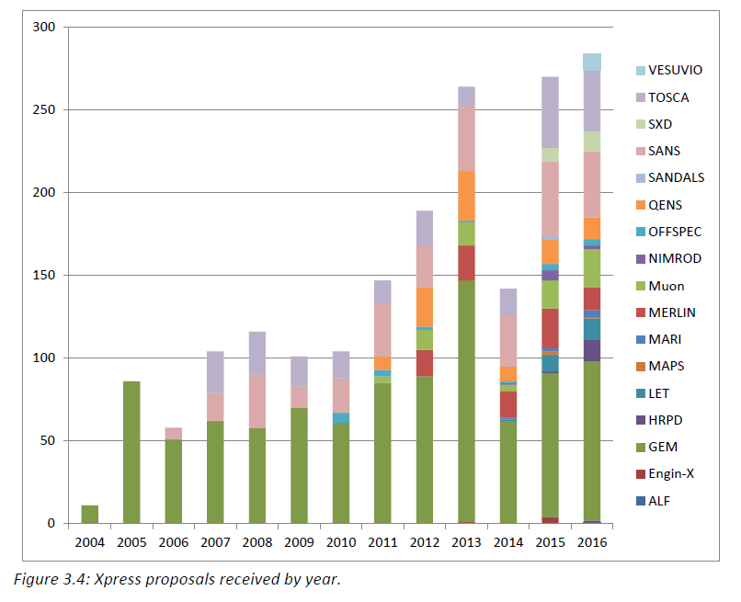
Xpress Access Growth
Notes:
Foundation of xpress on diffraction, predominantly with some SANS up to 2011.
2008 TS2 first neutrons
2009 ts2 phase 1 instruments (7) in scientific commisisoning / user programme
2011 onwards xpress service being made available to user community and broadened to include spectroscopy.
Need for spectroscopy sample changers lags – demand led?
SANS increase beyond 2008 due to sans2d and reflectometer instruments.
General increase in variety, not all supported by sample changers.
More time scheduled for xpress measurements – facilitiating blue sky in-house research

Slide 5
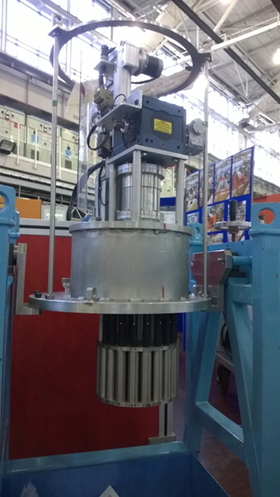
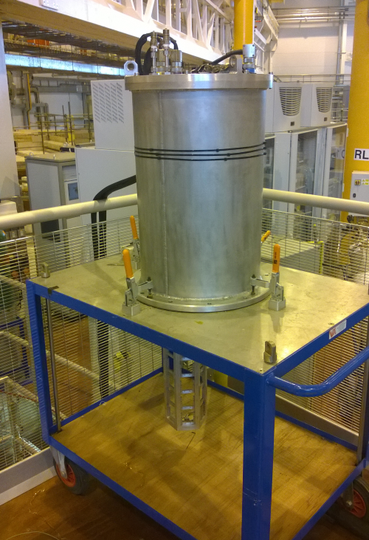
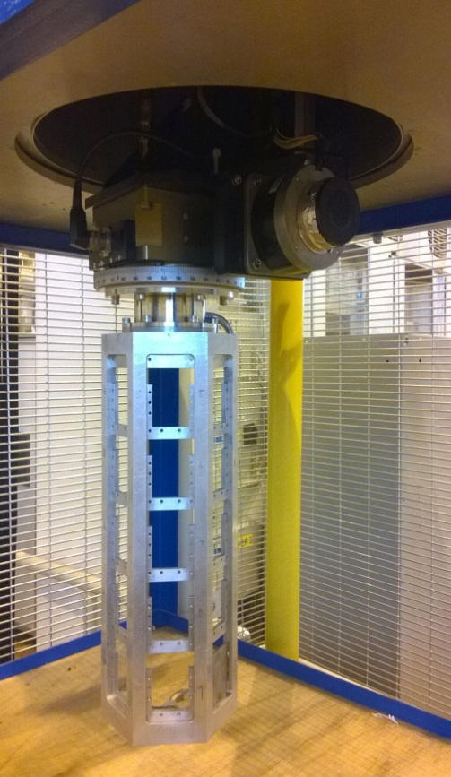
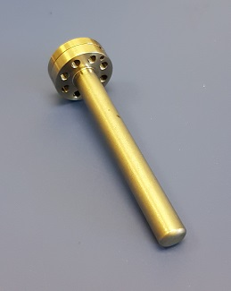
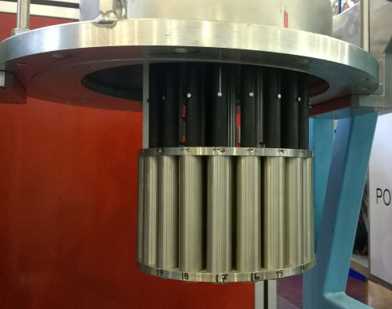
Diffraction Sample Changers

Slide 6
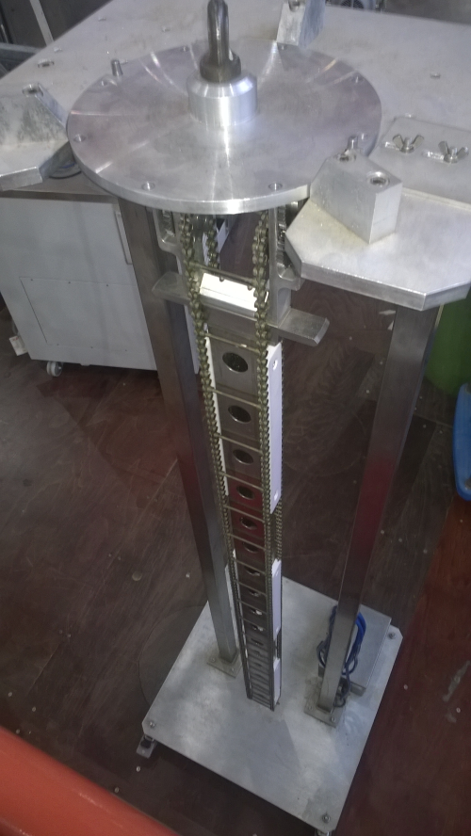
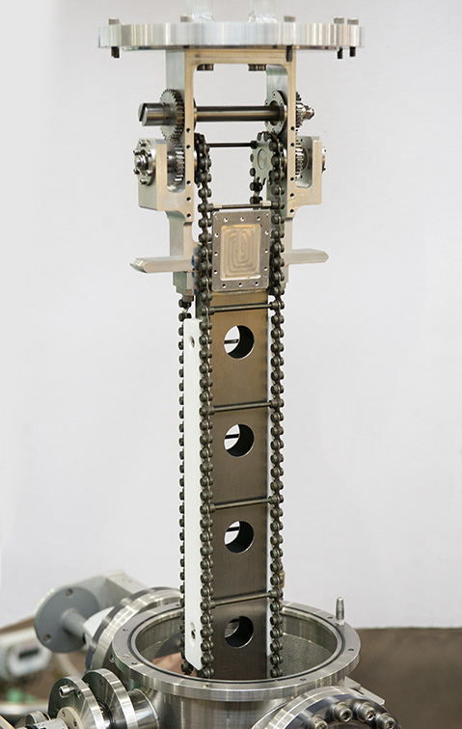
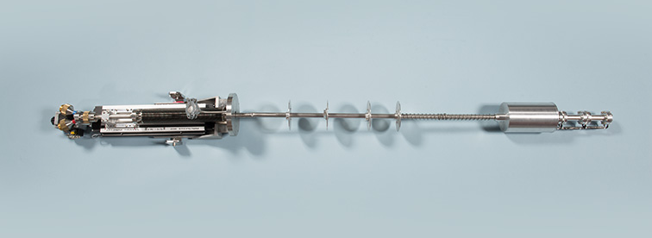
Spectroscopy Sample Changers

Slide 7
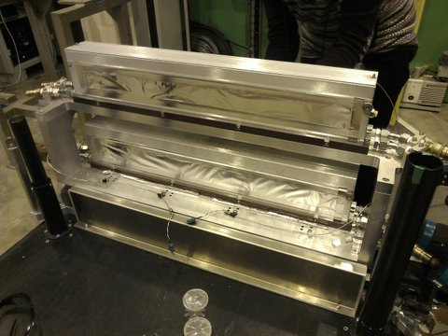
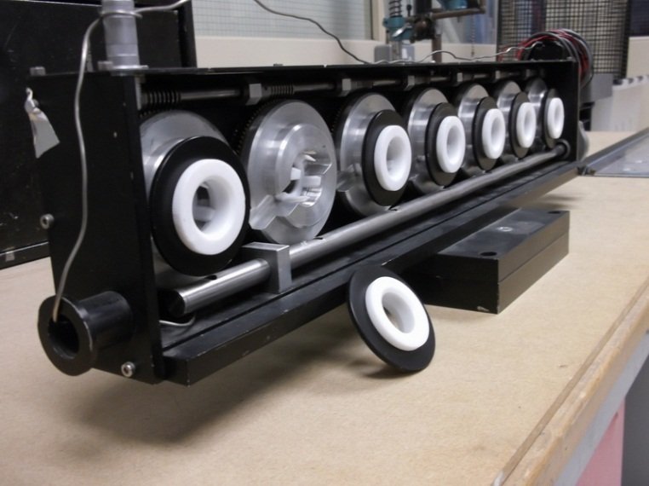
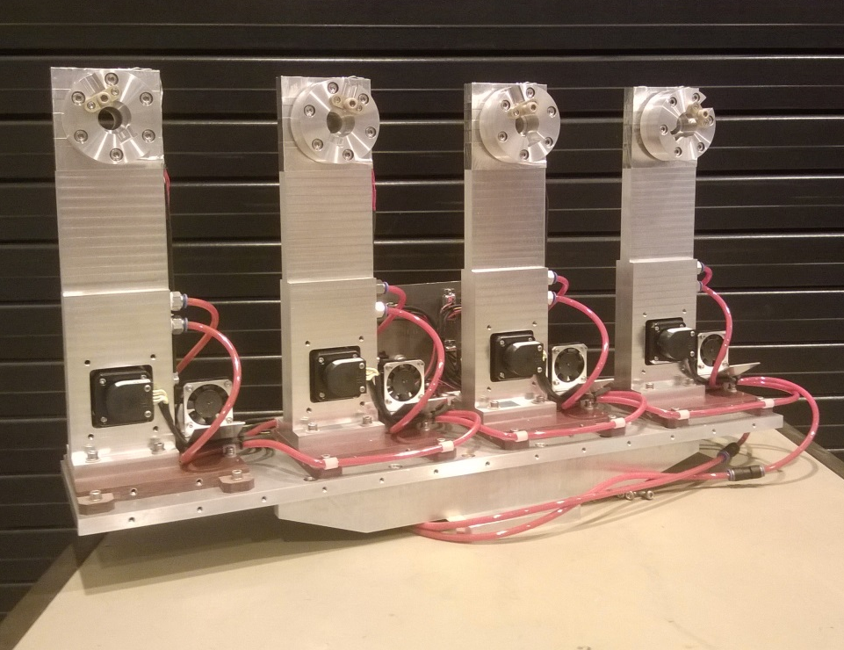
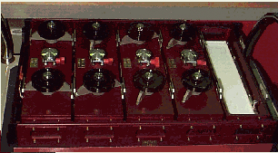
SANS & Reflectometry Sample Changers
Notes:
None of these SC’s change sample without a supporting sample positioner.

Slide 8
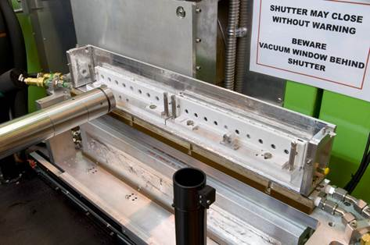
SANS & Reflectometry Sample Changers
Notes:
None of these SC’s change sample without a supporting sample positioner.

Slide 9
ISIS Sample Changer Overview
Type | Instrument | Sample Position | Supporting Motion | Sample Container | Temp Range | Capacity | Approx Max Throughput | Number of Axis | Operating Pressures | Supporting Sample Environment
Carousel | GEM, HRPD, POLARIS | Tank | None | Cylindrical Cans; 6,8 & 11mm | 300°K | 20 samples | 10 Hours | 1x Linear 1x Rotation | 1e-2mBar to Atmos | None
Array | NIMROD, SANDALS | Tank | None | Flat Can | 300°K to 365°K | 15 samples | 15 Hours | 1x Linear 1x Rotation | 1e-2mBar to Atmos | Water Bath
Chainsaw | TOSCA | Tank | None | Flat Can | 10 - 20°K | 36 samples | 4.5 Days | 1x Rotation | 1e-6mBar to Atmos | TOSCA Cryostat
Stacked Stick | MERLIN, IRIS | Tank | None | Annular Can | 7°K to 300°K | 3 samples | 15 Hours | 1x Linear | 1e-6mBar to Atmos | Top loading CCR
Rotating MKI | SANS2D, LOQ | Open | SPS | Standard & Banjo Cuvettes | 300°K | 7 samples | 3.5 Hours | 1 rotation | Atmos | Water Bath
Rotating MkII | SANS2D, LARMOR | Open | SPS | Banjo Cuvette | 300°K to 430°K | 4 samples | 2 Hours | 4 Rotation | Atmos | Water Bath
Single Tier | LOQ | Open | SPS | Standard, Banjo & Tank Cuvettes | 300°K to 550°K | 20 samples | ~10 Hours | 0 | Atmos | Water Bath
Double Tier | SANS2D, LARMOR | Open | SPS | Standard, Banjo & Tank Cuvettes | 300°K to 550°K | 40 samples | 7 Hours | 0 | Atmos | Water Bath
7 Sample Liquid Trough | SANS2D | Open | SPS | Trough | 300°K to 380°K | 7 samples | 2.5 Hours | 0 | Atmos | None

Slide 10
ISIS Sample Changer Overview
Type | Instrument | Sample Position | Supporting Motion | Sample Container | Temp Range | Capacity | Approx Max Throughput | Number of Axis | Operating Pressures | Supporting Sample Environment
Carousel | GEM, HRPD, POLARIS | Tank | None | Cylindrical Cans; 6,8 & 11mm | 300°K | 20 samples | 10 Hours | 1x Linear 1x Rotation | 1e-2mBar to Atmos | None
Array | NIMROD, SANDALS | Tank | None | Flat Can | 300°K to 365°K | 15 samples | 15 Hours | 1x Linear 1x Rotation | 1e-2mBar to Atmos | Water Bath
Chainsaw | TOSCA | Tank | None | Flat Can | 10 - 20°K | 36 samples | 4.5 Days | 1x Rotation | 1e-6mBar to Atmos | TOSCA Cryostat
Stacked Stick | MERLIN, IRIS | Tank | None | Annular Can | 7°K to 300°K | 3 samples | 15 Hours | 1x Linear | 1e-6mBar to Atmos | Top loading CCR
Rotating MKI | SANS2D, LOQ | Open | SPS | Standard & Banjo Cuvettes | 300°K | 7 samples | 3.5 Hours | 1 rotation | Atmos | Water Bath
Rotating MkII | SANS2D, LARMOR | Open | SPS | Banjo Cuvette | 300°K to 430°K | 4 samples | 2 Hours | 4 Rotation | Atmos | Water Bath
Single Tier | LOQ | Open | SPS | Standard, Banjo & Tank Cuvettes | 300°K to 550°K | 20 samples | ~10 Hours | 0 | Atmos | Water Bath
Double Tier | SANS2D, LARMOR | Open | SPS | Standard, Banjo & Tank Cuvettes | 300°K to 550°K | 40 samples | 7 Hours | 0 | Atmos | Water Bath
7 Sample Liquid Trough | SANS2D | Open | SPS | Trough | 300°K to 380°K | 7 samples | 2.5 Hours | 0 | Atmos | None
✓

Slide 11
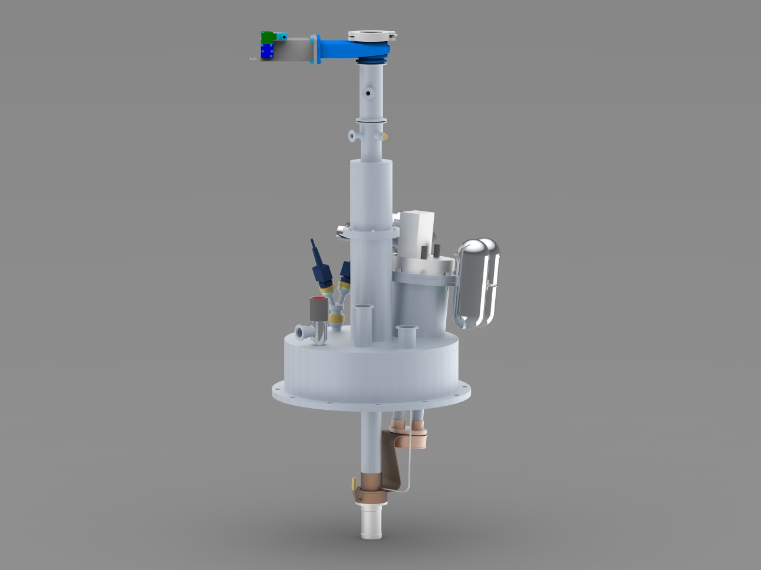
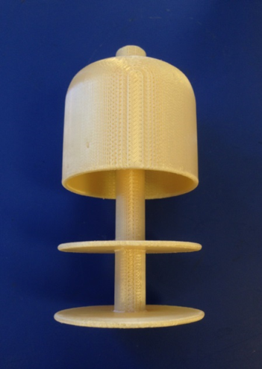
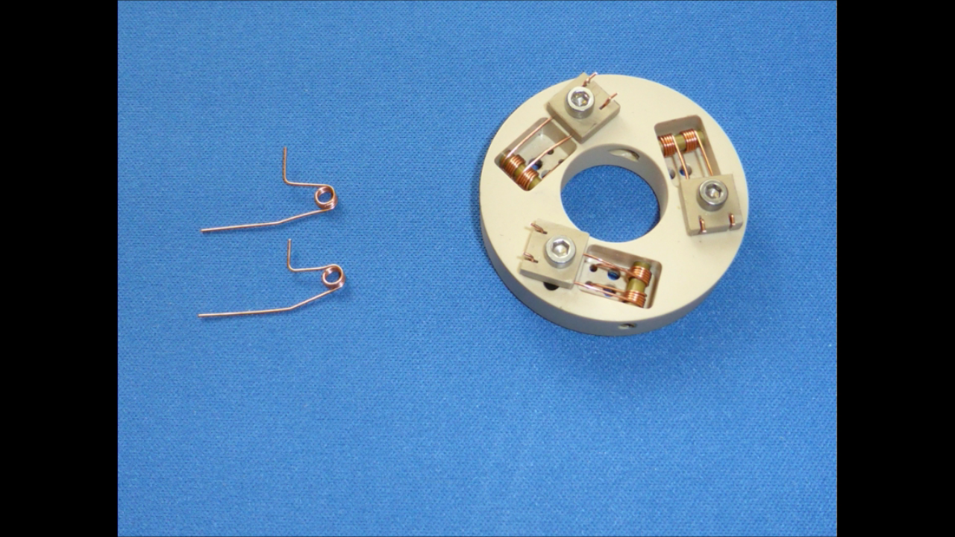
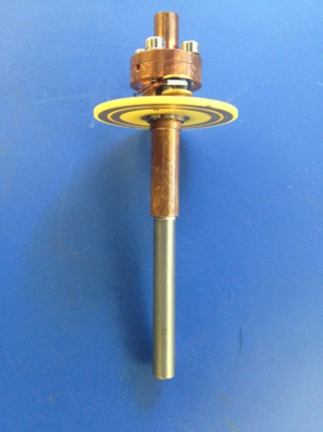
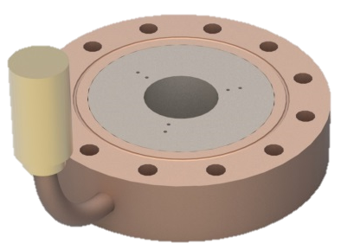
Isolating VAT Valve
CCR Adaption
Sensor Ports
He Port
Sample Carrier & Thermometry Contacts
He Capillary & Inlet
Notes:
Introduce gas sample change process

Slide 12

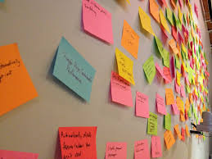
Robot Requirements
Development Requirements:
‘Perform sample pick & place action’
‘Low cost’
‘Minimal learning curve’
‘Integrate with beamline control computer’
‘Portable package– Deliver to a beamline’

Slide 13
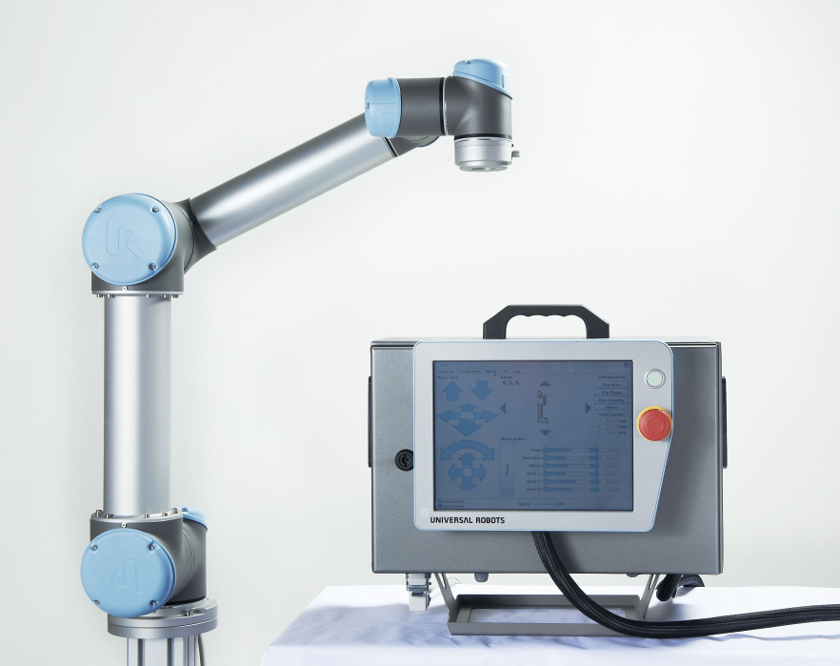
Universal Robots – UR5
Motion Specification:
≥6 Axis of Motion ✓
Spherical Motion Envelope; 0.5m≤ r ≤1.5m 0.85m
Motion Repeatability ≤±0.1mm ✓
Max Payload = 5kg✓
Control Specification:
Local & remote control Ethernet & Pendant
Integrate with existing instrumentation A&D I/O
Motion Path Planning via 3D environment Pendant HMI
Teach Mode ✓
Collaborative operation (ISO 10218-1) ✓
Technical Specification:
‘Maintenance Free’ Operation 35,000hrs
240V Power Source✓
Weigh ≤20kg 18.4kg
Notes:
Collaborative robot – teach mode, motion path simulation, simple programming interface, certified, with approiate risk assessment for collaborative operation.
Underlining principle – this should be delivered to sample position like any other SE.

Slide 14
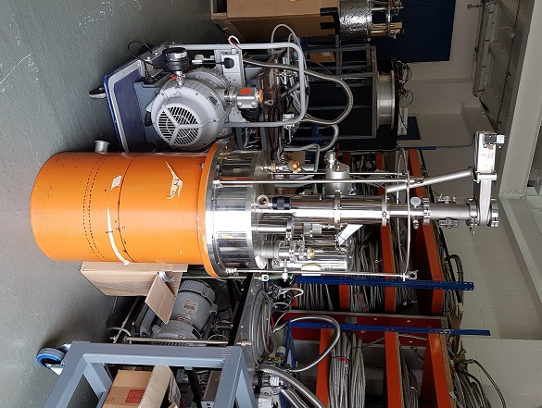
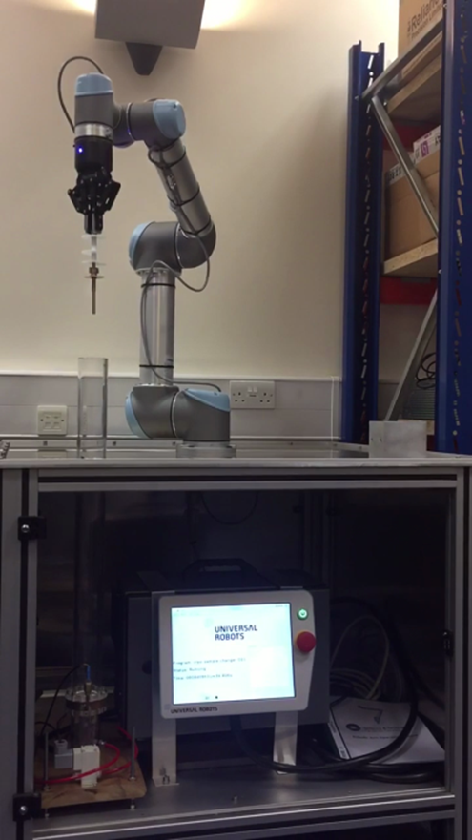
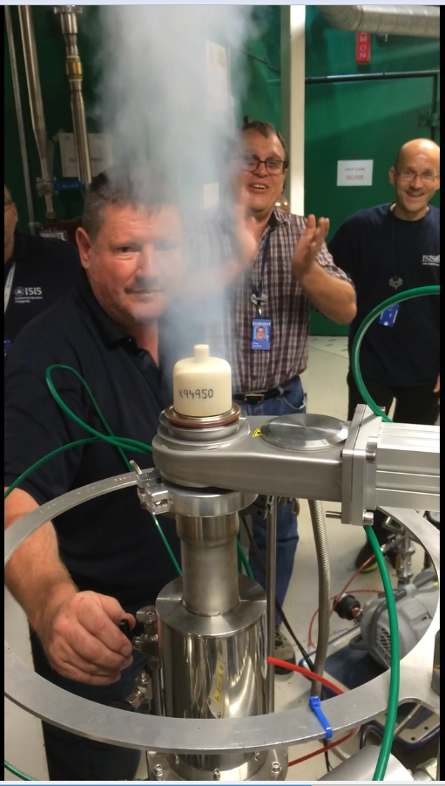
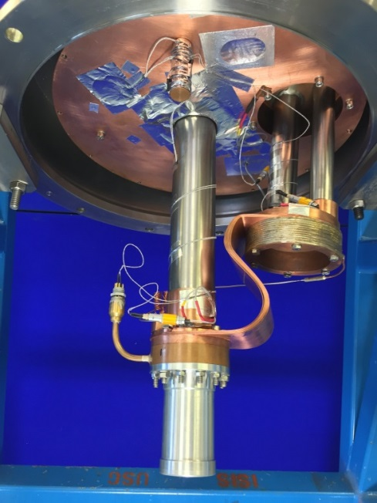
Cryogenic Robot Sample Changer
Notes:
Robot test stand.
Next step to integrate robot with CCR to perform pick and place.

Slide 15
Cryogenic Robot Sample Changer
‘Current status of the ISIS robotic cryogenic sample changer’ Journal of Neutron Research 19 (2017)
DOI 10.3233/JNR-170049
Notes:
Robot test stand.
Next step to integrate robot with CCR to perform pick and place.

Slide 16
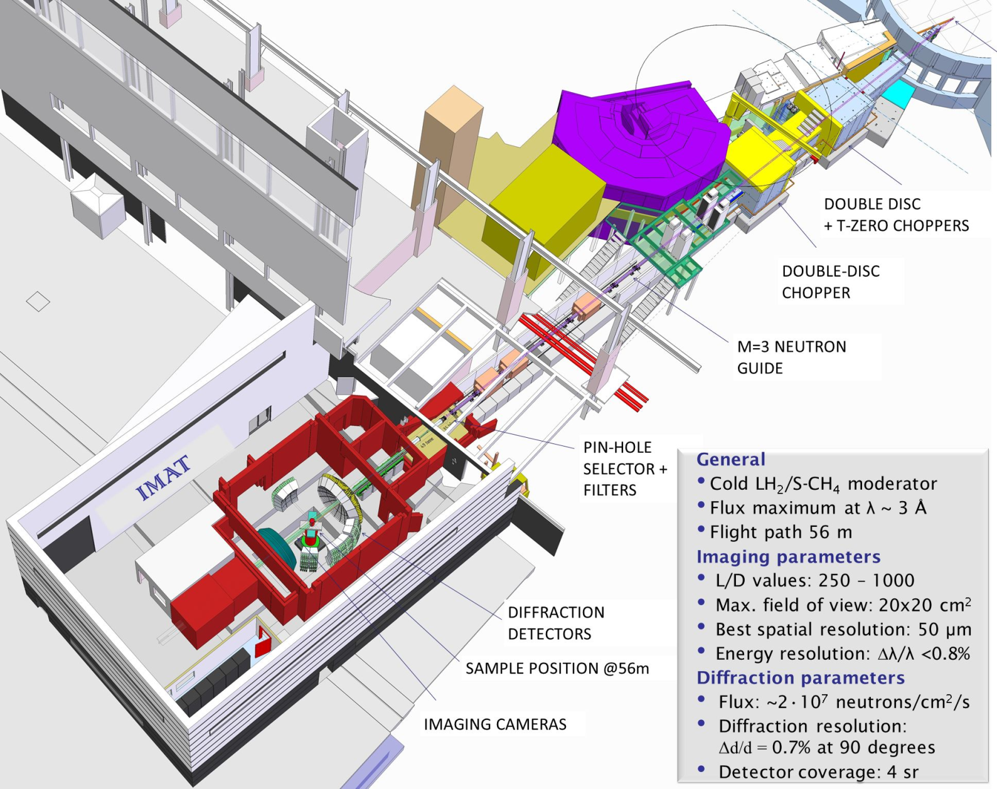
IMAT Camera Positioning System

Slide 17
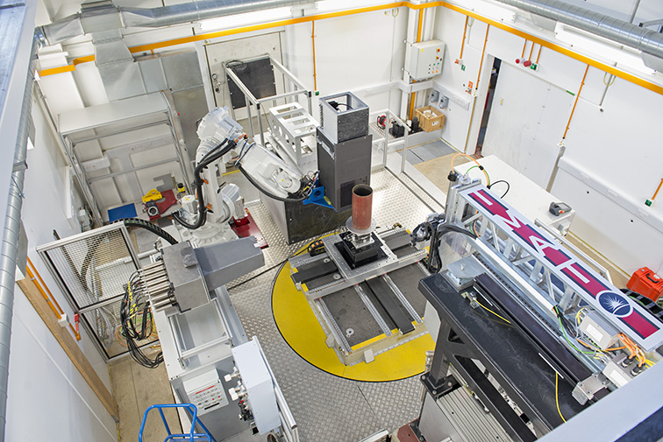

Slide 18
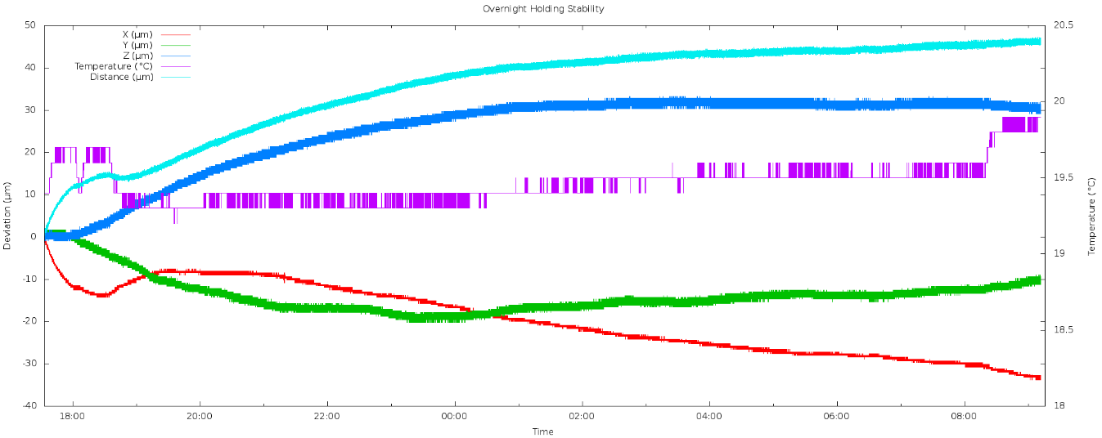
IMAT CPS – SAT Results
Repeatability – 31.49µm (with camera exchange)
Accuracy (Pose) - 65µm
1h Holding Stability – 14.47µm
16h Holding Stability* - 45µm
Notes:
*Not a requirement of the original specification
Results include robot and linear translation.
Robot system costs inc. installation and on-site commissioning c. 120k ex VAT
Does the robot engage a brake when in holding position? Are the motor drives switched of to reduce any heating effects?

Slide 19
Future Robotic Opportunities
Science Leads
Sample Positioning – Engineering Diffraction
Texture Measurements – Powder Diffraction
Automation for Industrial QA – Reflectometry
‘The development of more automated sample environment and procedures to broaden the user base’ - Spectroscopy
Engineering Leads
Cryogenic Sample Changer - Diffraction & Spectroscopy
‘Universal’ Sample Changer - Diffraction & Spectroscopy
Notes:
‘Universal’ Sample changer for diffraction – advantages:
Increases capacity, not limited by tank volume
Provides a mechanism for elevated temperatures
Disadvantages:
System complexity
SPS+SC Combined – advantages:
Automation of varying sample environments.
Reduction in sample changer variety.
Flexibility in motion, sample environments & sample shapes & sizes.
Disadvantages:
System complexity
Space overhead.
Costly.

Slide 20
Future Development Landscape
No step change in flux in the near term, sample throughput not a fundamental bottleneck.
Funding from ISIS science group budgets for Robot Sample Changer development is not a high priority.
Popularity of Xpress Access; growth or plateau?
Notes:
No smoking gun

Slide 21
Important steps to shift perspective
Development of in-house knowledge and skills
Demonstrating Benefit
Capitalising
Proving Capability

Slide 22
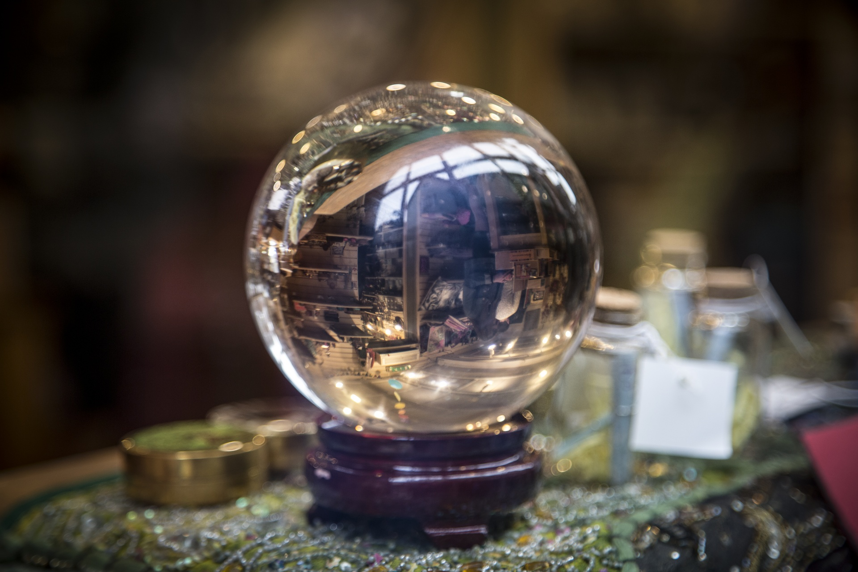
Rise of the Robots?

