Slide 1


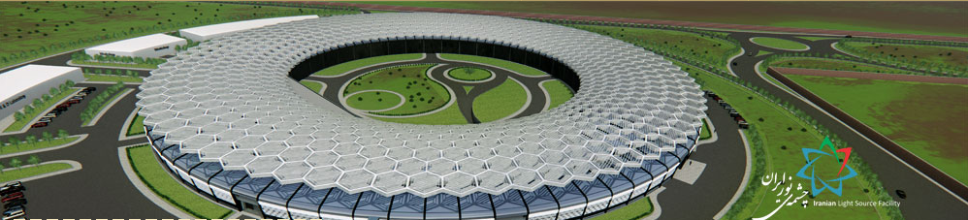
Iranian Light Source Facility.

Slide 2
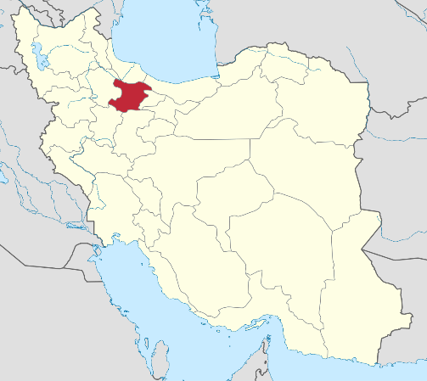
LINAC
0 to 150 MeV
BOOSTER
150 MeV to 3 GeV
Duration: 250 mSec
Frequency: 2 Hz
STORAGE RING
3 GeV
Circumference: 528 m
Current: 400 mA
RF frequency: 100 MHz
BEAMLINES
7 main beamlines
Emittance: 0.27 nm.Rad

Slide 3
ILSF Groups:
Control 5
Beam lines 4
Building 4
Science 3
Vacuum 4
Detector 3
Science 3
Mechanics 5
RF 4
Beam Dynamics 5
Power Supply 3
Magnets 4
Diagnostic 1
Total number ≈ 50

Slide 4
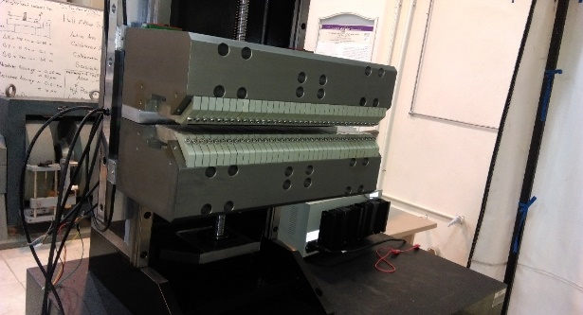
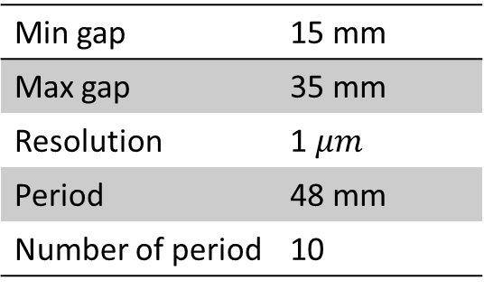
Motion Control experiences in ILSF
Undulator
Undulator specifications
Min gap | 15 mm
Max gap | 35 mm
Resolution | 1 $μm$
Period | 48 mm
Number of period | 10

Slide 5
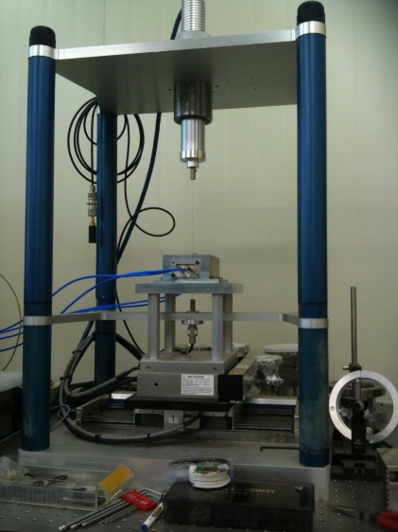
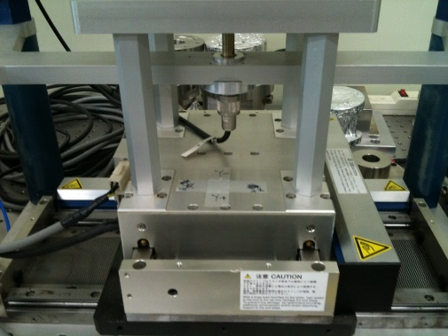
Motion Control experiences in ILSF
Beam Position Monitoring tool (BPM)

Slide 6
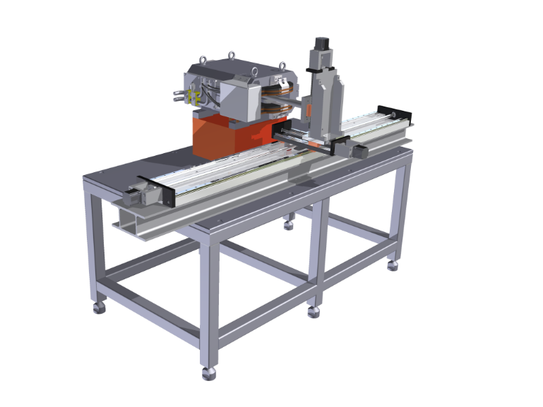
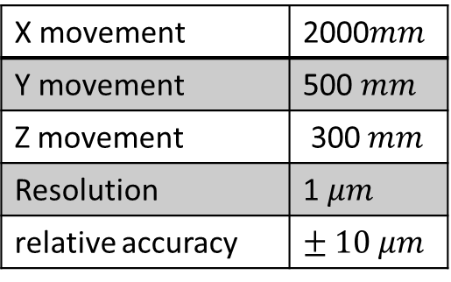
Motion Control experiences in ILSF
Hall Probe
Hall probe specifications
X movement | 2000$mm$
Y movement | 500 $mm$
Z movement | 300 $mm$
Resolution | 1 $μm$
relative accuracy | $$± 10 μm$$

Slide 7
Thanks for your Attention

