Slide 1


The software side of the moon
Alain BUTEAU
On behalf of Nicolas LECLERCQ and Jean COQUET

Slide 2
Agenda
Current Software Architecture for motion systems at SOLEIL
Strengths and weaknesses of the current solution
The (future) needs for motion systems
Conclusion

Slide 3
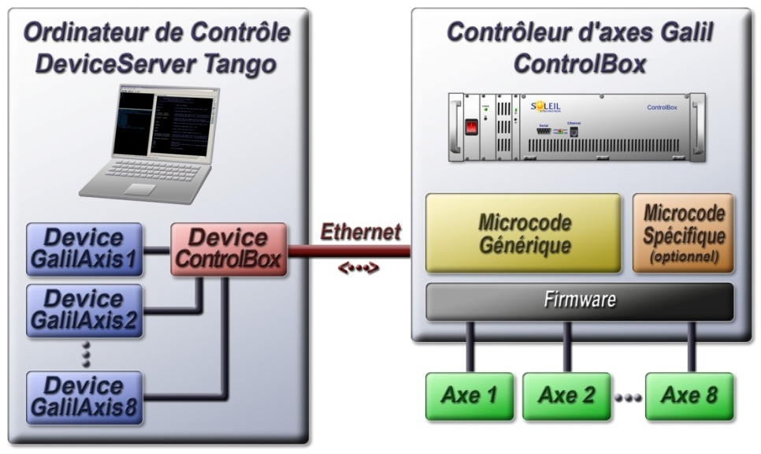
Software Architecture :
A layered approach
The Tango device :
  Has no knowledge of the underlying axis
  Does not implement any motion algorithms (like closed loop, strategies for homing, etc .)
It’s main role is to communicate with the MicroCode to :
  Give him parameters (like position to reach, moves order (go, forward, backward)
  Read back the axis status

Slide 4
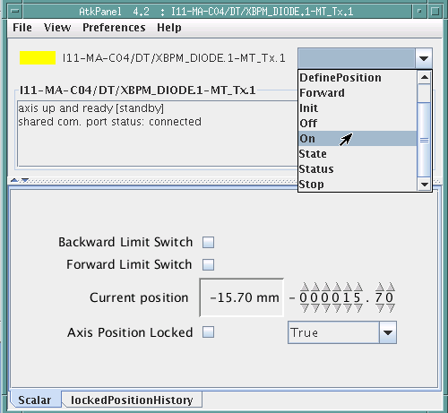
Software Architecture :
The device has a very simple interface
Just a little bit of history : SOLEIL brilliant engineers and technicians spent about 2 years to define the Device interface
  Of course with (long) internal discussions between ECA/ICA people and our users (i.e Machine experts or Beamlines scientists)
  The first real case scenario on the LUCIA beamline (first SOLEIL beamline installed at SLS in 2003) , gave us the opportunity to have a final, simple and sufficient interface
The device interface today is composed of :
  4 attributs (position, backward limit switch, axis locking)
  7 commands
  6 expert attributs (velocity, acceleration, etc..)
2 years

Slide 5
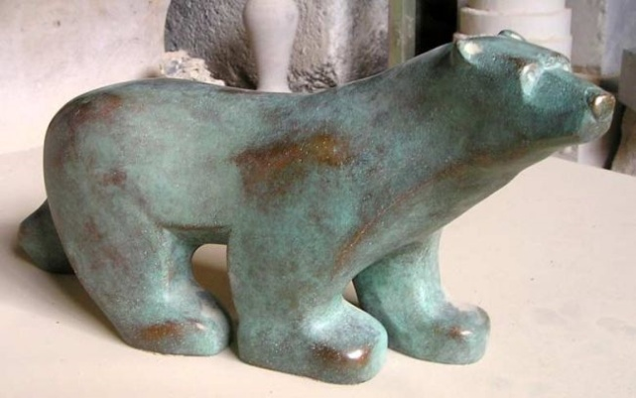

Software Architecture :
The device has a very simple interface
Francois POMPON , a french sculptor (1855 – 1933) spent all his life to simplify forms and polishing surfaces but beeing always closer to the main spirit of the subject he sculpted
One life
L’ours : Musée d’Orsay
2 years

Slide 6
Software Architecture :
A layered approach
On top of Axis devices we have devices :
  To control optical elements : Monochromators, Benders,etc ..
  To control Diffractometers
  For automated processes : doing scans, beamline energy setup ,etc .
All these upper layers rely exclusively on the Axis interface
  Which allowed us in some cases to use transparently “Non Galil” controllers (like for instance XPS ones for diffractometers )
Process devices :scans,etc
Optical devices
Axis devices

Slide 7
Strength and weaknesses
Strengths :
  Particularities and oddities of axis (stepper, brushless,etc ) are hidden from the software point of view : All Axis have the same software interface
  Current implementation of the software (both device and microcode ) proved to be robust and still flexible and opened to evolutions
  Layered approach proved its strengths after years of daily operation in our “software continuous updates approach ”
Weaknesses
  TCP/IP stack of the Galil requests “calm and peaful” networks : Check carefully the TCP/IP stack of the REVOLUTION Controllers
  Performances are limited because of the microcode frequency (1 cycle each 0.1s ) ➔ from the acquisition point of view (for example a step scan)
  The minimal dead-time is about 100 ms to :
    Ask the Galil to start the motion
    Check that state is not more MOVING

Slide 8
(Future ?) requirements
Grouped Axes : Hexapods, “TraitPointPlan”
  To be able to couple AT LOWEST LEVEL movements thanks to “complex” equations
Trajectories for “FlyScans” or “Continuous scans”
  One of the scenario we are currently working (i.e it does not work yet !!) on with XPS Controllers is the following .
  The user wants to collect data on 2D detectors while the diffractometer move continuously
    From h_0 to h_1
    From k_0 to k_1
    From k_0 to k_1
  Which means
    Calculate the positions of the real motors
    Load a trajectory in the motion controller, through an array giving for each axis: position, time, velocity
    Arm the master clock triggering system which will clock all acquisitions
    Start trajectories
    Acquire both detectors and motors positions
    Merge all the data into a single and unique file

Slide 9
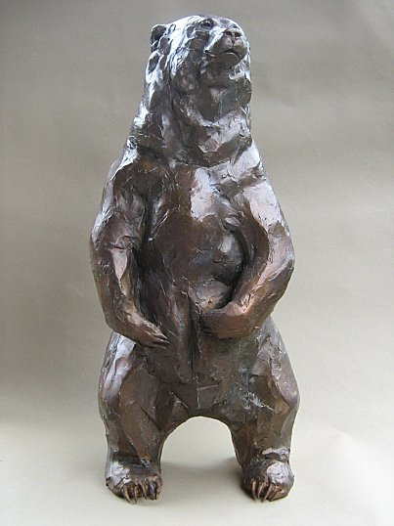
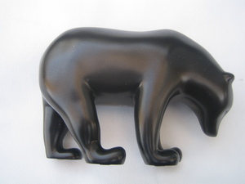
Conclusion
Choose whatever REVOLUTION system (it may be black!!) you want but :
  Keep the “Device Interface” simple
    We are not as patient as François Pompon was !!
  Avoid the Version 2 effect with a lot of unnecessary features
Do not forget :
  To check software interface of the supplier is rock-solid to be easily integrated in the Tango world
  To check TCP/IP robustness
  To check scan dead time performances
Be compliant with 2015 requirements
you do not yet know,
but you should already be aware of !!

