Slide 1
In the beginning
January 2007; there was Light
There was darkness
Notes:
Colleagues . Todays reading comes from the Diamond book of motion control. Chapters 1 to 3 beginning at verse 1
In the beginning was darkness; and in January 2007 there was light.
Light for users on phase 1 beamlines I06 I16 I03 I15 and

Slide 2
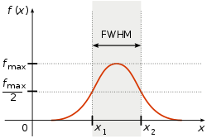
And the light was bright
X-rays from Diamond will be 1,000,000,000,000 times brighter than from
an X-ray tube !
Full Width Half Maximum
x2-x1 = 100 micron(h) x 50 micron(v)
MX data Collection rate 1 frame per second
Notes:
And the light was the brightest light ever shone before
And the beam was small, smaller than a human hair
And the detectors were slow.
So the CEO was happy. For nothing would ever use all his light.

Slide 3
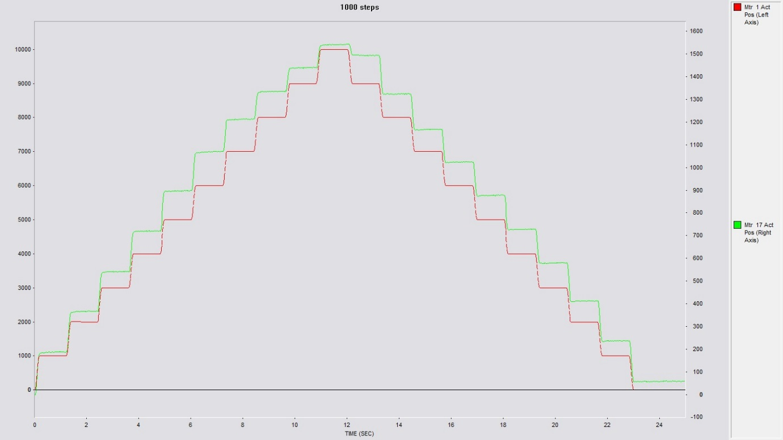
And the lord said 10% is good
10% x 50 micron = +/- 5 micron
STEP SCANNING
Move and settle < 0.5seconds
66% beam utilisation
Notes:
And he said unto his motion followers that 10% is good
Thou shalt maintain a step accuracy finer than 10% of the beam size.
Thou shalt move and settle in under 0.5 seconds and remain stable while the image is taken.
Go forth an be still. The step scan will be supreme

Slide 4
And while the motors were standing still
Detector rates increased during phase 2 to 10s even100s Hz
Pilatus area detectors commonplace
Average beam sizes reducing with each new beamline
MX beamlines demand continuous sample rotations
Notes:
And whilst the motors were standing still, detectors got faster
And the demand for finer spatial resolution meant beam sizes became smaller
And the lords of science maintained that 10% was still the rule.

Slide 5
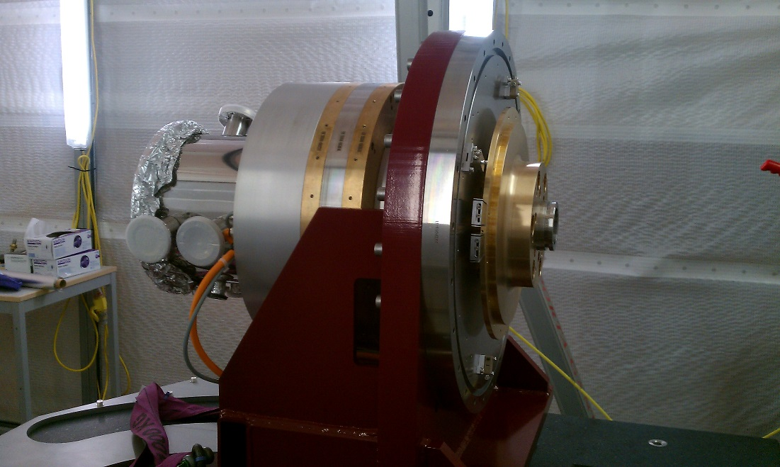
At first the gearbox disappeared
Diamond DD mono
Resolution increases from 1.8uRad to 5nR
Stability required 150nR
Speed range 36000:1
Max scan speed 1° per sec
Notes:
And men of science said achieve finer resolution but go faster
The gearbox disappeared and the direct drive system was born.
And lo from the humble MX goniometer the air bearing monochromator came into being
On I09 I20 and I23

Slide 6
And into phase 3 the beams got even smaller
I12 beam sizes down to 30 x 30 microns
J02 beam sizes down to 20 x20 microns
I04 beam sizes down to 10 x 5 microns
I24 beamsizes down to 5 x 5 microns
I22 microfocus 6 x 6 microns
I18 beamsizes down to 2 x 2.5 microns
I05 nano ARPES branch 0.7 x 0.7 microns
I20 4 bounce mono stability +/- 100nR
I14 beam sizes down to 50 x 50 nanometres
I08 beamsizes down to 20 x 20 nanometres
Notes:
And in phase 3 the beams get even smaller and the detectors get even faster.
And it was said that I24 could make step scans at over 200 Hz
But even that was not fast enough for the imaging beamlines
And Lo! Standing still was no longer an option

Slide 7
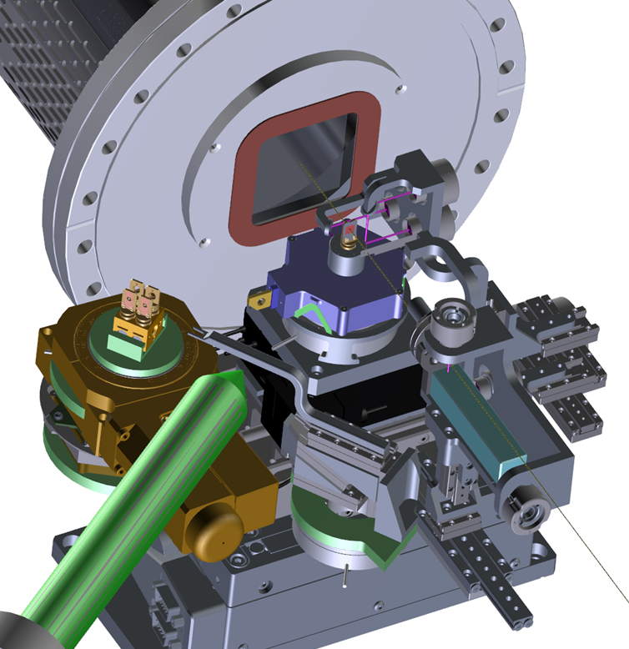
And the scientists stood back and said..
New J08 endstation
Smaller beamsizes
Continuous flyscan motion
Encoder resolution << 1 nm
Motion jitter < 5 nm.
Best so far is 5-10nm on I08
I14 struggling to meet this spec
I13 using alternative system
Notes:
At the end of phase 3 the lords of science stood and looked back on all they had done and said
This is not enough , we need smaller , faster and smoother.

Slide 8
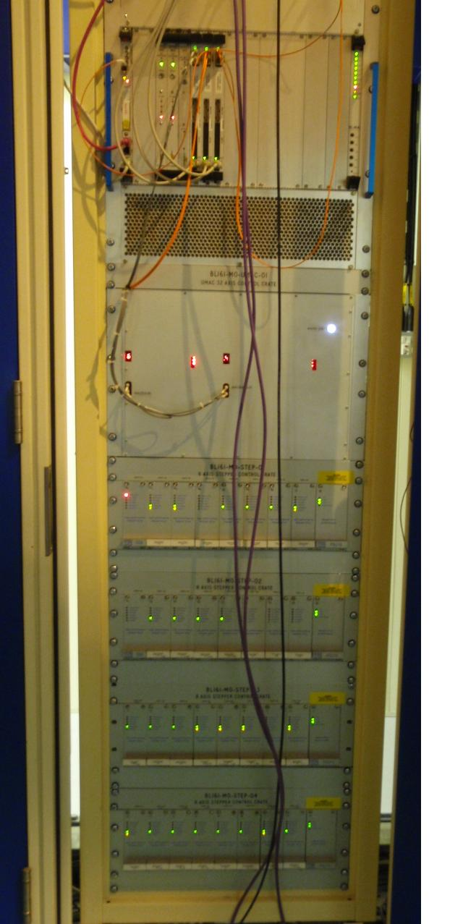
Archaeological Evidence
Motion IOC crate
Turbo PMAC2 VME Ultralight ( x3)
UMAC MACRO crate 2 x 16 axis expansion cards
Amplifier Crates – 8 axis stepper
Smart drive D28 - ½ stepping
Majority are 16 axes Stoegra crates
DC power supplies.
Notes:
Looking back into the dim and distant past we can still discover traces of the phase 1 motion controller
A 32 axis controller linked to 2 off 16 axes break out units in turn linking to amplifier crates and handling encoder feedback

Slide 9
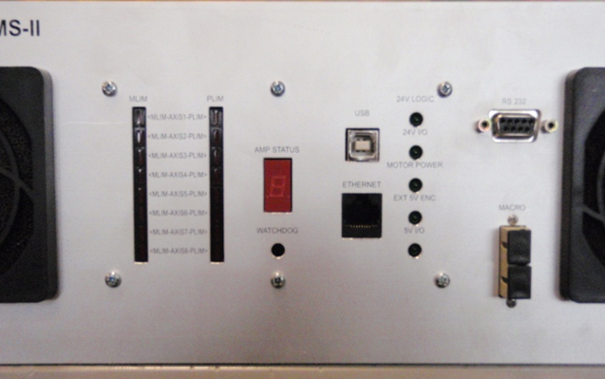
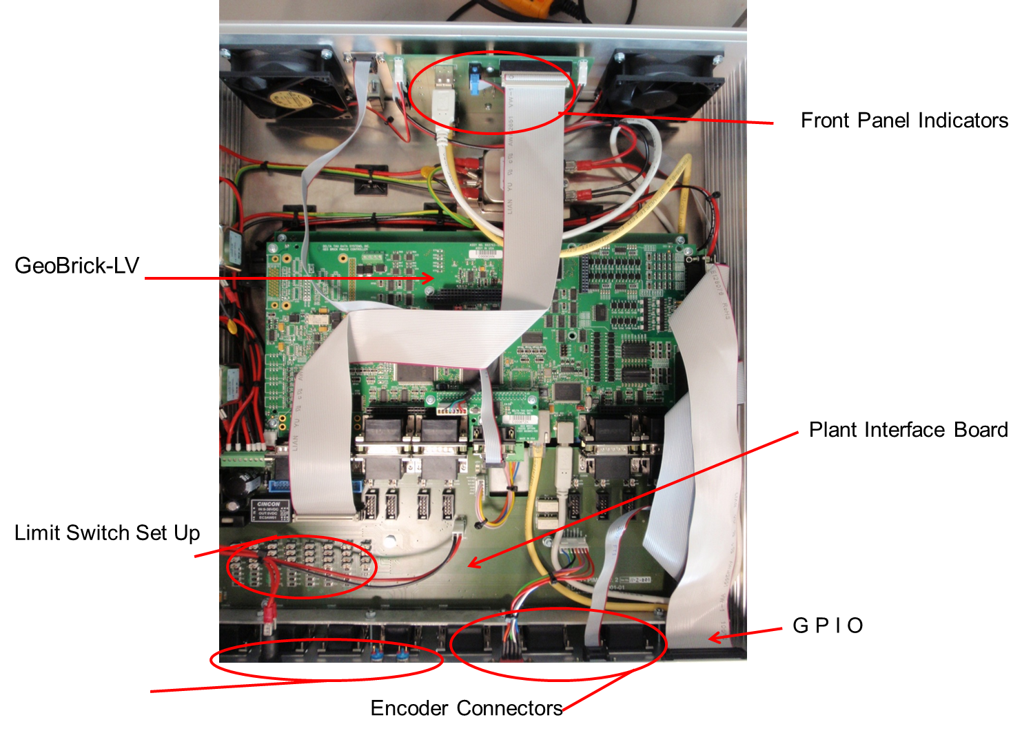
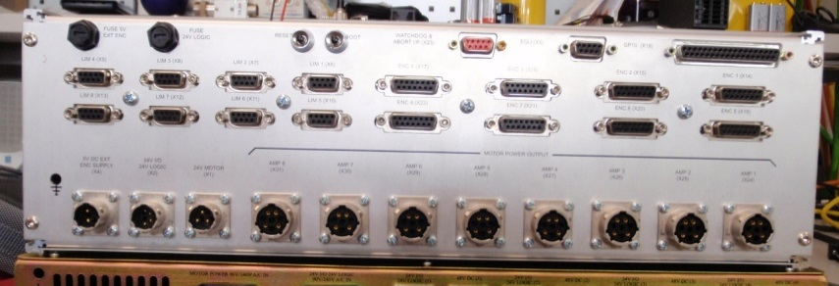
New Kids on the block
Notes:
Modern beamlines since 2010 have become used to the geoBrick
An 8 axis controller with 8 on board amplifiers ( stepper or servo)
Digital Encoder feedback and options for absolute or analogue , as well as step direction output.

Slide 10
I19 fast chopper
20 slot disc
2.45mm wide
30000 rpm
Desired Jitter 1.25us
Measured Jitter 0.35us
Equivalent to less than 1/3 encoder count.
Notes:
Precision motion does’ not just mean slow motion
I 19 required a fast chopper for hard x rays
Chopper frequency needed to be 10 KHz.
With adjustable slot width and jitter less than 5% of slot size

Slide 11
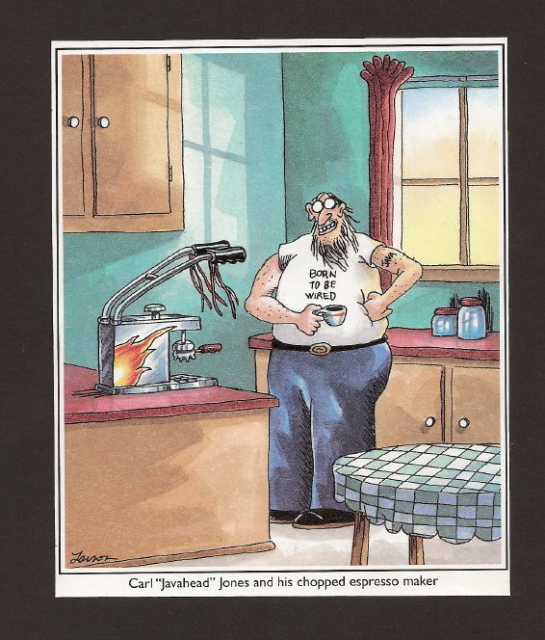
I19 fast chopper
2 pole brushless servo motor
UMAC 3U TPMAC control card
ACC24 direct PWM axis interface card
PWM input servo amplifier.
Digital link between amplifier and controller
Notes:
This could not be done in standard hardware
But other Delta Tau products allowed us to keep the EPICS interfaces standard.
We see for the first time a digital link between controller and amplifier.

Slide 12
Plane Grating Monochromator
Encoder resolution 5nR
Microstep resolution 0.5 nR
Standstill jitter +/- 30 counts at Diamond
Standstill jitter reduced from 7 counts p2p to 2 counts p2p
Settling reduced from 1 second to 0.1 second
Notes:
One of our first monochromators was a plain grating monochromator.
A novel method was developed to reduce standstill jitter and reduce settling times
Diamonds ‘shop floor’ is not as stable as their custom metrology suite

Slide 13
Plane Grating Monochromator
Notes:
A fast servo loop using a piezo responds much faster than the highly geared stepper
But Piezo requires analogue output, which was not a requirement for the standard phase 2 motion controller.
To achieve this the MACRO ring was reintroduced

Slide 14
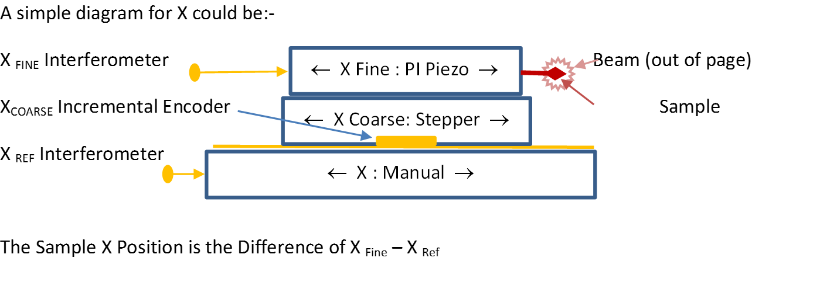
I08 SXM ( again)
Notes:
The current methodology for doing super precise motion is to used stacked stages
A traditional coarse motor stage carrying a short range high precision stage.
( not that new it was in all the phase 1 monos- just open loop!)

Slide 15
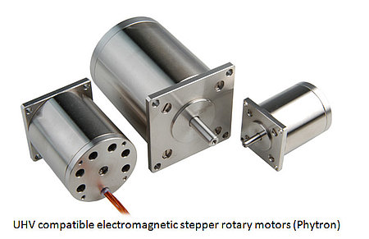
Coarse Stage
Stepper driven stage
40000 microsteps per rev
200:1 gearbox
1mm pitch screw
8 microsteps per nm
Vibration from motor
Vibration from controller
Non linear friction effects
microstepping
Notes:
Currently the coarse stage is a highly geared stepper motor stage.
This brings with it vibration AND heat
Controlling towards the nanometer also falls foul of friction

Slide 16
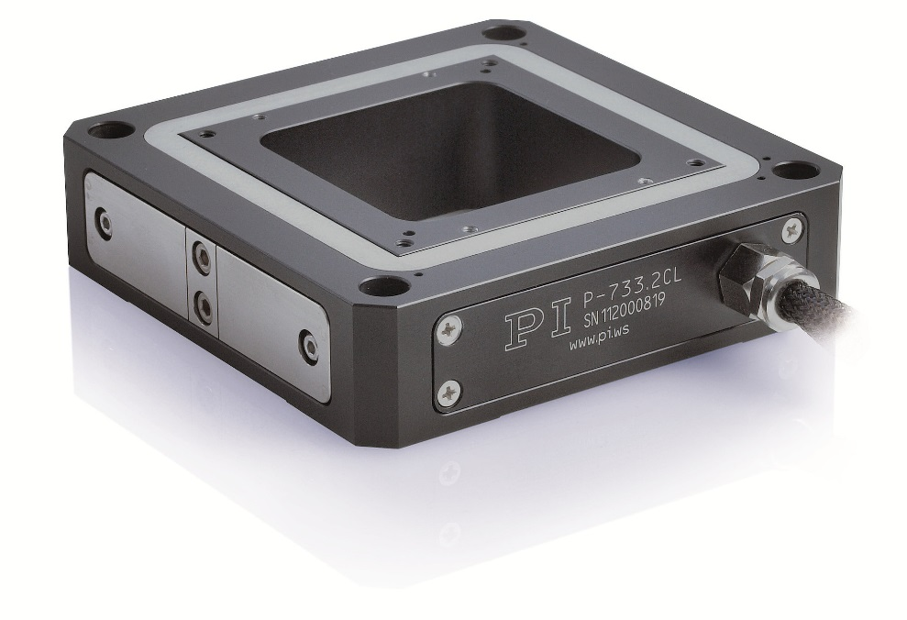
Fine stage
Piezo stack actuators
200 x 200 x 20 um travel
Cap sensor feedback ?
Quoted 0.3nm resolution
Analogue position demand
Separate amplifier
Internal tuning / set up
Notes:
The fine stages are based on piezo stack actuators in flexure based assemblies.
They are specifically designed for microscope applications.
Providing them with an analogue demand is non standard for our set up.

Slide 17

Feedback
Not this kind of feedback --->
Interferometer IDS3010
2 heads – count the difference
Absolute encoding BissC data
Programmable resolution
Custom feedback method
Complicated wiring scheme
Loss of signal 20 second reset
Notes:
A few more slides until your applause.
Our feedback challenge is the compromise between resolution and speed
Especially as our encoder installations typically max out at around 6MHz.

Slide 18
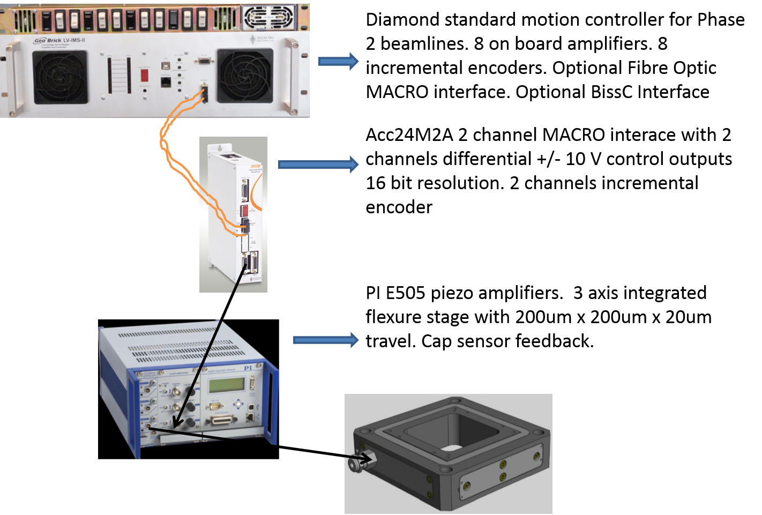
Custom Layout
Notes:
Getting the analogue required a MACRO accessory.
The Piezo amplifier has its own closed loop system
This should give better stability but is something else to learn how to tune.

Slide 19
Challenges
Standard product in custom configuration or Custom product with standard software interface
Depth of analogue output to control piezos 16,18, or 24 bit ?
Characterise the response of the piezos
Model :- test:- create custom servo controls
Notes:
How will we develop precision motion going forward.
This will require multidisciplinary teams in order to address the points in this slide.

Slide 20
3rd generation Motion controller
Current controller is stretched to full capacity
Science requirements already demanding greater
Phase 3 build complete – chance to look again
Consultation is nearly complete to gather requirements
Notes:
Mapping is very resource hungry, in both memory and communication overhead
Already we have consulted widely with engineering, science and controls on the requirements
For our next generation Motion controller.

