Slide 1
Introduction to Diamond light source at MOCRAF 2019
2019 MOCRAF Workshop,
ICALEPCS conference
Brian Nutter
Head of Motion Controls

Slide 2
P99-‘beamline development test rig’ see also xxxxxxxx
A beamline simulacrum specifically designed to provide a facility for full scientific testing of instrument prototypes.
Includes light sources, detectors and high precision motion stages.
Mainly used to develop the software stack for Mapping and Malcolm projects
Invaluable for testing the new coarse/precision stage stack for beamline J08
Provided verification for the DIAD beamline 10Hz beam selector between imaging and Diffraction.

Slide 3
Robot mounted Diffraction detector
DIAD beamline Dual Imaging and Diffraction
Imaging camera plus 2D diffraction detector
Robot to be moved to ‘any?’ position around sample
Robot must NOT be a risk to personnel
Robot must NOT be a risk to the detector
Robot must NOT be a risk to external equipment
Robot must NOT be at risk from external equipment
Robot must be integrated into EPICS and GDA
Safety rated PLC for Machinery Protection not PSS

Slide 4
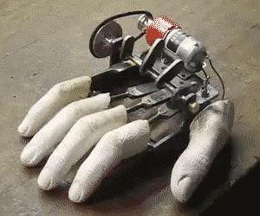
Revolution
Mocraf series started in 2011 by Soleil as part of the project to re-evaluate their motion control systems.
Diamond Light source now actively working on specification and procurement of its third generation motion control system
Requirements obtained from Science, Engineering, Controls and Motion teams.
Initial contact made to COTS suppliers to evaluate requirements against market offerings.
If commercially achievable tender process to start by end of current FY.

