Slide 2
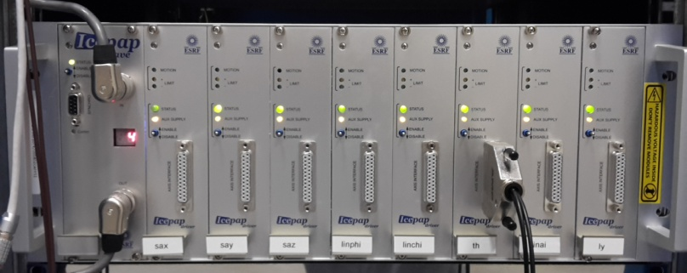
Motion Control At The ESRF
Standard motion controller at ESRF:
Other controllers used at the ESRF:
COTS controllers - interfaced or not with IcePAP
Specified or/and chosen or/and validated by ESRF
Directly bought by ESRF or, more frequently, procured by the subcontractors in charge of instrument/mechanics design and production
. 8 axes per crate . 1 controller board . System up to 128 axes
. More than 6000 axes installed at the ESRF
. Around 9 000 in total
. Collaboration with ALBA & MAX IV

Slide 3
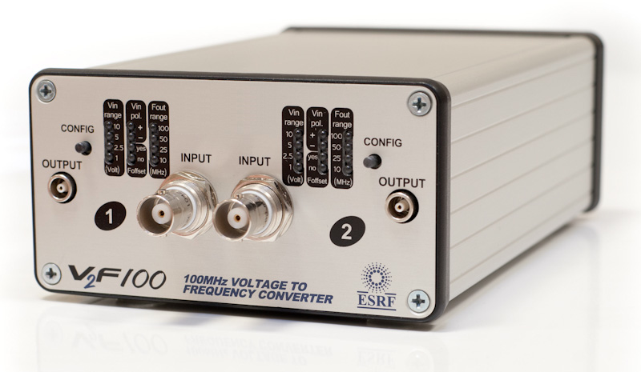
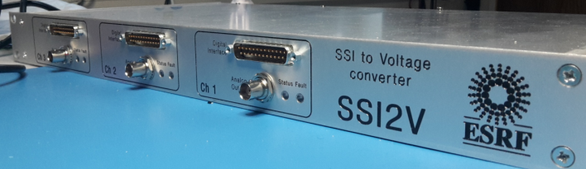
Motion Control At the ESRF
ESRF in-house developed motion interfaces:
Positioning Encoder Processing Unit
Voltage to SSI and SSI to Voltage interfaces
IcePAP - Encoder interface:
Sin-Cos
EnDAT
Biss-C
Voltage to frequency converters 100 MHz

Slide 4
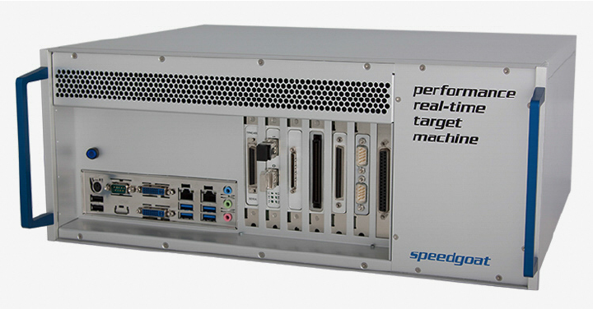
Motion Control At the ESRF
ESRF solution for real-time applications:
Speedgoat Hardware:
Real-time PC programmable from Matlab Simulink
Used for:
Rapid control prototyping
Hardware in the loop tests
Fast data acquisition and online data treatment
…

