Slide 1

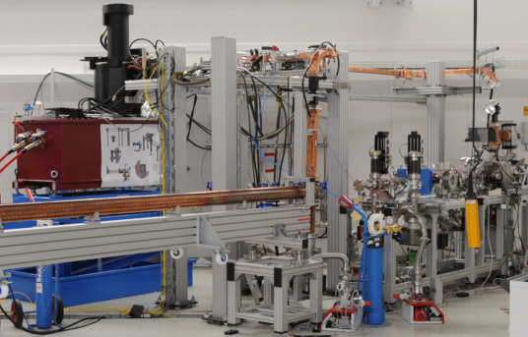
Compact linear accelerator FLUTE: status update
Anton Malygin, A. Bernhard, A. Böhm, E. Bründermann, S. Funkner, B. Härer,
S. Marsching, W. Mexner, M. J. Nasse, G. Niehues, R. Ruprecht, T. Schmelzer,
M. Schuh, M. Schwarz, N. Smale, P. Wesolowski, M. Yan, A.-S. Müller

Slide 2



FLUTE: Ferninfrarot Linac- Und Test-Experiment
Main goals for FLUTE
  Test facility for accelerator physics
  Compare CSR in simulation and experiment
  Experiments with THz radiation
  Test bench for new beam diagnostics
R&D topics
  Development of single-shot fs diagnostics
  Synchronization on a femtosecond level
  Systematic bunch compression and
  THz generation studies
Final electron energy | ~ 41 | MeV
Electron bunch charge | 1 pC - 3 | nC
Electron bunch length | 1 - 300 | fs
Pulse repetition rate | 10 | Hz
THz E-Field strength | up to 1.2 | GV/m

Slide 3
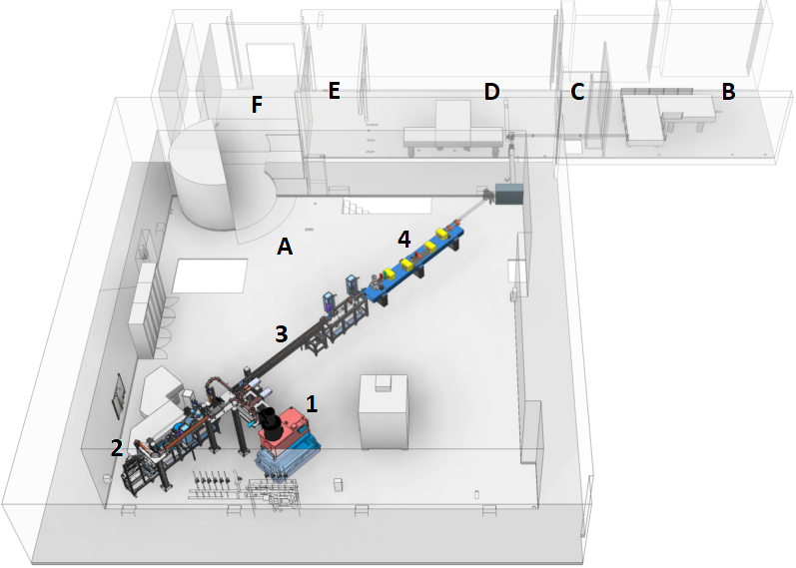
FLUTE: Layout
A – Experimental hall:
1 – Klystron with auxiliaries
2 – RF photo-injector gun
3 – Linac
4 – Bunch compressor
B – Laser clean room
C – Airlock
D – THz measurement room
E – Control room
F – Entrance area

Slide 4
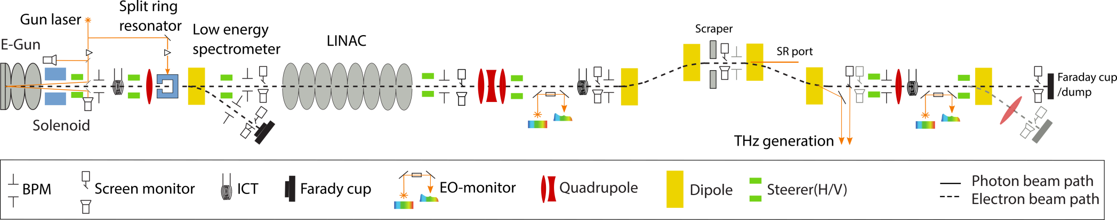
FLUTE: Layout & implementation
7-MeV section
41-MeV section
Buncher and THz section
Energy | 7 MeV
Bunch charge | 1 pC-3 nC
Beam size | 0.4-4.5 mm
Bunch length | 500 fs-2.5 ps
Energy spread | 0.14-0.8 %
𝝺 (laser) | 266 nm
Spot size | 0.5-2.5 mm
Pulse length | 500 fs-2 ps
Energy | 41 MeV
Bunch charge | 1 pC-3 nC
Beam size | 0.4-4.5 mm
Bunch length | 500 fs-2.5 ps
Energy spread | 0.24-1.8 %
Energy | 41 MeV
Bunch charge | 1 pC - 3 nC
Beam size | 40µm - 3 mm
Bunch length | few fs - 500 fs
Energy spread | 0.24 -1.8 %

Slide 5
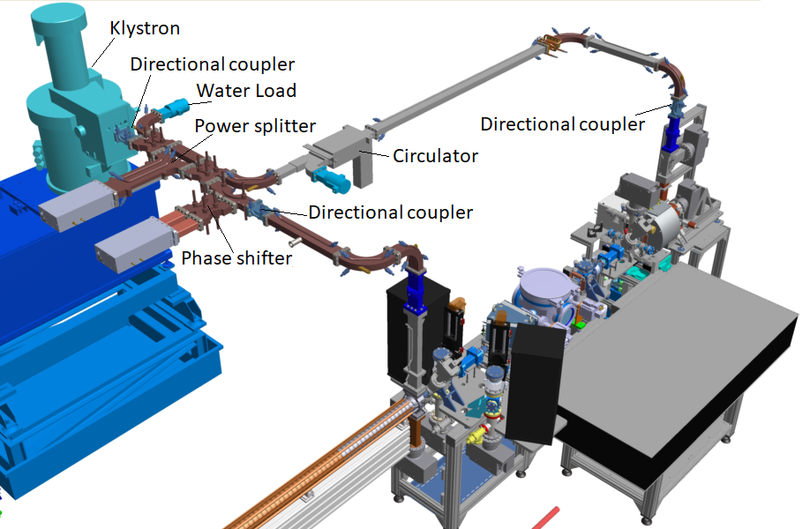
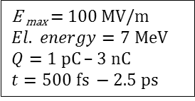
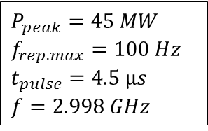
RF system configuration

Slide 6
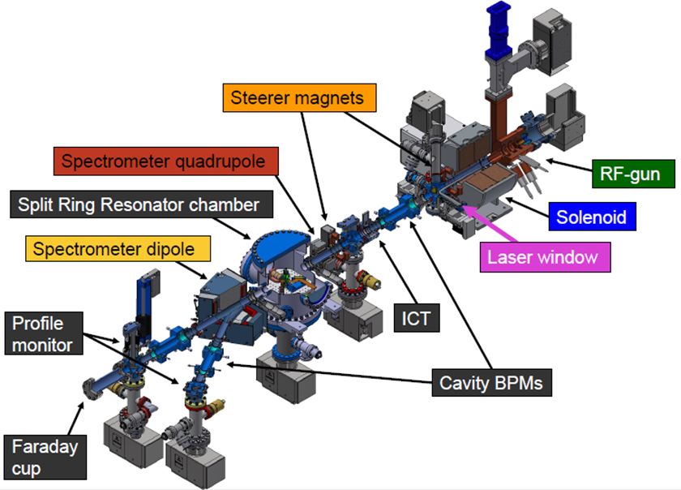
Beam diagnostics

Slide 7
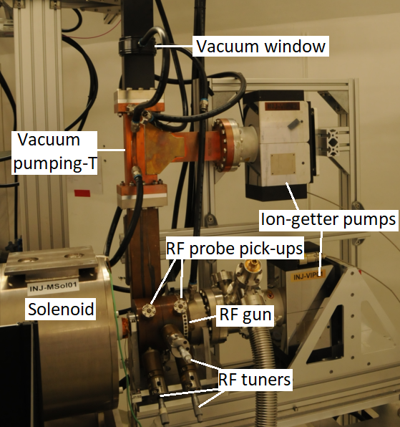
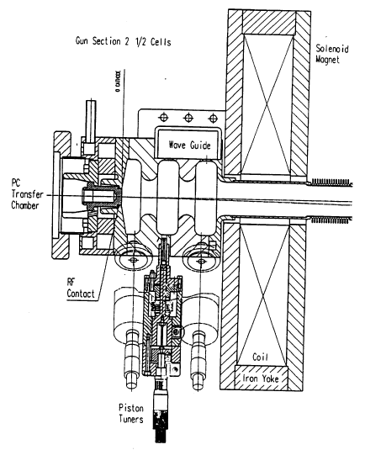
RF photo-injector configuration:
RF photo-injector parameters
Frequency | 2.998 | GHz
Cells | 2.5
Peak E-field | 100 | MV/m
Peak power | 20 | MW
Output energy | 7 | MeV
Maximum charge extracted from cathode per short:
Cu cathode up to 700 pC (assembled)
Cs₂Te up to 3 nC (planned)
Drawing taken from: R. Bossart, et. al. “A 3 GHz photoelectron gun for high beam intensity”, Nuclear Instruments and Methods in Physics Research, A 375 (1996) ABS 7 – ABS 8.

Slide 8
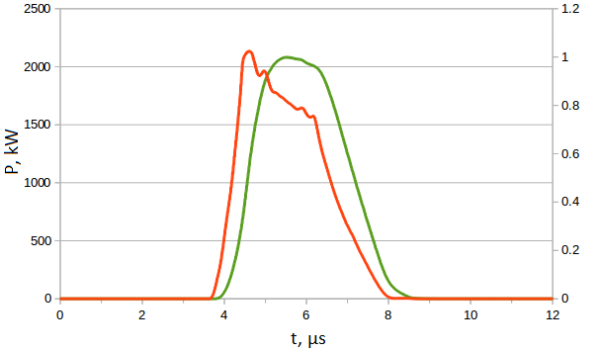
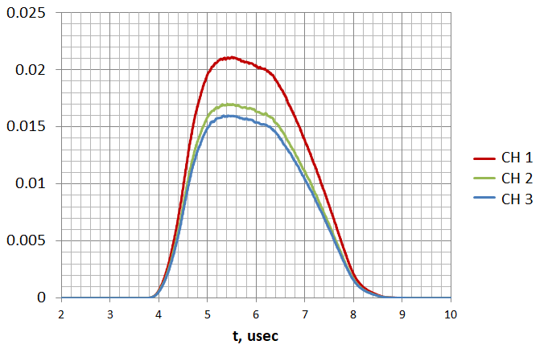
RF photo-injector commissioning results:
Input power from the klystron (red line – left axis) and normalised signal from the RF probe pick-up (first cell) (green line – right axis).
Input power into RF gun – 4 MW
Electron beam energy – 2 MeV
Signal from RF probe pick ups from three cells.
Red – first half-cell, Green- second cell, Blue – third cell.
Drawing taken from: R. Bossart, et. al. “A 3 GHz photoelectron gun for high beam intensity”, Nuclear Instruments and Methods in Physics Research, A 375 (1996) ABS 7 – ABS 8.

Slide 9
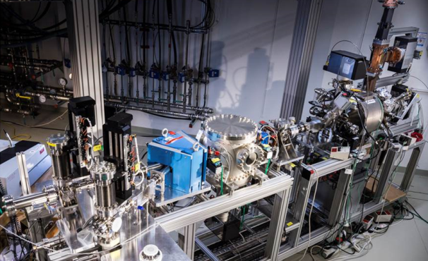
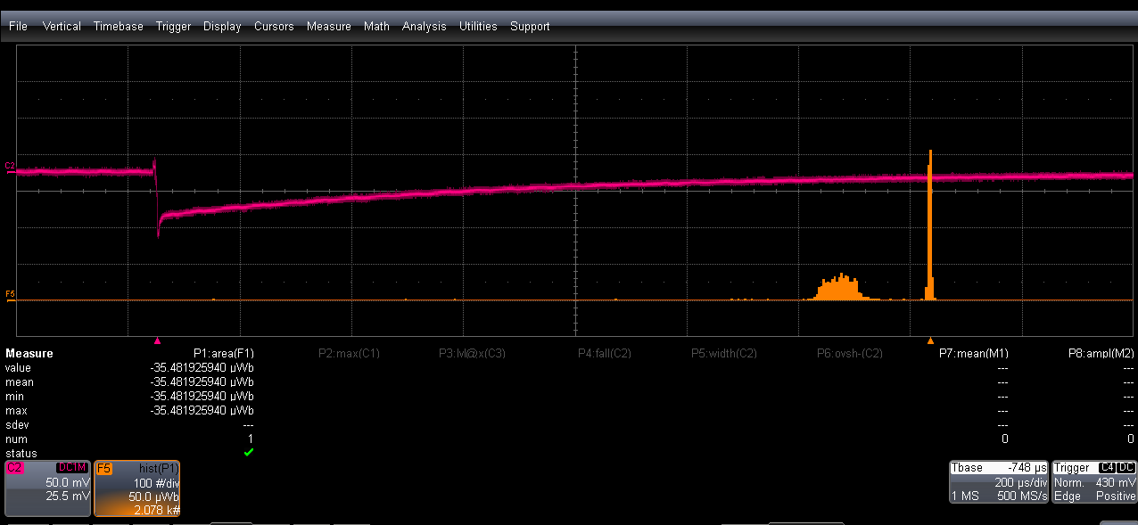
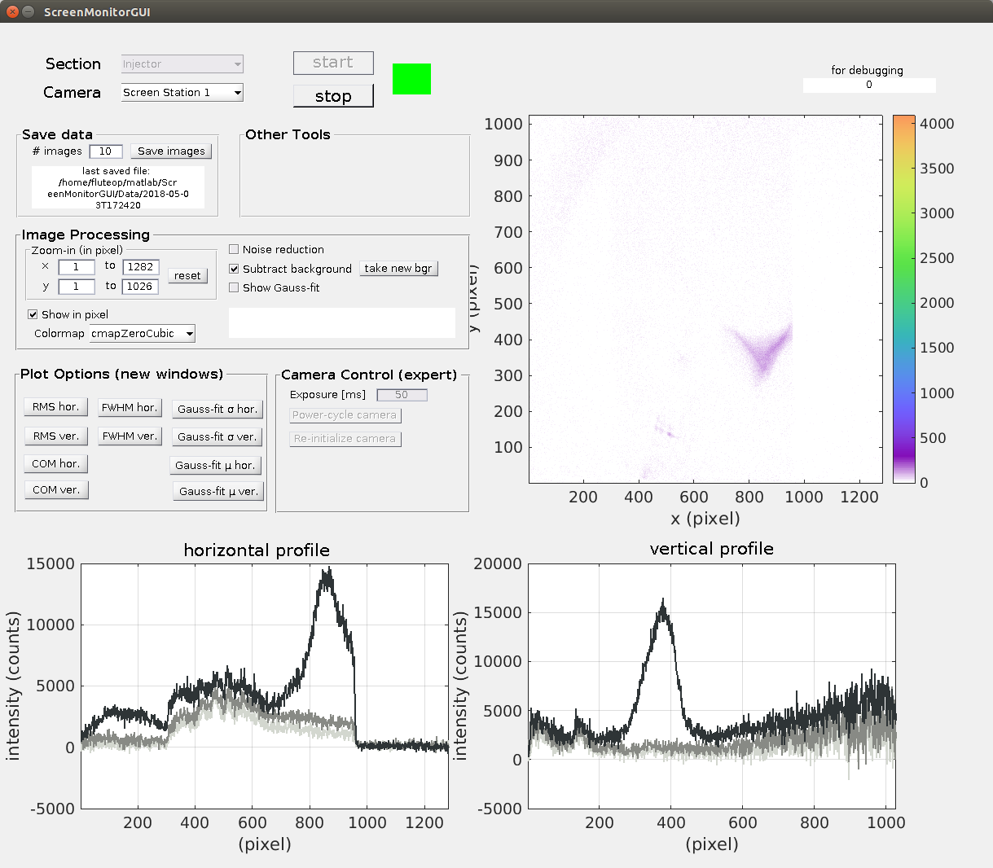
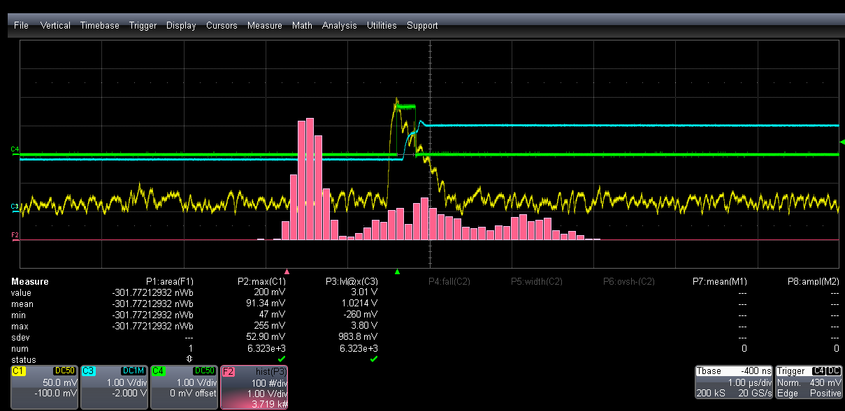

First electron beam:
Faraday cup signal
Dark current
Noise
Histogram
YAG screen monitor
Typical Faraday cup output (connected via a coax cable to a 1 MΩ terminated oscilloscope). Orange curve shows the histogram of the Faraday cup signal.
ICT signal
Noise
Laser ON
Histogram
Typical ICT signal. ICT trigger (green), ICT analog output (yellow), ICT capture and hold signal of the yellow trace (blue), histogram of the capture and hold signal (pink).

Slide 10
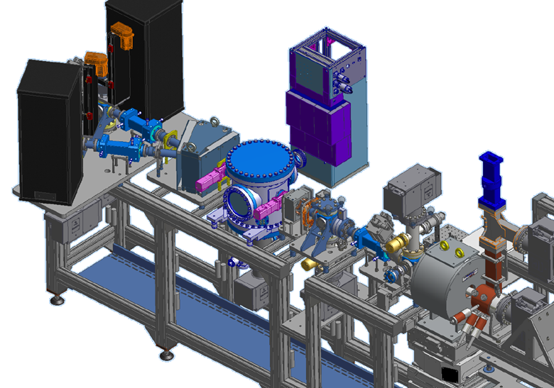
Split ring resonator experiment at FLUTE
Profile
monitor
~3 m
e-beam
Dipole
magnet
Steerer
SRR chamber
Quadrupole
Solenoid
RF gun

Slide 11
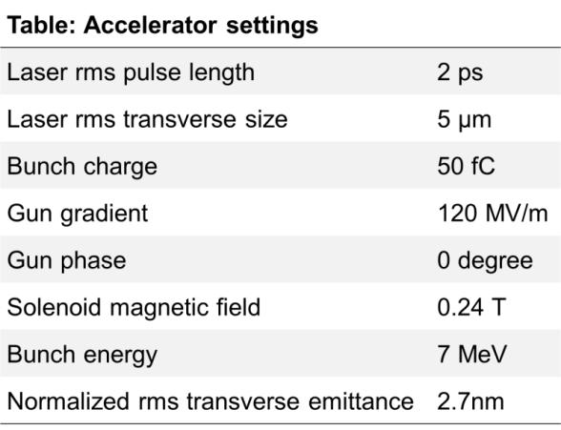
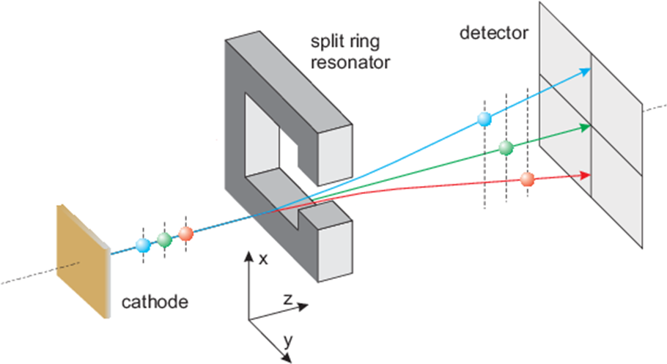
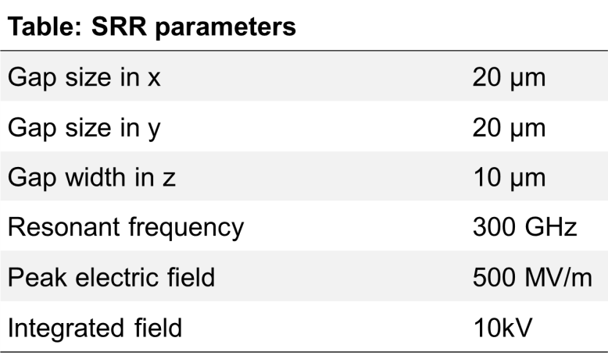
Principle of SRR diagnostics
„Split ring resonator based THz-driven electron streak camera featuring femtosecond resolution“
    J. Fabiańska, G. Kassier, T. Feurer, Sci. Rep. 4, 5645 (2014)
    M. Yan et al., TUPG56, IBIC 2016, Barcelona, Spain.
THz-range => high frequency f
  LiNbO₃ crystal => 35 fs pulse at 800 nm (FLUTE laser) converted to THz pulse
Field enhancement in SRR gap => large “kick” voltage V
  Enhancement factor ~100 (at 0.3 THz)
fs laser
ν
THz
pulse
LiNbO₃
UV
pulse
3×ν
E(t) in SRR gap
electric field
<2 ps

Slide 12
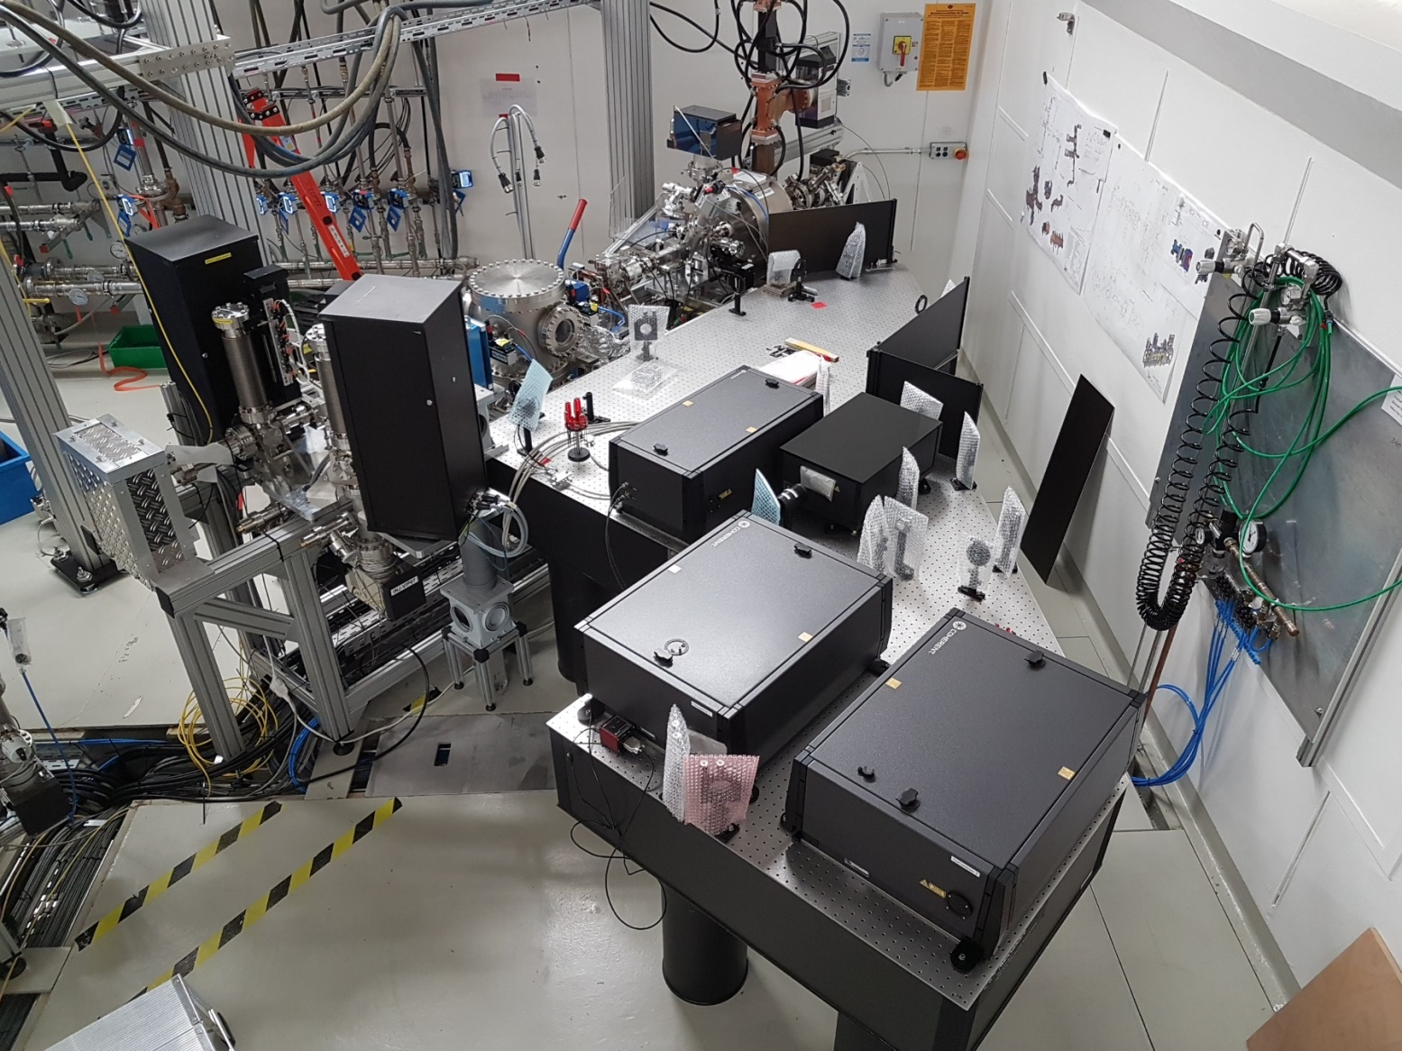
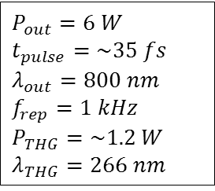
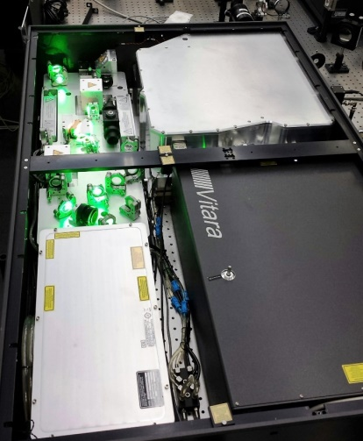
Laser system modifications:
New optical table has been installed next to the beam diagnostics section.
RF injector
SRR chamber
Pulse picker
THG
Compressor
Cathode signal
Compressor
SRR signal
Laser pulse

Slide 13
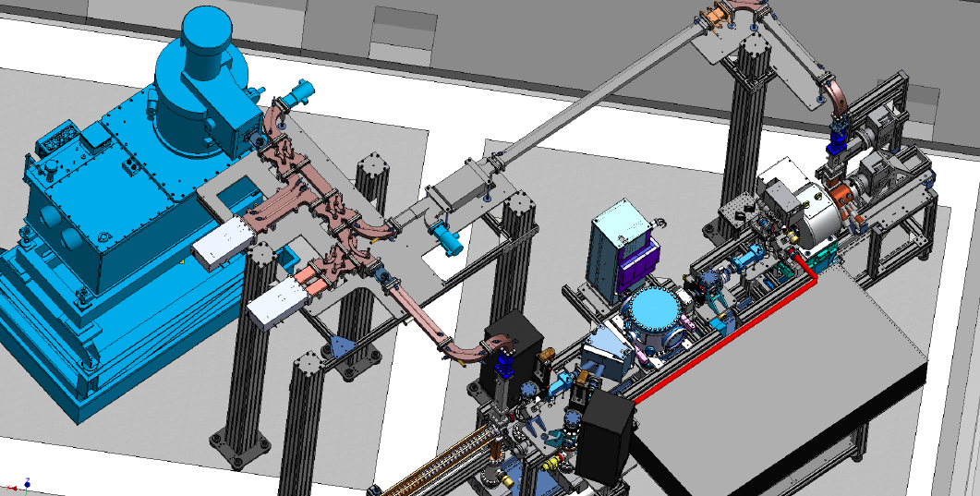
RF system commissioning
Problems and solutions:
Leaks (SF₆ gas) were found in the power splitter and the phase shifter – have been fixed
Circulator showed high insertion loss of 1.5 dB instead of 0.2 dB – new circulator was ordered expected delivery April 2019.
RF components and RF power:
Power splitter – 45 MW (RF power)
Phase shifter – 25 MW
New circulator – 20 MW
RF injector – 20 MW
Klystron
Circulator
RF injector
Power splitter
Phase shifter
Linac

Slide 14
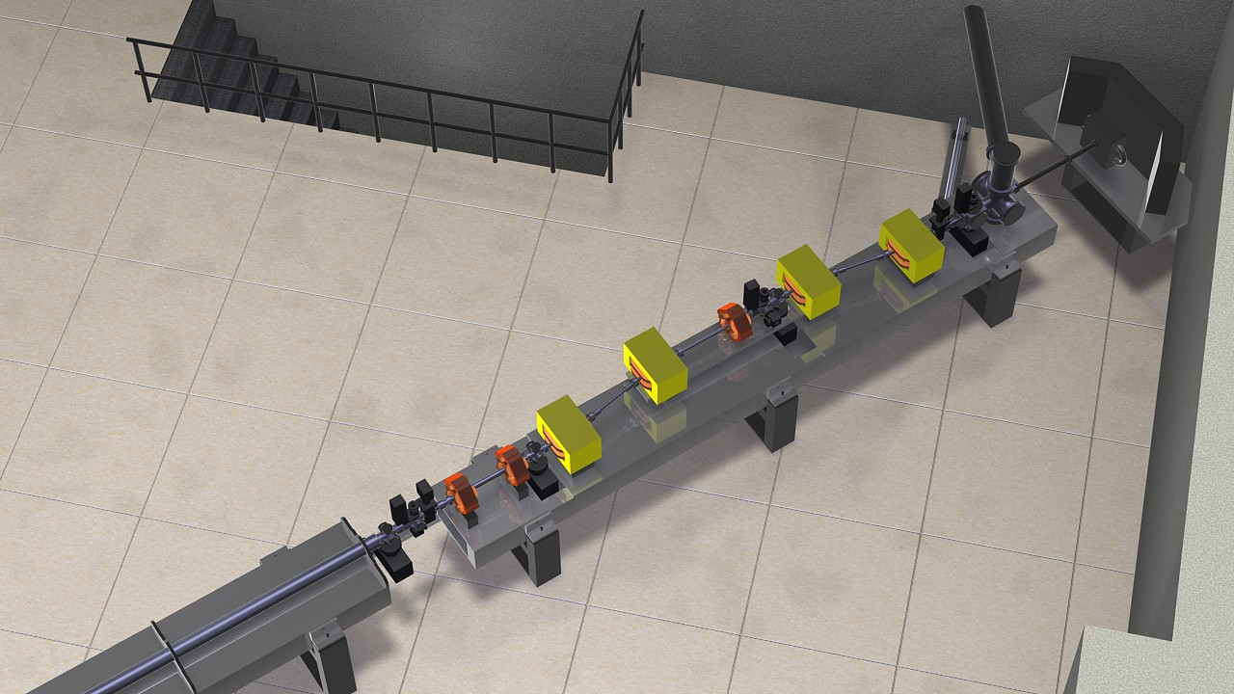
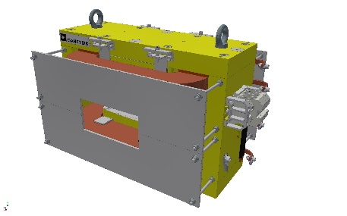
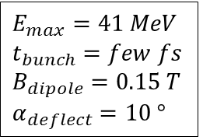
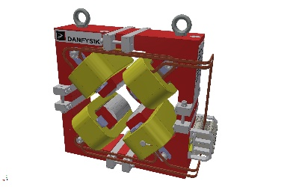
Bunch compessor
Dipoles have been delivered, measurement of magnetic field distribution is in progress at KIT and compared to the specifications.
Quadrupoles are in production.
Dipole
THz line
Beam dump
Bunch compressor
Quadrupole
Linac

Slide 15
Summary and Outlook
Assembly of the FLUTE RF injector (7 MeV) and associated diagnostics completed, conditioning ongoing – First electron beam measured
Conditioning results: RF power: 4 MW (limited by faulty circulator), Electron beam energy: 2 MeV, pulse length: 4.5 µs, repetition rate: 1 Hz has been reached
New circulator will be installed on April 2019. This will allow to continue RF conditioning of different RF components. RF–laser synchronization is in progress.
Dipoles for the bunch compressor have been delivered
Next steps: commissioning of the new circulator, power splitter, phase shifter and RF gun at full power, RF-laser synchronization, assembling Linac and the Linac RF distribution system, conditioning Linac.
Optimizing the design and assembly of the bunch compressor.
Thank you for your attention!

