Slide 1

Compensation of transient RF voltage using a kicker cavity
Friday, 9 November 2018, ESLSRF
Naoto Yamamoto,
Shogo Sakanaka, Takeshi Takahashi
High Energy Accelerator Research Organization Accelerator Laboratory (KEK)
Notes:
Thank you for coming to my seminar.
I’m naoto Yamamoto from KEK, japan.

Slide 2
Outline
*N. Yamamoto, et al., PRAB 21, 012001 (2018).
Harmonic RF system
  Motivation
  Physics
  Existing double RF system
Reduction of Transient beam loading effect
  Transient beam loading effect
  Reduction of the effect
  Normal-conducting TM020 cavity
Compensation of Transient effect
  Basic idea
  Compensation with a kicker cavity
  Numerical estimation
Summary
Main cavities
Kicker cavity
e⁻
Harmonic cavities
Notes:
Here, this is the outline of my presentation.
(skip, First I will introduce the double RF system
And then I will talk about the transient beam loading effect and the reduction scheme.
After that I will talk about compensation ideas of the remaining transient effect by using additional kicker cavity.)
Then finally, I will summarize my talk.

Slide 3
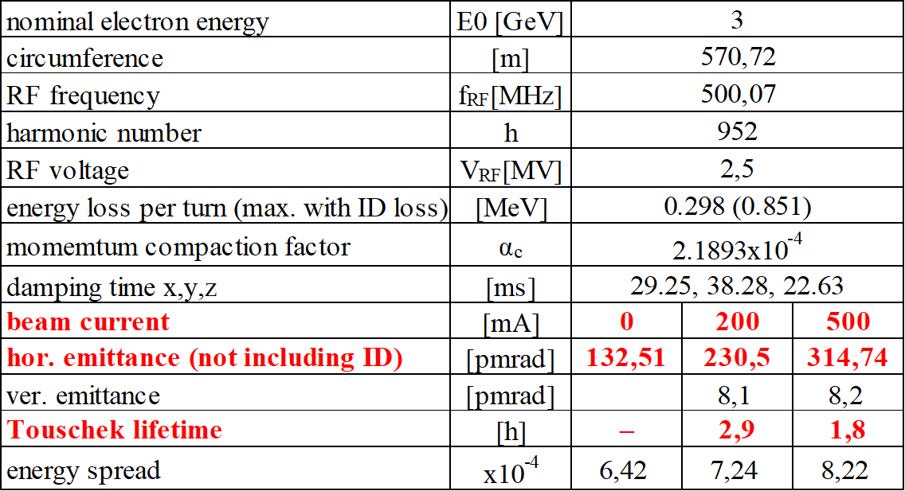
Motivation for harmonic RF system
Quasi diffraction-limited synchrotron light sources, which aim at achieving the beam emittances of < 100 pmrad are being actively designed.
In such ultralow-emittance rings, emittance growth due to intrabeam scattering are serious concerns.
http://kekls.kek.jp
KEK-LS
parameter
Notes:
OK. Let’s move onto the motivation.
...
...
This table shows the parameters of the 3GeV future light source at KEK (KEK-LS).
As you can see, the natural emittance at zero current is 130 pmrad.

Slide 4
Motivation for harmonic RF system
Quasi diffraction-limited synchrotron light sources, which aim at achieving the beam emittances of < 100 pmrad are being actively designed.
In such ultralow-emittance rings, emittance growth due to intrabeam scattering are serious concerns.
One of solutions to mitigate such adverse effects is to reduce the electron densities of the bunches.
For this purpose, the harmonic RF system is installed.
http://kekls.kek.jp
KEK-LS
parameter
Notes:
However, the beam emittance increases with the stored currents.

Slide 5
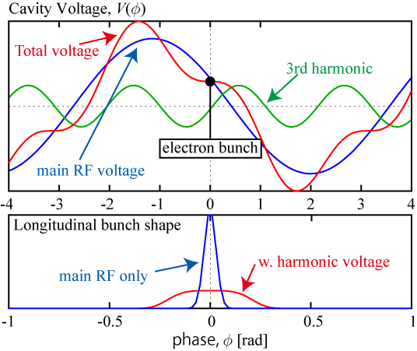
Physics of harmonic RF system
Storage ring main cavity is used to replace energy lost through synchrotron radiation.
By adding nth harmonic voltage (cavity), we can shape the bunch longitudinally.
Cavity voltage
Main cavities
(Frequency: f )
Total voltage
3rd harmonic voltage
e⁻
Flat potential condition
e⁻
Harmonic cavities
(Frequency: n x f )
Notes:
And then, by adding nth harmonic voltage , we can shape the bunch longitudinally.
In this figure, 3rd harmonic voltage is shown in satisfying the flat potential condition.
In this case, the focusing force of the total voltage becomes zero at the bunch center position.
Then the longitudinal bunch length is stretched.

Slide 6
Existing harmonic RF systems
Harmonic RF systems have been installed in several 3rd generation light sources, and they have been successfully operated to lengthen beam bunches. (ALS, BESSY-II, SLS, ELETTRA, MAX-IV, ...)
Existing 1.5GHz harmonic cavity ( 3rd harm. of 500MHz main cavity)
[1] J. M. Byrd, et al., Nucl. Instrum. Methods Phys. Res., Sect. A 455, 271 (2000).
[2] M. Georgsson, et al., Nucl. Instrum. Methods Phys. Res., Sect. A 469, 373 (2001).
[3] W. Anders and P. Kuske, in Proceedings of PAC 2003, (2003) p. 1186.
[4] M. Pedrozzi, et al., in Proceedings of SRF03 (2003) p. 91
[5] G. Penco and M. Svandrlik, Phys. Rev. Accel. Beams 9, 044401 (2006).
[6] N. Milas and L. Stingelin, in Proceedings of IPAC'10 (2010) p. 4719.
[7] P. F. Tavares, et al., Phys. Rev. Accel. Beams 17, 064401 (2014).
 |  | BESSY-II | ALS | SLS/ELETTRA
NC or SC |  | NC | NC | SC
R/Q | Ω | 124 | 161 | 176**
Unloaded-Q (Q₀₎ |  | 13,900 | 21,000 | 2.0E+08
Shunt impedance (R) | MΩ | 1.72 | 3.38 | 35200**
*NC: Normal conducting
SC: Super conducting
** Sum of two cavities
Notes:
...
Here I would like to introduce three existing 1.5GHz harmonic cavities.
These two cavities, developed for BESSY-II and ALS, are operated as normal-conducting cavities.
And the cavity of SLS and ELETTRA are operated as super conducting cavities.
The major difference between these normal and super conducting cavity is Q-Value.
By using the SC technology, very large Q-values can be achieved in exchange for the complex refrigerating system.

Slide 7
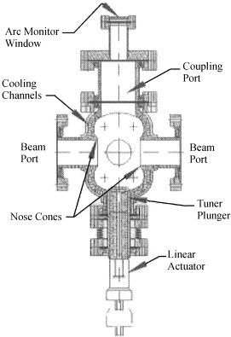
Existing harmonic cavities (cont.)
BESSY-II
SLS/ELETTRA
ALS
 |  | BESSY-II | ALS | SLS/ELETTRA
Type |  | NC | NC | SC
R/Q | Ω | 124 | 161 | 176
Q₀ |  | 13,900 | 21,000 | 2.00E+08
R | MΩ | 1.72 | 3.38 | 35200
Bessy-II : W.Anders, et .al., Proc. PAC (2003) TPAB004
ALS : J. Byrd, et. al., NIM A, 439 (2000) pp.15-25
SLS: N. Milas. et.al., Proc. IPAC’10 (2010) THPE084
Notes:
In this slide, the schematic design of the three cavities are shown.
...
There are two cavities and liquid He reservoir to operate with 4K.
By using the SC technology, very large Q-values can be achieved in exchange for the complex refrigerating system.

Slide 8
Outline
Double RF system
  Motivation
  Physics
  Existing double RF system
Reduction of Transient beam loading effect
  Transient beam loading effect
  Reduction of the effect
  Normal-conducting TM020 cavity
Compensation of Transient beam loading effect
  Basic idea
  Compensation with a kicker cavity
  Numerical estimation
Summary
Notes:
OK. next I would like to move the next topic “Transient beam loading effect and it’s reduction.

Slide 9
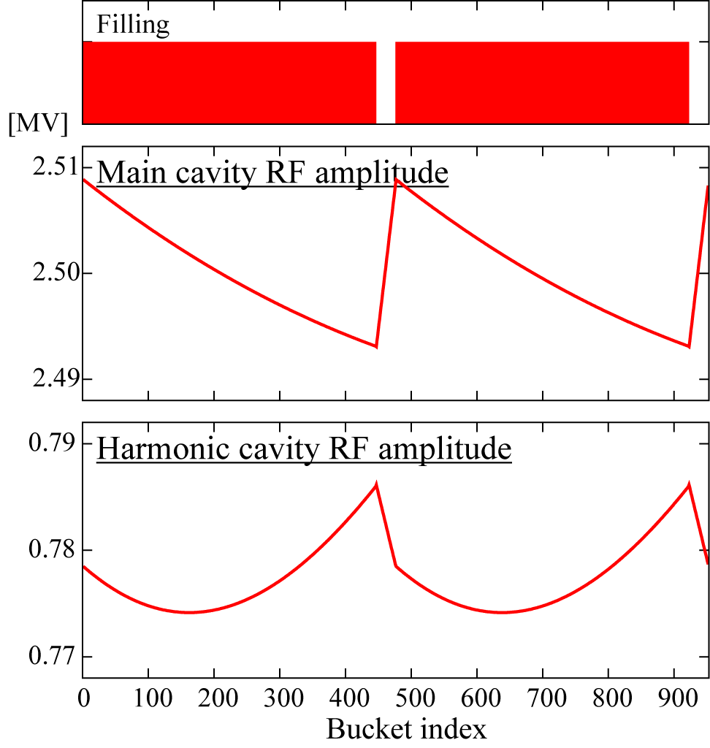
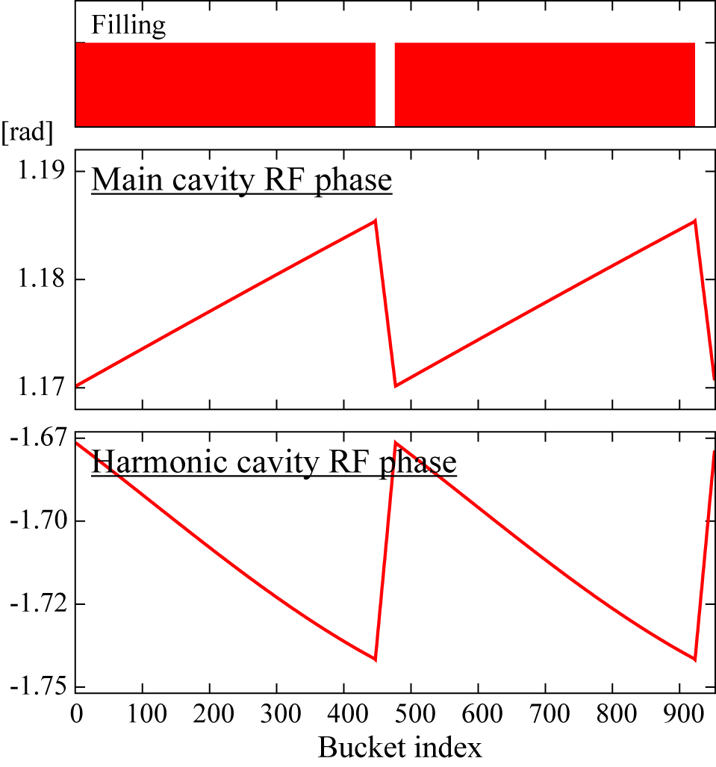

Transient beam loading effect
When the gaps ( i.e. unoccupied RF buckets) are introduced in the fill pattern of the stored beam, the bunch gaps induce considerable variations in both amplitude and phase in the RF voltage.
Higher harmonics, the effect is more serious.
Cavity voltage vs Bucket index
(60 ns gap,
KEK-LS)
Amplitude
Phase
60 ns
Main cavity
(500MHz)
1.6 %
Harmonic cavity
(1.5GHz)
7.1%
Notes:
...
..., because the stored energy of the higher frequency cavities are low.
These plots shows the amplitude and phase of the cavities as a function of the bunch index (i.e. time).
The bunch index is corresponding to the time.
From Here to here means one revolution period of the ring.
If there are 60 ns bunch gaps in KEK-LS, the fluctuations like these plots are expected.
For the main cavity, the fluctuation is estimated to be 1.6%.
On the other hand, for the harmonic cavity, it is achieved to 7.1%.
So the effect is five factor larger for the harmonic cavity.

Slide 10
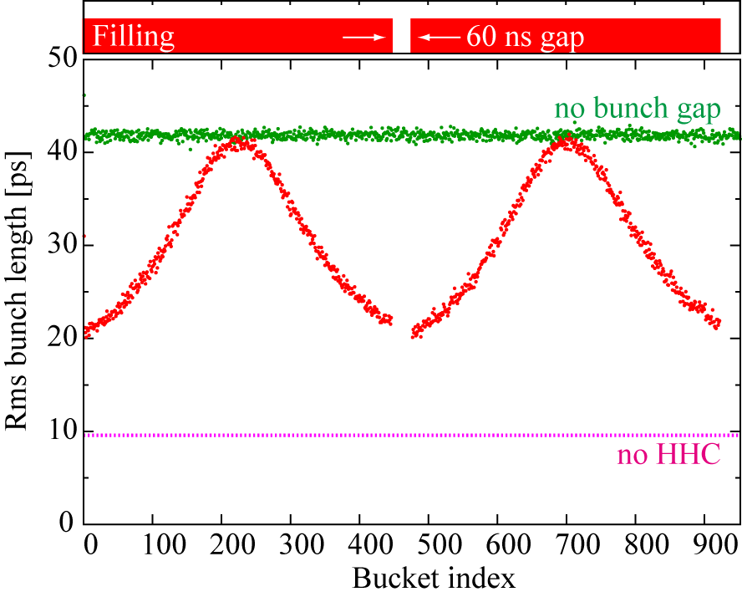
Transient beam loading effect
When the gaps ( i.e. unoccupied RF buckets) are introduced in the fill pattern of the stored beam, the bunch gaps induce considerable variations in both amplitude and phase in the RF voltage.
The higher frequency (> 1.5GHz) cavity, the effect is more serious.
Cavity voltage vs Bucket index
(60 ns gap,
KEK-LS)
Amplitude
Phase
60 ns
Main cavity
(500MHz)
1.6 %
Harmonic cavity
(1.5GHz)
7.1%
Notes:
When voltage fluctuations exist, the flat potential condition, which is required to lengthen bunches, can not be kept anymore.
Then the bunch length are also affected.

Slide 11
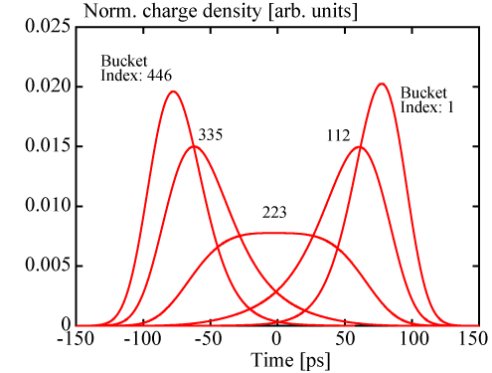
Transient beam loading effect
When the gaps ( i.e. unoccupied RF buckets) are introduced in the fill pattern of the stored beam, the bunch gaps induce considerable variations in both amplitude and phase in the RF voltage.
The higher frequency (> 1.5GHz) cavity, the effect is more serious.
Cavity voltage vs Bucket index
(60 ns gap,
KEK-LS)
Amplitude
Phase
60 ns
Main cavity
(500MHz)
1.6 %
Harmonic cavity
(1.5GHz)
7.1%
Notes:
When voltage fluctuations exist, the flat potential condition can not be kept anymore.
Then the bunch length are also affected.
The bunch shapes responds according to the rf conditions of the bunch index.

Slide 12
Transient beam loading effect (cont.)
*J. Byrd’s presentation on ALERT, Sep. 2016
*J. M. Byrd, et al., NIM A 455, 271 (2000).
NC harmonic cavity
ALS
112 ns gap
16 ns gap
Notes:
These phenomena are observed at several light sources.
These date are obtained at Advanced light source.
As I described, they used normal-conducting harmonic cavities.
In the 112 ns gap situation, very large phase shift in the bunch train are observed.

Slide 13
Transient beam loading effect (cont.)
SLS
*M. Pedrozzi, et al., SRF03 (2003) p. 91
284 ns gap
SC harmonic cavity
better than NC-cavity,
but the considerable effect.
*G. Penco and M. Svandrlik,
PRAB 9, 044401 (2006).
ELETTRA
160 ns gap
Notes:
And the similar phenomena were observed even with super-conducting harmonic cavities.
However the bunch gap is much lager then NC cavity cases.
So more than 100 ns or around 300ns.

Slide 14
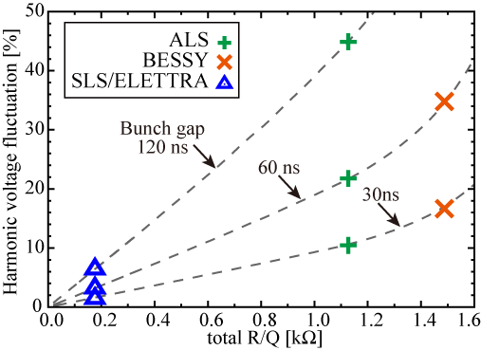
Reduction of the effect
Such transient effects were well-investigated by J. Byrd, et al. .
It was reported that the reduction of a total R/Q of harmonic cavities is essential to alleviate such transient effects.
Harmonic voltage fluctuation (KEK-LS)
vs Total R/Q
 |  | BESSY-II | ALS | SLS/ ELETTRA
R/Q | Ω | 124 | 161 | 176
Unloaded-Q |  | 13900 | 21000 | 2.0E+08
Coupling | β | 0.82 | 1.08 | 3099
Loaded- Q |  | 7631 | 10088 | 64514
Fill time | us | 1.6 | 2.1 | 13.7
Cav. number |  | 12 | 7 | 1 module
total R/Q | Ω | 1488 | 1127 | 176
V_{hc} / cav. | kV | 65 | 111 | 777
Pc / cav. | kW | 2.4 | 3.6 | 0.0
ΔV_{c}/V_{c}(60ns) |  | 35.0% | 22.0% | 3.2%
Notes:
In this figure, three described harmonic cavities are positioned like this.
So from these plot, the advantage of the SC cavities are clear.

Slide 15
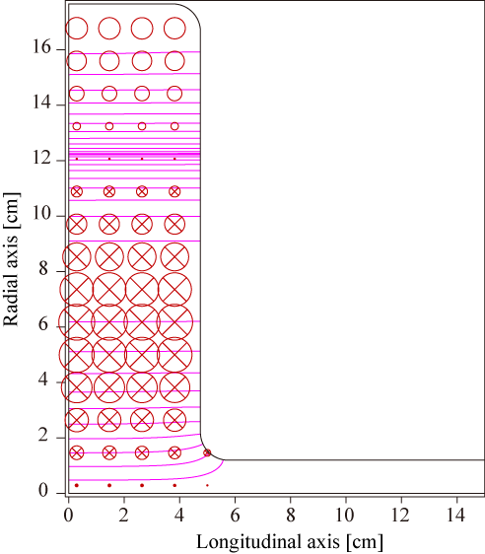
Normal-conducting harmonic TM020 cavity
Normal conducting TM020 cavity is a candidates because of it’s high unloaded-Q and small R/Q (large stored energy).
Parameter | Symbol | Value
Resonant frequency | f_{res} | 1.5 GHz
R/Q | R/Q | 77.2 Ω
Unloaded Q | Q₀ | 37500
Inner radius | - | 176.5 mm
Gap length | - | 95 mm
Max. power dissipated on the cavity wall
 | P_{c,max} | 10 kW
Cavity voltage at P_{c,max} | V_{c,cell} | 170 kV
Max. electric field on the inner surface
 | E_{max} | 3.2 MV/m
Max. power density on the inner surface
 | ρ_{max} | 10 W/cm2
Notes:
However in this slide, we would like to propose the normal-conducting harmonic cavity.
..
This is a quarter model of the cavity calculated by SUPERFISH cord.
This is a overview of the model calculated by CST cord, and this is the electric field of TM020 mode.
The cavity parameter is summarized here.
Because the cavity volume increases compared with TM010 cavities, the max. power dissipated also increases.

Slide 16
HOM-Damped TM020 cavity (508MHz)
* H. Ego, et. al., PASJ11, (2014) MOOL14
This type cavity was pioneered by Dr. Ego and was developed as a accelerating cavity for the “Spring-8 II” storage ring.
Notes:
Here, I would like to introduce the HOM-damped TM020 cavity
The 508 MHz cavity already exists.
..
This figure shows the cavity structure.
There are HOM damping slots at the location of the magnetic node of the TM020 mode.
The other modes except of the TM020 are strongly damped,
and simultaneously the Quality factor of 60,000 is realized.
Thanks to the high unloaded-Q ,
They realized higher accelerating voltage with shorter longitudinal length.

Slide 17
Reduction of the effect
Such transient effects were well-investigated by J. Byrd, et al. .
It was reported that the reduction of a total R/Q of harmonic cavities is essential to alleviate such transient effects.
Harmonic voltage fluctuation (KEK-LS)
vs Total R/Q
 |  | BESSY-II | ALS | SLS/ ELETTRA
R/Q | Ω | 124 | 161 | 176
Unloaded-Q |  | 13900 | 21000 | 2.0E+08
Coupling | β | 0.82 | 1.08 | 3099
Loaded- Q |  | 7631 | 10088 | 64514
Fill time | us | 1.6 | 2.1 | 13.7
Cav. number |  | 12 | 7 | 1 module
total R/Q | Ω | 1488 | 1127 | 176
V_{hc} / cav. | kV | 65 | 111 | 777
Pc / cav. | kW | 2.4 | 3.6 | 0.0
ΔV_{c}/V_{c}(60ns) |  | 35.0% | 22.0% | 3.2%
Notes:
Let’s back to the fluctuation plot.

Slide 18
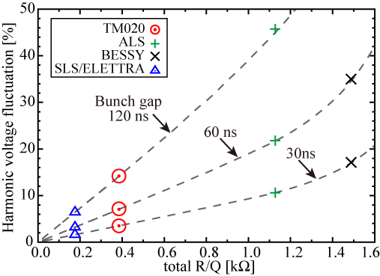
Normal-conducting TM020 cavity
*N. Yamamoto, et al., PRAB 21, 012001 (2018).
Normal conducting TM020 cavity is a candidates because of it’s high unloaded-Q and small R/Q (large stored energy).
 |  | TM020 | ALS | SLS/ ELETTRA
R/Q | Ω | 77 | 161 | 176
Unloaded-Q |  | 37449 | 21000 | 2.0E+08
Coupling | β | 0.27 | 1.08 | 3099
Loaded-Q |  | 29411 | 10088 | 64514
Fill time | us | 6.2 | 2.1 | 13.7
Cav. number |  | 5 | 7 | 1 module
total R/Q | Ω | 385 | 1127 | 176
V_{hc} / cav. | kV | 155 | 111 | 777
Pc / cav. | kW | 8.4 | 3.6 | 0.0
ΔV_{c}/V_{c}(60ns) |  | 7.1% | 22.0% | 3.2%
Harmonic voltage fluctuation (KEK-LS)
vs Total R/Q
Notes:
Let’s back to the fluctuation plot.
The values calculated with the TM020 harmonic cavities are located here.
So comparing to the existing NC cavities, the much better performance are expected.
And the performance is slightly lower than SC cavities.

Slide 19
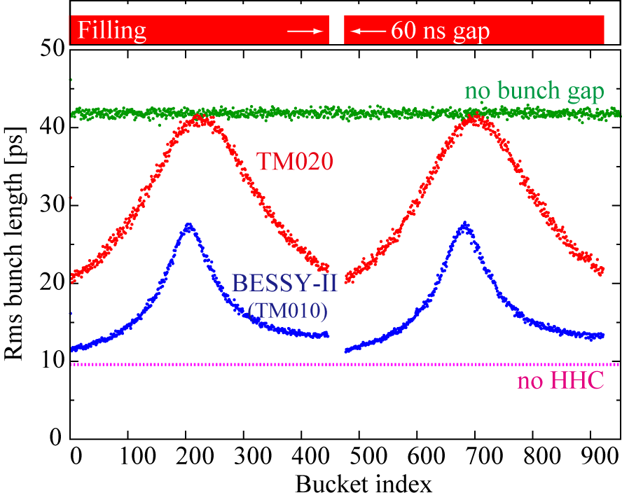
Normal-conducting TM020 cavity
*N. Yamamoto, et al., PRAB 21, 012001 (2018).
Normal conducting TM020 cavity is a candidates because of it’s high unloaded-Q and small R/Q (large stored energy).
Harmonic voltage fluctuation (KEK-LS)
vs Total R/Q
 |  | TM020 | ALS | SLS/ ELETTRA
R/Q | Ω | 77 | 161 | 176
Q₀ |  | 37449 | 21000 | 2.0E+08
Coupling | β | 0.27 | 1.08 | 3099
Q_{L} |  | 29411 | 10088 | 64514
Fill time | us | 6.2 | 2.1 | 13.7
Cav. number |  | 5 | 7 | 1 module
total R/Q | Ω | 385 | 1127 | 176
V_{hc} / cav. | kV | 155 | 111 | 777
Pc / cav. | kW | 8.4 | 3.6 | 0.0
ΔV_{c}/V_{c}(60ns) |  | 7.1% | 22.0% | 3.2%
Notes:
This plot shows the rms bunch length compared with the existing NC cavities with the bunch gaps of 60ns

Slide 20
Outline
Double RF system
  Motivation
  Physics
  Reviews of existing double RF system
Reduction of Transient beam loading effect
  Transient beam loading effect
  Key parameter for the reduction of the effect
  Normal-conducting TM020 cavity
Compensation of Transient beam loading effect
  Basic idea
  Compensation with a kicker cavity
  Numerical estimation
Summary
Notes:
Let’s move to the last topic “active compensation of the transient beam loading effect”.

Slide 21
Basic idea of the compensation
If the voltage fluctuation is small, we can further reduce the transient effect using an active compensation technique.
We investigated two measures;
(a) compensation on the main and harmonic cavities,
(b) compensation using a separate kicker cavity.
Advantage of the method (b)
Input RF power is minimized by optimizing the cavity bandwidth.
Disadvantage
Another space in the ring, RF system (low level system, RF amp ...)
Main cavities
(Frequency: f )
e⁻
(b)
Kicker cavity
e⁻
Harmonic cavities
(Frequency: n x f )
Notes:
There are some advantages on method (b).
..
Because the bandwidth of main and harmonic cavities are very narrow, which is around several tens kHz.
So if we take the method (b), we need relative large RF power.
Of course, there are some drawbacks, we need ..., ..

Slide 22
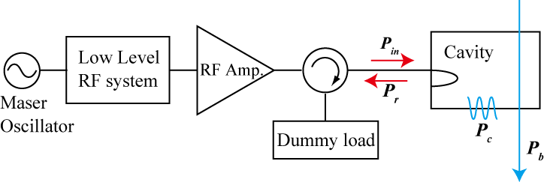
Compensation with a kicker cavity
System overview
We will use an active feedforward low level control, a kicker cavity having the wide bandwidth and a Solid state amplifier.
Solid State Amp.
Kicker cavity
Main cavities
(Frequency: f )
Feedforward modulated signal
(calculating from filling pattern)
e⁻
Harmonic cavities
(Frequency: n x f )
Frequency | [MHz] | 500
R/Q | [Ω] | 175
Unloaded-Q |  | 40000
Cavity number |  | 1
Cavity coupling |  | 199
Loaded-Q |  | 200
3dB bandwidth | [MHz] | 2.5
← assumed kicker cavity parameters
(not optimized)
Notes:
OK, I will explain the system overview of the method (b).
...
This table is the parameters for kicker cavity.
we consider that almost same to the main cavity are used as the kicker cavity.
Then the resonance frequency is 500MHz, but the cavity coupling is around 200.
In this case, the 3db bandwidth are estimated to be 2.5MHz.

Slide 23
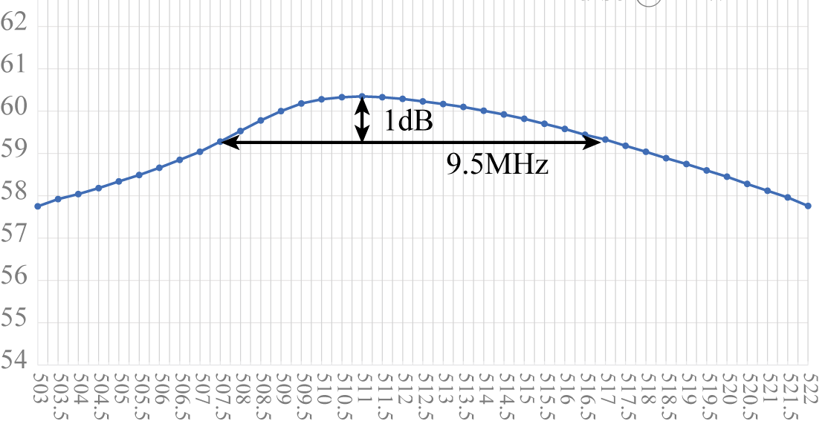
Compensation with a kicker cavity
System overview
We consider to use an active feedforward low level control, a kicker cavity having the wide bandwidth and a Solid state amplifier.
Solid State Amp.
Kicker cavity
Main cavities
(Frequency: f )
[dBm]
Frequency vs Output power
Feedforward modulated signal
(calculating from filling pattern)
e⁻
Harmonic cavities
(Frequency: m x f )
LDMOS(MRFE6VP61K25N)/NXP
Test data @ R＆K Company Limited.
Notes:
We have also developed the wideband Solid state amplifier collaborating with the commercial company.
This figure shows the bandwidth of the SSA.
It is found that the 1db-bandwidth of the 9.5MHz are already obtained with 1 kW.

Slide 24

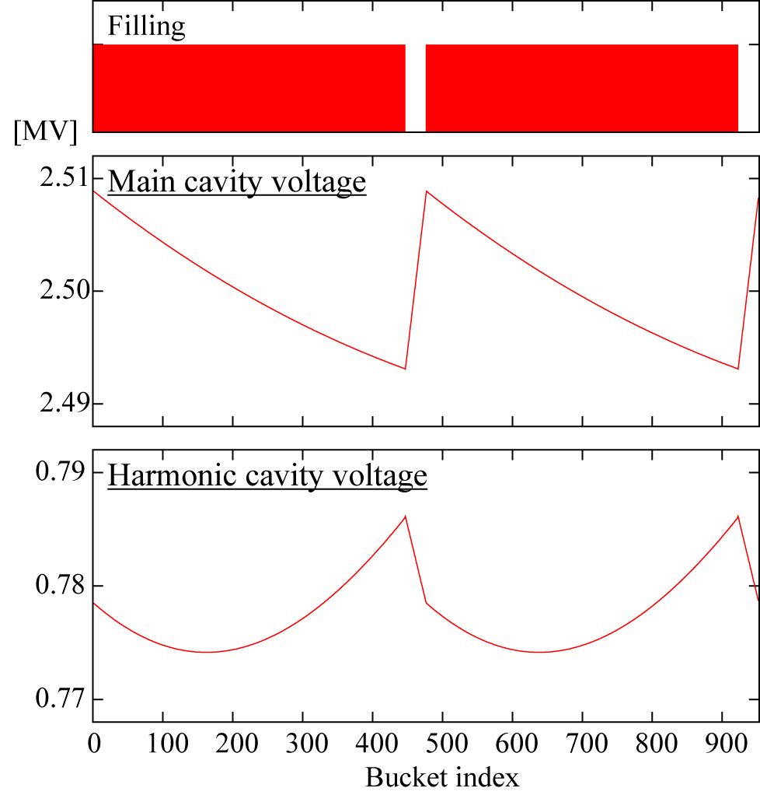
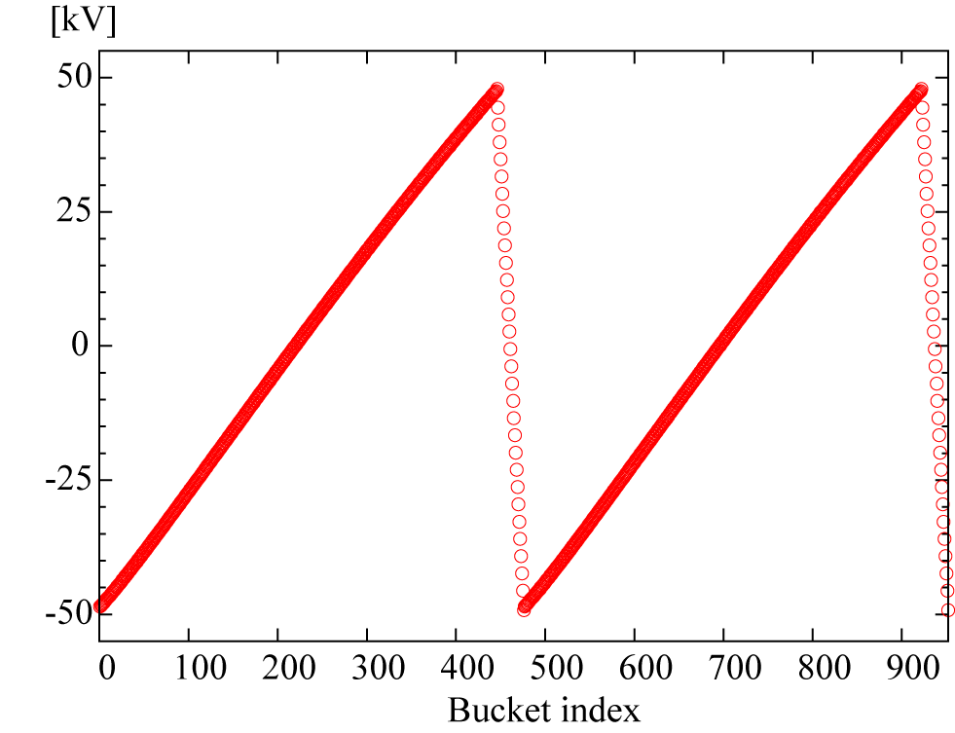
Numerical estimation (KEK-LS)
How to obtain the feedfoward signal
The RF voltage of the kicker cavity can be decided to suppress phase shifts of the bunches along the train.
* Main and harmonic voltage can be evaluated from the fill pattern.
60 ns
(TM020 HC)
Notes:
From this slide, I’ll show the details of compensation and numerical estimation results.
...
Then the voltage of the kicker cavity is decided from this formula, which is so-called energy conservation law.
In the case of 60ns gaps at KEK-LS, the voltage is evaluated like this.

Slide 25
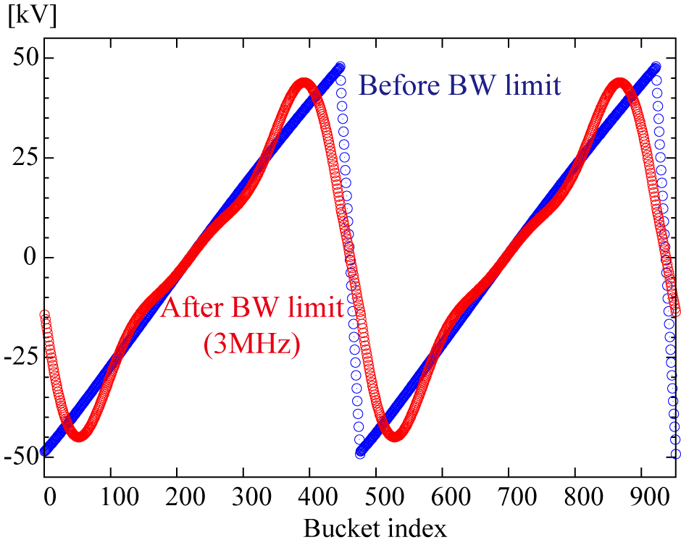
Numerical estimation (KEK-LS)
How to obtain the feedfoward signal
Evaluate the kicker cavity voltage
Apply the bandwidth limitation, where the bandwidth should be wider than the repetition frequency of the bunch train.
1.05 MHz
Notes:
For the realistic compensation, ...

Slide 26
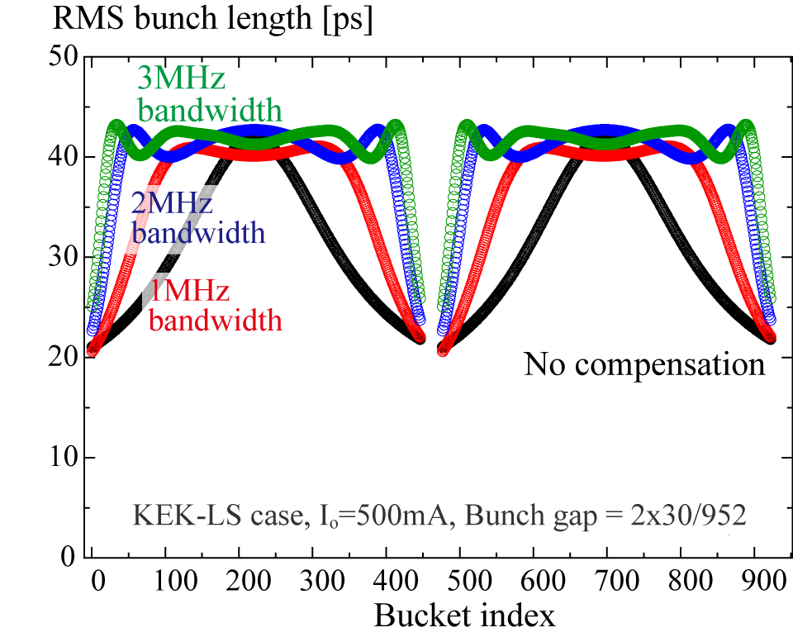
Numerical estimation (KEK-LS)
How to obtain the feedfoward signal
Evaluate the kicker cavity voltage
Apply the bandwidth limitation, where the bandwidth should be wider than the repetition frequency of the bunch train.
1.05 MHz
(w. TM020 HC)
Notes:
For the realistic compensation, ...

Slide 27
Numerical estimation (KEK-LS)
How to obtain the feedfoward signal
Evaluate the kicker cavity voltage
Apply the bandwidth limitation, considering the repetition frequency of the bunch train.
Input RF power can be estimated, taking into account the cavity and amplifier responses.
Compensation bandwidth | Average Bunch length | Peak Generator Power | Average Generator Power
[MHz] | [ps] | [kW] | [kW]
－ | 31.1 | － | －
1 | 35.6 | 11.1 | 5.6
2 | 39.6 | 31.6 | 11.1
3 | 40.9 | 46.7 | 14.7
Notes:
For examples,
when we select the 3MHz bandwidth, the average bunch length of 40.9 ns are achieved
with the peak generator power of 47 kW and the average generator power of 15 kW.
We think that these values are reasonable ( and feasible)

Slide 28
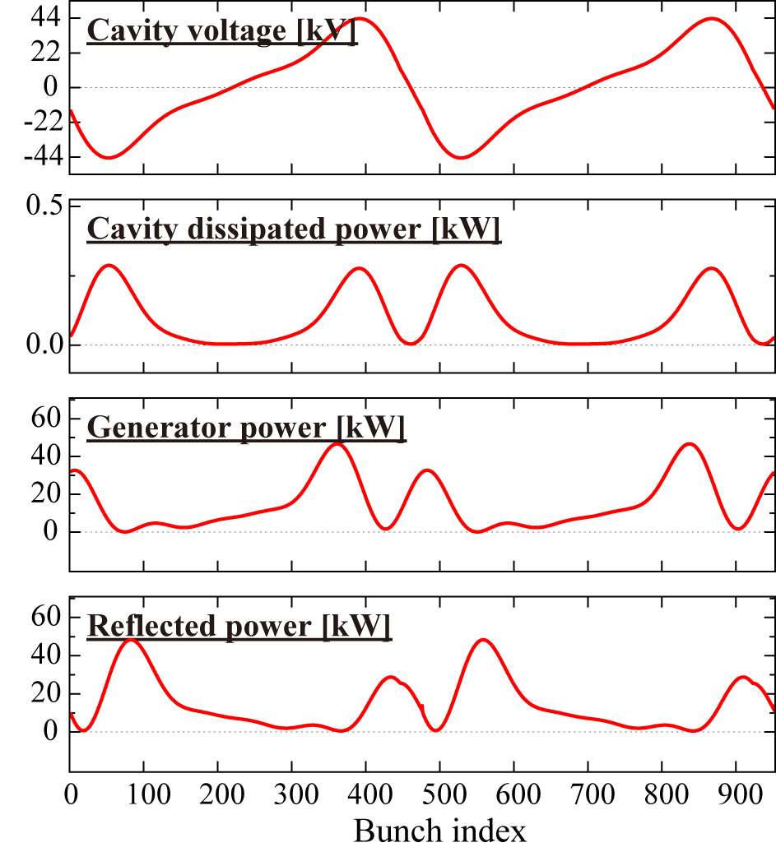
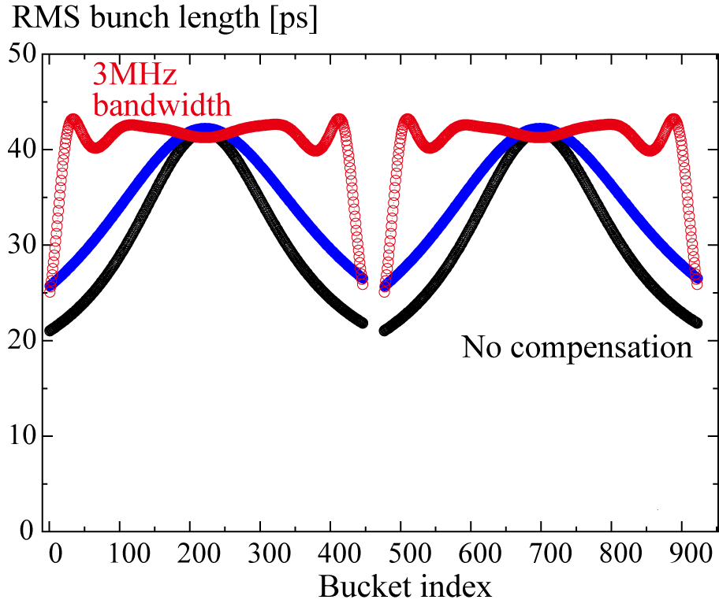
Numerical estimation (KEK-LS)
Compensation bandwidth | Average Bunch length | Peak Generator Power | Average Generator Power
[MHz] | [ps] | [kW] | [kW]
3 | 40.9 | 46.7 | 14.7
Using SC harmonic cavity
60ns bunch gap
Notes:
In this figure, we also plotted the calculation result by using the SC harmonic cavity.

Slide 29
Numerical estimation (SLS)
Such compensation scheme can be applied to the SC harmonic system.
At SLS, when the bunch gap was around 280 ns, considerable transient effect was observed.
*M. Pedrozzi, et al., SRF03 (2003) p. 91
280 ns
Notes:
In addition, I will show another example of the compensation.
...
As shown before,..
By using the kicker cavity, the bunch length can be improved.

Slide 30
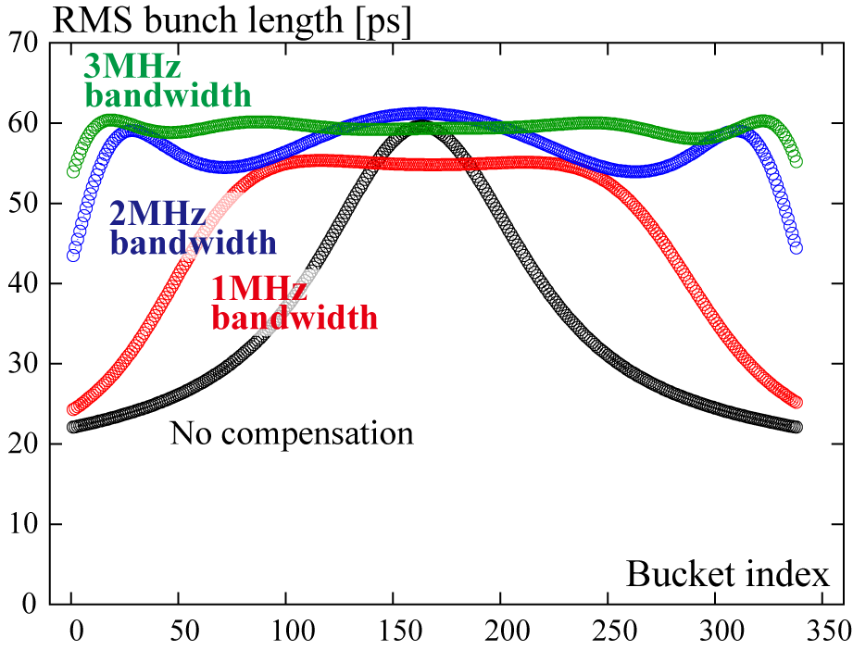
Numerical estimation (SLS)
Kicker cavity parameter
(not optimized)
Frequency | [MHz] | 500
R/Q | [Ω] | 175
Unloaded-Q |  | 40000
Cavity number |  | 1
Cavity coupling |  | 199
Loaded-Q |  | 200
3dB bandwidth | [MHz] | 2.5
Compensation bandwidth | Average Bunch length | Peak Generator Power | Average Generator Power
[MHz] | [ps] | [kW] | [kW]
－ | 35.8 | － | －
1 | 46.3 | 25.8 | 16.8
2 | 56.9 | 84.1 | 35.6
3 | 59.3 | 98.3 | 39.1
Notes:
The kicker cavity parameters are same to the KEK-LS case.
Please look at the figure of the bunch length.
In any compensation cases, the bunch length performances are improved.
(And for the 3MHz case, almost transient effect can be avoided.)
Further required input power are summarized in this table.
So if we input the RF power of 100kW, the transient effect is almost perfectly compensated.
These values are large but from the perspective of the cavity structure, these rf power are acceptable.

Slide 31
Summary
Harmonic RF system is essential in ring based future light source.
Normal conducting TM020 cavity is a candidates for harmonic cavities because of it’s high unloaded-Q and small R/Q (large stored energy).
By using single kicker cavity with active feedfoward LLRF system, the beam loading effect for the double RF system can be minimized and avoided.
(This technique can be applied to not only NC but also SC systems.)
Future tasks
Concrete designs of
  the HOM-damped/high-coupling kicker cavity
  the (adaptive) feedforward Low level RF system
  Several tens kW level solid state amp. with wide bandwidth.
Notes:
Finally, I summarize my presentation.
...
For the future tasks,
We have to make
That’s all. Thank you.

