Slide 1
A novel injection scheme using R.F. manipulation for SOLEIL upgrade
M.-A. Tordeux on behalf of Accelerators and Engineering Division

Slide 2
Upgrade project
Top-Up injection process
Manipulation in longitudinal plane
Analogy between transverse and longitudinal planes
Summary

Slide 3
Upgrade project
Future upgrade of SOLEIL →
Reduce the horizontal emittance below 100 pm.rad
in order to maximize the intensity of coherent photon flux arriving at the beamlines, especially in the soft tender X-rays range up to 3 keV.
Constraints among a long list:
Reuse of the existing tunnel and its radiation shielding wall → machine with same length of 350 m and specific geometry to maintain the existing insertion device source points as much as possible.
Preserve a current of 500 mA in multibunch operation, preserve time structure and time resolved operations with top-up injection.

Slide 4
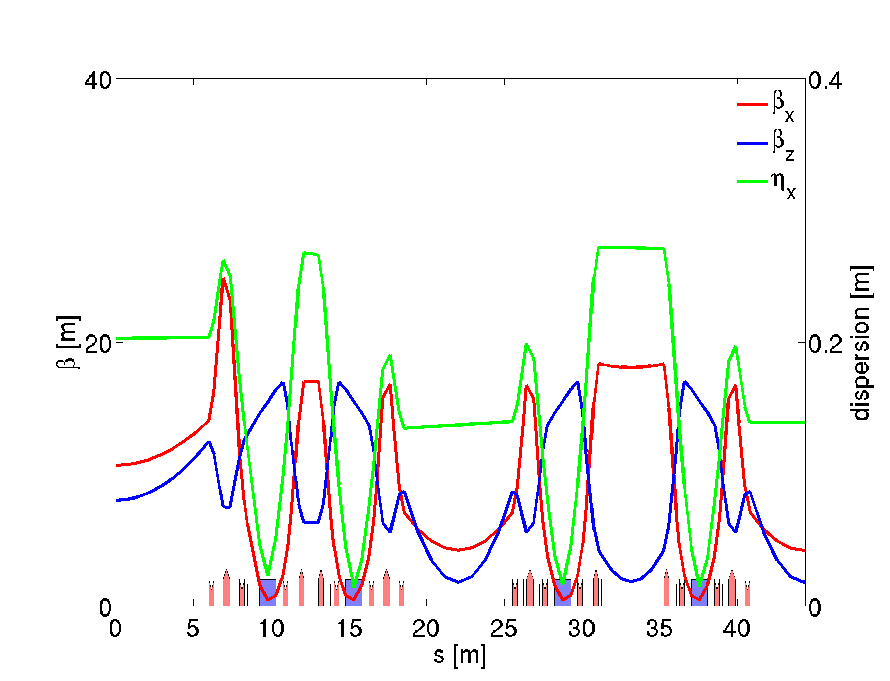
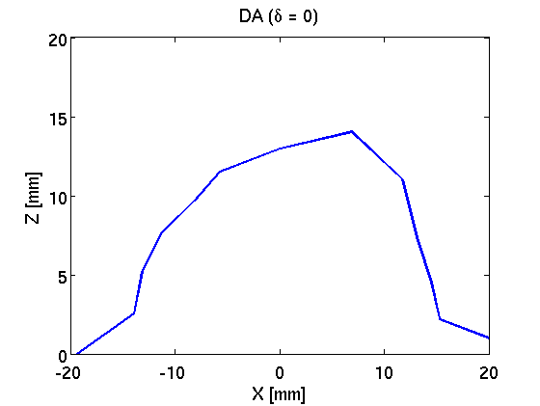
Top-Up injection process (transverse plane)
Present SOLEIL lattice
ε_{x}= 4 nm.rad
1/8 ring
Simulated Dynamic Aperture without error
Off axis injection of the Booster beam
Large betatron oscillation
Off axis injection
Stored beam
Injection kickers
Injected beam

Slide 5
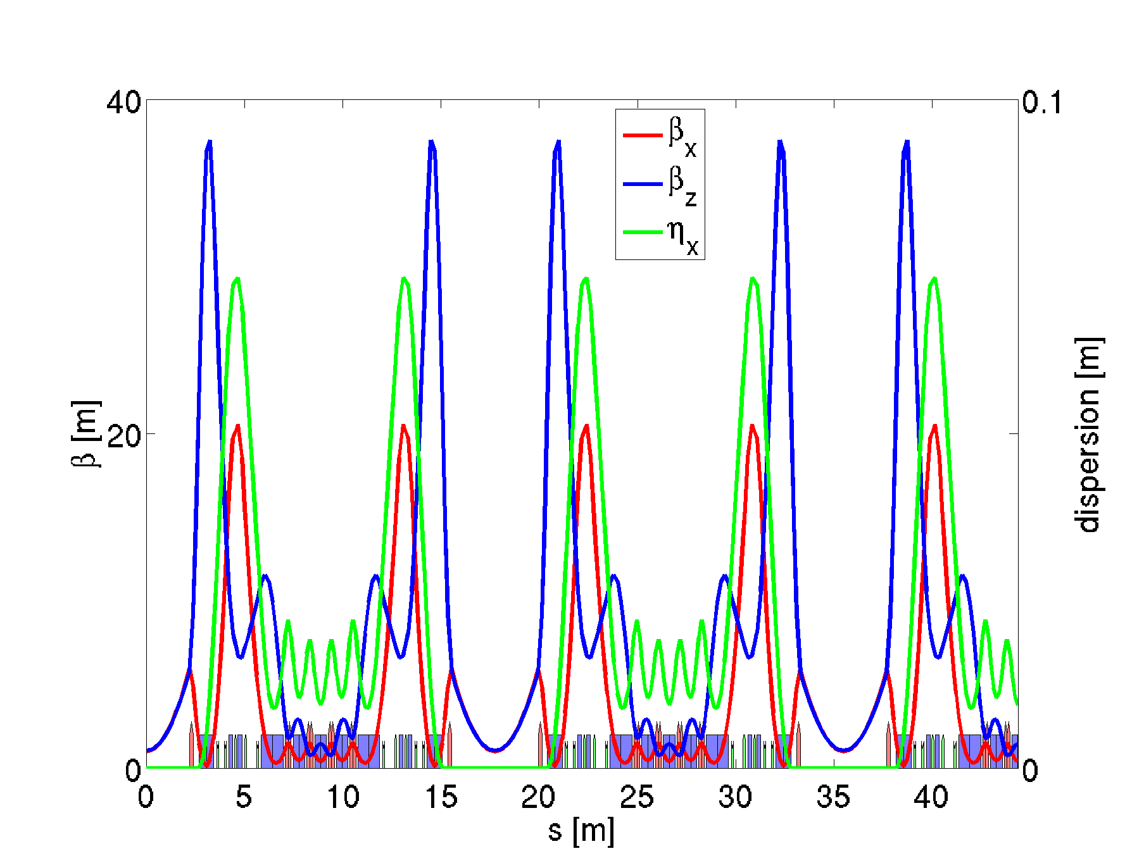
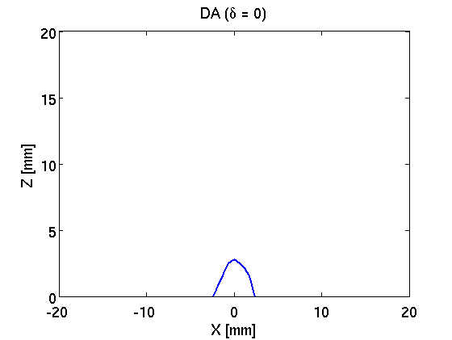
Top-Up injection process (transverse plane)
Baseline lattice for Upgrade:
7BA structure
ε_{x}= 72 pm.rad
1/8 ring
Simulated Dynamic Aperture without error
Pinhole!
Forget OFF axis injection!

Slide 6
Top-Up injection process (transverse plane)
Baseline lattice for Upgrade:
7BA structure
ε_{x}= 72 pm.rad
1/8 ring
Simulated Dynamic Aperture without error
Pinhole!
Try ON axis injection
But standard on-axis injection scheme (swap-out) requires ultra-fast kickers that are far from feasibility in SOLEIL case (352 MHz).

Slide 7
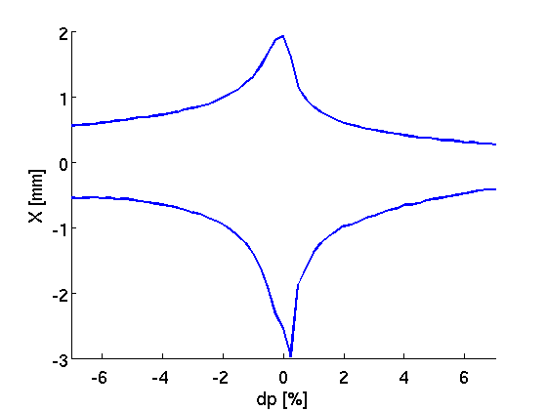
Top-Up injection process (transverse plane)
Baseline lattice for Upgrade:
7BA structure
ε_{x}= 72 pm.rad
Simulated Dynamic Aperture without error
1/8 ring
DA (δ = + 6%)
Simulated Dynamic Aperture without error
This is an ON (chromatic)-axis injection!
Chromatic axis for a beam which is shifted in energy
Stored beam
Injected beam
MIK = Multipole injection kicker

Slide 8
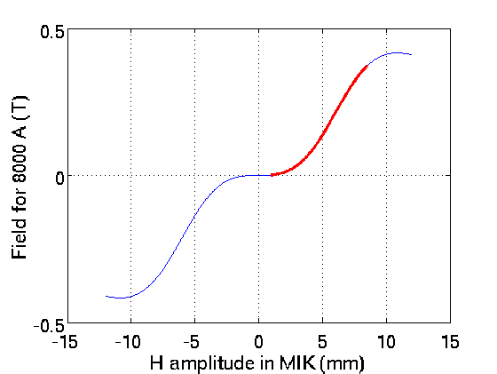
Top-Up injection process (transverse plane)
Field profile for MIK
Chromatic axis for 6% energy offset
The MIK is a magnetic device with zero field on axis (no perturbation of the stored beam), and a field off axis that will kick the injected beam on the chromatic axis.
Device already installed on MAXIV Lab., soon on SOLEIL (collaboration SOLEIL, MAXIV Lab.).
Unperturbed
stored beam
This is an ON (chromatic)-axis injection!
Chromatic axis for a beam which is shifted in energy
Stored beam
Injected beam
MIK = Multipole injection kicker

Slide 9
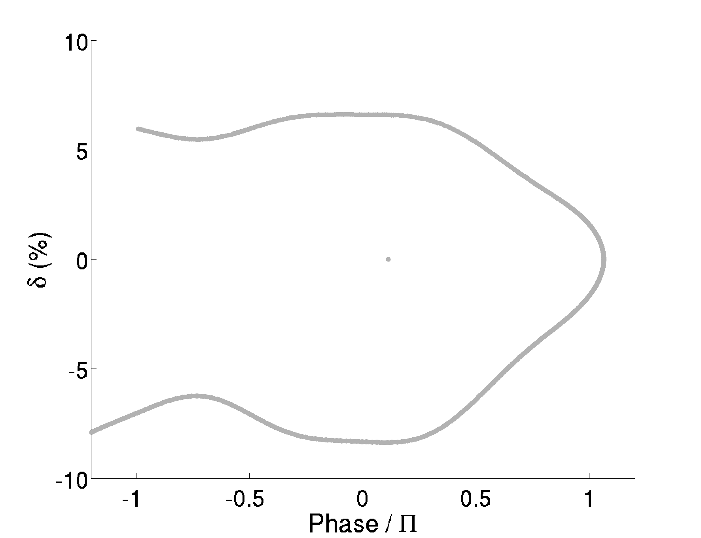
Manipulation in longitudinal plane
How to capture a particle which is shifted in energy (« off-momentum »)?
Injection
6% energy offset
Natural trajectory
Particle is lost!
Origin of phase corresponding to ϕ_{s}

Slide 10
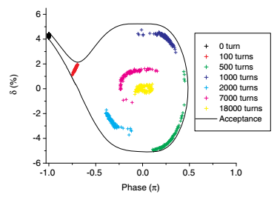
Manipulation in longitudinal plane
How to capture a particle which is shifted in energy (« off-momentum »)?
Idea from SLS group: use the natural golf club shape of the longitudinal plane to inject and store an off-momentum beam, in top-up mode.
Injection of an off-momentum beam at phase - π
Natural damping into the stored beam
Cf. M. Aiba et al., Longitudinal injection scheme using short pulse kicker for small aperture electron storage rings,
Phys. Rev. ST Accel. Beams 18, 020701 (2015).

Slide 11
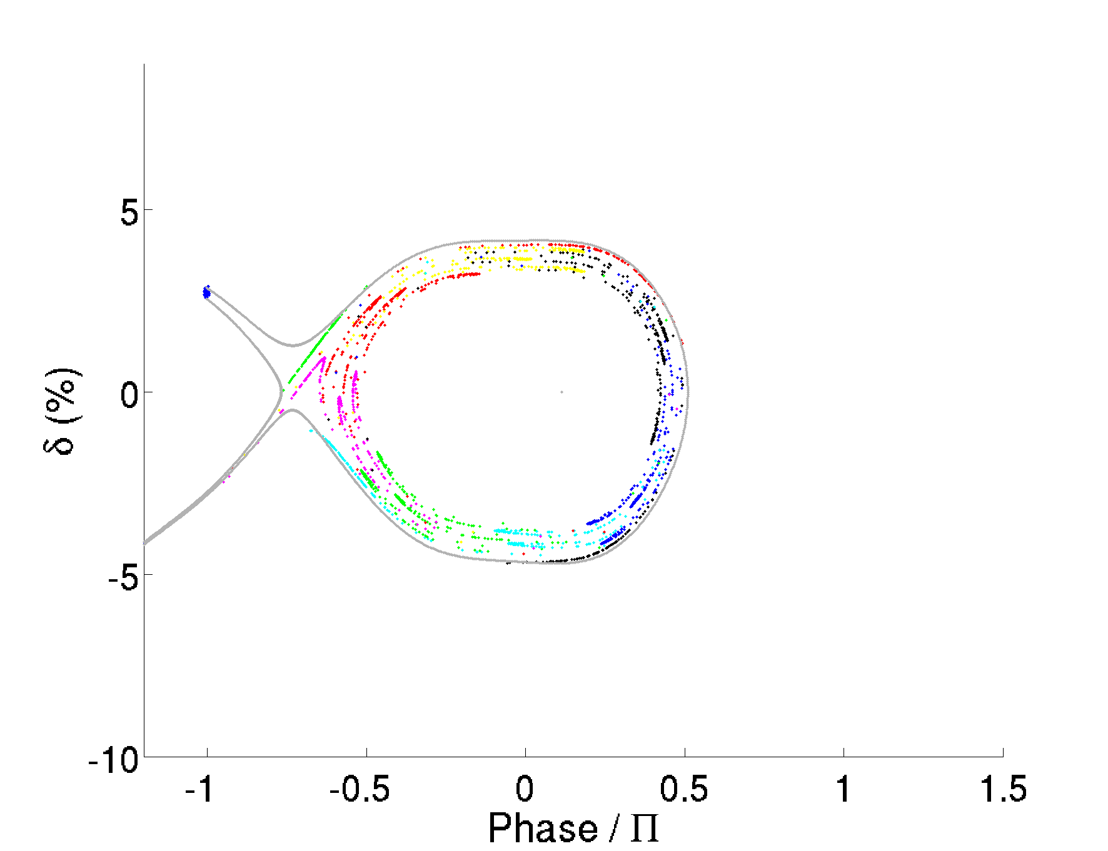
Manipulation in longitudinal plane
How to capture a particle which is shifted in energy (« off-momentum »)?
Applied to SOLEIL Upgrade (baseline lattice with 3rd harmonic cavity)
Origin of phase corresponding to ϕ_{s}

Slide 12
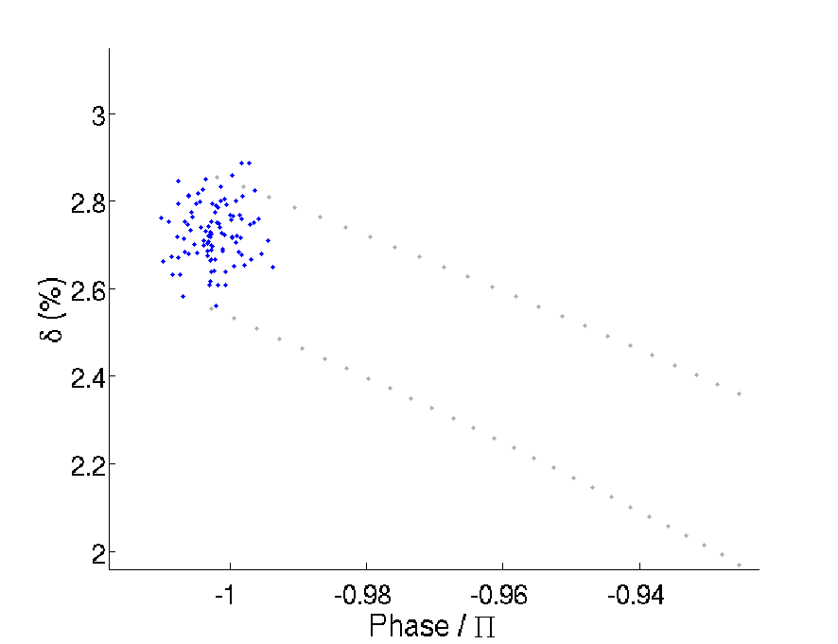
Manipulation in longitudinal plane
How to capture a particle which is shifted in energy (« off-momentum »)?
Injected bunch length and energy spread acceptance uncompatible with Booster performances
Applied to SOLEIL Upgrade
5 ps
Energy offset too low to spread enough the chromatic orbit and allow the use of a MIK
2 10⁻³
Origin of phase corresponding to ϕ_{s}

Slide 13
Manipulation in longitudinal plane
How to capture a particle which is shifted in energy (« off-momentum »)?
Keep the idea of injection at phase - π
Natural trajectory
Particle is lost!
Origin of phase corresponding to ϕ_{s}

Slide 14
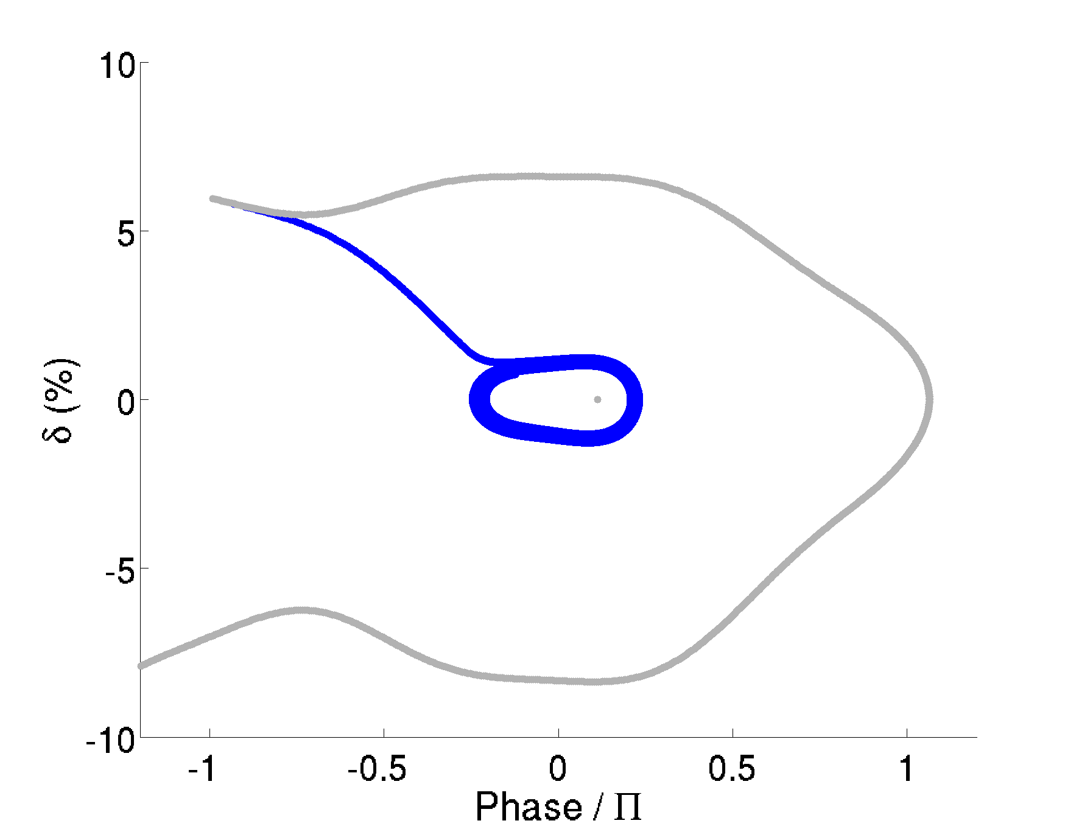
Manipulation in longitudinal plane
How to capture a particle which is shifted in energy (« off-momentum »)?
+ Longitudinal kick
Natural trajectory
Forced trajectory: Particle is captured into the longitudinal bucket
Origin of phase corresponding to ϕ_{s}

Slide 15
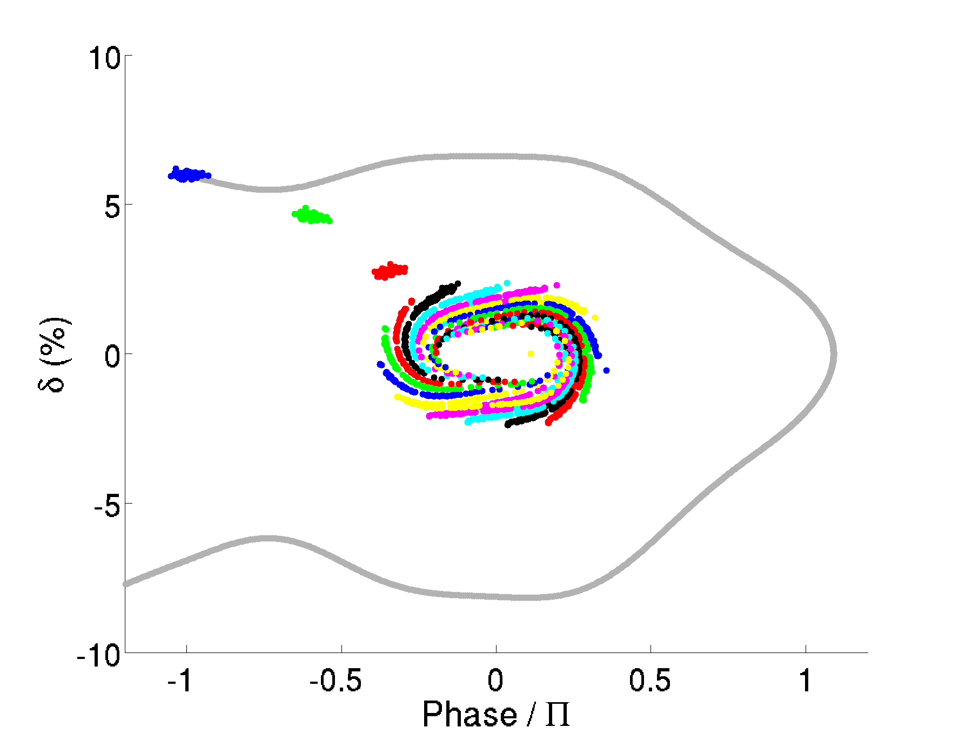
Manipulation in longitudinal plane
Case of a realistic beam from a Booster
Injected beam
ϕ_{i} = - π and δ_{i} = + 6 %
+ Longitudinal kick
Plot every 50 turns
Origin of phase corresponding to ϕ_{s}

Slide 16
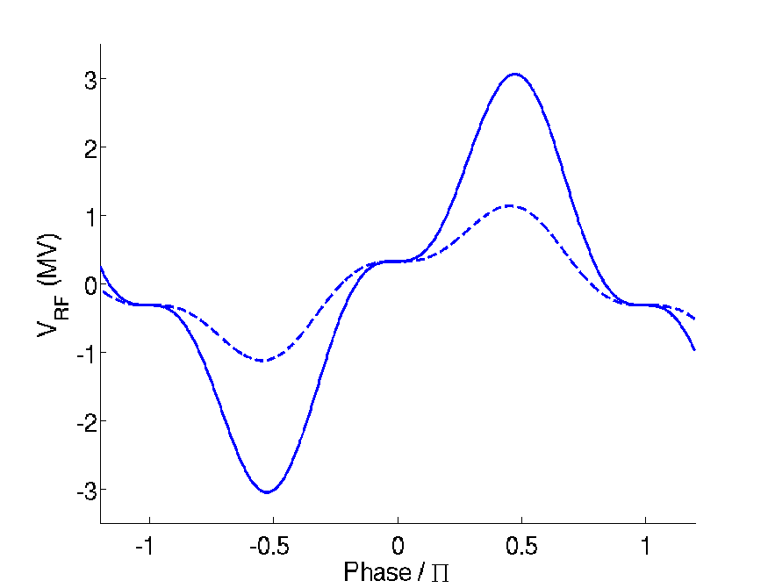
Manipulation in longitudinal plane
The longitudinal kick is produced by an additional RF pulse, during the time of injection.
Procedure:
Switch on V_{RF add} before beam is injected @ phase -π
Switch off when beam reaches ϕ_{s} , after ~200 turns
Requirements:
Do not perturb the stored beam
Plot every 50 turns
Additional
transient
RF pulse
Injected beam
Main 352 MHz RF pulse and its 3rd harmonic for operation
V_{main} = 0.9 MV
U₀ = 310 keV/turn
+ additional pulses during injection:
V_{ad} _{352 MHz} = 1.4 MV + shifted by ϕ_{s}
V_{ad} _{3rd} = V_{add} /3
Unperturbed
stored beam

Slide 17
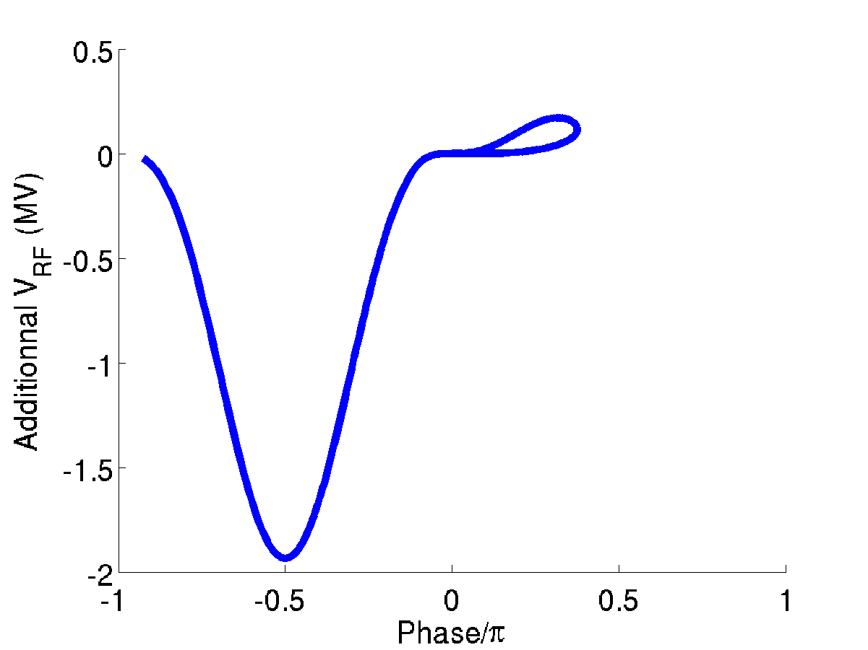
Manipulation in longitudinal plane
$$\text{L}=\frac{2 Q_{L}}{2 π f_{RF}}$$
Switch on / off takes into account the loaded quality factor Q_{L} of cavities:
One must consider:
How to get similar τ_{L} for 3rd HC compared to main RF
The phase control of main RF during voltage change
Total V_{RF add} seen by the ‘central’ particle during injection process
Injection time
175 µs
75 µs
Main RF:
ΔV = +1.4 MV dephased by ϕ_{s}
@ 3 Hz as a first approach
Injected beam
0.9 MV
Start to switch off, lets say 75 µs before time of beam reaching ϕ_{s}
Start to switch off
Worse case of supraconducting RF: Q_{L} = 10⁵ , τ_{L} = 90 µs
→ still compatible with beam dynamics.

Slide 18
Analogy between transverse and longitudinal planes
… and launched from an offset phase (- π), its energy is damped thanks to a longitudinal Non Linear Kicker (transient RF pulse - main and harmonic).
A beam with energy offset is put on chromatic axis with a transverse Non Linear Kicker (MIK) …
Field profile for Transverse NLK (MIK)
Voltage profile for Longitudinal NLK (RF)
Additional
transient
RF pulse
Injected beam
Injected beam
Unperturbed
stored beam
Unperturbed
stored beam

Slide 19
Summary
The use of a Transverse NLK (MIK) allows to inject an off-momentum beam ON (chromatic) AXIS. Unlike swap-out injection method, this doesn’t require very fast kicker, but a ‘slow’ MIK.
Then the beam is captured in the longitudinal plane thanks to a Longitudinal NLK. No short injected beam is needed. Damping process in longitudinal plane is accelerated.
Impact of errors are under investigation (Injector, Storage Ring magnets, R.F.), together with simulation on different lattices.
R.F. tests are under way (see presentation P. Marchand)
Issue on Harmonic Cavity: is there any possibility not to modulate its voltage during injection, without any impact on stored beam?

