Slide 1
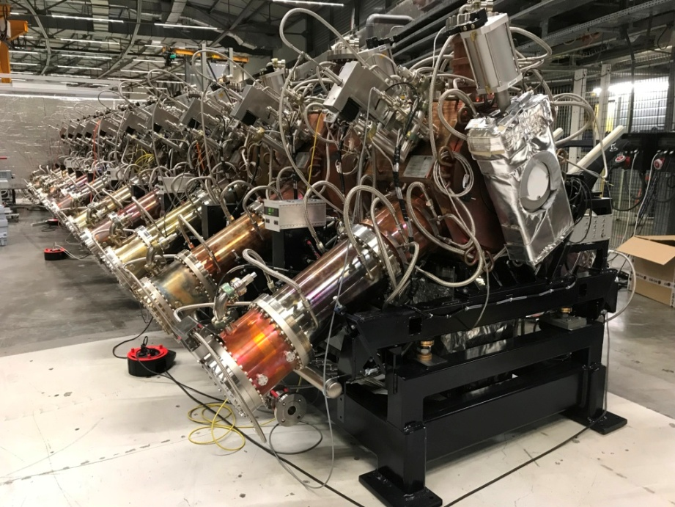

22nd ESLS RF Meeting - SOLEIL
Paris, 8-9 November 2018
Harmonic RF systems for ESRF-EBS
- Preliminary considerations -
Jörn Jacob, Vincent Serrière

Slide 2
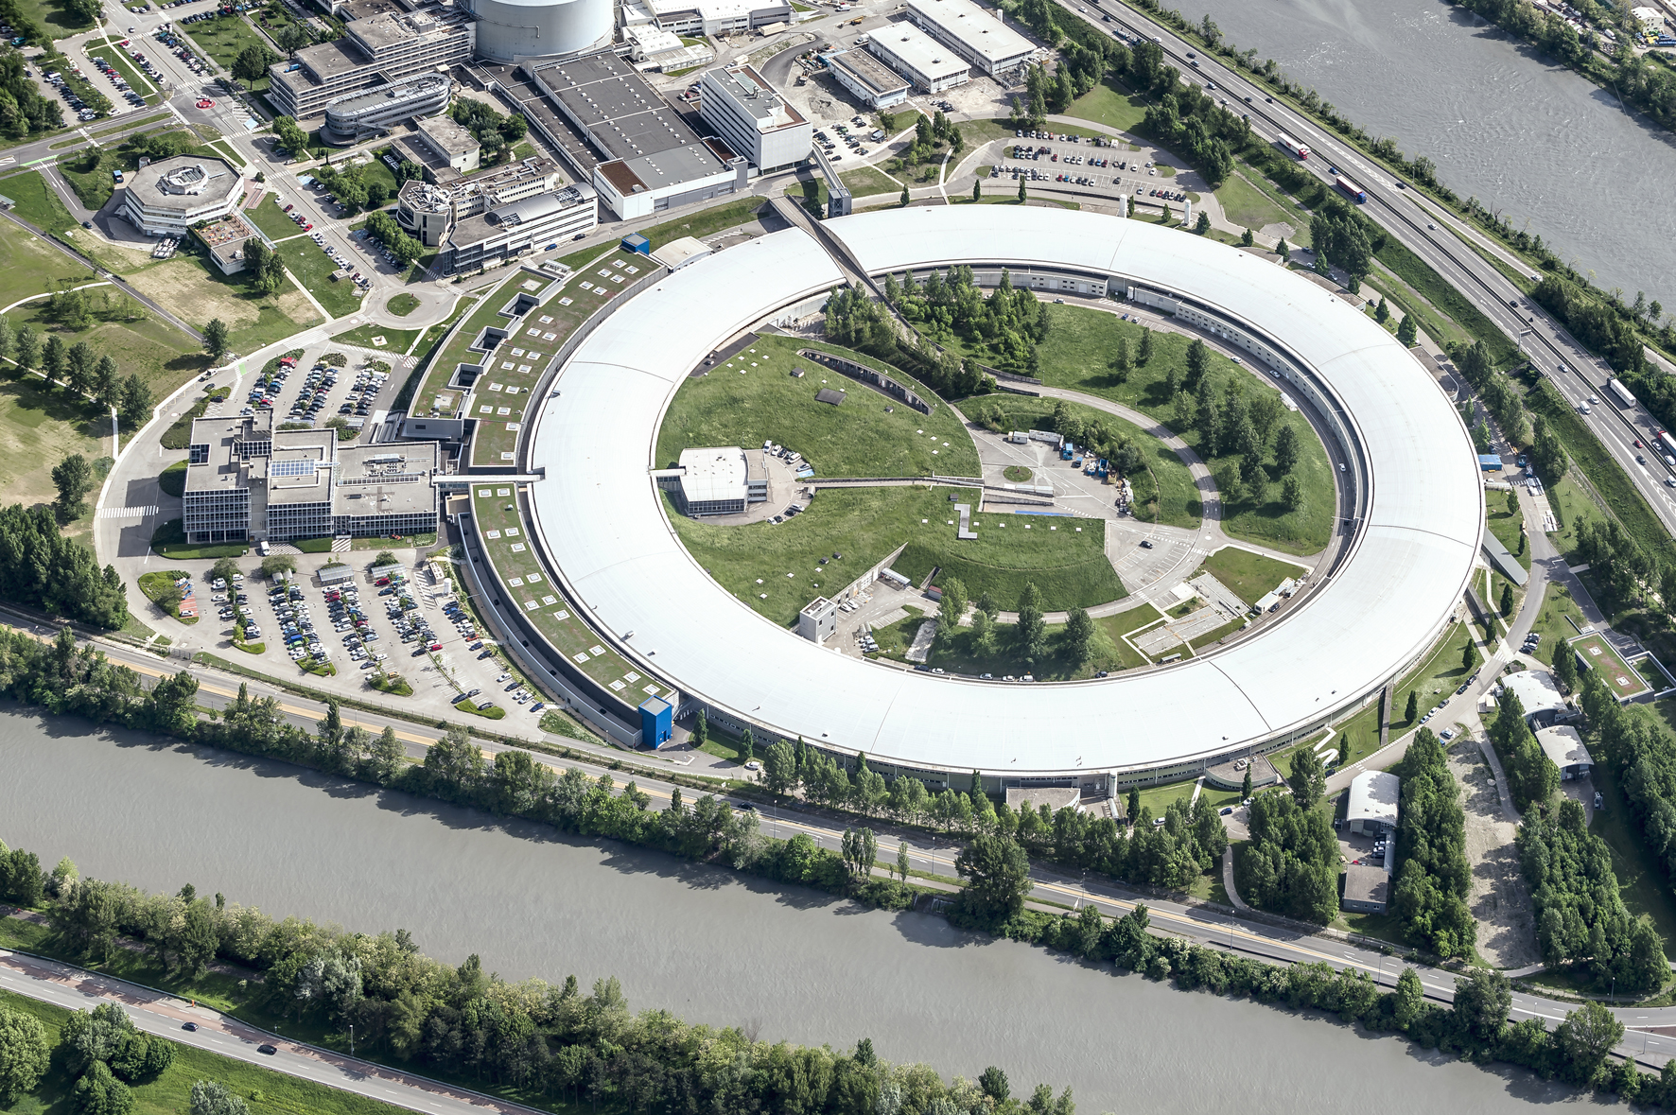

ESRF: First 3rd generation synchrotron light source
Up to 100 keV X-rays
Circ = 844 m
6 GeV Booster
200 MeV Linac
6 GeV Storage Ring
200 mA
Existing Storage Ring
1992: commissioning
1994: external users
since then:
many upgrades
brilliance increase by about a factor 1000
New Extremely Brilliant Source: EBS
further brilliance increase by a factor 40
2019: installation
2020: commissioning and resume user service

Slide 3
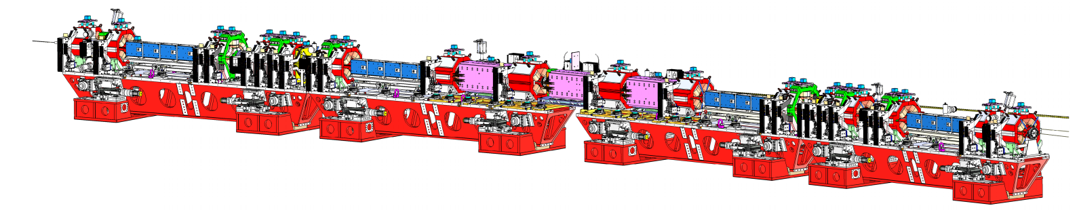
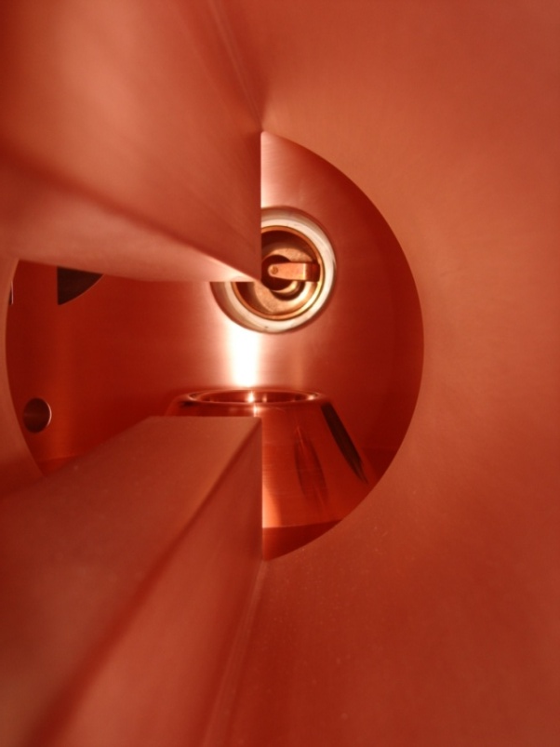

RF upgrade for the ESRF-EBS storage ring
Extremely Brilliant Source: ε_{x}: 4 nm → 134 pm
10 December 2018: shut down existing machine
2019: Installation of new machine
2020: Commissioning EBS and Beamlines
August 2020: Back to user service mode

Slide 4
EBS RF system Layout
EBS Storage Ring
Cell 5
Cell 7
EBS RF upgrade:
Remove 5 five-cell cavities
Remove 2 prototype HOM damped cavities from cell 23
Install 13 single cell HOM damped cavities in cells 5, 7, 25
Suppress existing 3rd Klystron transmitter in cell 25
Move 3 x 150 kW SSAs from cell 23 to cell 25
Rebuild waveguide distribution system
Rebuild control system for klystron transmitters and cavities
Symmetric 3dB splitting using existing magic T’s
-7 dB
-7 dB
KLYS 1
KLYS 2
NEW Teststand: in new adjacent building
75 kW
tower
75 kW
tower
75 kW
tower
75 kW
tower
75 kW
tower
75 kW
tower
Space for 3rd harmonic RF system
  Still under study:
    5 to 6 active NC cavities
    or passive Super3HC type?
  ≈ 40 kW per NC cavity from SSA
3x existing 150 kW SSAs
Cell 25

Slide 5
MAIN RF parameters for ESRF-EBS upgrade
Total energy loss: 3.2 MeV/turn
    Energy loss from dipole radiation: 2.5 MeV/turn
    Energy loss from ID radiation: 0.7 MeV/turn
Maximum RF Voltage: 6.6 MV
Stored current with operational margin: 220 mA
HOM damped cavities:
    2 of 3 prototypes on SR since 2013: 0.5 MV / 90 kW (standard operation)
    Prototypes validated with beam up to: 0.6 MV / 150 kW (phased for max beam loading)
    All 12 series cavities conditioned to: 0.75 MV
EBS 30 % less total RF power than now: ≈ 1 MW at nominal 200 mA

Slide 6

HOM damped single cell cavities
Movable Tuner
Power Coupler
f_{res} | 352.372 | MHz
Q₀ | 35700 | (measured)
R/Q | 145 | Ω
R_{s} | ≈ 5 | MΩ
Tuning range | -350 / +900 | kHz
V_{acc} nom/max | 500 / 750 | kV
Ion Pump
HOM dampers with HOM absorbers
[See A. D’Elia’s talk]

Slide 7
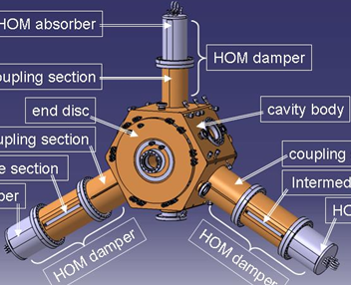
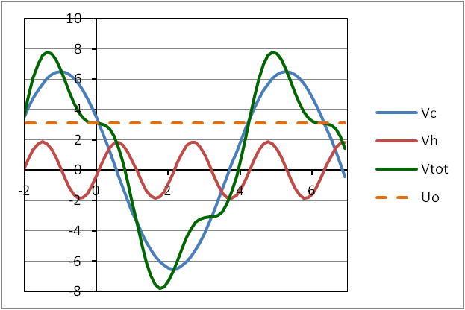
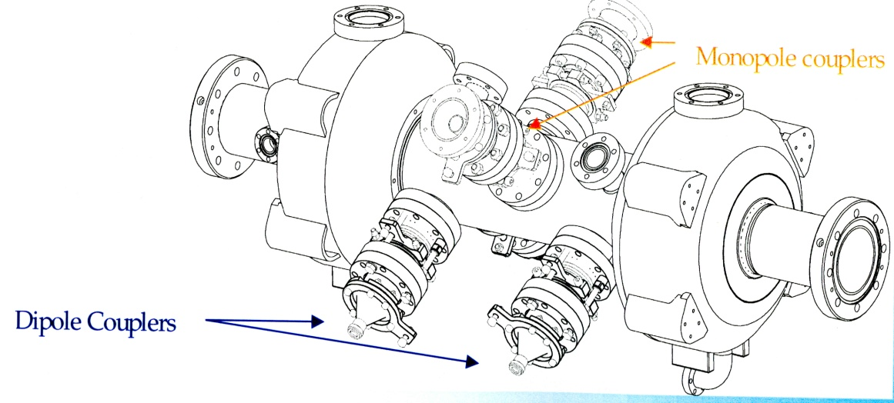
Harmonic RF system for bunch lengthening
352.37 MHz
Qo = 34500
V [MV]
Vtot
Vc = 6.6 MV
Uo = 3.2 MV
ω_{RF} t
Vh,opt = 1.89 MV
Active copper cavity:
Scaling to 1057.1 MHz
Qo = 20000
R/Q = 145 Ω
OR
Passive SC cavity:
Super3HC scaled to 1057.1 MHz

Slide 8
Beam loading - NC active harmonic cavity for bunch lengthening
V_{gr}
V_{acc}(φ) = V_{c} sin(φ_{s} + φ) + V_{h} sin(nφ_{h} + nφ)
Optimum Working point (1st & 2nd derivatives = 0):
φ_{s} = π - arcsin[ n²/(n²-1) U₀/V_{c} ]
V_{h,opt} = sqrt[ V_{c}²/n² - U₀²/(n²-1) ]
φ _{h,opt} = (1/n) arcsin[- U₀ / (V_{h,opt} (n²-1) ]
Optimum tuning (min power) ⇔ load angle = 0:
ψ such that V_{gr} // V_{c}
ψ_{h} such that V_{ghr} // V_{h}
Beware, in the vector diagram:
Main RF turns at φ = ωt
Harmonic RF at nφ = nωt
θ
V_{g}
-ψ
φ
V_{C}
V_{b}
-ψ
φ_{s}
I_{beam}
V_{br}
V_{bhr}
ψ_{h}
V_{bh}
φ_{gh} = π/2 – n φ_{h}
V_{gh}
-nφ_{h}
V_{ghr}
ψ_{h}
V_{h}
nφ
☞ φ_{harm} = n φ_{gh}
θ_{h}

Slide 9
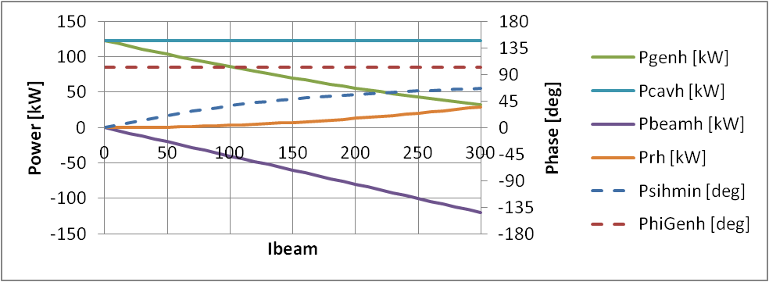
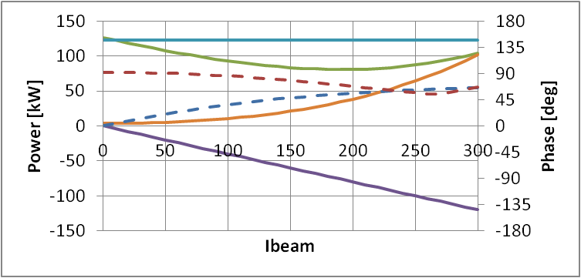
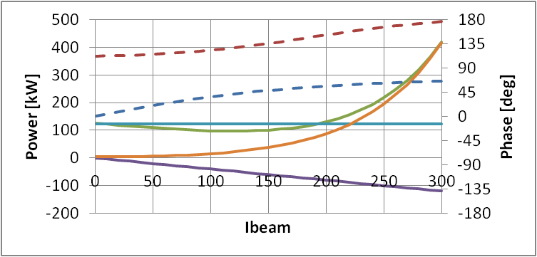
Beam loading for FIVE 3rd Harmonic active NC cavities
Coupling: β_{h} = 1
V_{h} = V_{h,opt} = 1.89 MV
nφ_{h} = nφ_{h,opt} = -12.2 deg
Working point very sensitive to harmonic cavity tuning
Below 200 mA:
Pgenh-max = 130 kW
Phi-load = 0 deg
Phi-load = -10 deg
Phi-load = +10 deg

Slide 10
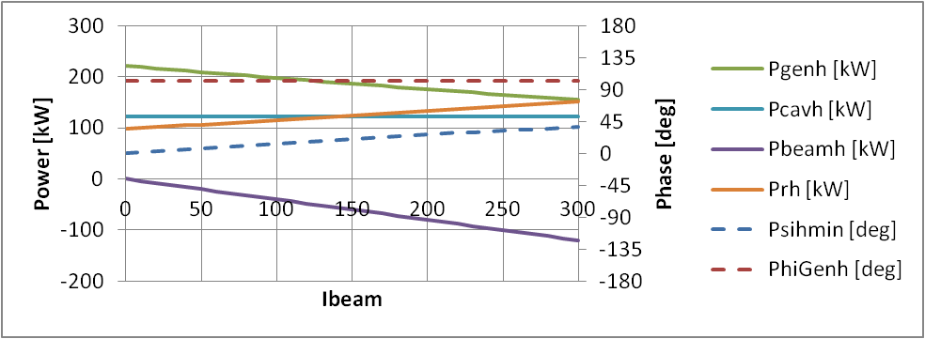
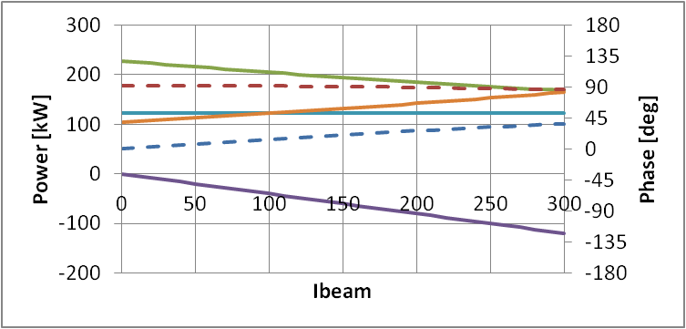
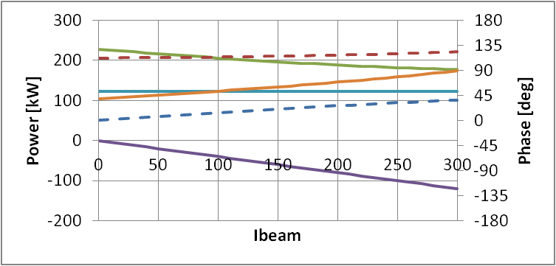
Beam loading for FIVE 3rd Harmonic active NC cavities
Coupling: β_{h} = 5
V_{h} = V_{h,opt} = 1.89 MV
nφ_{h} = nφ_{h,opt} = -12.2 deg
Working point less sensitive to harmonic cavity tuning
Below 200 mA:
Pgenh-max = 230 kW
Phi-load = 0 deg
Phi-load = -10 deg
Phi-load = +10 deg

Slide 11
Robinson DC (2nd type) – Integration of synchrotron equation
Assumptions:
RF loops (Amp, Phi, tuning | slower than | Synchrotron motion | slower than | Cavity Bandwidths (main & HC)
B ≈ 1 Hz | << | fs ≈ 1 kHz … | << | Above ≈ 40 kHz
⇓
  Tuning angles, generator amplitudes and phases are constant at the scale of the synchrotron motion
  The beam induced voltages in the cavities follow the beam phase
    f_{s} = f_{rf} x sqrt [ α K’ / (2π h E₀/e) ], (K’<0 ⇔ DC Robinson instability)
    K’ = -V_{c} cos φ_{s} - nV_{h} cos(nφ_{h}) + V_{b} sin ψ + nV_{bh} sin ψ_{h} (Eq. 1)
> 0
Main RF, giving f_{s0}
< 0
Harm. RF, for cancelling f_{s}
< 0
Main RF
beam loading
(Robinson term)
> 0
Harm. RF,
beam loading
(Stabilizing effect)

Slide 12
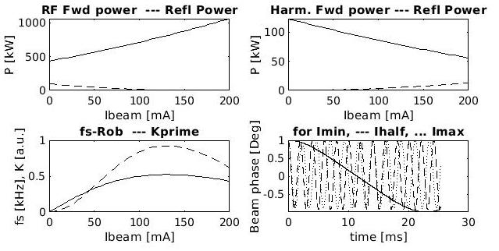
Robinson DC (2nd type) – Integration of synchrotron equation
Numerical integration of synchrotron equation:
  Uniform filling (no transients)
  Starting with beam phase offset by +1 or -1 deg
  Tracking V_{b}, V_{bh} and φ_{beam} turn by turn
  Checking convergence (neglecting synchrotron oscillation damping)
  No linearization !
V_{h} = V_{h,opt} = 1.89 MV
nφ_{h} = nφ_{h,opt} = -12.2 deg
5 cavities, β_{h} = 1
→ stable
Eq. 1
← Numerical integration

Slide 13
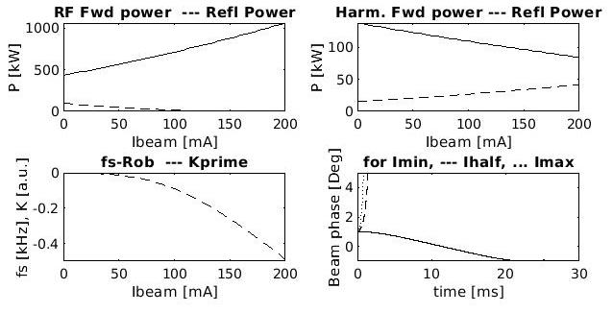
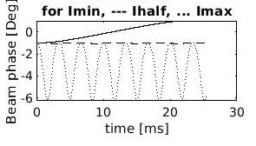
Robinson DC (2nd type) – Integration of synchrotron equation
V_{h} = V_{h,opt} = 1.89 MV
nφ_{h} = nφ_{h,opt} = -12.2 deg
5 cavities, β_{h} = 2
→ Unstable for I_{beam} > 0
Eq. 1
Start with
φ_{beam} = +1 deg
Start with
φ_{beam} = -1 deg
Only for negative beam phases: stabilization through non-linearity of voltage waveform
Equilibrium for ≈ 100 mA

Slide 14
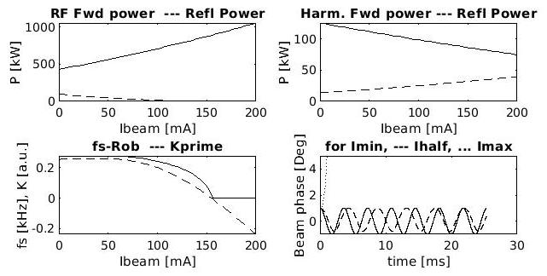
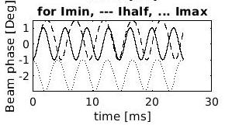
Robinson DC (2nd type) – Integration of synchrotron equation
V_{h} = 1.80 MV ( ≠ V_{h,opt} )
nφ_{h} = nφ_{h,opt} = -12.2 deg
5 cavities, β_{h} = 2
→ Unstable for I_{beam} > 150 mA
Eq. 1
Start with
φ_{beam} = +1 deg
Start with
φ_{beam} = -1 deg
Threshold at ≈ 150 mA confirmed by numerical integration

Slide 15
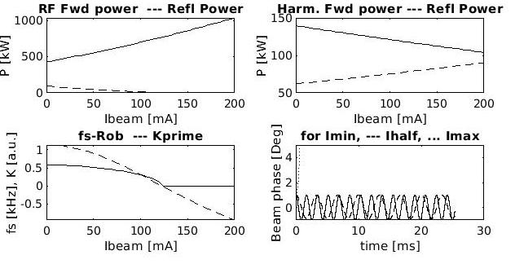
Robinson DC (2nd type) – Integration of synchrotron equation
V_{h} = 1.50 MV ( ≠ V_{h,opt} )
nφ_{h} = nφ_{h,opt} = -12.2 deg
5 cavities, β_{h} = 5
→ Unstable for I_{beam} > 130 mA
Eq. 1
Start with
φ_{beam} = +1 deg
Threshold at ≈ 130 mA confirmed by numerical integration
For active system, Integration of synchrotron equation indicates:
Robinson stable if Harmonic RF beam loading > Main RF beam loading
  Sufficient harmonic cavity impedance,
  Sufficient number of harmonic cavities
  Upper limit for coupling β_{h}

Slide 16
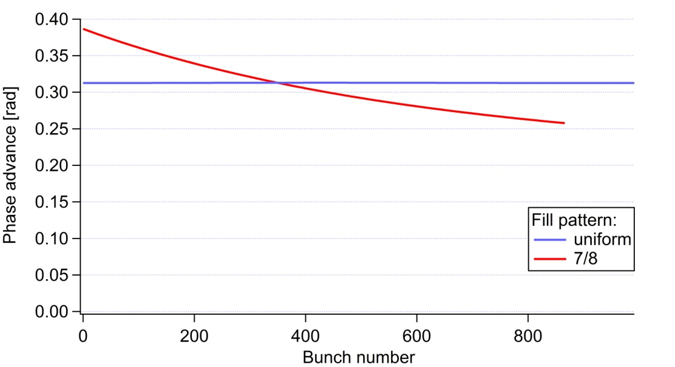
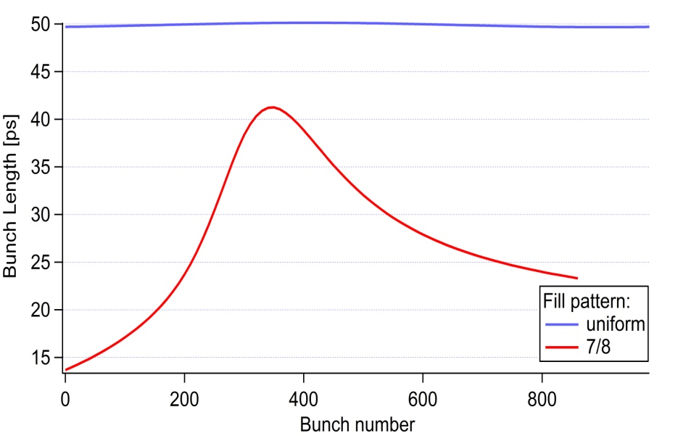
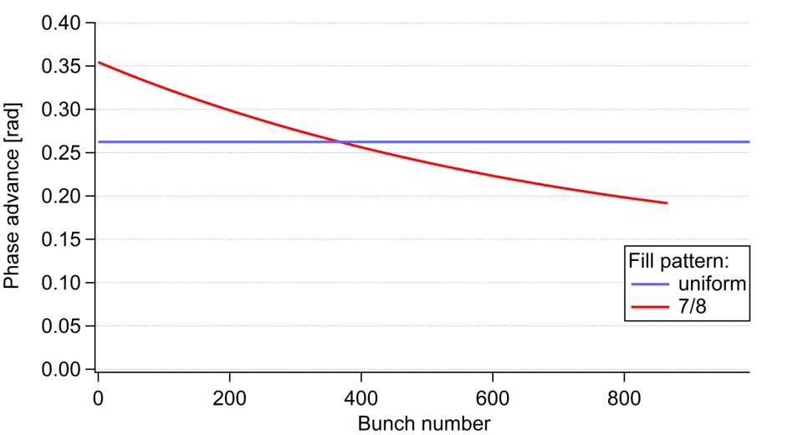
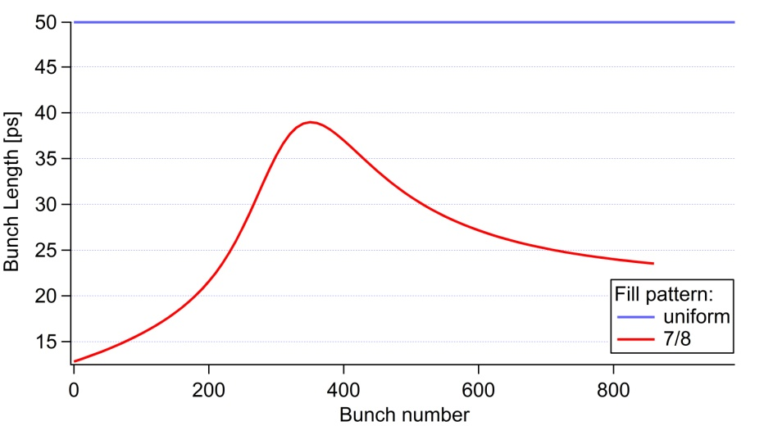
Multibunch / single particle tracking – Robinson & Phase transients
V_{h} = V_{h,opt}
φ_{h} = φ_{h,opt}
5 active NC cavities
β_{h} = 5
β_{h} = 4
For both cases: Phase transients: 0.16 rad,
! DC Robinson stable for large β_{h} !

Slide 17
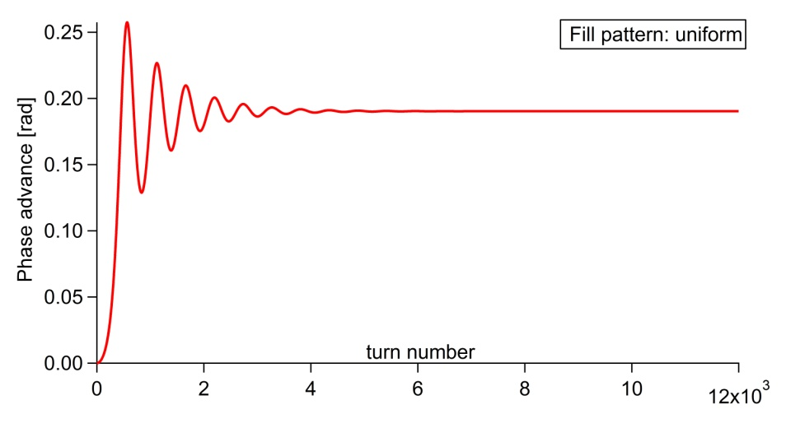
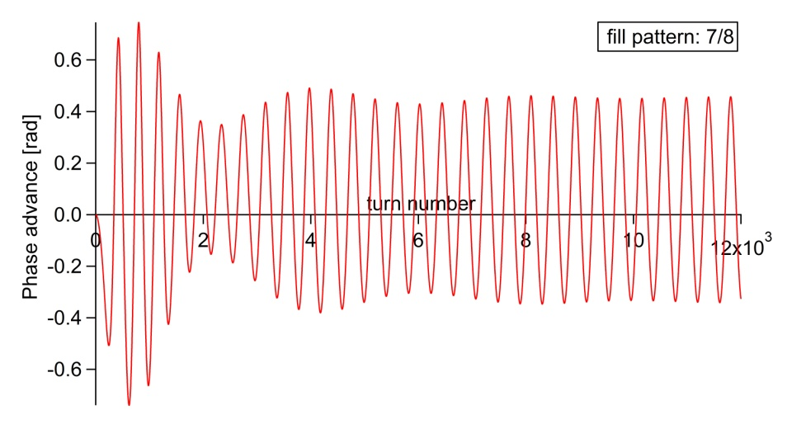
Multibunch / single particle tracking – Robinson & Phase transients
V_{h} = V_{h,opt}
φ_{h} = φ_{h,opt}
5 active NC cavities
β_{h} = 3
Uniform fill pattern
Condition for bunch elongation to 50 ps
It looks like AC Robinson instability,
BUT: needs to be checked with multibunch multiparticle tracking codes !
7/8 fill pattern
β_{h} < 3: AC like instabilities also for uniform filling

Slide 18
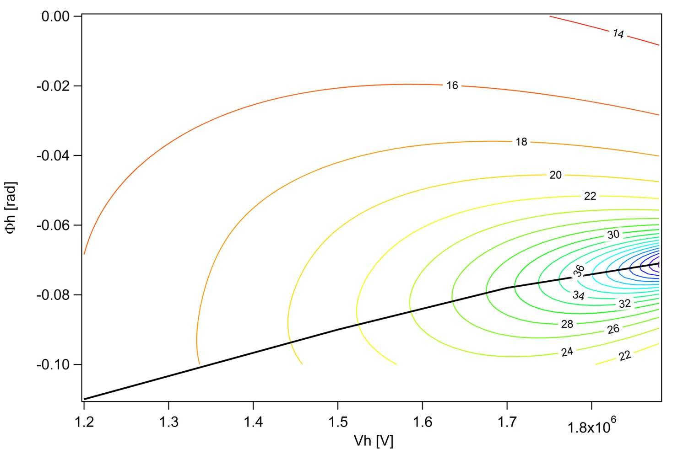
Multibunch / single particle tracking – Robinson
Bunch length computed with theoretical formula for the obtained total voltage
Stable
5 active NC cavities
β_{h} = 5
UNIFORM filling
Optimum Bunch
Lengthening
DC Robinson threshold given by Tracking*
Unstable

Slide 19
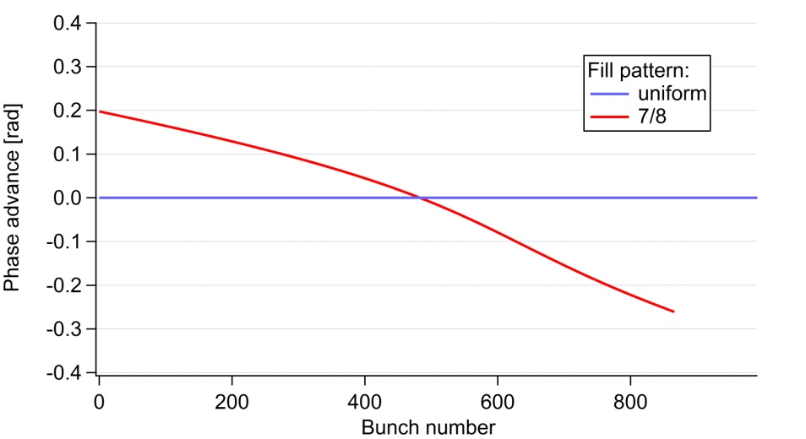
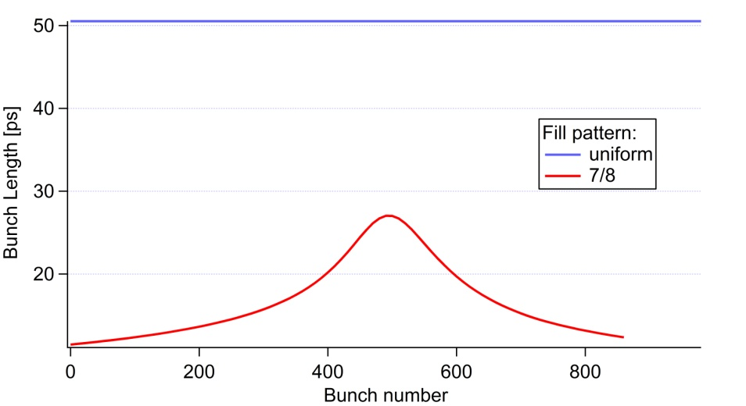
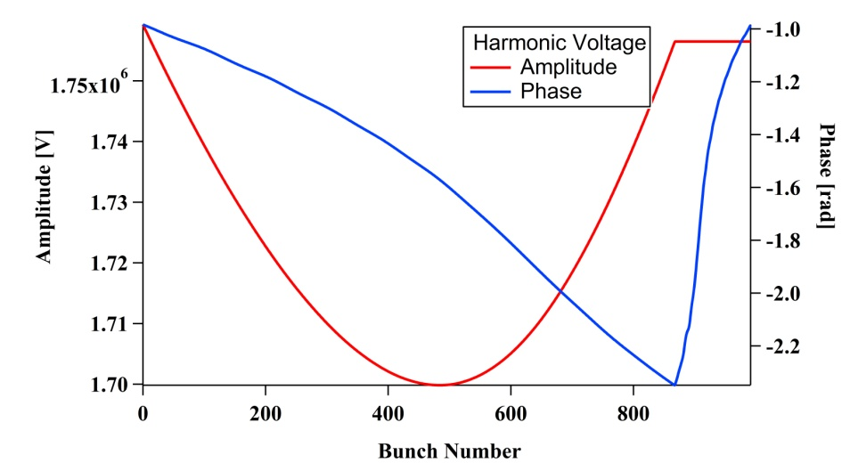
Multibunch / single particle tracking – Robinson & Phase transients
Passive SC Cavity: R/Q = 90 Ω , Q₀ = 2e8
# SC passive Cavities | 1 | 2 | 3 | 4 | 5
Phase Transient [rad] | 0.45 | 0.46 | 0.54 | 0.58 | 0.67

Slide 20
CONCLUSIONS of these very preliminary calculations
Active normal conducting cavities
  Integration of synchrotron equation indicates that strong beam loading from the harmonic cavities would be needed to avoid Robinson DC
  This is in contradiction with multibunch single particle tracking results requiring high β_{h} for stability
  Is the obtained AC like instability real? -> to be checked with multiparticle multibunch tracking
  Working points around [V_{h,opt}, φ_{h.opt}] look close to region of instability: this also needs to be confirmed
Passive Super3HC like SC cavities
  Former studies indicate that bunch lengthening operation at low current (e.g. few bunch fillings) is unstable (Robinson AC) unless several SC cavities are installed
  Phase transients with passive harmonic cavities, even with low R/Q as for SC cavities, seem to be stronger than with active cavities: to be confirmed
More studies are needed
  The results presented here are very preliminary and partially contradictory
  We decided to show them in order to trigger discussions and motivate further studies

