Slide 1
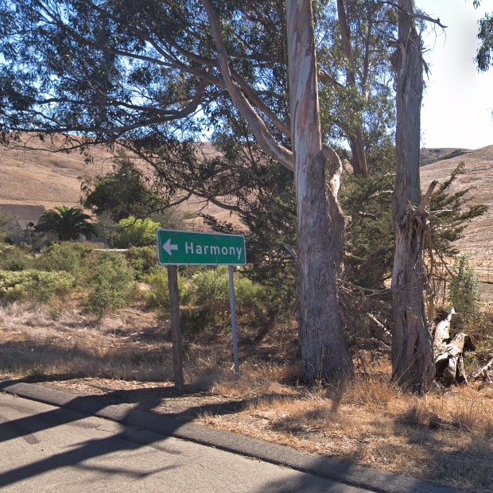
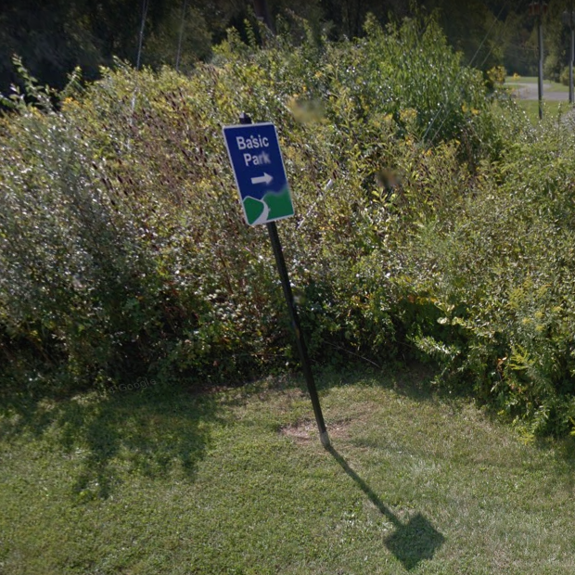
System design concept
PETRA IV
Old and new machine
The Fundamental RF System
The Harmonic RF System
Google Streetview

Slide 2
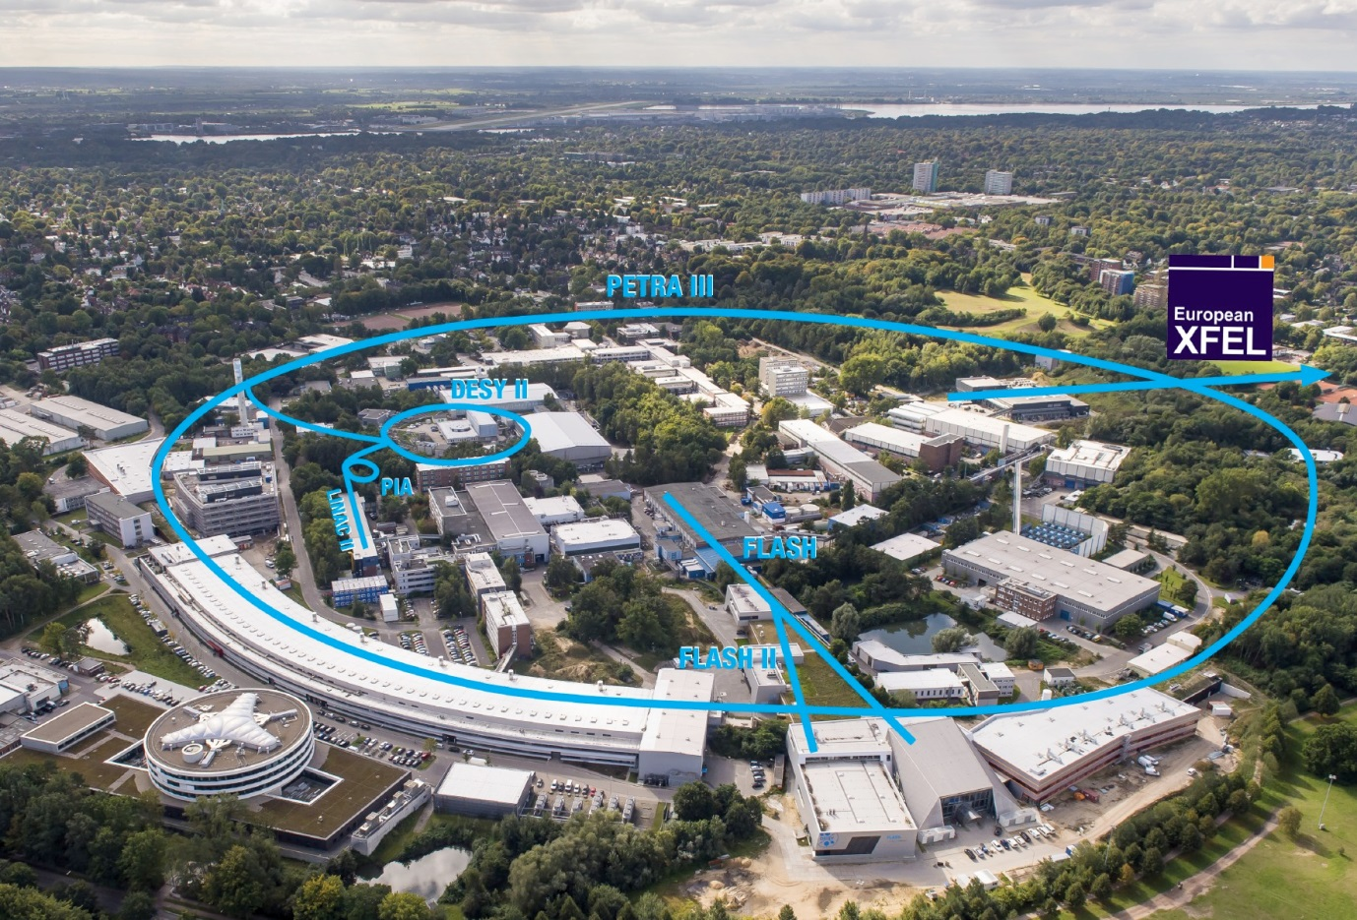
PETRA III
Main parameters:
l = 2304 m
beam energy = 6.08 GeV
beam current: 100 mA (4.8 E12 e⁻),
Top Up
emittance (hor.) = 1 nmrad
energy loss: ca. 5 MeV per turn
(ca. 65 % from damping wigglers)
20 undulators
fill pattern:
timing mode :
    40 bunches, 192 ns gap
    60 bunches, 128 ns gap
continuous mode:
    480 bunches, 16 ns gap
    960 bunches, 8 ns gap

Slide 3
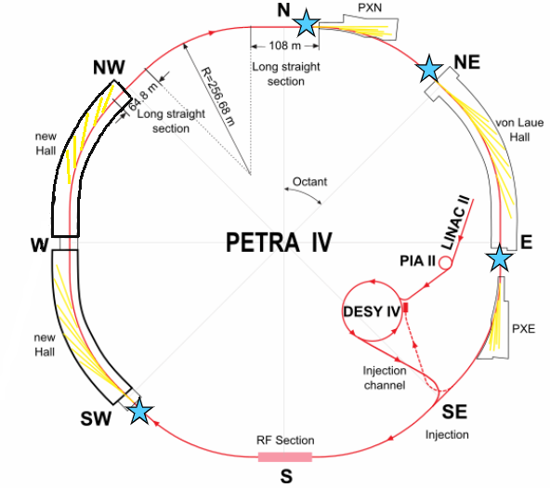
Plans for PETRA IV
2 more experimental halls
complete new pre-accelerator chain
New injection scheme (no topup – but swap out part of beam and on axis injection

Slide 4
RF-Related PETRA IV Parameters
„H7BA“-Lattice with 26 IDs
 |  | remarks
Energy | 6.0 GeV
RF frequency | 500 MHz
Circumference voltage | 6 MV_{nom} (9 MV_{max}) | Optimized for max. Touschek lifetime. Effect of 3. harm. syst. has not yet been considered
Beam current | 200 mA
Energy loss per turn | 3.32 MeV | IDs included
Energy spread | 0.905·10⁻³ | w/o IBS
Momentum compaction factor | 1.43·10⁻⁵ | About 80 times smaller than PETRA III
Bunch length (1σ) | 6.8 ps
Long. damping time | 16.2 ms

Slide 5
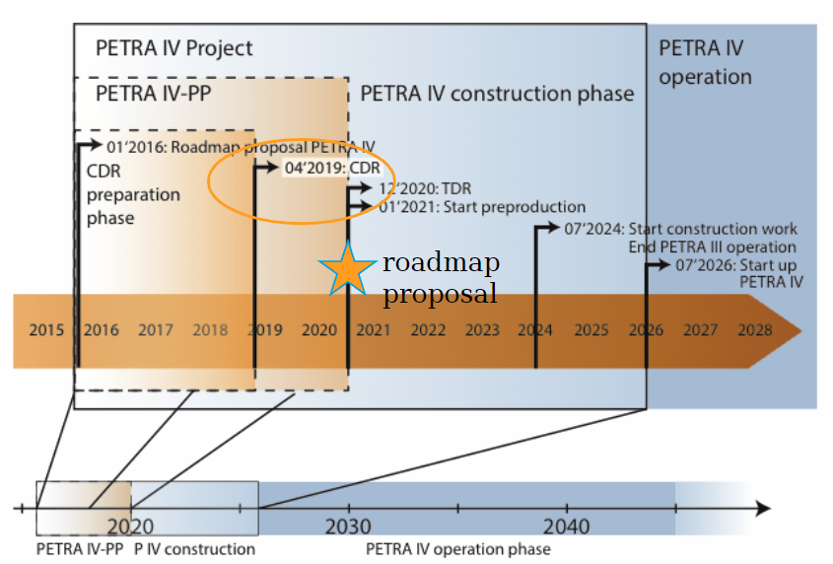

Slide 6
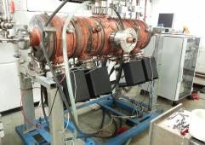
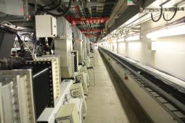
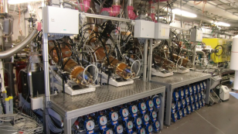
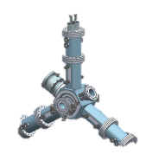
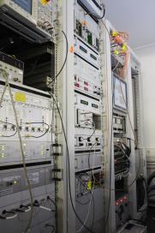
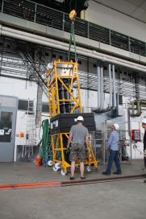

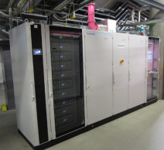
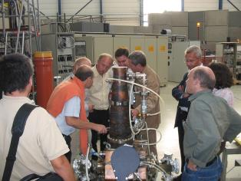
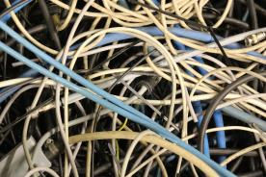
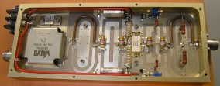
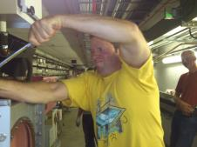
rf- part of PETRA IV

Slide 7
Fundamental cavities
What options are there?
Continuing use of the existing
5- or 7-cell cavities
☺ Cheap
☺ High shunt-impedance
☺ Space-saving
☺ Decades of experience
☹ Unclear HOM spectrum with high impedances
☹ Hardly any possibilities for HOM damping
Developing a new cavity
☺ Cavity can be optimized for PETRA IV
☹ Need about 5 years from idea
to the first prototype
☹ Childhood diseases are expected
Using an existing and proved modern cavity design
☺ Operating experience available
☺ Childhood diseases are overcome
☹ Possibly not ideal for PETRA VI
“The MAC believes that it is mandatory to replace the present RF cavities with HOM-damped ones. Given the long lead time to develop such systems the MAC recommends to finalize a design based on well-established solutions (e.g. BESSY cavities or a rescaled version of the ESRF ones) and to start the construction of a prototype as soon as possible. The MAC would like to see a related fully resource-loaded plan.”

Slide 8
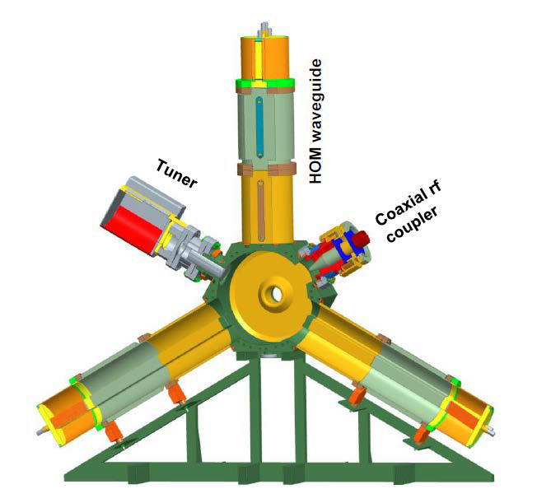
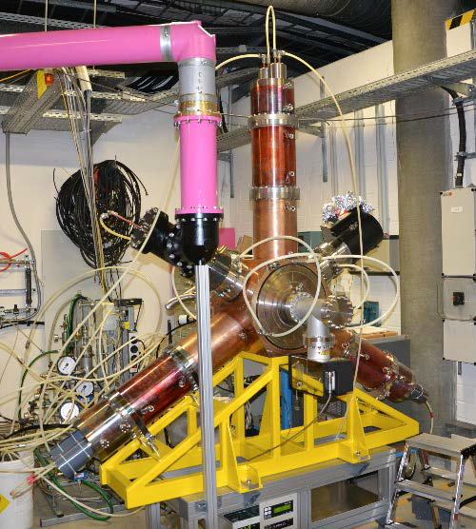
HOM-Damped EU-Cavity
Existing and proved modern cavity design for synchrotron light sources
Courtesy of Ernst Weihreter, HZB
Courtesy of Wolfgang Anders, HZB

Slide 9
HOM-Damped EU-Cavity
Cavity Parameter | Design (2002) | Series (BESSY 2013)
RF frequency | 500 MHz | 499.654 MHz
Tuning range | not reported | 2 MHz
Shunt impedance | 4 MΩ | 3.4 MΩ (A10) | influenced by damper cut-off PETRA 7-cell cav.: 3.95 MΩ per cell
Cut-off frequency of HOM dampers | 650 MHz | 625 MHz
Longitudinal HOM impedances | 4 kΩ w/o E011 | < 10.8 kΩ (∗) | PETRA 7-cell cav.: 32 kΩ per cell
Transverse HOM impedances | < 170 kΩ/m | < 50 kΩ/m (∗) | PETRA 7-cell cav.: 450 kΩ/m per cell
Quality factor | not reported | 29.600 (A10)
Maximum cavity voltage | 895 kV | 730 kV (A10)
Maximum power dissipation | 100 kW | 78.4 kW (A10)
Operational cavity voltage | - | 500 kV (A17, B18) | 15 arcing trips per cavity and year (A17) PETRA 7-cell cav.: 1.2 arcing trips per cavity and year (0.2 arcing trips per cell and year) @ 240 kV per cell
Insertion length | < 700 mm | 500 mm
Beam hole diameter | 74 mm | 74 mm
(A10): ALBA, 2010
(A17): ALBA, 2017
(B18): BESSY 2018
(∗): Data of the 2nd PT

Slide 10
HOM-Damped EU-Cavity
How many Cavities are required for PETRA IV?
PETRA III:
<1> arcing trip per cavity and year @ 0.80 MV/m
ALBA:
<15> arcing trips per cavity and year
Circumference voltage | 6 MV | 6 MV | 9 MV
Number of Cavities | 12 | 20 | 20
Operational cavity voltage | 500 kV | 300 kV | 470 kV
Cavity voltage gradient | 1.67 MV/m | 1.00 MV/m | 1.57 MV/m
Power dissipation per cavity | 36.8 kW | 13.2 kW | 29.8 kW
Power to beam per cavity | 55.3 kW | 33.2 kW | 33.2 kW
Coupler power | 92.1 kW | 46.4 kW | 63.0 kW
5% transmission loss | 4.6 kW | 2.3 kW | 3.1 kW
Coupling factor | 2.5 | 3.5 | 2.1
Total rf power consumption | 1160 kW | 975 kW | 1325 kW
Installed rf Power (20% reserve included) | 12 x 115 kW | 20 x 60 kW | 20 x 80 kW

Slide 11
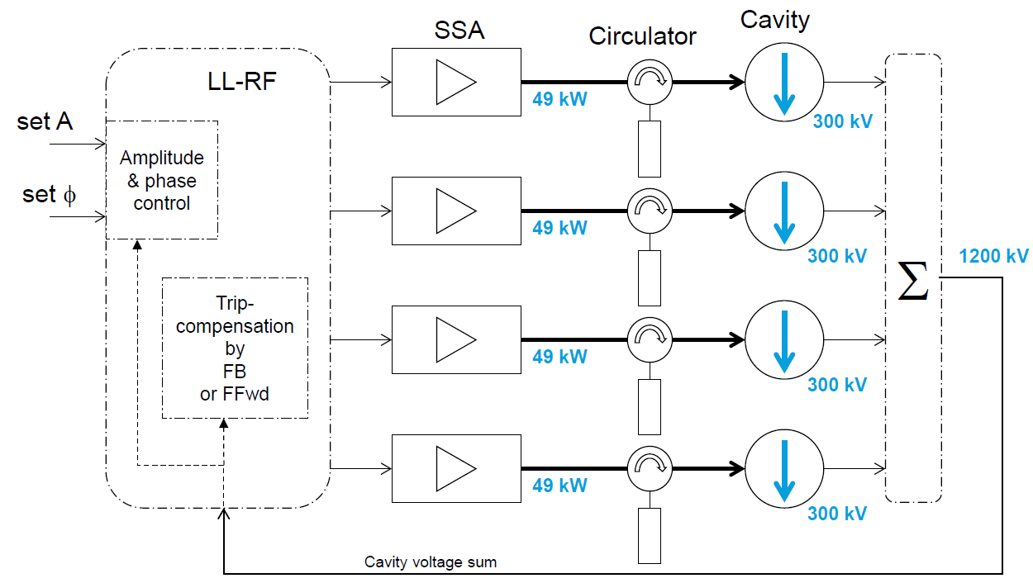
Trip Compensation
Many cavities make a big trip-potential
Voltage and power at nominal operation

Slide 12
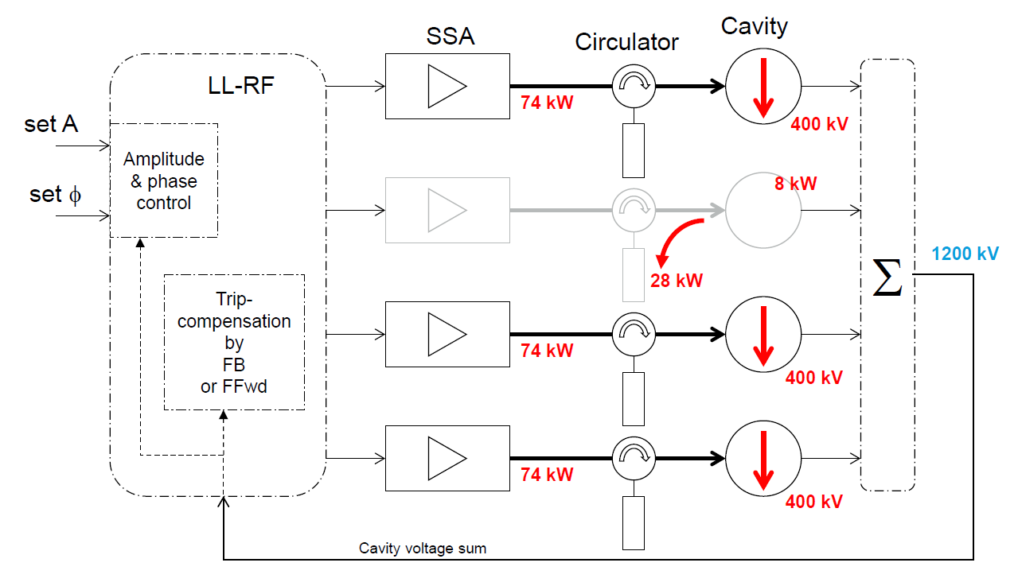
Trip Compensation
Voltage and power at nominal beam operation with one system tripped
Synchronous phase changes by 2 °
from 33.6° to 35.6°
Many cavities make a big trip-potential

Slide 13
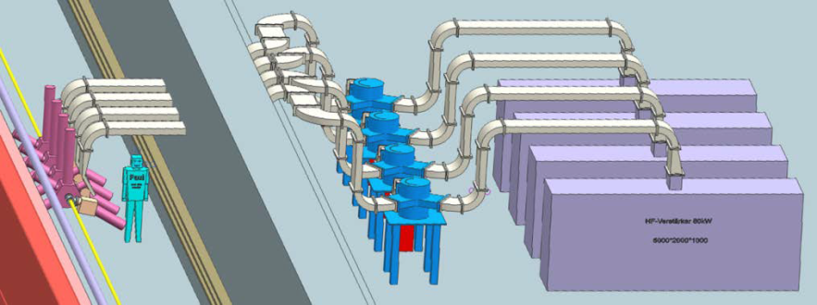
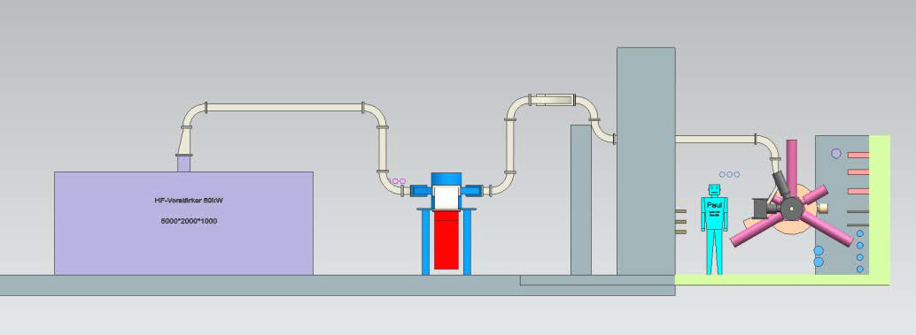
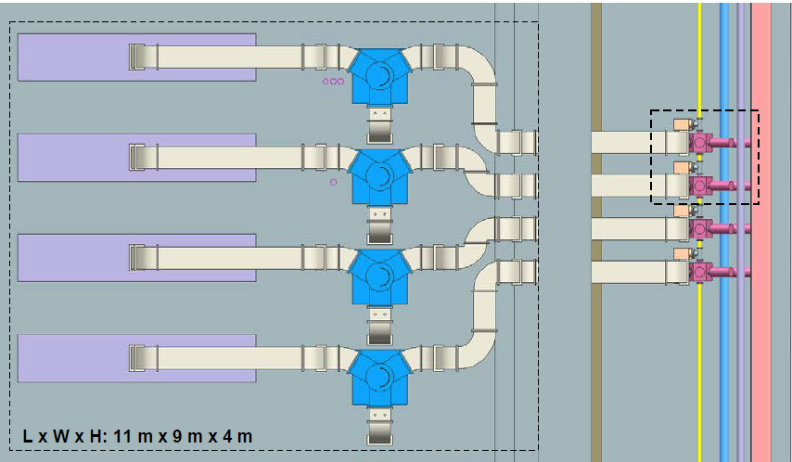
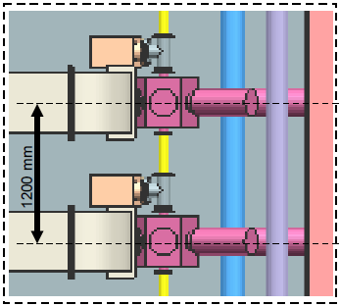
RF System Structure (fundamental)
5 groups with 4 cavities

Slide 14
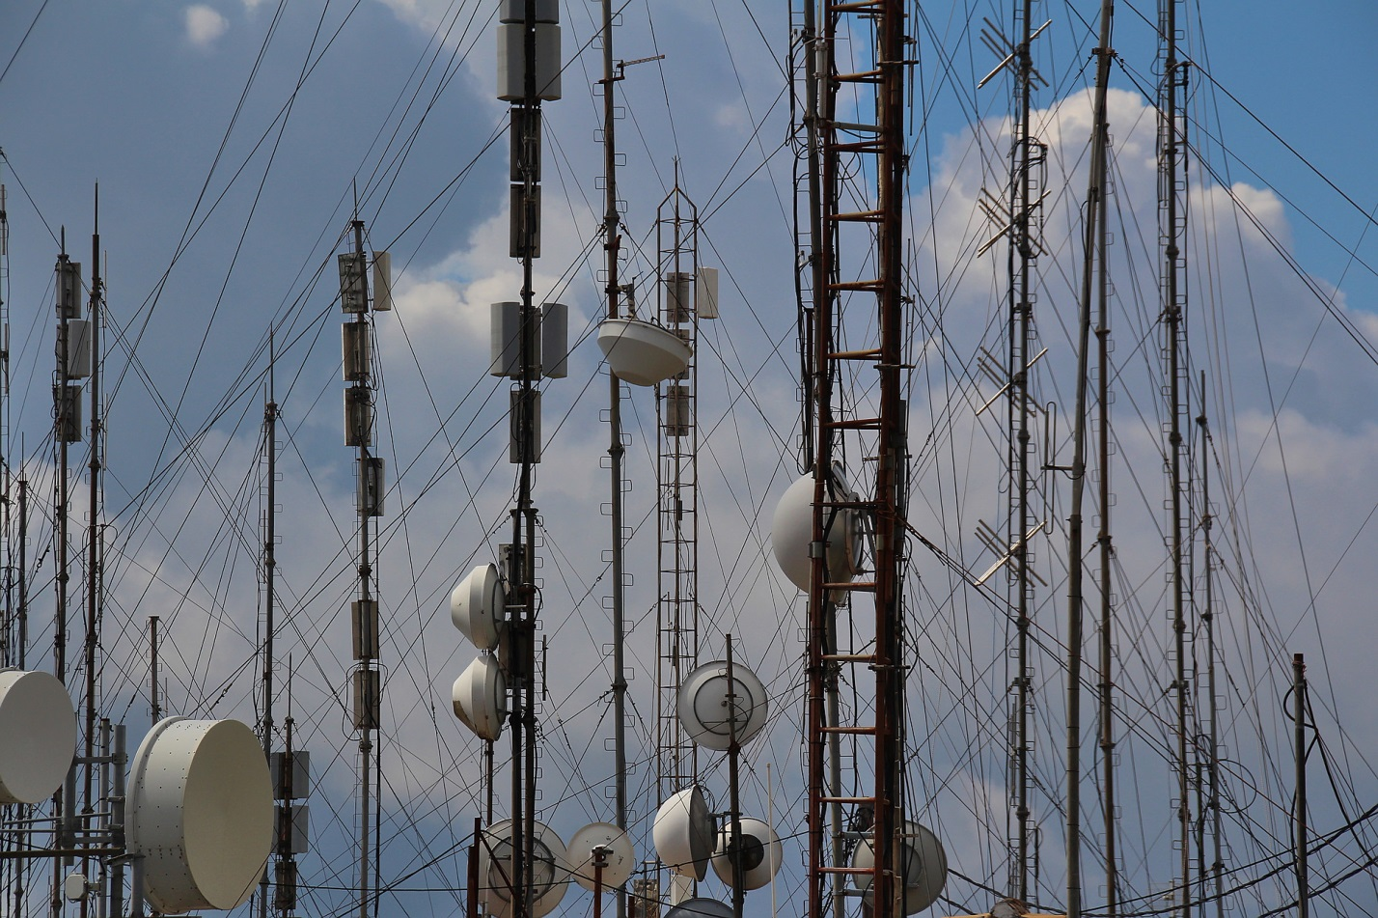
Harmonic RF- system

Slide 15
How can a Harmonic RF System be realized
Three different designs are common used
The simplest case is just a passive copper cavity. The harmonic voltage is induced by the beam itself. V_{HHC} or φ_{HHC} can be adjusted by tuning the resonance frequency.
Something more complex is an active system. The cavity is fed by a RF power source like the fundamental RF system.
Even more complex is the use of a superconducting cavity. It makes sense for example if high V_{HHC} is required, but the space for a corresponding number of copper cavities is not available.

Slide 16
Pros and Cons of Different Designs
Incomplete selection
Passive copper cavity
☺ simplest set-up
☹ optimum operation only
possible at one beam
current
Gap in the fill pattern induces a strong modulation of the V_{HHC} and φ_{HHC} which limits the effect
operation on the Robinson unstable slope, generating a Robinson growth rate
Active copper cavity
☹ RF power source required
allow operation near optimum V_{HHC} and φ_{HHC} for any I_{beam}
Gap in the fill pattern induces a strong modulation of the V_{HHC} and φ_{HHC} which limits the effect
operation on the Robinson unstable slope, generating a Robinson growth rate
Superconducting cavity
Cryogenic system required
Because of the narrow cavity bandwidth, difficult to achieve ideal φ_{HHC} and V_{HHC} at the same time.
Passive operation down to very low currents
less sensitive to transients (filling gap)
less sensitivity to the Robinson instability due to small BW and detuning near 90°

Slide 17
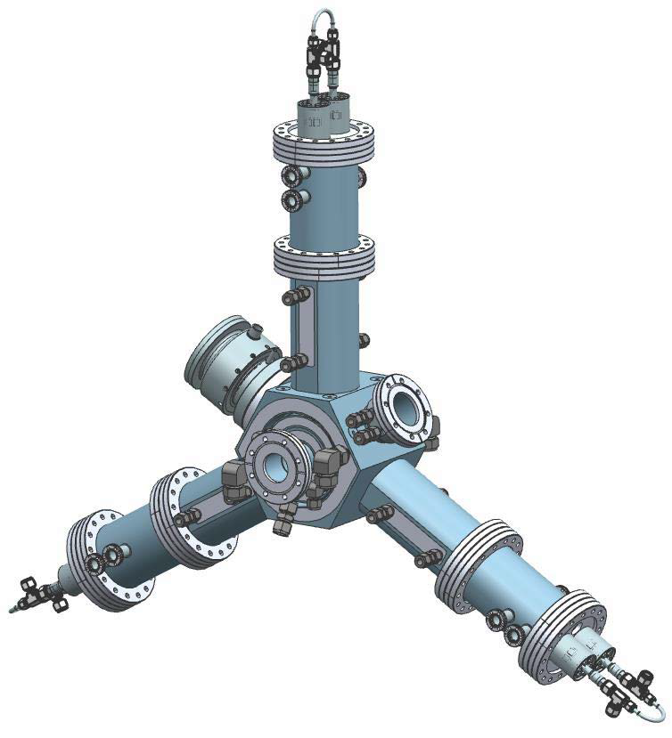

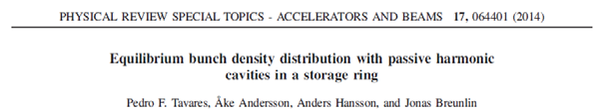
Harmonic RF System for PETRA IV
Consideration of a 3rd harmonic system using downscaled HOM-Damped EU-Cavities
The formula gives the required ratio k_{fp} = V_{HHC}/V_{RF}
The subscript fp stands for flat potential
Required Voltage
U₀ = 3.32 MeV
V_{RF} = 6 MV
n = 3 (1,5 GHz)
⇒k_{fp} = 0.27
⇒ΣV_{HHC} = 1.62 MV
Required number of cavity
cells
Limiting parameter is the
voltage gradient
VRF /cell length ≤ 1 MV/m
cell length = 10 cm
⇒V_{HHC} ≤ 100 kV
⇒N_{C} ≥ 16
chosen
NCC = 20
for higher reliability
Courtesy of Beatriz Bravo, ALBA

Slide 18
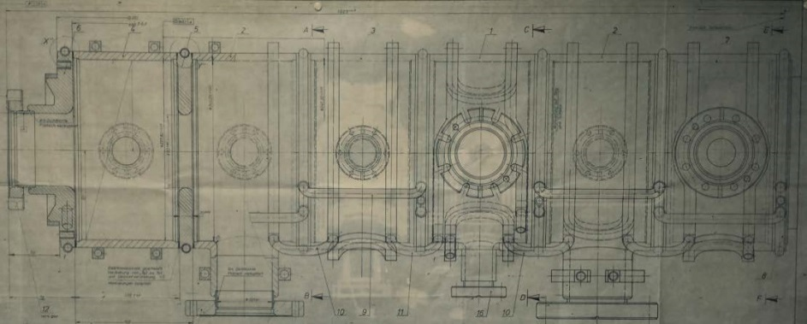
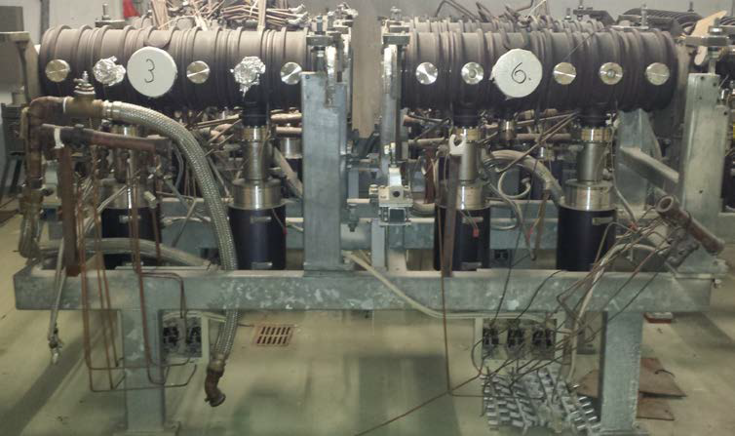
Harmonic RF System for PETRA IV
Consideration of a 2rd harmonic system using old PETRA 6-cell cavities
The formula gives the required ratio k_{fp} = V_{HHC}/V_{RF}
The subscript fp stands for flat potential
Required Voltage
U₀ = 3.32 MeV
V_{RF} = 6 MV
n = 2 (1,0 GHz)
⇒k_{fp} = 0.385
⇒ΣV_{HHC} = 2.31 MV
Required number of cavity
cells
Limiting parameter is the
power dissipation per cell P_{diss}/cell ≤ 3 kW
⇒V_{HHC} ≤ 86 kV
⇒N_{C} ≥ 27
chosen
N_{CC} = 30 (5 cavities)
for higher reliability
≈20 cavities are available

Slide 19
Harmonic RF System for PETRA IV
Comparison of PETRA 6-cell cavity and downscaled HOM-Damped EU-Cavity
Harmonic Number | 2 | 2 | 3 | 3
Cavity type | Passive PETRA 6-cell Cavity | Active PETRA 6-cell Cavity | Passive downscaled HOM-Damped EU-Cavity | Active downscaled HOM-Damped EU-Cavity
Number of HHC-cells | 30 | 30 | 20 | 20
R/Q per HHC-cell | 45 Ω ⁽¹⁾ (56.7 Ω ⁽²⁾) | 45 Ω ⁽¹⁾ (56.7 Ω ⁽²⁾) | 88 Ω ⁽³⁾ | 88 Ω ⁽³⁾
R_{S} per HHC-cell | 1.22 MΩ ⁽¹⁾ (1.53 MΩ ⁽²⁾) | 1.22 MΩ ⁽¹⁾ (1.53 MΩ ⁽²⁾) | 1.50 MΩ ⁽³⁾ | 1.50 MΩ ⁽³⁾
Operational HHC voltage per cell | 77 kV | 77 kV | 81 kV | 81 kV
Operational HHC voltage | 2.31 MV | 2.31 MV | 1.62 MV | 1.62 MV
HHC voltage gradient | 513 kV/m | 513 kV/m | 810 kV/m | 810 kV/m
Bandwith | 37 kHz | 74 kHz | 88 kHz | 176 kHz
HHC-detuning | 80.9° 116 kHz | 71.6° 116 kHz | 82,2° 320 kHz | 74.3° 320 kHz
Power dissipation per HHC-cell | 2.43 kW | 2.43 kW | 2.19 kW | 2.19 kW
Power dissipation of all HHC-cells | 72.9 kW | 72.9 kW | 43.7 kW | 43.7 kW
(1) The experimental study of a higher harmonic rf system in PETRA, Kohaupt, PAC1983_2525
(2) B. Dwersteg –MHC- 27.06.1983
(3) 1.5 GHz CAVITY DESIGN FOR THE CLIC DAMPING RING AND AS ACTIVE THIRD HARMONIC CAVITY FOR ALBA, May 2017

Slide 20
fin
Thank you,
for Your
attention

Slide 21
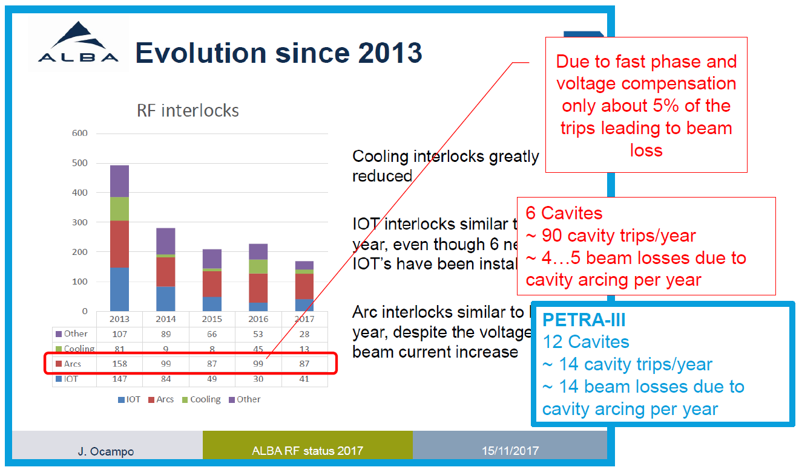
Annex / HOM-Damped EU-Cavity
ALBA RF Statistics

Slide 22
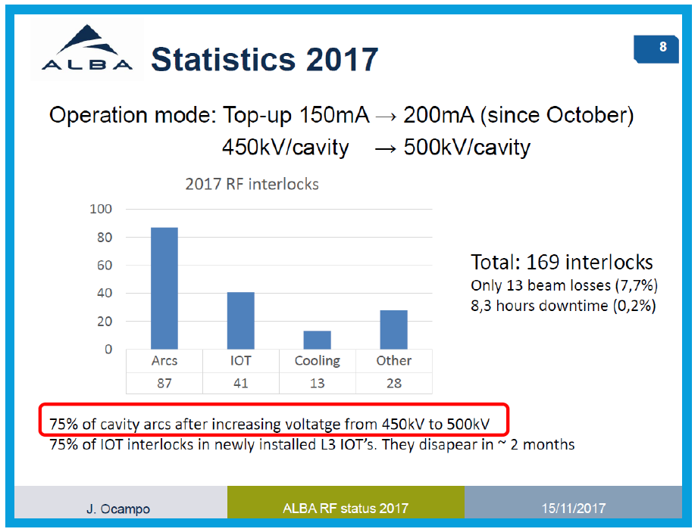
Annex / HOM-Damped EU-Cavity
ALBA RF Statistics

