Slide 1
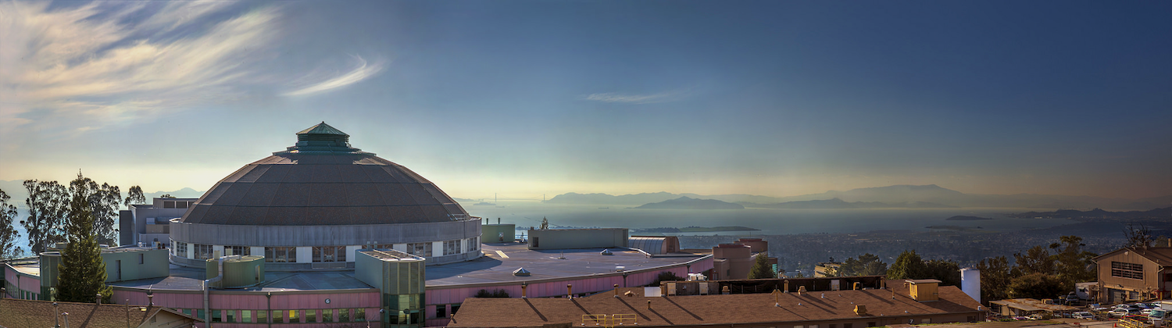



ALS-U Plans for the RF Systems
Ken Baptiste
ESLS-RF Meeting #22, Synchrotron Soleil
11-09-2018
Contributors: M. Betz, Stefano De Santis, Q, Du, M. Johnson, T. Luo, M. Venturini, M. Vinco, S. Virostek

Slide 2
Outline
ALS-U Project Overview
Accumulator Ring RF
  System Scope
  System Requirements
  Approach
    RF Cavities
    RF Source
    Installation Challenges
Storage Ring RF
  System Scope
  System Requirements
  Approach
    RF Cavities
    Cavity Temperature Controllers
    3rd Harmonic Cavities
Conclusion
Notes:
Three systems:
AR RF
SR RF
3HC
Briefly step through the scope of each RF system
Then, I’ll present
the requirements
our approach
the risks
and the status & future plans

Slide 3
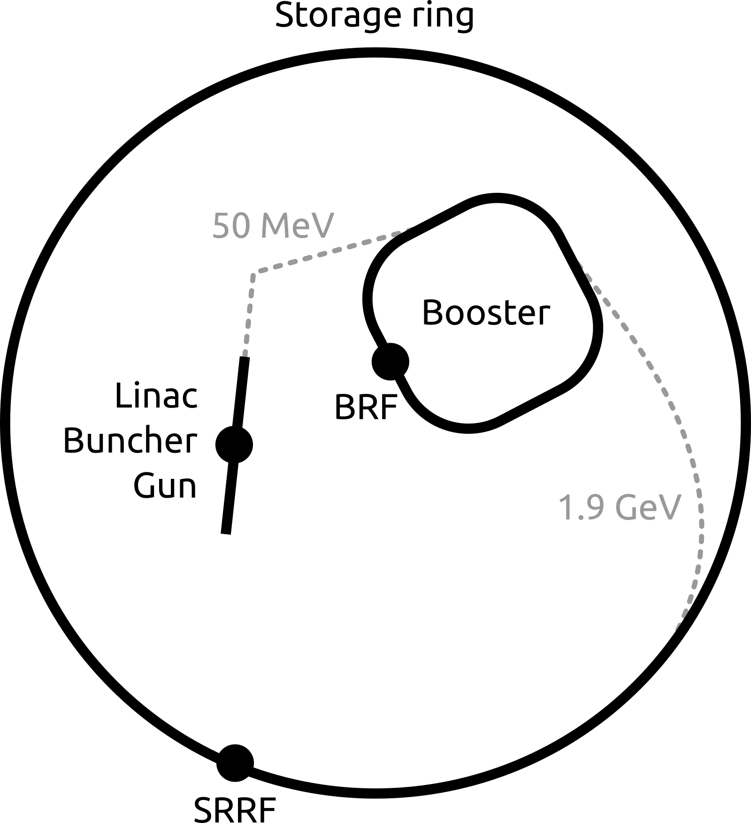
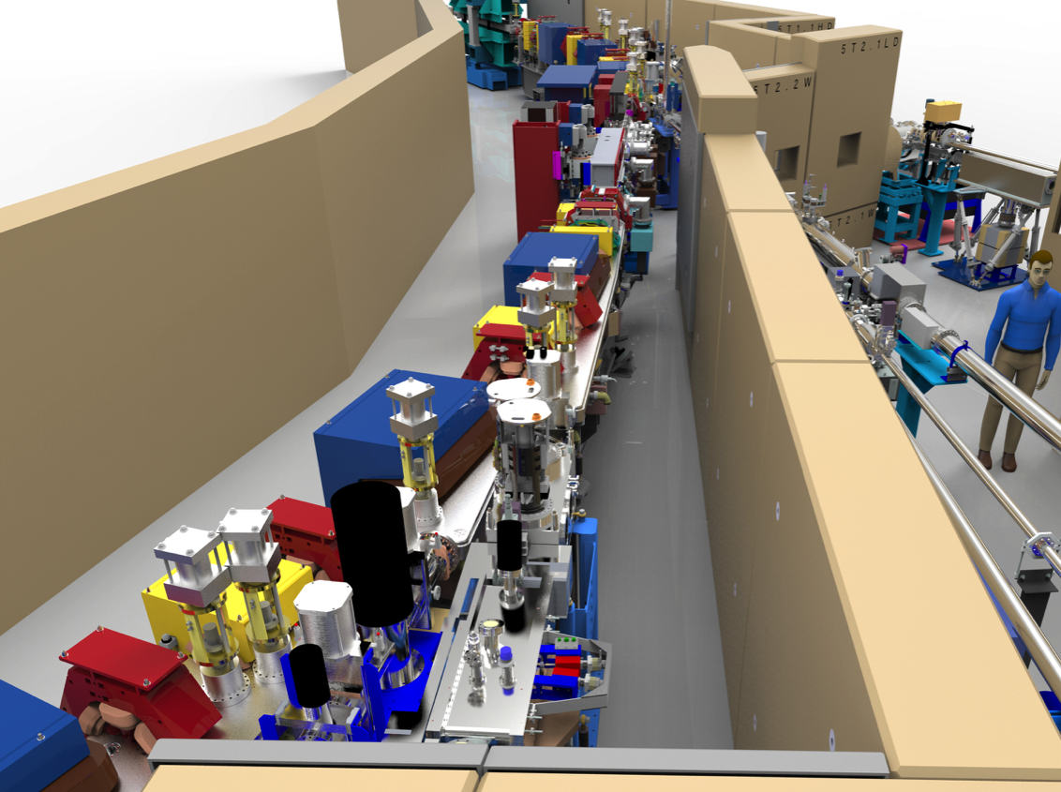
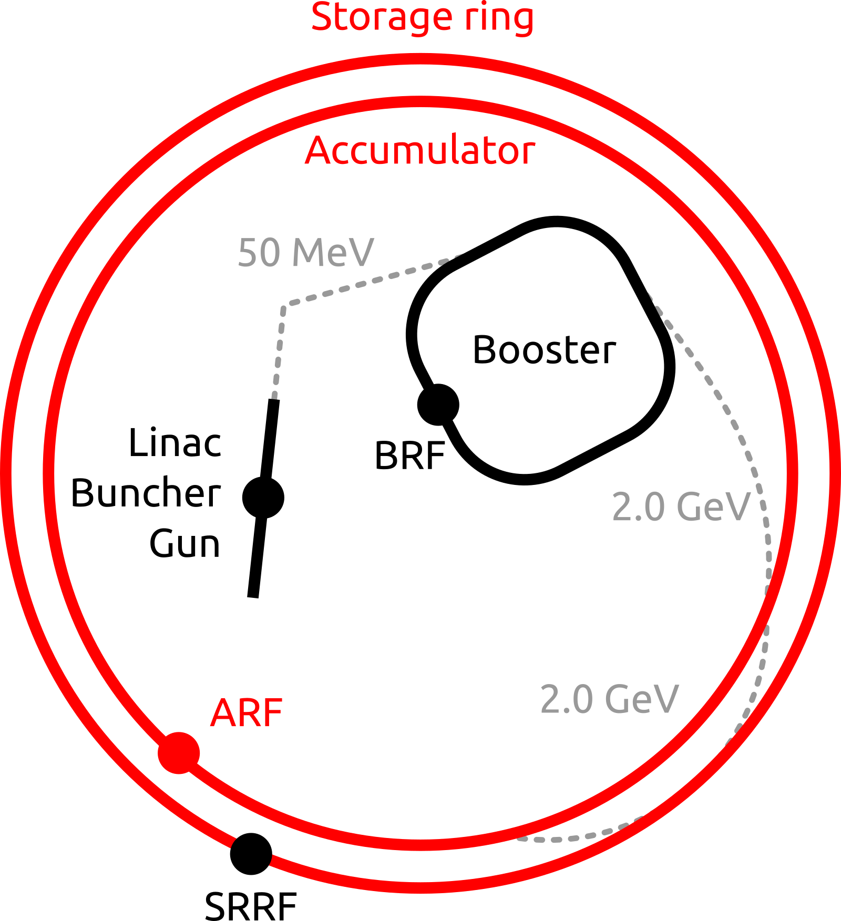
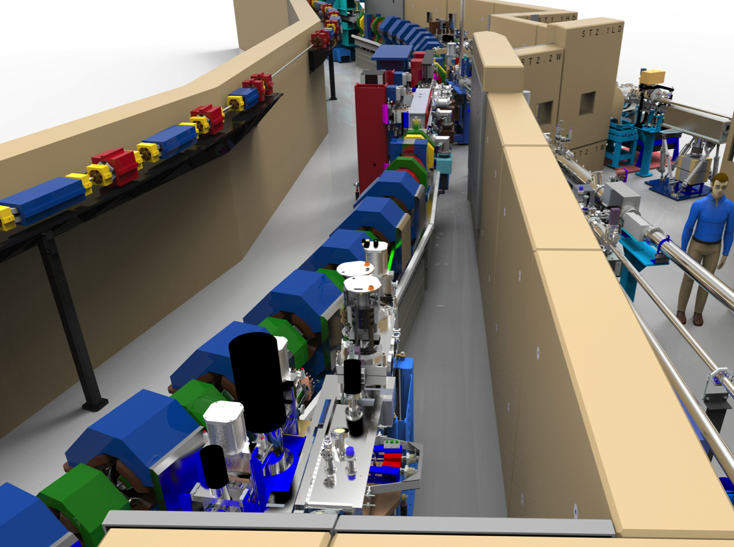
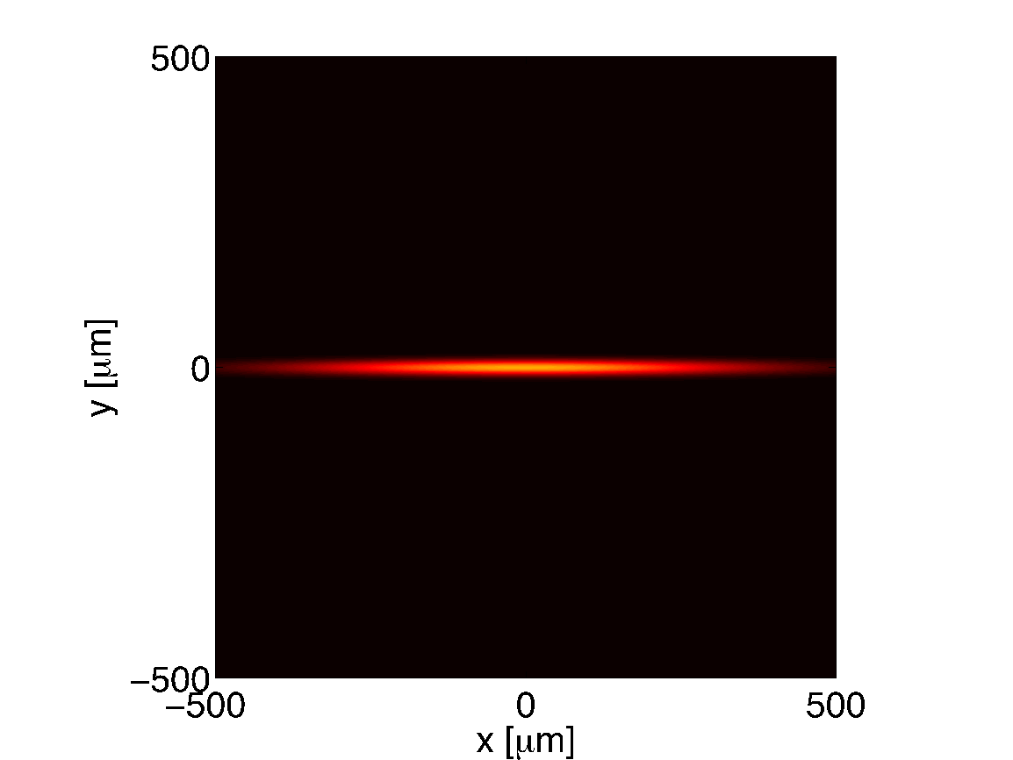
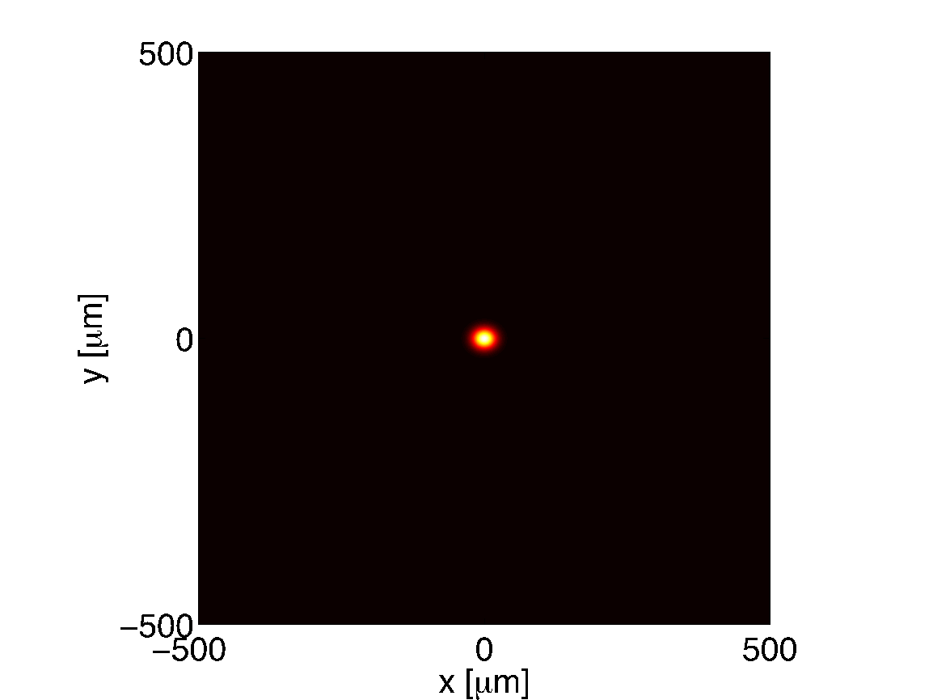
ALS-U: Overview
> 100 fold increase in soft x-ray brightness
Requires new lattice in the storage ring, diffraction limited emittance
Unique: on axis swap out injection
to satisfy the smaller dynamic apertures of the new lattice
New accumulator ring for topping-up the swapped-out bunch train
ALS
Storage ring
Beam profile
ALS - U
Accumulator
Storage ring
Notes:
The scope for each RF system includes these 11 major subsystems with a few exceptions
I apologize, this slide should have been a table…

Slide 4
ALS-U: Overview
Notes:
The scope for each RF system includes these 11 major subsystems with a few exceptions
I apologize, this slide should have been a table…

Slide 5
ALS-U: Overview
Notes:
The scope for each RF system includes these 11 major subsystems with a few exceptions
I apologize, this slide should have been a table…

Slide 6
Accumulator Ring RF System
Notes:
The scope for each RF system includes these 11 major subsystems with a few exceptions
I apologize, this slide should have been a table…

Slide 7
AR RF System: Scope
New ring, therefore all new equipment
  New Cavities (x2)
  New High Power 500 MHz CW RF Solid-State Amplifier (SSA) (x2)
  RF Distribution
  Control System Interface
  Timing System Interface
  Personnel Protection System Interface
  AR Equipment Protection System Interface
  AR RF Sub-systems
    Digital Low Level RF Control
    Cavity Resonance Control
    Cavity Temperature Control
    AR RF Equipment Protection (Arc, RF, Vac, Temp, Flow, etc.)
    Vacuum System Interface
    Utilities
  Location Shielding Modifications
  Pre-test and RF Conditioning
  Installation
Notes:
The scope for each RF system includes these 11 major subsystems with a few exceptions
I apologize, this slide should have been a table…

Slide 8
AR RF System: Cavity Requirements
ALS-U AR – 2.0 GeV | New Cavity
# of Cavities | 2
R_{s} (ea)
Cav Voltage (kV) | 649
Coupling β
Energy loss per turn (keV) | 247
BM Beam Pwr (kW) | 12.35 ¹
ID Beam Pwr (min gap) (kW) | 0
3HC Beam Pwr (kW) | 0
Parasitic Beam Pwr (kW) | 0.2
Total Beam Pwr (kW) | 12.54
Cavity Pwr (no beam) (kW)
Cavity Pwr (w/beam) (kW)
Waveguide Losses (kW)
High Power Amplifier (kW)
5.0-3.0 MΩ
1-2
42-70
48-76
1-2
98-154
¹ 50 mA
Notes:
For the AR requirements…
Start with column on left
ALS SR cavity, beam and RF source power parameters
Comparing with the right column
ALS-U AR beam and RF power
You can see that a cavity with cavity parameters equal to the current cavity would satisfy
Beam loading is ~1/10th
RF source power required is lower – a clear candidate for a SS amplifier

Slide 9
AR RF System: Approach for New Cavities
Options
Purchase Commercial Cavity
    Research Instruments – EC 500 MHz HOM Damped, coaxial loop coupler
    Toshiba – ASP 500 MHz HOM Damped, coaxial loop coupler
Copy legacy ALS SR 500 MHz partially HOM Damped, aperture coupled
Design new cavity by scaling NLC 714MHz HOM Damped, aperture coupled.
Down-Select
Order/Manufacture 3 cavities, install 2 to satisfy the AR installation schedule.
then
Continue to develop sector AR11S location for cavities in SR tunnel.
Design/modify SR roof blocks to accommodate AR cavities/distribution.
Design RF Distribution to accommodate the AR cavities & egress for waveguides from roof blocks.
Notes:
New 500 MHz Cavities
Easier to leverage existing cavity designs: B-Factory, NLC, Dampy, others
Potentially lower cost power RF source
Potentially might need a frequency agile controller for injection, could depend on harmonic #
New D-LLRF needs to be developed and designed

Slide 10
AR RF System: Candidate Cavity Requirements
ALS-U AR – 2.0 GeV | ALS Cavity | Toshiba ASP Cavity | RI EC Cavity | Other HOM Damped Cavity
# of Cavities | 2 | 2 | 2 | 2
R_{s} (ea) | 4.9 MΩ | 3.6 MΩ | 3.4 MΩ | X.X MΩ
Cav Voltage (kV) | 649 | 649 | 649 | 649
Coupling β | 1.13 | 1.10 | 1.09 | X.XX
Energy loss per turn (keV) | 247 | 247 | 247 | 247
BM Beam Pwr (kW) | 12.35 ¹ | 12.35 ¹ | 12.35 ¹ | 12.35 ¹
ID Beam Pwr (min gap) (kW) | 0 | 0 | 0 | 0
3HC Beam Pwr (kW) | 0 | 0 | 0 | 0
Parasitic Beam Pwr (kW) | 0.2 | 0.2 | 0.2 | 0.2
Total Beam Pwr (kW) | 12.54 | 12.54 | 12.54 | 12.54
Cavity Pwr (no beam) (kW) | 43 | 58.6 | 62 | XX.X
Cavity Pwr (w/beam) (kW) | 49.3 | 64.9 | 68.3 | XX.X
Waveguide Losses (kW) | 1.4 | 1.8 | 1.9 | X.X
Power Amplifier (kW) total | 100 | 131.6 | 138.5 | XXX.X
¹ 50 mA
Notes:
For the AR requirements…
Start with column on left
ALS SR cavity, beam and RF source power parameters
Comparing with the right column
ALS-U AR beam and RF power
You can see that a cavity with cavity parameters equal to the current cavity would satisfy
Beam loading is ~1/10th
RF source power required is lower – a clear candidate for a SS amplifier

Slide 11
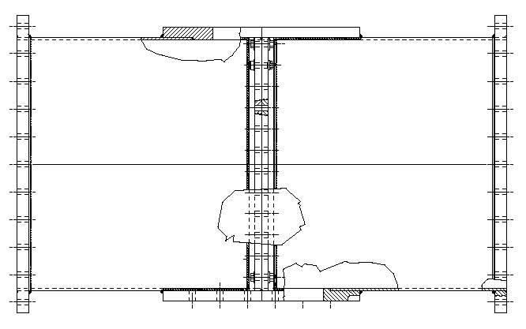
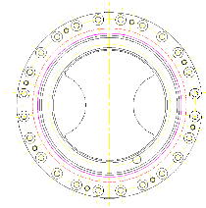
AR RF System: ALS Cavity
The ALS cavity was based on the Daresbury cavity with some geometry/cooling modifications and was built to specification by Interatom/Siemens.
The ALS cavity needs no modification to meet AR RF requirements. However, due to the significant interference with shielding, a change in the coupling scheme may be needed.
Split WR1800 Waveguide to Cavity Transition
Iris Flange Profile
β: 1 to 3.2

Slide 12
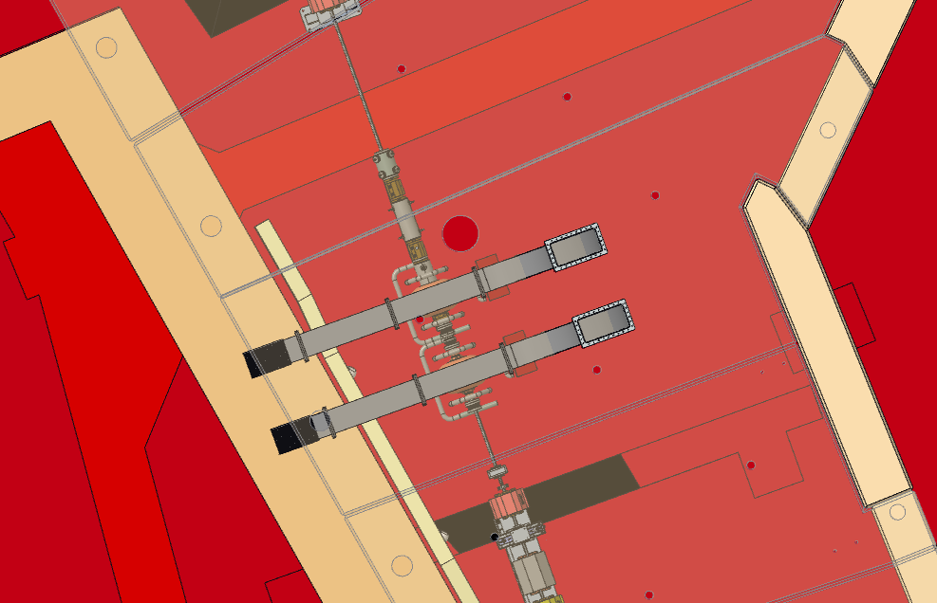
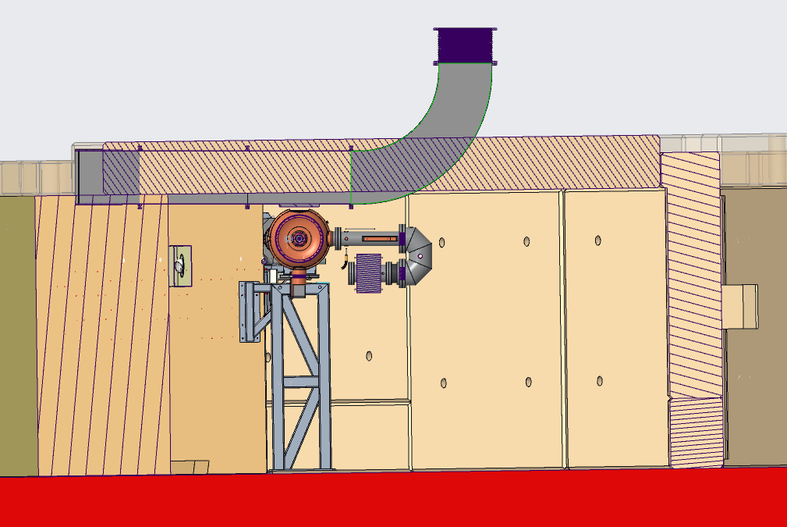
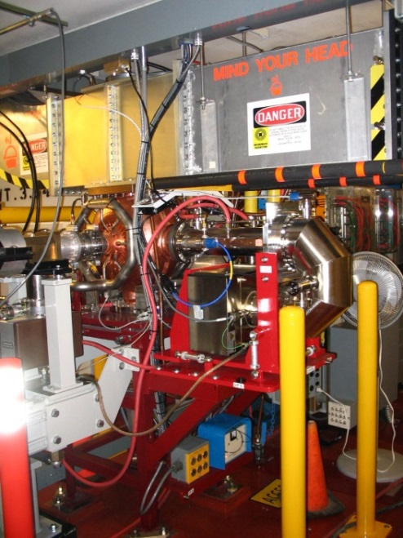
AR RF: Shielding Block Mods Significant
ALS Cavities – significant shielding mods needed
New dog-house blocks
New dog-house blocks
Notes:
New 500 MHz Cavities
Easier to leverage existing cavity designs: B-Factory, NLC, Dampy, others
Potentially lower cost power RF source
Potentially might need a frequency agile controller for injection, could depend on harmonic #
New D-LLRF needs to be developed and designed

Slide 13
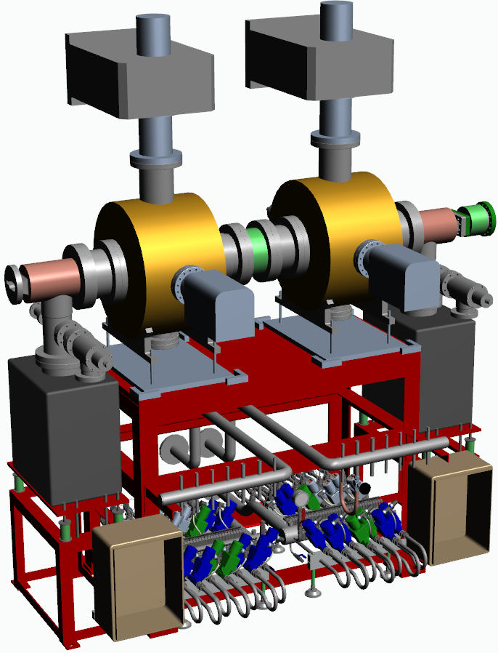
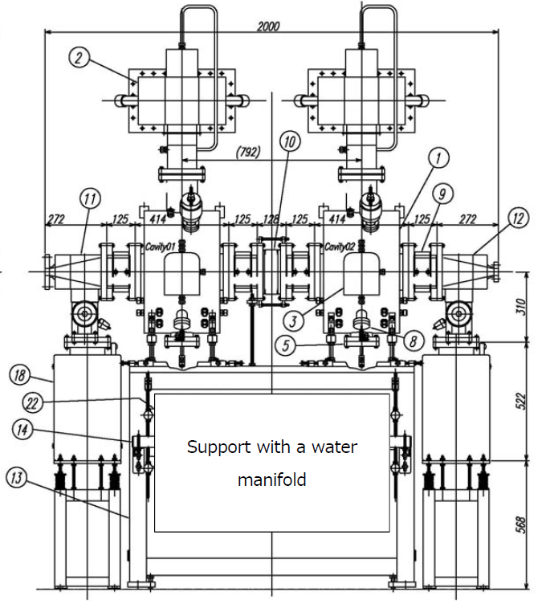
AR RF System: Toshiba ASP Cavity
Designed by a collaboration between KEK, Institute for Solid State Physics, Univ. of Tokyo and Toshiba from early 1990’s.
The Toshiba ASP cavity needs no modification to meet AR RF requirements. However, due to the minor interference with shielding, a change in the coupling scheme may be needed.
SiC HOM Damper (3x)
2000.0mm
(78.74”)
Power Coupler
Tuner Motor
~2520 mm
~99.2”
1400.0 mm
55.1”
Notes:
New 500 MHz Cavities
Easier to leverage existing cavity designs: B-Factory, NLC, Dampy, others
Potentially lower cost power RF source
Potentially might need a frequency agile controller for injection, could depend on harmonic #
New D-LLRF needs to be developed and designed

Slide 14
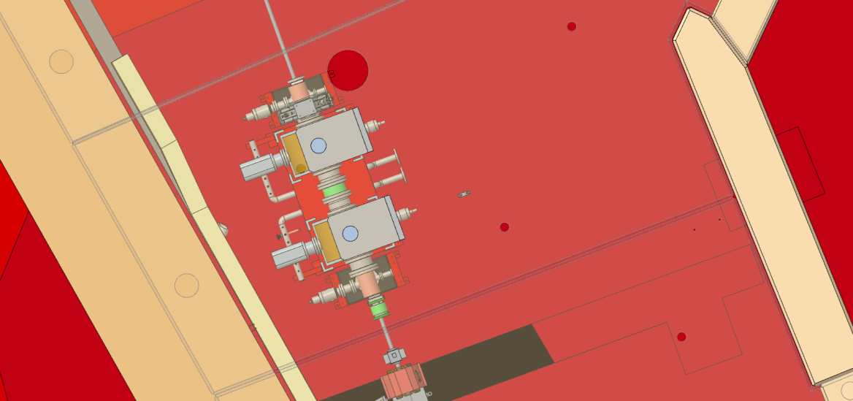
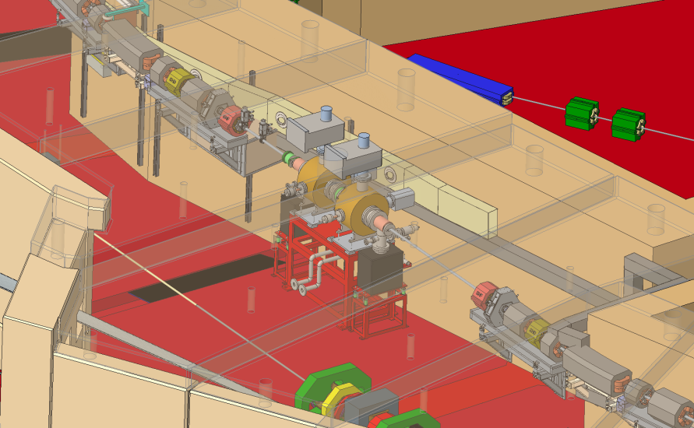
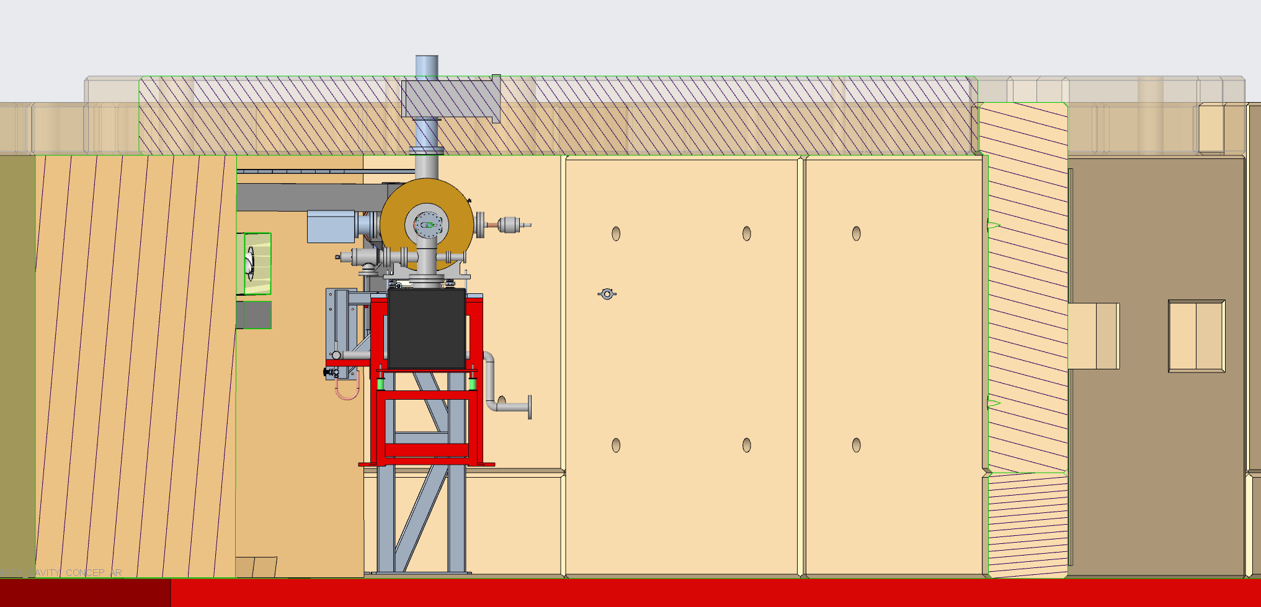
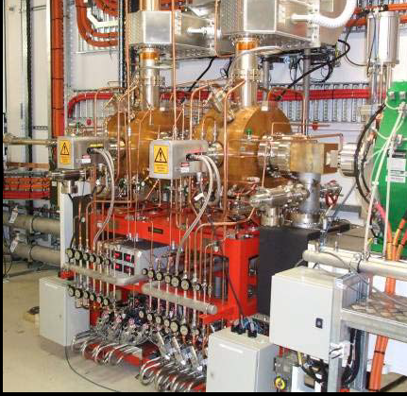
AR RF: Shielding Block Mods Potentially Minor
Toshiba - ASP Cavity – potentially minor shielding mods
New dog-house blocks
New dog-house blocks
Extend coaxial line. WG Transition above roof block?
NDA?
Notes:
New 500 MHz Cavities
Easier to leverage existing cavity designs: B-Factory, NLC, Dampy, others
Potentially lower cost power RF source
Potentially might need a frequency agile controller for injection, could depend on harmonic #
New D-LLRF needs to be developed and designed

Slide 15
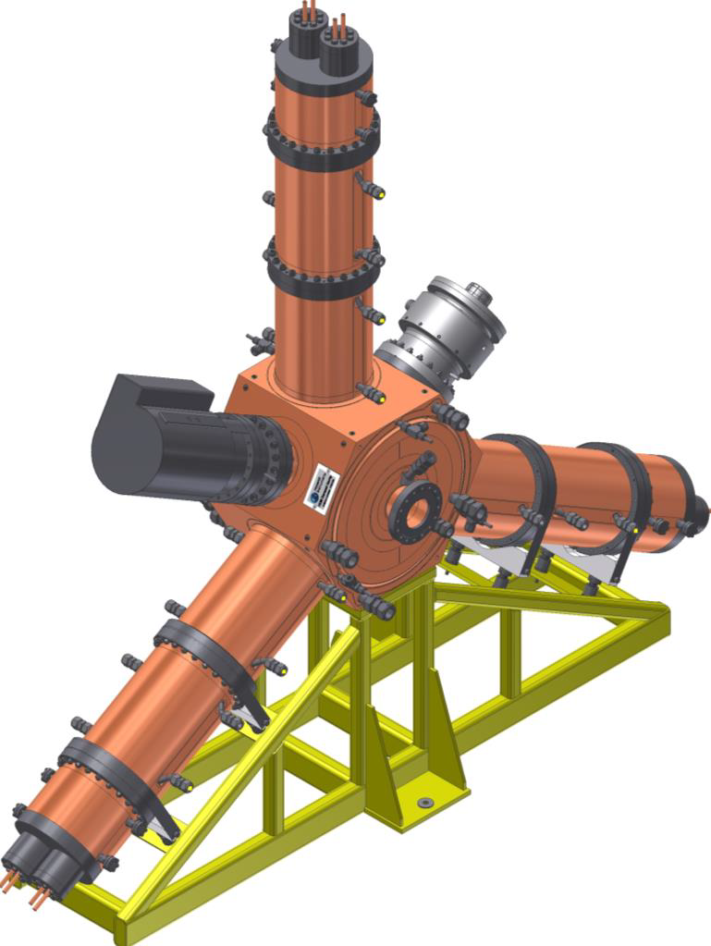
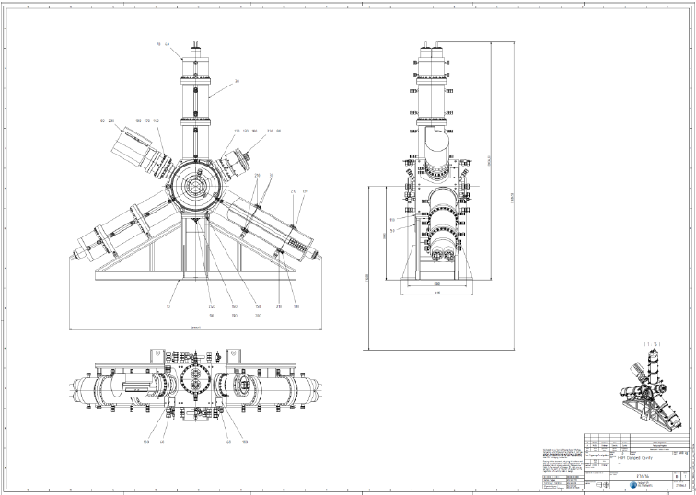
AR RF System: RI – EC Cavity
Designed by a collaboration between Bessy, Delta, Daresbury and Tsing Hua University from 2000-2006. Modifiactions made by ALBA, RI and others have led to improved HOM dampers and power coupler mechanics & cooling.
The RI EC cavity needs no modification to meet AR RF requirements. However, due to the significant interference with shielding, a change in the orientation and the shape of the HOM dampers may be needed.
Ridged WG
HOM Damper (3x)
Power Coupler
w/o WG Transition
2636.0 mm
103.8”
Tuner Motor
2159.7mm
85.03”
500.0 mm
19.7”
1400.0 mm
55.1”
Notes:
New 500 MHz Cavities
Easier to leverage existing cavity designs: B-Factory, NLC, Dampy, others
Potentially lower cost power RF source
Potentially might need a frequency agile controller for injection, could depend on harmonic #
New D-LLRF needs to be developed and designed

Slide 16
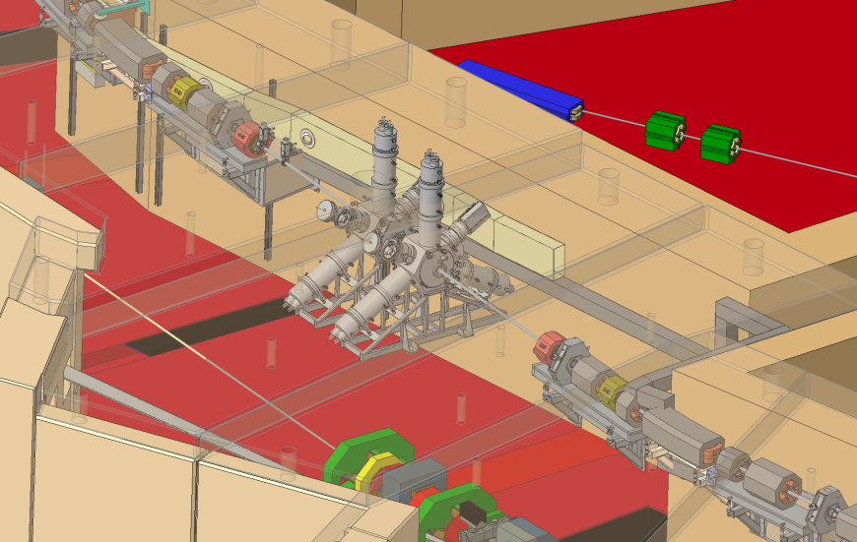
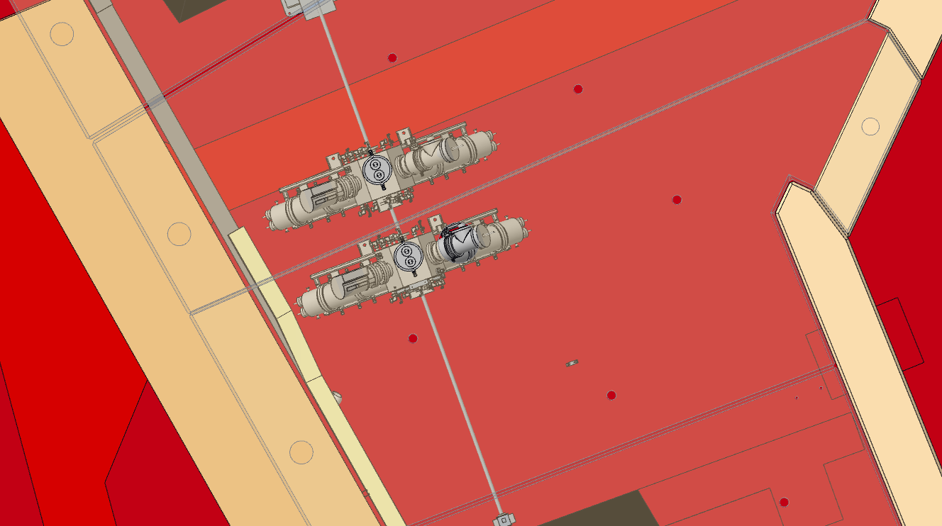
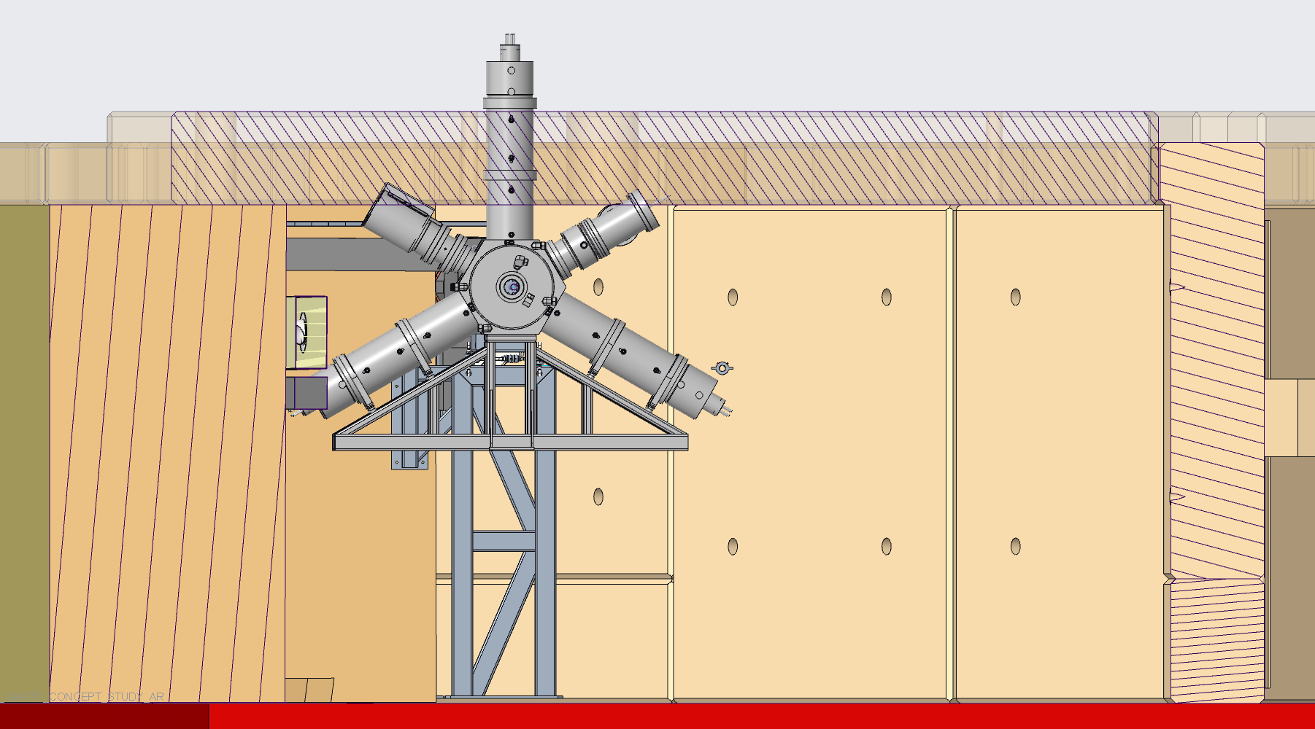
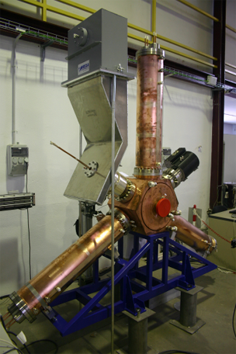
AR RF: Shielding Block Mods Significant
Research Instruments EC Cavity – moderate shielding mods needed
New dog-house blocks
Coupler WG transition will remain vertical.
New dog-house blocks
Notes:
New 500 MHz Cavities
Easier to leverage existing cavity designs: B-Factory, NLC, Dampy, others
Potentially lower cost power RF source
Potentially might need a frequency agile controller for injection, could depend on harmonic #
New D-LLRF needs to be developed and designed

Slide 17
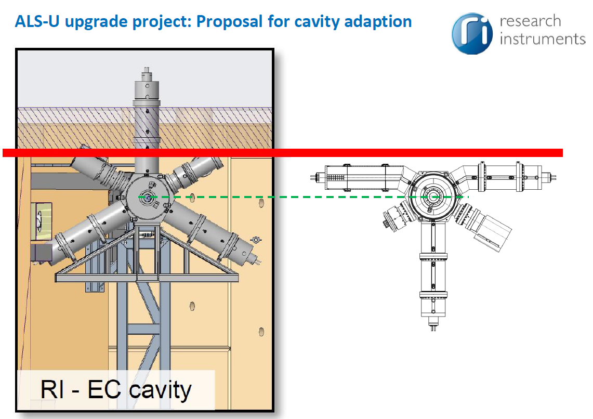
AR RF: Shielding Block Mods Potentially Minor
Research Instruments EC Cavity
  orientation change, rotate cavity 180°
  proposed HOM Damper shape change, needs evaluation.
New dog-house blocks
Notes:
New 500 MHz Cavities
Easier to leverage existing cavity designs: B-Factory, NLC, Dampy, others
Potentially lower cost power RF source
Potentially might need a frequency agile controller for injection, could depend on harmonic #
New D-LLRF needs to be developed and designed

Slide 18
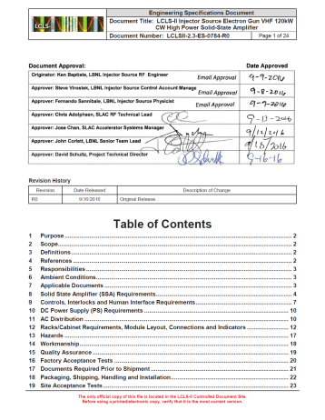
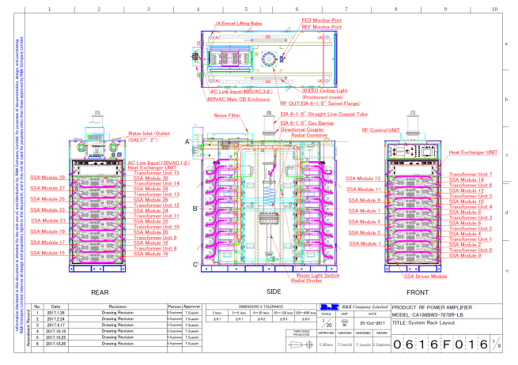
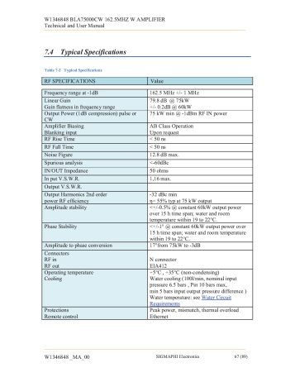
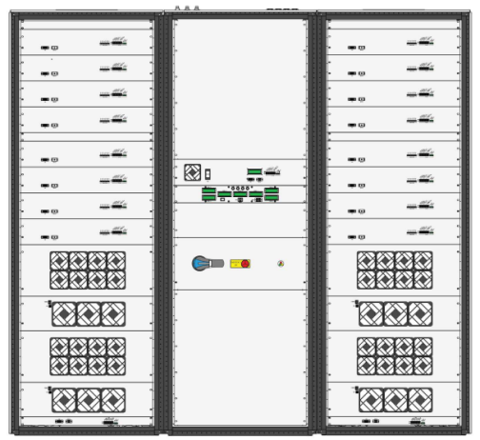
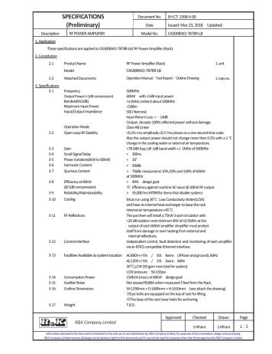
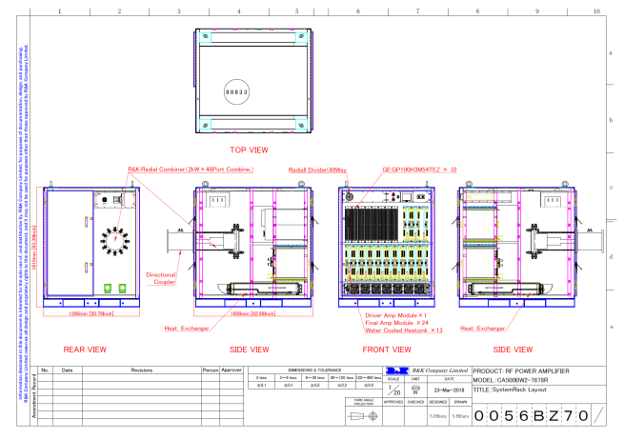
AR RF Source: Approach – RF SSA(s) COTS*
Specify-procure RF amplifiers: (2) 500 MHz (60 kW – 80 kW CW).
Leverage recent experience:
  FNAL RFQ, 162.5 MHz 75 kW CW SSA (2014)
  LBNL delivered to LCLS II Gun B, 186 MHz (2x) 60 kW CW SSA (2017)
186 MHz SSA
60 kW CW
60 Final Transistors
(Preliminary)
500MHz SSA
60 kW CW
96 Final Transistors
162.5 MHz SSA
75 kW CW
128 Final Transistors
* Nearly, requires custom freq, interface, etc.
Notes:
New 500 MHz Cavities
Easier to leverage existing cavity designs: B-Factory, NLC, Dampy, others
Potentially lower cost power RF source
Potentially might need a frequency agile controller for injection, could depend on harmonic #
New D-LLRF needs to be developed and designed

Slide 19
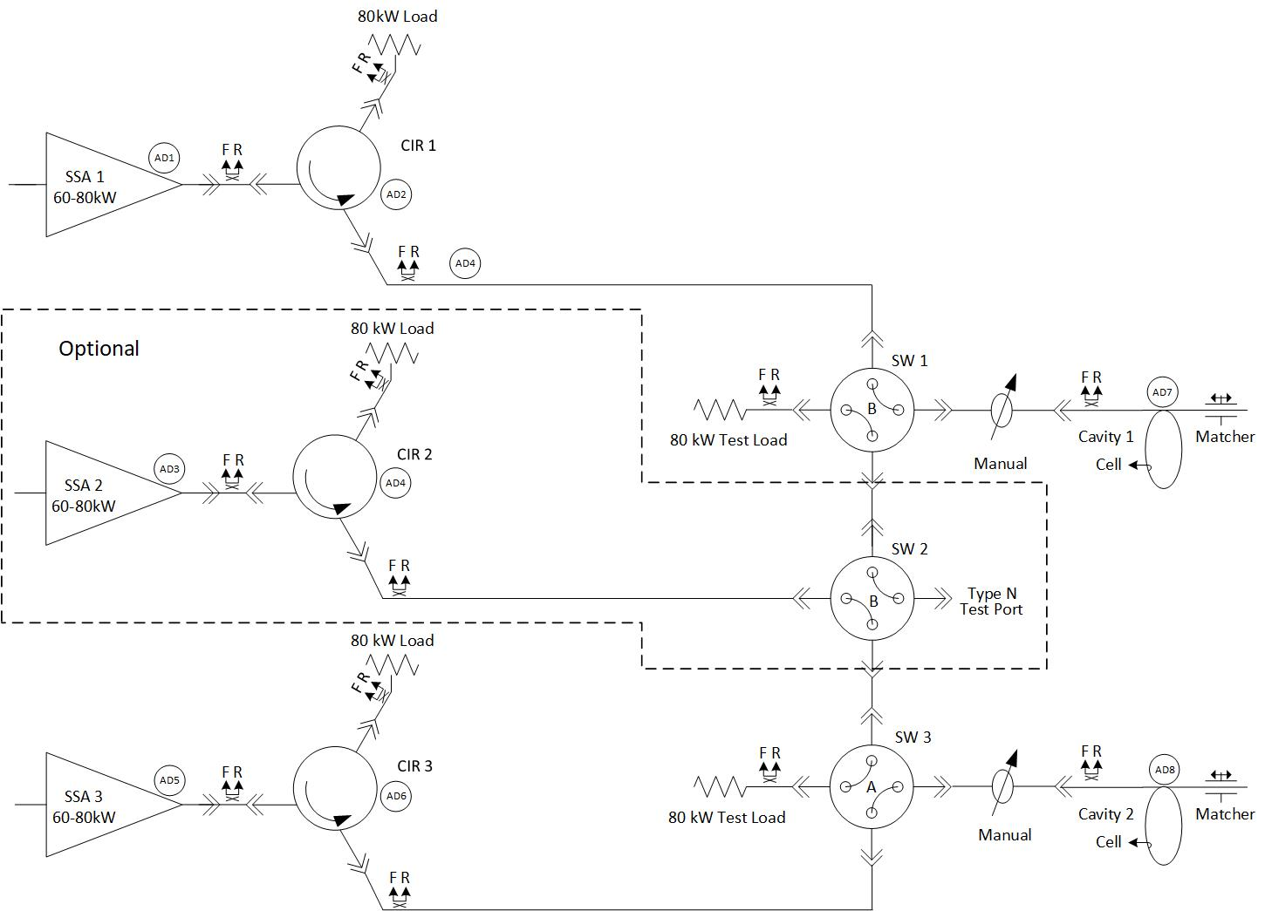
AR RF Distribution: Approach COTS
Specify-procure 2 ea. RF SSA (60 kW – 80 kW)
Specify-procure 2 ea. Circulators (80 kW)
Procure 4 ea. RF Loads (80 kW)
Procure 2 ea. 4-port WG Switches
Optional: Specify-procure 2 ea. Cavity Temp. Control Sys.
Optional: 3rd SSA, Circulator, WG SW & Load
Notes:
New 500 MHz Cavities
Easier to leverage existing cavity designs: B-Factory, NLC, Dampy, others
Potentially lower cost power RF source
Potentially might need a frequency agile controller for injection, could depend on harmonic #
New D-LLRF needs to be developed and designed

Slide 20
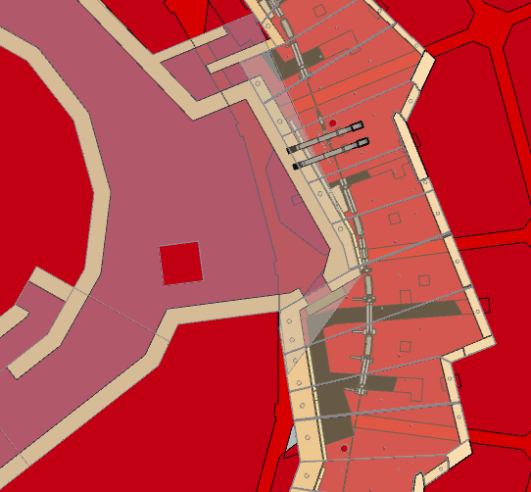
AR RF System Equipment Location: AR Sector 11S
AR
SR
SSA
H₂O
SSA
AR11S
Rack
BR
TL

Slide 21
Storage Ring RF System
Notes:
The scope for each RF system includes these 11 major subsystems with a few exceptions
I apologize, this slide should have been a table…

Slide 22
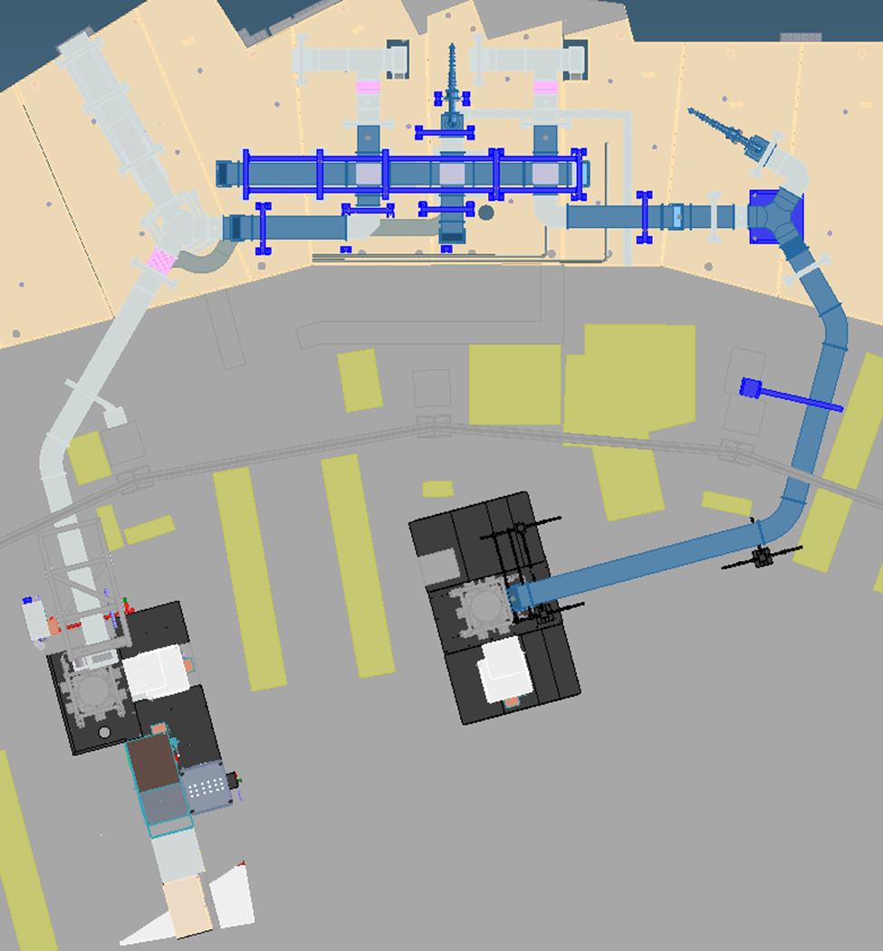
SR RF System: Scope
ALS-U:
Re-use existing RF Cavities, RF Sources, Distribution, LLRF Controls, Intrlks, etc. Pending final CBI analysis.
Modification to WG Matcher to avoid AR interference
Study/Modify power coupler to increase coupling
Upgrade SR Cavity Temperature Control System
Install 3rd Harmonic Cavity Temperature Control System
ALS:
Replaced RF source & sub-systems (AIP09-14)
  Redundant, 2-klystron system with a wave guide switch matrix (currently commissioning)
  New HVPS, Filter Cabinet and IGBT dis-connect switch
  New D-LLRF Controller (currently commissioning)
  New PLC based Control & Interlock systems
Replaced Vacuum Pump Controllers (AIP18)
Replacing Flow & Temp Intrlock upgrade (AIP19)
Planning Tuner Drive Motor & Controller upgrade (future AIP)
SR
3HC
H₂O
SR Cav
H₂O
Kly #2
Kly #1
22

Slide 23
SR RF System: Requirements
ALS Cavity | ALS - 1.9GeV | ALS-U – 2.0GeV
Frequency | 499.6 MHz | 500.35 MHz
# of Cavities | 2 | 2
R_{s} (ea) | 4.9 MΩ | 4.9 MΩ
Cav Voltage (kV) (each) | 649 | 300
β_{opt} (ALS SR cav β max = 3.15) | 2.93 | 10.07 ¹
Energy loss per turn (keV) | 326.5 | 329
Bend Mag Beam Pwr (kW) (500mA) | 112.6 | 125
ID Beam Pwr (min gap) (kW) | 44 | 35
3HC Beam Pwr (kW) | 6.6 | 4.4
Parasitic Beam Pwr (kW) | 2.5 | 2.2
Total Beam Pwr (kW) | 165.7 | 166.9
Cavity Pwr (no beam) (kW) | 43 | 9.2
Cavity Trans. Pwr (w/beam) (kW) | 125.8 | 127.6
Waveguide Losses (kW) | 3.5 | 2.6
Klystron Pwr (kW) | 255.2 | 257.8 ²
May be a good enough reason to replace cavities
¹ Coupling required exceeds coupler’s adj. range
² Each cavity would have ~35 kW reflected power at 500 mA due to the lack of coupling range.
Notes:
Col 1
Copper cavities, re-entrant single cell cavities
Cavity coupler set for near matched condition – maximizes efficiency
Partially HOM damped, E-Type, Ridged WG, Cavity Temperature control
Designed for 70 kW max, 750 kV gap voltage
ALS-U requires lower accelerating voltage, 600 kV vs. 1.3MV (ALS)
Col 2
Re-using a single cavity would meet the accel voltage req, slightly relaxed from current ALS operation point
However
Cavity coupler does not have sufficient range to create a matched condition - ~11 kW reflected per cavity
Not as big of a problem as the transmission power through coupler which would be in a range above which we are comfortable (>150 kW)
Col 3
2 cavity solution
Each cavity operated at even lower accelerating voltage 300 kV – easier and more reliable
but worsens the cavity match and power efficiency at 500 mA
Cavity coupler does not have sufficient range to create a matched condition - ~26 kW reflected per cavity
Transmission power through the coupler and total power is lower than current ALS operation
2 cavity solution supported by the high power amplifier/wg distribution system
The re-use of the ALS HPA/2 cavity solution is our baseline

Slide 24
SR RF System: Approach for New Cavities
ALS-U should replace cavities if CBI, caused by HOMs, are greater than be reliably managed by passive dampers, cavity temperature control and longitudinal FB.
ALS should replace cavities, if ALS-U does not, in order to improve operating efficiency by reducing excess reverse power caused by insufficient coupling factor, improve vacuum in SR03S and to simplify maintenance with common spare cavities, couplers, tuners, dampers, etc.
Options
Purchase Commercial Cavity
    Research Instruments – EC 500 MHz HOM Damped, coaxial loop coupler
    Toshiba – ASP 500 MHz HOM Damped, coaxial loop coupler
Design new cavity by leveraging legacy ALS SR cavity
Design new cavity by scaling NLC 714MHz HOM Damped, aperture coupled.
Down-Select
Order/Manufacture 2 or 3 cavities, install 2 to satisfy the SR installation schedule.
Notes:
New 500 MHz Cavities
Easier to leverage existing cavity designs: B-Factory, NLC, Dampy, others
Potentially lower cost power RF source
Potentially might need a frequency agile controller for injection, could depend on harmonic #
New D-LLRF needs to be developed and designed

Slide 25
SR RF System: Candidate Cavities
ALS-U SR – 2.0 GeV | ALS Cavity | Toshiba ASP Cavity | RI EC Cavity | Other HOM Damped Cavity
Frequency | 500.35 MHz | 500.35 MHz | 500.35 MHz | 500.35 MHz
# of Cavities | 2 | 2 | 2 | 2
R_{s} (ea) | 4.9 MΩ | 3.79 | 3.1 MΩ | X.X MΩ
Cav Voltage (kV) | 300 | 300 | 300 | 300
Coupling β (reqr’d/avail) | 10.07/3.15 ¹ | 8.01/3.0 ¹ | 6.75/8.0 | X.XX
Energy loss per turn (keV) | 329 | 329 | 329 | 329
BM Beam Pwr (kW) | 125 | 125 | 125 | 125
ID Beam Pwr (min gap) (kW) | 35 | 35 | 35 | 35
3HC Beam Pwr (kW) | 4.4 | 4.4 | 4.4 | 4.4
Parasitic Beam Pwr (kW) | 2.2 | 2.5 | 2.5 | 2.5
Total Beam Pwr (kW) | 166.6 | 166.9 | 166.9 | 166.9
Cavity Pwr (no beam) (kW) | 9.2 | 11.9 | 14.5 | XX.X
Cavity Pwr (w/beam) (kW) | 127.6 | 95.3 | 98.0 | XX.X
Waveguide Losses (kW) | 2.6 | 2.7 | 2.7 | X.X
Power Amplifier (kW) total | 257.8 ² | 243.3 ³ | 198.7 | XXX.X
¹ Coupling required exceeds coupler’s adj. range
² Each cavity would have ~35 kW reflected power at 500 mA due to the lack of coupling range.
³ Each cavity would have ~25 kW reflected power at 500 mA due to the lack of coupling range.
Notes:
For the AR requirements…
Start with column on left
ALS SR cavity, beam and RF source power parameters
Comparing with the right column
ALS-U AR beam and RF power
You can see that a cavity with cavity parameters equal to the current cavity would satisfy
Beam loading is ~1/10th
RF source power required is lower – a clear candidate for a SS amplifier

Slide 26
SR RF System: What ALS Cavity needs upgraded
Redesign the RF coupling iris to accommodate ALS-U SR RF coupling requirement.
Evaluate/Modify both HOM dampers to improve the HOM damping.
Evaluate/Modify cavity body geometry to improve the shunt impedance, reduce the power density and suppress the multipacting.
The modification to the ALS cavity is moderate, thus the thermal/mechanical design and the production method can be similar to ALS cavity.
Split WR1800 Waveguide to Cavity Transition
Iris Flange Profile
β: 1 to 3.2

Slide 27
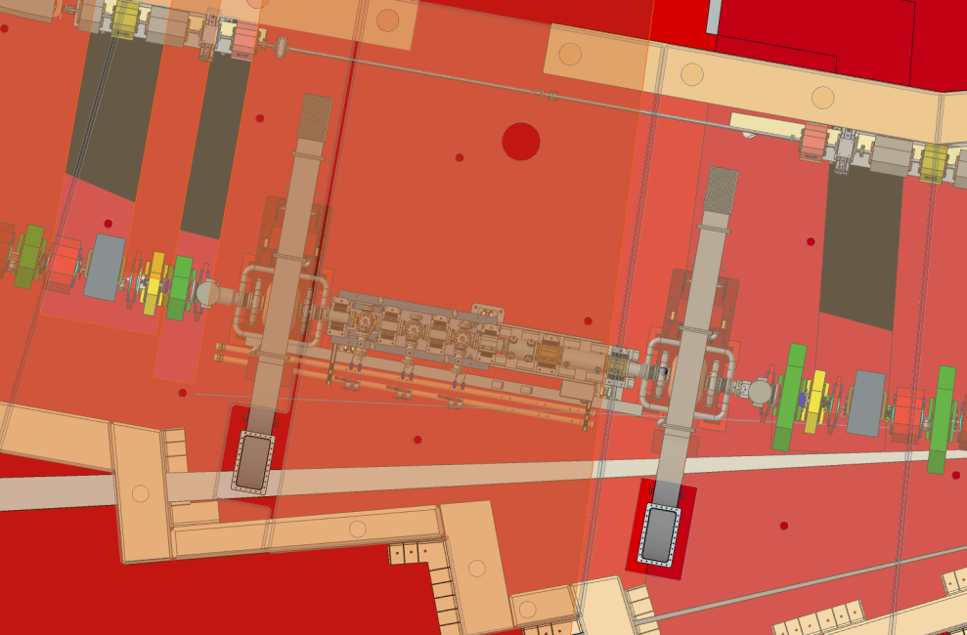
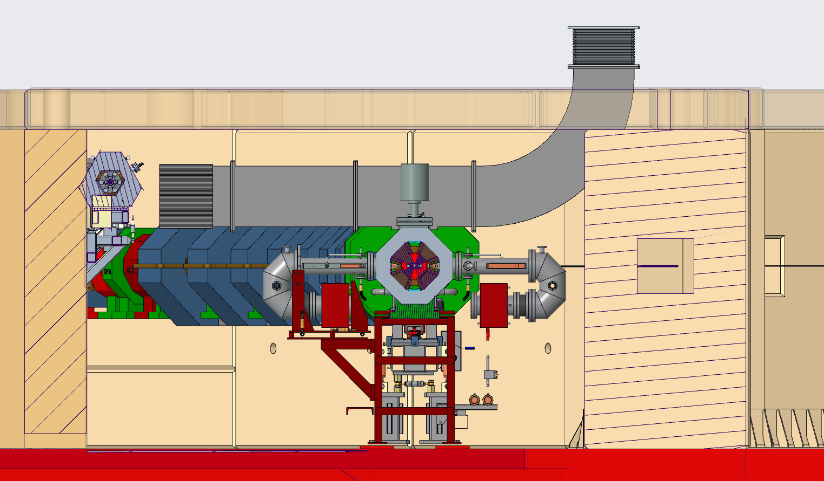
SR RF: Shielding Block Mods None
ALS SR Cavities
Notes:
New 500 MHz Cavities
Easier to leverage existing cavity designs: B-Factory, NLC, Dampy, others
Potentially lower cost power RF source
Potentially might need a frequency agile controller for injection, could depend on harmonic #
New D-LLRF needs to be developed and designed

Slide 28
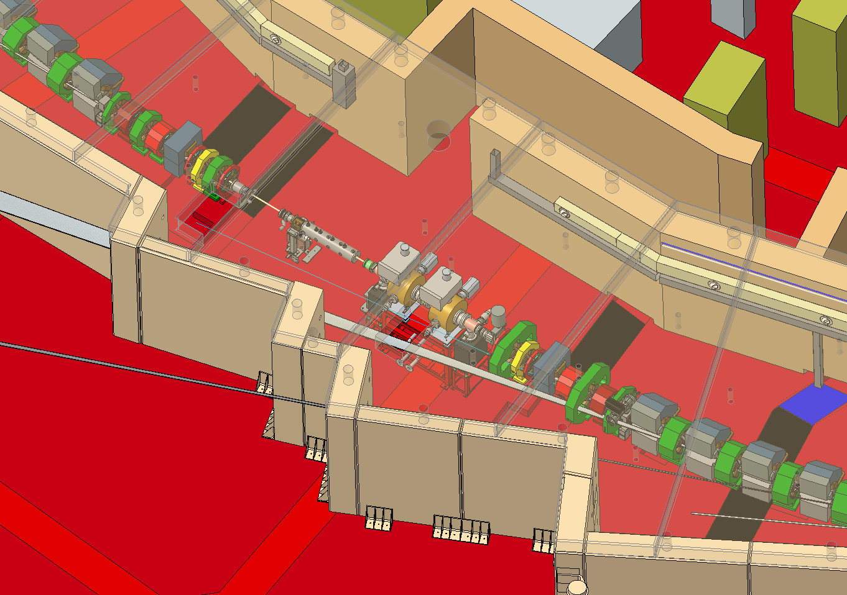
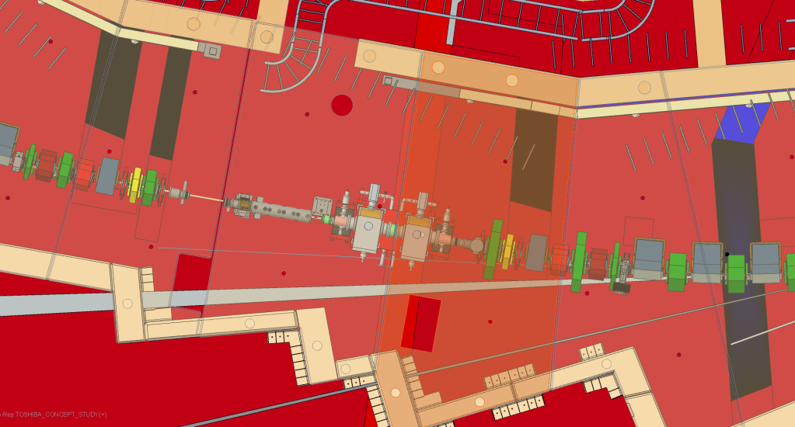
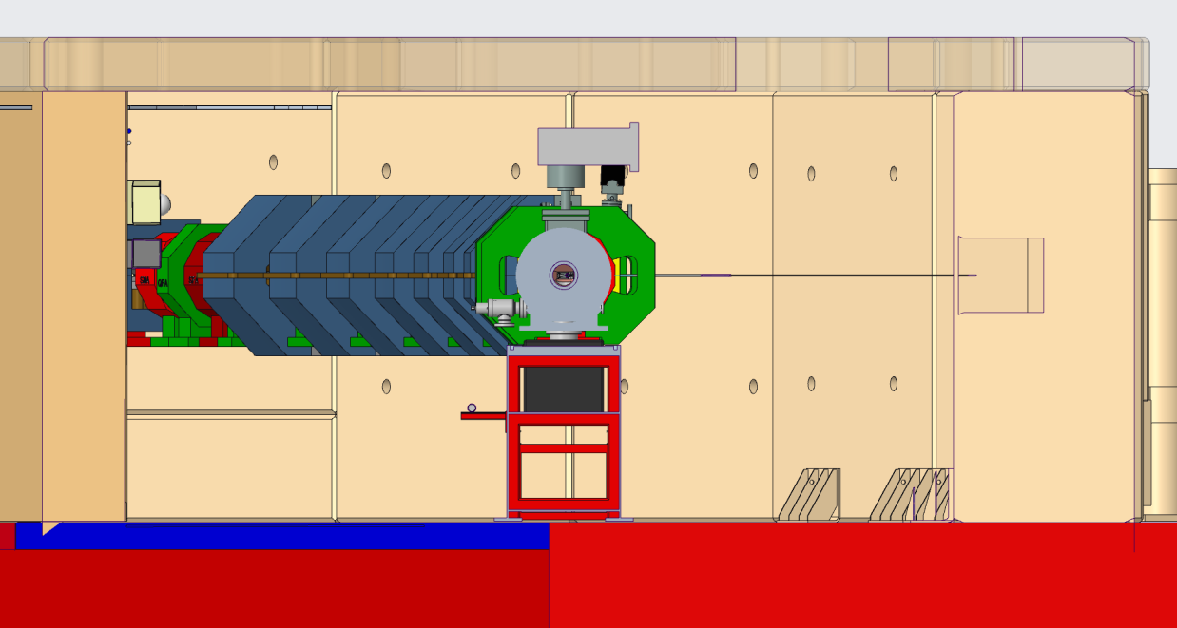
Storage Ring RF: Shielding Block Mods None
Toshiba - ASP Cavity – no shielding mods but longitudinally cavities won’t fit
Notes:
New 500 MHz Cavities
Easier to leverage existing cavity designs: B-Factory, NLC, Dampy, others
Potentially lower cost power RF source
Potentially might need a frequency agile controller for injection, could depend on harmonic #
New D-LLRF needs to be developed and designed

Slide 29
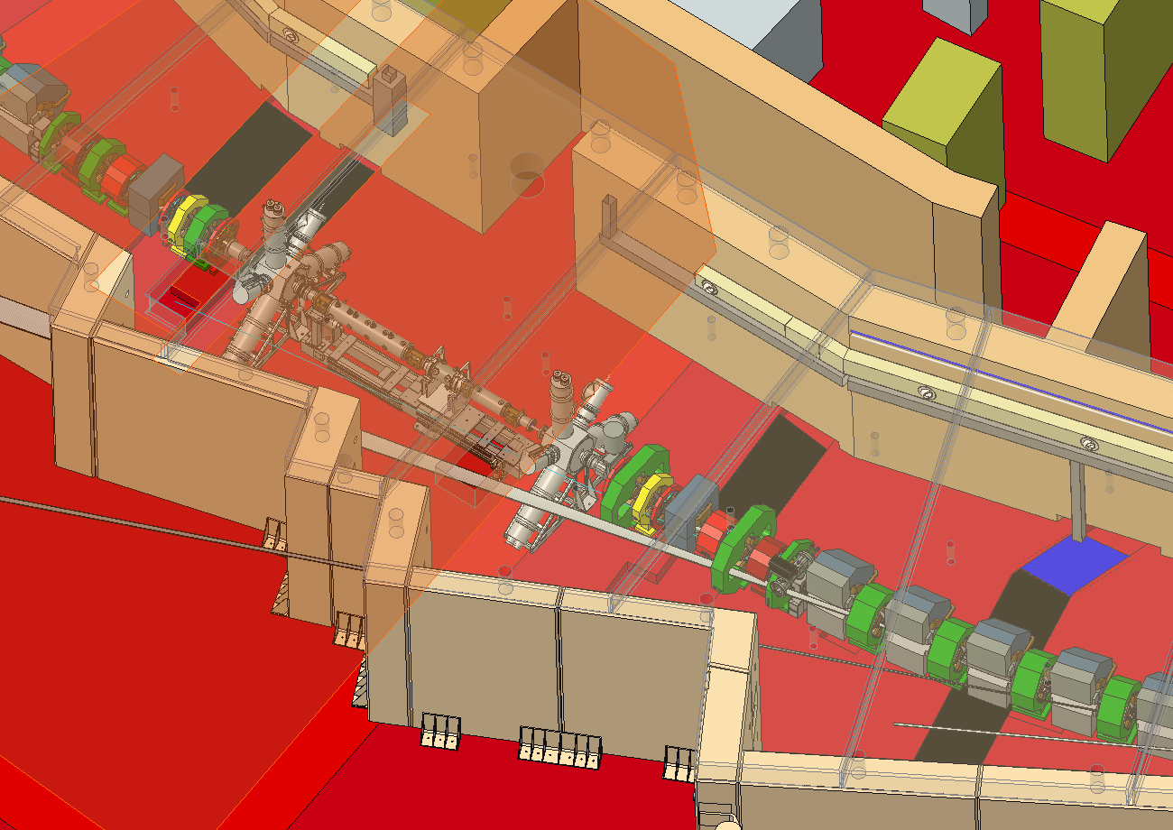
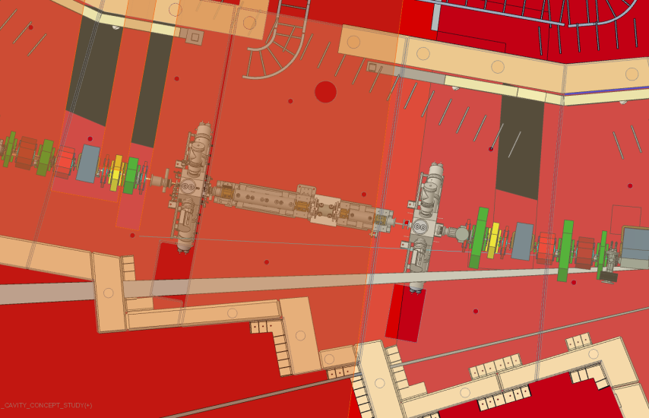
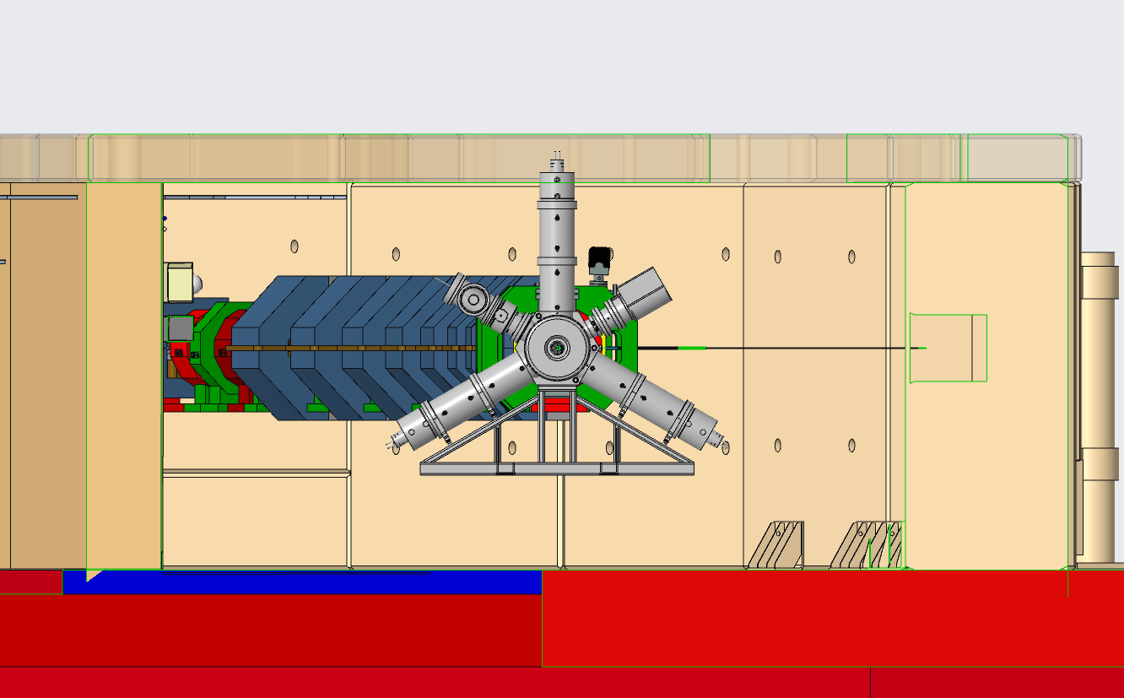
SR RF: Shielding Block Mods Moderate
Research Instruments EC Cavity – moderate shielding mods needed or modify HOM Damper to eliminate shielding mods.
New dog-house blocks
Coupler WG transition could be rotated 90° to minimize the size of the hole in roof.
New dog-house blocks
Notes:
New 500 MHz Cavities
Easier to leverage existing cavity designs: B-Factory, NLC, Dampy, others
Potentially lower cost power RF source
Potentially might need a frequency agile controller for injection, could depend on harmonic #
New D-LLRF needs to be developed and designed

Slide 30
3rd Harmonic System
Notes:
The scope for each RF system includes these 11 major subsystems with a few exceptions
I apologize, this slide should have been a table…

Slide 31
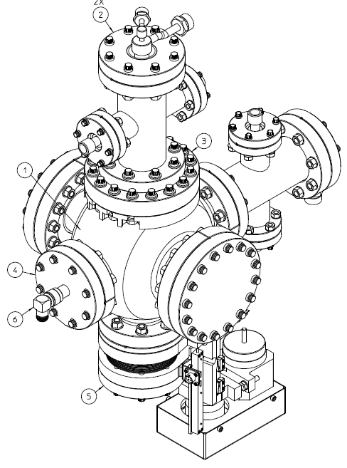
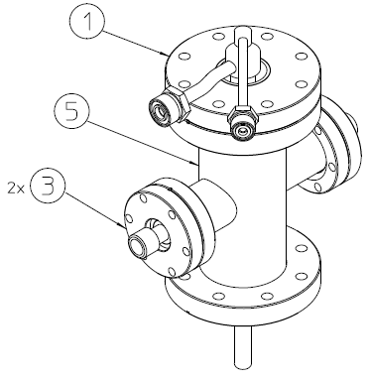
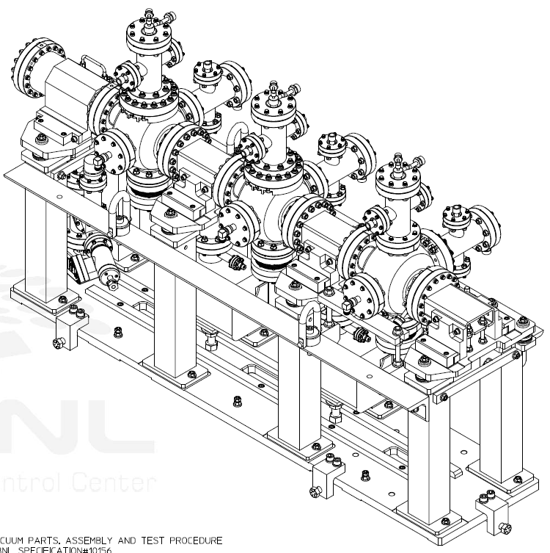
3HC RF System: Overview
6 cavities built at LLNL & LBNL.
5 Installed in SR then reduced to 3.
E-Type HOM Damper
Cavity with 2 E-Type HOM Antenna Damper installed

Slide 32
3HC RF System: Requirements
 | Cavity Design | ALS SR 1.9 GeV | ALS-U SR 2.0 GeV | ALS-U SR 2.0 GeV
Frequency | 1.499 GHz | 1.499 GHz | 1.501 GHz | 1.501 GHz
Bore Dia. | 5 cm | 5 cm | 5 cm | 5 cm
R/Q | 80.4 | 80.4 | 80.4 | 80.4
Calc Q | 27677 | 27677 | 27677 | 27677
Calc R_{s} | 2.23 MΩ | 2.23 MΩ | 2.23 MΩ | 2.23 MΩ
Meas Q | 21000 | 21000 | 21000 | 21000
Meas R_{s} | 1.69 MΩ | 1.69 MΩ | 1.69 MΩ | 1.69 MΩ
Opt. R_{s} | - | - | 1.4 MΩ | 1.4 MΩ
# of Cavities | 6 fabricated 5 available | 3 installed | 2 installed | 2 lengthen 1 shorten
Cell Voltage | 125 kV (max) | 86 kV | 86 kV | 253 kV, 69 kV
Cell Pwr | 5.0 kW (max) | 2.2 kW (avg) | 2.2 kW (avg) | (2) 4.7 kW (1) 1.4 kW
Harmonic Voltage | - | 258 kV | 172 kV | 184 kV
Stability Analysis |  | Stable w/LFB | Not stable w/LFB | Potentially stable
Notes:
Col 1
Copper cavities, re-entrant single cell cavities
Cavity coupler set for near matched condition – maximizes efficiency
Partially HOM damped, E-Type, Ridged WG, Cavity Temperature control
Designed for 70 kW max, 750 kV gap voltage
ALS-U requires lower accelerating voltage, 600 kV vs. 1.3MV (ALS)
Col 2
Re-using a single cavity would meet the accel voltage req, slightly relaxed from current ALS operation point
However
Cavity coupler does not have sufficient range to create a matched condition - ~11 kW reflected per cavity
Not as big of a problem as the transmission power through coupler which would be in a range above which we are comfortable (>150 kW)
Col 3
2 cavity solution
Each cavity operated at even lower accelerating voltage 300 kV – easier and more reliable
but worsens the cavity match and power efficiency at 500 mA
Cavity coupler does not have sufficient range to create a matched condition - ~26 kW reflected per cavity
Transmission power through the coupler and total power is lower than current ALS operation
2 cavity solution supported by the high power amplifier/wg distribution system
The re-use of the ALS HPA/2 cavity solution is our baseline

Slide 33
3HC RF System: Approach for New Cavities
ALS-U should replace the cavities if CBI, caused by HOMs, cannot be reliably managed with 2 cavities lengthening and 1 cavity shortening with passive dampers, cavity temperature control and longitudinal FB.
Options
Design new cavity by leveraging legacy ALS 3HC cavity
Order/Manufacture 2 or 3 cavities, install 1 or 2, depending on their shunt impedance and power handling capabilities, to satisfy the SR installation schedule.
Notes:
New 500 MHz Cavities
Easier to leverage existing cavity designs: B-Factory, NLC, Dampy, others
Potentially lower cost power RF source
Potentially might need a frequency agile controller for injection, could depend on harmonic #
New D-LLRF needs to be developed and designed

Slide 34
Conclusion
The Scope and Requirements are understood and we have developed a conceptual plan that will meet these needs.
Currently in preliminary design, details are surfacing that will help both ALS-U project and ALS facility make strategic decisions on RF cavities.
The leading cavity candidate for the AR is the RI EC cavity.
The leading cavity candidate for the SR is the RI EC cavity.
The leading cavity candidate for the 3HC is likely an in-house design to be built to specification.
Our preferred approach would be to select the cavity solution that serves both ALS-U AR and ALS SR, to use existing SR RF systems and purchase COTS systems based on recent successes for the AR.

Slide 35
Thank you

Slide 36
Backup Slides

Slide 37
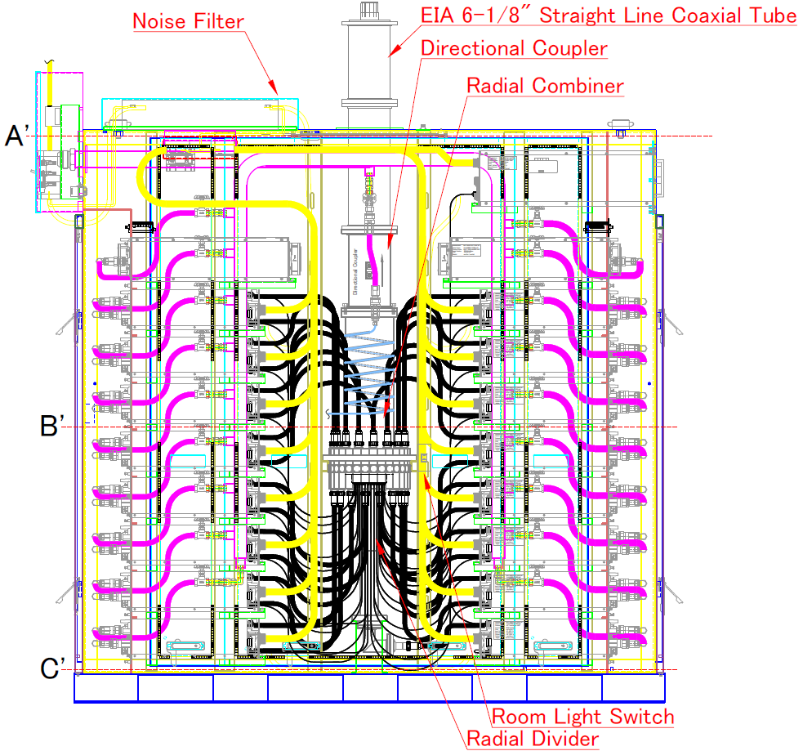
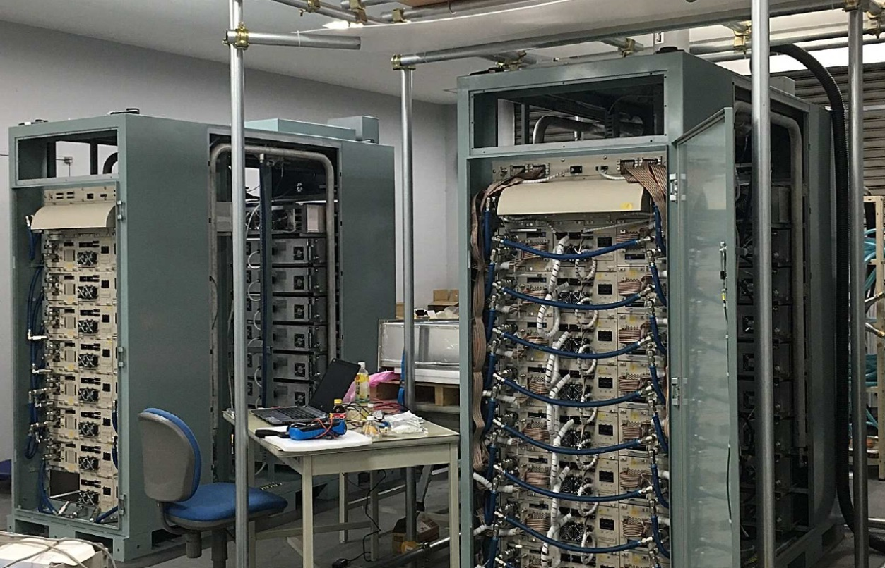
New AR RF Source (example)
60 kW CW SSA at 186 MHz
87” L x 100” H x 36” W, 6000 lbs.
Two 60 kW CW SSA at 186 MHz preparing for test at factory

Slide 38
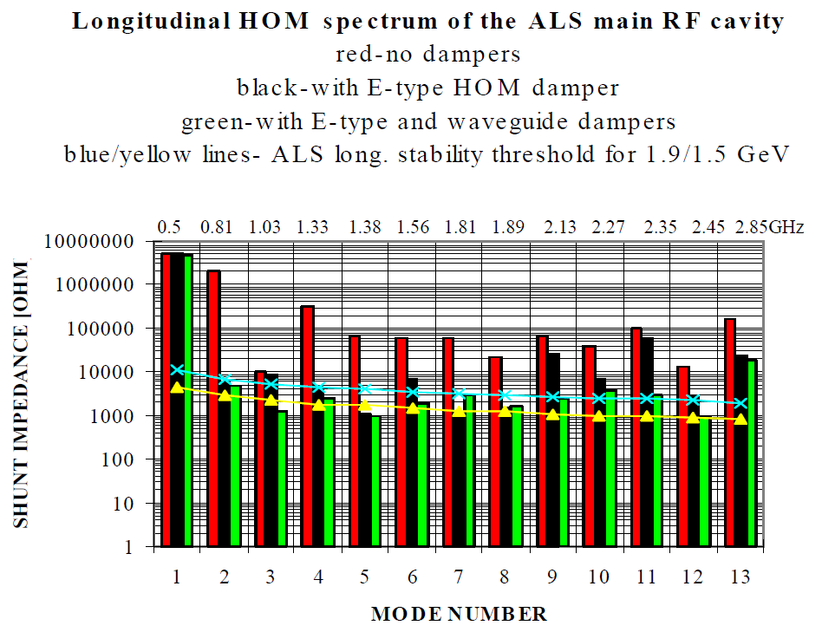
Existing SR Cavity – HOM Spectrum

