Slide 1
SLS RF operation and status of the SLS-2 project
Lukas Stingelin :: Group RF Systems 1 :: Paul Scherrer Institut
22nd ESLS-RF workshop, from 8th November to 9th of November 2018,
Synchrotron SOLEIL, Gif-sur-Yvette Cedex, France

Slide 2
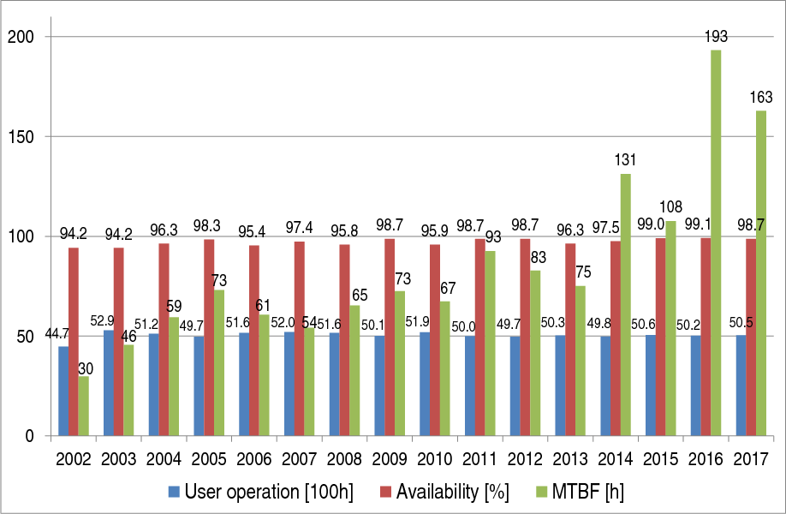
SLS Operation Statistics
Main issues in 2017:
water leak in photon absorbers
Broken rectifier in magnet power supply

Slide 3
SLS Operation Statistics 2018
Main reasons for RF events:
Drifts and settings of interlock thresholds (~4h)
Klystron vacuum and modulation anode overcurrent (~3h)
Loose contact in cooling rack (~1.5h)
Flow switches (~1h)

Slide 4
SLS RF works
Done:
LINAC PFN: Capacitor replacement
LINAC PFN: Thyratron replacement
LINAC pulser board spare
LINAC dump switch upgrade
LINAC: Sample&Hold box spares
Booster: Controls integration and operation with solid state amplifier
In Progress:
LINAC isolation Oil treatement
LINAC pulser board upgrade to shorter bunches
LINAC spare structures?
LINAC LLRF-upgrade → «SwissFEL»
Storage-Ring: Klystron optimization
Storage-Ring: HOMFS upgrade
Storage-Ring: LLRF upgrade
Storage-Ring: HOM-absorber investigation
Super-3HC: Controls interface
Refurbishment of 500MHz Klystrons from Daresbury

Slide 5
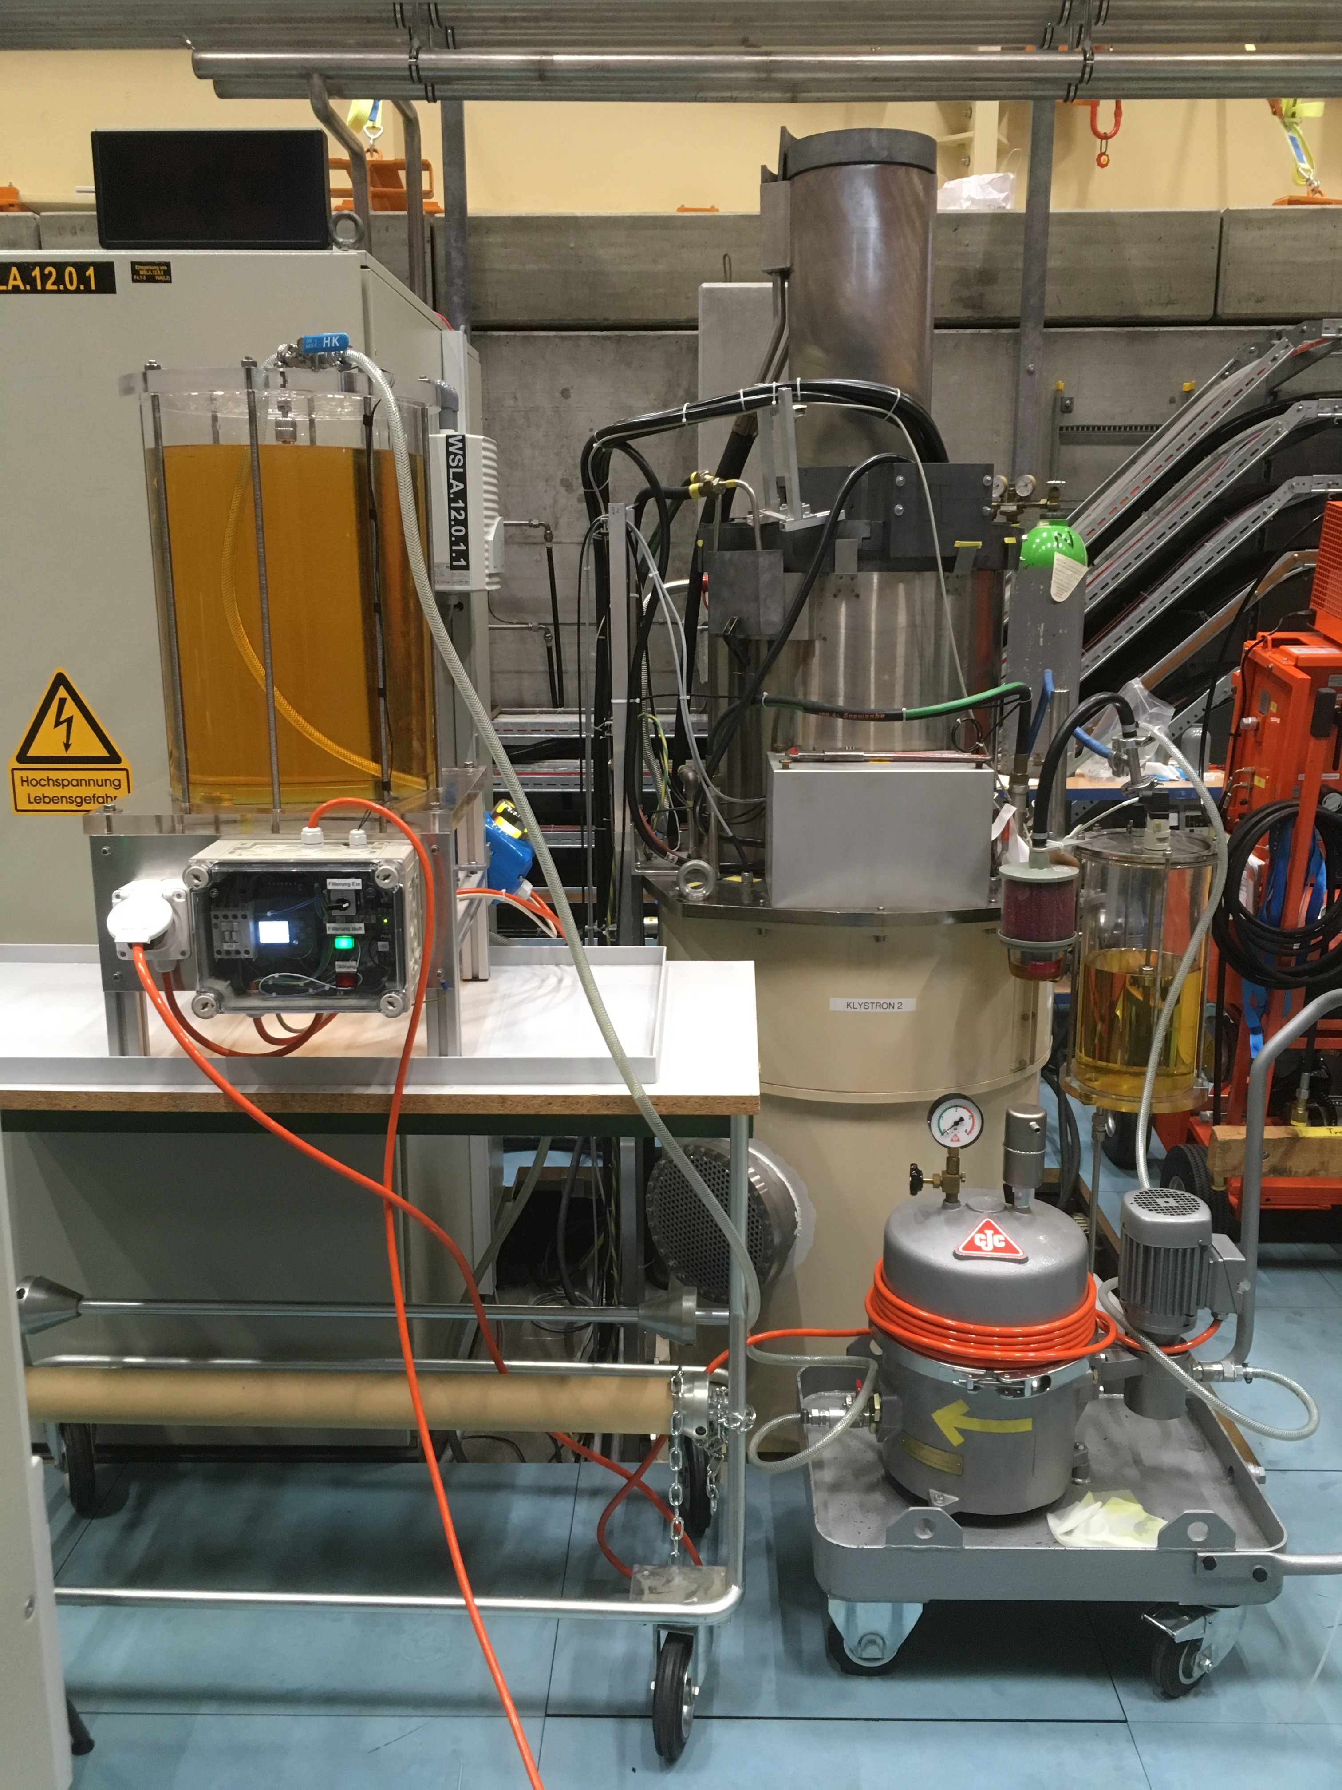
Problems with Air bubbles and Oil filtering in the LINAC
Outage during last ESLS-RF workshop: Arcing in the Klystron tank prevented operation
Air bubbles accumulated under the Klystron plug → bubbles floating up caused arcs
Mobile oil treatement plant helped against the bubbles, but reduced high voltage capability
Improved setup with filter→
Transparent Tank to inspect bubbles
Klystron Tank
Pump Control with «LOGO»-PLC:
Fill tank above
Wait until no air bubbles
Open valve and fill Klystron tank
(Courtesy of D. Kunz)
Oil Filter and pump

Slide 6
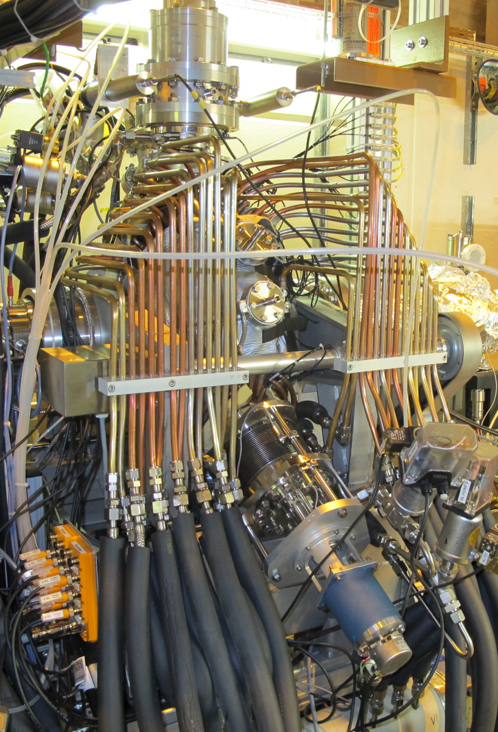
Specification for SLS1&2 Main RF-System
RF-Noise specification: noise induced energy oscillation < 10% of Energy spread
Gap in Filling Pattern: ≥ 10 buckets
Green: normal operation of SLS2 with 3 cavities
Orange: Backup solution with 2 cavities in SLS2

Slide 7
Specification for SLS1&2 Super-3HC

Slide 8
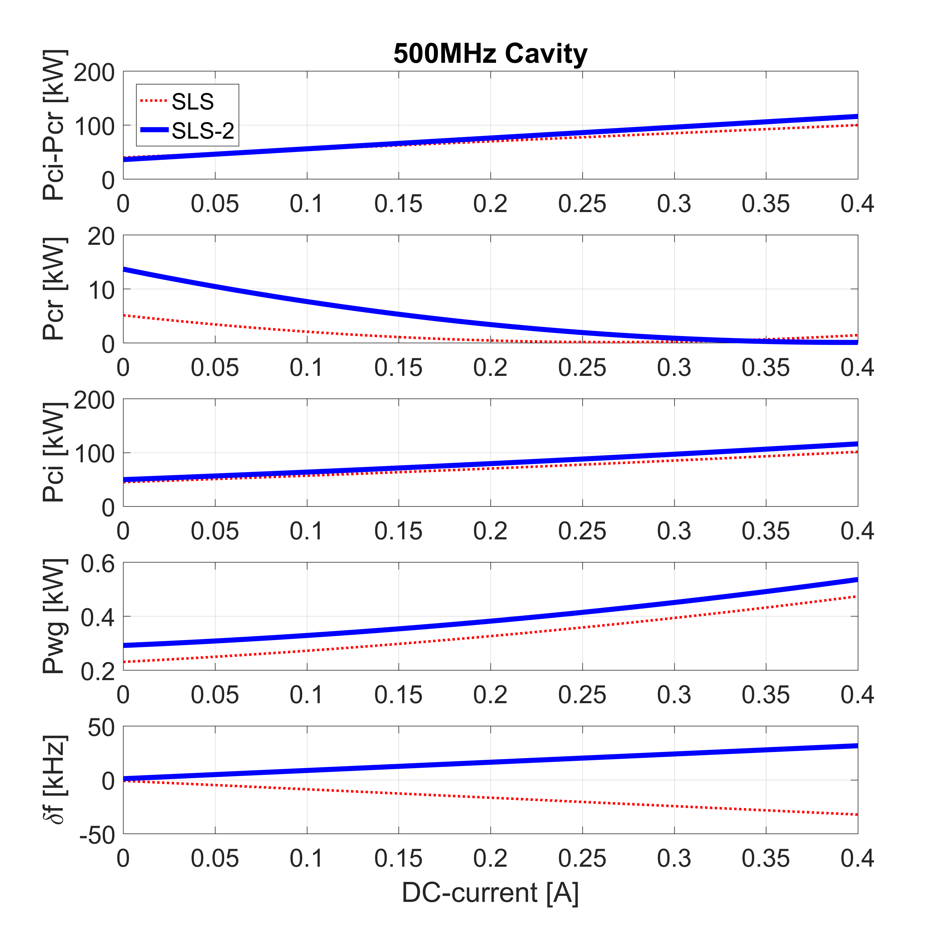
Power requirement for 3 cavity operation in SLS2 and normal operation in SLS1
Slightly increased power requirement for SLS2
Higher reflected power without beam loading
Detuning in other direction (negative momentum compaction)

Slide 9
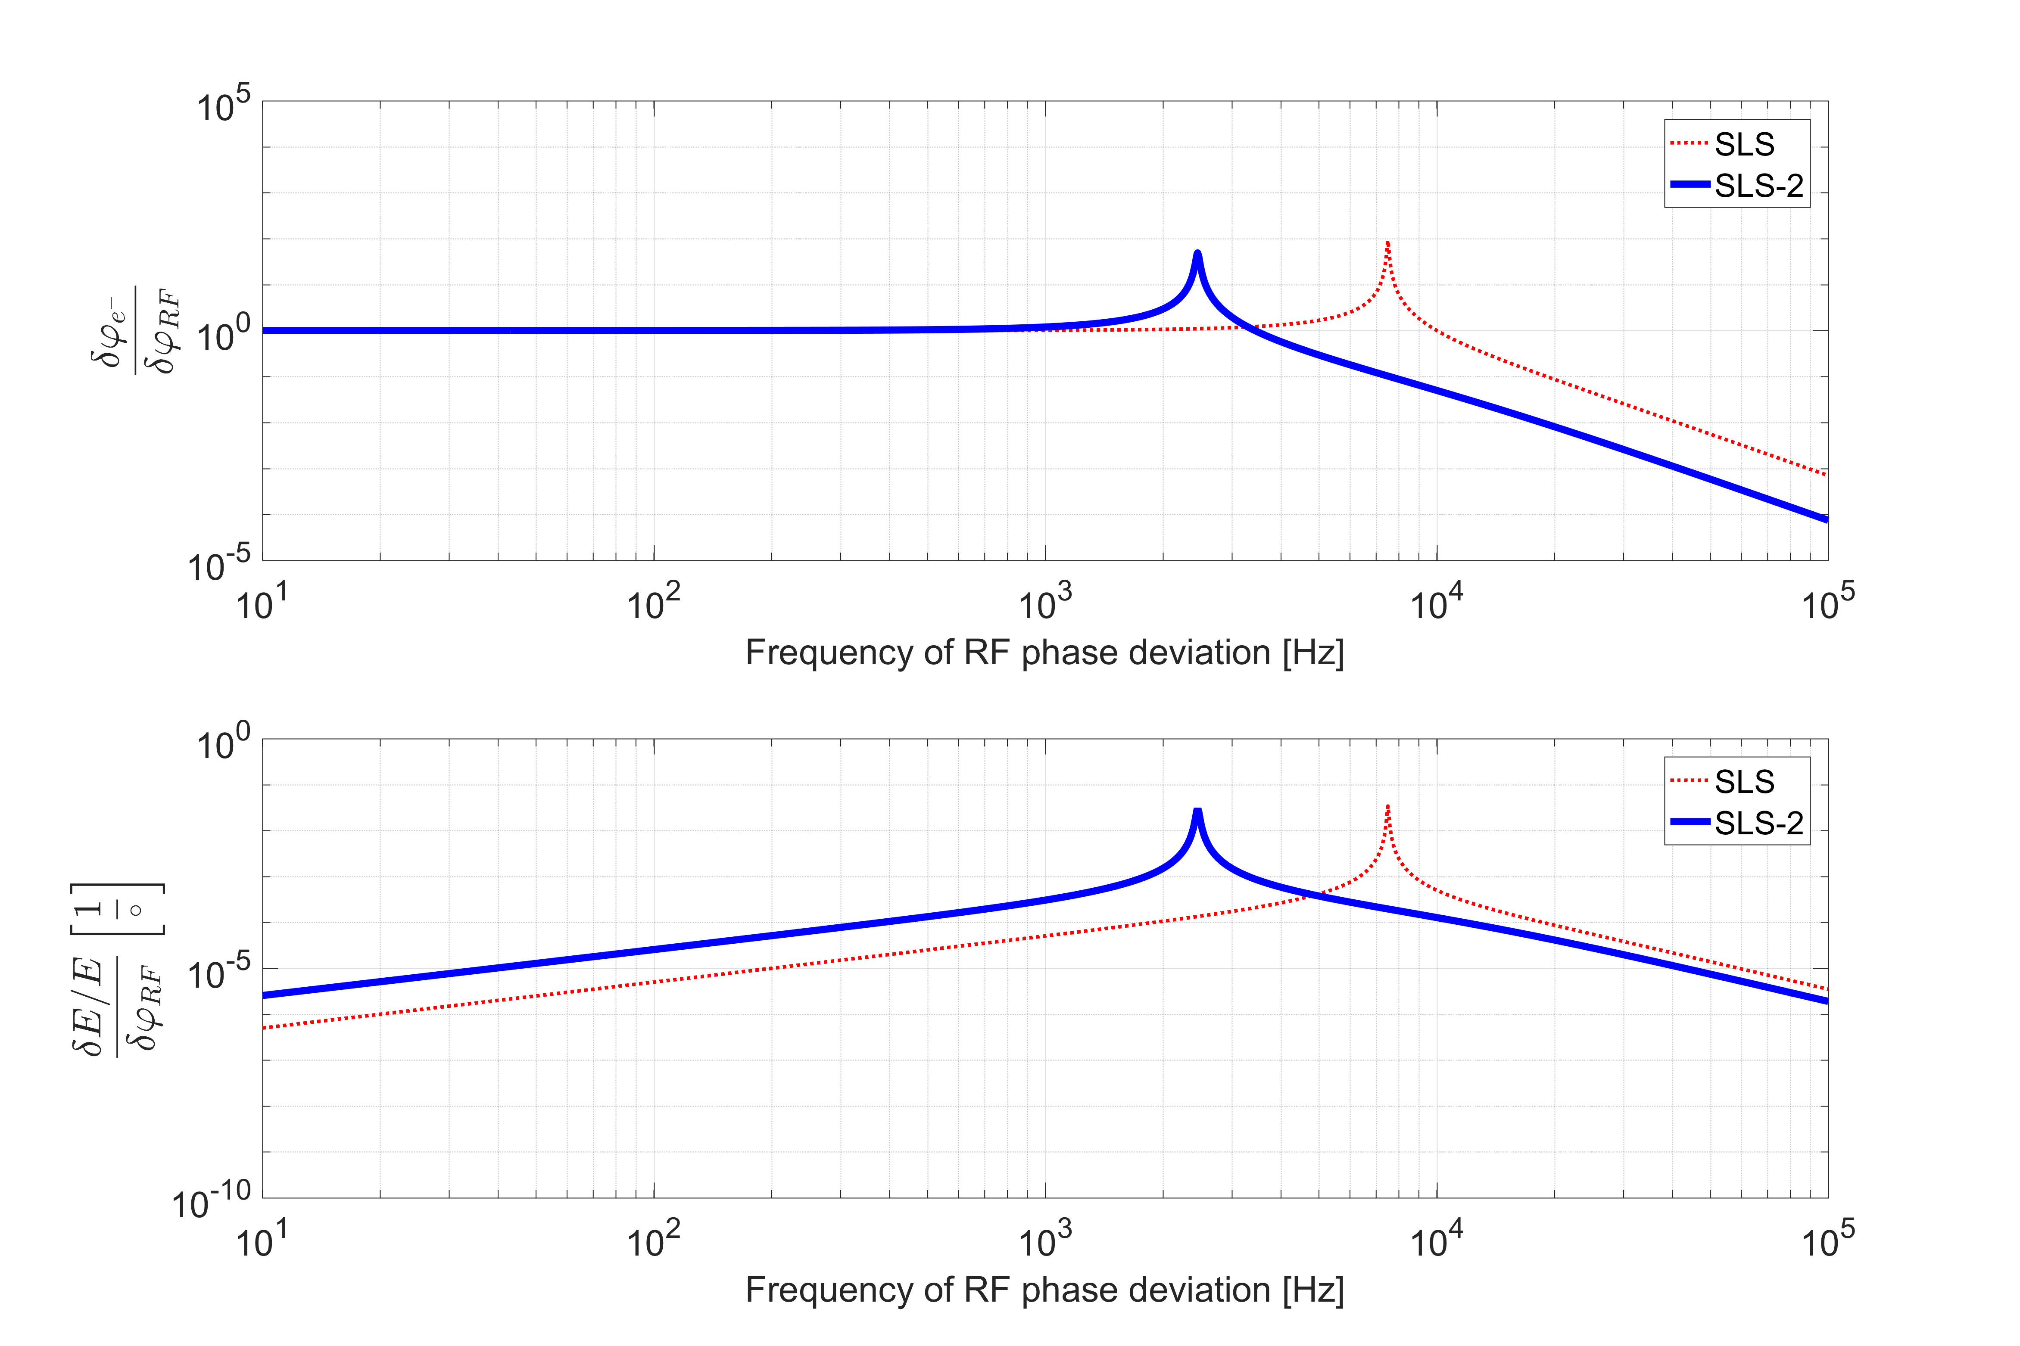
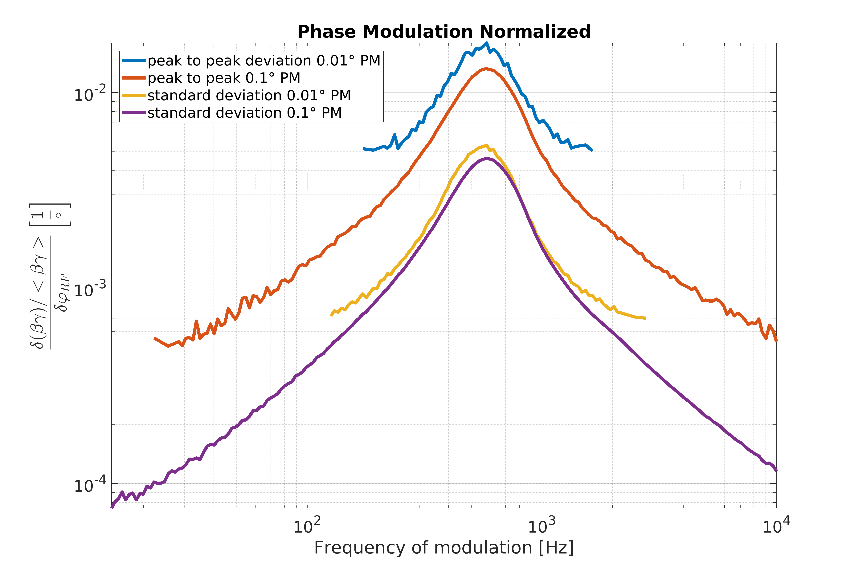
SLS2 Noise Investigations
Without Harmonic Cavity
With Ideal Harmonic Cavity
Analytical model of phase noise propagation based on Laplace transform
SLS2 is more subseptible to low frequency noise
SLS2 phase noise < 0.02° (SLS1: < 0.5°)
SLS2 Klystron PS noise < 0.82V
Numerical simulation of phase noise propagation with PELEGANT
To be done: Simulation of passive harmonic cavity case and gap in filling pattern

Slide 10
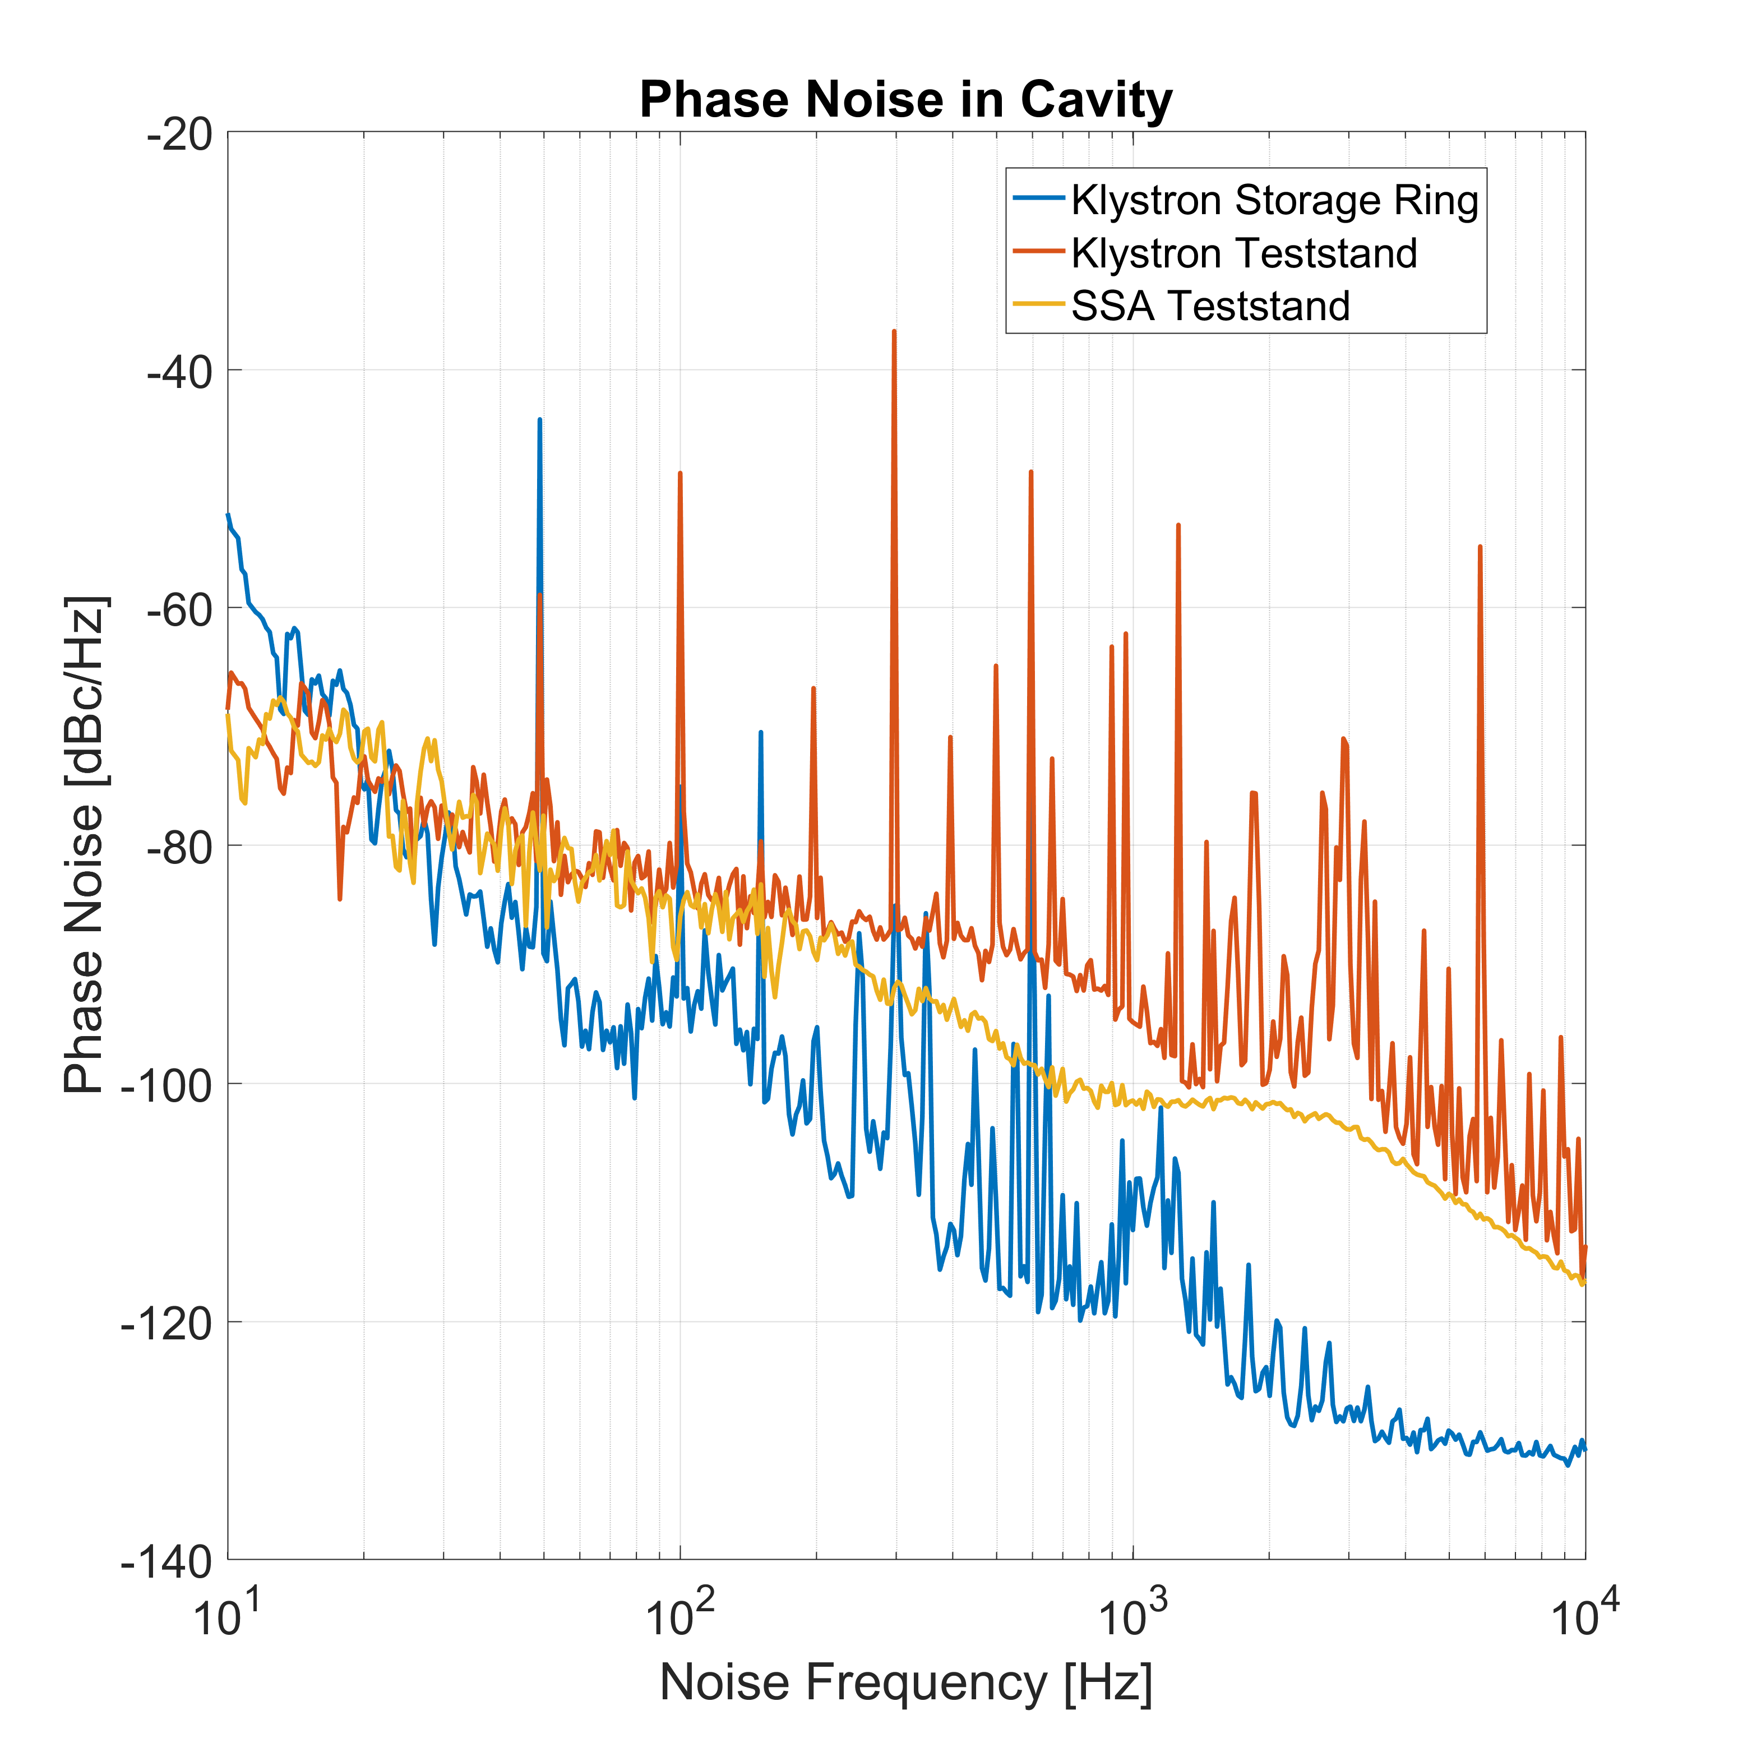
Preliminary noise measurements: Comparison of Klystron- and Solid State Amplifier
Teststand Klystron supply operates with Pulse Step Modulation
Storage Ring Klystron supply operates without Pulse Step Modulation

Slide 11
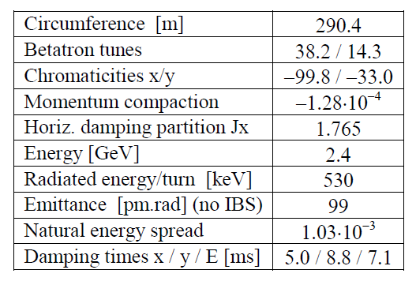
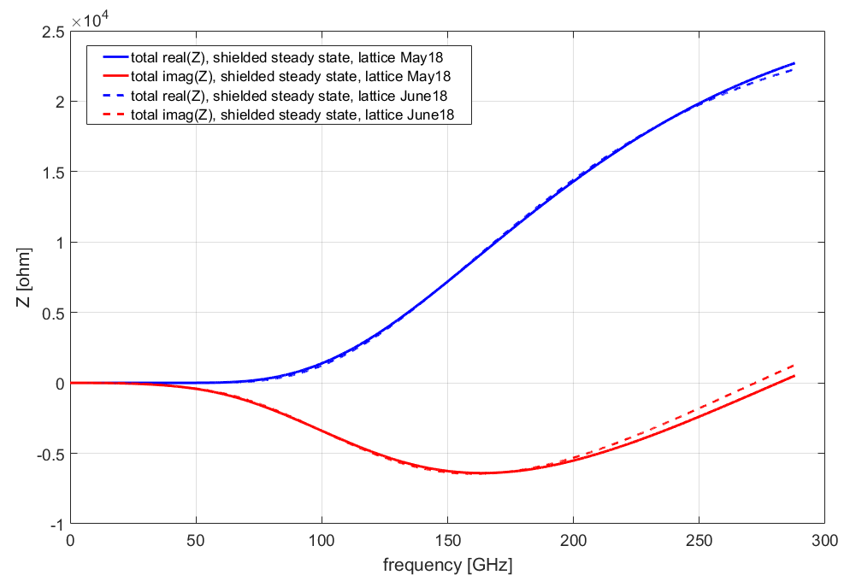
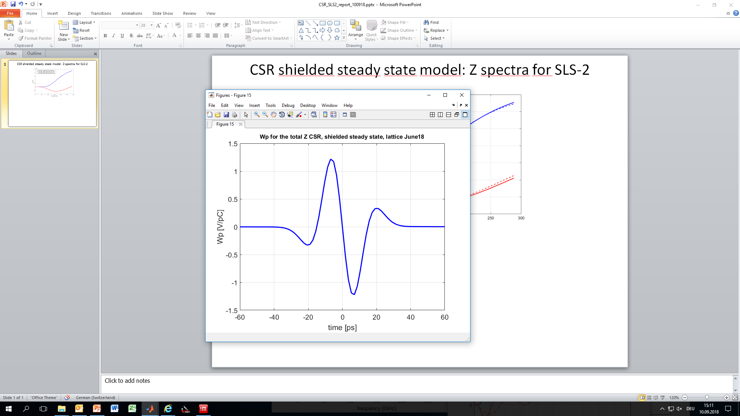
SLS2 Provisional Z-budget: Coherent Synchrotron Radiation (CSR)
SLS-2 magnet list, lattice May18:
SLS-2 parameters , June 2018
BN = Normal Bend
L_{tot} = 37.8 m, R_{min} = 4 m, R_{max} = 11.08 m
BS = Super Bend
L_{tot} = 1.2 m, R_{min} = 1.45 m, R_{max} = 8.5 m
VB/VBM/VBS = Vertical focusing Bend
L_{tot} = 29.68 m, R = 11.66 m
AN/ANM/ANS = reversed bend
L_{tot} = 43.2 m, R = 24.55 m
Beam pipe diameter : 20 mm
α = -1.33*10⁻⁰⁴
SLS-2 lattice,
May 2018
τ (s) = 6.5*10⁻⁰³
(Wp for σ = 2.6 mm gaussian bunch)
head
The two lattices show minor changes in Z_{CSR}-spectra
tail
(Courtesy of A. Citterio)

Slide 12
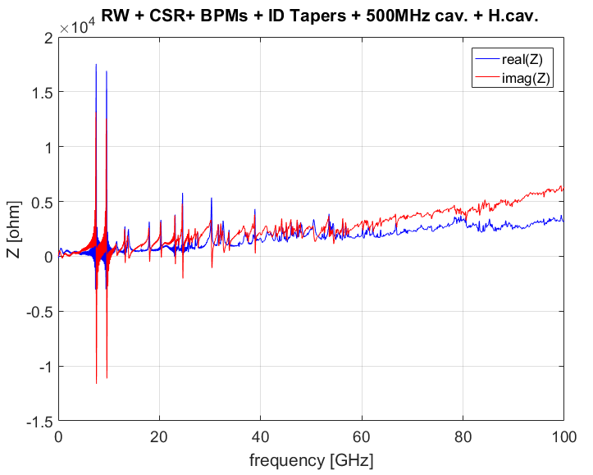
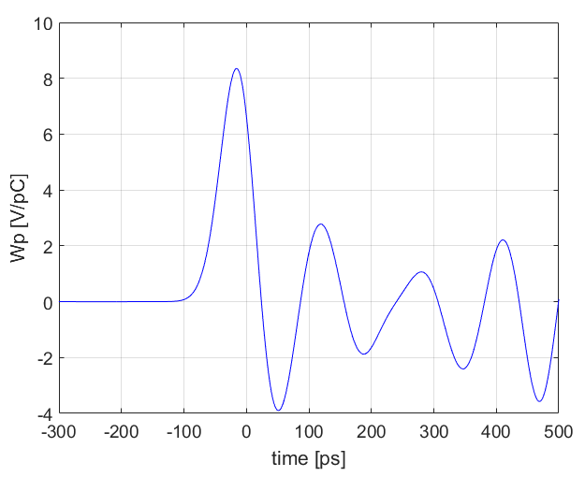
SLS2: The existing Z-budget we have……
Wake pot. for 9 mm σ bunch
…what we have:
….and what we have to add:
Round cross section of Ø20mm, total length 290.4m–14m–28m NEG-coated copper
Two kind of IDs with NEG coated copper:
ID1: Ø 4mm,total length of 14m
ID2: Ø 6mm, total length of 28m
Thickness of NEG = 500 nm.
Assumed conductivity: σ = 1.1E6 [S/m]
Any other transition (taper), photon channels not taken into account so far,
Kickers, septa, MBF kickers
Bellows,
Any additional ID…
Design optimization of the existing
Z-budget
(Courtesy of A. Citterio)

Slide 13
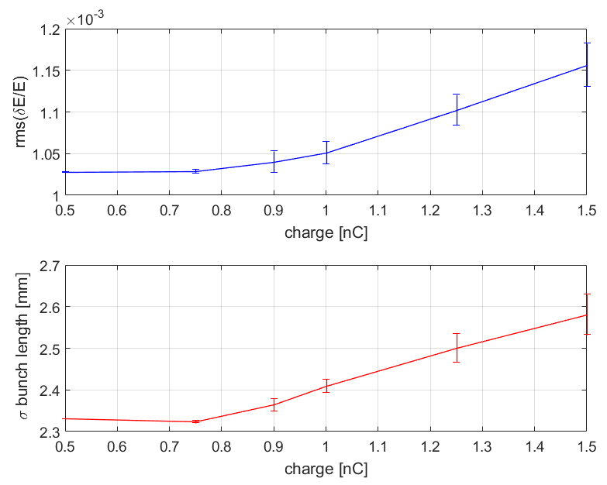
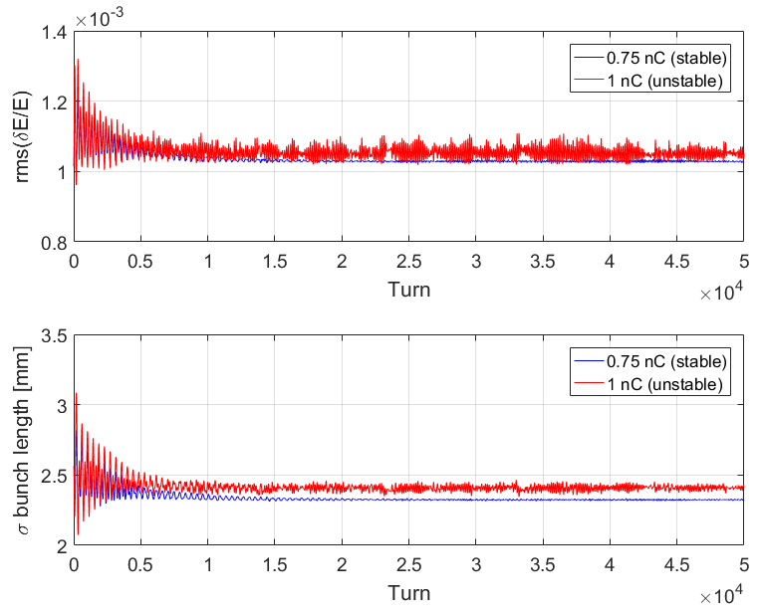
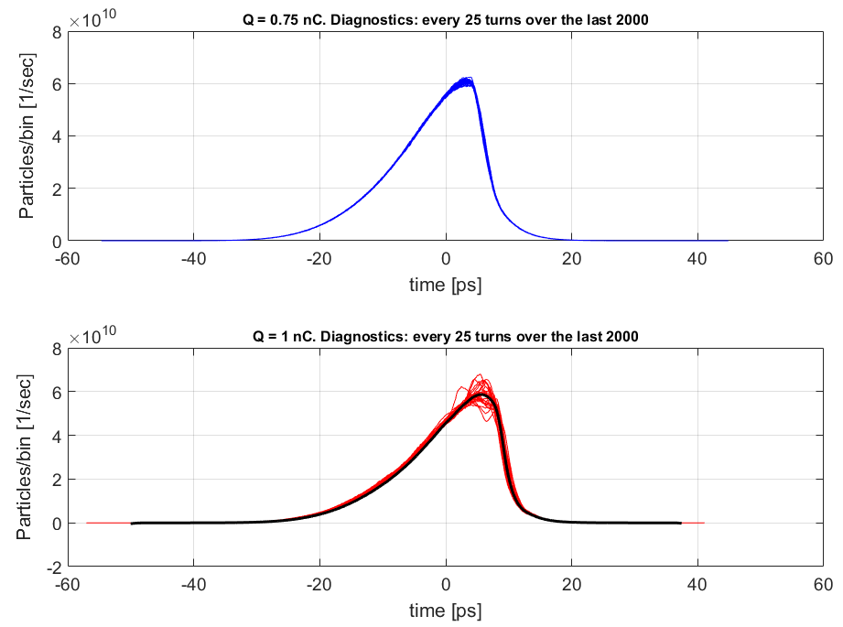
SLS2 Logitudinal MW Instabilities: no HC Z_{geometric} + RW + CSR_{(shielded} _{s.s.)}
Thr.: 0.75 nC
Thr.: 0.75 nC
Limit of stable regime
ELEGANT settings: single bunch, 8E8 MP,
Z- spectrum up to 300 GHz.
Lattice: June 2018 (latest update).
Harmonic Cavity : OFF.
(black = average)
Unstable regime
Threshold without Harmonic Cav.: 0.75 nC (< 1 nC op. charge !)
(Courtesy of A. Citterio)

Slide 14
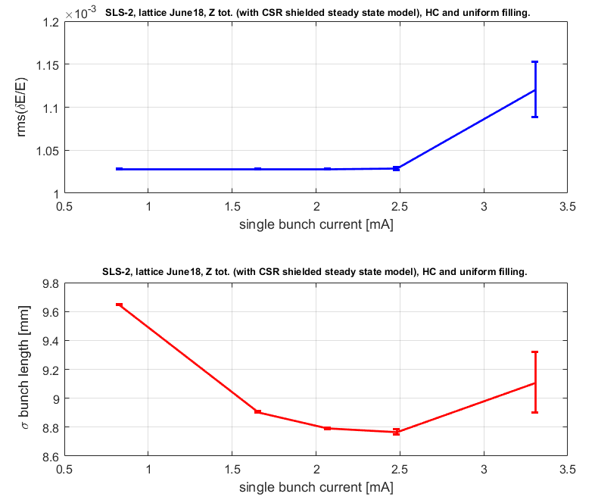
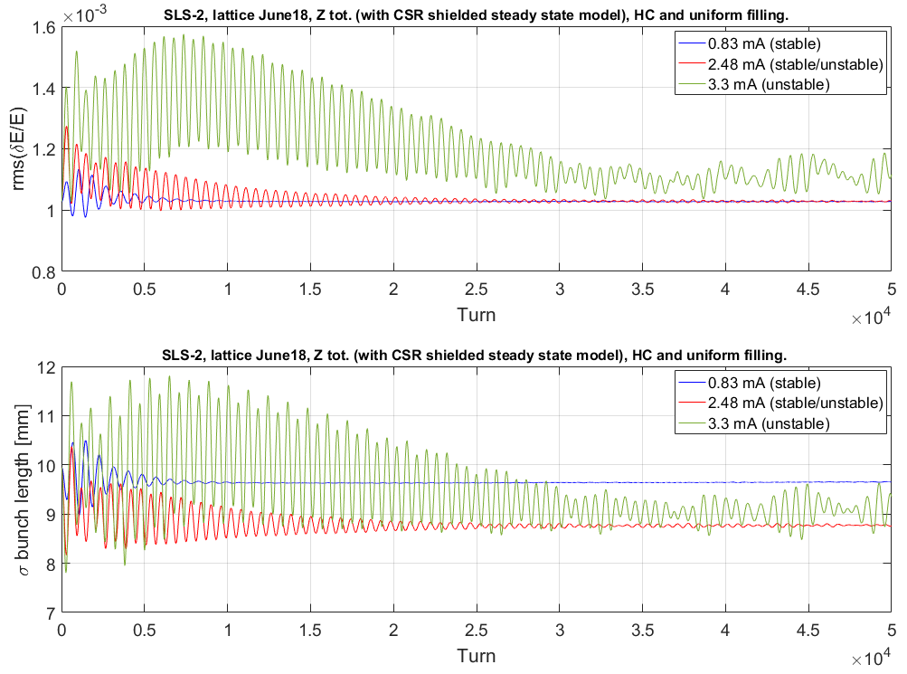
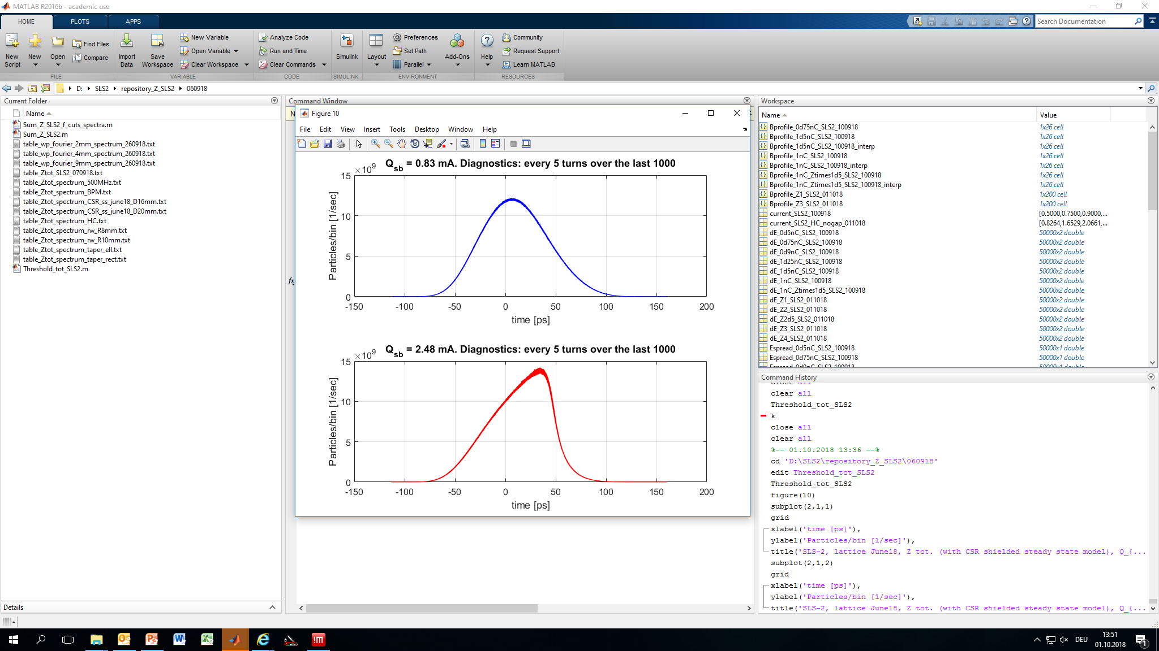
SLS2 Logitudinal MW Instabilities: with 3HC
Z_{geometric} + RW + CSR_{(shielded} _{s.s.)}
Thr.: 2.48 mA
Thr.: 2.48 mA
Super-3HC : ON, with only 1 cell.
500 MHz Cav. setting: 3 Cav
Current tested: 400 mA, but with f*Z_{tot}
(with f= 1, 2 ,2.5 ,3 ,4).
Expected safety threshold with uniform filling looks guaranteed within a factor 3,
or I_{sb} = 2.48 mA.
The gap in filling pattern will reduce the margin.
(Courtesy of A. Citterio)

Slide 15
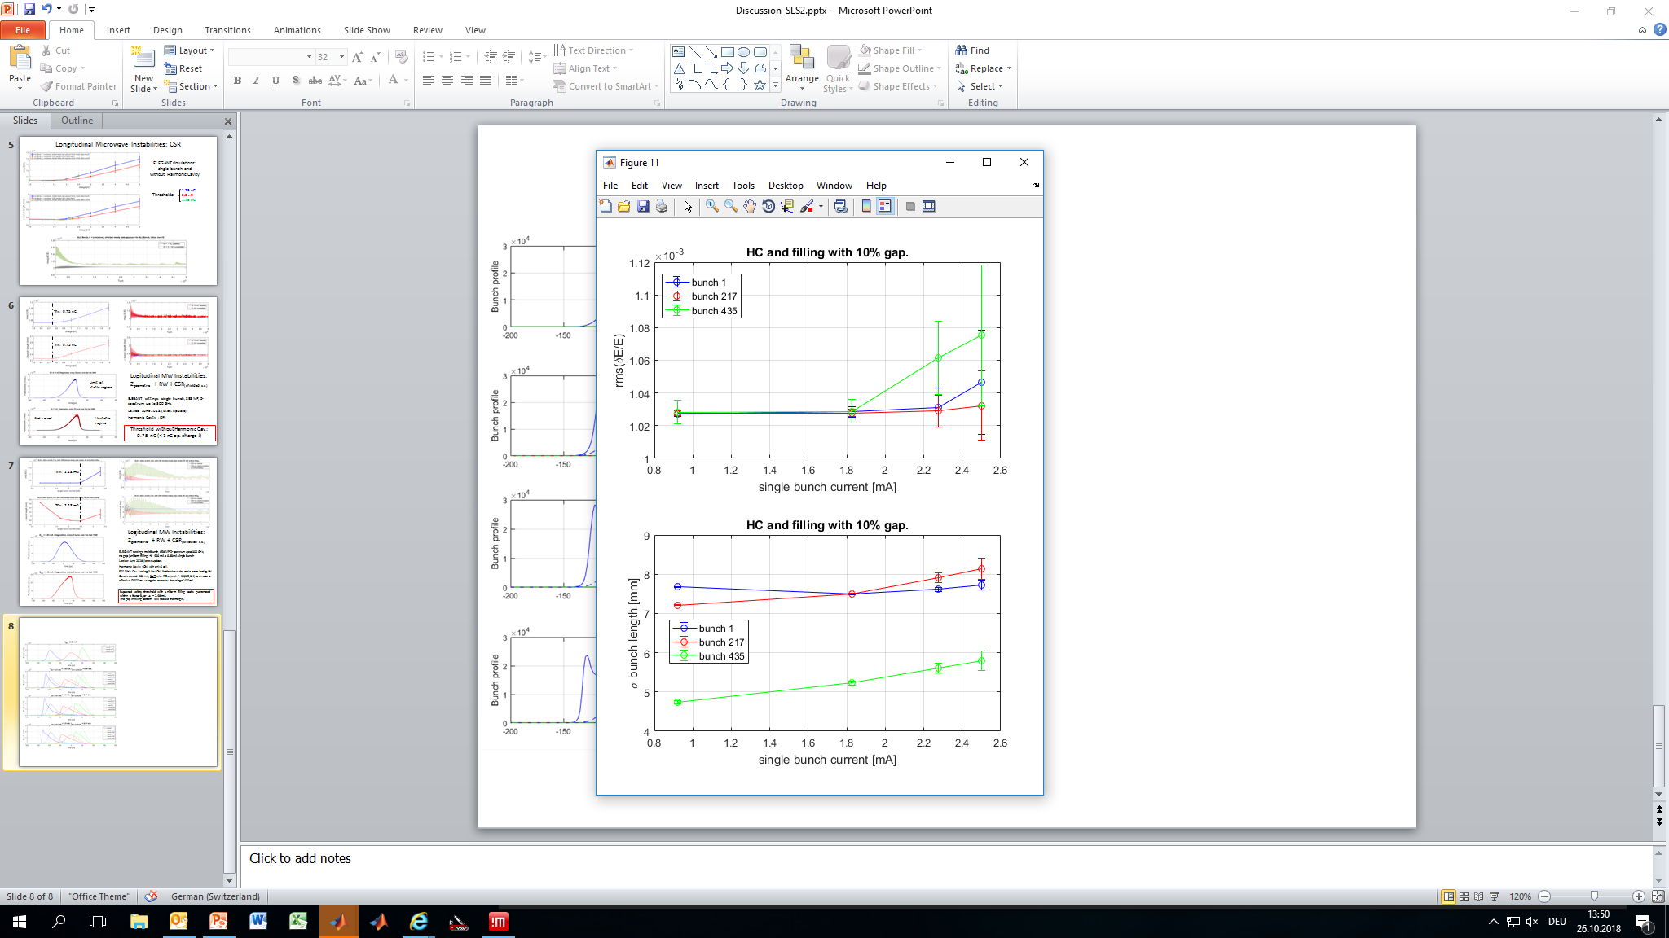
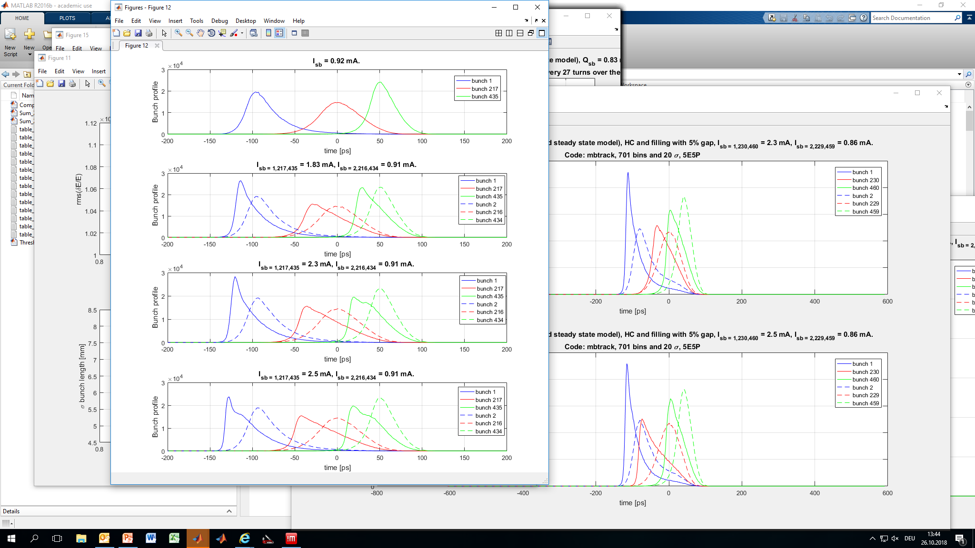
SLS2 Logitudinal MW Instabilities: 3HC and gap
Z_{geometric} + RW + CSR_{(shielded} _{s.s.)}
Thr.: 1.8 mA
Mbtrack settings: multibunch, 5E5 MP/bunch,
Z modeled with W_{f}(t) and L, 10% gap filling pattern → 400 mA ≡ 0.9 mA sb
Current tested: bunches n. 1/217/435 up to
2.5 mA, others at 0.9 mA
Preliminary threshold with 10% gap filling pattern: I_{sb} = 1.8 mA.
(Courtesy of A. Citterio)

Slide 16
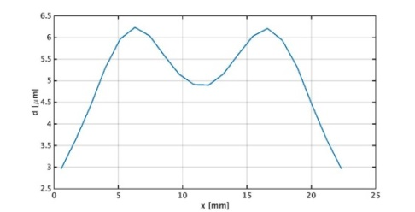
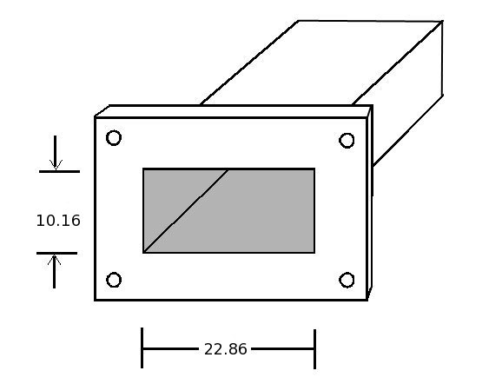
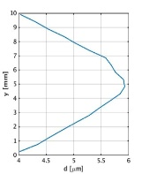
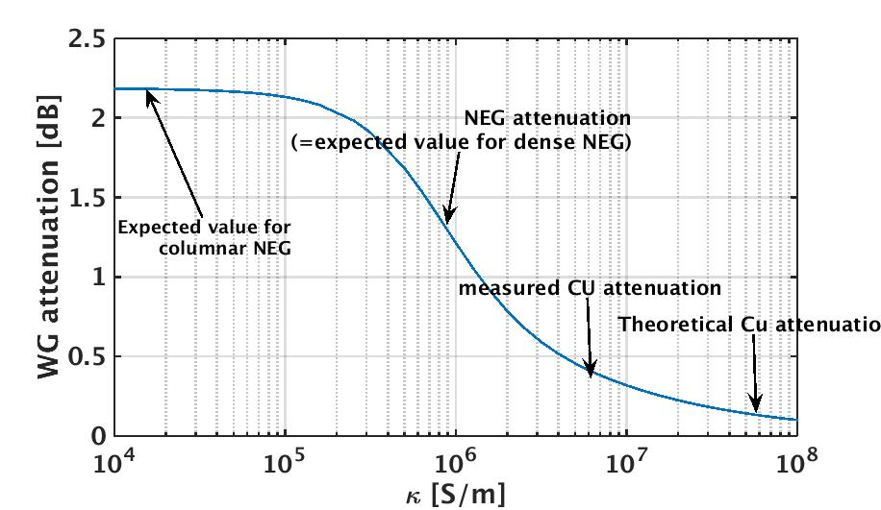
SLS2: Characterization of RF properties of NEG coatings for SLS2 (on going process…)
X-band waveguide with length: 1300 mm
1100 mm with average thickness of 5.1 um
200 mm length with avg. thickness 3.1 um
Process gives also systematic transverse thickness variations, theoretical profiles as calculated with MOLFLOW shown in the figure
Port 2
DUT: WR 90 waveguide (NEG on Cu or Cu)
El. Short
Port 1
l = 1300 mm
Double short the waveguide to create resonator
30 dB directional coupler to measure resonances
Insertion loss of waveguide shows up in width of the resonances/Q factors
Use measured scattering parameter model of setup (modelled in Matlab) to fit resonance Q factor to insertion loss and to NEG conductivity
Big advantage of approach: Don’t rely on comparison between Cu and NEG, but do direct measurement!
(Courtesy of M. Dehler, A. Citterio, X. Liu)

Slide 17
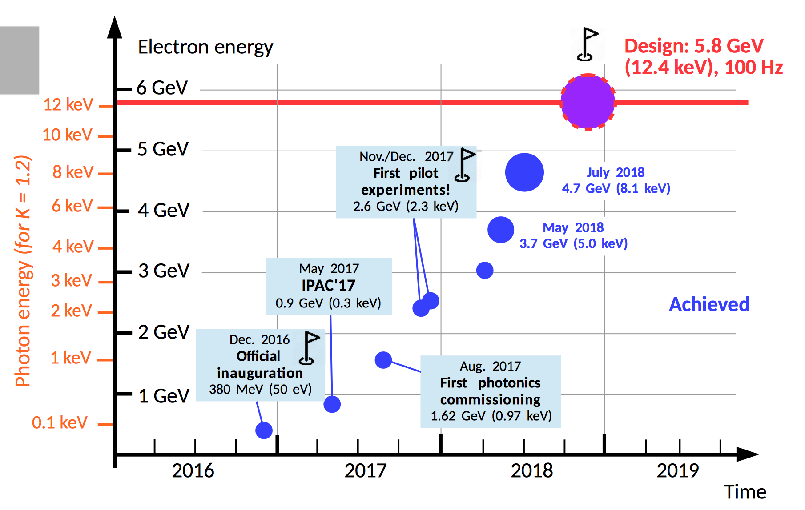
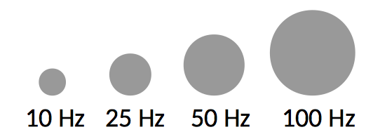
SwissFEL Machine Evolution
(Courtesy of P. Craievich and SwissFEL team)

Slide 18
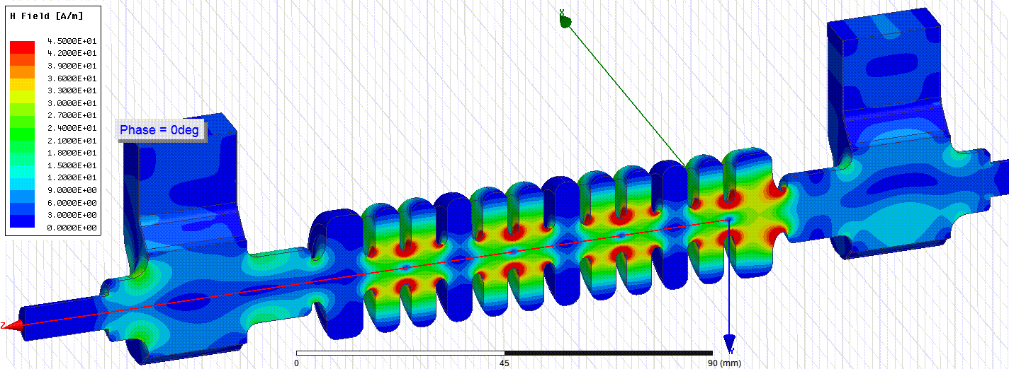
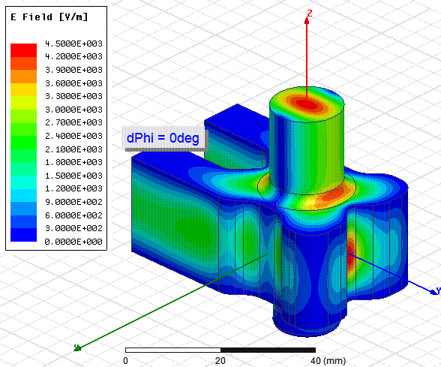
Outlook Athos (soft-X-ray line)
Athos schedule:
Athos dogleg ready for commissioning since June 2018
U38 module prototype delivered in June 2018
Delay chicanes in procurement
Undulator installation Jan. 2019 – March 2020
First pilot experiment end 2020
User operation from 2021
Post-undulator X-band TDS with variable polarization
Collaboration between CERN, DESY and PSI
(Courtesy of P. Craievich and SwissFEL team)

Slide 19
Wir schaffen Wissen – heute für morgen
Thank you for your attention!
We thank
Ryutaro Nagaoka and Francis Cullinan for their support on the mbtrack code.
ESRF for coating of the X-band waveguide
KEK (D. Zhou) for providing CSR-impedance and SLAC (K. Bane, C. Mayes) for discussions
RF- and SLS2 team

