Slide 1
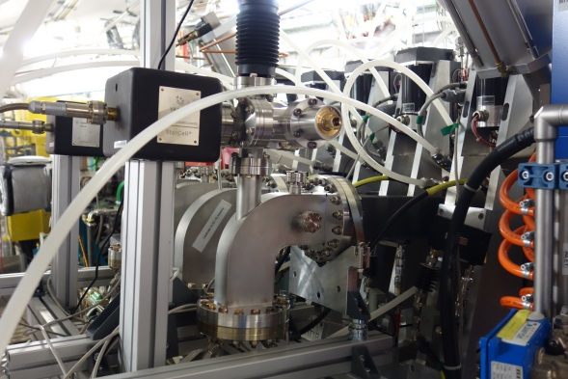
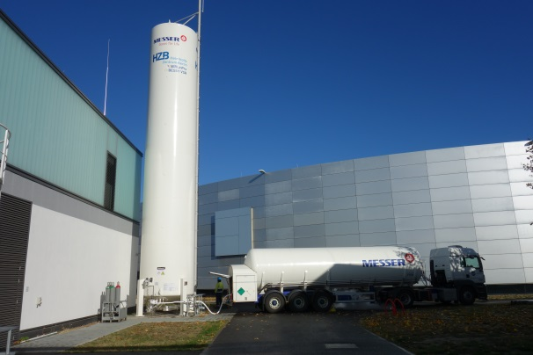
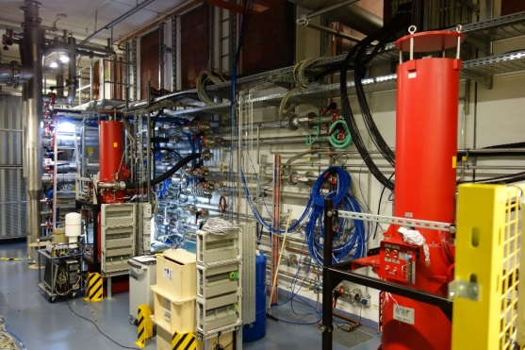
Status of RF at HZB: BESSY II, MLS, bERLinPro and BESSY VSR
Wolfgang Anders
Helmholtz-Zentrum Berlin for Materials and Energy (HZB)
22th ESLS-RF Meeting 8.-9.11.2018 at Soleil

Slide 2
Outline
BESSY II
  Harmonic cavities repaired and installed
MLS
  Diodes in IOT power supply partly burned
BERLinPro
  270 kW Prototype transmitter tests finished
  300 kW loads from St. Petersburg arrived
  First klystron at bERLinPro diode operation
BESSY VSR
  SSA L-band transmitters ordered
  Two more 5 cell PETRA cavities and 80 kW 500 MHz transmitters for booster

Slide 3
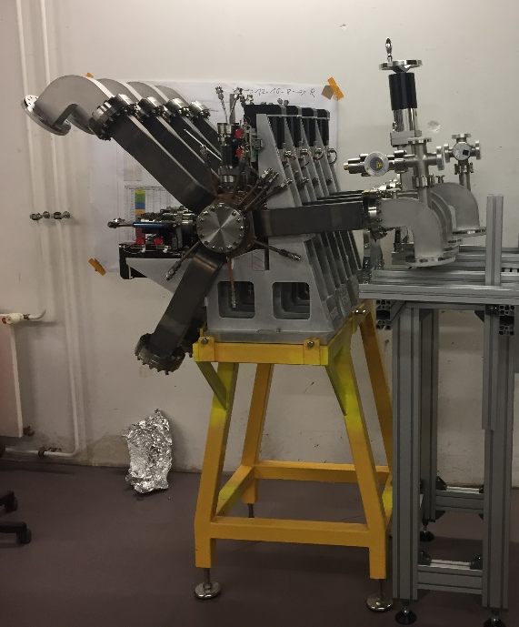

BESSY II: Reinstallation of harmonic cavities
In 2016 we had problems with the harmonic cavities (1.5 GHz nc) and we removed them from the ring
In this shutdown we reinstall with some modifications:
  One body has to be changed because of a leakage
  Upper waveguides now bend, so that no ferrite crumbs can fall into the cavity
  Vacuum pumps at the waveguides
  IR camera to monitor ferrite temperature
Modified
harmonic cavities

Slide 4
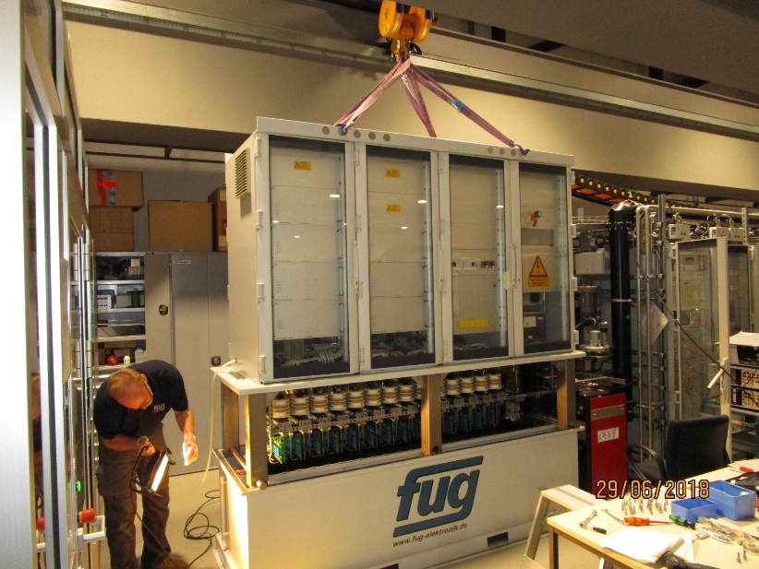
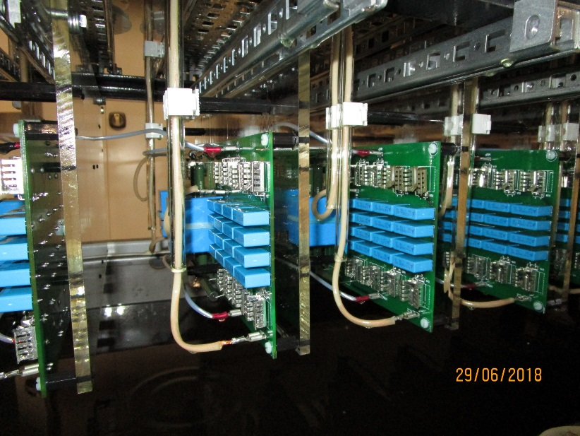
MLS: Problems with IOT power supply
At the MLS IOT transmitter we had some minor instabilities but do hear the noise of arcing in the power supply.
We lifted the power supply out of the oil vessel.
Some of the diodes have been burned.
We changed all rectifier boards.
IOT transmitter power supply lifted out of the oil vessel
Diodes and capacitors in oil

Slide 5
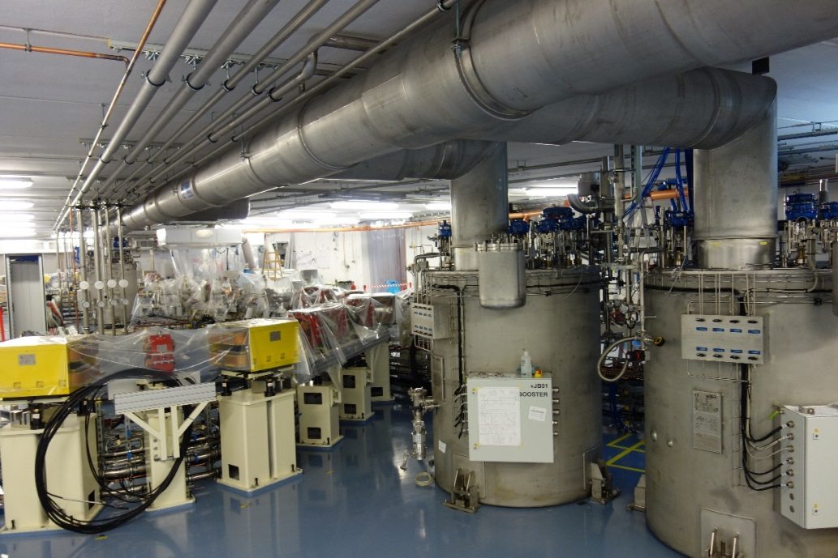
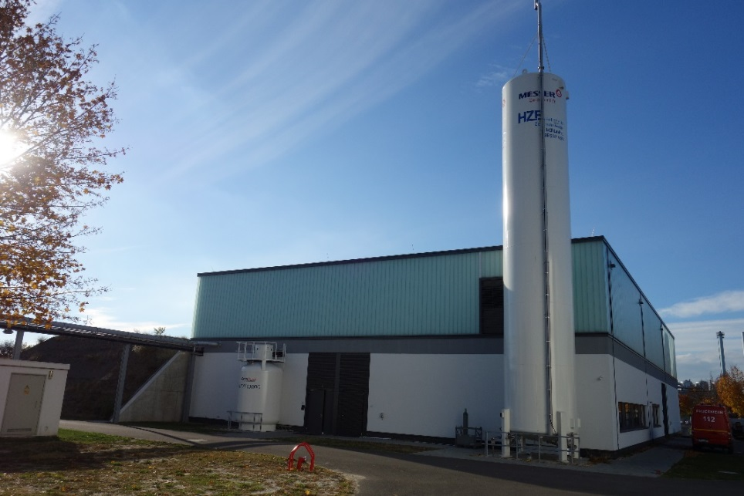
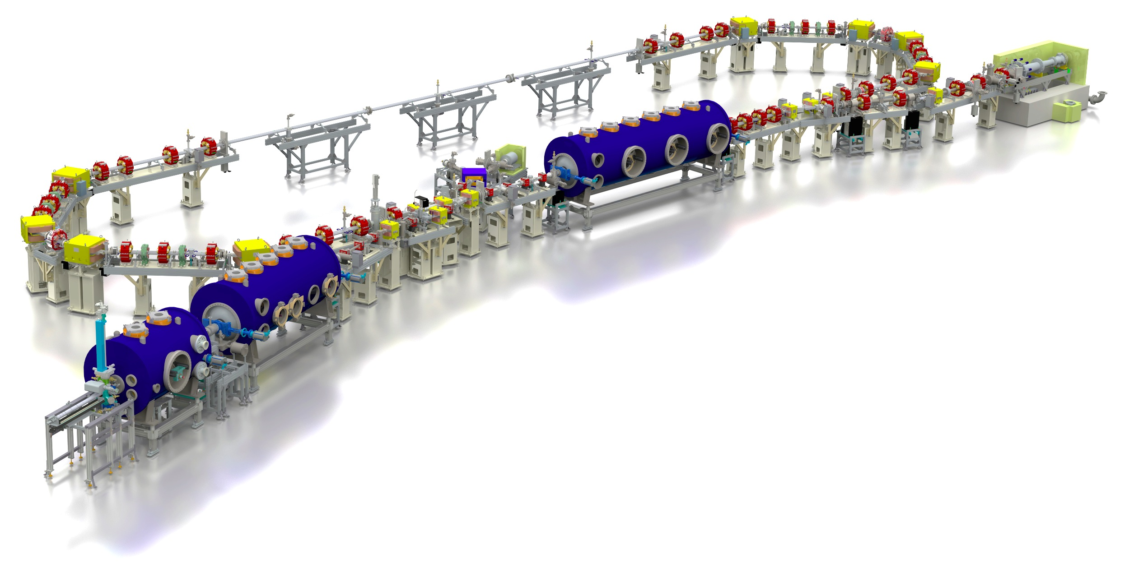
bERLinPro: Overview
Berlin Energy Recovery Linac Project is now in the installation phase
Building mostly ready
Cabling mostly done
Magnets installed
Vacuum chamber partly installed
Cryogenic preparing commissioning
Gunmodule tested in test-hall → now cavity cleaned again to be installed in summer 2019
First beam expected end of 2019
bERLinPro ring and building

Slide 6
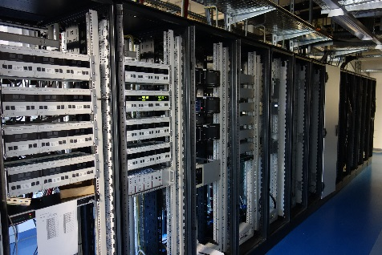
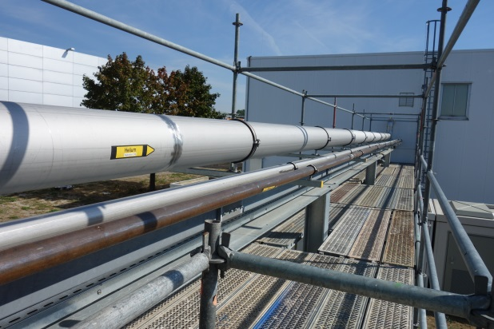
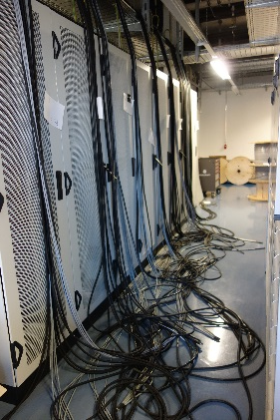
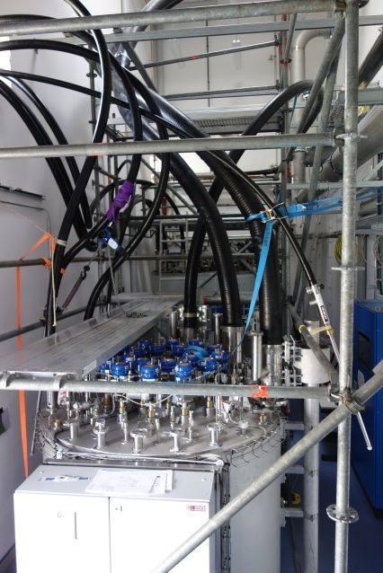
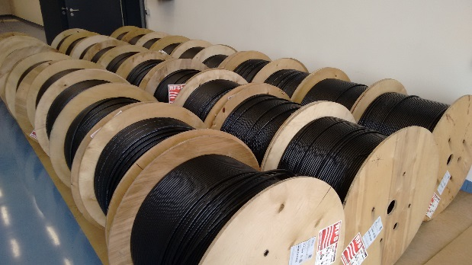
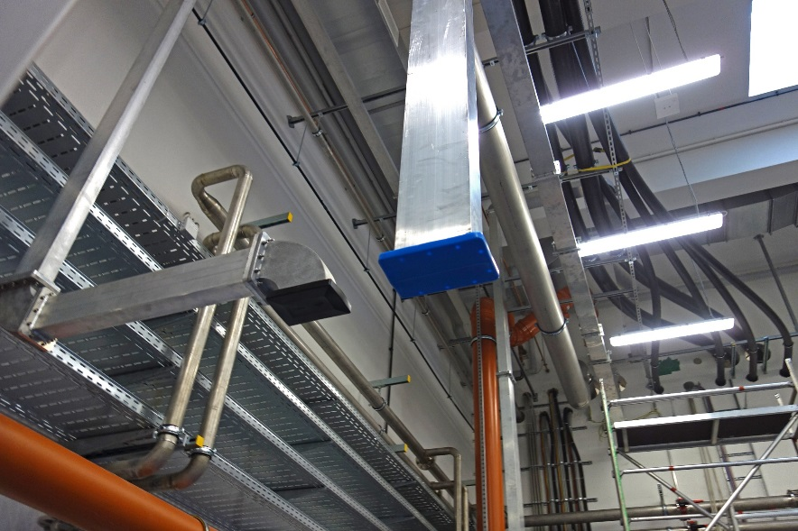
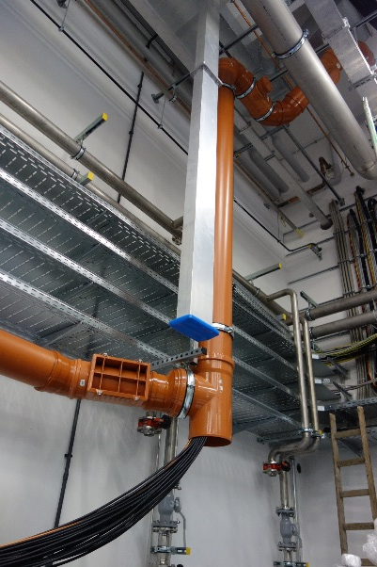
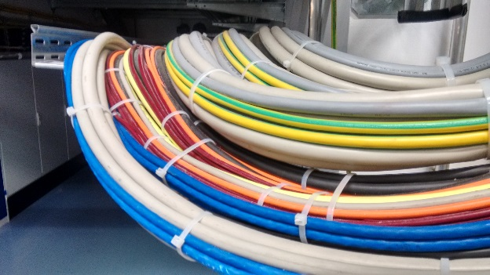
bERLinPro: Installations
Vacuum controls
Cryogenic installations
Cables and waveguides

Slide 7
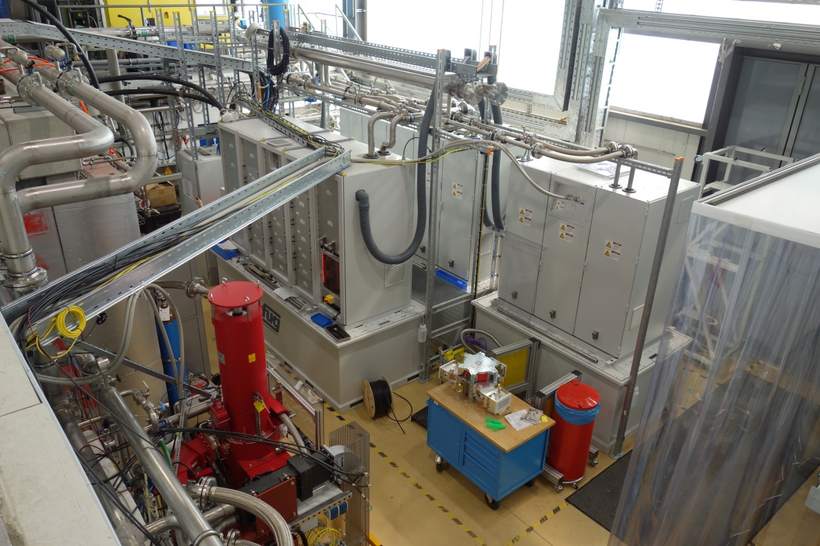
bERLinPro: 270 kW prototype transmitters tests finished
1.3 GHz 270 kW_{cw} transmitter was commissioned in the testing hall
Maximum was 220 kW limited by the water load, but we ordered better loads
Tests are finished and transmitter will be moved to bERLinPro beginning next year
1.3 GHz 270 kW_{cw} transmitter in the testing hall

Slide 8
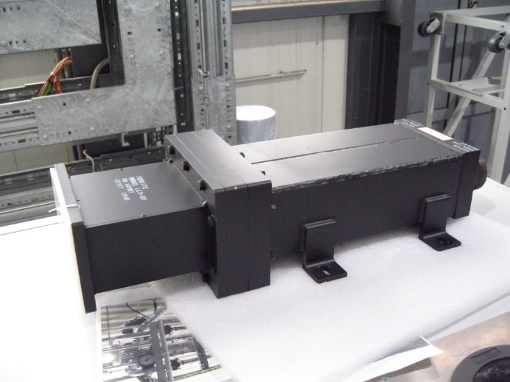
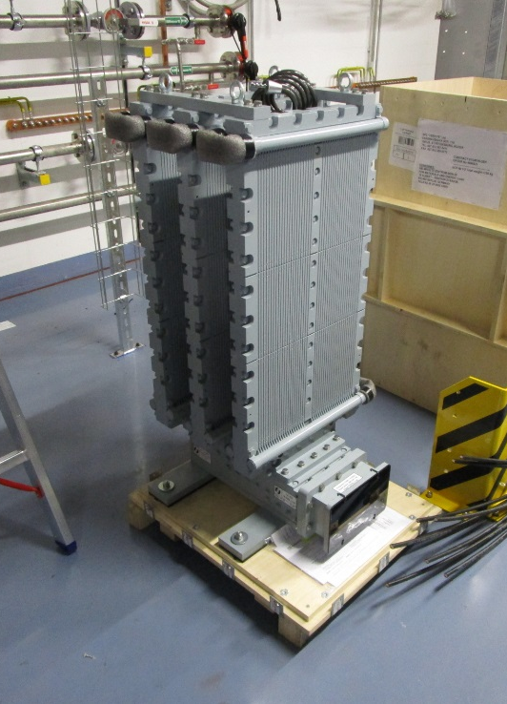
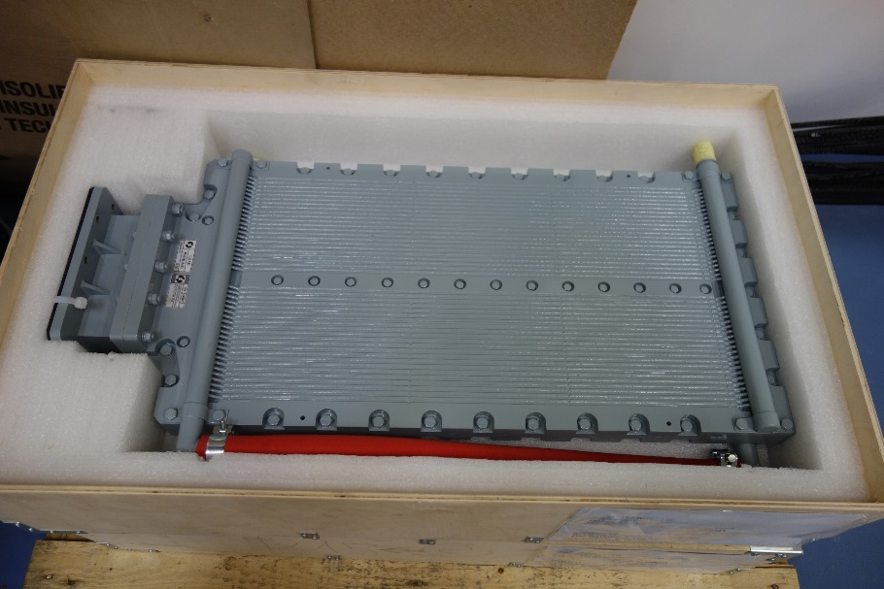
bERLinPro: 300 kW loads arrived
Old 300 kW load started arcing at ~40 kW.
There was only a O-ring and a ceramic window between cooling water and RF area.
As advice of some instituts we bought new loads from Ferite St. Petersburg
Old 300 kW load
100 kW load
300 kW load

Slide 9
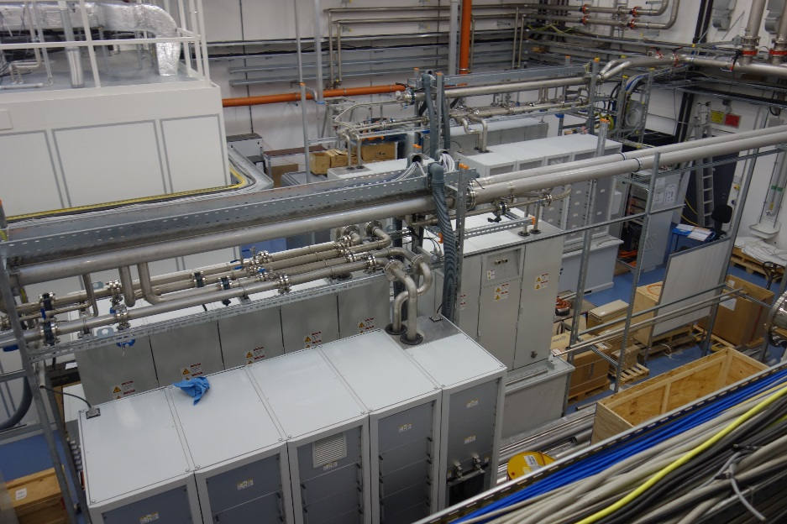

bERLinPro: 270 kW transmitter installations
Two 600 kW power supplies and two 1.3 GHz 270 kW klystrons are installed in bERLinPro building. Third transmitter is still in testing hall.
Water cooling is ready since end of September.
➔ We started commissioning of the first transmitter !
Two 600 kW power supplies
Two 270 kW klystrons

Slide 10
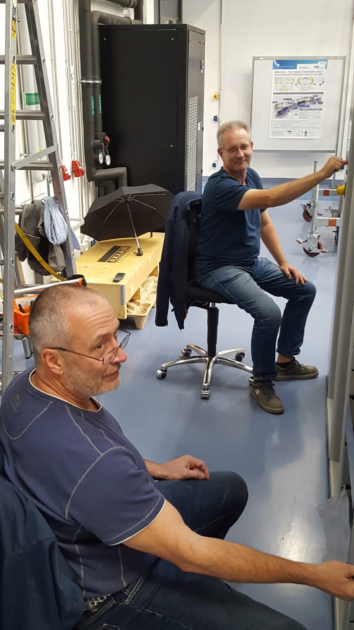
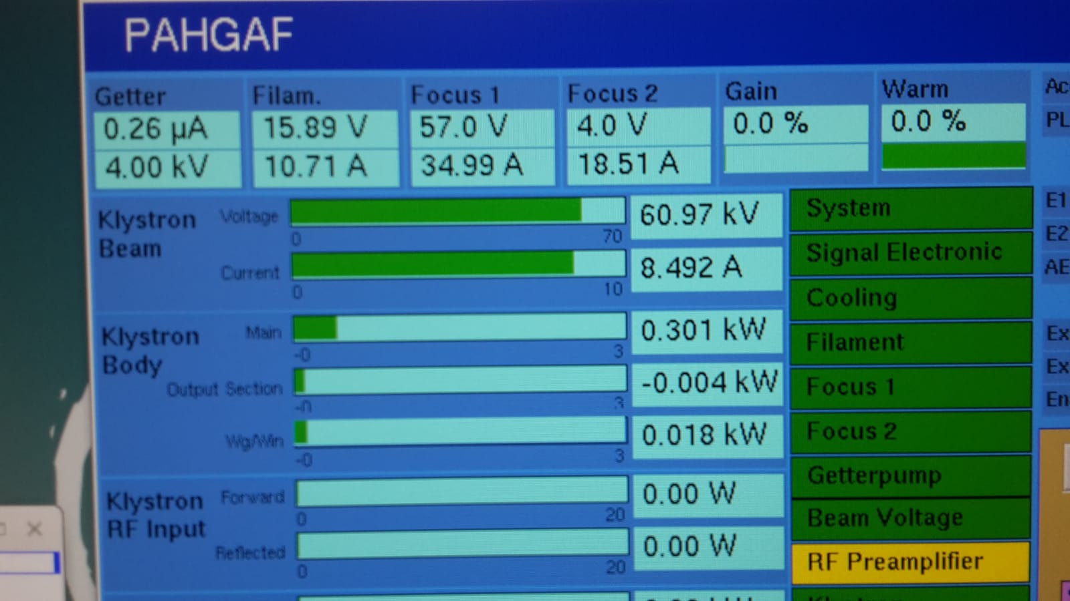
bERLinPro: Diode operation of first klystron
First klystron was commissioned in diode operation up to the design values of 61 kV and 8.5 A beam current. RF operation will follow soon. The water piping for the second RF load is missing.
The transmitter is the first device at berlinPro using the complete infrastructure as cabling, mains, water cooling and control system.
Andreas and Harry commis-sioning the transmitter
61 kV 8.5 A achieved

Slide 11
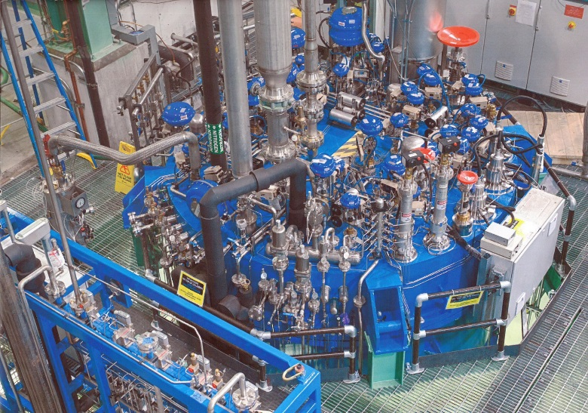
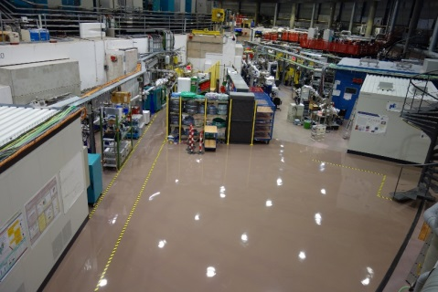
BESSY VSR: Overview
short & bunches
BESSY VSR is a project to provide short and long bunches simultanously to the users.
The accelerating voltage is 1.5 MV at 500 MHz using nc cavities.
By installing superconducting cavities at the 3rd and 3.5rd harmonic the gradient is alternately flat or steep
long
1.7 ps
15 ps
1.7 ps
voltage: 1.5 MV @ 0.5 GHz
20 MV @ 1.5 GHz
17.1 MV @ 1.75 GHz
Machine studies and diagnostics upgrade
Cryoplant ordered
Transmitters ordered
1.5 GHz cavity desinged call for tender
Couplers call for tender
HOM loads are designed
Upgrade of booster in preparation
New testing hall
Much infrastructure
RF voltage at BESSY VSR
Ordered cryoplant at FermiLab and installation area

Slide 12

BESSY VSR: L-band SSA ordered
For the bERLinPro linac we need 15 kW transmitters at 1.3 GHz
For BESSY VSR we need 15 kW transmitters at 1.5 & 1.75 GHz
➔ We put all together an made a call for tender for all these transmitters
There was very strong competition, because the companies wanted to have a good reference for a industrial project
As a result we achieved a very good price.
Delivery date will be August 2019

Slide 13
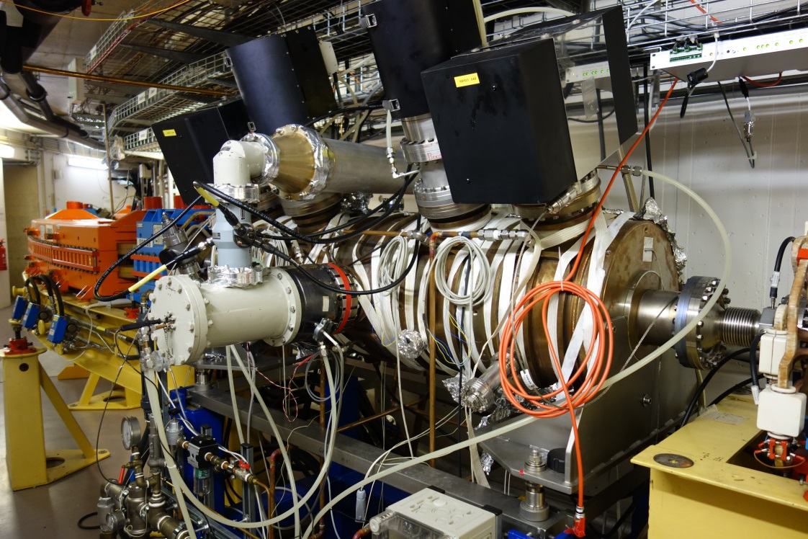
BESSY VSR: Cavities and transmitters for booster
BESSY VSR need short bunches for injection
We will install two more 5-cell PETRA cavities and two 80 kW SSA
PETRA cavities are bought from DESY
80 kW SSA will be the same as we installed in 2015
PETRA cavity in the BESSY II booster

Slide 14

Summary
At BESSY II the 3rd harmonic cavities are reinstalled with some modifications
At the MLS several diodes burned in the IOT power supply
bERLinPro is in the installation phase
BESSY VSR is in the ordering phase

