Slide 1
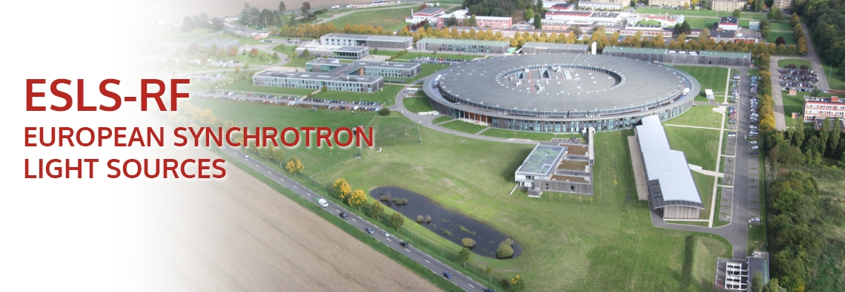
WELCOME TO SOLEIL
Amor Nadji
On behalf of Synchrotron SOLEIL
22nd ESLS-RF yearly meeting 08-09 November 2018 @SOLEIL (Gif-sur-Yvette/France)

Slide 2


SOLEIL is the French synchrotron light source, both a large scale facility and a research laboratory.
Shareholding of the French public centers CNRS and CEA, SOLEIL is at the service of the international scientific community and industry.
72 %
28 %
350 permanent staff.
Functioning budget per year : ~ 55 M€.

Slide 3
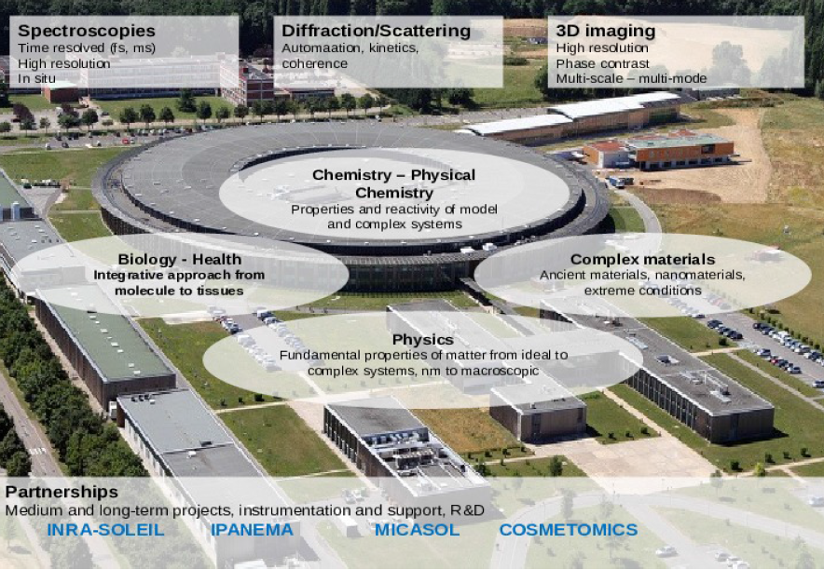
Scientific Strategy
Plateforms
Medium-long term projects, support and complementary instrumentations, interfaces R&D
Ancient materials:
IPANEMA
Environmental
sciences
Biology-health

Slide 4
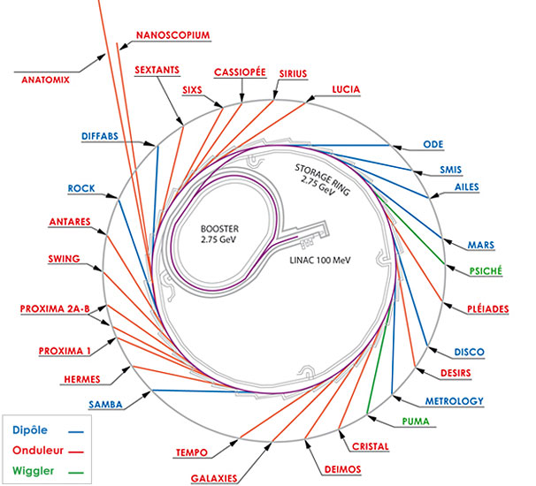
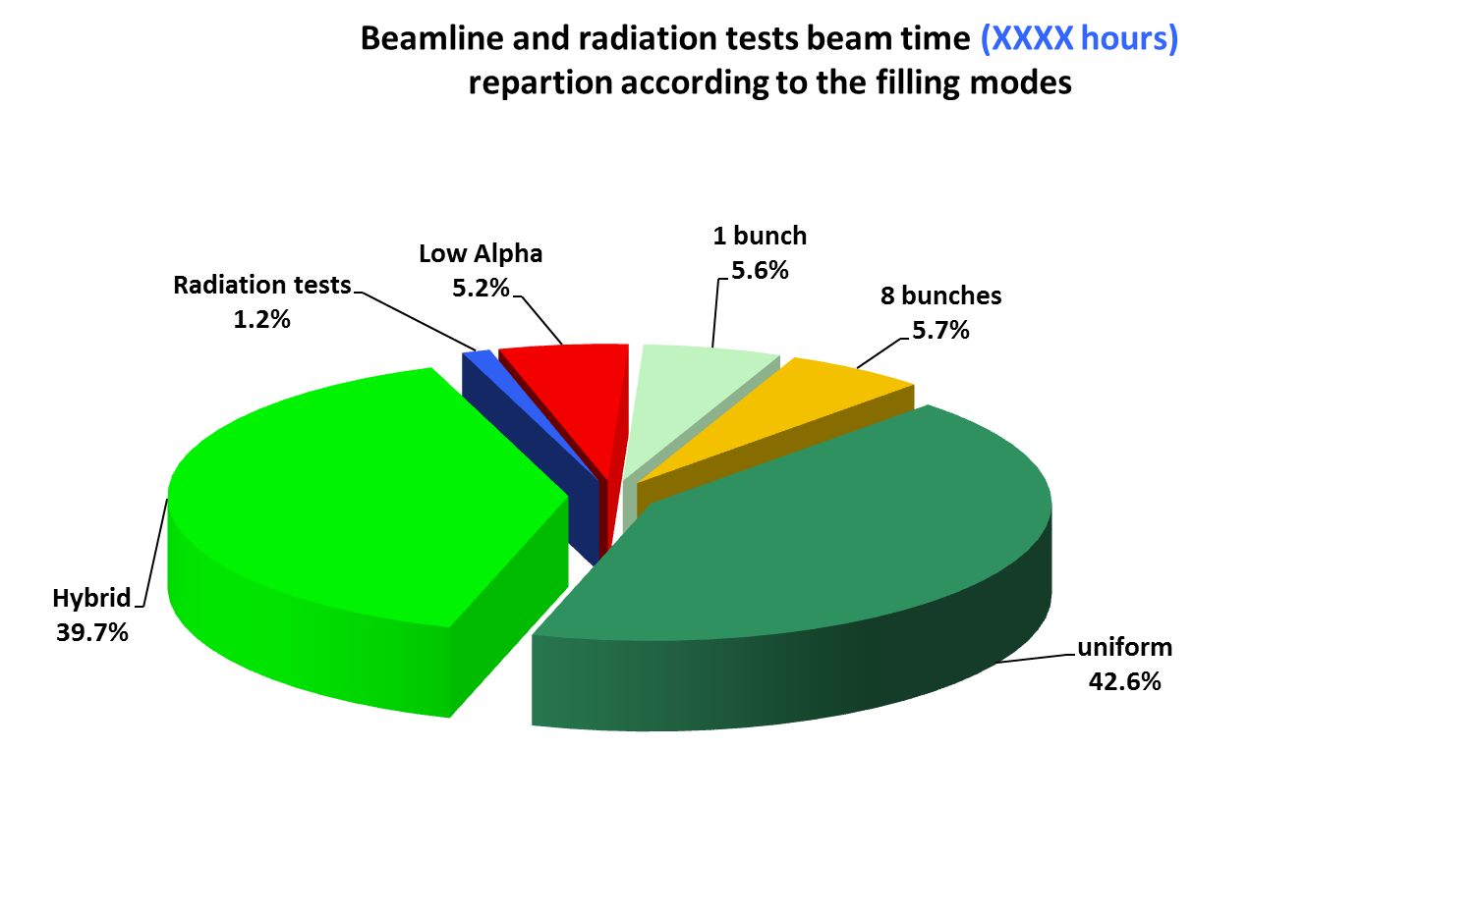
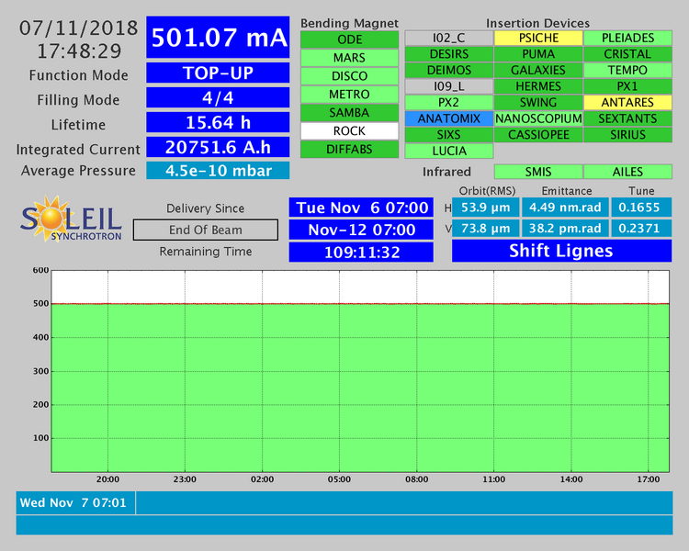
SOLEIL : A 3rd generation Synchrotron Light Source
Open to users since 2008
29 beamlines operational in 2018.
> 42000 users visits since 2008.
> 600 articles published yearly.
Machine availability > 98% and MTBF > 90 hours.
Mode of operation Bunch fill. patterns | User Operation in 2018 | Ultimate performance achieved
Multibunch (M2) | 500 mA | 500 mA
Hybrid/camshaft mode (M) | 425 mA + 5 mA | 425 mA + 10 mA
8 bunches (8) | 100 mA | 110 mA
1 bunch (S) | 16 mA | 20 mA
Low-α: Hybrid mode (L) | 4.7 ps RMS for 65 µA | < 3.2 ps RMS for 15 µA
Broadband spectrum:
9 orders of magnitude from far IR to hard X-rays.
~ 5000 hours of photon beam for user operation.
Top up injection in all modes

Slide 5
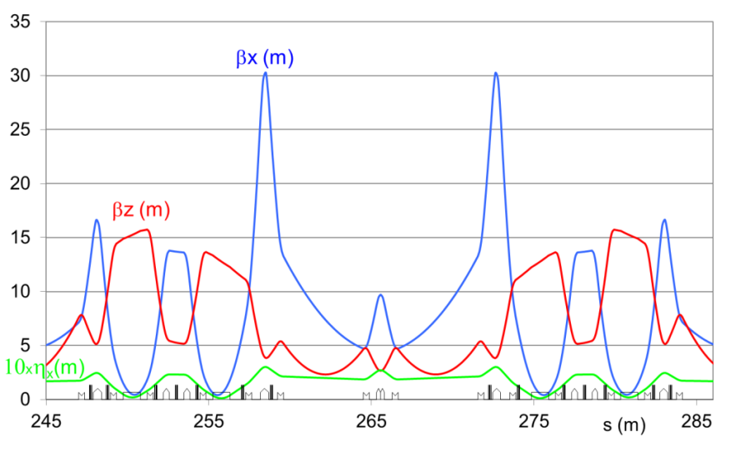
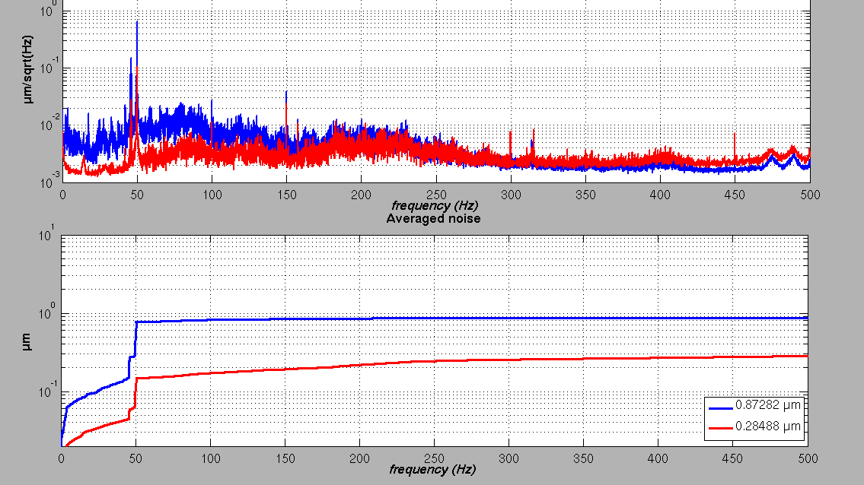
  SOLEIL Lattice and Some Parameters
Rather small Circumference: 354 m
ε_{x0} = 4 nm.rad @ 2.75 GeV
16 cells
High ratio of free straight sections (~45%)
24 straight sections
4 x 12 m
12 x 7 m
8 x 3.6 m
Very compact magnetic structure
SDL - SDM
SDM - SDC - SDM
Very stable beam
Vertical plane
FOFB ON
FOFB OFF
200 nm RMS in the middle of the straight sections
One long straight section (SDL13, accommodating 2 long beamlines) has been modified.
5

Slide 6
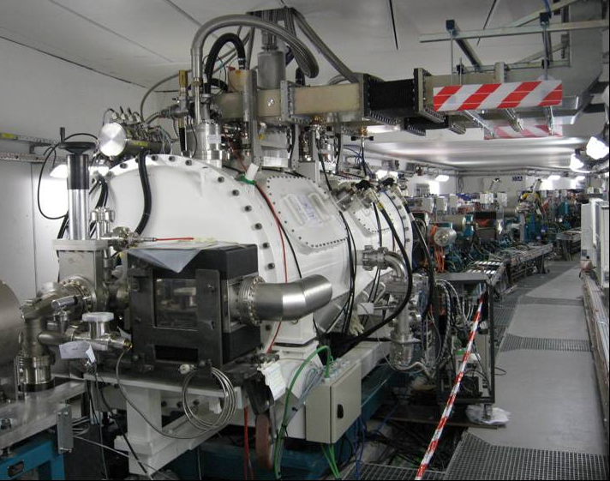
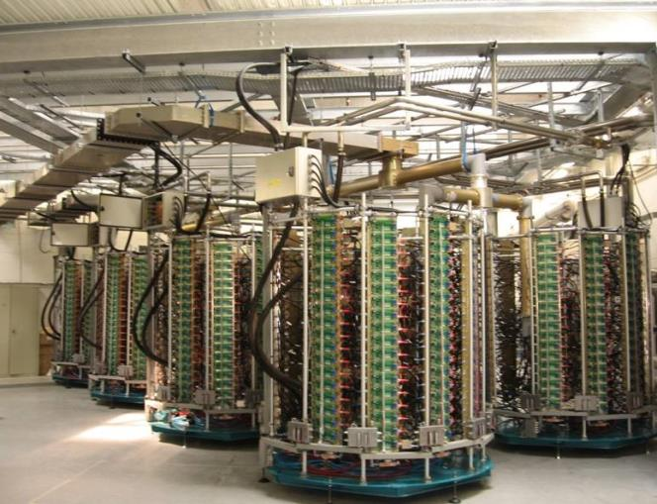
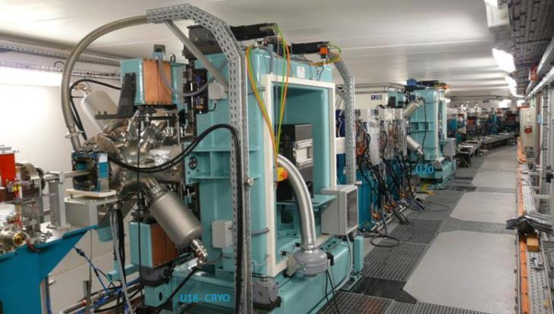
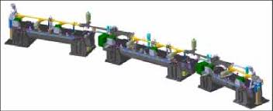
352 Superconducting RF cavity
RF Solid State Amplifiers
Diverse Insertion Devices
Extensive use of NEG coating

Slide 7
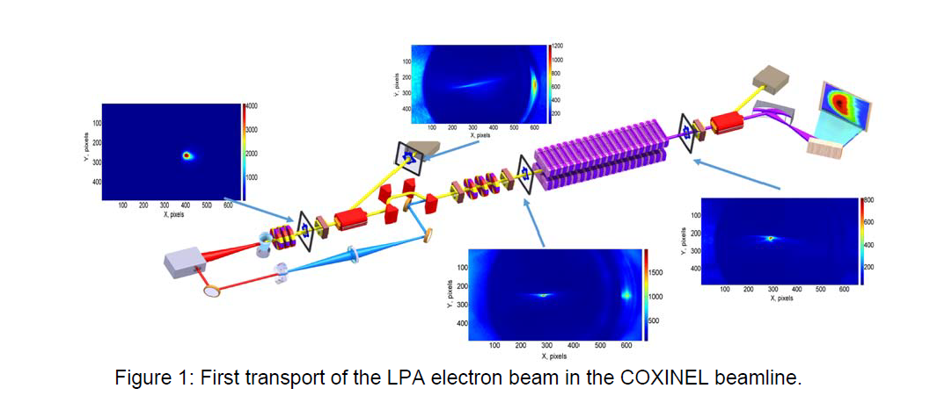
COXINEL
(COherent Xray source INferred from Electrons accelerated by Laser)
ERC Grant (M.E. Couprie)
Aims at demonstrating Free Electron Laser amplification with present LWFA
performances Using an existing TW laser.

Slide 8

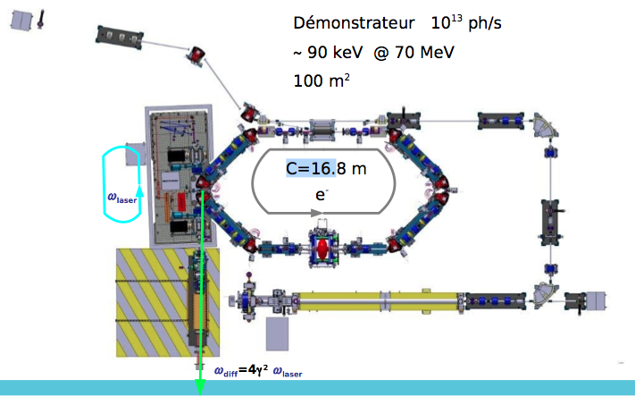
ThomX: X-ray compact source
Principle:
X Compton : 10- 100 keV
Low energy ring: 50 MeV
Fabry-Pérot cavity
Flux: 10¹²-10¹³ ph/s
Under construction at LAL (ORSAY)
8
Notes:
8

Slide 9
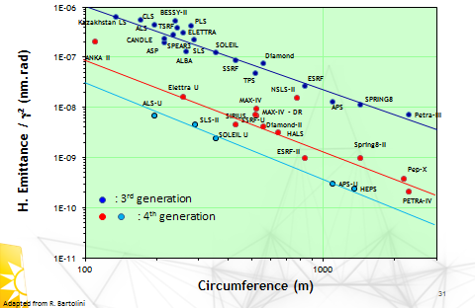
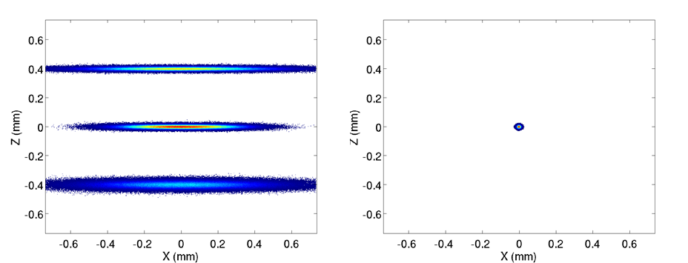
Towards 4th Generation Storage Ring
Evolution of the
emittance
Evolution of the
beam size

Slide 10
Timeline for the proposed upgrade
Date | Phase
Dec. 2016 | Council meeting, presentation of the first proposal for an upgrade.
2017 - 2019 | Discussions regarding the definition of the project (beamlines and storage ring); definition of objectives. Baseline Lattice defined.
2018 - 2019 | Continuation of discussions and prototyping to assess feasibility of key options.
2019 | Decision to launch a Conceptual Design Report (CDR).
2019-2020 | CDR based on preliminary studies and prototyping.
2020 | Decision to launch a Technical Design Report (TDR).
2020-2022 | Technical Design Report.
2022 | Decision to start the project.
2022-2025 | Reconstruction of storage ring and beamlines.
2026 | Restart of user operation.

Slide 11
RF system: is it the new Swiss knife for the storage ring?
RF system used to compensate the energy loss of the particles due to synchrotron
radiation.
RF system for bunch lengthening
RF system for bunch shortening
RF system for injection
RF system as a feedforward to cope with the transient beam loading.
Development of RF Undulator-Based Insertion Devices for Storage Rings
RF optimization is a strong function of storage ring performance priorities.

Slide 12
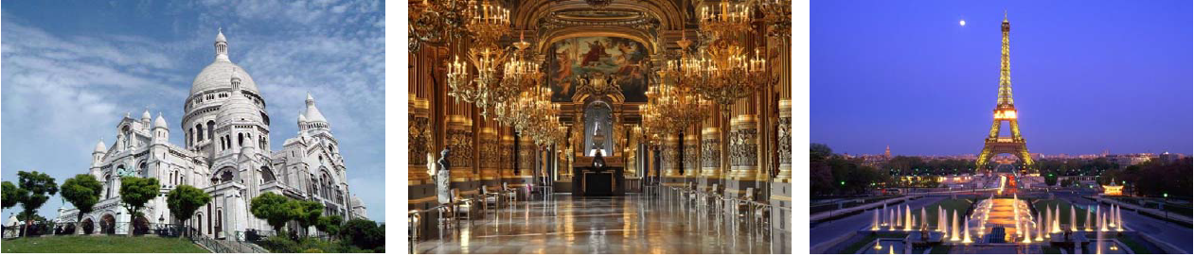
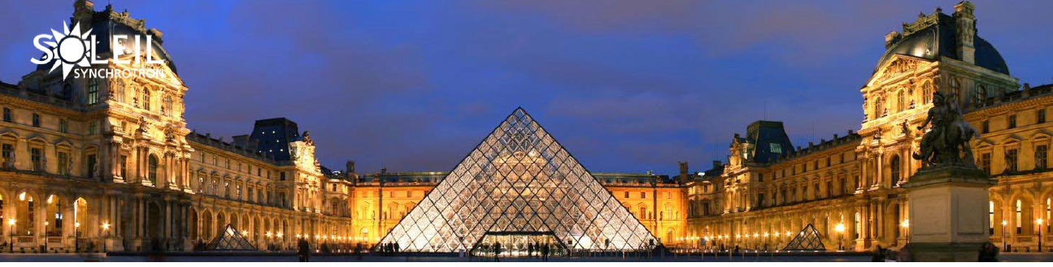
I wish you a successful Workshop
and
Enjoy your stay in PARIS

