Slide 1


National SYNCHROTRON Radiation Centre
SOLARIS
Jagiellonian University, Krakow, Poland
Piotr Goryl
Motion Workshop, Soleil, 11-05-2011

Slide 2

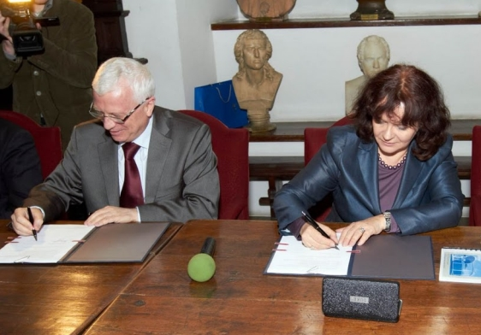
History
October 2009 adjusted feasibility study submitted
February 2010 evaluation process successfully completed
  the project approved
9 April 2010
The Minister of Science
and Higher Education
and
The Jagiellonian University Rector
signed the contract for
National Electromagnetic Radiation
Research Centre
at The Jagiellonian University

Slide 3
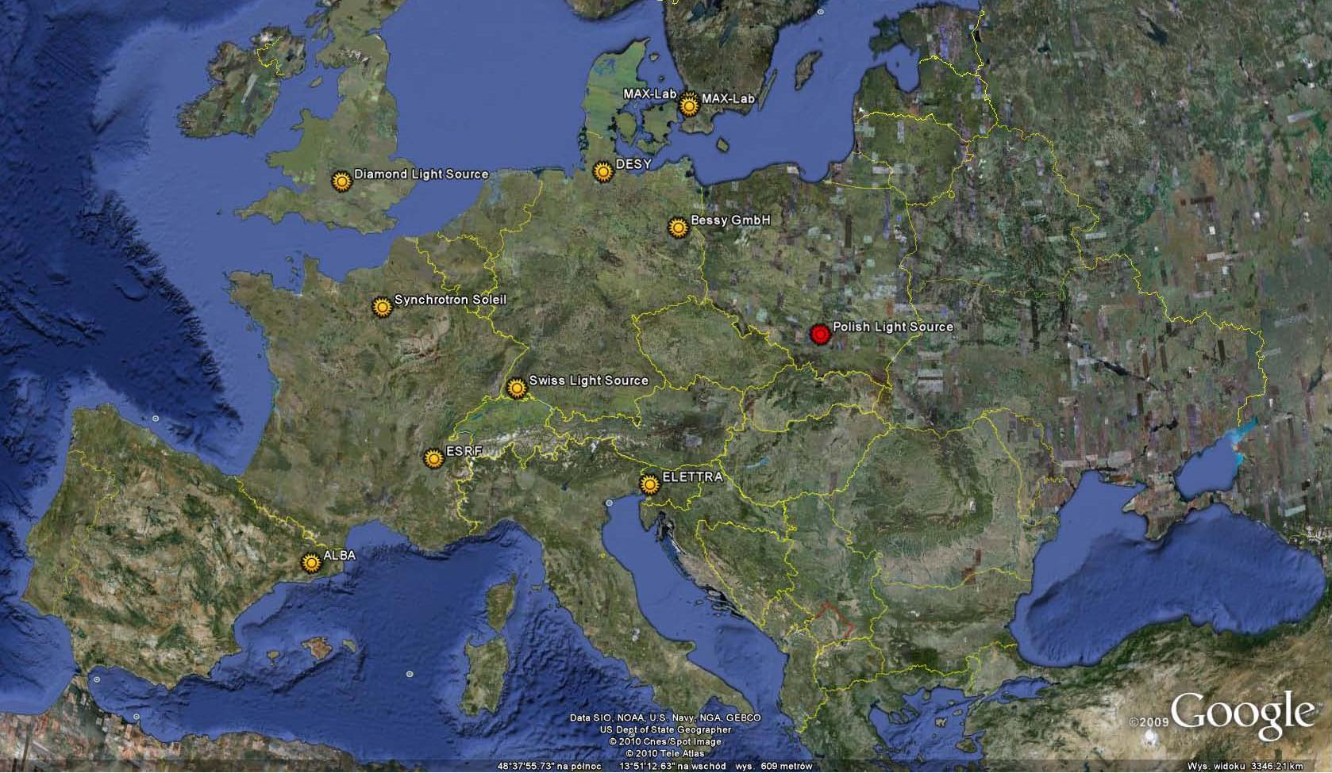
Localization
Kraków, Poland

Slide 4
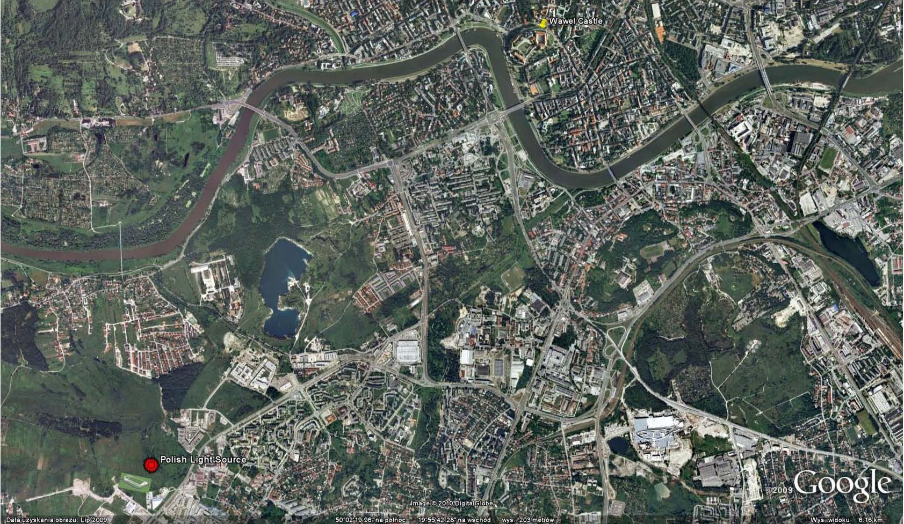
Localization
Kraków, Poland
Wawel Castle
Synchrotron

Slide 5
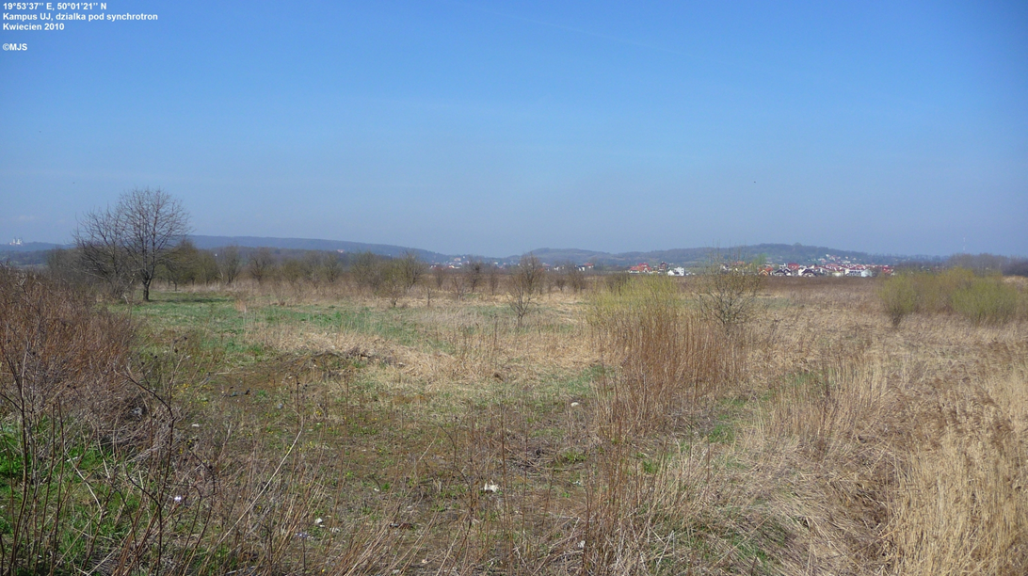
Localization
Kraków, Poland

Slide 6
Machine
Ring will be a copy of MAX IV 1.5
  Energy: 1.5 GeV
  Emittance: 5.6 nm rad
  Circumference: 96 m
  Current: 500 mA
  Number of straight sections: 12 (10 for IDs)
Injector: 500 MeV, ramping in ring (in future 1.5 GeV and top-up)

Slide 7
Machine
500 MeV

Slide 8
BeaMLINE
One beamline in the Project:
  LEEM/XPEEM (U2) - undulator
Other with separate budget
  Soft X-ray Spectroscopy (U1) - undulator
  Low Energy Line (NIR, Vis, UV, Soft X-ray) (U3) - undulator
  Absorption Spectroscopies with Magnetic Materials (U4) -undulator
  Near- and Far-infrared spectroscopy and Microscopy (BM1) –bending magnet
  X-ray Diffraction (W1)
  Macromolecular Crystallography (W2)
  Material Science Beamline (W3)

Slide 9
General Schedule

Slide 10
Current Activities
Building execution project
On going procurements in parallel with MAX-lab
On going training – 2 people in MAX-lab, one in PSI, one in ALBA
Linac project in finalization
Machine project in MAX-lab
Beamline will be built in PSI then moved

Slide 11
Questions
Hardware platform
  Dedicted box
  PLCs, cPCI, VME ?
Type of motors:
  Beamline(s) ???
    DC
    step
  RF cavities – step motors
  Diagnostics
    Screens – simple solution
Preference in direct network attached controllers
Number of axis unknown
…

Slide 12
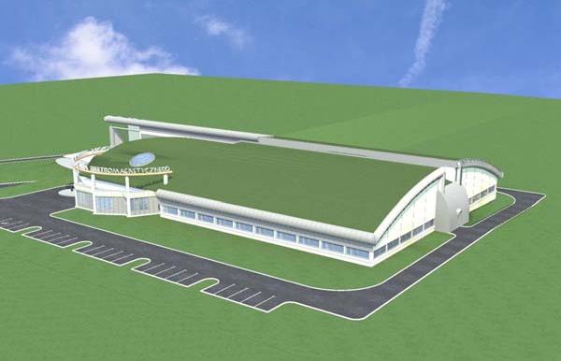
Welcome IN 2014 or even before
Thanks for your attention

Slide 13
FURTHER BEAMLINES PROPOSED FOR CONSTRUCTION AT AN EARLY STAGE (2014/2015) AS INDEPENDENTLY FINNANCED PROPOSALS:
A. Low and medium photon energies (< 2000 eV)
Soft X-ray Microscopy and Microtomography (U2) - undulator
  Photon energy range: 100 eV - 2 keV , Energy resolution DE/E: 10⁻⁴
  Experimental techniques: STXM (Scanning Transmission X-ray Microscopy), PEEM (Photo-Electron Emission Microscopy), spatially resolved NEXAFS
Low Energy Line (NIR, Vis, UV, Soft X-ray) (U3) - undulator
  Photon energy range: (I) 1 - 10 eV, (II) 10 - 250 eV , Energy resolution DE/E: 10⁻⁴ - 4* 10⁻⁴
  Experimental techniques: ARPES (Angular Resolved Photoelectron Spectroscopy) and SRPES (Spin Resolved Photoelectron Spectroscopy), photoemission ionic spectroscopy, fluorescence spectroscopy, absorption spectroscopy, luminescence and different coincidence spectroscopies (life-times)
Absorption Spectroscopies with Magnetic Materials (U4) -undulator
  Photon energy range: 250 eV - 1.5 keV , Energy resolution DE/E: 10⁻⁴ - 10⁻³
  Experimental techniques: XAS (X-ray Absorption Spectroscopy): XANES, EXAFS with emphasis on XMCD (X-ray Magnetic Dichroism)
Near- and Far-infrared spectroscopy and Microscopy (BM1) –bending magnet
  Photon energy range: 0.001 eV - 1.5 eV [(I) 10 - 1000 cm⁻¹, (II) 600 - 6000 cm⁻¹ ]
  Resolving power Dk: (I) 0.001 cm⁻¹, (II) 0.125 cm⁻¹
  Experimental techniques: Far-infrared absorption spectroscopy, Near-infrared spectromicroscopy with high spatial resolving power, photoacustic spectroscopy

Slide 14
B. Higher photon energy lines (> 2000 eV)
X-ray Diffraction (W1)
  Source: Wiggler ( 2 T)
  Photon energy range: 8 keV - 15 keV
  Experimental techniques: Powder diffraction XRD (X-Ray Diffraction), SAXS (Small Angle X-ray Scattering), reflectometry, microdiffraction
Macromolecular Crystallography (W2)
  Source: SC Wiggler ( 3.5 T)
  Photon energy range: 6 keV - 20 keV
  Experimental techniques: Single crystal X-ray diffraction, PX (Protein Crystallography), MAD (Multiwavelength Anomalous Diffraction)
Material Science Beamline (W3)
  Source: SC Wiggler ( 3.5 T)
  Photon energy range: 4 keV - 20 keV
  Experimental techniques: X-ray diffraction (XRD), X-ray absorption (XANES, EXAFS)

