Slide 1
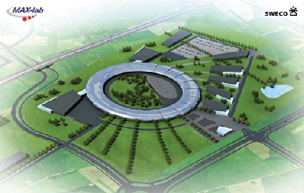
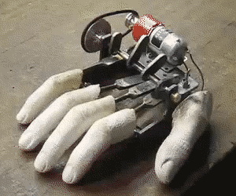
WORKSHOP
Exchange around motion control in radiation facilities

Slide 2


WELCOME to the workshop
Exchange around motion control in radiation facilities on 11th and 12th of May 2011 at Synchrotron SOLEIL site
Organized by Synchrotron SOLEIL & MAX IV Laboratory

Slide 3
Summary
4 questions ?
WHAT
WHY
WHEN
WHO
Topics
Beginning of a revolution and benefits expected
Agenda
Participants

Slide 4
WHAT ?
Sharing information between radiation facilities and providing an overview in motion control
Technical solutions used and features
Experience and lessons learned
Strategic choices
Tomorrow : advanced features and new technologies
A goal is to achieve a written synthesis

Slide 5
WHY ?
Why the workshop is organized by SOLEIL and MAX IV ?
  SOLEIL starts an upgrade of its motion controller used since 2003, in order to maintain the facility at a high level of performance
  MAX IV needs to define an up-to-date motion system architecture and to select a motion controller.
SOLEIL and MAX IV have similar requirements (reliable, performing, flexible)
& guidelines (costs & time effective)
TECHNICAL COLLABORATION
  called REVOLUTION : REconsider Various contrOLler for yoUr moTION
  The first step of the collaboration: workshop about motion control in radiation facilities.

Slide 6
WHY ?
Why attend the workshop ?
Subtitle : What are the benefits expected ?
  We know that motion control is a key element ,which takes part in radiation facility performance.
Therefore, it is important to:
Share information and experiences
Share views on future challenges
  So we are ready
  to meet new requirements
  and improve our products (hardware & software)

Slide 7
WHEN ?
Agenda
Wednesday May, 11th
Start | End | main duration | question duration | Facility | Ref | Talk | Speaker | Chairman
13:30 | 13:45 | 00:15 |  |  | In | Welcome & Introduction | D. Corruble | D. Corruble
13:45 | 14:05 | 00:15 | 00:05 | MaxIV | Tl.01 | MAXIV : Requirement in motion control for new facility | M. Lindberg
14:05 | 14:25 | 00:15 | 00:05 | SOLARIS | Tl.02 | SOLARIS : Requirement in motion control for new facility | P Goryl
14:25 | 14:55 | 00:20 | 00:10 | SOLEIL | Tl.03 | Status and Plans in Motion Control at SOLEIL | D. Corruble
14:55 | 15:10 | 00:15 |  |  | Br.1 | Break | /
15:10 | 15:40 | 00:20 | 00:10 | DESY | Tl.04 | Motion control in DESY | T. Kracht
15:40 | 15:55 | 00:15 | 00:15 | ESRF | Tl.05 | Status and plans in positioning and motion control at ESRF | J-M Clement & J. Lindon
15:55 | 16:25 | 00:15 |  | ALBA | Tl.06 | Motion control Status in ALBA | G. Cuni
16:25 | 16:55 | 00:20 | 00:10 | DLS | Tl.07 | Motion control Status in DIAMOND | B. Nutter
16:55 | 17:55 | 01:00 |  |  | Vi | SOLEIL Facility visit | All | P. Betinelli
17:55 | 19:15 | 01:20 |  |  | Ds.1 | Discussion : Experience in motion control & technical solutions used | All
19:15 | 19:30 | 00:15 |  |  | Br.2 | Break
19:30 |  |  |  |  | Di | Departure for dinner at restaurant
Thursday May, 12th
Start | End | main duration | question duration | Facility | Ref | Talk | Speaker | Chairman
09:00 | 09:30 | 00:20 | 00:10 | DLS | Tl.08 | Epics Motor Interface | E. Shepherd | D. Spruce
09:30 | 10:00 | 00:20 | 00:10 | SOLEIL | Tl.09 | Tango devices for motion and advanced features | A. Buteau
10:00 | 10:30 | 00:20 | 00:10 | SLS | Tl.10 | Advanced issues in SLS optics control | M. Dach
10:30 | 10:45 | 00:15 |  |  | Br.3 | Break | /
10:45 | 12:00 | 01:15 |  |  | Ds.2 | Discussion : Strategies, advanced features & motion control evolution | All | K. Larsson
12:00 | 13:00 | 01:00 |  |  | Lu | Lunch at Soleil | /
13:00 | 14:00 | 01:00 |  |  | Co | Last round : Conclusion for a written synthesis | All

Slide 8
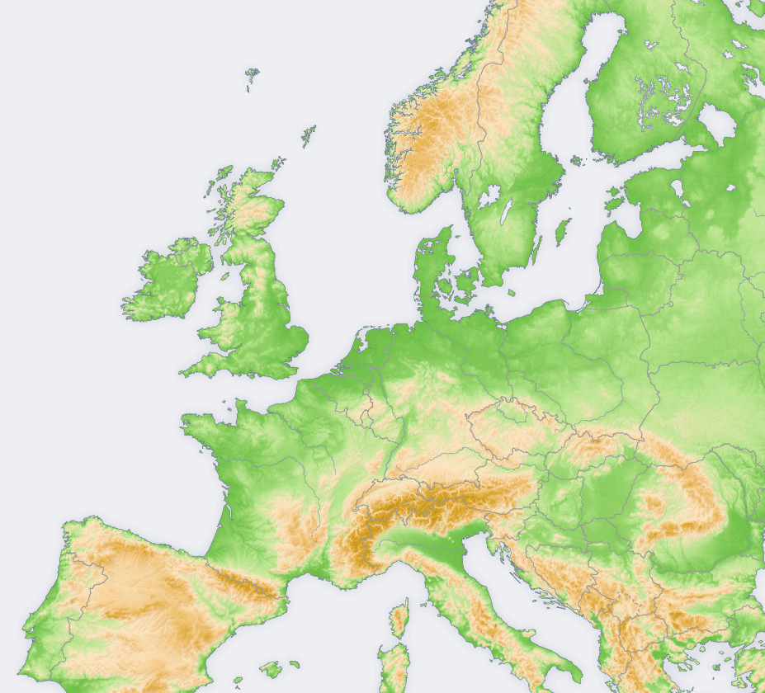
WHO ?
The participants
people from 7 european facilities
MAX IV
DIAMOND
SOLARIS
DESY
SOLEIL
SLS
ESRF
ALBA
Our colleagues from ELETTRA
regret not being able to come.

Slide 9


The end of the beginning
Any questions ?
Enjoy the workshop!

