Slide 1
Motion Control at Astronomical Observatories: The Design of the Gemini Mount Control System
Andy Foster
Observatory Sciences Limited

Slide 2
Motion Control at Observatories
Mount Axes (altitude and azimuth)
Cassegrain Rotator (for Alt-Az mounts)
  De-rotates the sky field in the image plane.
Acquisition and Guidance Units
  Probe arms, tertiary mirror.
  Provides wave front sensing data to preserve guiding, primary mirror figure, and overall collimation.
Instruments
  Optical bench components: Lenses, Mirrors, Filter slides, beam-splitters etc.
Laser Guide Star stability
  Movement of optical components along the laser propagation path.

Slide 3

Gemini Observatory
Twin 8m Optical/IR Telescopes
  Summit of Mauna Kea, Hawaii
  Cerro Pachon, Chile
  Commissioned 1998 - 2002
Controlled with EPICS

Slide 4
Gemini Control System Perspective
VME VxWorks based systems

Slide 5
MCS Context Diagram

Slide 6
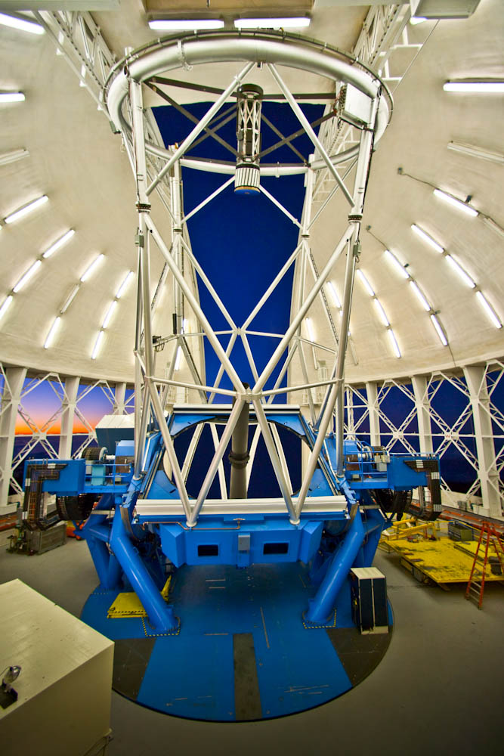
Gemini Mount

Slide 7
Drive Subsystem
Friction type drive system
8 Azimuth motors, 4 elevation motors
  arranged in pairs
  Hydraulically pre-loaded against drive track
  2.68 HP (2 kilo-Watt) Brushless DC motors
8/4 Tacho’s
8/4 FST-2 Amplifiers (Kollmorgen)
Maximum slew rate:
  2 deg/s in Azimuth
  0.75 deg/s in Elevation

Slide 8
Encoder subsystem
Heidenhain LIDA Tape Encoder
  Distance encoded reference marks
  Compensation electronics (IK320)
  40 µm pitch (5 milli-arcseconds)
  4/2 read-heads
  Azimuth 9.6m diameter full circle
  Elevation 8m diameter fraction of circle
Translation sensors for elevation
  Analogue signals
One Friction Driven Encoder per axis
  2 MHz pulse stream
Elevation tilt switch (direction for homing)
Two Azmiuth topple brackets to resolve azimuth position ambiguity at start-up
(-270° to +270°)
Tracking stability: 10 milli-arcseconds RMS (closed-loop)

Slide 9
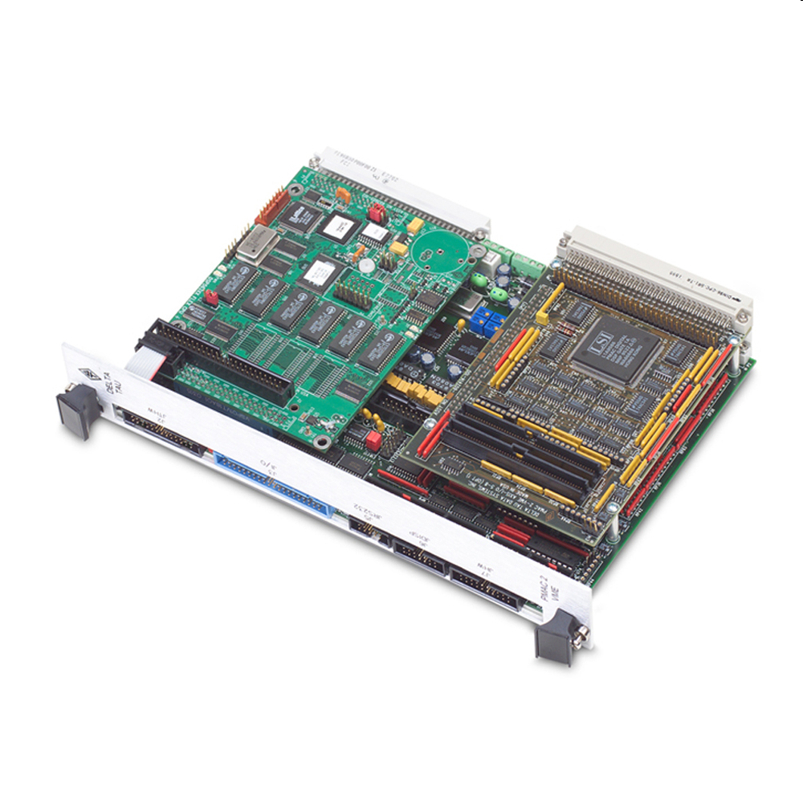
Main Axes servo control
Uses two VME PMAC 2 controllers
  With on-board DPRAM

Slide 10
Control Loops
Inner velocity loop implemented by FST-2 with feedback from tacho-generators.
Outer position loop, closed in PMAC, with feedback from the various encoders in the system.
Tacho Averaging (op-amp) circuit takes the individual tacho signals and produces an averaged tacho signal, fanned out 8/4 times.
The Velocity Command Combining (op-amp) circuit sums the MCS velocity demand and the GIS velocity demand and fans the result out 8/4 times. Allows the GIS to move the telescope.

Slide 11
Interfacing the Heidenhain Tape Encoder to PMAC
It proved very difficult (in 1996) to provide an interface between the IK320 electronics and PMAC.
Heidenhain suggested a much simpler way to interface their tape to PMAC.
  Implement the required compensation on PMAC, using the Heydemann technique, rather than use the IK320!
To provide a position value from each tape encoder head, we need to count tape pitches and interpolate between them using the analogue sine and cosine signals that each head produces.
The outputs produced by the interpolation process will contain periodic errors due to various mechanical and electronic imperfections in the system.
These errors can be reduced using a well known compensation technique, developed by
Peter L. M. Heydemann.

Slide 12
User written DSP56000 code

Slide 13
Purpose of the Mount Control System Software
  The purpose of the MCS software is to provide a command driven interface to the mount hardware.
  This interface is used by the TCS and the engineering screens to control the mount.
  The engineering screens provide the means by which hardware calibrations and other engineering work are undertaken.
  The MCS software controls several hardware subsystems, hiding the details of these devices from the higher level principal systems.

Slide 14
Gemini, EPICS & PMAC
Gemini was the first astronomical telescope to use PMAC with EPICS. In 1996/97, Tom Coleman (APS) kindly wrote the initial driver/device support
  Lots of learning and challenges
Originally, there were two types of VME device support for standard EPICS records (AI, AO, BI, BO, SI, SO):
  ASCII – send strings to mailbox to set parameters
  DPRAM – register based, read and write Dual-Ported Ram memory locations
Later, we added the ability to support the PMAC Fast Data Logging facility in EPICS:
  Very useful in commissioning.
The Gemini MCS used individual records, pointing at appropriate memory locations, to control motors

Slide 15
TCS/MCS Interface
18 commands can be sent to the MCS
  move, stop, datum, follow, park etc
The “FOLLOW” command causes the MCS axes to follow a stream of demanded positions sent from the TCS at 20 Hz. 5 values are sent:
  demanded azimuth
  demanded elevation
  time at which these positions apply
  time at which these data were sent (normally, 50ms ahead of apply time).
  the track ID to which they refer (used by the software to initiate a slew to a new target)
These data enter the MCS database through a field capable of holding an array in a “genSub” record.
  Because we are guaranteed that a “ca_put_array” is an atomic operation.
Within the MCS:
  interpolation is performed on the demands to increase the frequency to 200 Hz (5ms)
  velocities are determined
  Positions and velocities are written down to a circular buffer on the PMAC

Slide 16
MCS/PMAC Interface
The FOLLOW command was implemented, at the PMAC level, with a motion program, running in PVT (Position-Velocity-Time) mode.
The motion program continually reads one half of a circular buffer filled with position and velocity demands while EPICS writes new positions and velocities to the other half of the buffer.
The buffer itself is located in Dual Ported Ram, onboard PMAC, and is filled over the VME backplane, from EPICS records configured to use PMAC DPRAM device support.

Slide 17
PMAC and Time
One interesting challenge was how to start the telescope moving at the correct time of day, given there is no notion of absolute time in PMAC.
This was done via a hardware signal from the Bancomm time card, triggering the motion program at an exact time of day.
  Delay of a few hundred µs
The other issue was making sure we keep the two PMAC’s (one for azimuth, one for elevation) in sync, over a long period of time. Since they ran off different crystal oscillators, the chances are they would drift.
This was achieved by synchronizing the PMAC timebases with a 1 MHz output clock provided by the Bancomm VME card.

Slide 18
Upgrading the current system?
Since the Gemini design (mid-90’s), a great deal of development has occurred in both EPICS software and PMAC hardware.
EPICS Software:
  ASYN
  Work on the Motor Record
  New model(s) of ASYN based device/driver support for motor controllers.
PMAC Controllers:
  Ethernet based rather than VME
  Power-PMAC Linux based controller
Plenty of scope for upgrades!
  Could we just run the whole TCS on a Power-PMAC?
  Still some custom DSP code to take care of
  Interface to the time-of-day?

Slide 19
Acknowledgements
My old colleagues on this project:
John Wilkes, Senior Servo Engineer (now at Renishaw)
Chris Carter, now a servo engineer with TMT

Slide 20
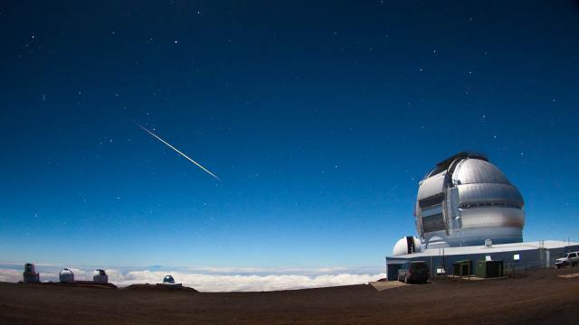

Gemini North & South

