Slide 1
Status of the ASTRID2 RF systems
Jørgen S. Nielsen
Center for Storage Ring Facilities (ISA)
Aarhus University
Denmark

Slide 2
ASTRID2
ASTRID2 is the new synchrotron light source in Aarhus, Denmark, since 2013
ASTRID2 main parameters
  Electron energy: 580 MeV
  Emittance: 12 nm
  Beam Current: 200 mA
  Circumference: 45.7 m
  6-fold symmetry
    lattice: DBA with 12 combined function dipole magnets
      Integrated quadrupole gradient
  4 straight sections for insertion devices
  Using ASTRID as booster (full energy injection)
      Allows top-up operation

Slide 3
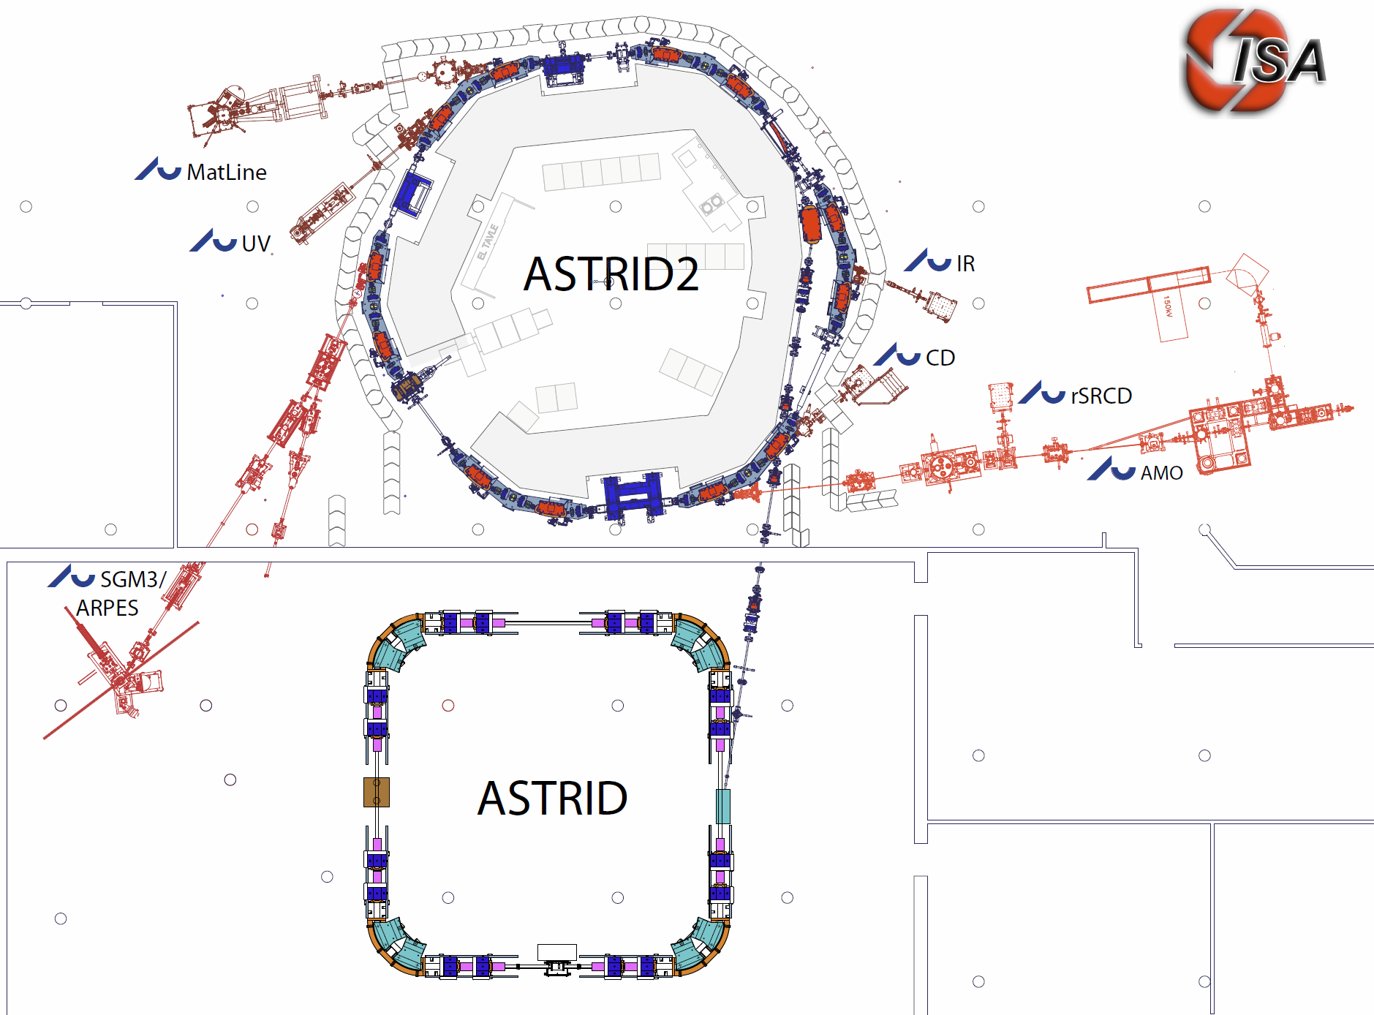
The ASTRID 2 facility
ASTRID2 main parameters
Circumference 45.71m
Energy 580MeV
Current 200mA
Characteristic energy 257eV
RF frequency 105MHz
Harmonic 16
Horiz. emittance 12nmrad
#Straight sections 6
Length of straight sections 2.82m
#ID’s 3
10m
Microtron (100MeV)
Notes:
Microtron, Booster, Inj. Bl., A2 ring, 6 beamlines, 7 experiments

Slide 4
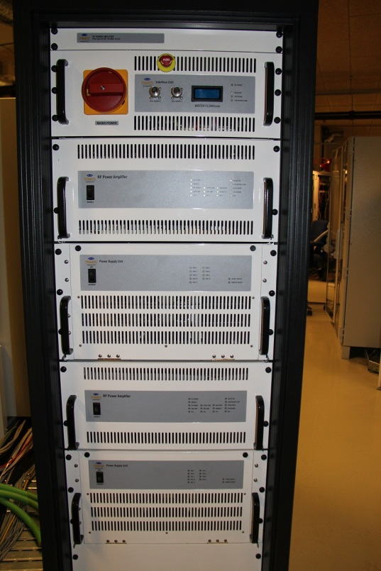
ASTRID2 RF
105 MHz (like ASTRID)
Main RF parameters
  Harmonic: 16
  RF voltage: 50-150 kV
  Synchrotron frequency: 10-20 kHz
  Synchrotron radiation
  power: ~1.4 kW
  Cavity power: 0.5-7 kW
8 kW solid state amplifier from Tomco Technologies (Australia)

Slide 5
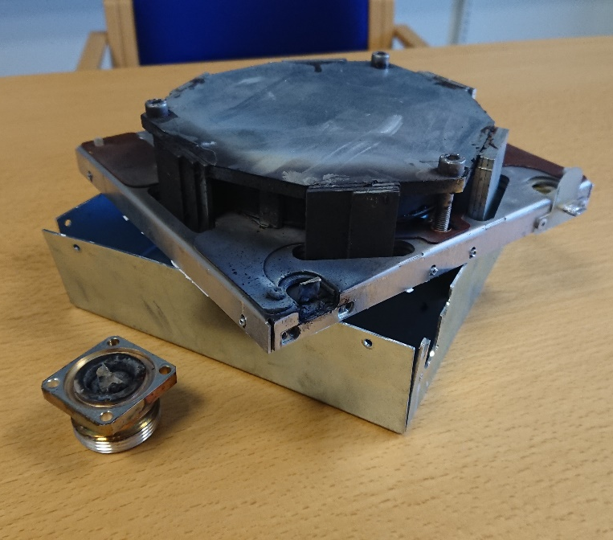
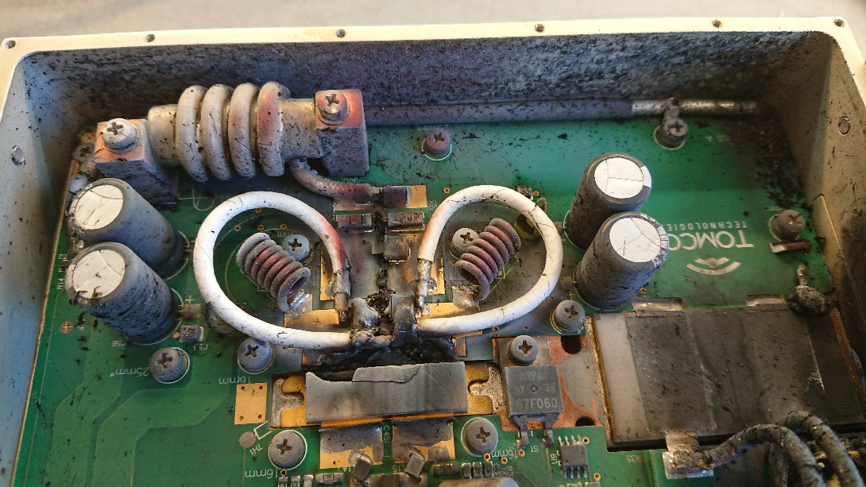
Problems, problems, …
ASTRID: Raditek 1 kW solid-state amp:
  Twice burned the transistors (unknown reason)
    Commercial FM broadcast amplifier from Raditek Inc.
ASTRID2: Tomco 8 kW solid-state amp:
  Burned two 1 kW sub amplifier modules
    1: Burned one amplifier submodule
    2: Burned one circulator

Slide 6
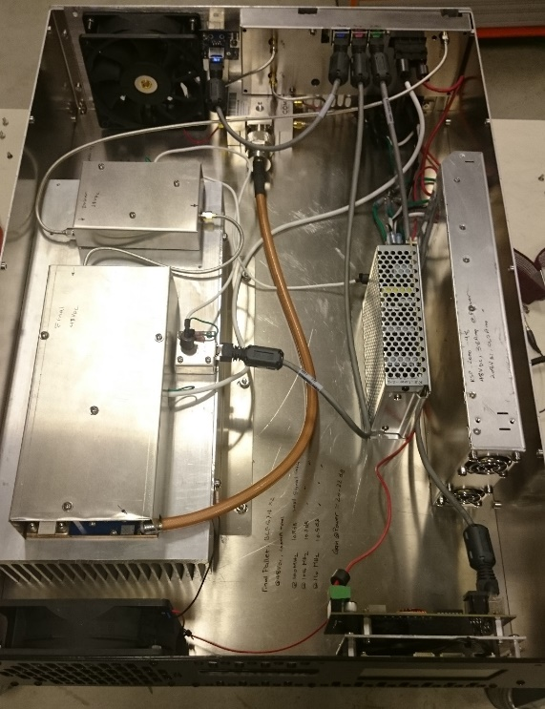
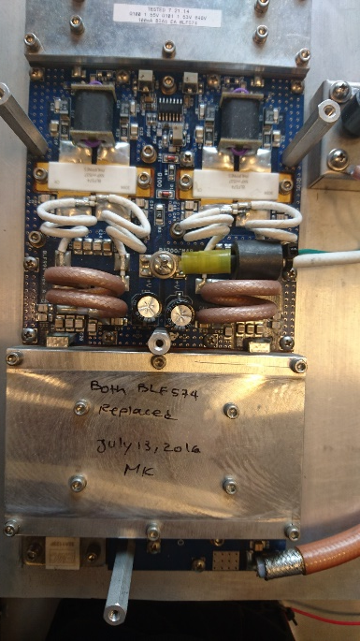
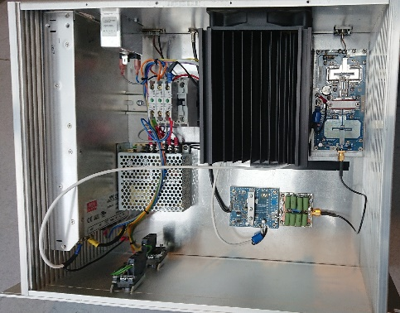
ASTRID Problems
ASTRID: Raditek 1 kW solid-state amp:
  Twice burned the transistors (unknown reason)
    Commercial FM broadcast amplifier from Raditek Inc.
      Power module: Commercial 1 kW FM broadcast module (BLF574)
Backup:
Homemade 600 W amplifier based on commercial FM broadcast amplifier module

Slide 7
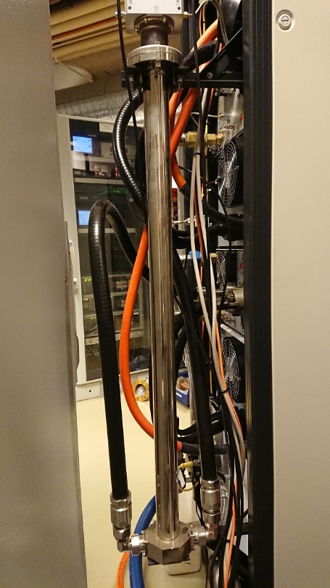
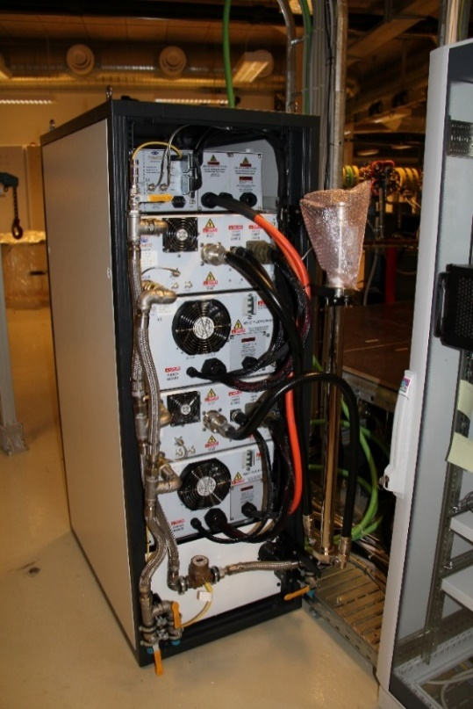
ASTRID2: Tomco 8 kW SSA
Consist of eight 1 kW amplifier modules
  Combined 2 and 2 and then to 4 kW
  The two 4 kW boxes are then combined to the full 8 kW
    Simple in-phase radial type
Specified to withstand full reflection at any angle
  Individual 1 kW circulators on each of the
  1 kW amplifier modules

Slide 8
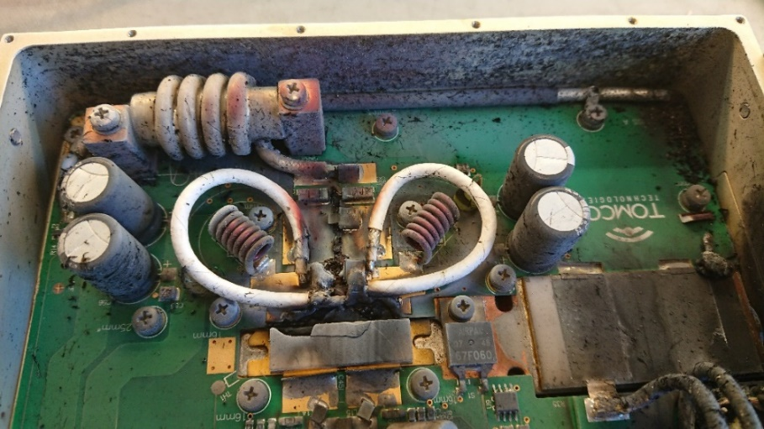
Tomco 8 kW SSA failures
Amplifier submodule:
  Exploded when turning on the amplifier at relative high power, probably with cavity not correctly tuned
  Tomco repaired the module free of charge (courtesy)
Circulator:
  Failed during deliberate test with high reflected power (detuned cavity)
    Using one box: 4 kW forward power, ~2.5 kW reflected power

Slide 9
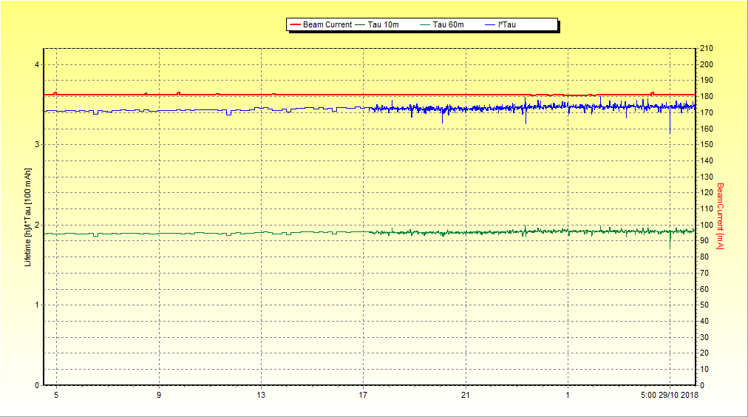
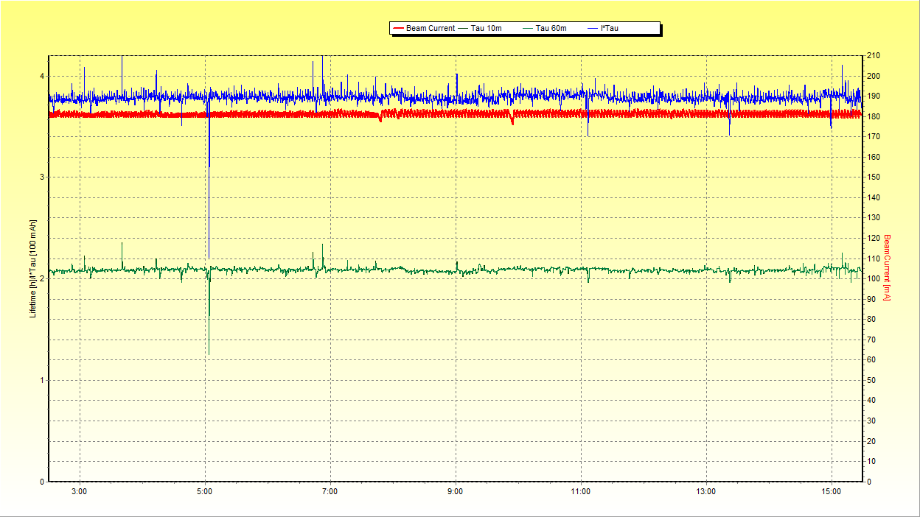
Consequences
For four months we had to use only one PA box (4 kW)
  Reduced cavity voltage =>
  reduced beam lifetime (only 1.9 h and not 2.1 h)
  Blue curve: Beam lifetime * Beam current [Ah]
Beam current
Beam current
Beam lifetime
Beam lifetime

Slide 10
Long term solution
Ordered a 8 kW circulator
  Only allow 2 kW reflected power in steady state
  To be installed in December
More monitoring and interlock of reflected power
Should allow us to run higher cavity amplitudes hopefully giving higher beam lifetime
Question:
  Can a power combiner split reflected power unequally?
    Both failures were with no beam
    Thank you for your attention

